Slide 1







July–September 2025
Quarterly
Business Review
Meeting
Tuesday, October 28, 2025
Mohit Chaturvedi
Vice President—Strategic Accounts
mohit.chaturvedi@aptaracorp.com
m: +1.206.227.5861

Slide 2
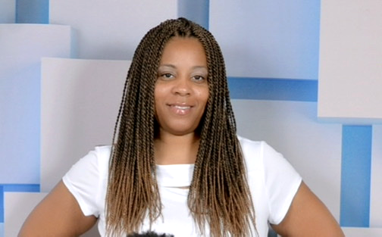
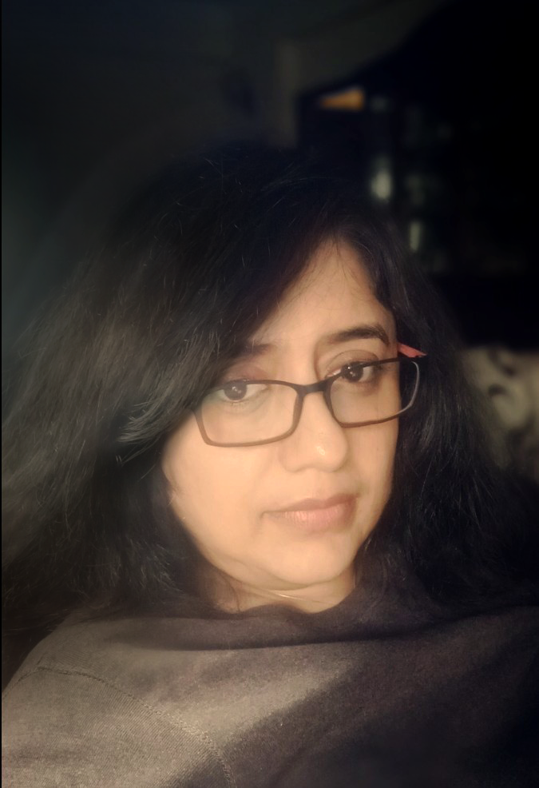
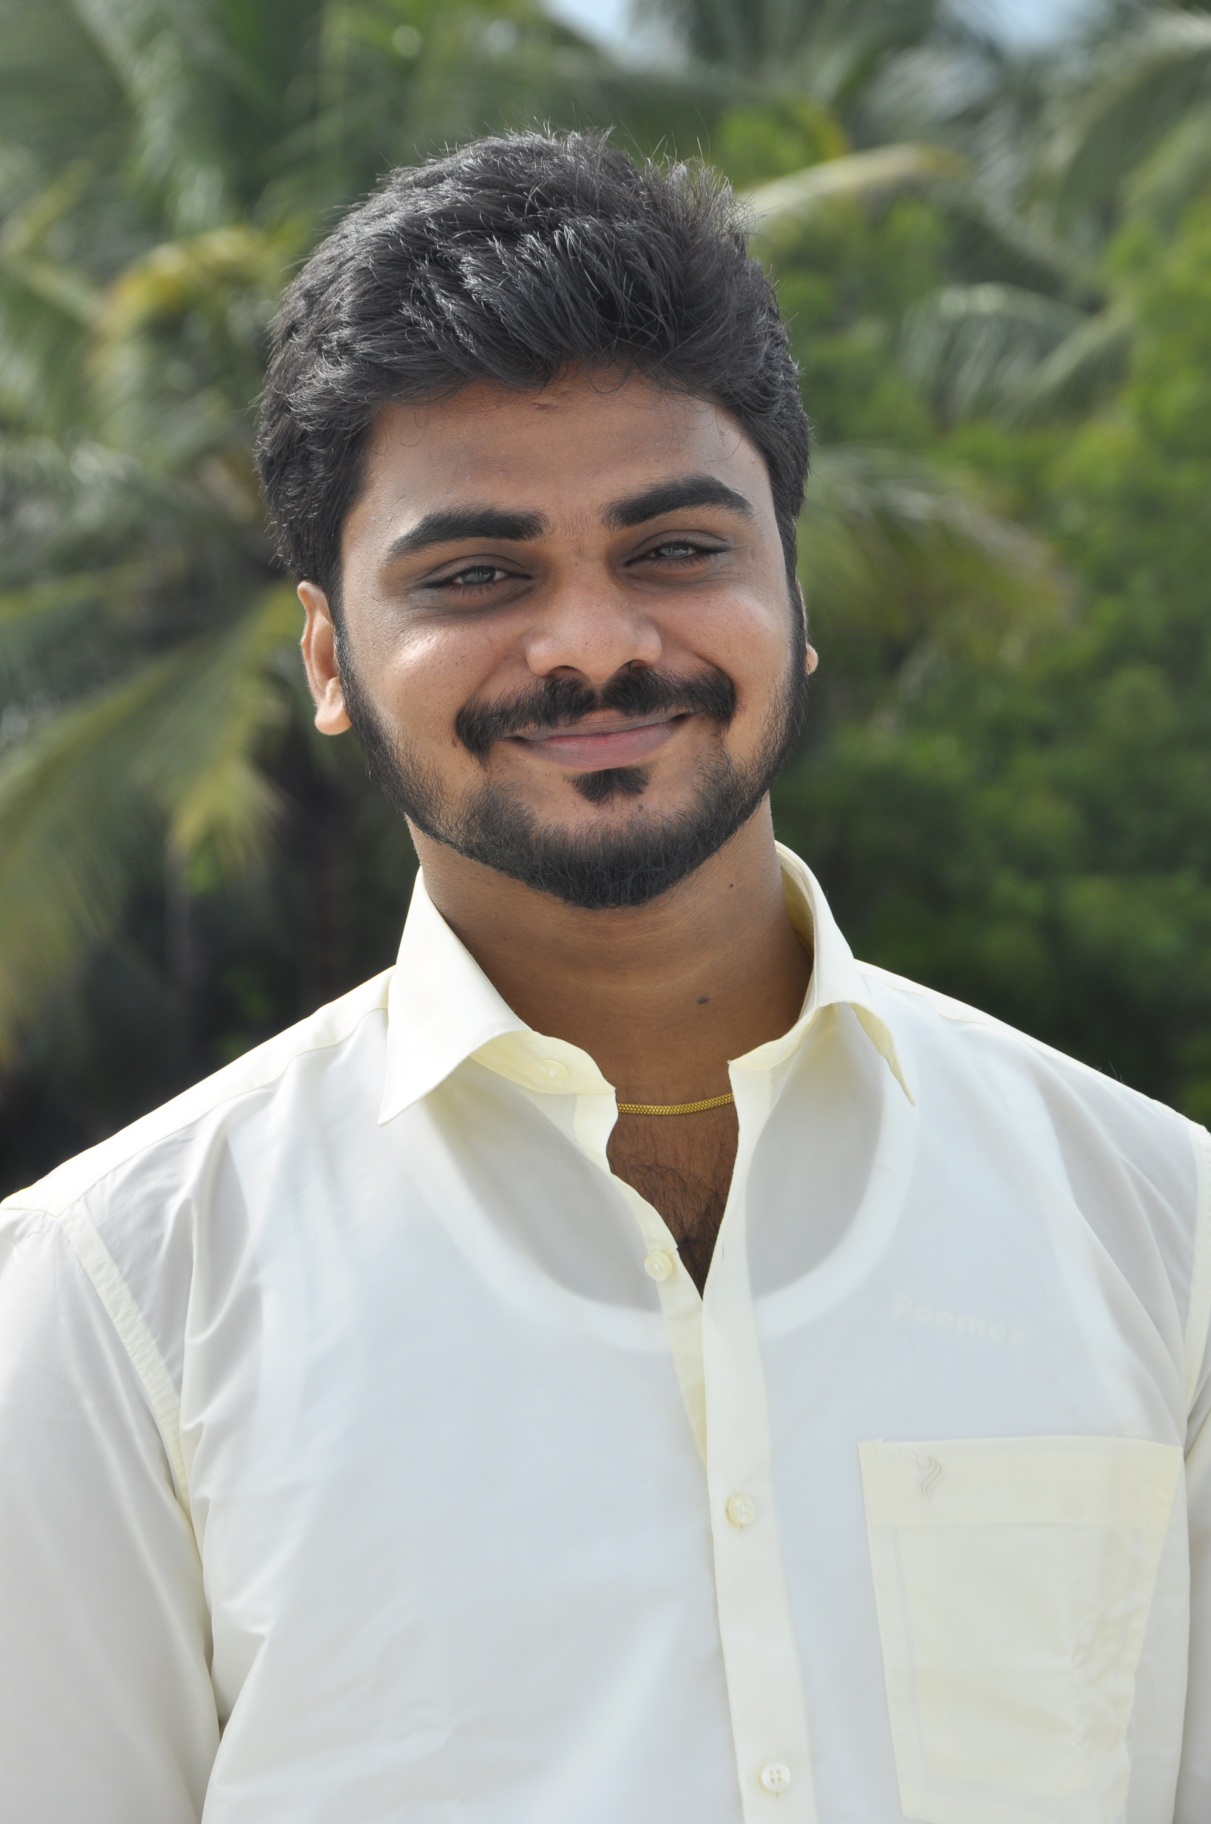
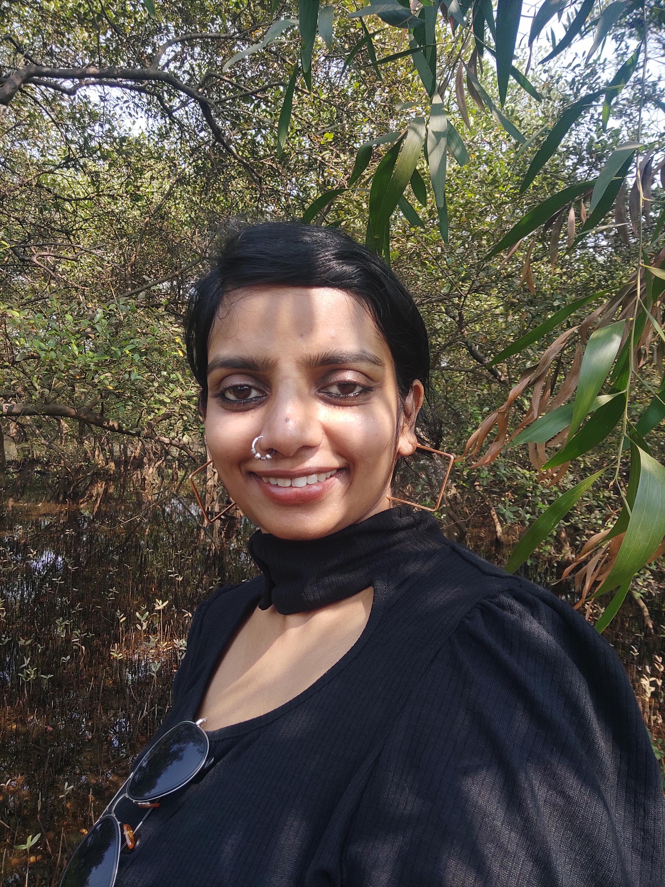
Utilization Report 2025
Keisha Raines
Nilashree Das
Arun Prakash
Joyce
Chacko
Engagement Manager
Instructional Designer
Instructional Designer
Instructional Designer
98%
94%
92%
98%
Available hrs.
Actual hrs.
Available hrs.
Actual hrs.
Available hrs.
Actual hrs.
Available hrs.
Actual hrs.

Slide 3
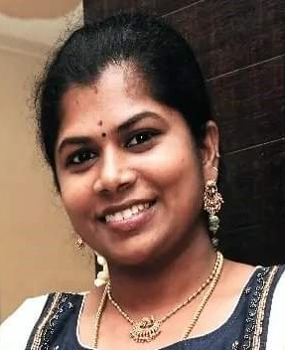
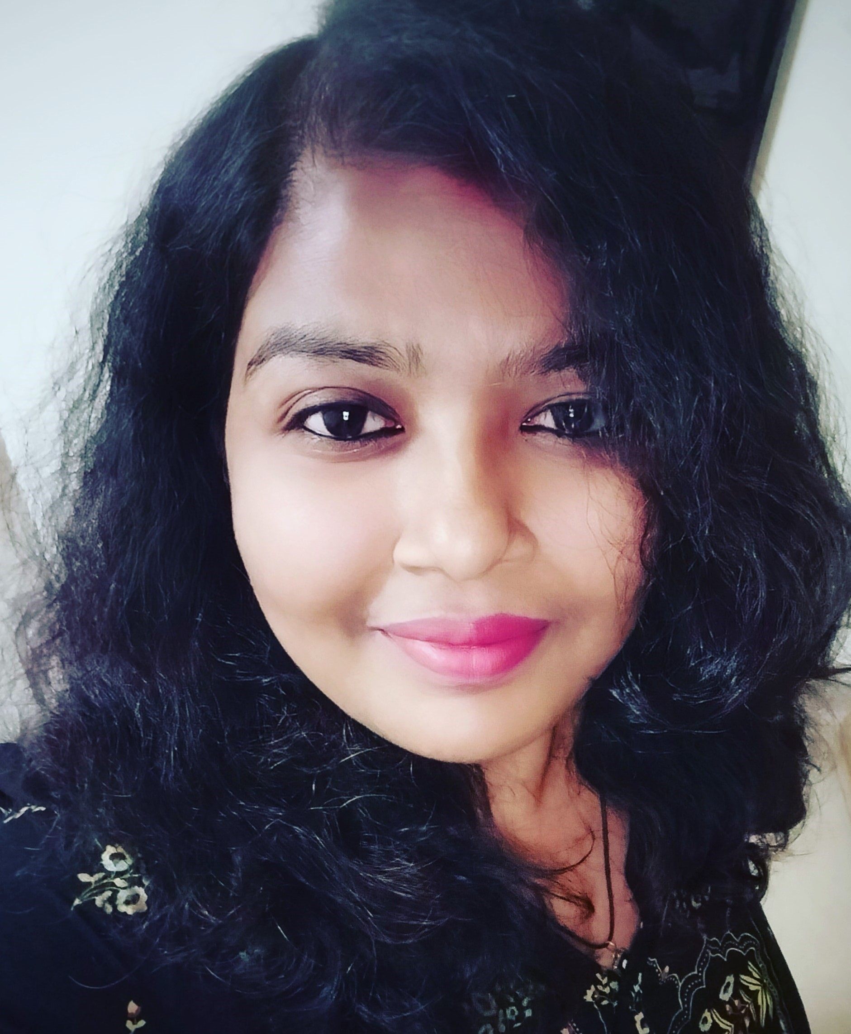
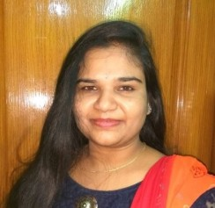
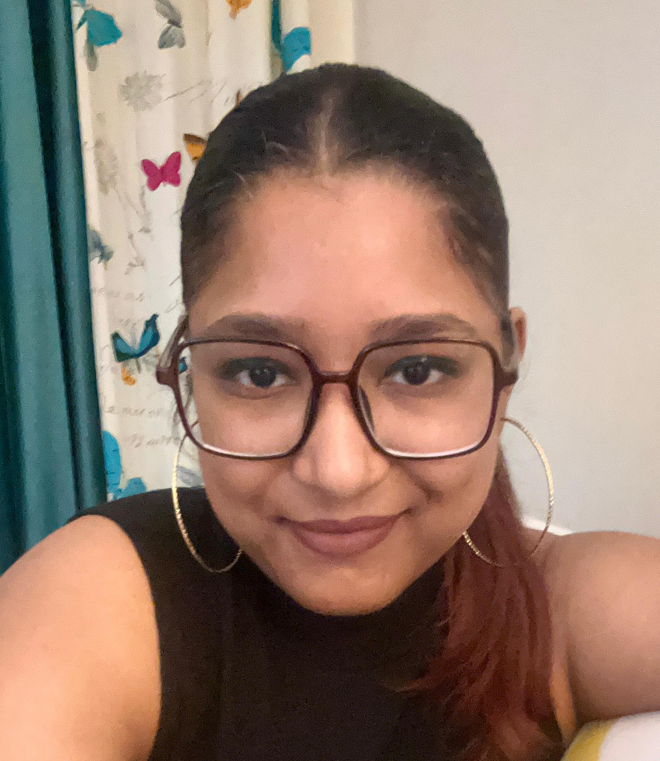
Utilization Report 2025
Mukila Subramanian
Sujata
Raj
Jyothi Pottabathini
Yagya Shreyasi
Instructional Designer
Instructional Designer
Instructional Designer
Instructional Designer
85%
98%
94%
98%
Available hrs.
Actual hrs.
Available hrs.
Actual hrs.
Available hrs.
Actual hrs.
Available hrs.
Actual hrs.

Slide 4
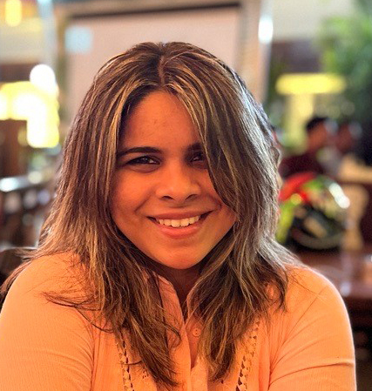
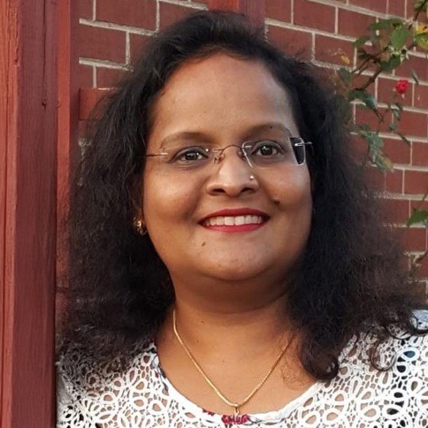
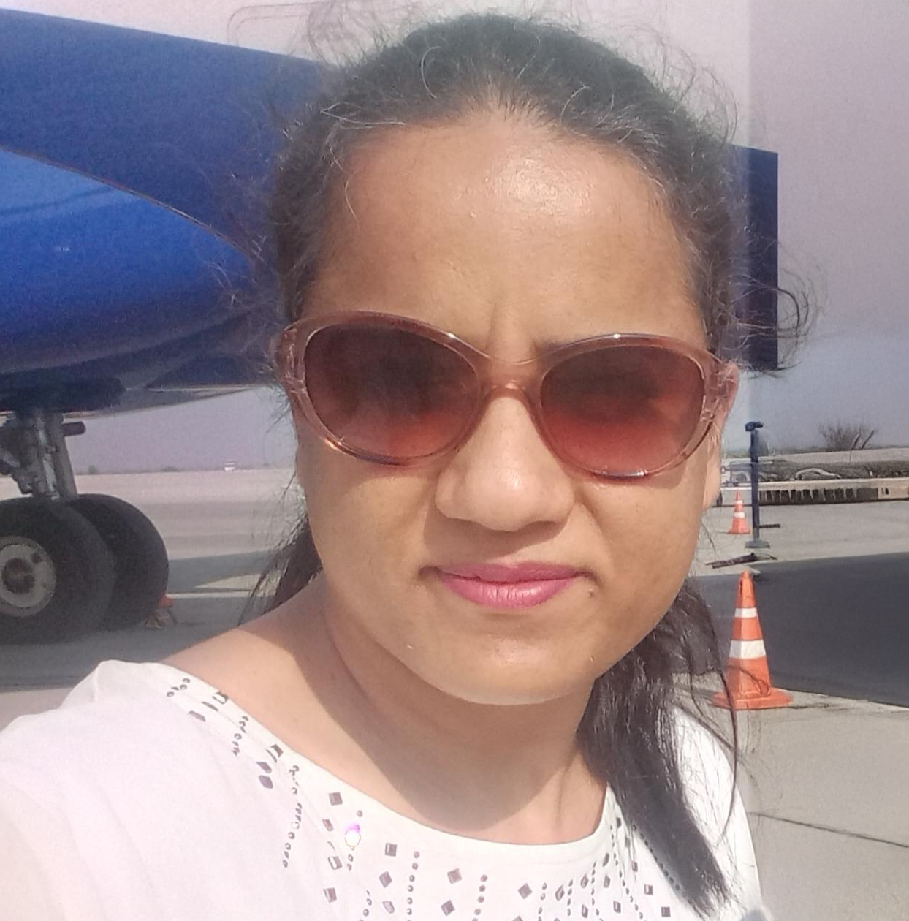
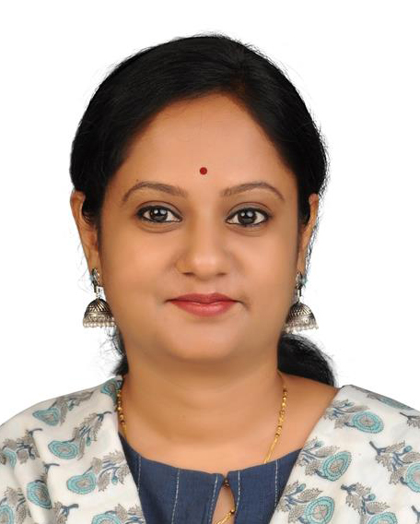
Utilization Report 2025
Glynelle Desouza
Maria Peter
Deepika
Tuli
Indu Radhakrishnan
Instructional Designer
Instructional Designer
Instructional Designer
Instructional Designer
99%
93%
95%
95%
Available hrs.
Actual hrs.
Available hrs.
Actual hrs.
Available hrs.
Actual hrs.
Available hrs.
Actual hrs.

Slide 5
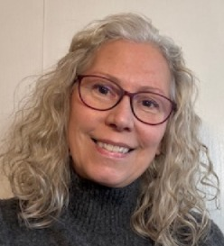
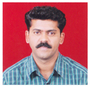
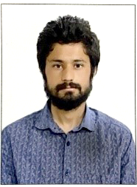
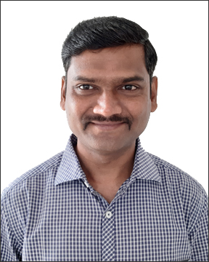
Utilization Report 2025
Patsy
Coffey
Sagar Hegnekar
Deepak
Choudhary
Parag Makode
Instructional Designer
Graphic Designer
Graphic Designer
Graphic Designer
88%
98%
85%
100%
Available hrs.
Actual hrs.
Available hrs.
Actual hrs.
Available hrs.
Actual hrs.
Available hrs.
Actual hrs.

Slide 6
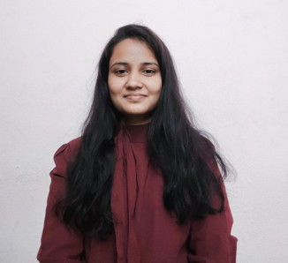
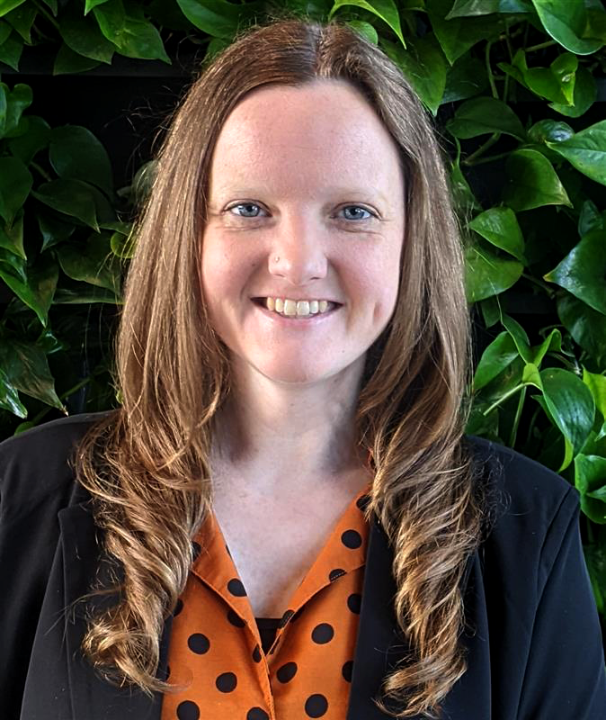
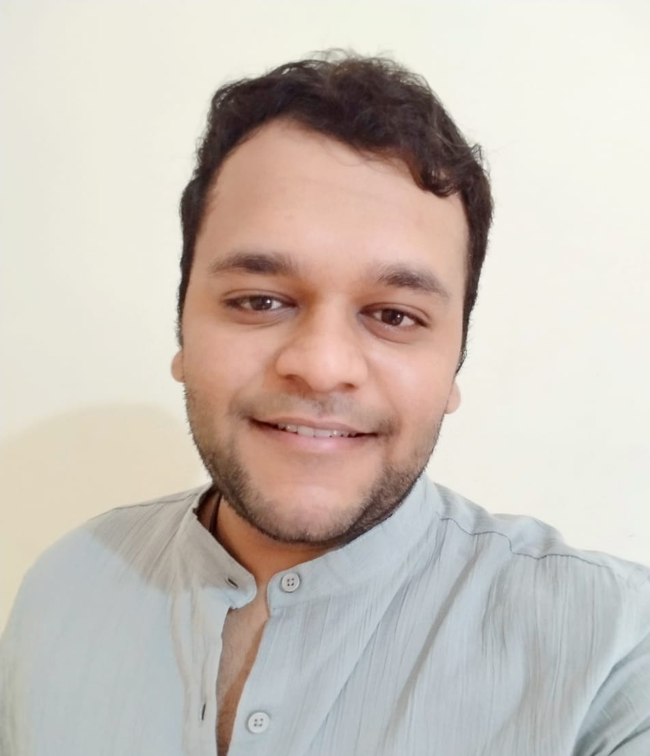
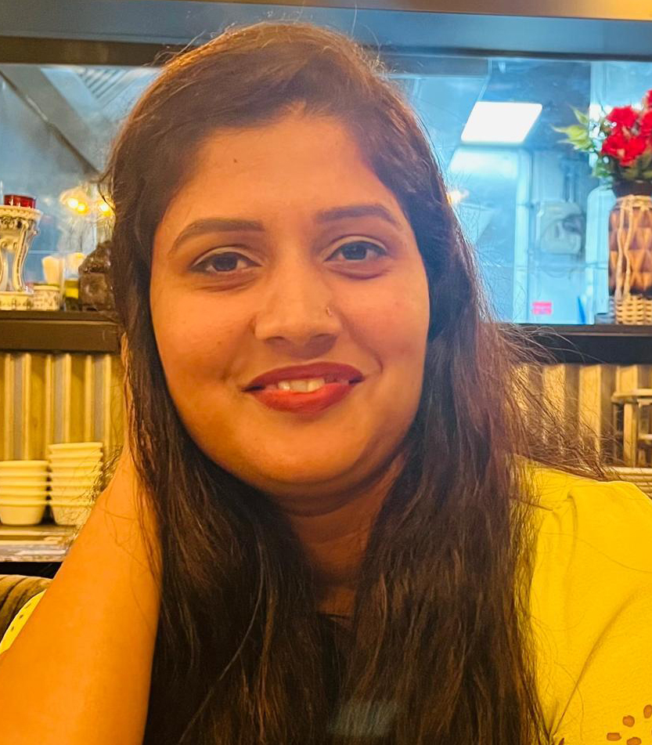
Utilization Report 2025
Anuja
Bhalke
Stephanie Yasko
Ajinkya Dambelkar
Ashwini Dhumal
Graphic Designer
Graphic Designer
Graphic Designer
Functional Quality Analyst
97%
92%
89%
90%
Available hrs.
Actual hrs.
Available hrs.
Actual hrs.
Available hrs.
Actual hrs.
Available hrs.
Actual hrs.

Slide 7

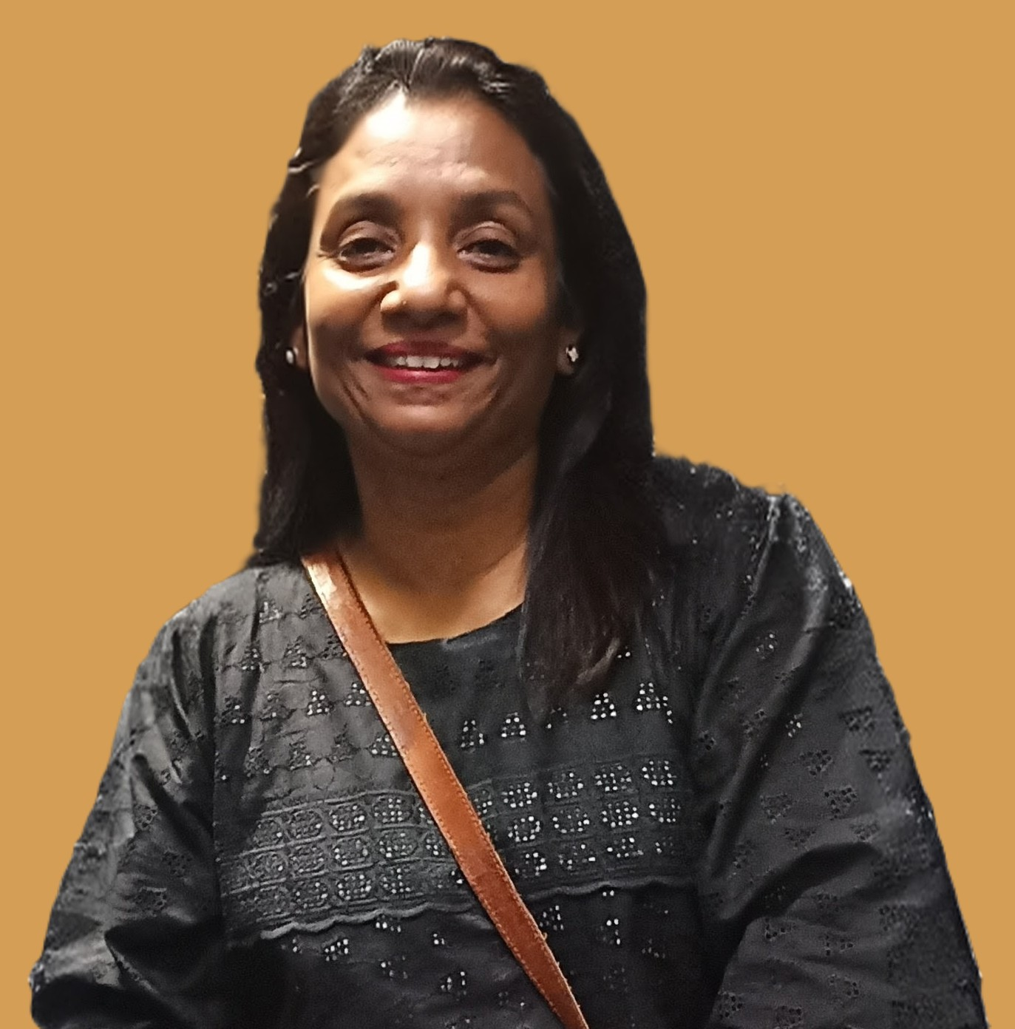
Utilization Report 2025
Karina
Singh
Stephen Calhoun
Ivan Hernandez
Chandni Kapoor
Instructional Designer
Instructional Designer
Instructional Designer
Instructional Designer
97%
97%
96%
95%
Available hrs.
Actual hrs.
Available hrs.
Actual hrs.
Available hrs.
Actual hrs.
Available hrs.
Actual hrs.

Slide 8
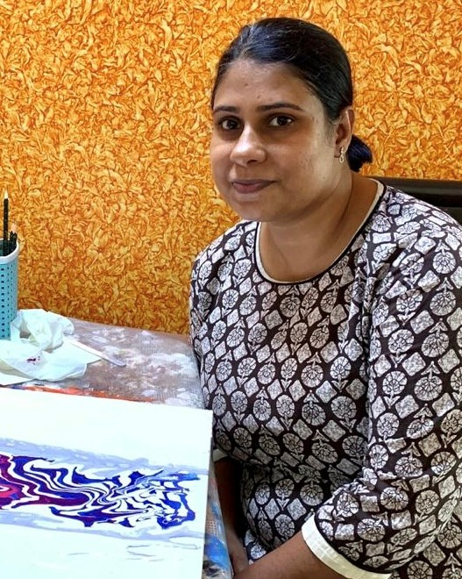
Utilization Report 2025
Mala Magotra
Steven Chamberlain
Nidhi
Sharma
Aaron
Forte
Instructional Designer
Instructional Designer
Instructional Designer
Instructional Designer
95%
95%
94%
92%
Available hrs.
Actual hrs.
Available hrs.
Actual hrs.
Available hrs.
Actual hrs.
Available hrs.
Actual hrs.

Slide 9
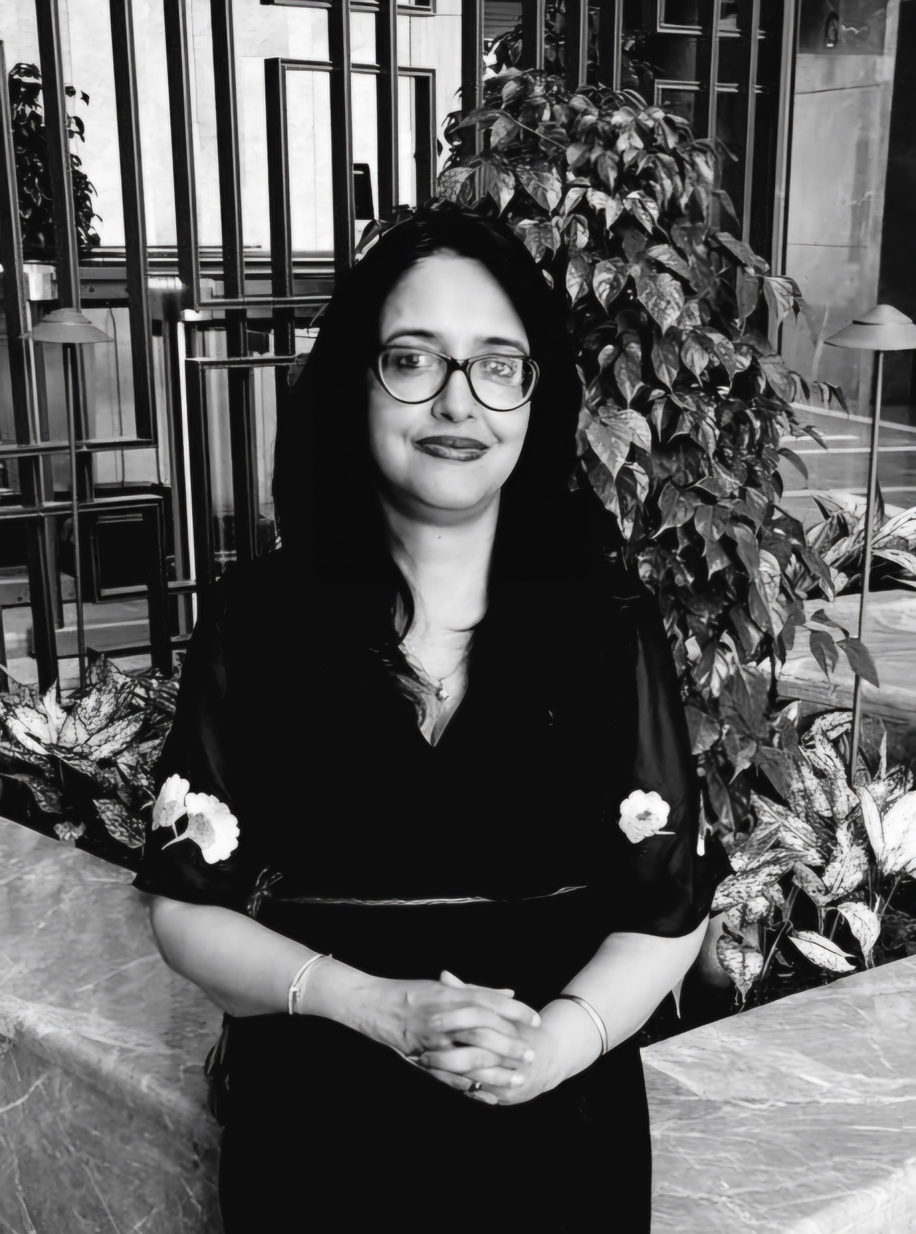
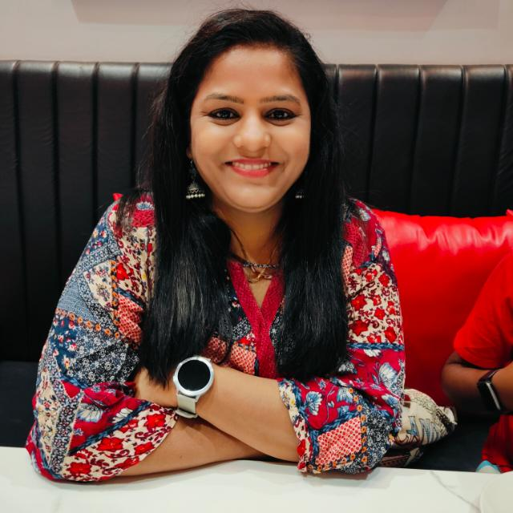
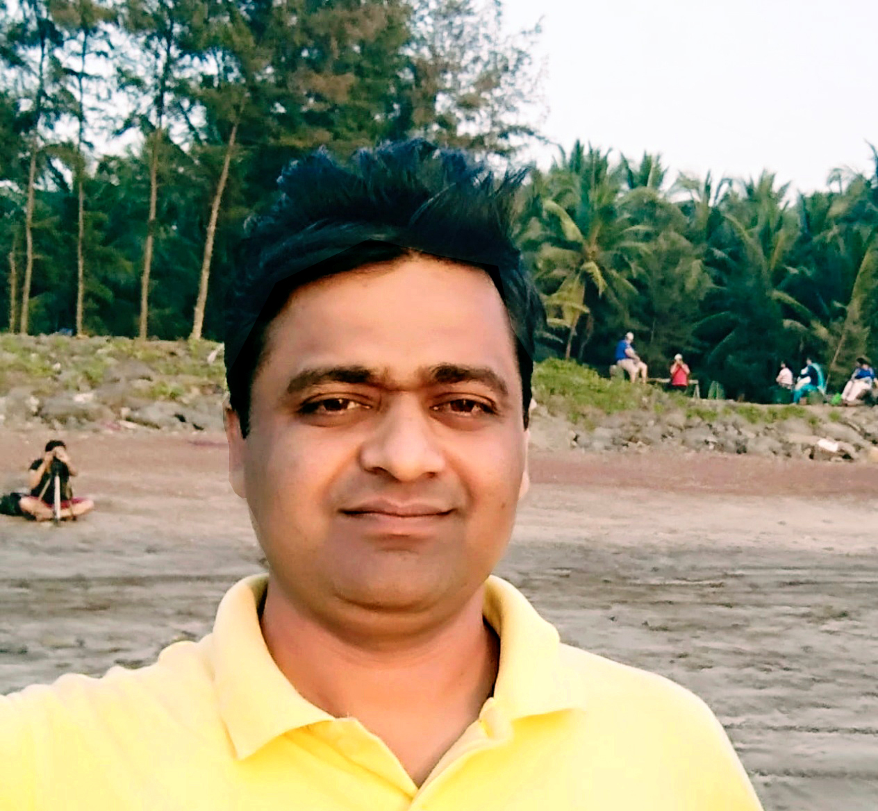
Utilization Report 2025
Rich
Smith
Sharmila Chakravarty
Prachi Bendale
Rajendra Suryawanshi
Instructional Designer
Instructional Designer
Instructional Designer
Graphic Designer
91%
88%
87%
80%
Available hrs.
Actual hrs.
Available hrs.
Actual hrs.
Available hrs.
Actual hrs.
Available hrs.
Actual hrs.

Slide 10
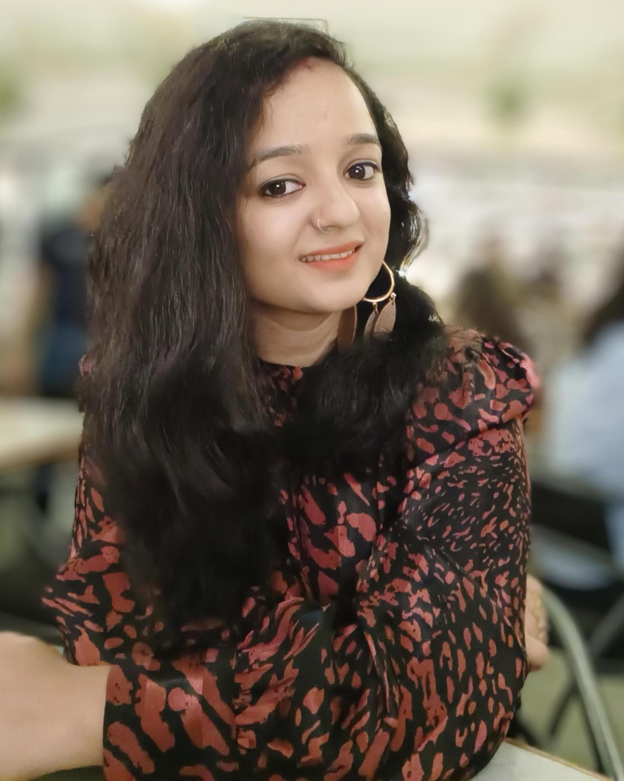
Utilization Report 2025
Priyanka
Pandy
Functional Quality Analyst
91%
Available hrs.
Actual hrs.

Slide 11
Performance Summary
Name | Role | Rating | Top Skills | Key Strengths
Joyce Chacko | Instructional Design | 5 | Instructional Design, Content Development | Project leadership, Team coordination
Maria Peter | Instructional Design | 5 | Instructional Design, Content Development | System adaptation, Quality consistency
Glynelle Desouza | Instructional Design | 5 | Instructional Design, Content Development | Natural leadership, Quick learner
Deepika Tuli | Instructional Design | 4 | Instructional Design, Content Development | Quality assurance, Detail orientation
Patsy Coffey | Instructional Design | 4 | Instructional Design, Content Development | Communication, Process adherence
Prachi Bendale | Instructional Design | 4 | Instructional Design, Storyline | Problem solving, Speed
Deepak Choudhary | Technical Specialist | 4 | Storyline, Graphic Design | Technical expertise, Storyline mastery
Stephanie Yasko | Graphic Design | 4 | Graphic Design, Other Tools | Graphic design, Process definition
ArunPrakash P | Instructional Design | 4 | Instructional Design, Content Development | Adaptability, Content realignment
Sujata Raj | Content Developer | 4 | Content Development, Communication | Content development, Team collaboration
Indu Radhakrishnan | Instructional Design | 4 | Instructional Design, Content Development | Writing skills, Adaptability
Aaron Forte | Instructional Design | 3 | Developing | Feedback incorporation, Template adherence
Rich Smith | Instructional Design | 3 | Developing | Requirement adherence, Question asking
Sharmila Chakravarty | Instructional Design | 3 | Storyline | Speed, Competency
Nilashree Das | Instructional Designer | 2 | Storyline | Storyline competency, Direction following

Slide 12
Skills Matrix
Name | Instructional Design | Content Development | Storyline | Graphic Design | Other Tools | Communication | Leadership | Problem Solving
Joyce Chacko | 5 | 5 | 4 | 3 | 4 | 5 | 5 | 5
Maria Peter | 5 | 4 | 3 | 3 | 4 | 5 | 4 | 5
Glynelle Desouza | 5 | 4 | 4 | 3 | 4 | 5 | 5 | 5
Deepika Tuli | 4 | 4 | 3 | 2 | 3 | 4 | 3 | 5
Patsy Coffey | 4 | 4 | 3 | 2 | 3 | 5 | 4 | 4
Prachi Bendale | 4 | 3 | 4 | 3 | 4 | 4 | 3 | 5
Deepak Choudhary | 3 | 3 | 5 | 4 | 5 | 3 | 2 | 5
Stephanie Yasko | 3 | 3 | 3 | 5 | 4 | 4 | 3 | 4
ArunPrakash P | 4 | 4 | 3 | 2 | 3 | 3 | 3 | 5
Sujata Raj | 3 | 5 | 2 | 2 | 3 | 4 | 3 | 4
Indu Radhakrishnan | 4 | 4 | 3 | 2 | 3 | 4 | 3 | 4
Aaron Forte | 3 | 3 | 3 | 2 | 2 | 2 | 2 | 3
Rich Smith | 3 | 3 | 3 | 2 | 2 | 2 | 2 | 3
Sharmila Chakravarty | 3 | 3 | 4 | 2 | 3 | 3 | 2 | 3
Nilashree Das | 2 | 3 | 4 | 2 | 2 | 2 | 1 | 2
Skills Level Guide:
1-2: Beginner/Learning
Intermediate
4-5: Advanced/Expert

Slide 13
Skills Matrix Heatmap
Team Skills Heatmap
Joyce Chacko | 5 | 4 | 4 | 3 | 4 | 5 | 5 | 5
Maria Peter | 5 | 4 | 3 | 3 | 4 | 5 | 4 | 5
Glynelle Desouza | 4 | 5 | 4 | 3 | 3 | 4 | 5 | 5
Deepika Tuli | 4 | 4 | 3 | 2 | 3 | 4 | 5 | 5
Patsy Coffey | 4 | 4 | 3 | 3 | 3 | 4 | 4 | 5
Prachi Bendale | 3 | 3 | 4 | 3 | 4 | 5 | 3 | 4
Deepak Choudhary | 3 | 3 | 3 | 3 | 4 | 4 | 3 | 4
Stephanie Yasko | 3 | 3 | 3 | 5 | 4 | 4 | 3 | 4
ArunPrakash P | 4 | 4 | 4 | 2 | 3 | 3 | 2 | 3
Sujata Raj | 3 | 5 | 2 | 2 | 2 | 3 | 3 | 5
Indu Radhakrishnan | 3 | 3 | 3 | 2 | 3 | 3 | 2 | 3
Aaron Forte | 3 | 3 | 4 | 2 | 2 | 2 | 2 | 2
Rich Smith | 3 | 3 | 4 | 2 | 2 | 2 | 2 | 3
Sharmila Chakravarty | 3 | 4 | 3 | 2 | 2 | 2 | 2 | 3
Nilashree Das | 2 | 3 | 4 | 2 | 2 | 2 | 2 | 2
Instructional
Design
Content
Development
Storyline
Graphic Design
Other Tools
Communication
Leadership
Problem Solving
- 5.0
- 4.5
- 4.0
- 3.5
- 3.0
- 2.5
- 2.0
- 1.5
- 1.0
Skill Level

Slide 14
Thank You

