Slide 1
SOMNATH PAWAR
SENIOR GRAPHIC DESIGNER - PORTFOLIO

Slide 2
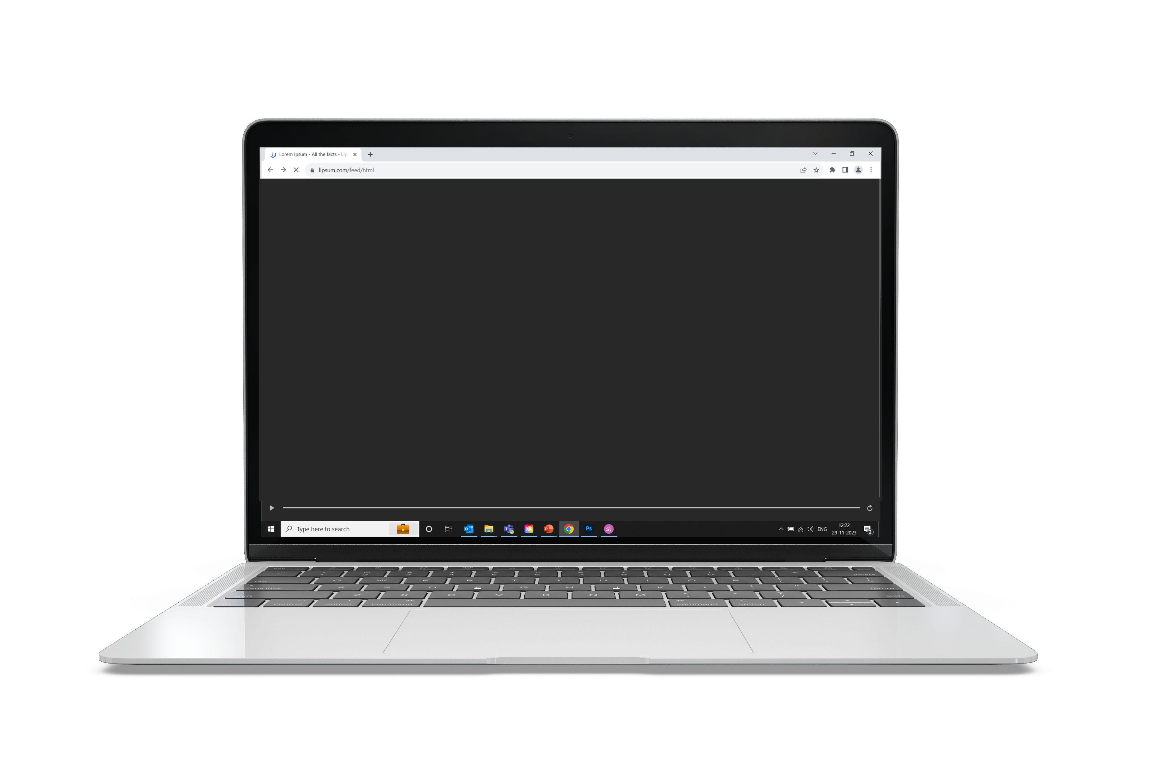
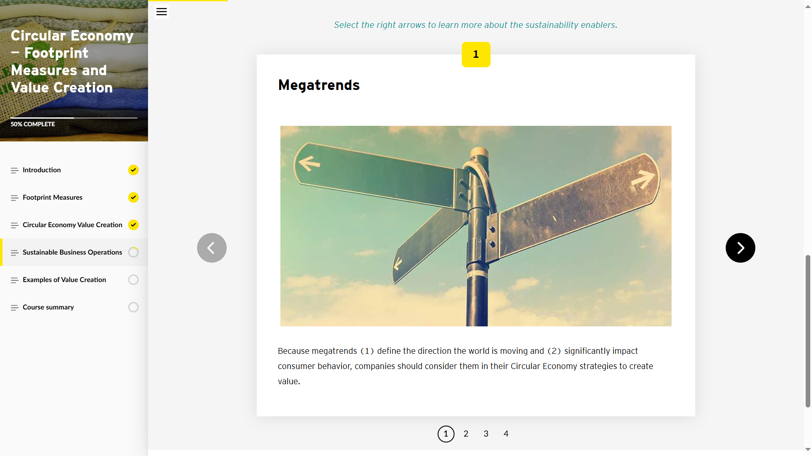
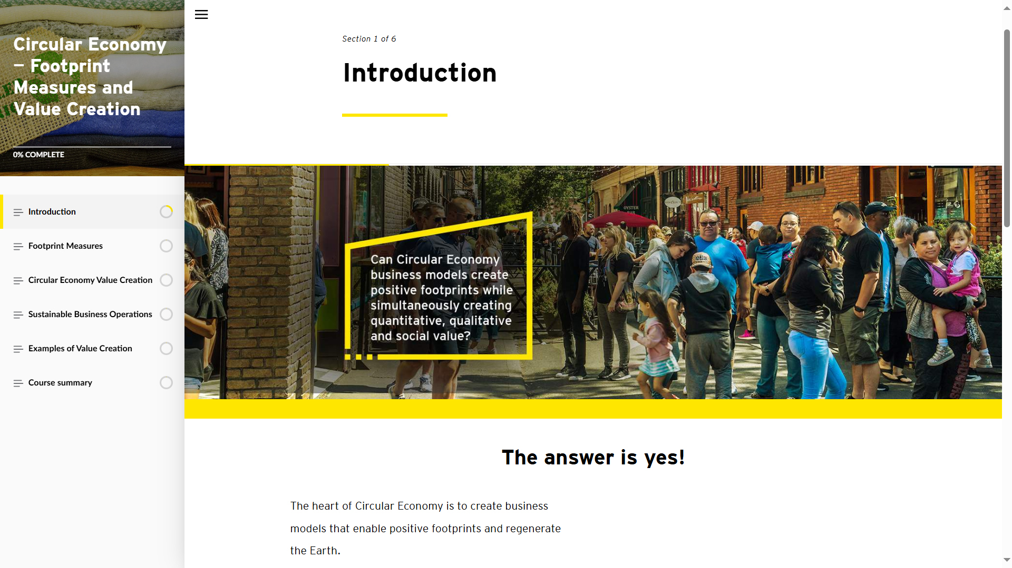
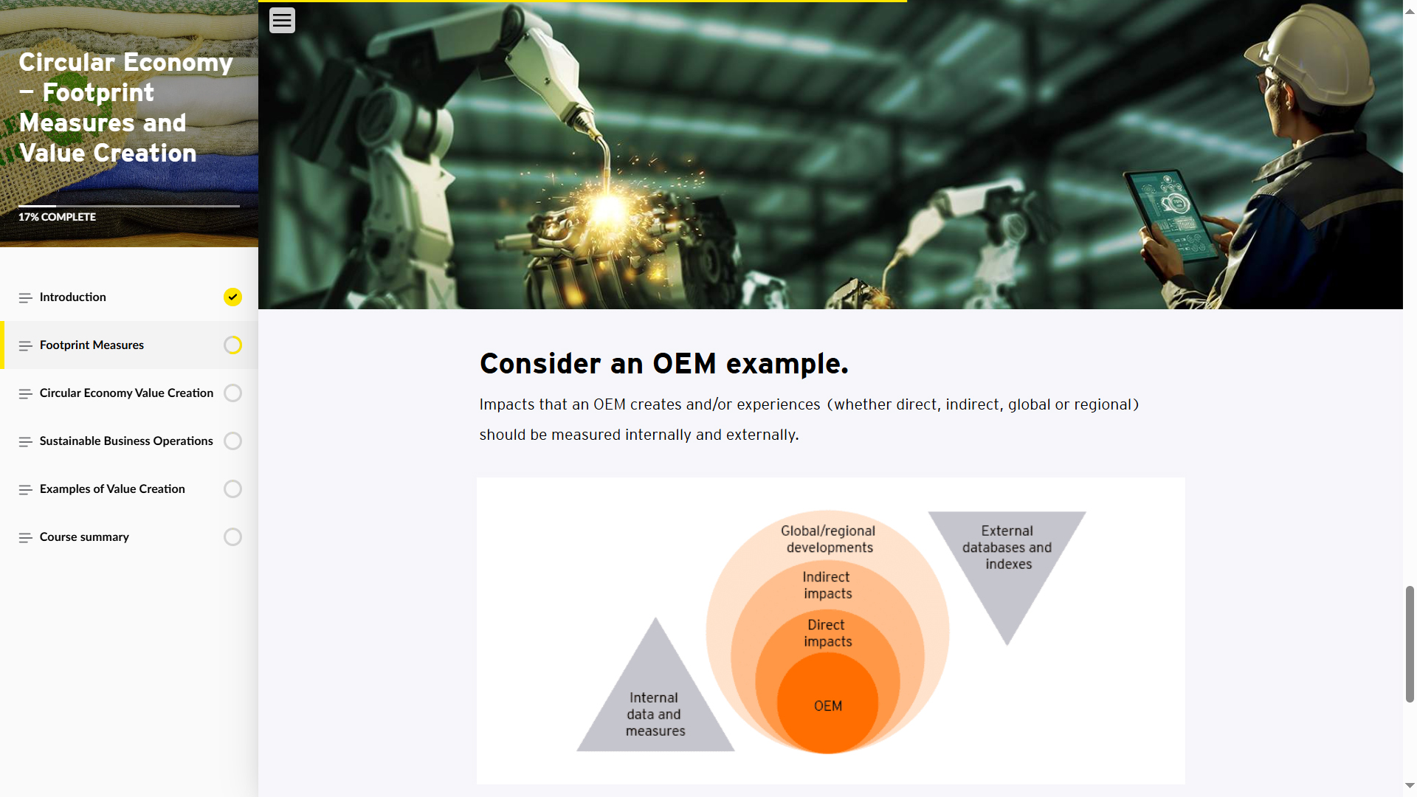
Articulate Rise Course Design Sample - 1
The complete course was developed using Articulate Rise.
Used Photoshop CC to design/edit mockups.

Slide 3
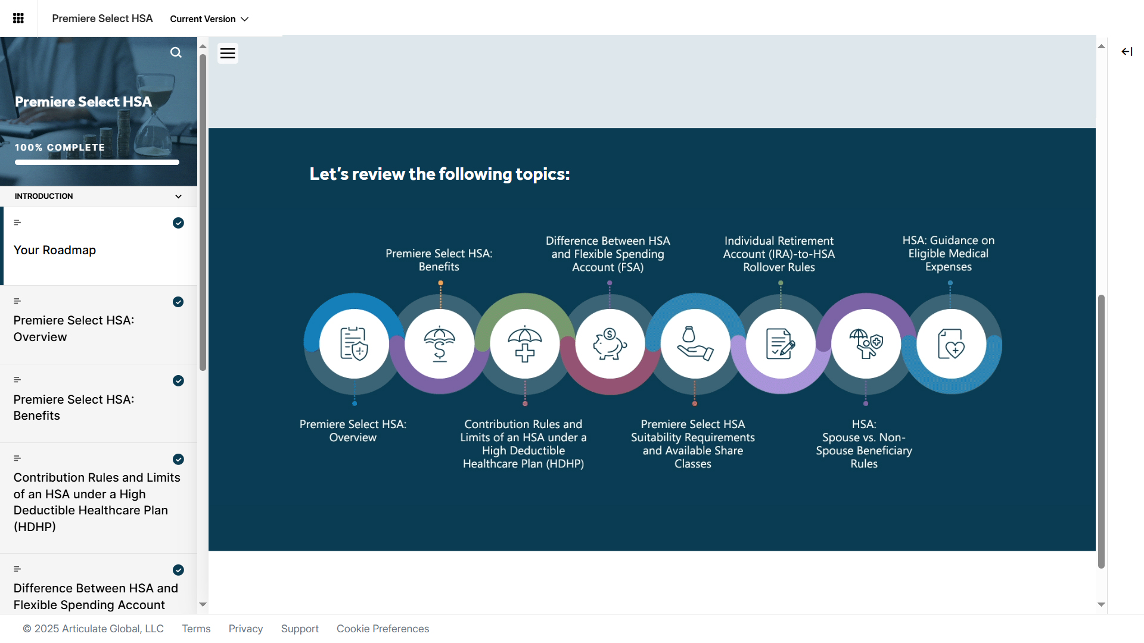
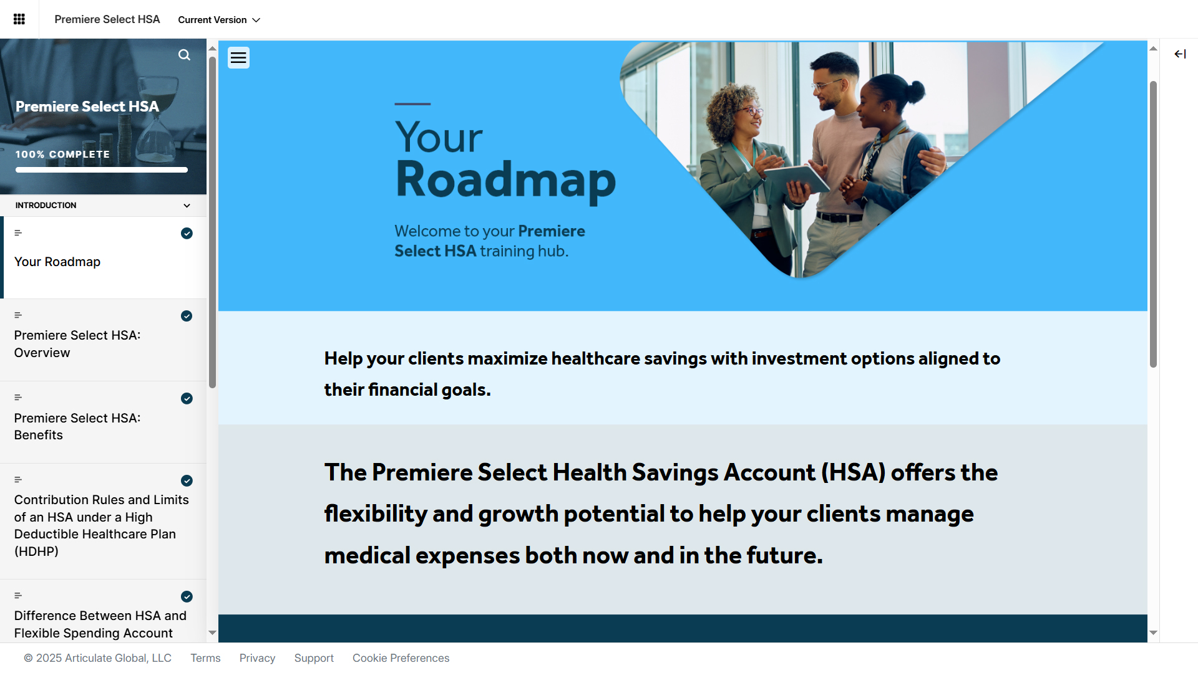
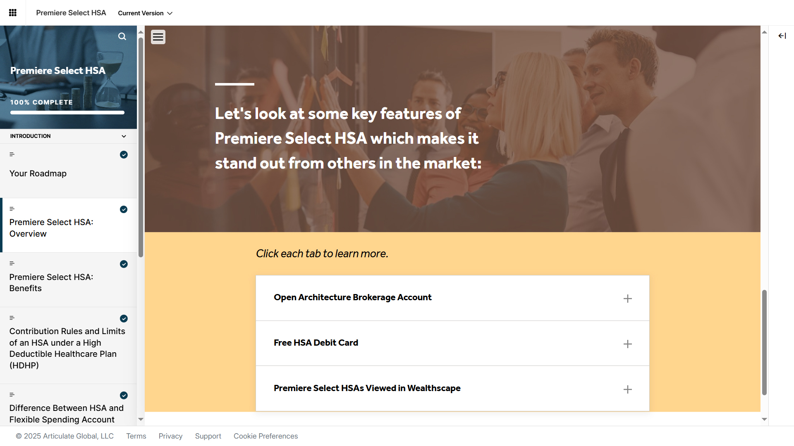
Articulate Rise Course Design Sample - 2
The complete course was developed using Articulate Rise.
Used Photoshop CC to design/edit mockups.

Slide 4
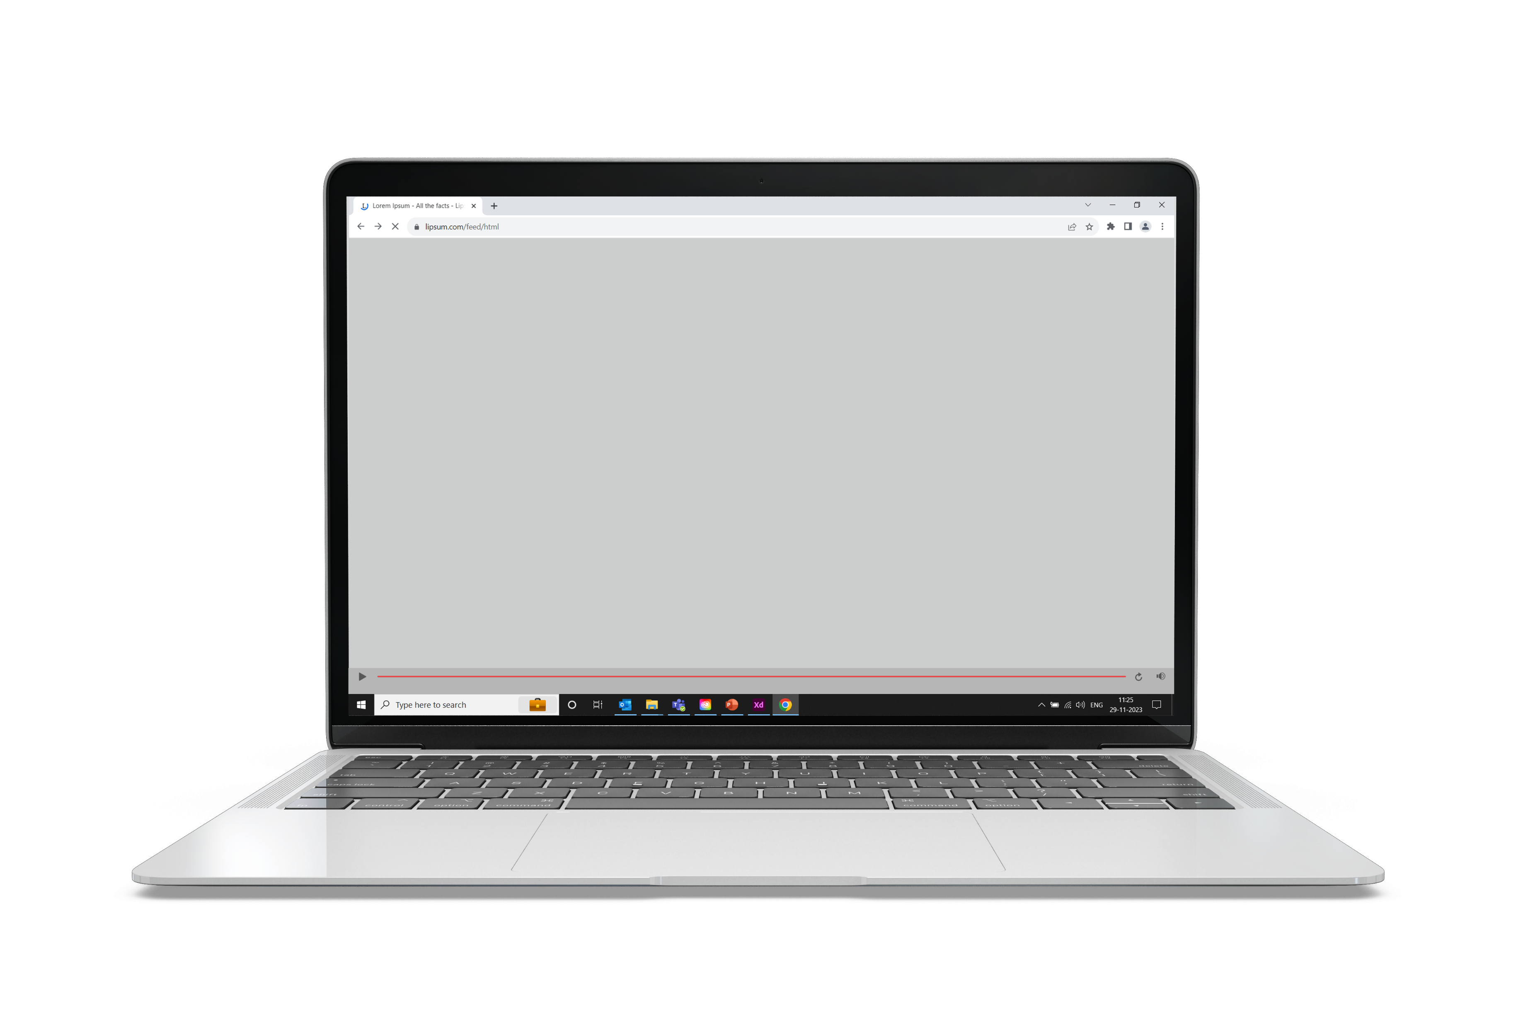
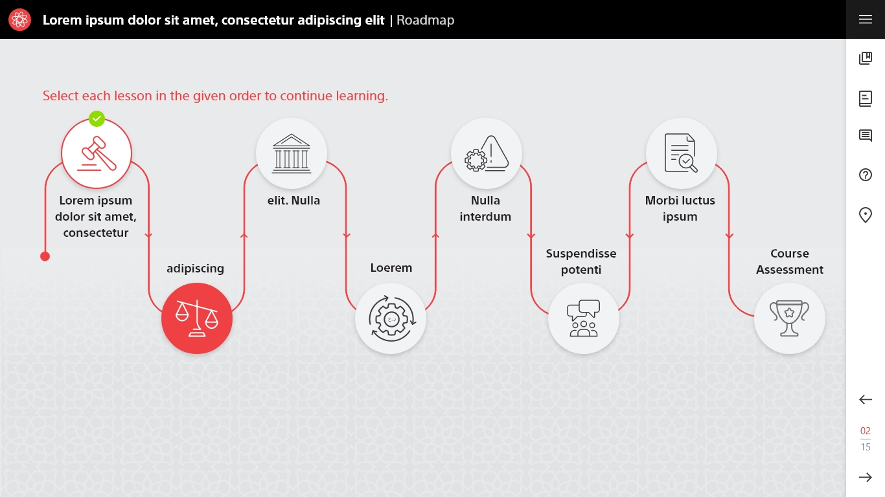
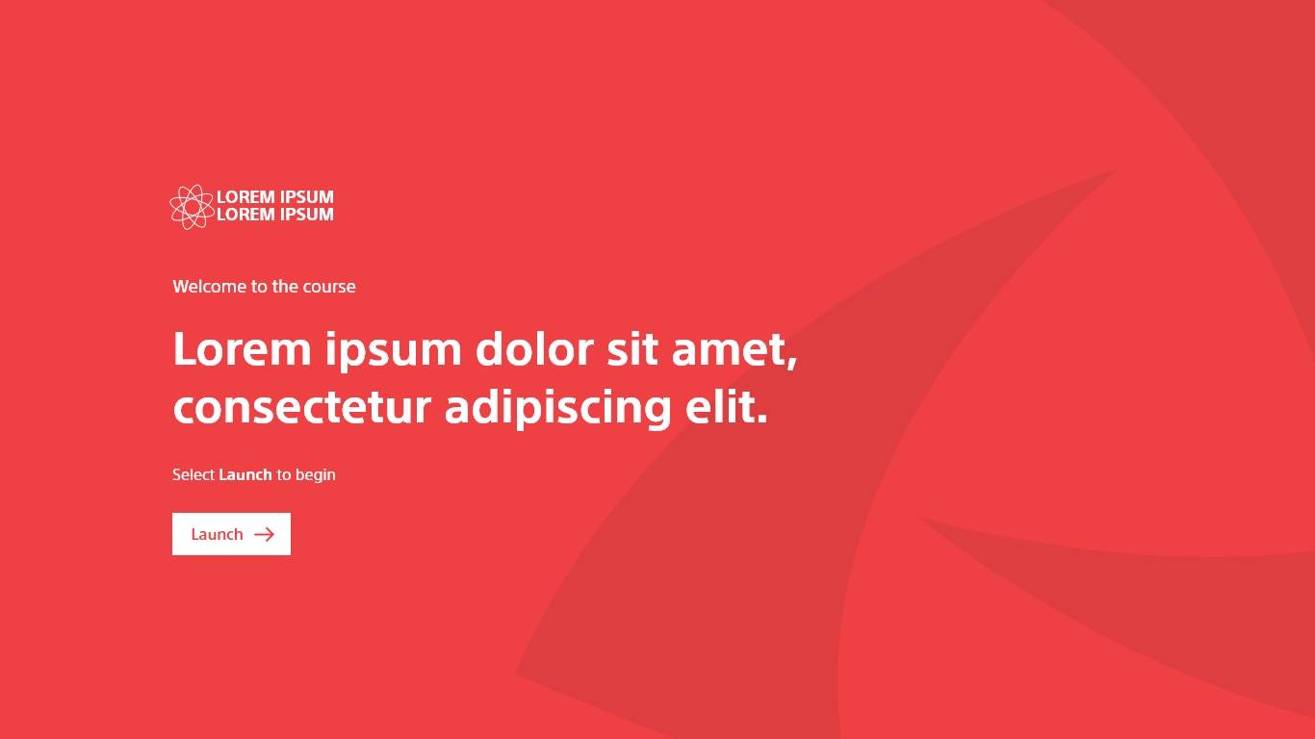
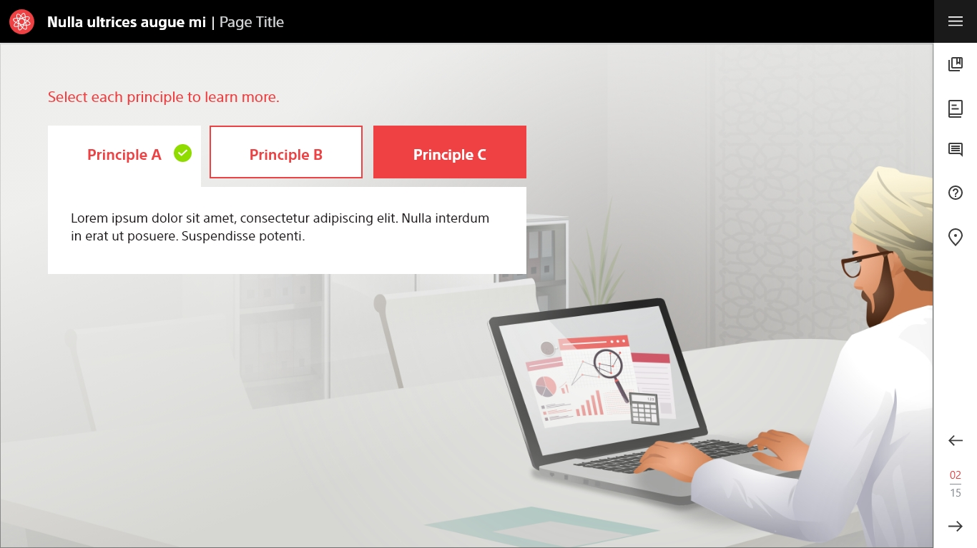
Articulate Storyline 360 Course Design Sample - 1
The complete customized course was developed using Articulate Storyline 360.
Used Adobe XD to edit/extract the assets.

Slide 5
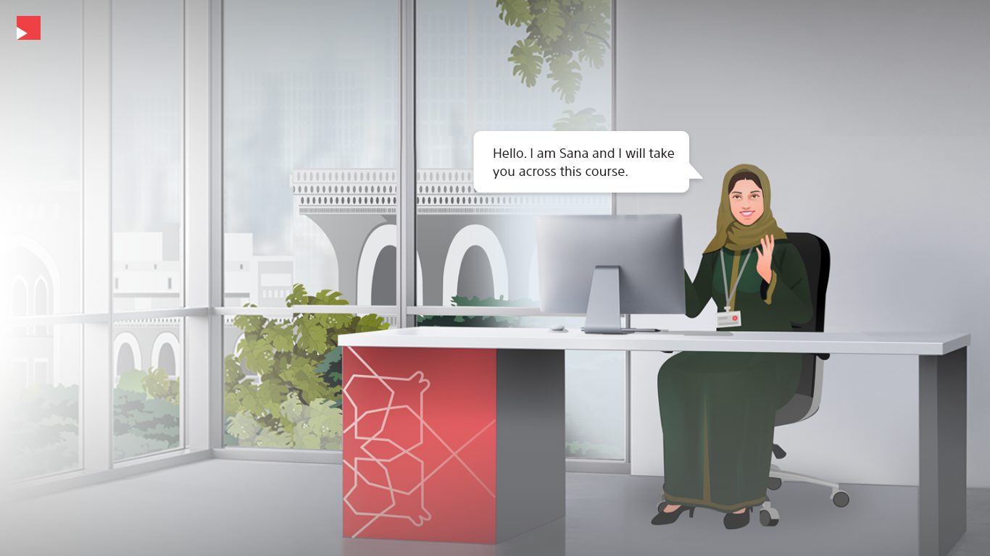
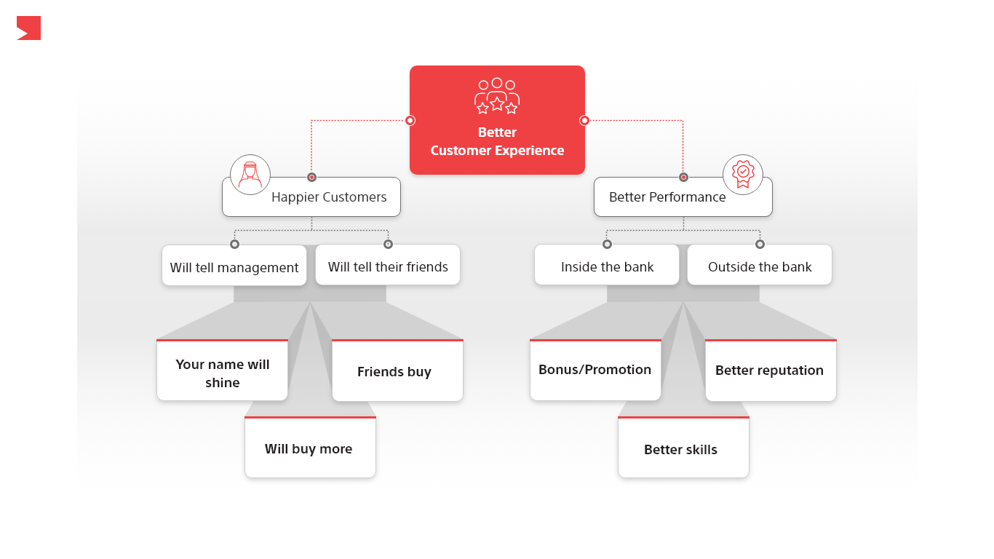
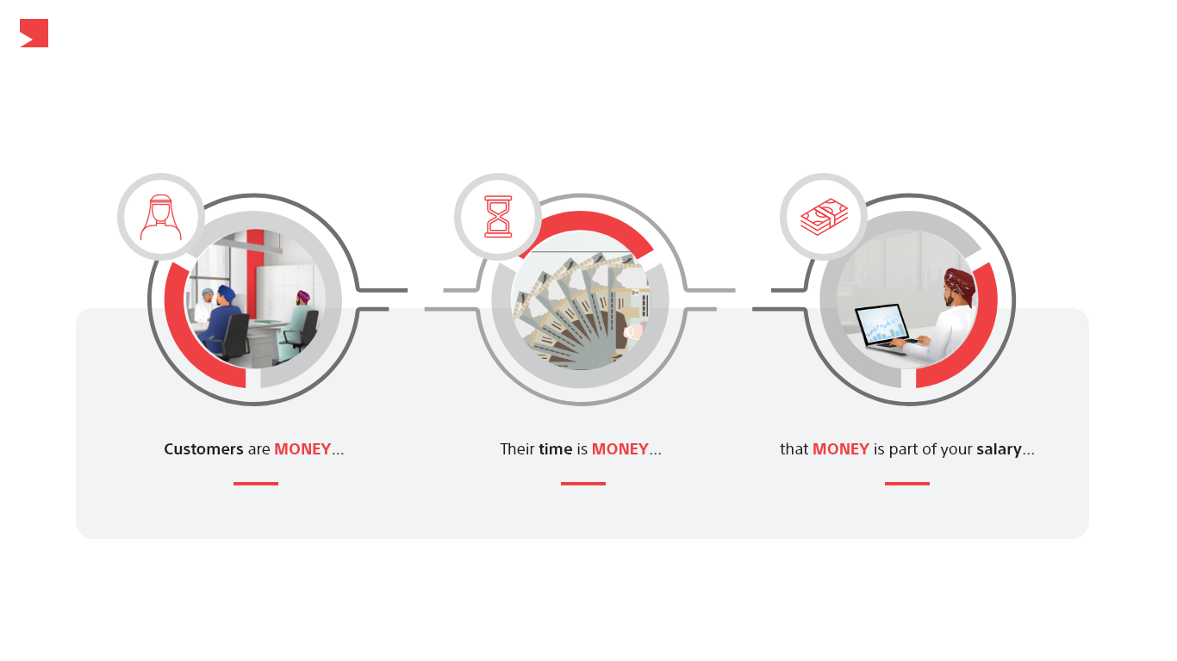
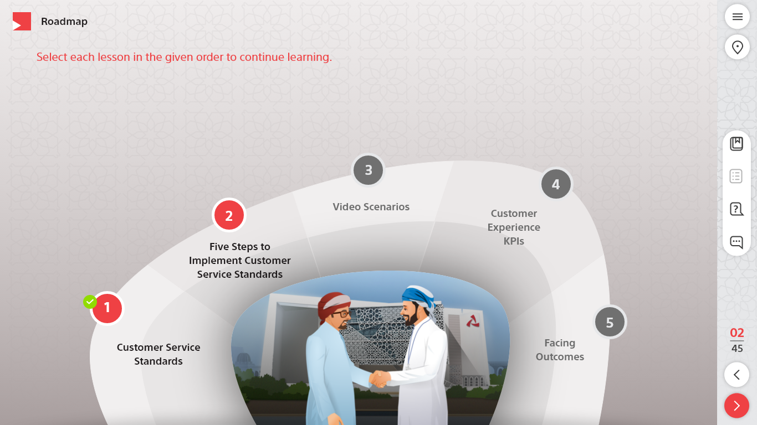
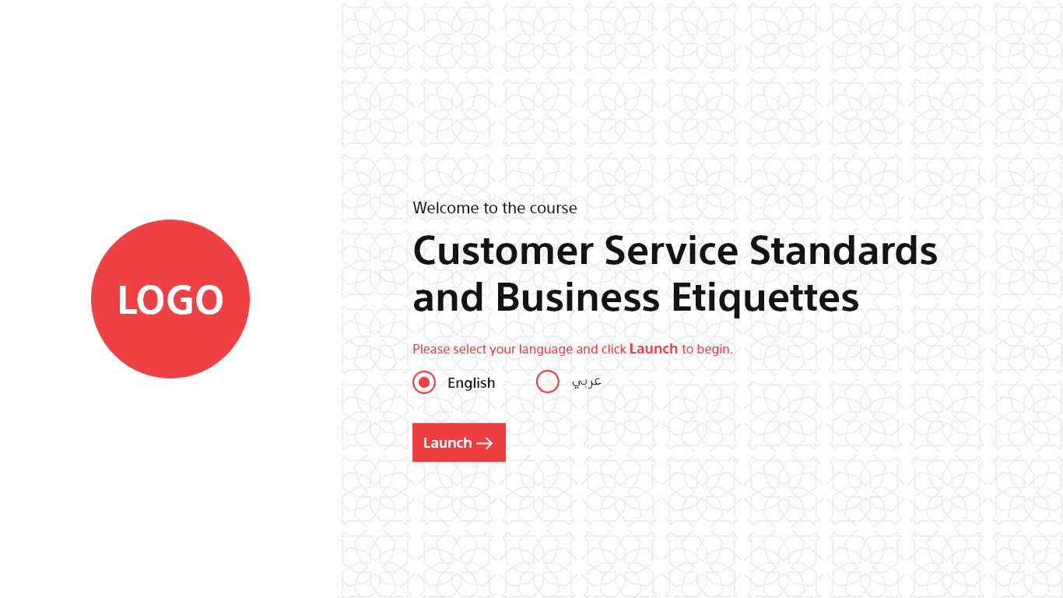
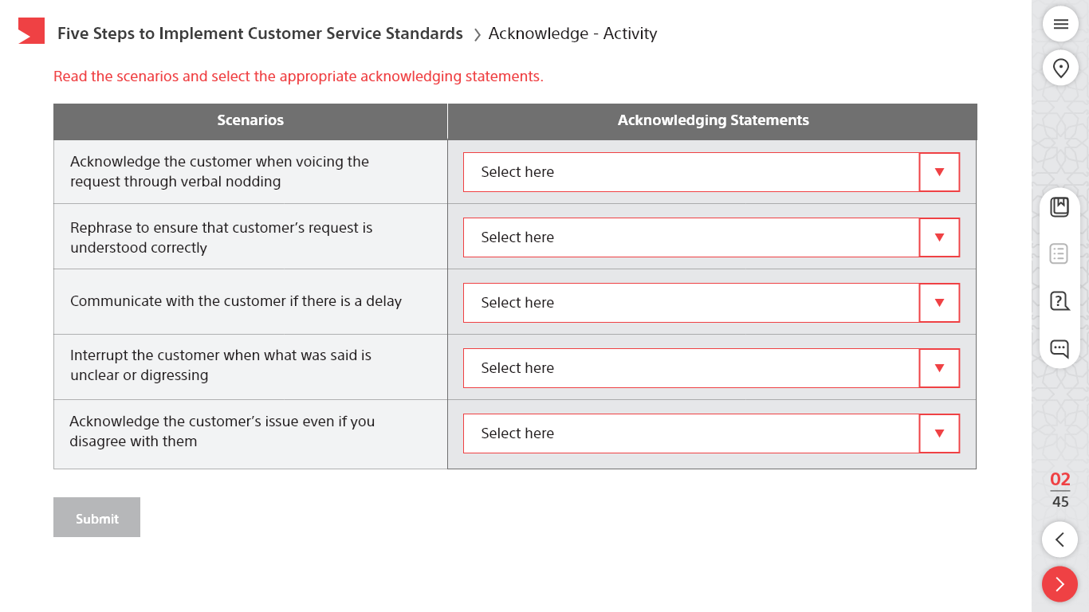
Articulate Storyline 360 Course Design Sample - 2
The complete customized course was developed using Articulate Storyline 360.
Used Adobe XD to edit/extract the assets.

Slide 6
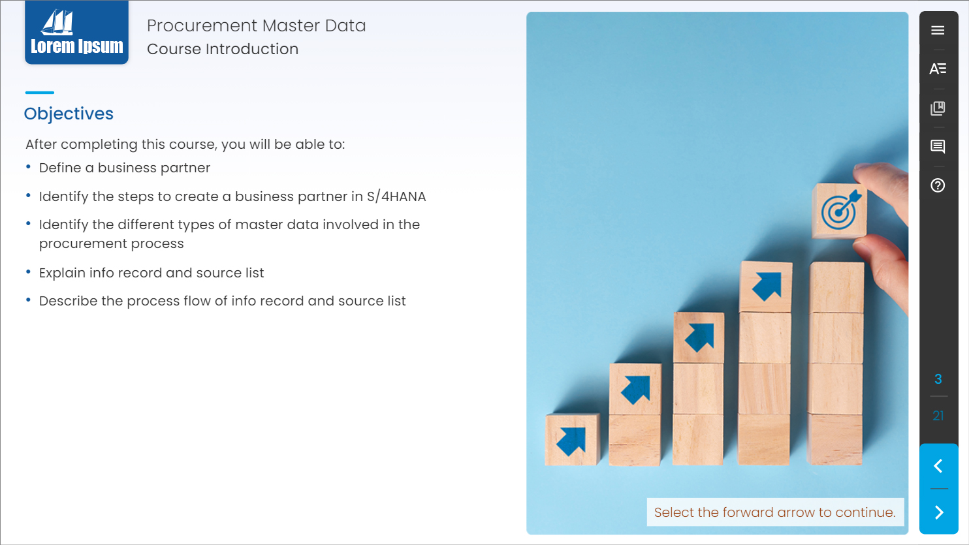

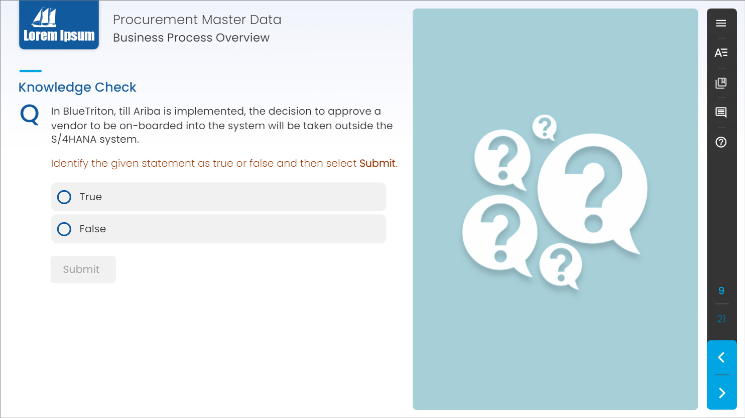
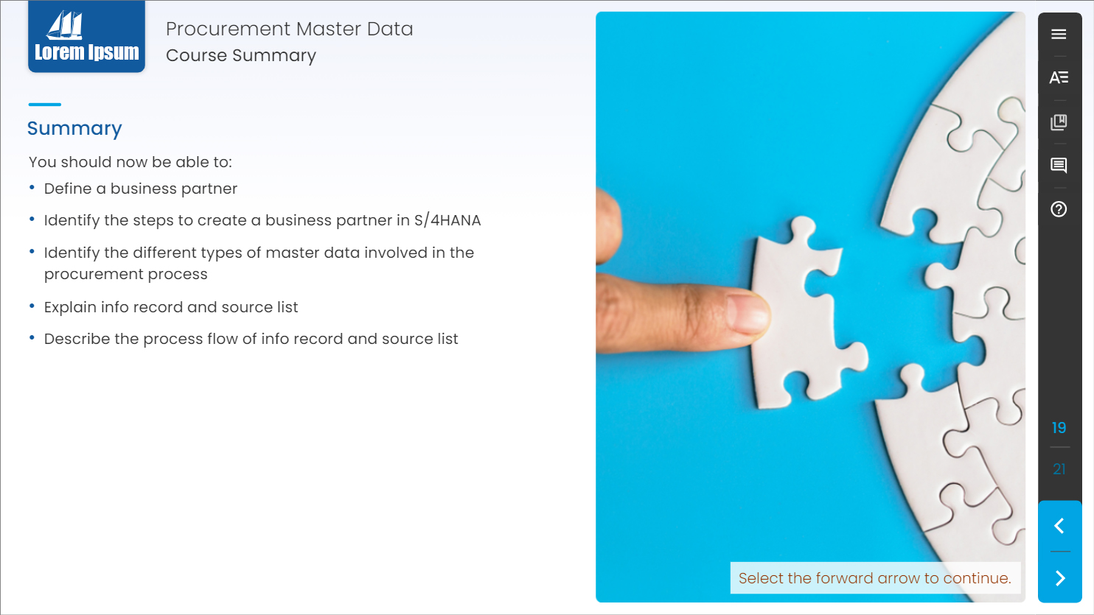
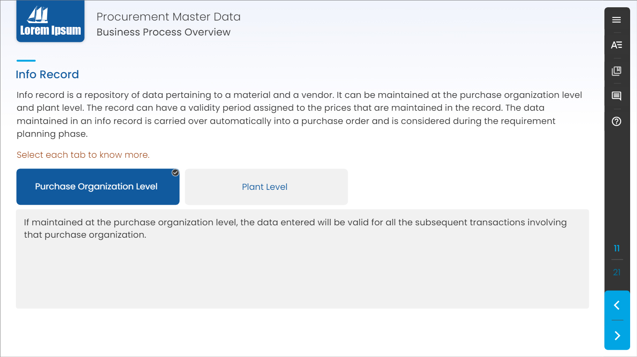
Articulate Storyline 360 Course Design Sample - 3
The complete customized course was developed using Articulate Storyline 360.
The course was Web Content Accessibility Guidelines (WCAG) Compliance.
Used Photoshop CC to design/edit mockups.

Slide 7
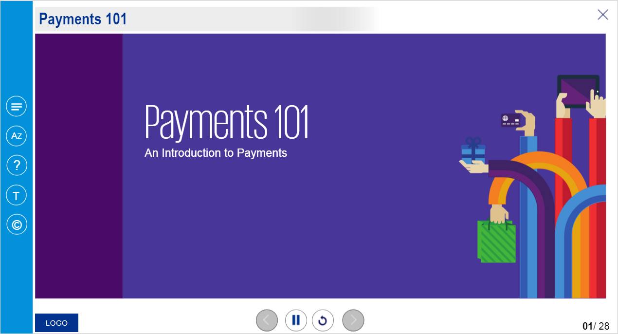
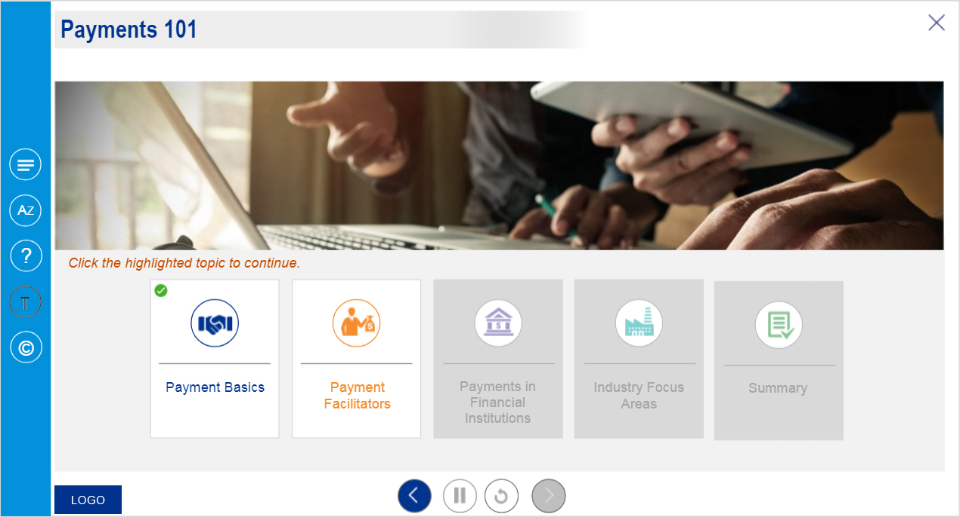
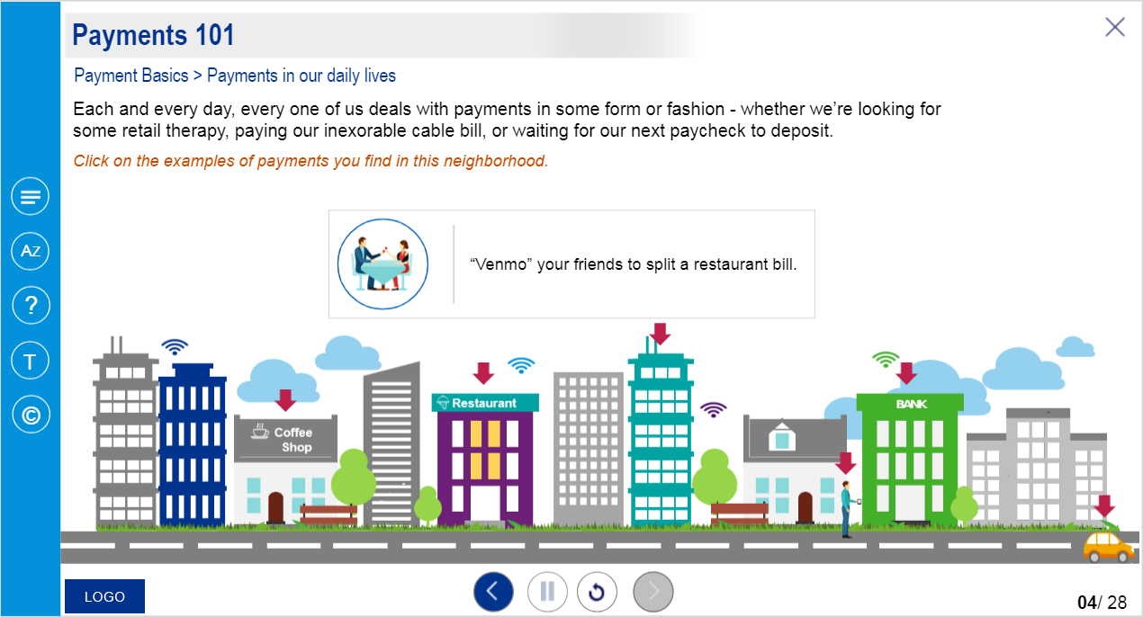
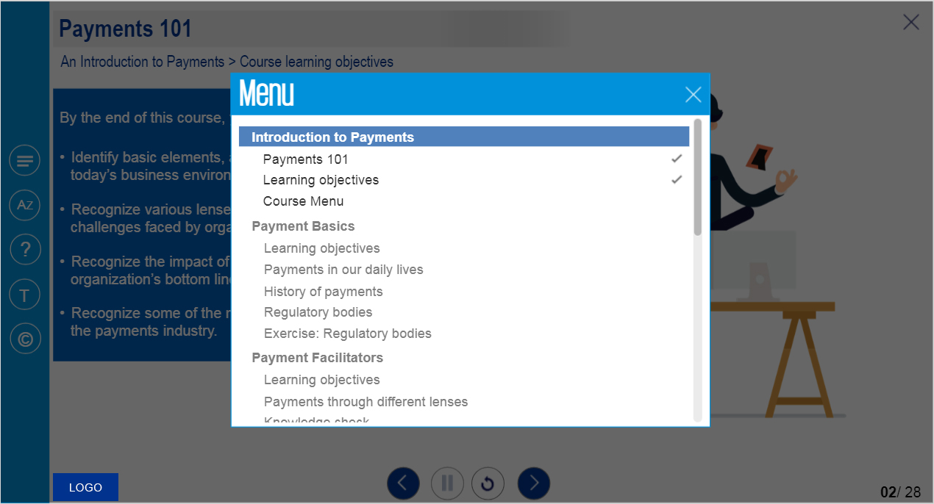
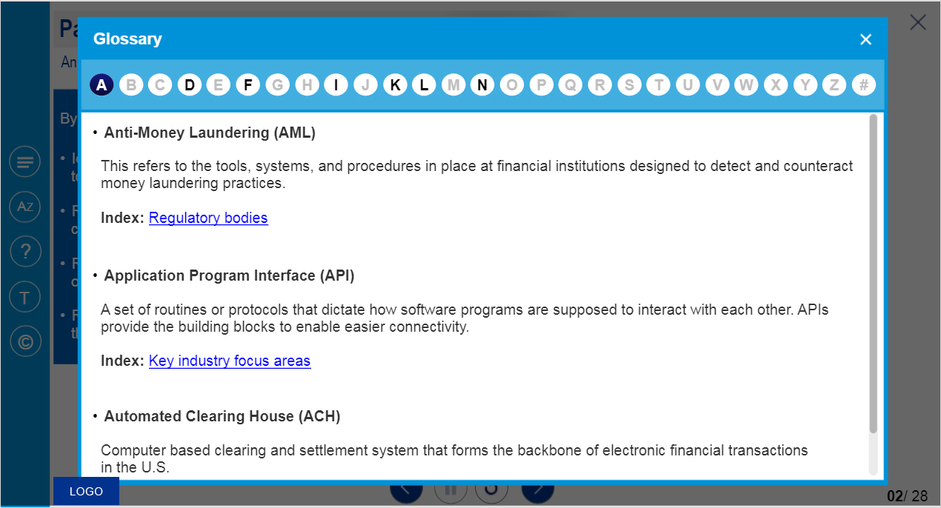
Articulate Storyline 3 Course Design Sample - 1
The course was developed using Articulate Storyline 3.
Used Photoshop CC to design/edit mockups.

Slide 8
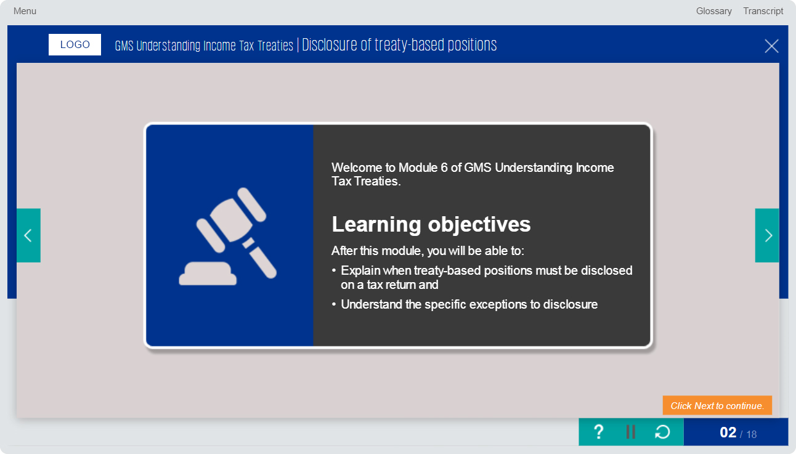
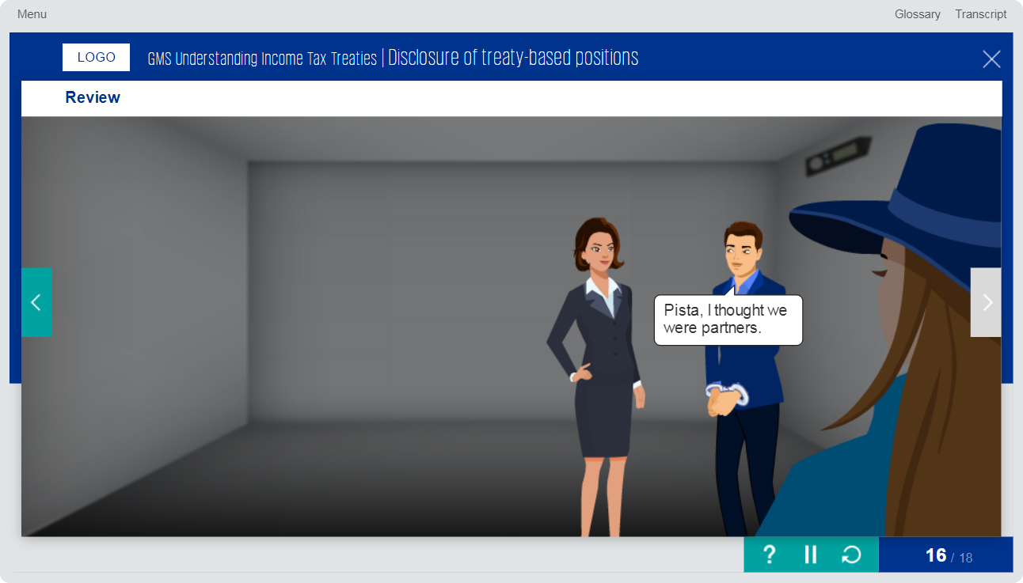
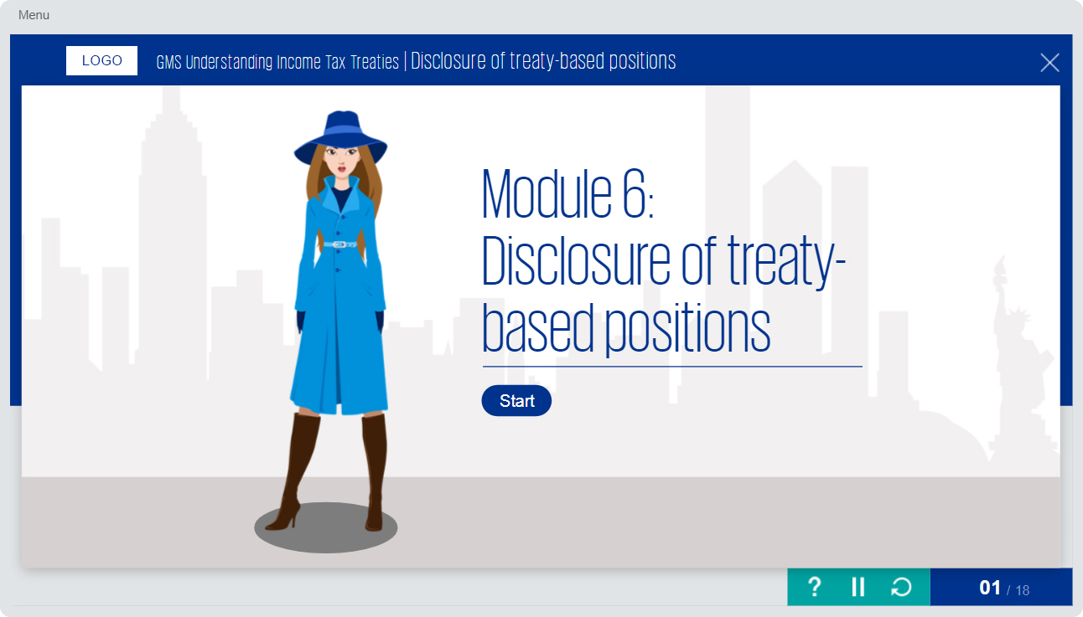
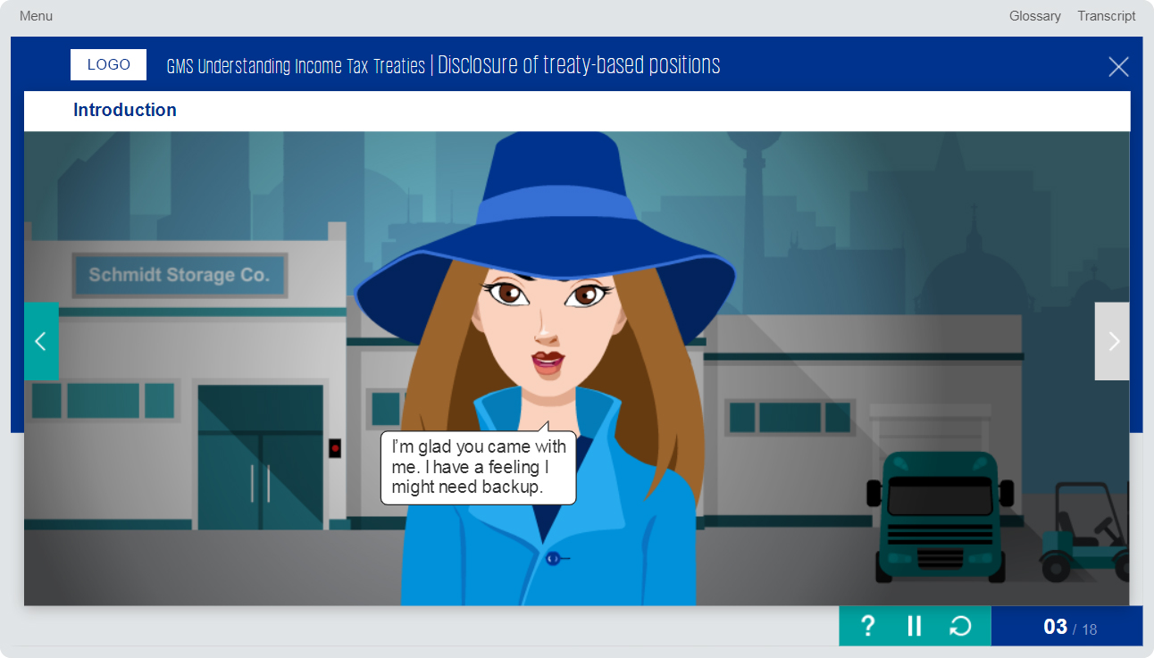
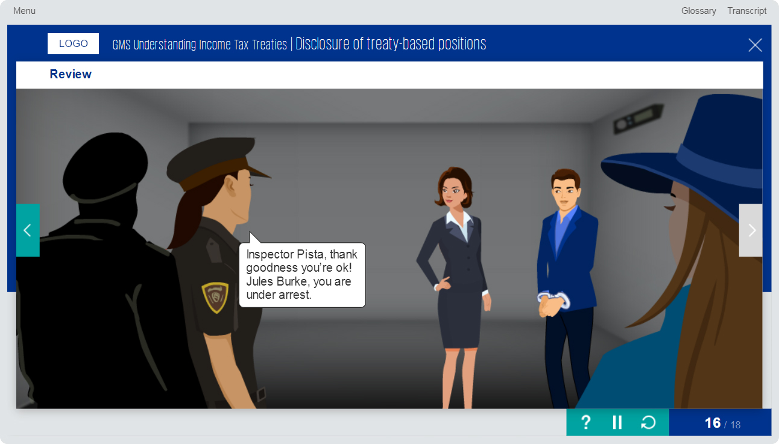
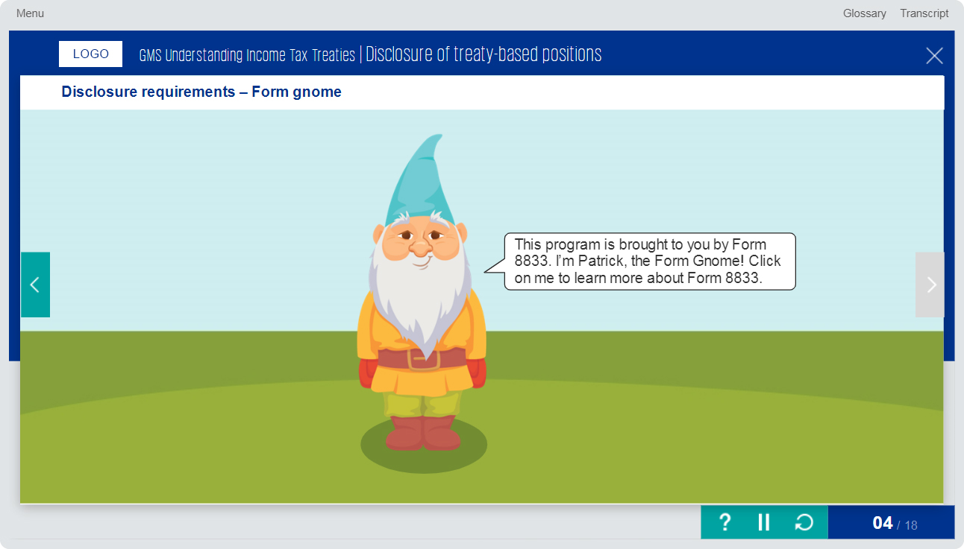
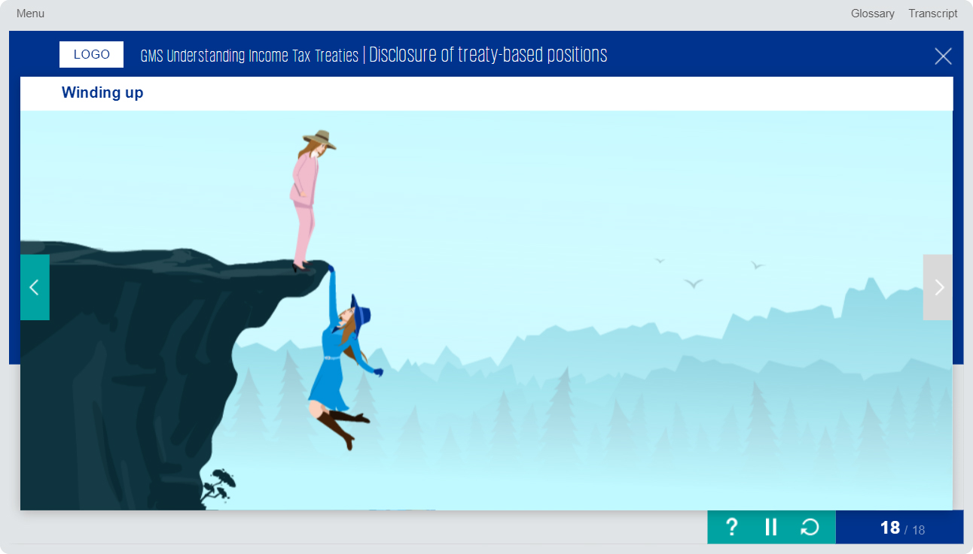
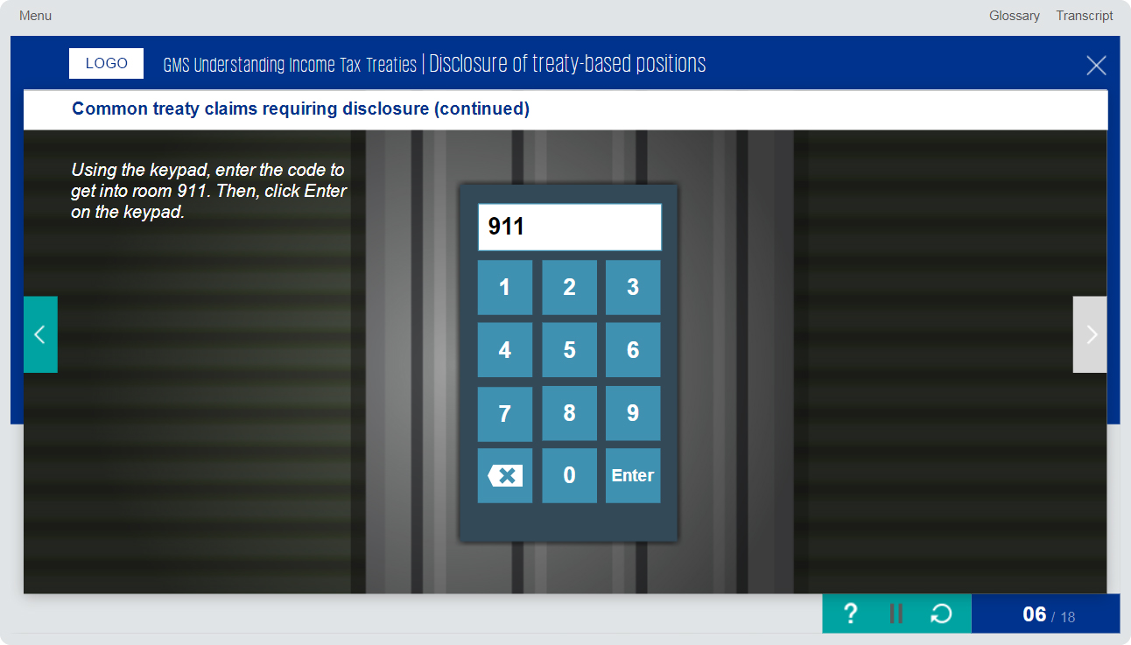
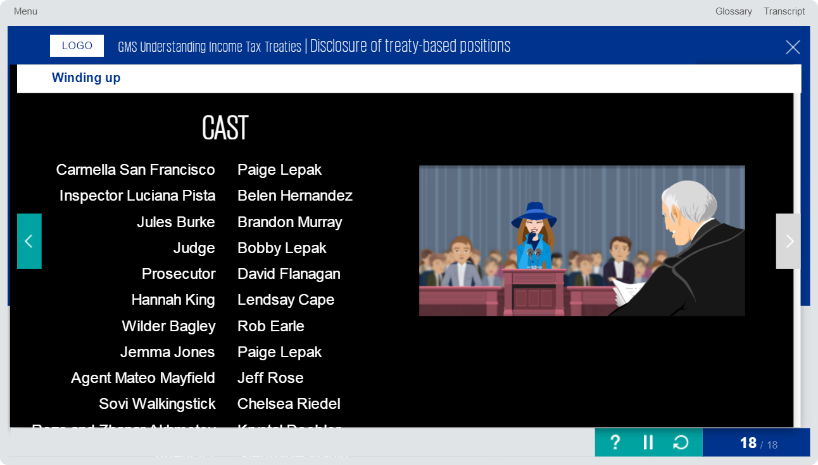
Articulate Storyline 3 Course Design Sample - 2
The course was developed using Articulate Storyline 3.
Used Photoshop CC to design/edit mockups.

Slide 9
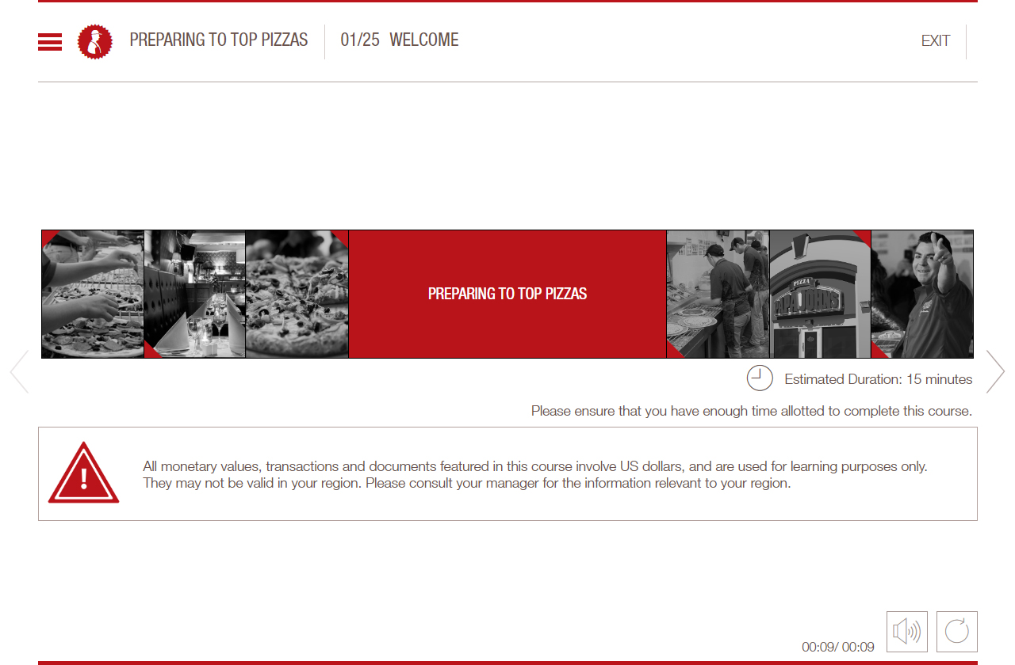
Micro Learning Sample
Used Camtasia, Photoshop CC and Audacity applications to design this learning.

Slide 10
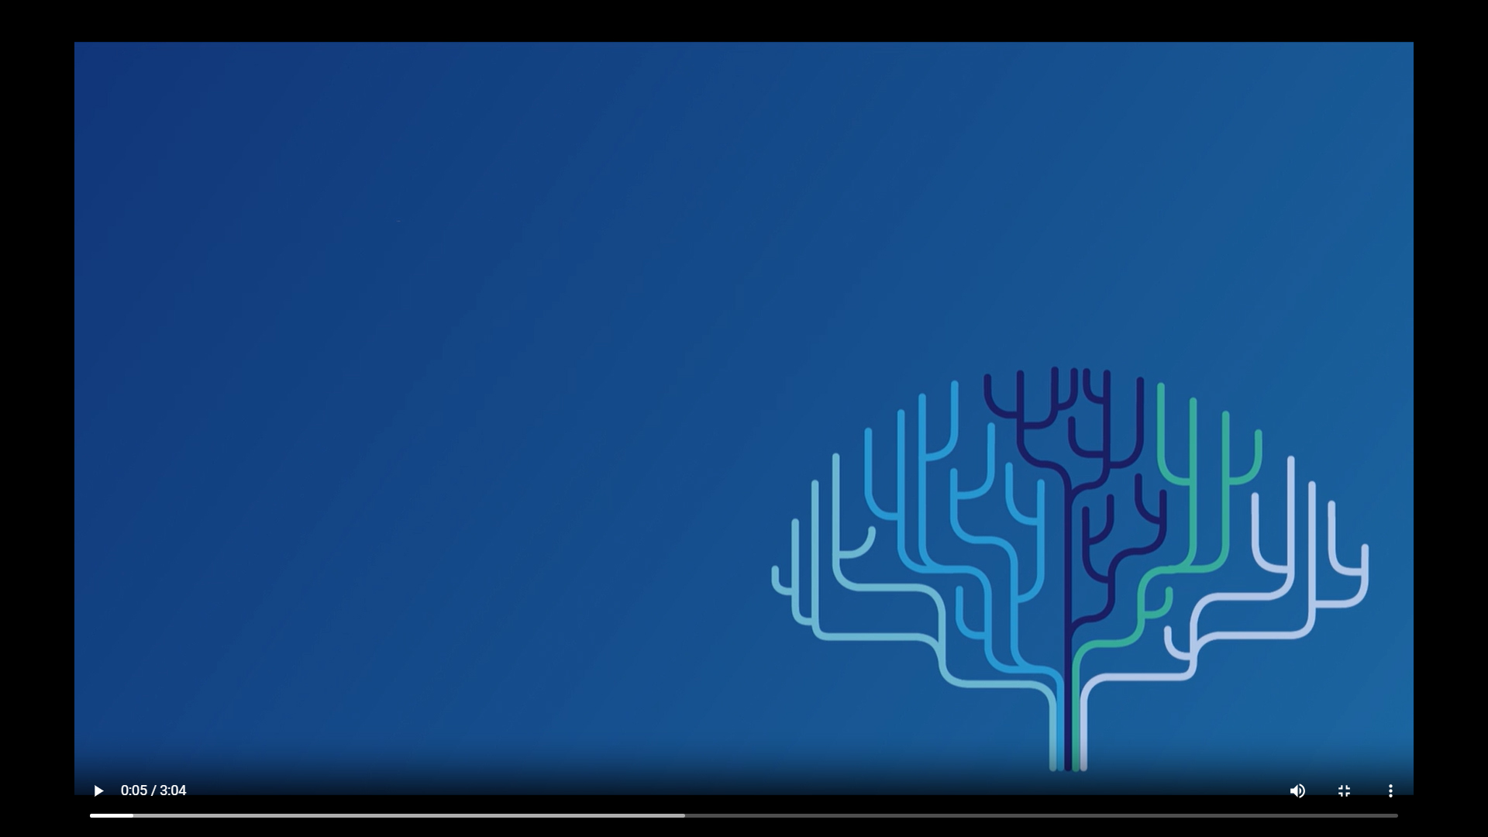
Video Based Learning Sample 1
Used Adobe Premiere, Photoshop CC, Audacity applications to design this learning.

Slide 11
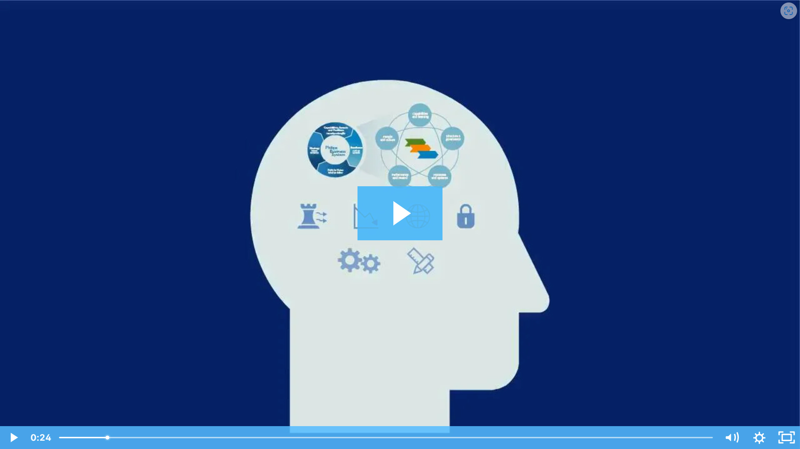
Video Based Learning Sample 2
Used Adobe Premiere, Photoshop CC, Audacity applications to design this learning.

Slide 12
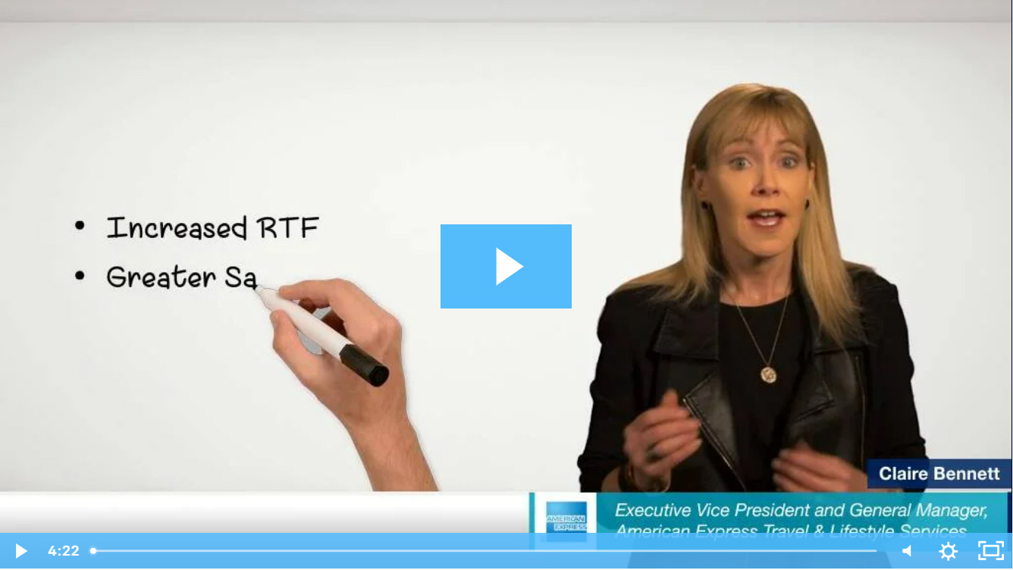
Green Screen Animations Sample
Used Adobe After Effects, Photoshop CC, Animate and Audacity applications to design this learning.

Slide 13

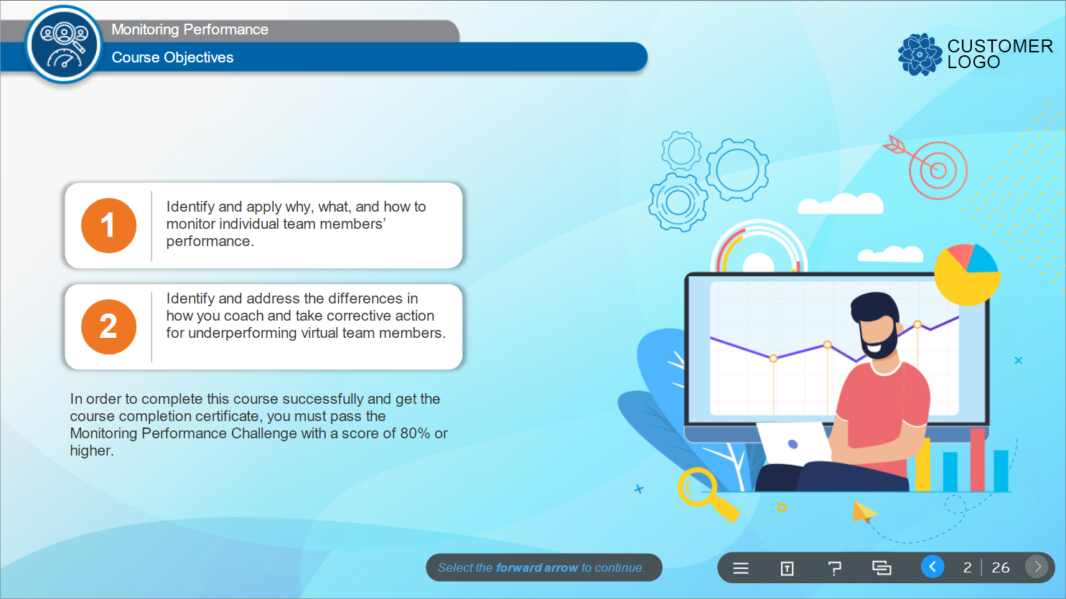
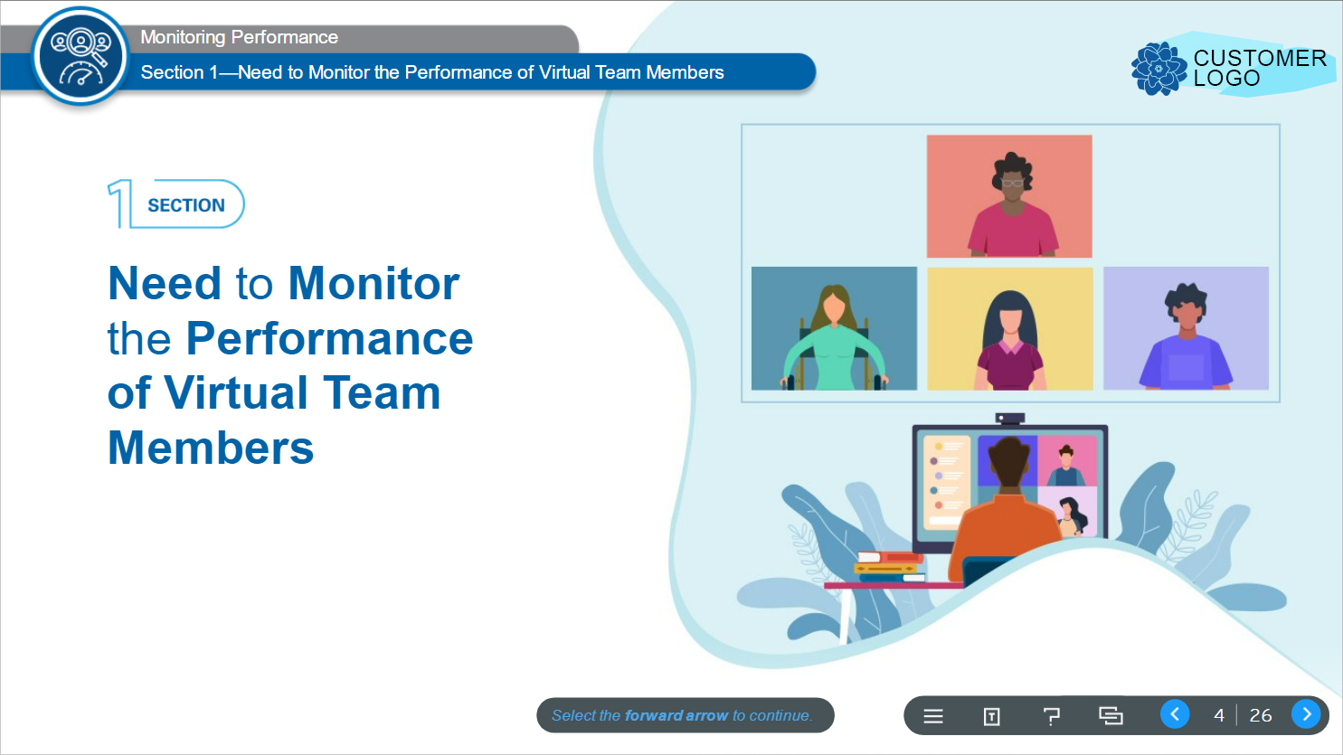

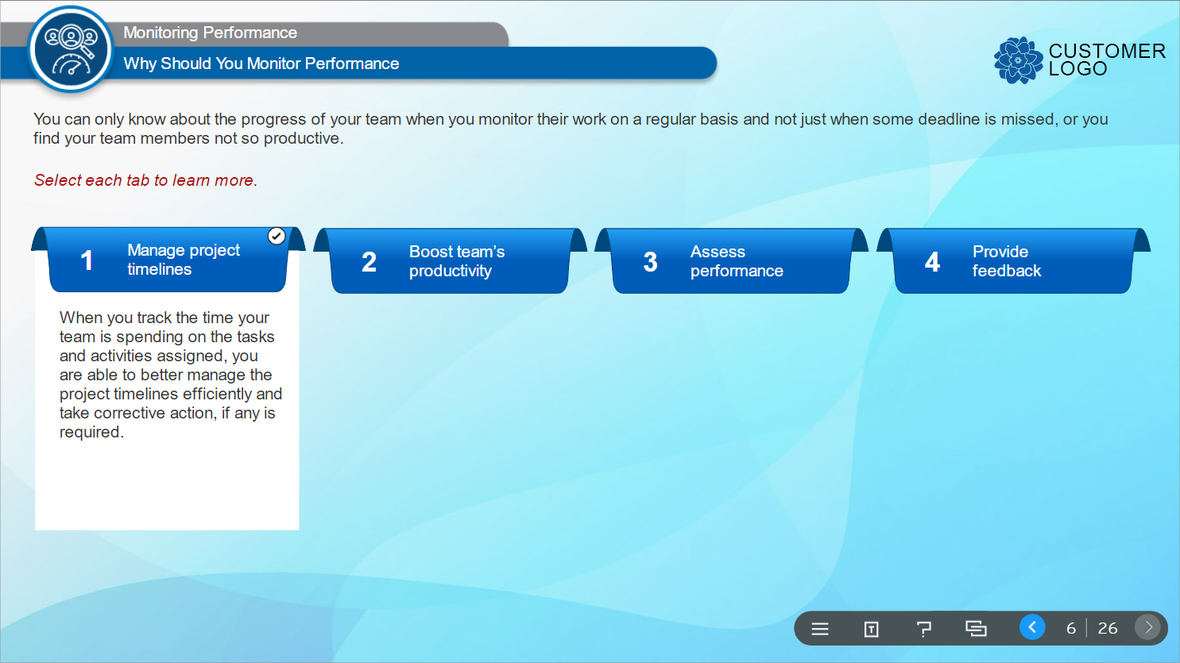
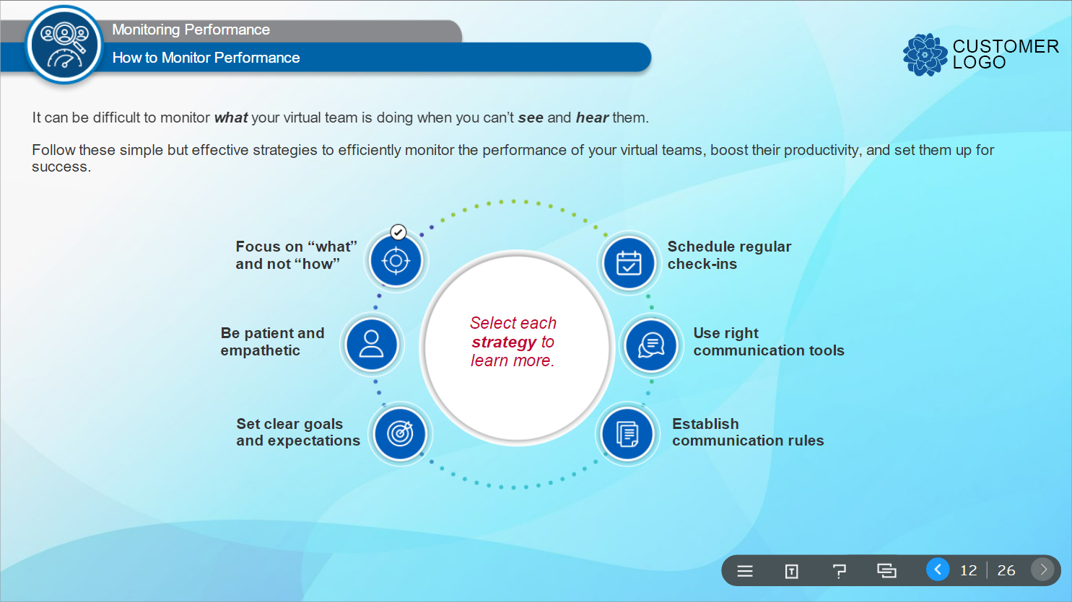
Photoshop Mock-up Design Sample - 1
The course was developed using Articulate Storyline 360.
Used Photoshop CC to design mockups.

Slide 14
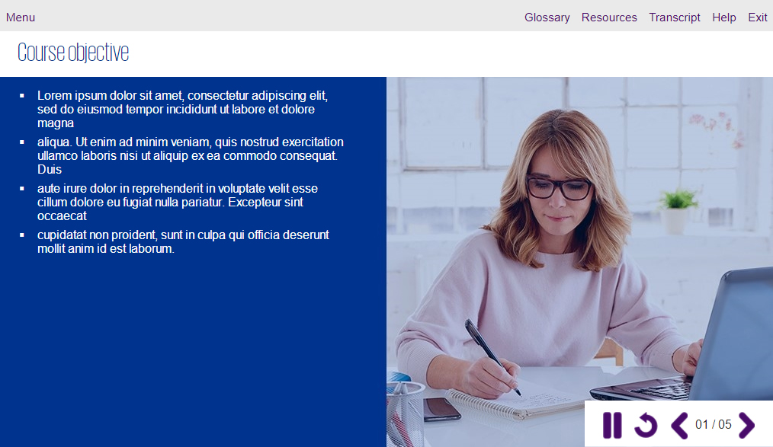
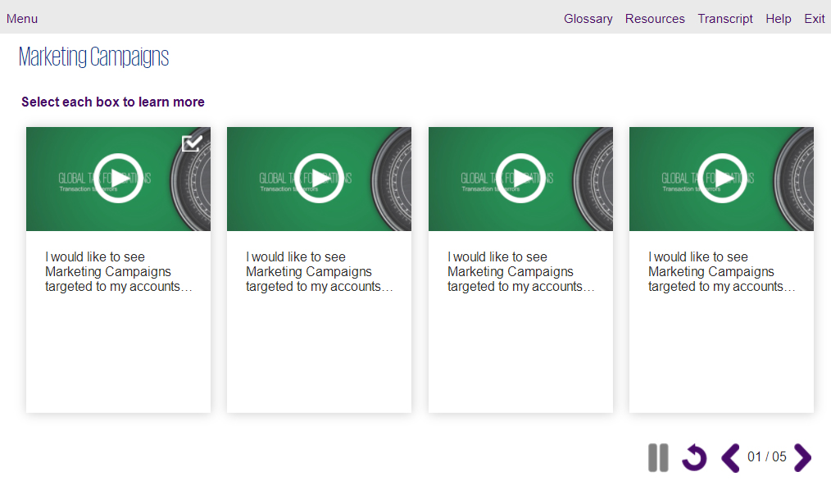
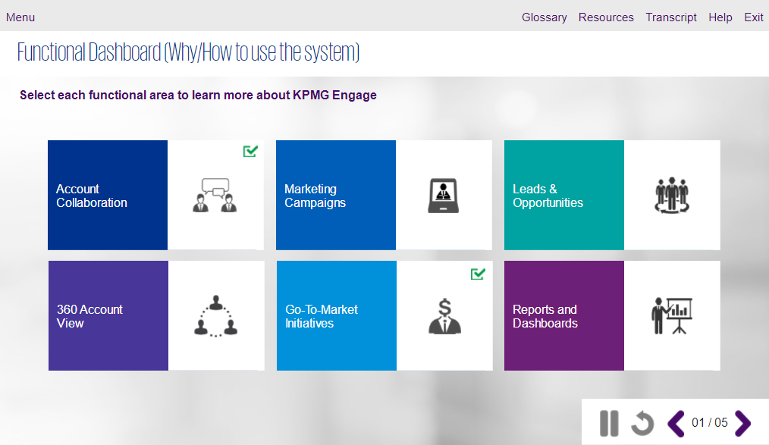
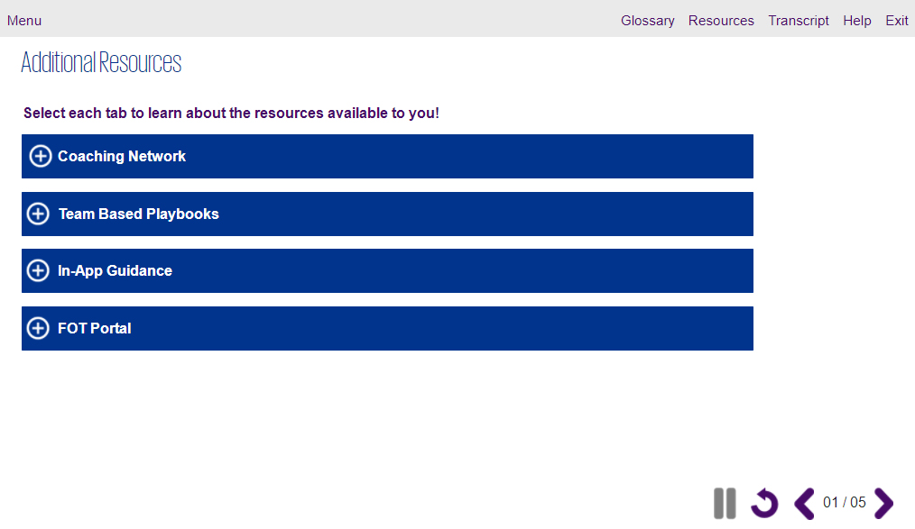
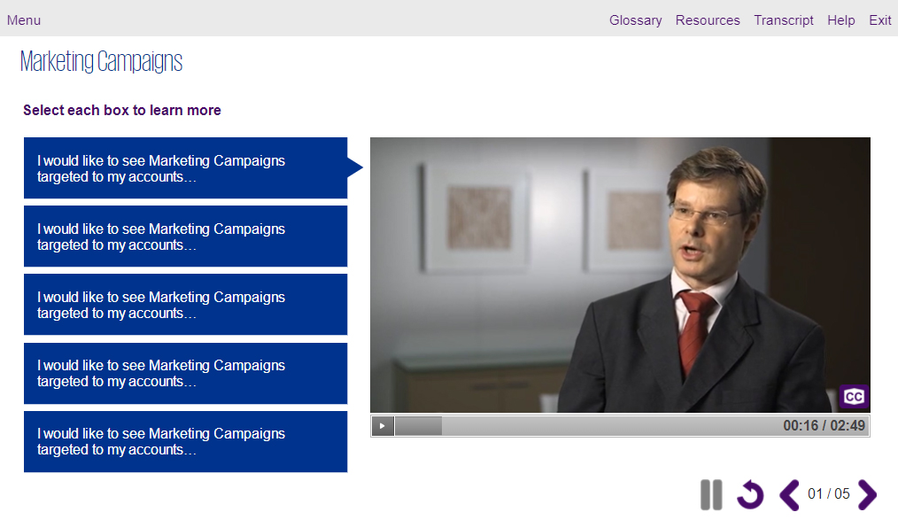
Photoshop Mock-up Design Sample - 2
The course was developed using Articulate Storyline 3.
Used Photoshop CC to design mockups.

Slide 15
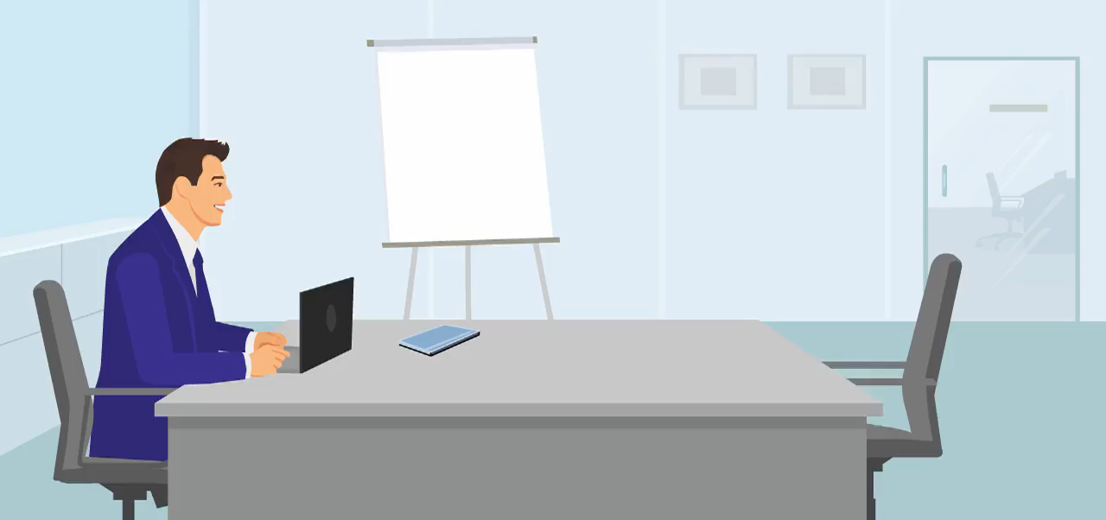
Adobe Flash Animation
The animation was created using Adobe Flash.

Slide 16

Adobe Flash Animation
The animation was created using Adobe Flash.

Slide 17




Tools Proficiency
Development tools
Articulate Rise 360
Articulate Storyline 360
Articulate Storyline 3
Design Tools
Adobe Creative suite (Photoshop, Illustrator, Indesign, XD)
MS Office Suite (PowerPoint, Word, Excel)
Animation/Video Tools
Adobe Flash/Animate
Sound Editing Tools
Audacity

Slide 18
Thank You

