Slide 1

Graphic design
Portfolio
Shivani Walia
Associate Manager - Graphic Design
Notes:
Good morning, everyone.
I am Abhijit, working as a Senior Manager - Programming. Today, I am excited to present the portfolios of two of our talented team members: Varsha, our UI/UX Designer, and Gaurav, our Web Developer.

Slide 2
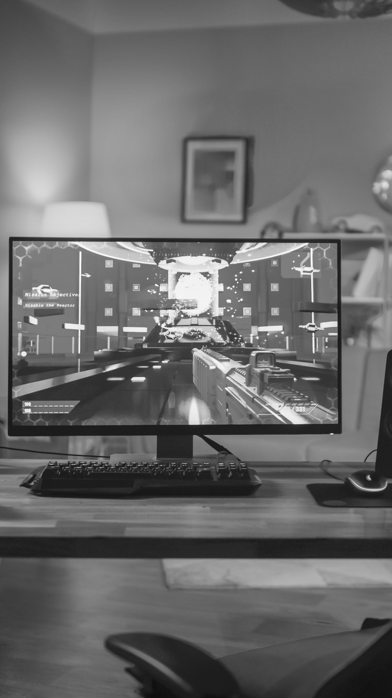
A visual timeline
01
Skill sets
02
Work
03
Training Tool

Slide 3




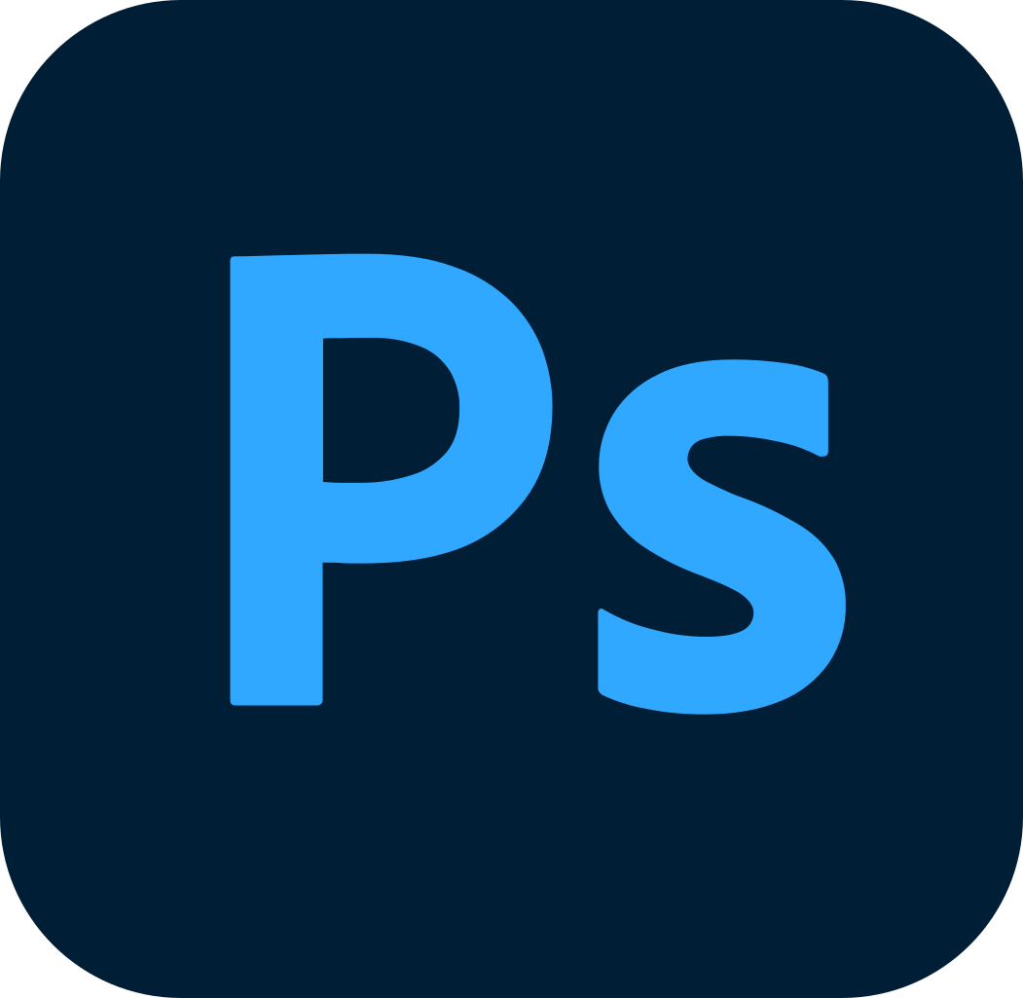
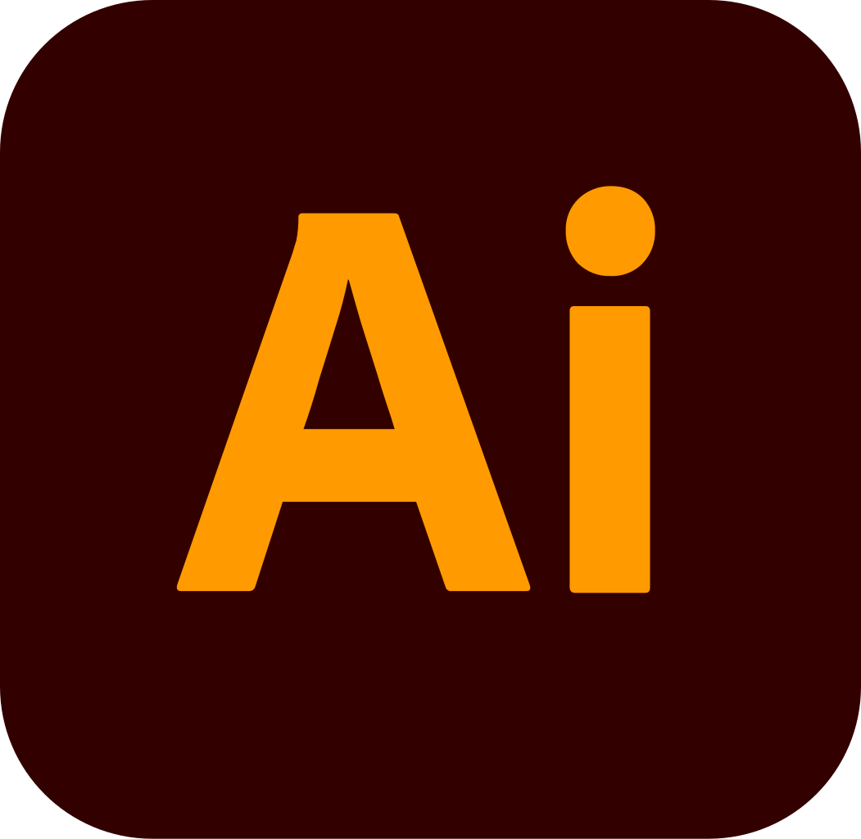

Skill sets
Articulate Rise 360
Articulate Storyline360
Adobe XD
Adobe Photoshop CC
Adobe Illustrator CC
Adobe Animate CC

Slide 4
Showcase…
Showcasing my expertise through a curated selection of impactful projects and innovative solutions.

Slide 5
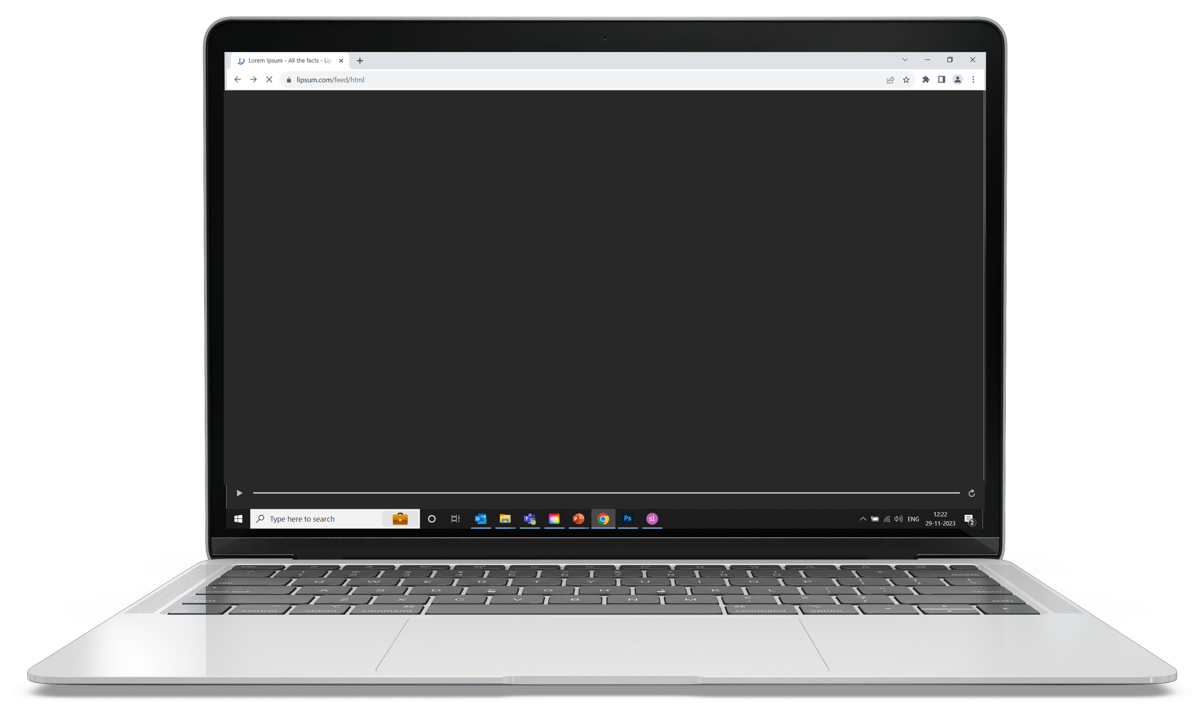
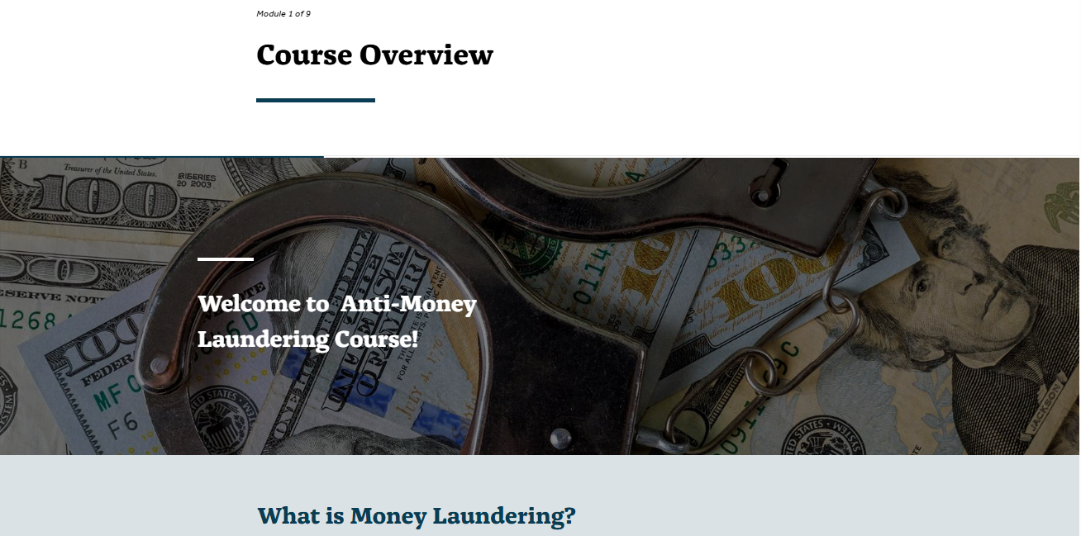
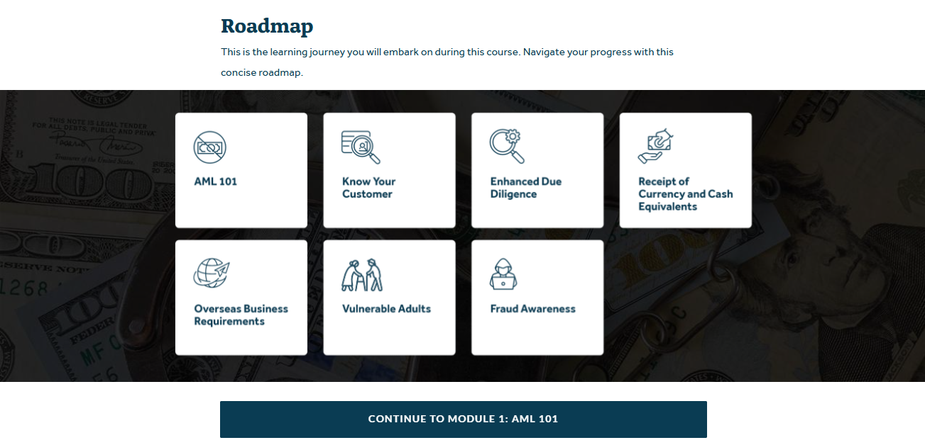
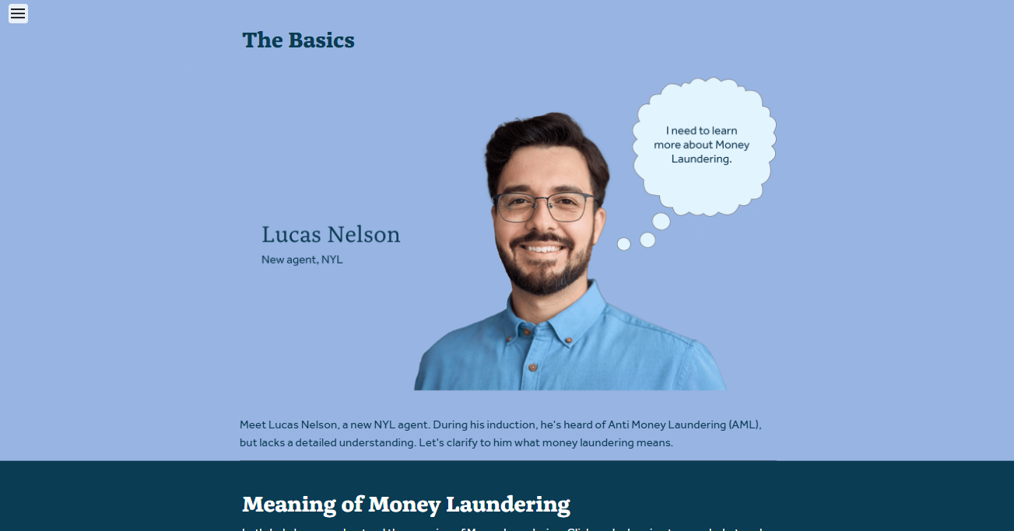
Articulate Rise Course Design Sample - 1
The complete course was developed using Articulate Rise.
Used photoshop CC to design/edit mockups.

Slide 6
Articulate Rise Course Design Sample - 2
The complete course was developed using Articulate Rise.
Used Illustrator CC to design/edit mockups.

Slide 7
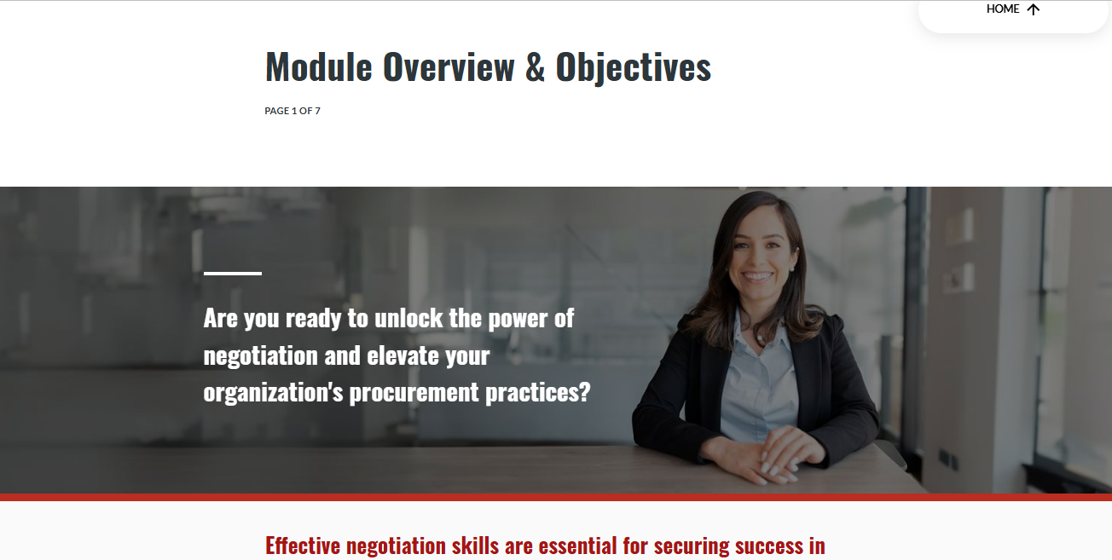
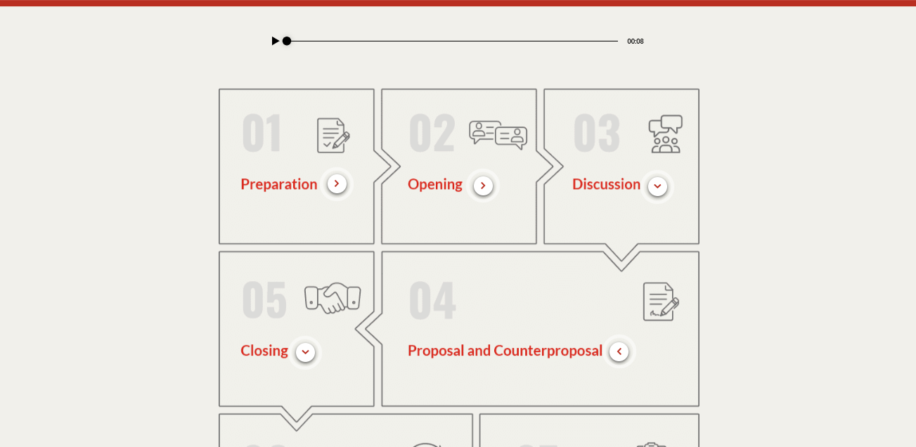
Articulate Rise Course Design Sample - 3
The complete course was developed using Articulate Rise.
Used photoshop CC to design/edit mockups.

Slide 8
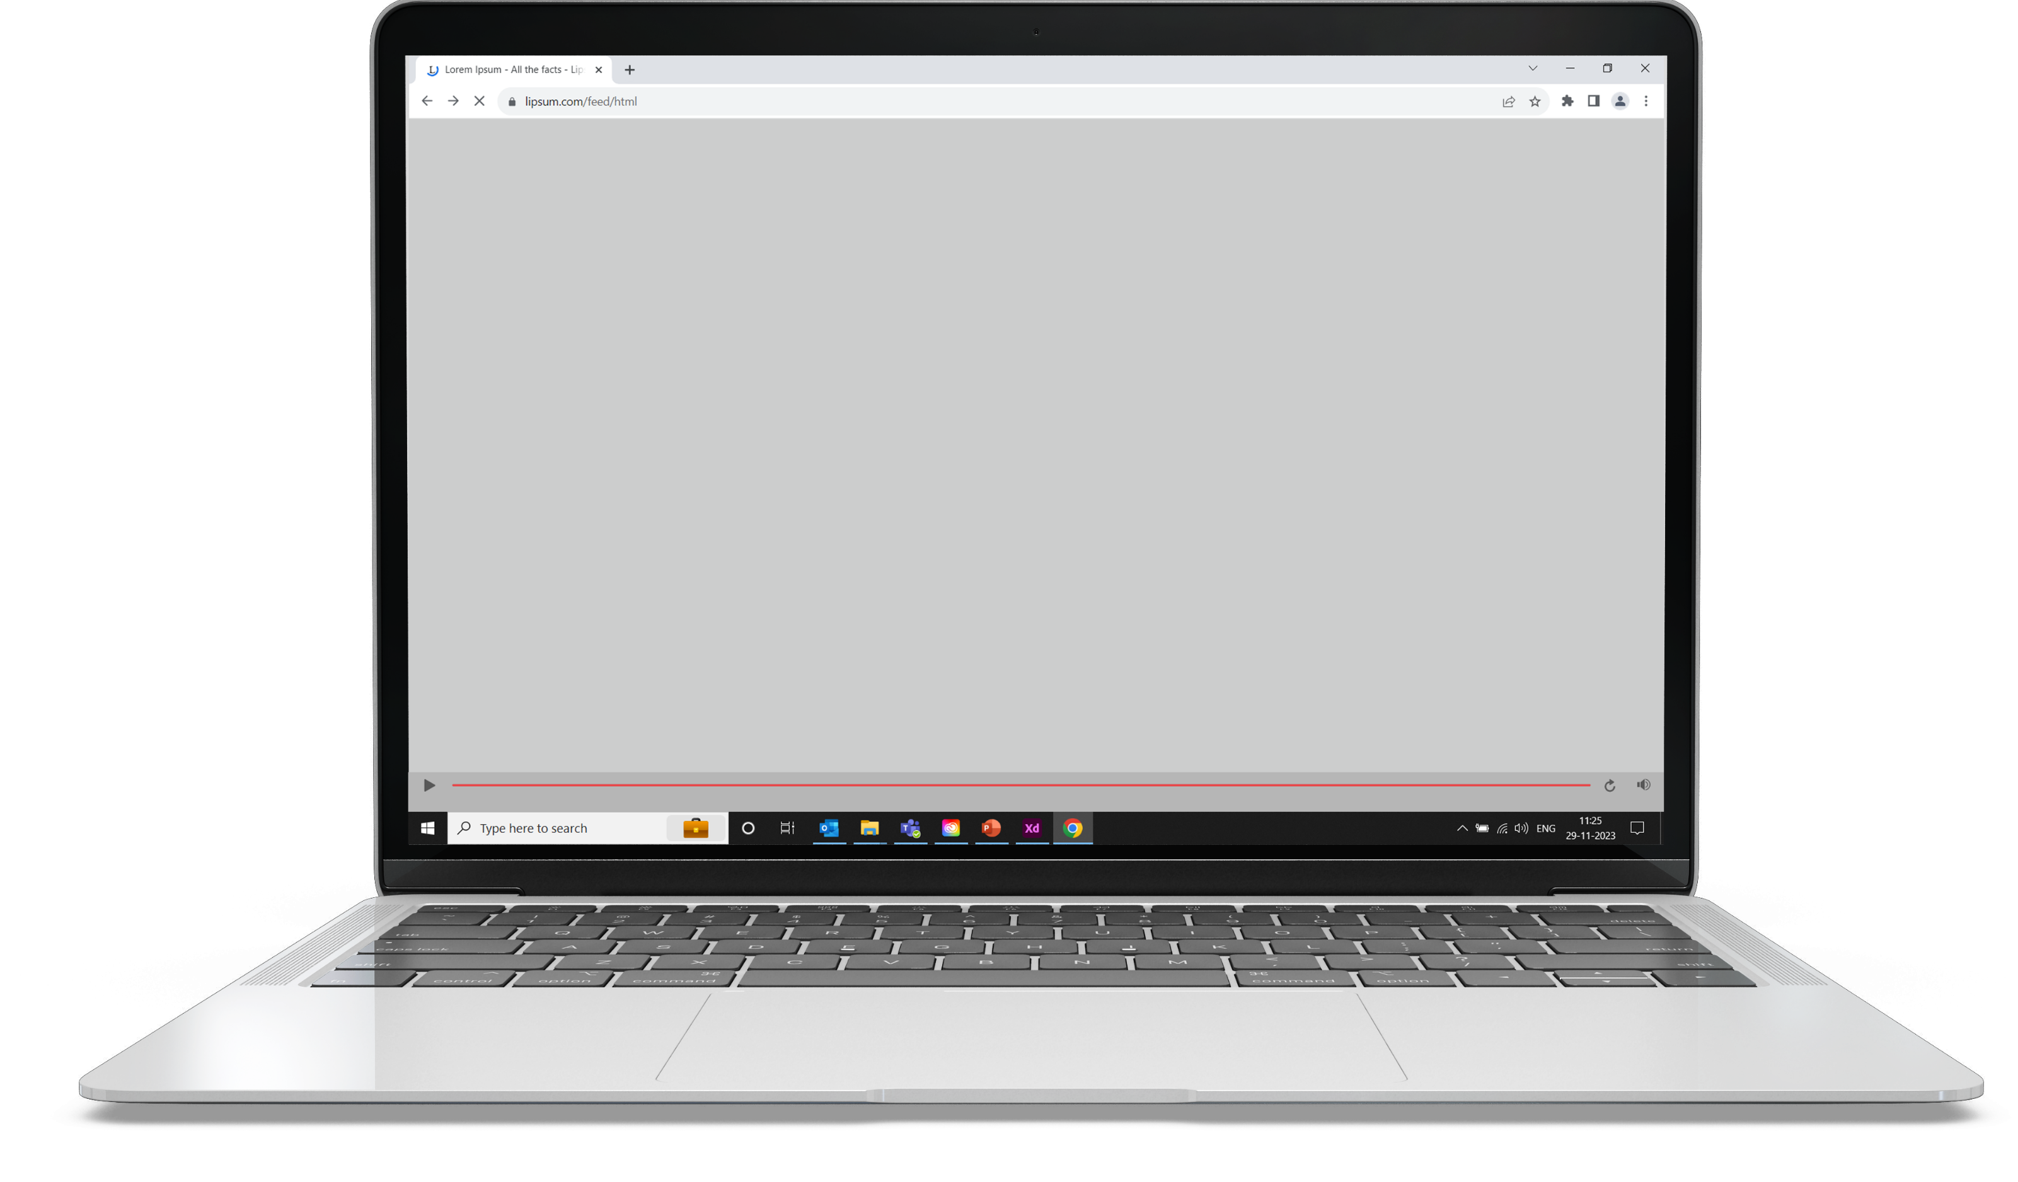
Articulate Storyline 360 Course Design Sample - 1
The complete customized course was developed using Articulate Storyline 360.
Used Adobe XD to edit/extract the assets.

Slide 9
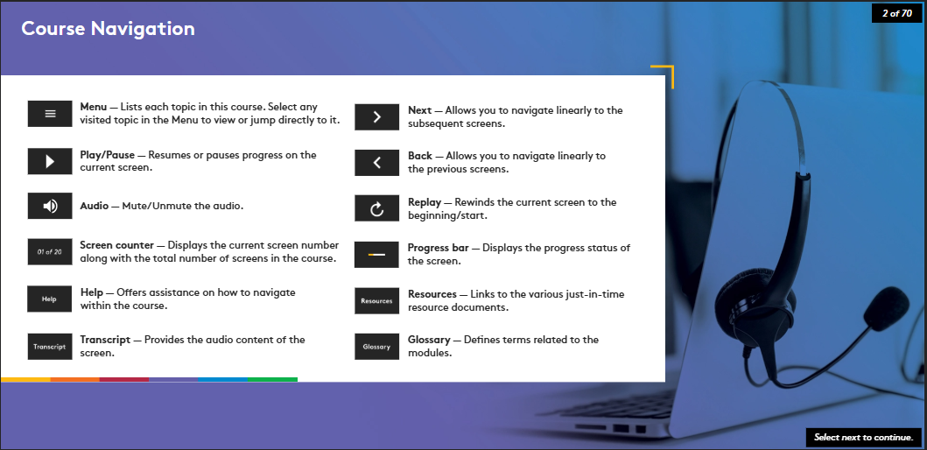

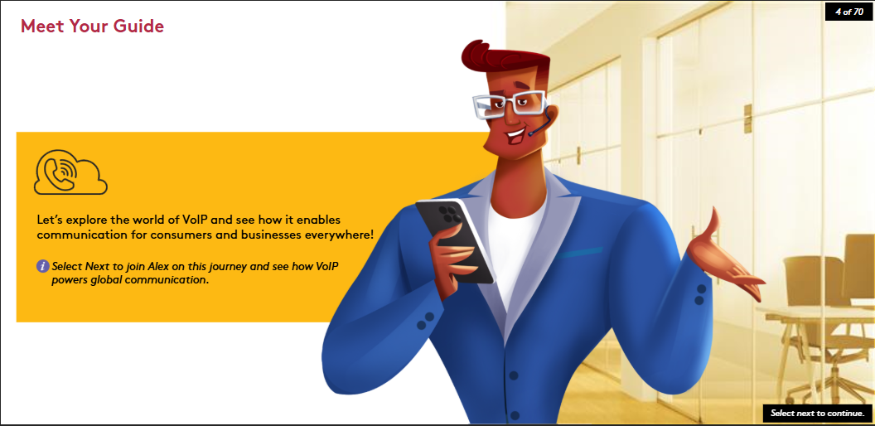
Articulate Storyline 360 Course Design Sample - 2
The complete customized course was developed using Articulate Storyline 360.
Used Adobe XD to edit/extract the assets.

Slide 10
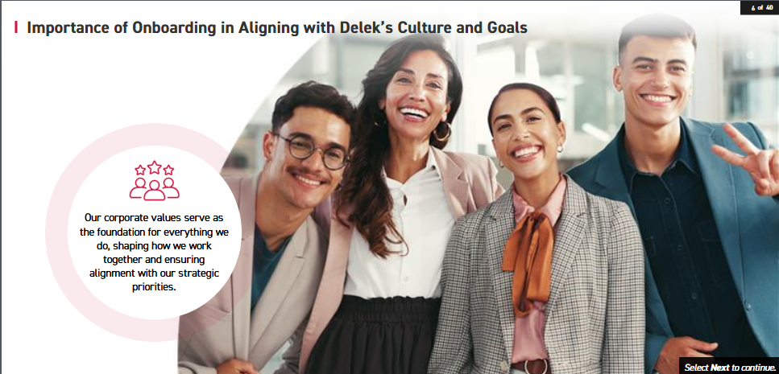
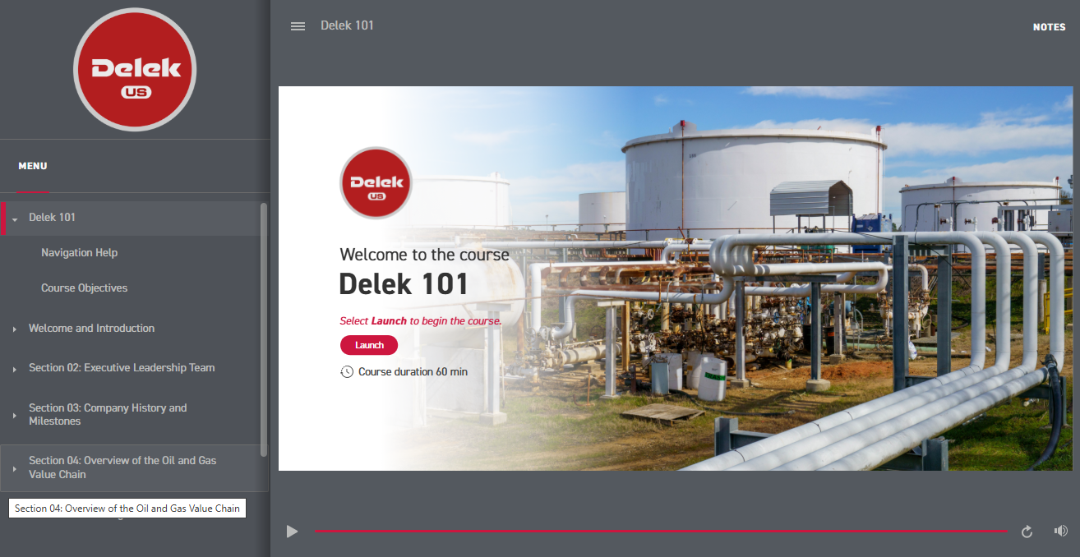
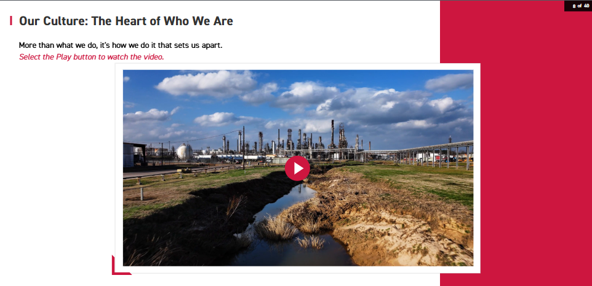
Articulate Storyline 360 Course Design Sample - 3
The complete customized course was developed using Articulate Storyline 360.
Used Adobe XD to edit/extract the assets.

Slide 11
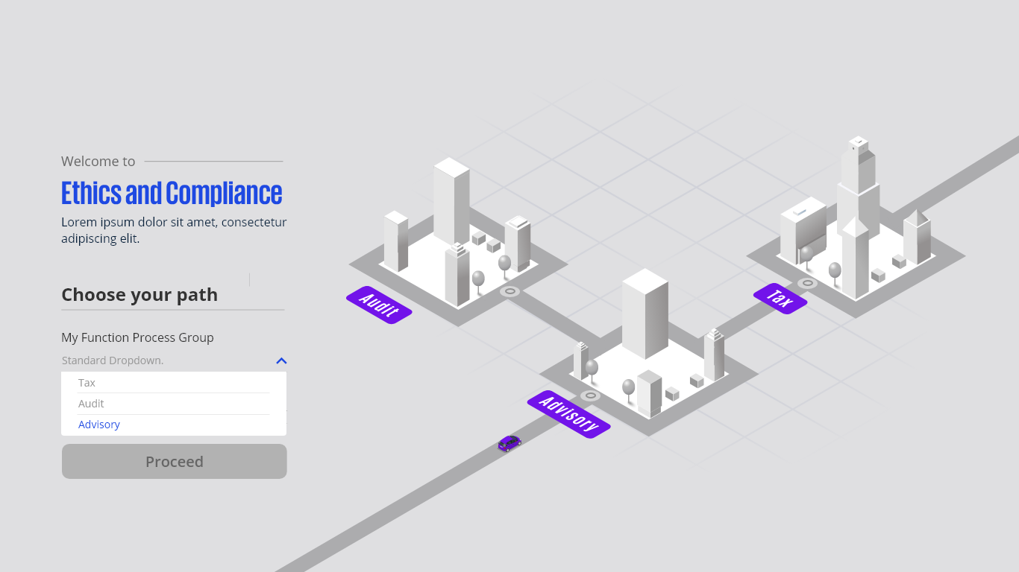
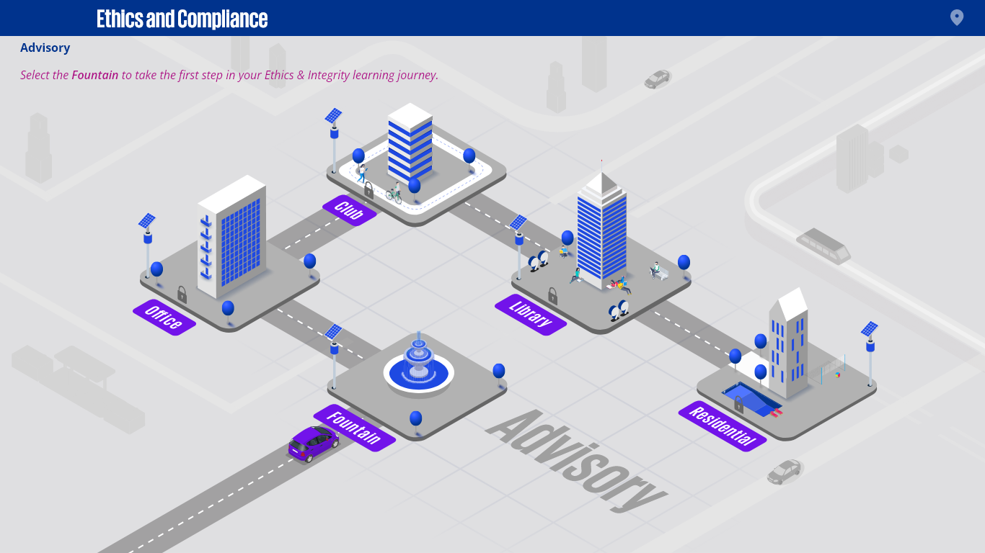
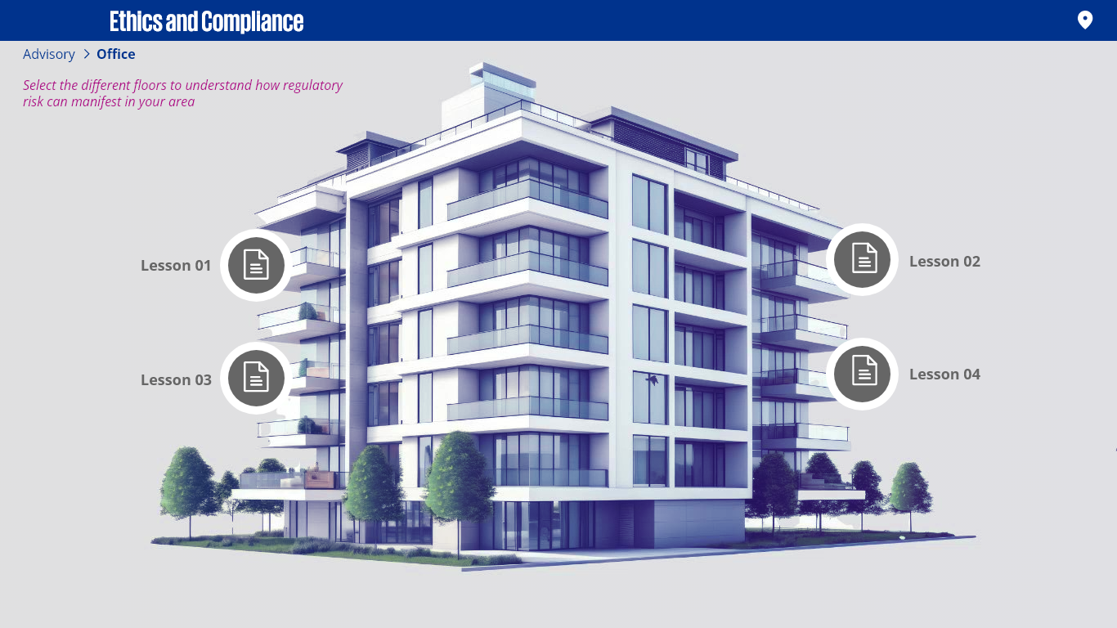
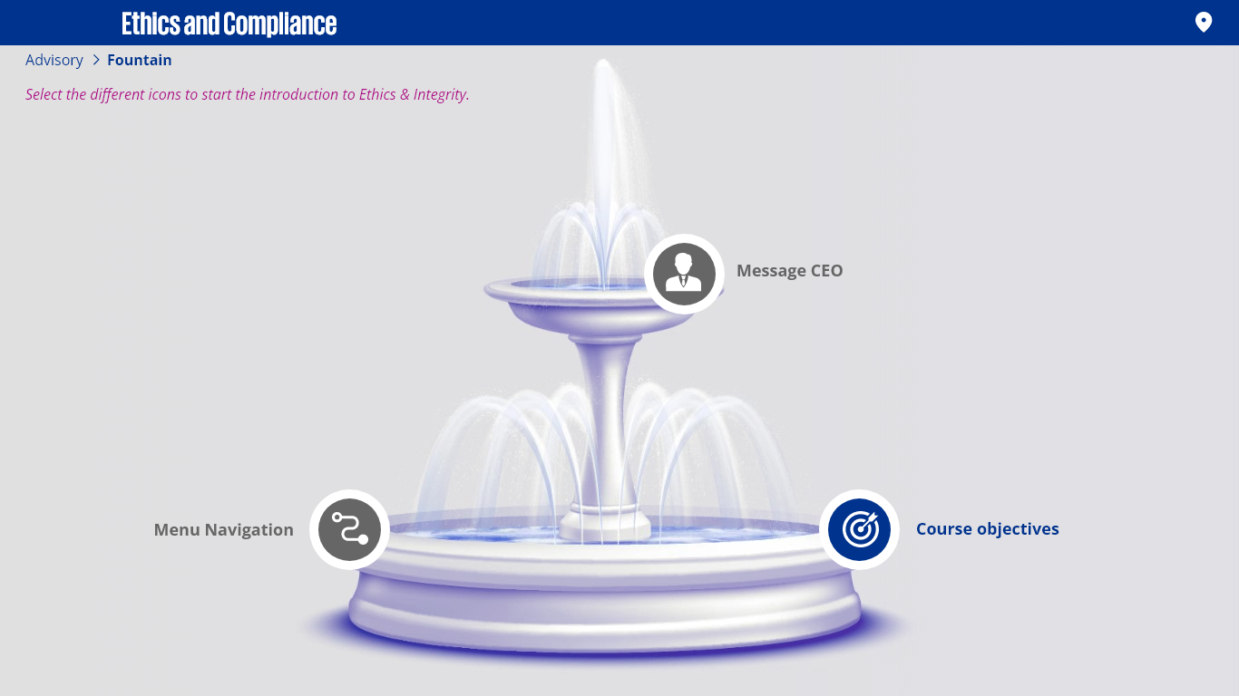
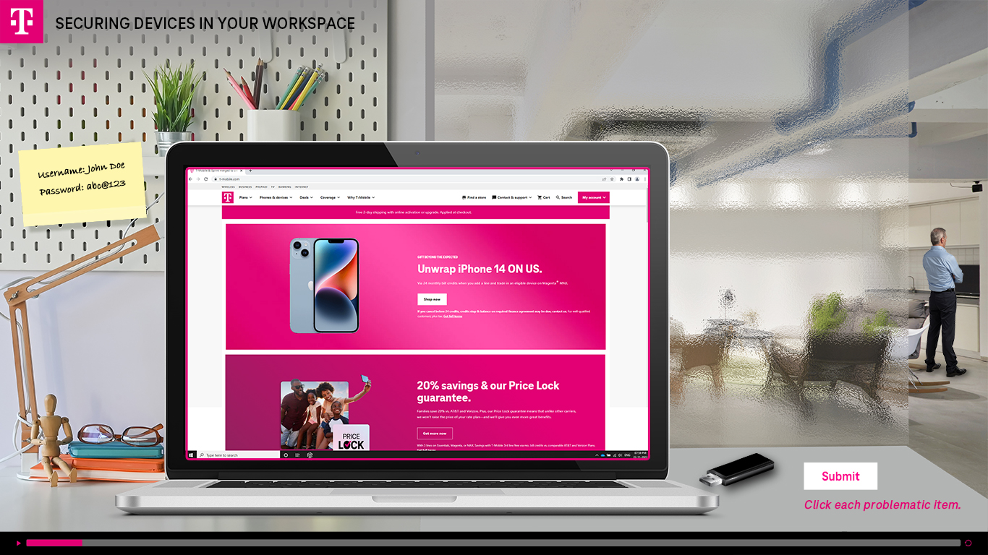
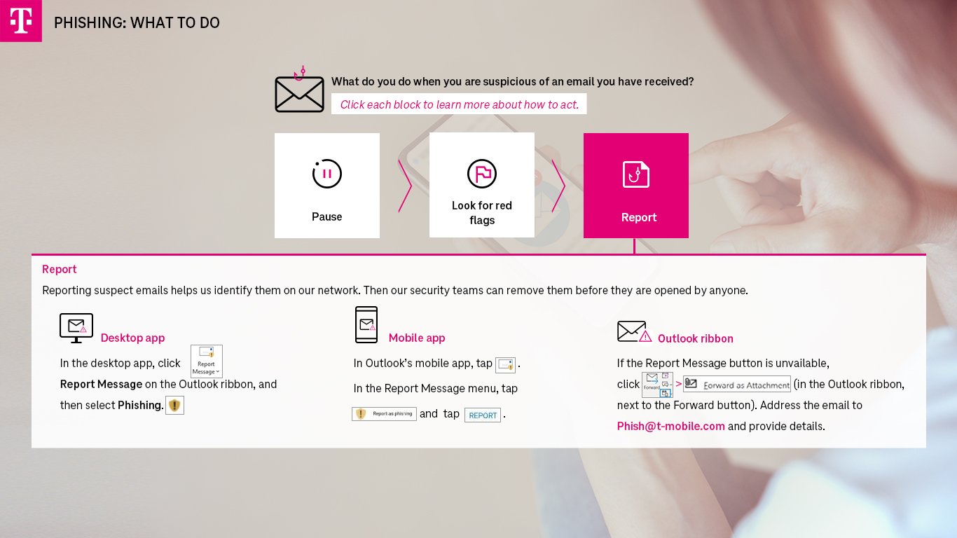
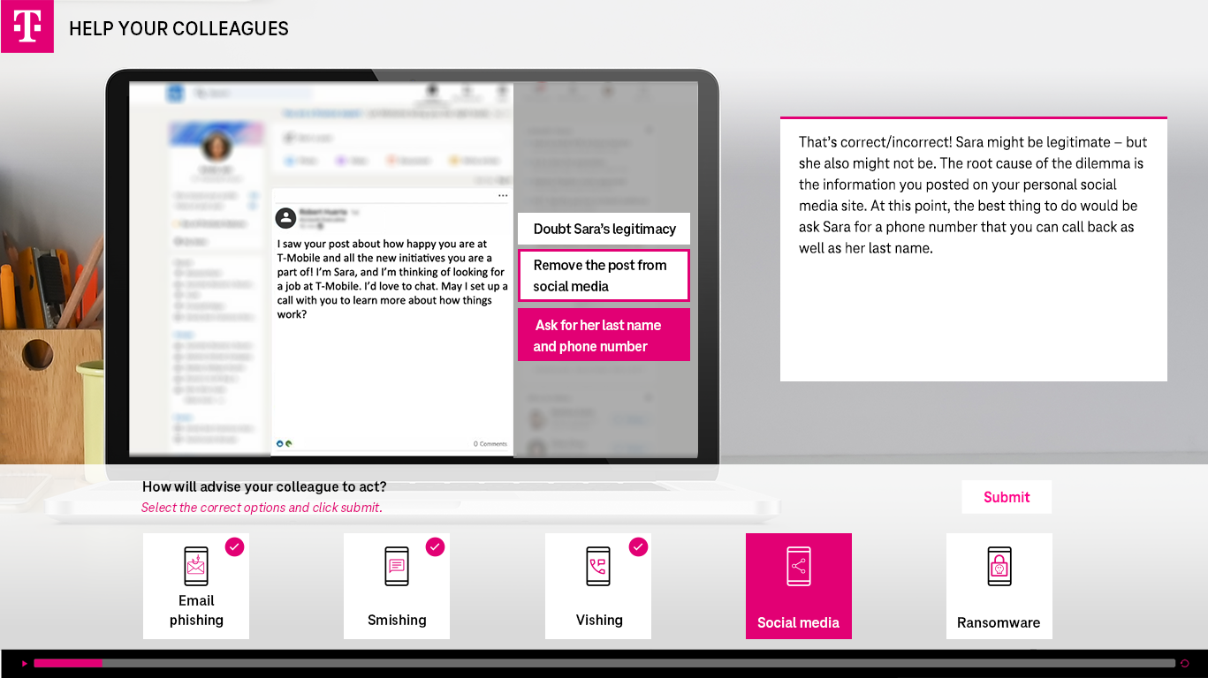
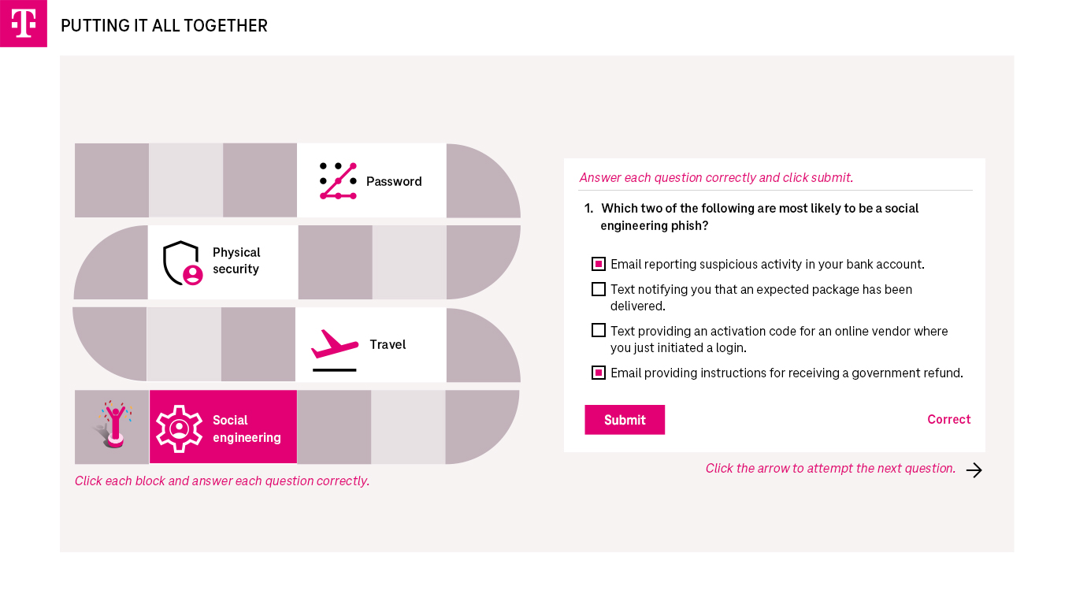
Mock up design

Slide 12




Tools Proficiency
Development tools
Articulate Rise 360
Articulate Storyline 360
Design Tools
Adobe Creative suite (Photoshop, Illustrator, Indesign, XD)
MS Office Suite (PowerPoint, Word, Excel)
Animation/Video Tools
Adobe Flash/Animate
Sound Editing Tools
Audacity

