Slide 1
SOMNATH PAWAR
SENIOR GRAPHIC DESIGNER - PORTFOLIO

Slide 2
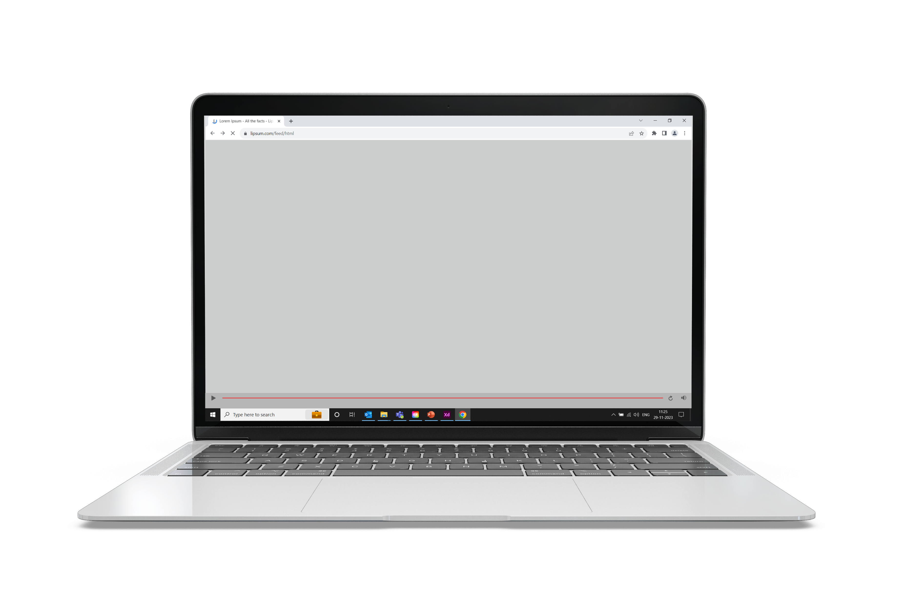
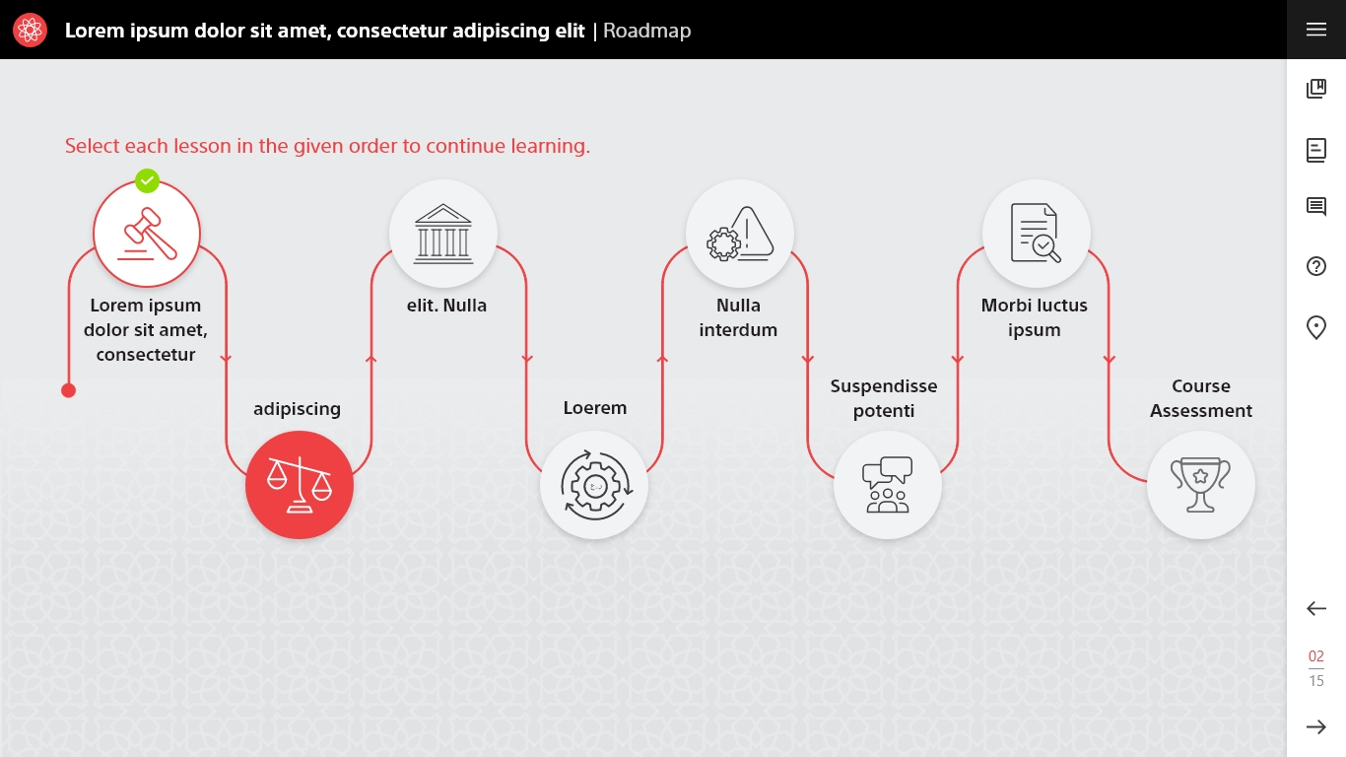
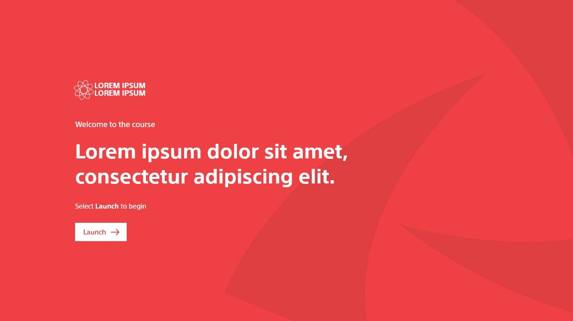
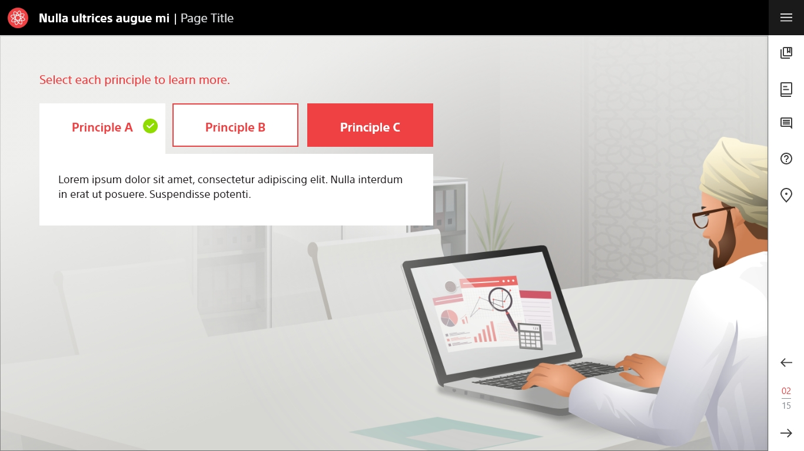
Articulate Storyline 360 Course Design Sample - 1
The complete customized course was developed using Articulate Storyline 360.
Used Adobe XD to edit/extract the assets.

Slide 3
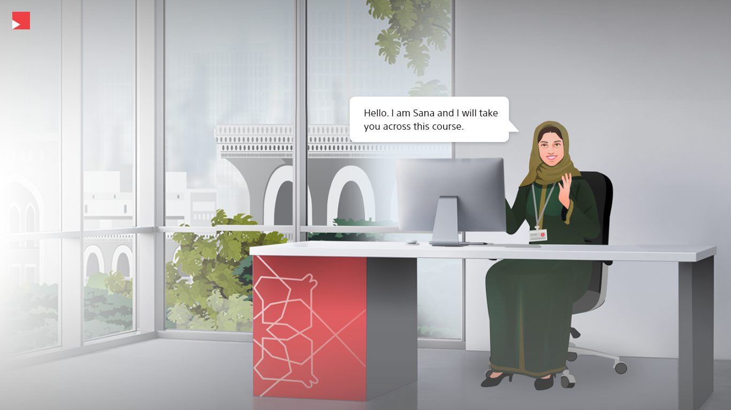
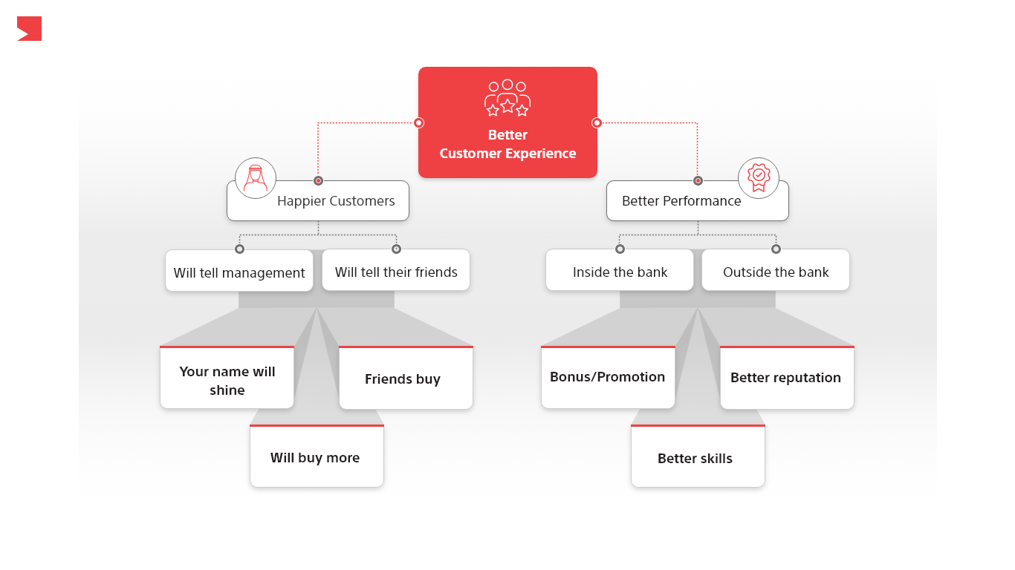
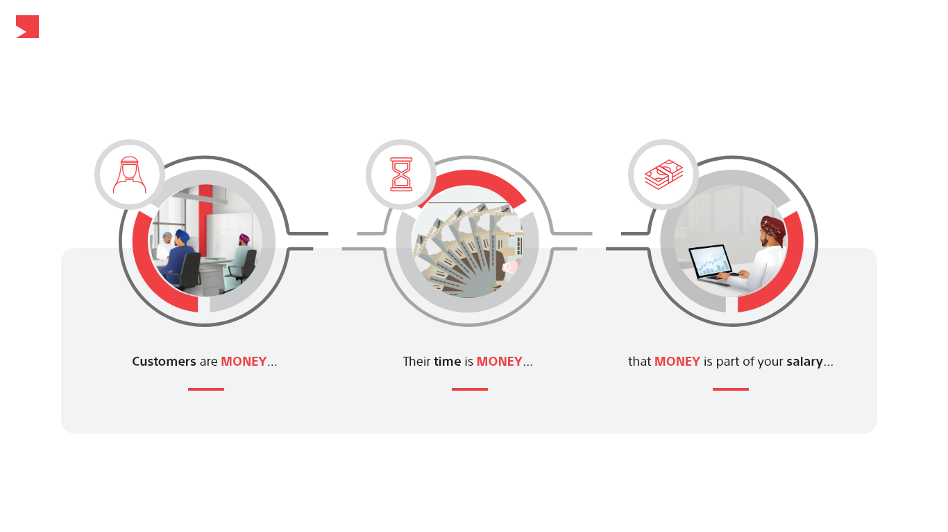
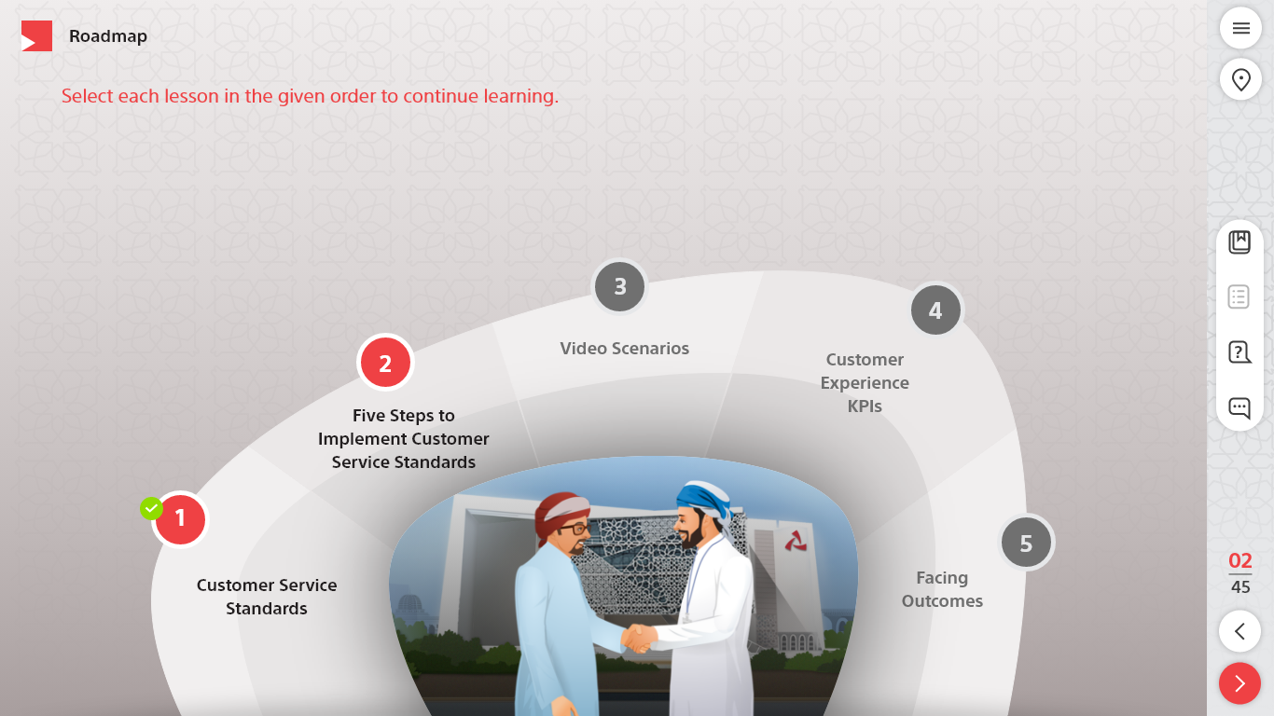
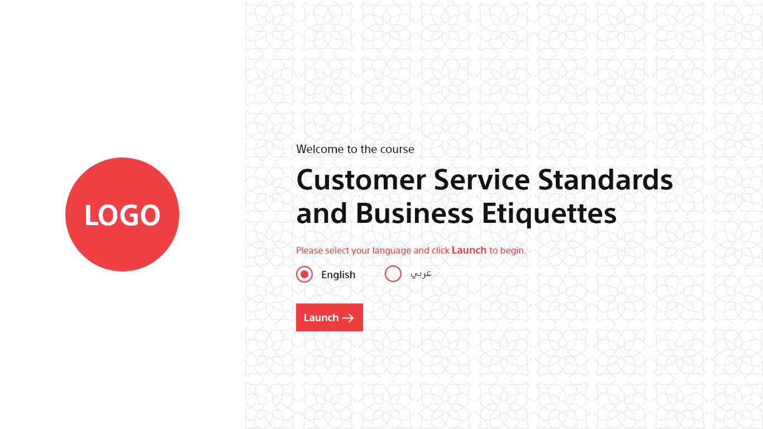
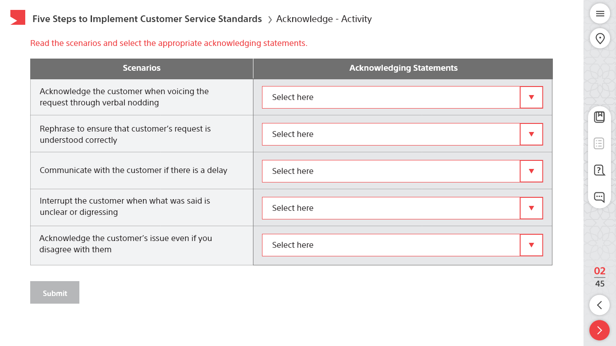
Articulate Storyline 360 Course Design Sample - 2
The complete customized course was developed using Articulate Storyline 360.
Used Adobe XD to edit/extract the assets.

Slide 4
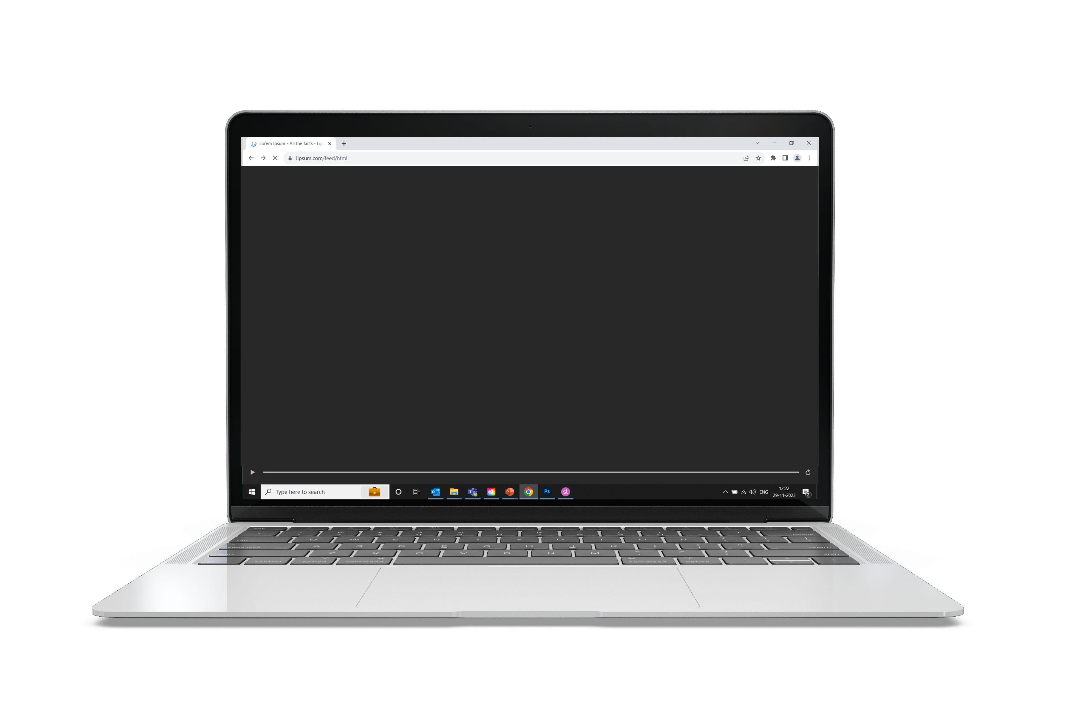
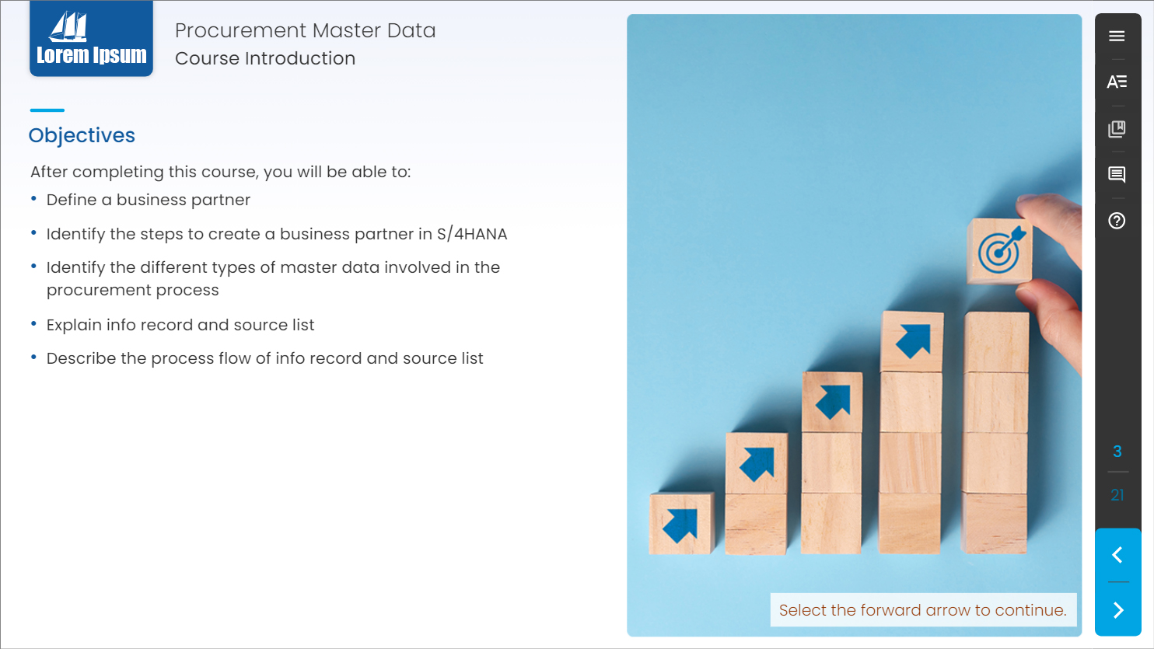

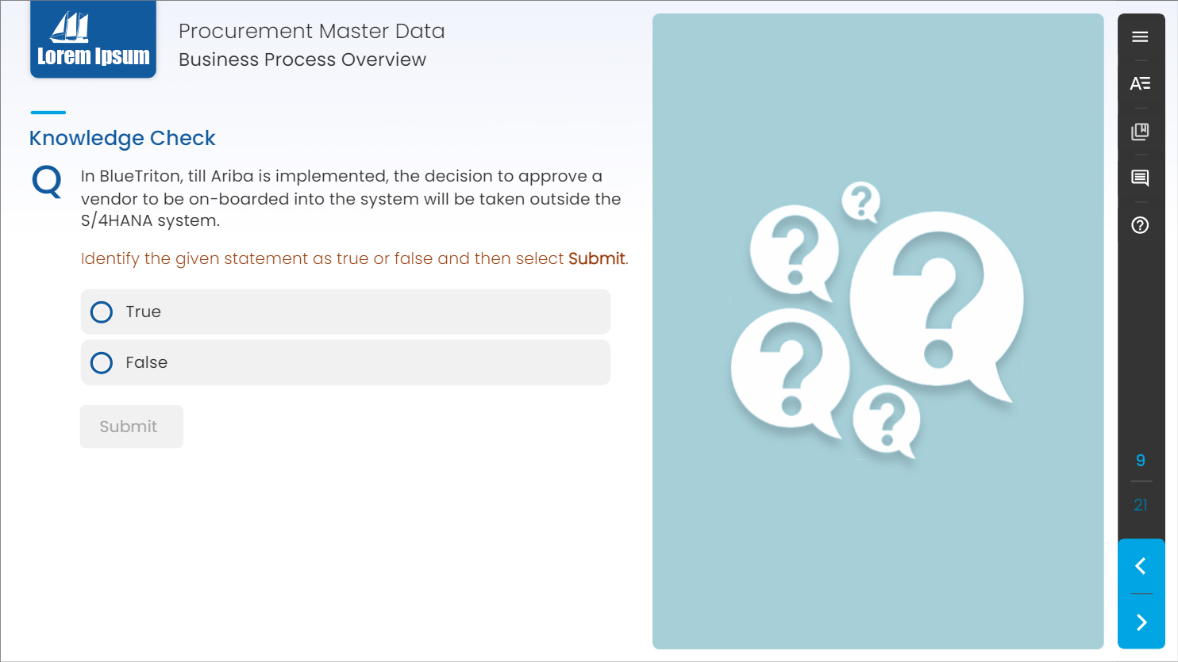
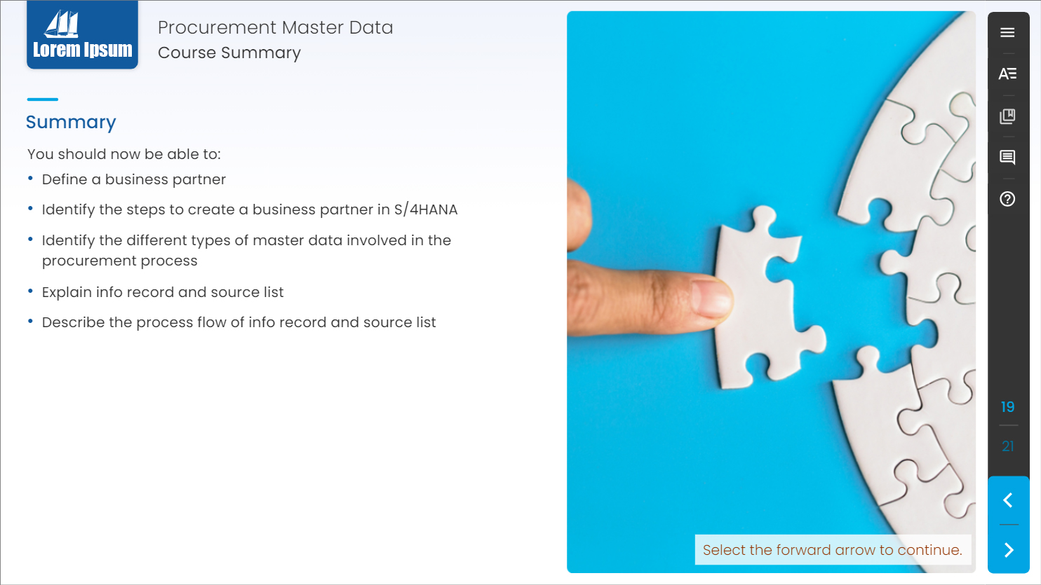
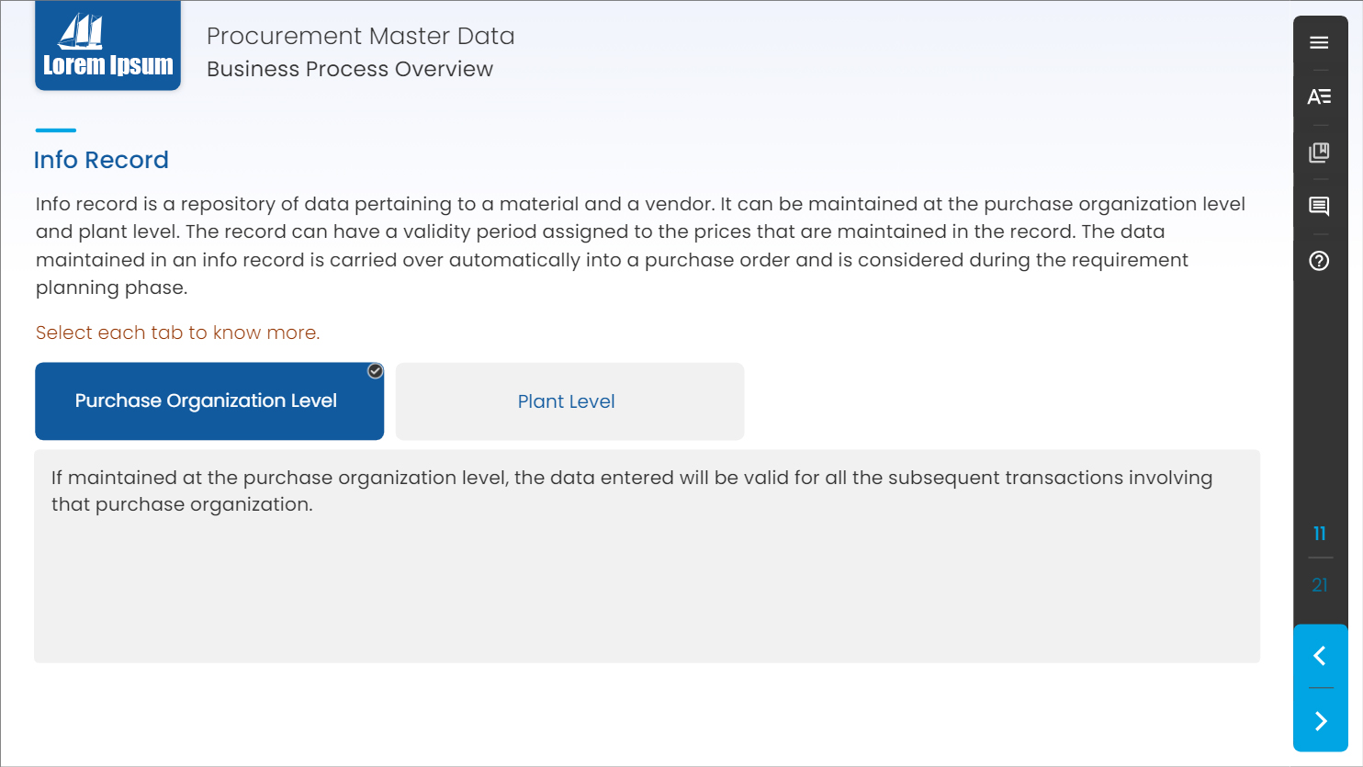
Articulate Storyline 360 Course Design Sample - 3
The complete customized course was developed using Articulate Storyline 360.
The course was Web Content Accessibility Guidelines (WCAG) Compliance.
Used Photoshop CC to design/edit mockups.

Slide 5
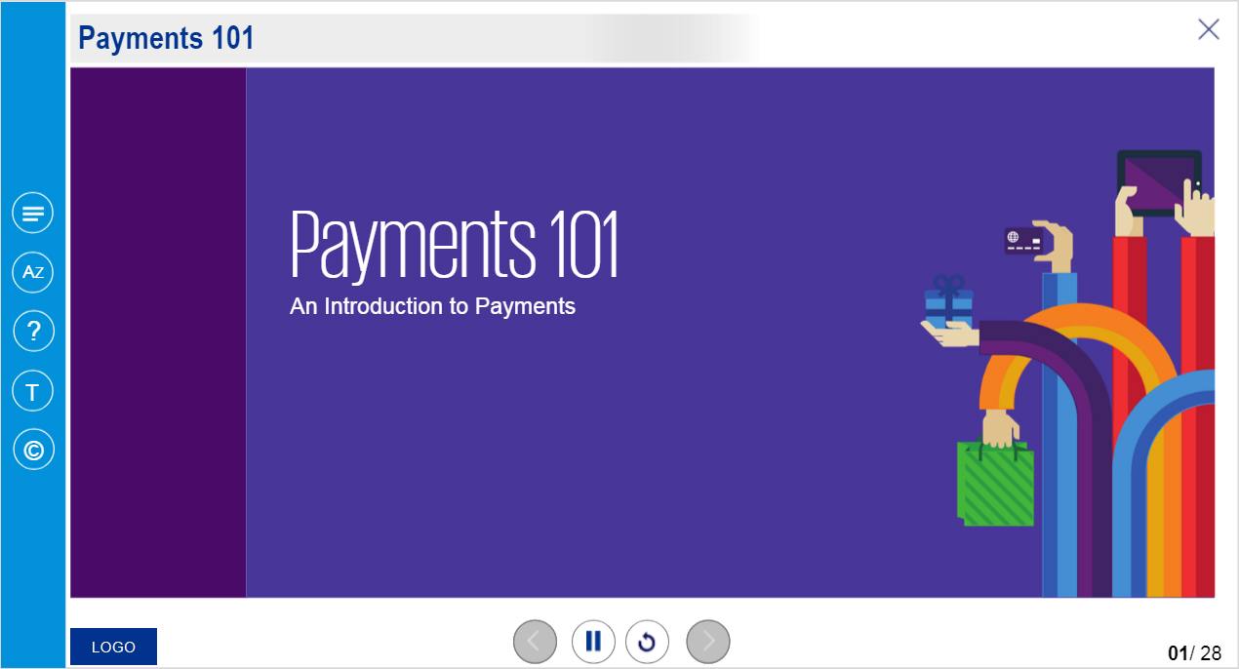
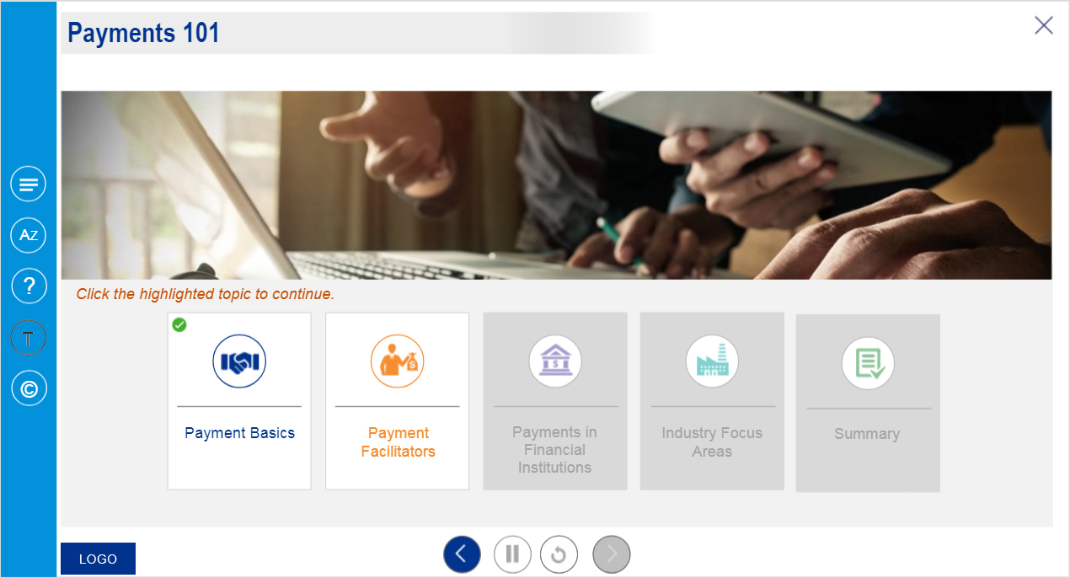
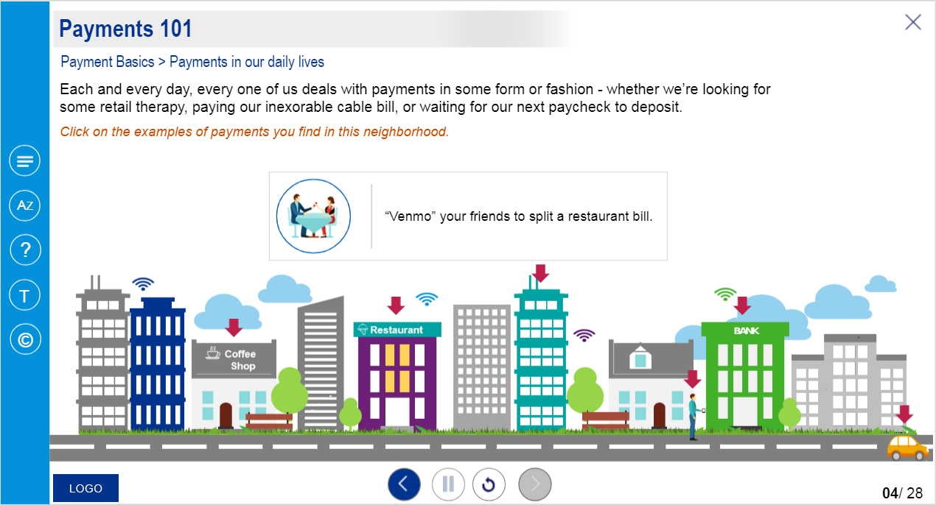
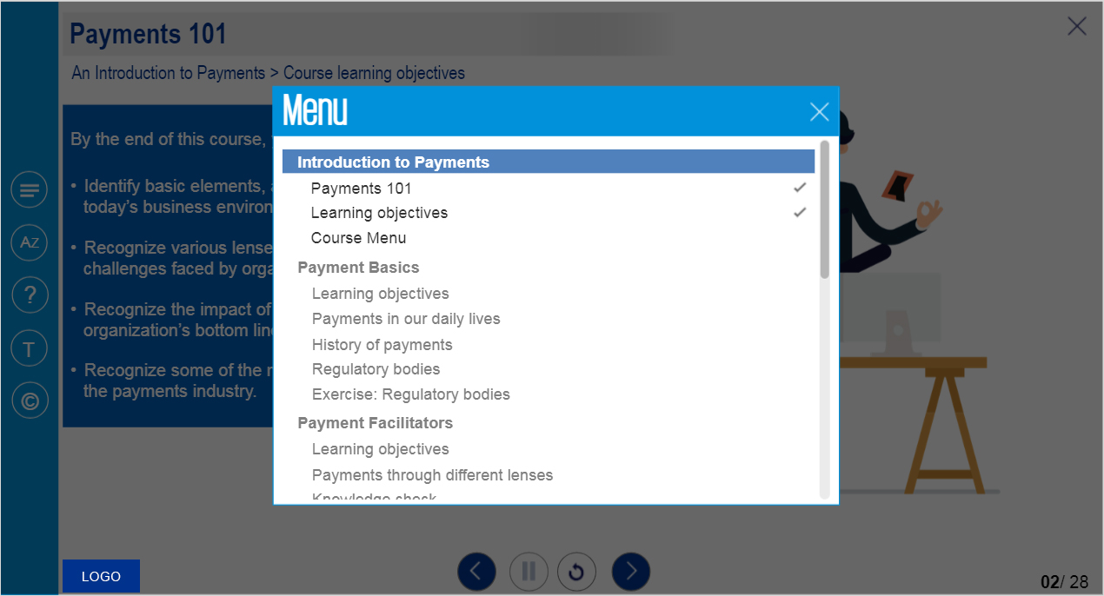
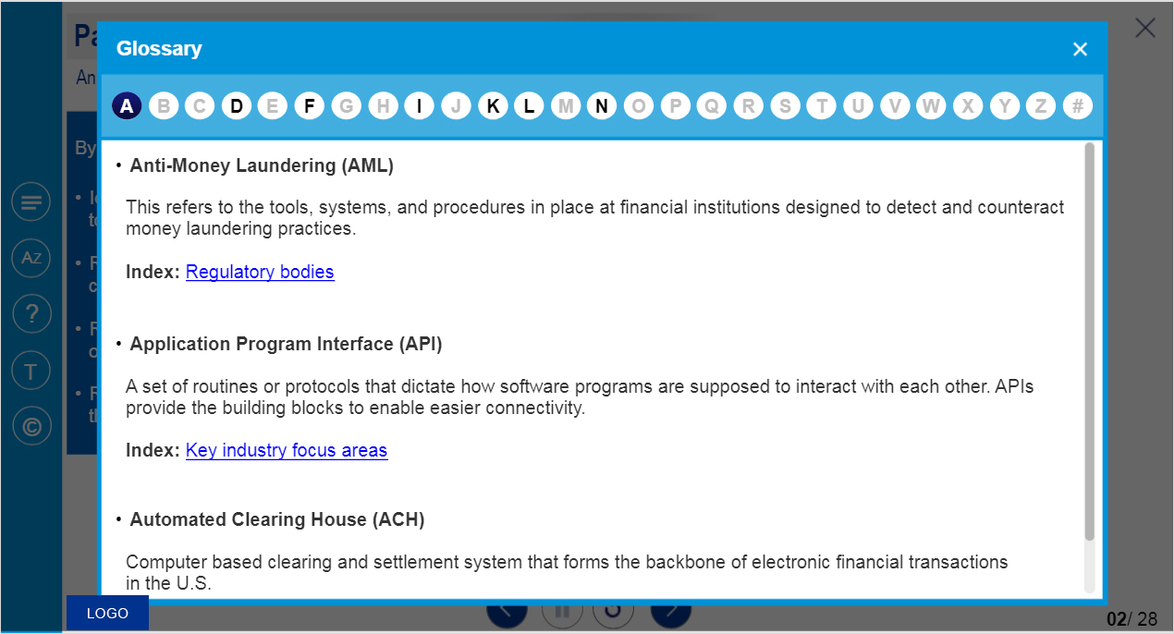
Articulate Storyline 3 Course Design Sample - 1
The course was developed using Articulate Storyline 3.
Used Photoshop CC to design/edit mockups.

Slide 6
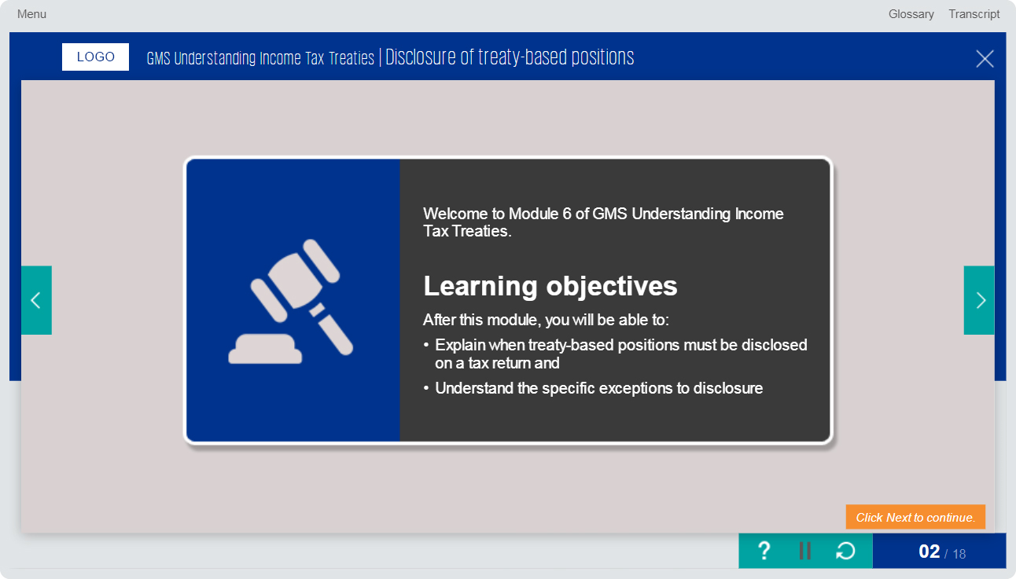
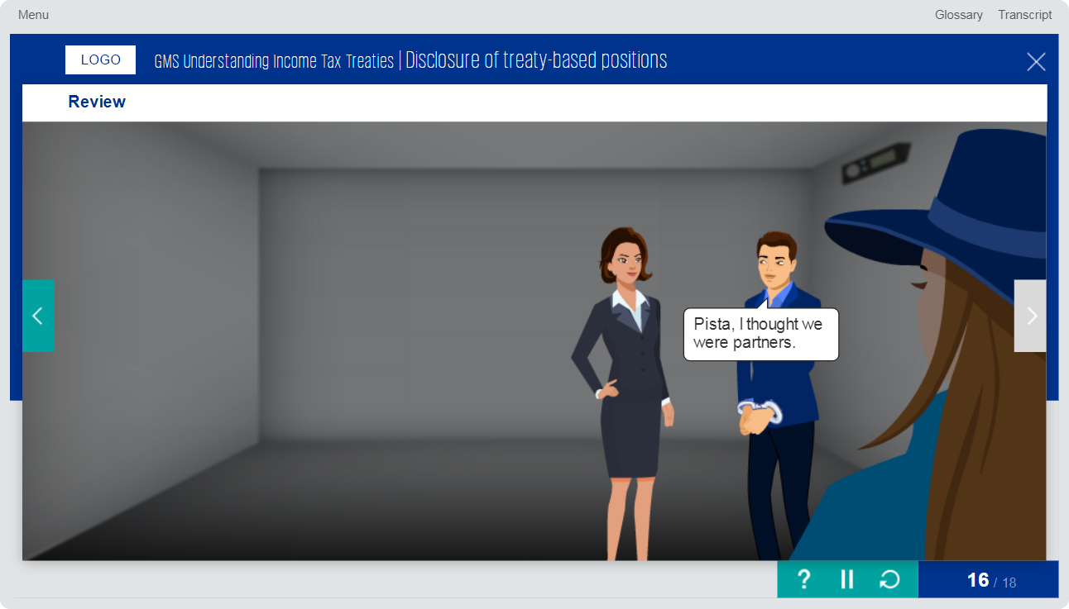
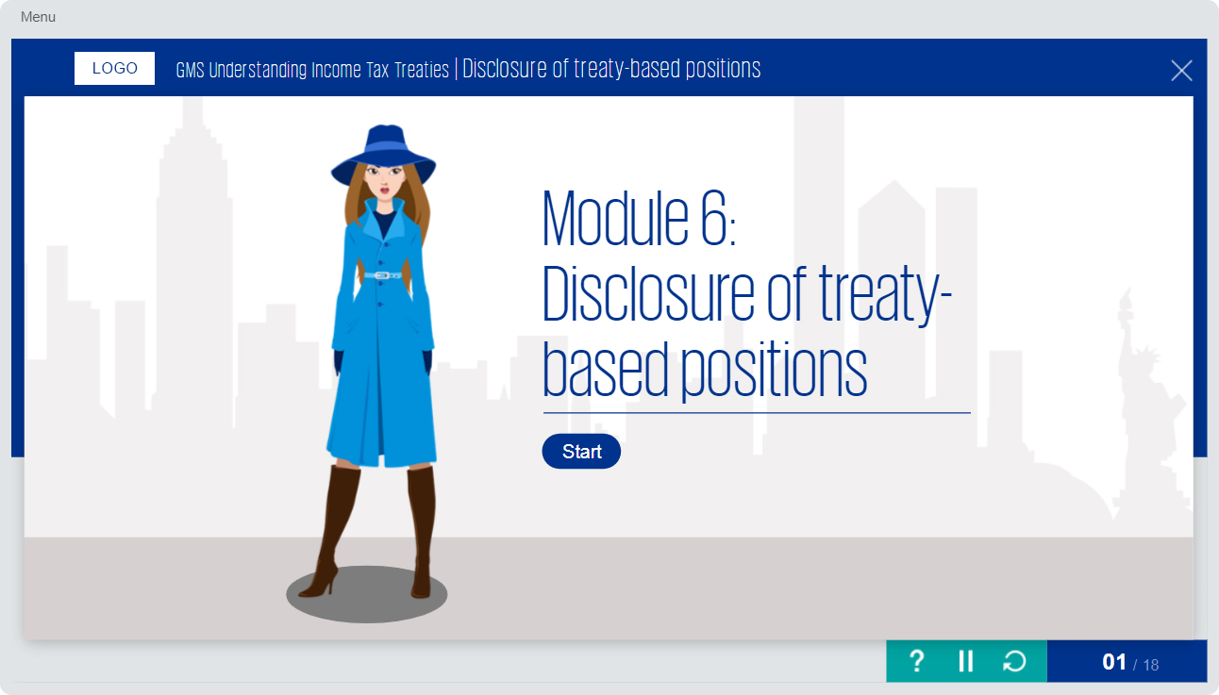
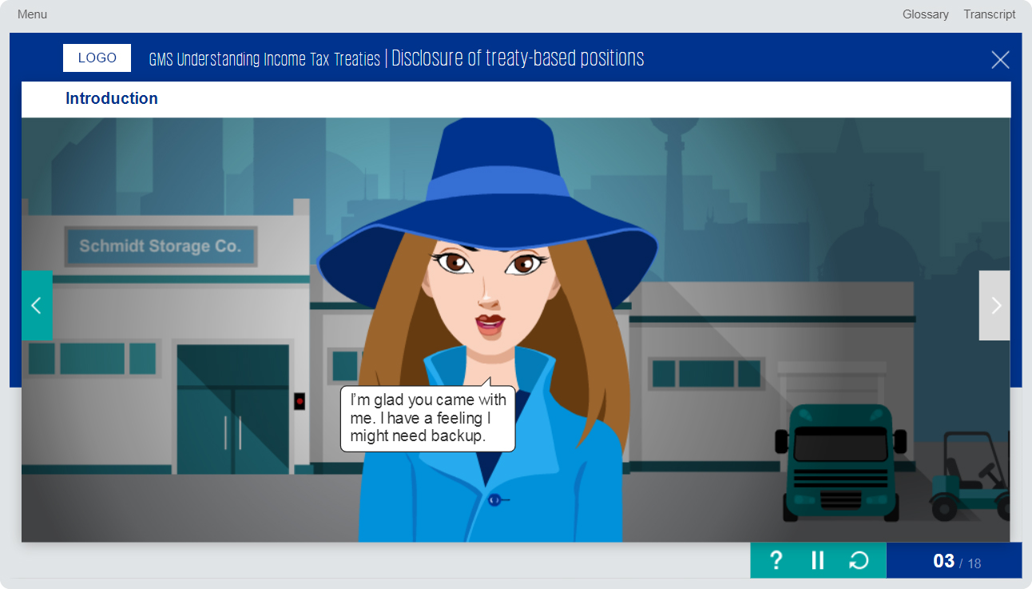
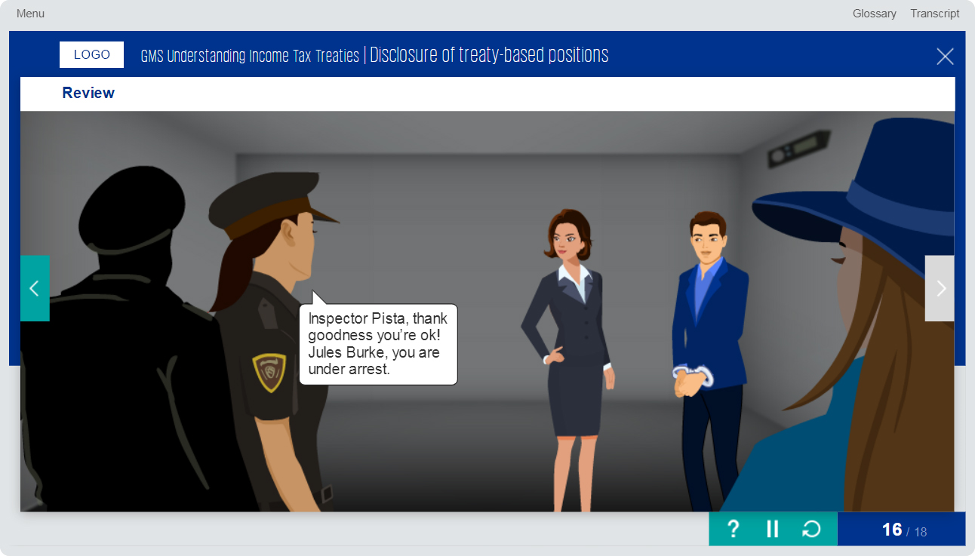
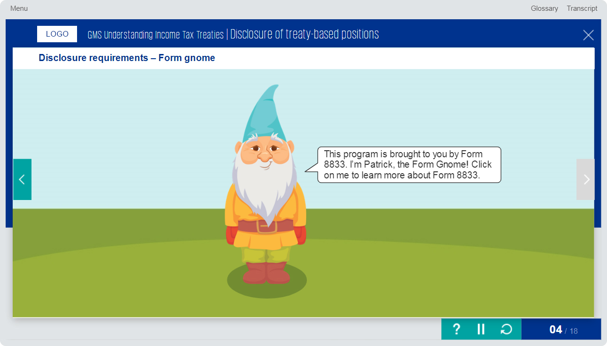
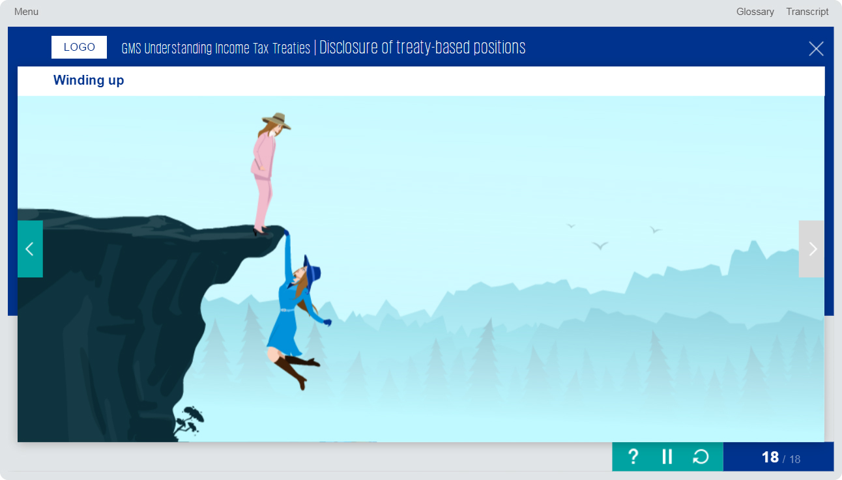
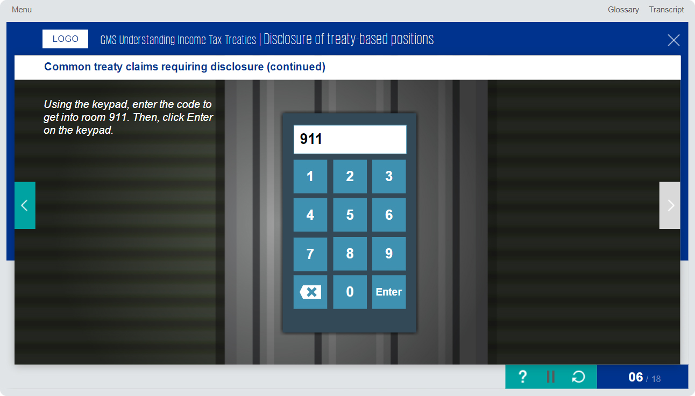
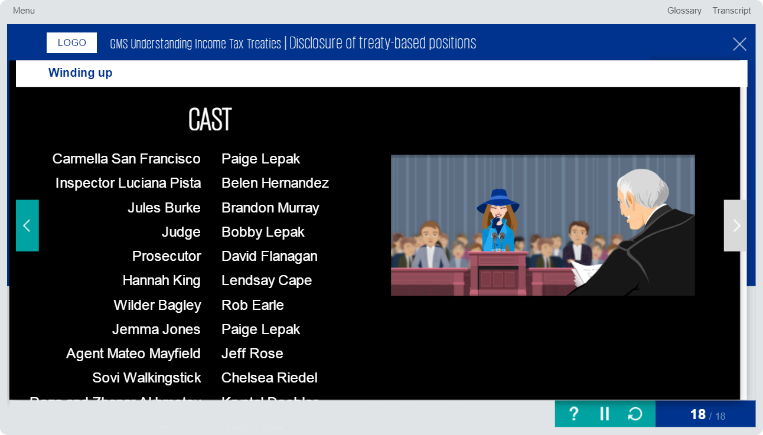
Articulate Storyline 3 Course Design Sample - 2
The course was developed using Articulate Storyline 3.
Used Photoshop CC to design/edit mockups.

Slide 7

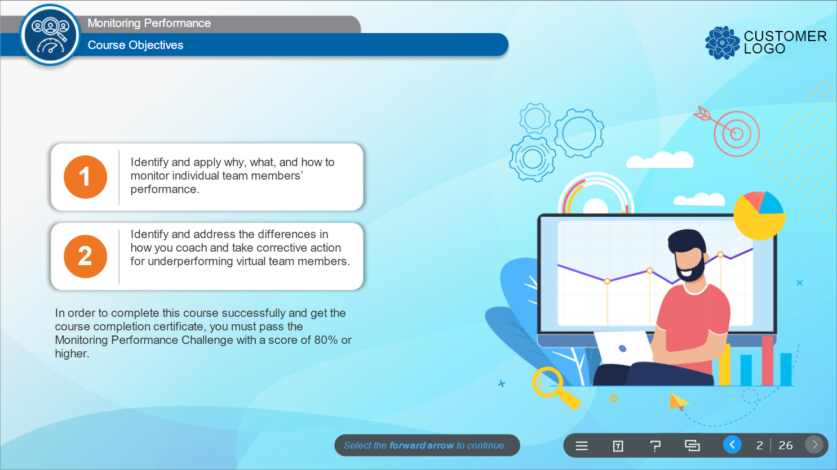
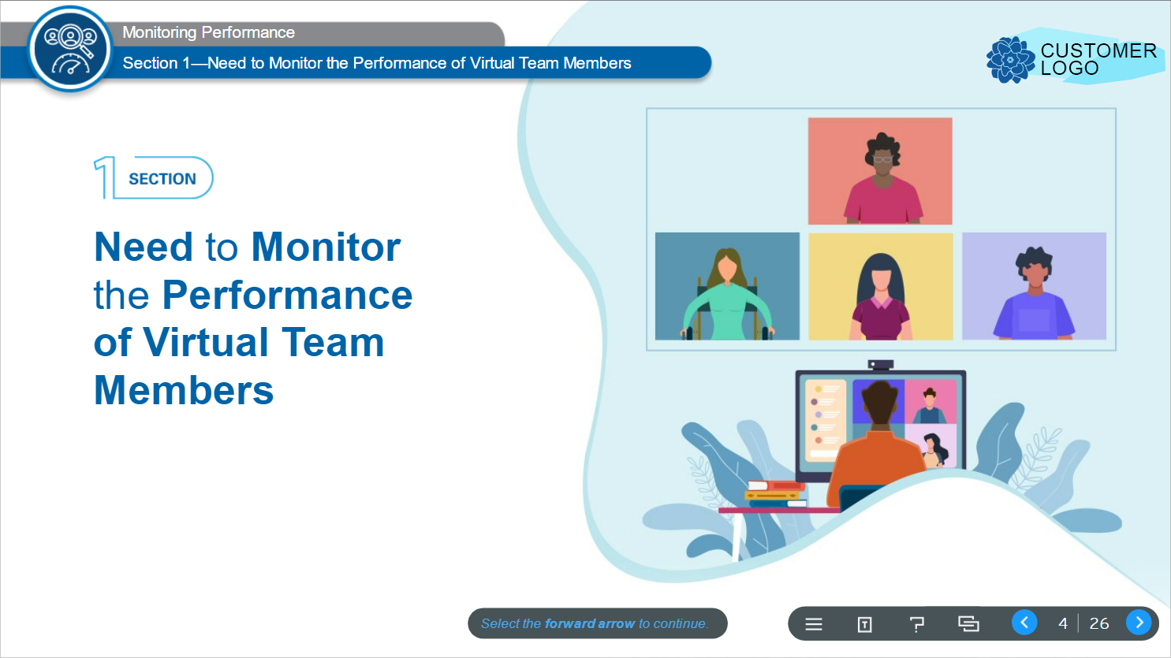

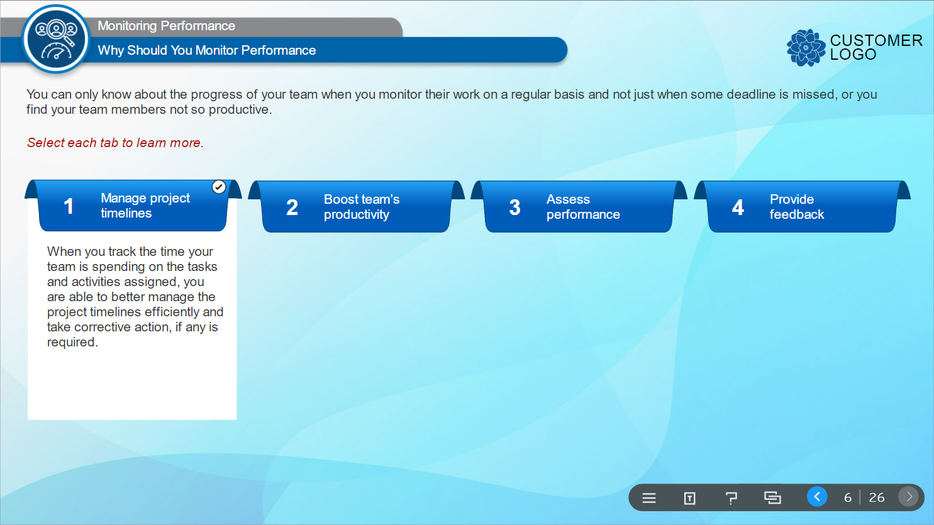
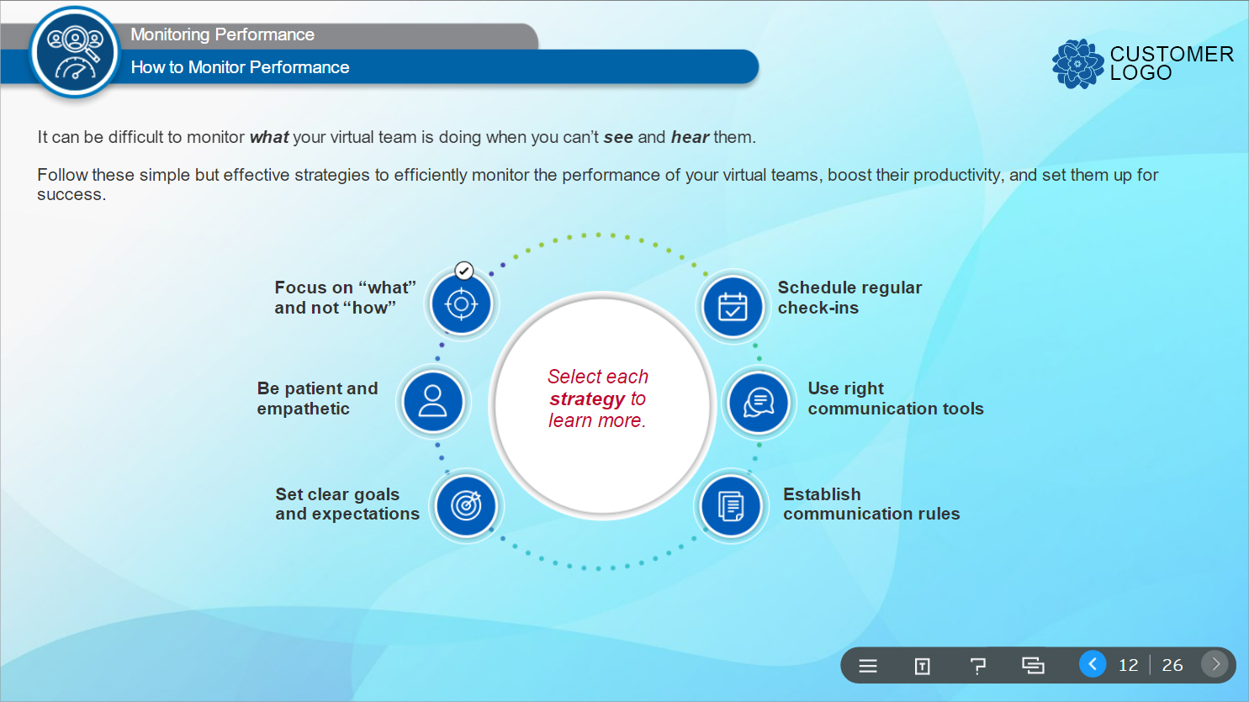
Photoshop Mock-up Design Sample - 1
The course was developed using Articulate Storyline 360.
Used Photoshop CC to design mockups.

Slide 8
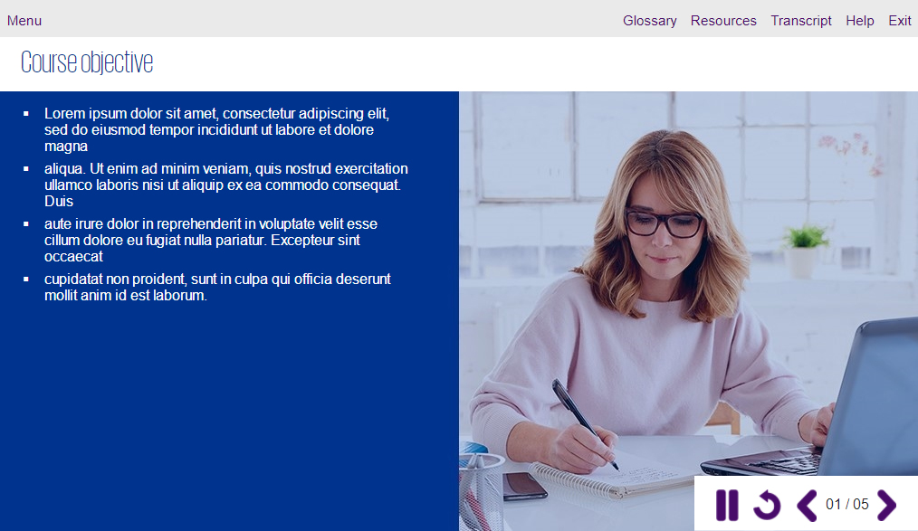
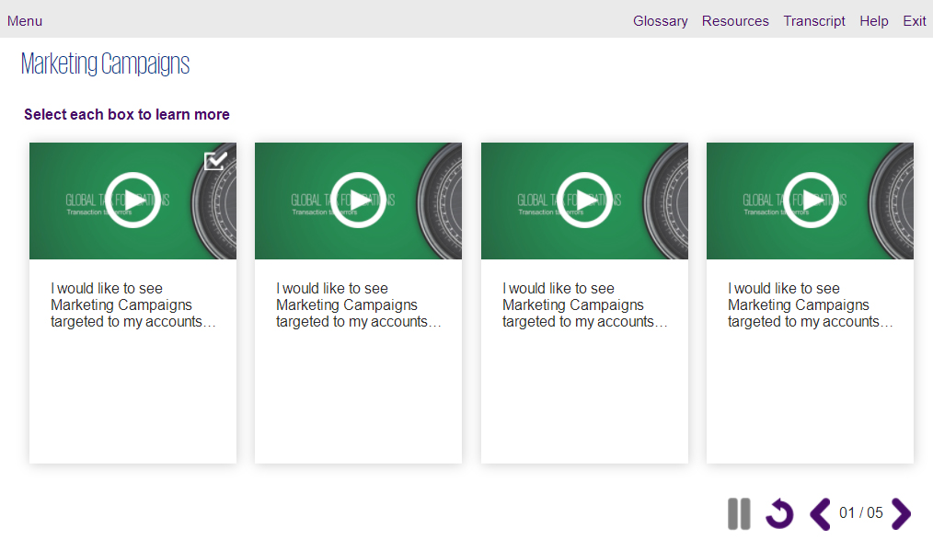
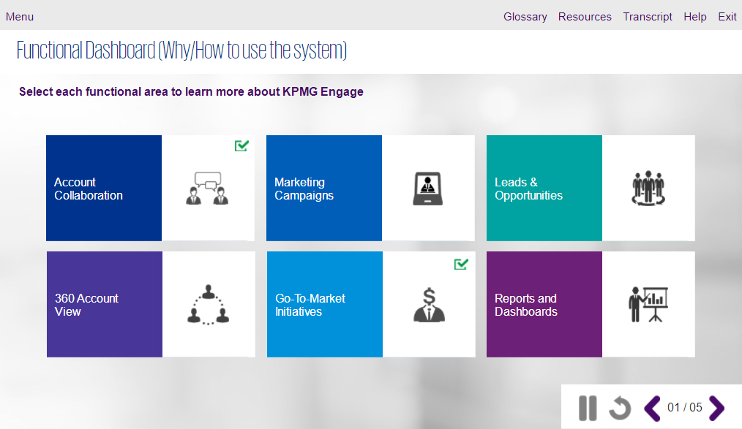
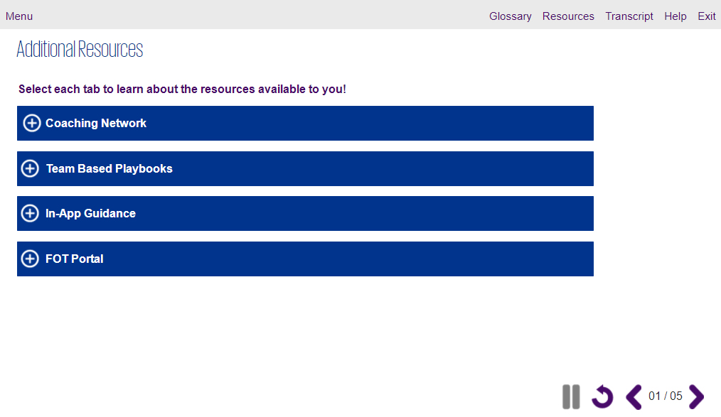
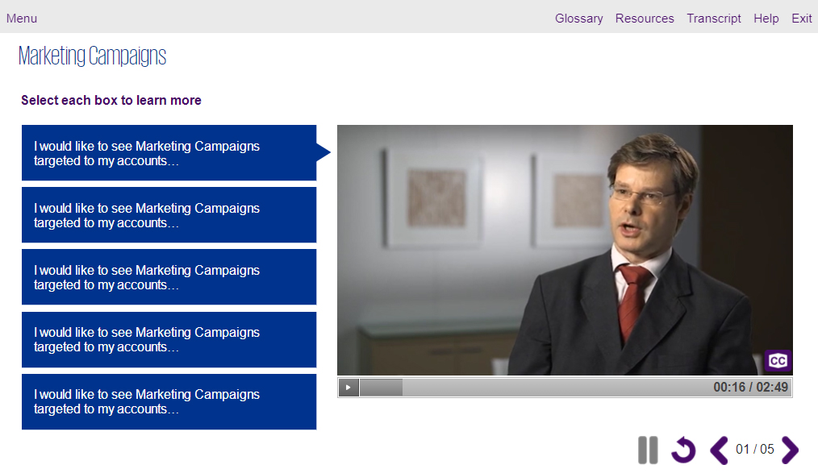
Photoshop Mock-up Design Sample - 2
The course was developed using Articulate Storyline 3.
Used Photoshop CC to design mockups.

Slide 9
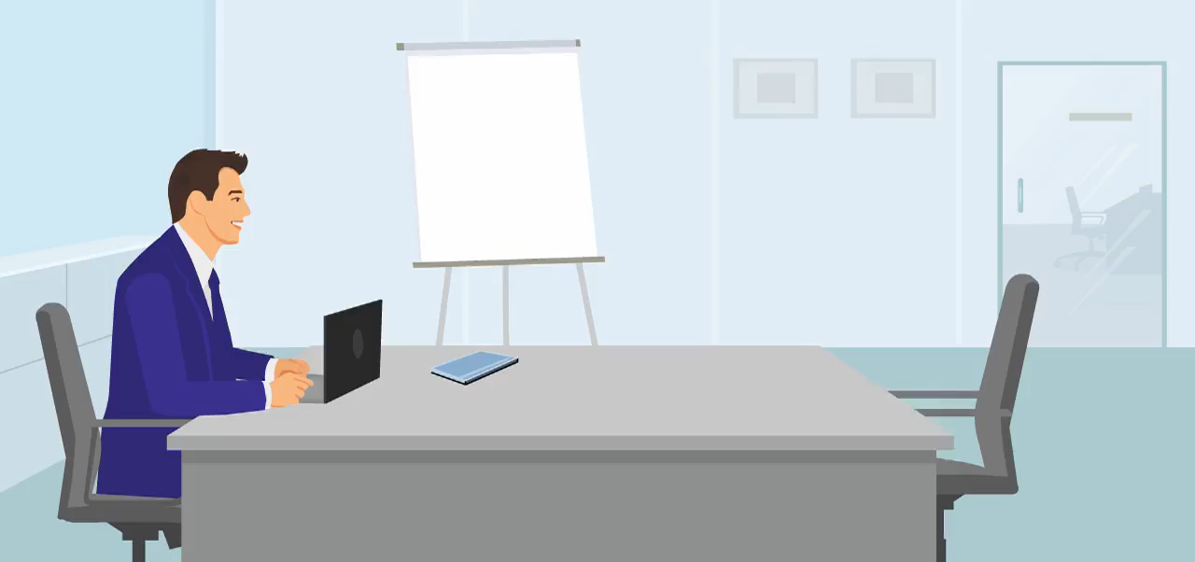
Adobe Flash Animation
The animation was created using Adobe Flash.

Slide 10

Adobe Flash Animation
The animation was created using Adobe Flash.

Slide 11




Tools Proficiency
Development tools
Articulate Storyline 360
Articulate Storyline 3
Design Tools
Adobe Creative suite (Photoshop, Illustrator, Indesign, XD)
MS Office Suite (PowerPoint, Word, Excel)
Animation/Video Tools
Adobe Flash/Animate
Sound Editing Tools
Audacity

Slide 12
Thank You

