Slide 1


Deepak Choudhary
E-learning Designer and Developer

Slide 2

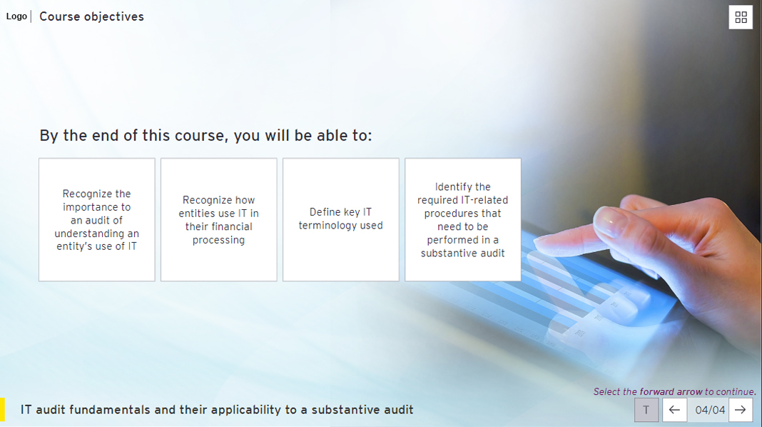
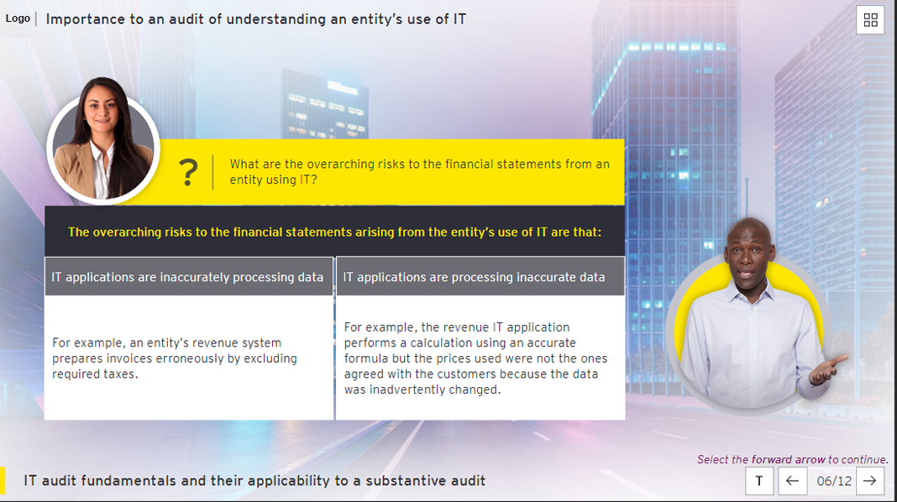
Photoshop Samples
Mockups created for storyline course using Photoshop.

Slide 3
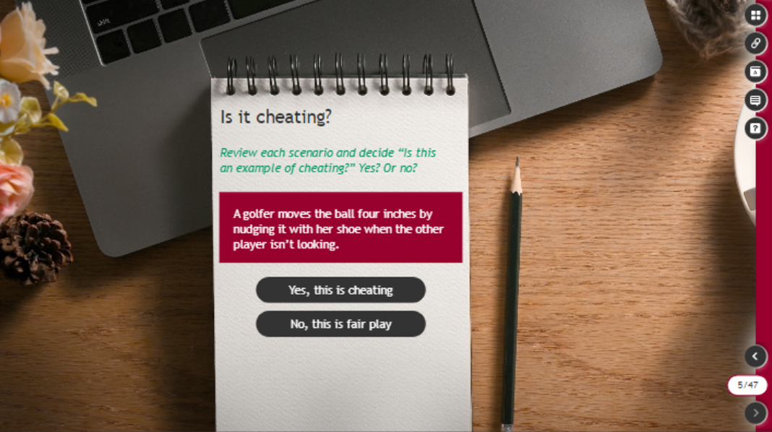


Photoshop Samples
Mockups created for storyline course using Photoshop.

Slide 4
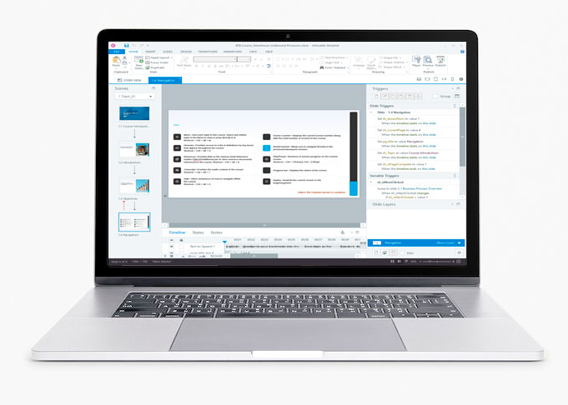

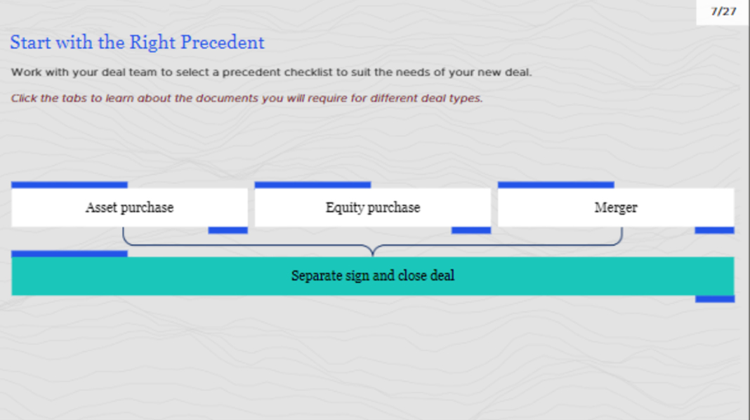

Storyline Samples
This WCAG storyline course is created using the tools mentioned below.
Tools:
Storyline 360
Adobe Photoshop

Slide 5
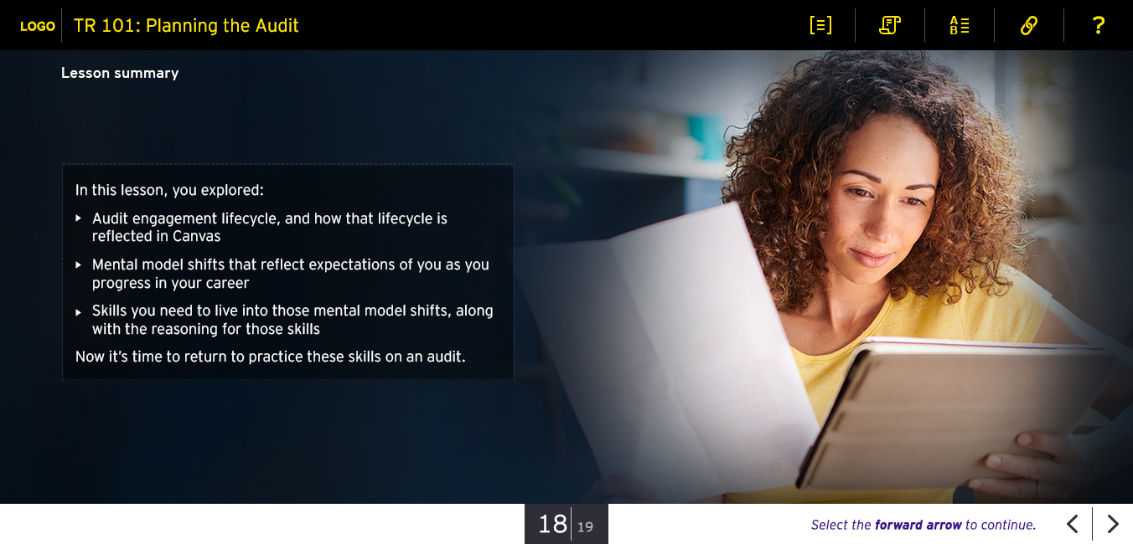

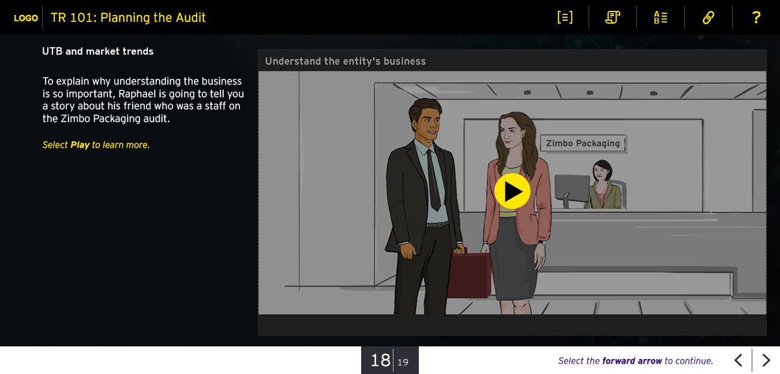
Storyline Samples
This WCAG storyline course is created using the tools mentioned below.
Tools:
Storyline 360
Adobe Photoshop

Slide 6
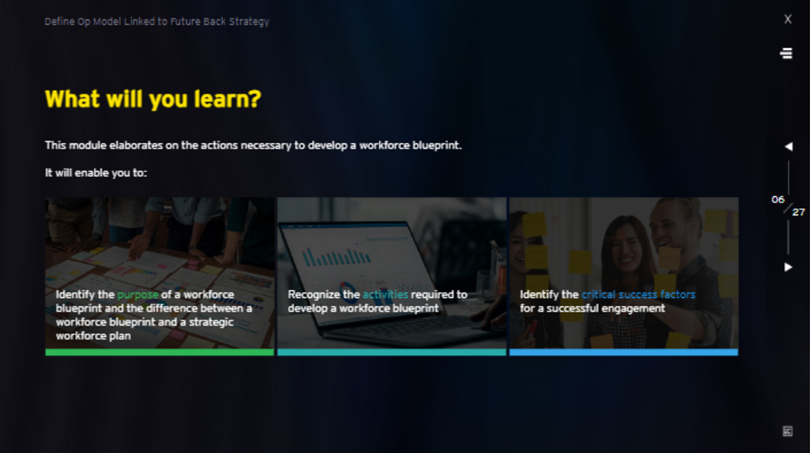
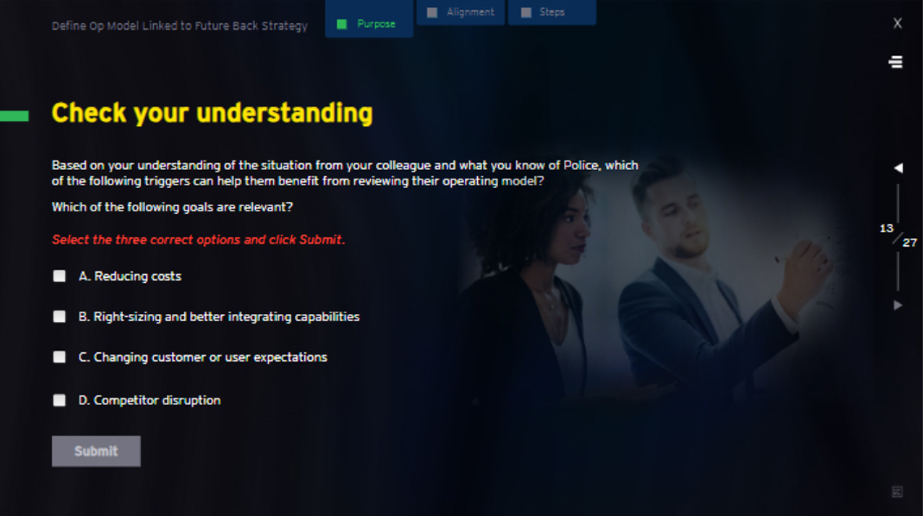
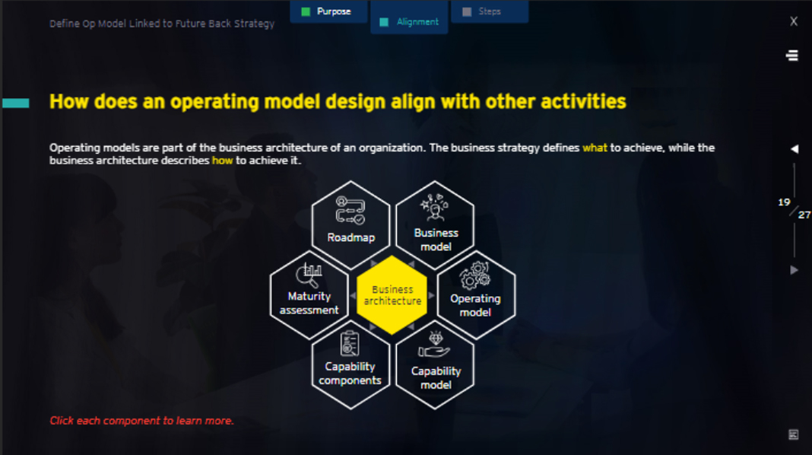
Storyline Samples
This storyline course is created using the tools mentioned below.
Tools:
Storyline 360
Adobe Photoshop

Slide 7

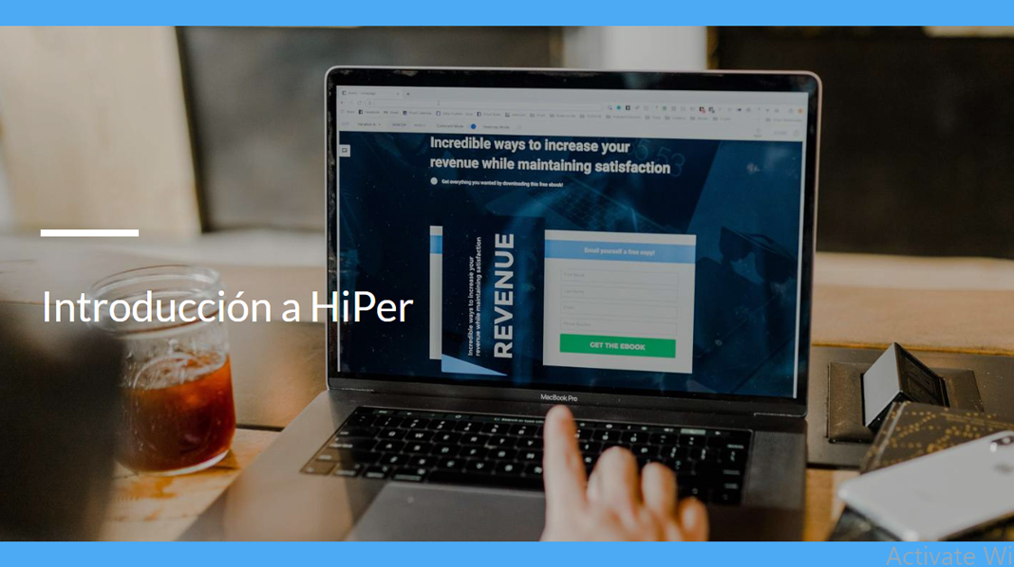
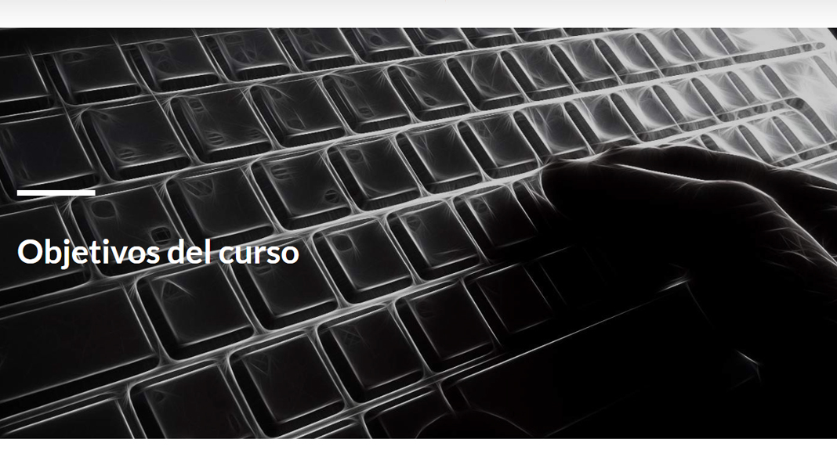
Rise Samples
This course is created using Rise 360

Slide 8


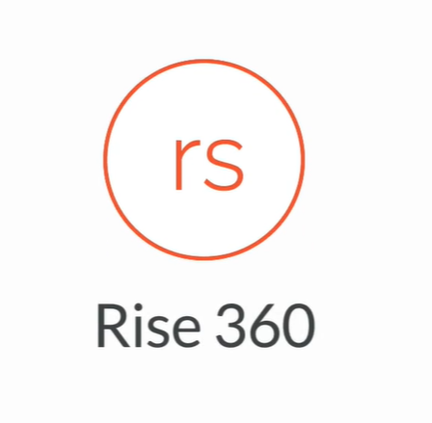










Training Tool
Tool
Level (Intermediate/Advanced/Expert)
Adobe Photoshop CC
Expert
Adobe Illustrator CC
Intermediate
Articulate Rise
Expert
Audacity
Expert
MS Office Suite (PowerPoint, Word, Excel)
Expert
Adobe XD
Intermediate
Adobe Animate
Intermediate
Vyond
NA
Adobe Captivate
Expert
Articulate Storyline 360
Expert
Camtasia
Expert
HTML5
Intermediate
CSS
Intermediate

Slide 9
THANK YOU

