Slide 1












GAMIFICATION SAMPLES
CAPABILITIES PRESENTATION TO
DAREN HARBER | SR. VICE PRESIDENT, MANAGED SERVICES
Daren.Harber@aptaracorp.com | m: +1.703.389.5524

Slide 2


















APTARA OVERVIEW
30K+
Headquartered in the
employees worldwide
across our global delivery centers and service lines. Aptara employees approximately 5000.
9
Global delivery
centers
60+
Awards &
recognition
United States
12th
$
30+
Years of experience
in the training industry
150+
Serving fortune
1,000 clients
Consecutive year in
the top 20 companies
In training industry watch list
Flexible
Pricing and working
models
ISO: 27001:2013, ISO 22301:2019
ISO:9001:2015,
PCI DSS, SOC, HIPPA, GDPR and CMMI 3 Certified
Scalability
Capacity to process large volumes quickly and accurately 24/7/365
Learning Lifecycle
Author • design • format • enrich
• produce • package • distribute
• manage
Global Support Services
We work across industries, geographies, lines of service and specialties to bring you
customized solutions

Slide 3
















































LEARNING SERVICES CLIENTS
Healthcare and Pharmaceutical
Engineering & Manufacturing
Insurance
BFSI
Consulting, HR & Telecom
Retail
EdTech
Publishing
Non-profit Organizations

Slide 4






















































OUR CLIENTS (OTHER SECTORS)
BFSI & Healthcare
Telecom & DTH
Consumer Durables
Travel & Others
Automotive & E-Commerce
Gaming
Publishing & Content

Slide 5

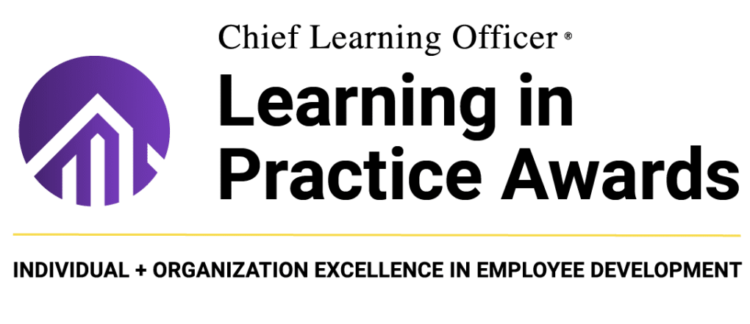






AWARDS & RECOGNITION
AWARDS and RECOGNITION
HIGHLIGHTS
Best Results Of Learning Program
Brandon Hall Awards for Excellence
Top 20 Learning Portal Company
Top 100 Digital Content Company
Top 100 Global Outsourcing Company
Best Education &Training Campaigns
Learning In Practice Award: Silver

Slide 6







APTARA’S TRAINING SOLUTIONS
The training catalog also aims at providing enhanced learner experiences and flexibility. It enables organizations to provide continuous learning opportunities, track learner progress, and maintain consistency in training initiatives while offering cost-effective and scalable solutions.
Our training catalog prioritizes the incorporation of current learning technologies in our solutions to effectively respond to the ever-changing demands of our industry.
Our training offerings include:
Business Simulations
Gamification
Microlearning
Adaptive Learning
Artificial Intelligence
AR/VR
Mirrors the dynamic real-world settings
Experiential learning without any risk
Effective in strategic thinking, decision making, problem solving, financial or market analysis, operations, teamwork and leadership
More engaging and challenging interactivities
Increased learner motivation
Learning games are based on constructivism. The power of play brings in:
  Immersive and autonomous learning experience
  Learning from failures
  Higher learner motivation and engagement
  More confidence on the abilities gained
Learning using self-contained, small chunks or bits of learning assets can cater to:
Just-in-Time Learning
Contextual Learning
Adaptive Learning
Social Learning
Organic Learning
One-size-fits-all never works with learning
Mandatory certification and refresher trainings have become a great burden for many organizations
Leveraging on adaptive learning can dynamically personalize training
Personalized learning experiences
Real-time feedback and assessment
Data-driven insights and analytics
Continuous learning and upskilling
Higher learner motivation and engagement
Higher learner engagement
Real-world application
Adaptive learning
Analytics and performance tracking
Encourages collaboration and teamwork
Accessibility and inclusivity

Slide 7









LEARNING PROFESSIONAL SERVICES
On-Demand Staffing
On-Demand Staffing
Customer Support Specialists
Strategic Needs Analysis
FLEXIBLE/DEDICATED STAFFING MODELS
LEARNING CONSULTING SERVICES
Aptara places expert consultants with our clients on a flexible timeline or a dedicated basis, allowing organizations to expand their teams’ skills and support without the expense of adding permanent headcount.
Aptara provides consultants with a cross cultural training and multilingual capabilities. Our consultants work closely with you on a variety of requirements from process transformation, CX support and helpdesk to systems administration and maintenance. Our teams help bridge the cultural gap and boost your training initiatives.
Change Management Specialists
Process Development Specialists
User Adoption and Transformation
Data Analytics and Dashboard Specialists

Slide 8

GAMIFICATION

Slide 9

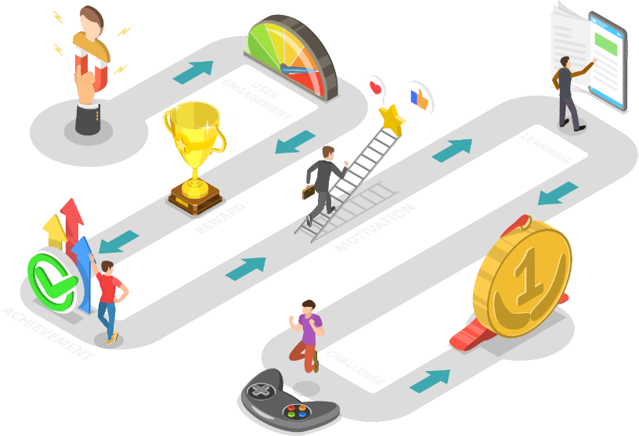
GAMIFICATION: UNDERLYING PHILOSOPHY
Tell me and I’ll forget; show me and I may remember; engage me and I’ll understand. (Chinese proverb)
  Engage the learner in “play” mode vs. the default “work” mode.
    Learning interventions that use game-mechanics
    Time-bound activities
    Scoring
    Levels of difficulty
    Awards
    Competition to engage and teach
    Design for outcomes, not engagement
    Skills need to be transferrable from the gamified experience to the actual job environment
    e.g., If you are designing a gamified learning experience for surgeons, you primarily want better surgery outcomes, not leaderboard-driven competition/engagement.
    Engagement should be a design consideration, not an objective in and of itself.
    Keep gameplay simple
    The gameplay, challenge, or mission should be difficult, not complicated.
    Don’t start with the aim of developing an overly layered or complex game; aim to make the content engaging and let the chips fall where they may.
9

Slide 10

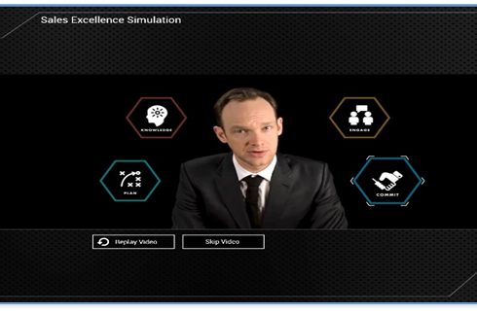
SALES EXCELLENCE SIMULATION
    About: A simulation game to improve the selling skills of the sales team in the most engaging way.
    Design highlights:
    Various modules to assess the learner’s ability to apply sales strategies
    Adaptive pathways (based on the learner performance) to drive the learning journey
    The content was presented as interactive role-playing scenarios
    The learners were required to perform a variety of tasks, such as, analyzing financial documents, LinkedIn profiles, observing sales interaction, stating their observations, or making decisions in a simulated environment
    Personalized experience
    Opportunity to experience real-world applications
    Real-time feedback and low on cognitive load
    Built using – Custom HTML5
    In 2017, the client and Aptara, won a Brandon Hall Gold Award for:
    Best Use of Games and Simulations for Learning
    View Demo
10

Slide 11
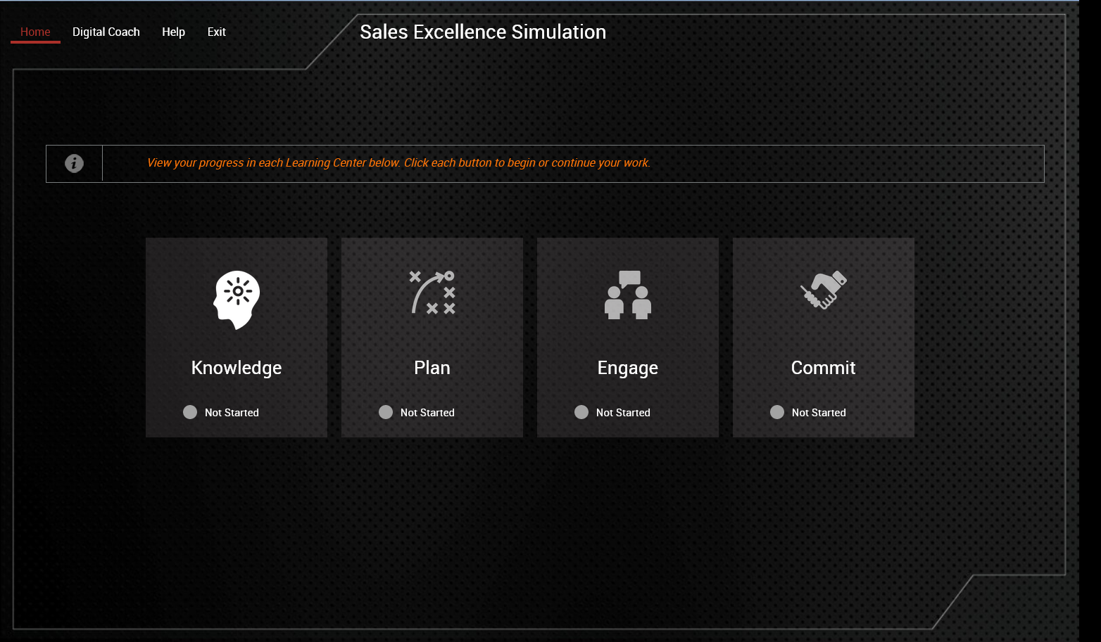
SALES EXCELLENCE SIMULATION
11

Slide 12
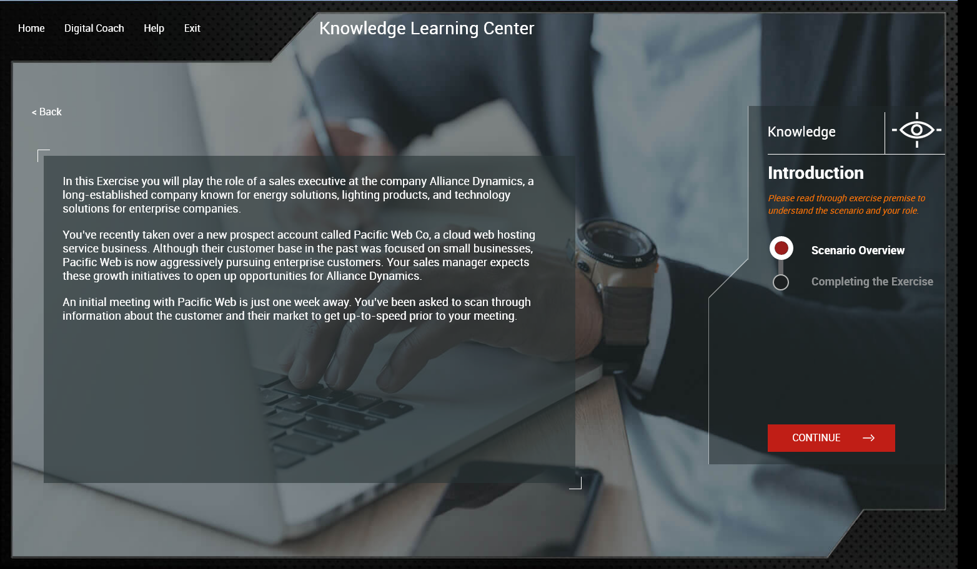
SALES EXCELLENCE SIMULATION
12

Slide 13
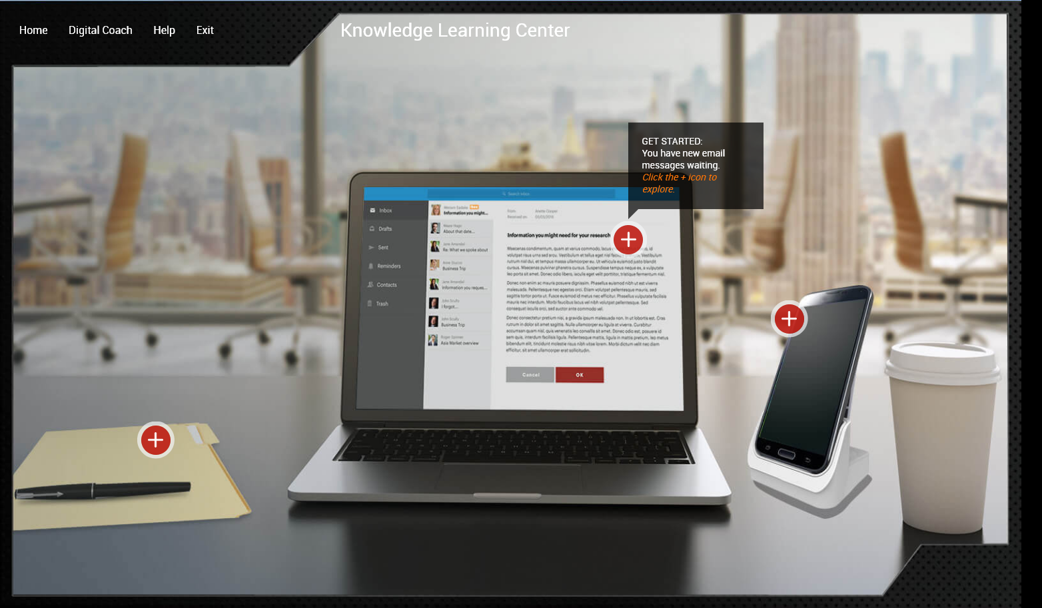
SALES EXCELLENCE SIMULATION
13

Slide 14
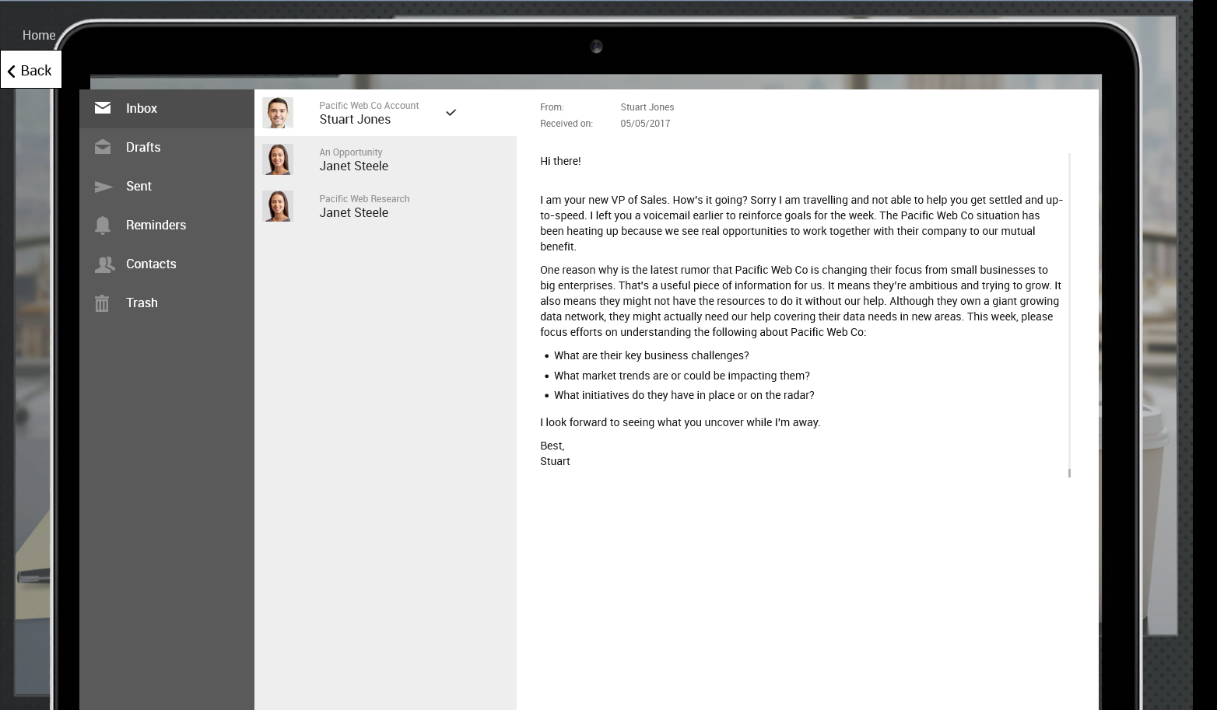
SALES EXCELLENCE SIMULATION
14

Slide 15
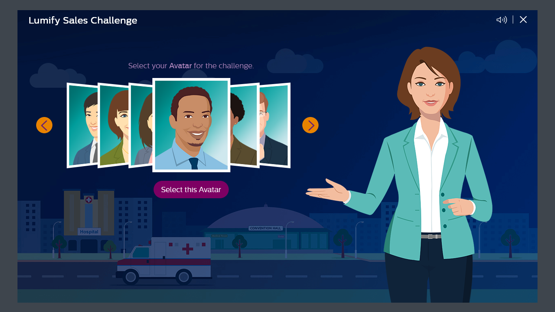
LUMIFY SALES CHALLENGE
    About: A gamified learning with assessment helping Philips personnel to understand the functionality and set-up of Lumify product range that provide users with the information needed to direct customers to the right Lumify resource.
    Design highlights:
    Conversation-based game approach set in Lumify sales and support scenarios​
    Remedial game challenges only for users who cannot solve the core game challenge​
    Scoring mechanism for the responses in the challenges​
    Separate video animations for Lumify product, POCUS market, and product/app support​
    Wider range of guides and support materials on product installation and use​
    Built using – HTML5
    View Demo
15

Slide 16
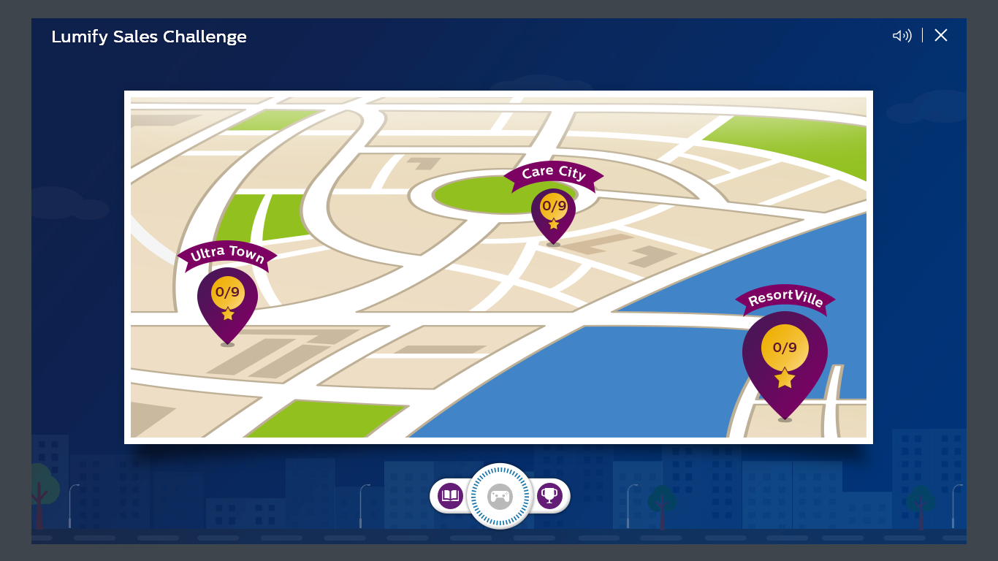
LUMIFY SALES CHALLENGE
16

Slide 17
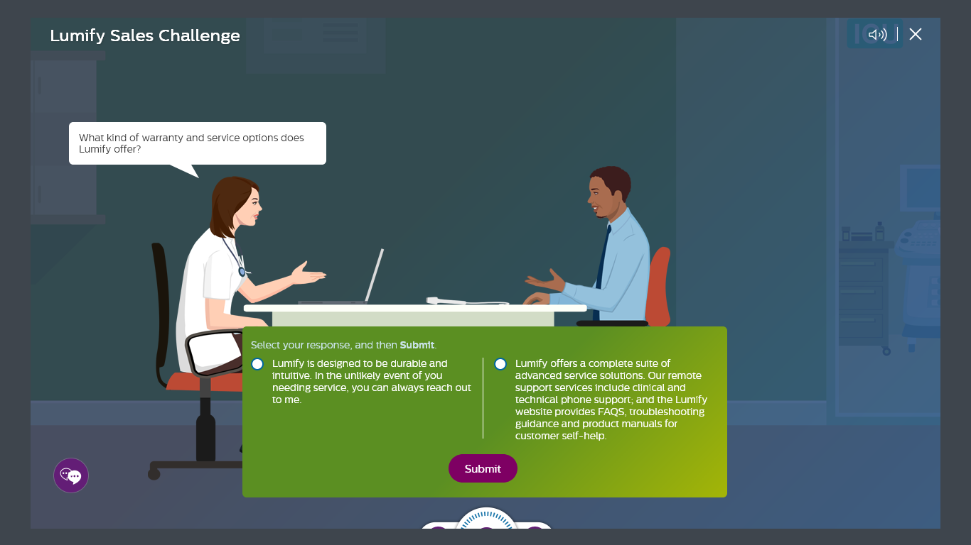
LUMIFY SALES CHALLENGE
17

Slide 18
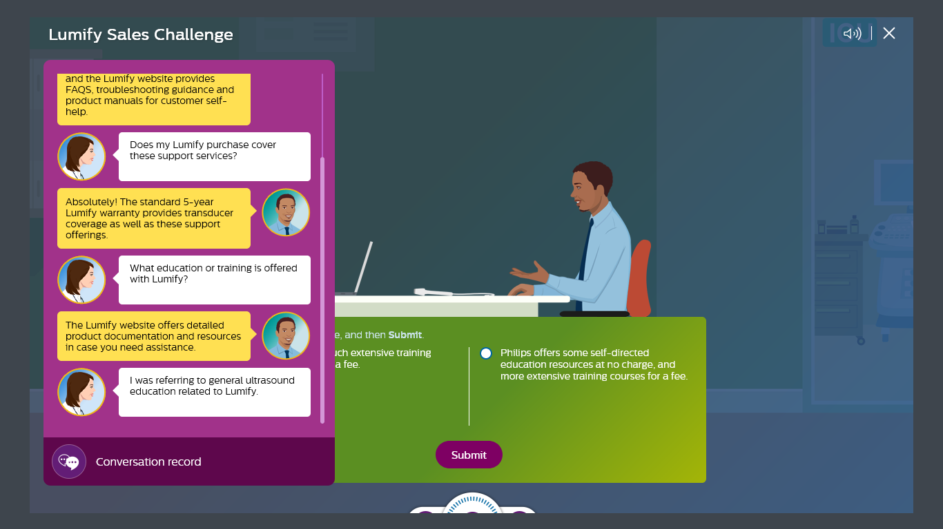
LUMIFY SALES CHALLENGE
18

Slide 19
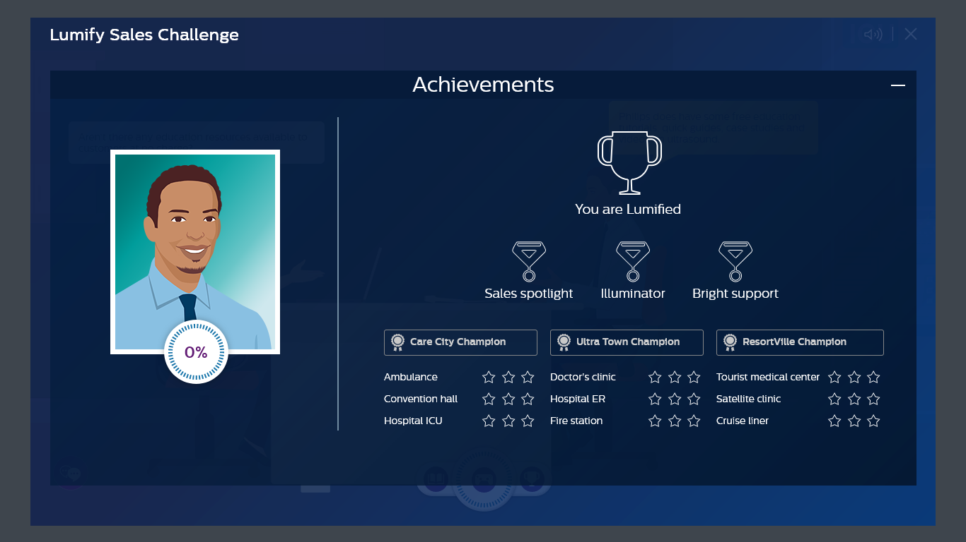
LUMIFY SALES CHALLENGE
19

Slide 20

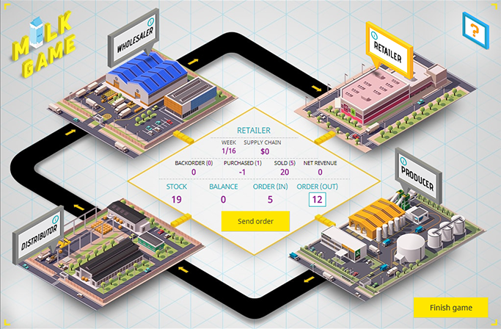
MILK GAME
    About: A game to teach concepts and procedures of managing supply chain operations. This was developed as part of a global training program for new hire supply chain professionals of a Big Four professional services firm.
    Design highlights:
    Role-play based that lets players experience typical supply chain problems – wholesaler, distributer, producer, and retailer, and teaches the importance of collaboration
    Designed to test players’ understanding of the concept of demand and supply and provide consolidated status of the supply chain and players’ role
    The game is played in rounds, which simulates in weeks
    Game Leader specifies the game name, weeks and selects the role. Game Leader can choose to add a BOT player in place of a particular role in case they lack players, but all four players cannot be a BOT player
    The game allows learners to learn and discover their way to knowledge retention and application
    Built using – Custom HTML5, .NET
    View Demo
20

Slide 21
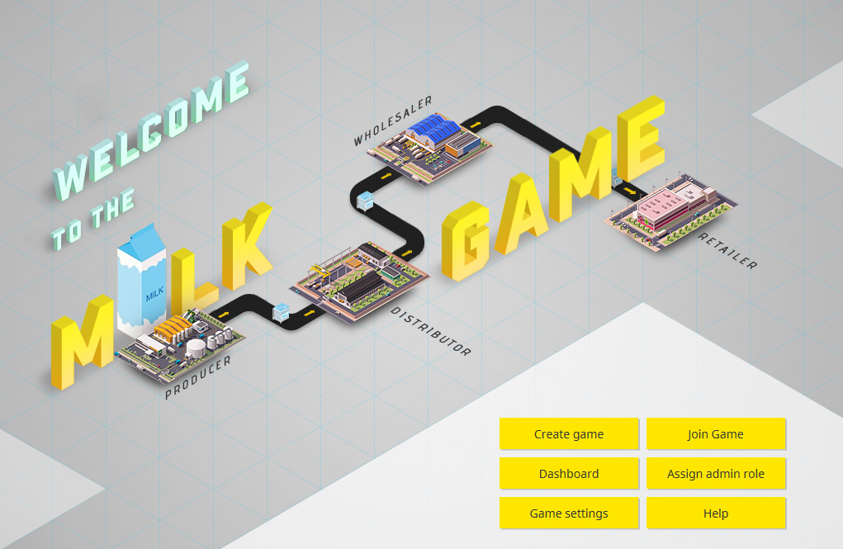
MILK GAME
21

Slide 22
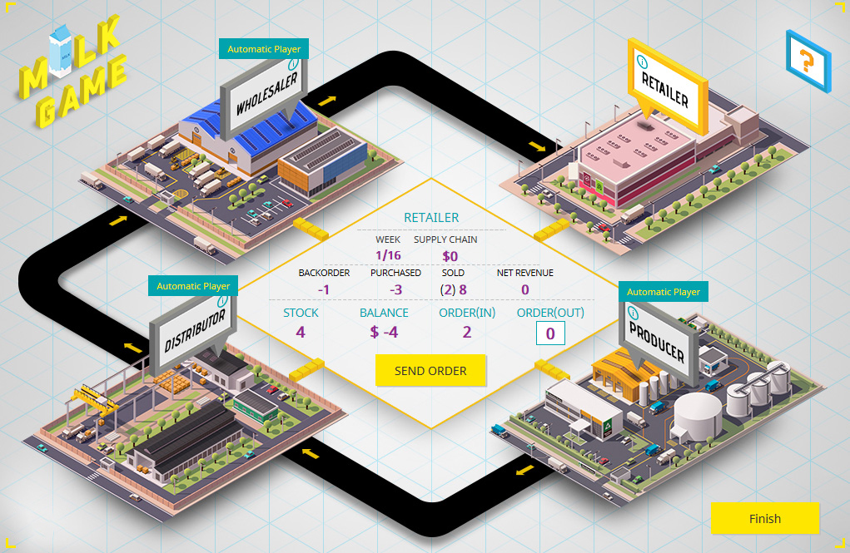
MILK GAME
22

Slide 23
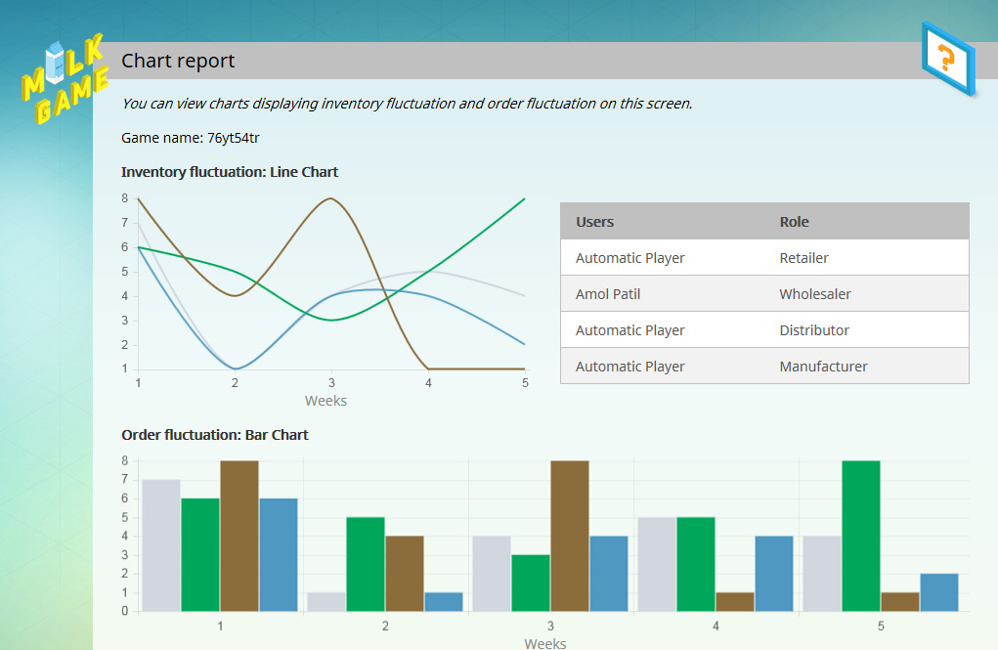
MILK GAME
23

Slide 24
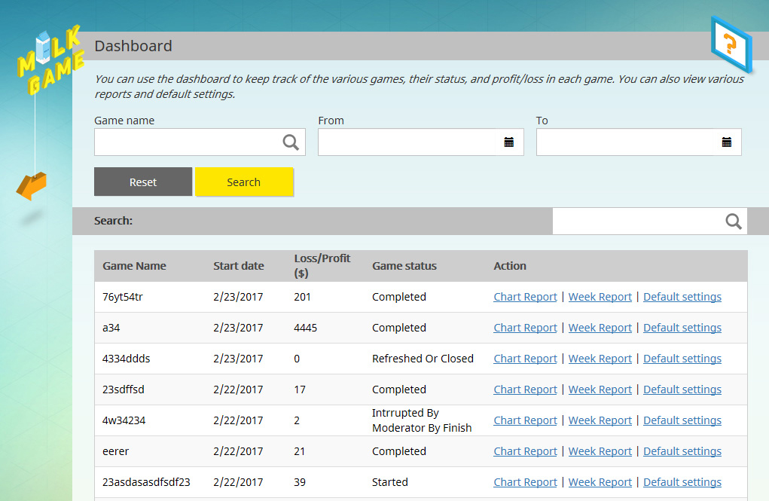
MILK GAME
24

Slide 25
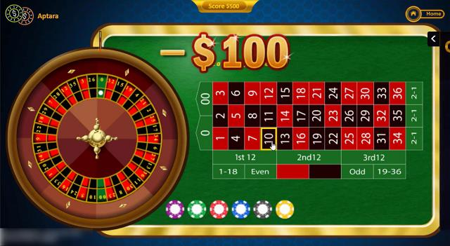
ANTITRUST ROULETTE
    About: Game-based quiz modules to test user’s understanding of Intel’s Antitrust policy and how to apply its principles
    Design Highlights:
    Short games with 5 questions presented in a Casino theme
    Eye-catching visuals, sound effects, and complex functionalities
    Used as a crowd pulling element in a sales and marketing workshop
    Custom coded with Microsoft Surface tablet as the target device
    Realistic depictions of the Roulette Poker and Lucky777 games
    Built using – HTML5
View Demo
25

Slide 26

ANTITRUST ROULETTE
26

Slide 27
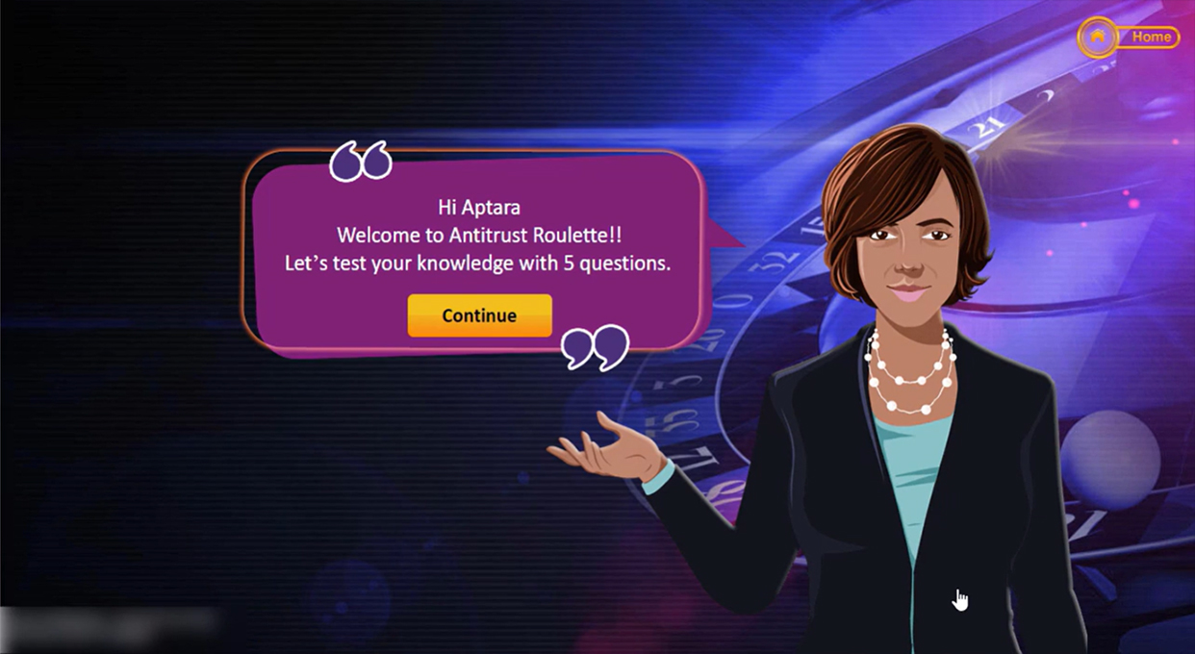
ANTITRUST ROULETTE
27

Slide 28

ANTITRUST ROULETTE
28

Slide 29
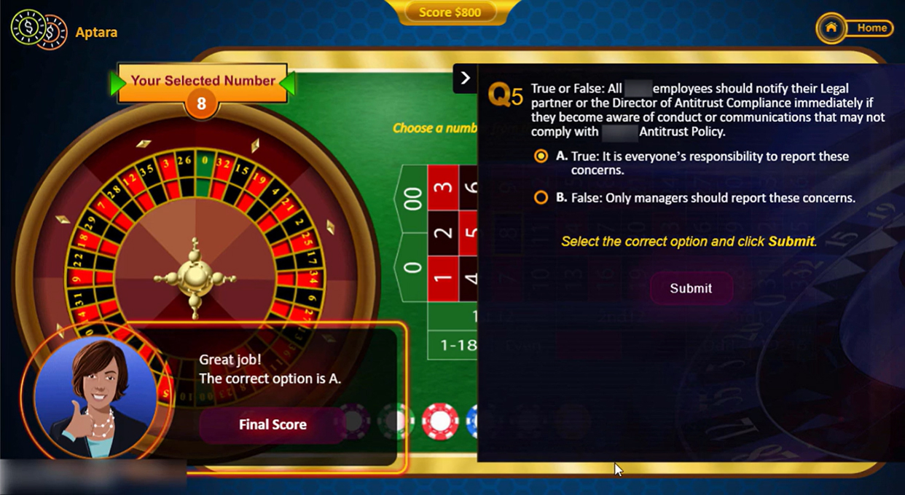
ANTITRUST ROULETTE
29

Slide 30
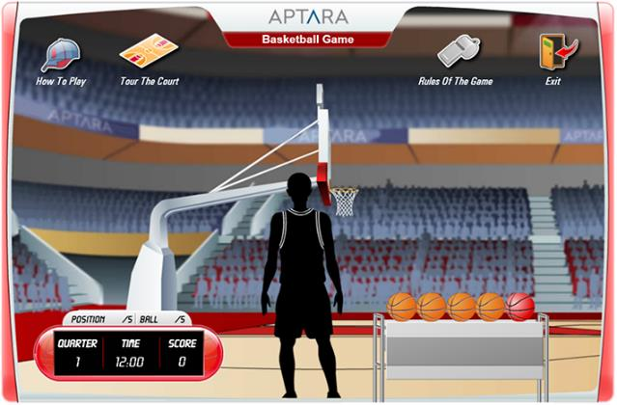
ASSESSMENT GAME
    About: A game-based assessment design to evaluate learners understanding on fraud prevention and detection concepts
    Design Highlights:
    Designed using basketball game theme
    To be played at three different levels – Easy, Medium, and Hard
    Progression from easy to hard level based on scoring minimum 80% in a level to advance to the next level
    Score is calculated based on the number of balls shot into the basket in the time allotted
    A ball is shot into the basket only when the user answers the question correctly
    Features pool of questions and questions are randomly presented to users at each attempt
    Built using – Articulate Storyline 360
    View Demo
30

Slide 31
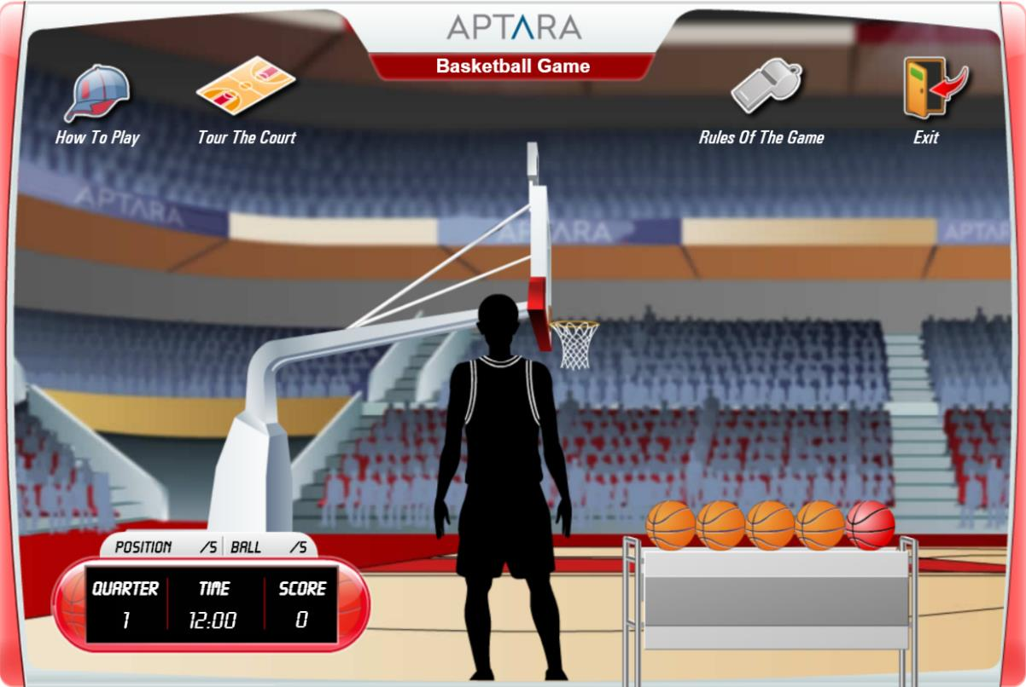
ASSESSMENT GAME
31

Slide 32
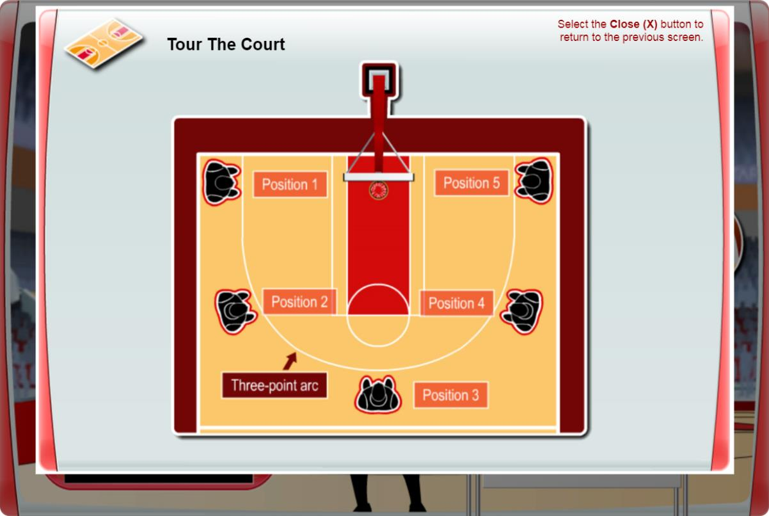
ASSESSMENT GAME
32

Slide 33
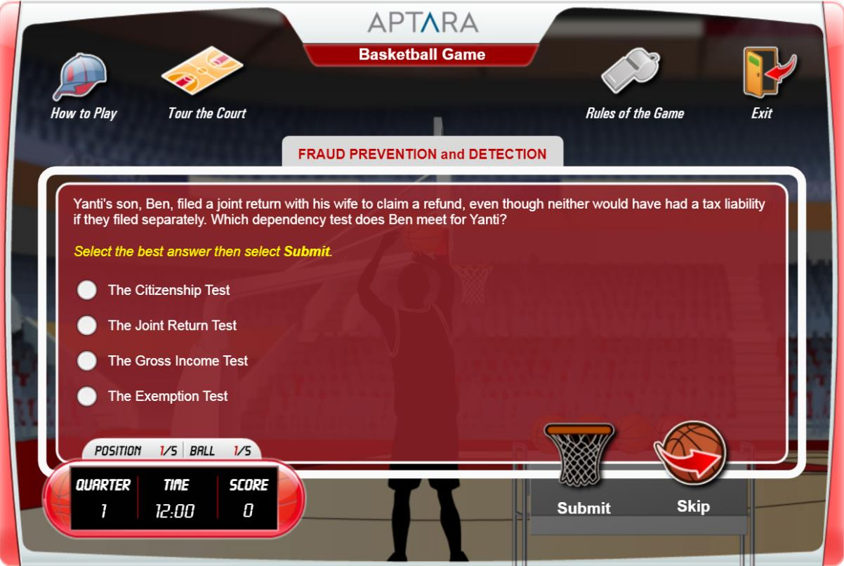
ASSESSMENT GAME
33

Slide 34
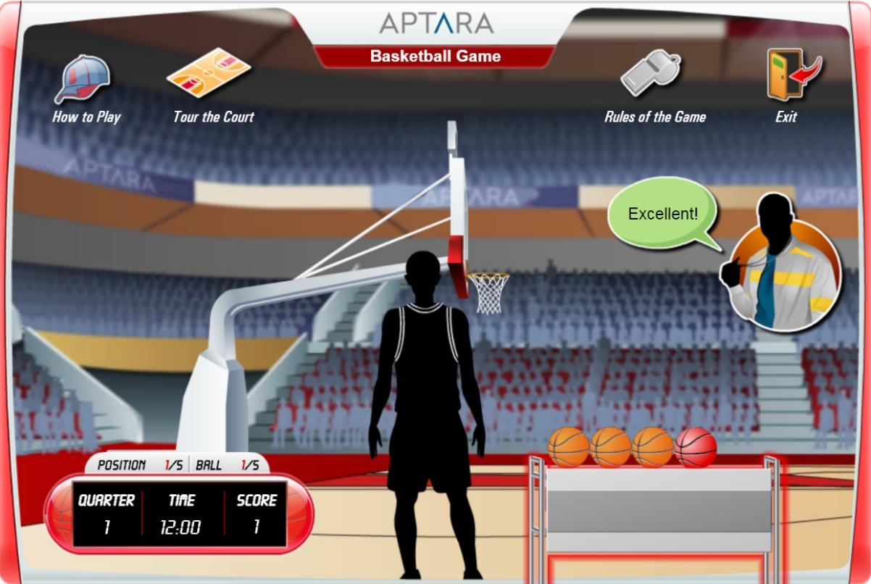
ASSESSMENT GAME
34

Slide 35
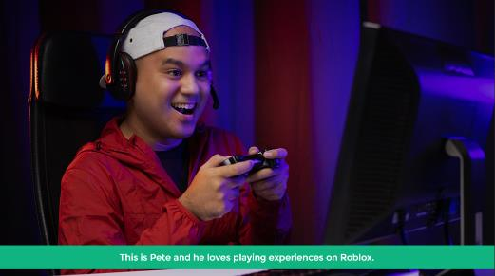
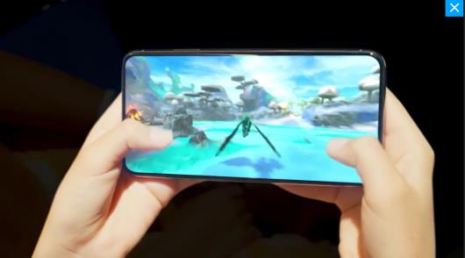
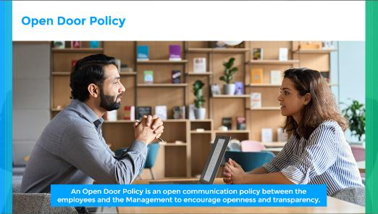
BLENDED LEARNING FOR ROBLOX
    About the Project: To design and develop highly engaging and effective learning materials for the employees of a very well-known gaming platform. This project of 125+ hours of learning involved two programs across various topics, such as HR Policies, IT Management Systems, Technical Troubleshooting, and Moderation process for user-generated content.
    New hire training: A blended approach with virtual classroom and self-paced online module
    Role-based/Specialist training: Multiple eLearning modules
    Design Highlights:
    Learning paths for learners from different business lines
    Game-based scenarios
    Storytelling techniques
    Simulations
    Animations
    Built using – Articulate Storyline 360
Password: iEnergizer_2022
View Demo
Password: iEnergizer_2022
View Demo
Password: iEnergizer_2022
View Demo
35
35

Slide 36
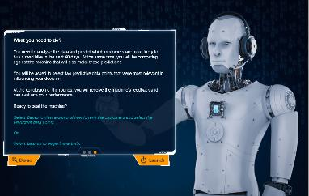
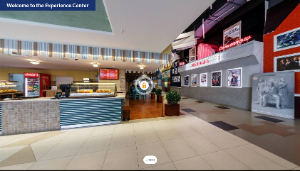

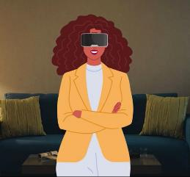


ADDITIONAL SAMPLES
    Analytics Infuse Game
    Gamified simulation as a learning aid for content on Analytics, Big Data and Artificial Intelligence (AI)
    The simulation uses a futuristic theme that is:
  facilitated through a data model
  driven using highly interactive features
  time bound
    Designed to influence and impress. (Affective domain)
    Built using – Custom HTML5
    COSM
    A role-based training design to cater to personalized learning experience
    Competency-based induction driven through exploratory, panoramic view
    Use of AI-generated video and audio
    Environment created using rich visuals
    Built using – Articulate Storyline 360, and AI agent
    Office of the CIO
    An immersive learning design to help learners know all about CIO, one of the divisions at Workday
    Immersive experience by leveraging the 360° image interactions
    Exploratory approach to learn is implemented through 360 view of the environment and clickable hotspots within it
    Real people videos added life to the course by making it effective and engaging
    Built using – Articulate Storyline 360 and green-screen videos
    Origin of Language
    Engaging and immersive learning design to learn origin of language
    Microlearning that utilizes the Articulate 360's panoramic feature for an interactive learning experience
    An Excavation theme is used with 360° interactions to pan, explore, and learn
    Self-running sequences of bite-sized information
    Built using – Articulate Storyline 360
Cost Range: $15,475 to $17,800
View Demo
View Demo
View Demo
View Demo
36

Slide 37
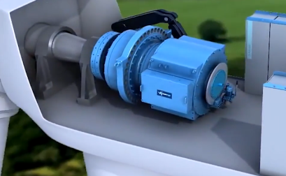
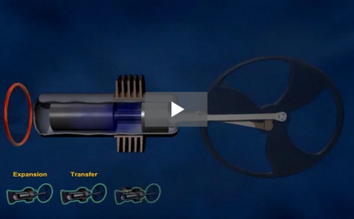
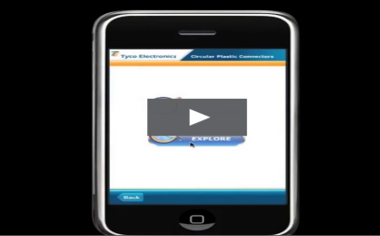
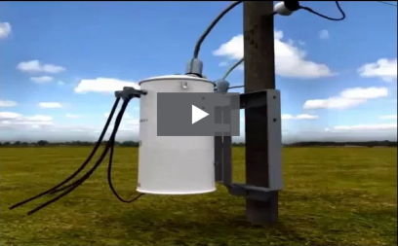
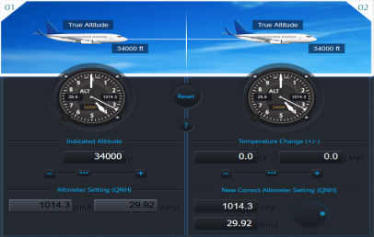
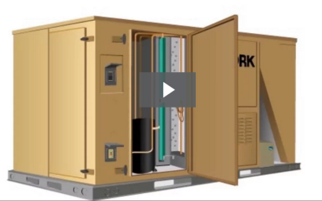
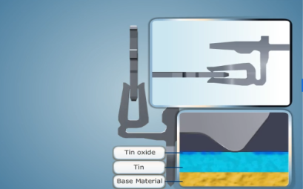
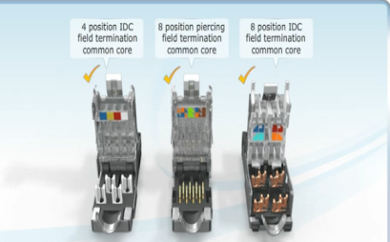

3D WORK SAMPLES
3D Samples
Stirling Engine
Circular Connector
Transformer Animation
Etihad – Free Play
York Animation
Blade Server
Tyco Animation
Eyeball Animation

Slide 38

Thank you

