Slide 1

Portfolio
Ajinkya Dambelkar
Graphic Designer (Articulate Storyline)

Slide 2
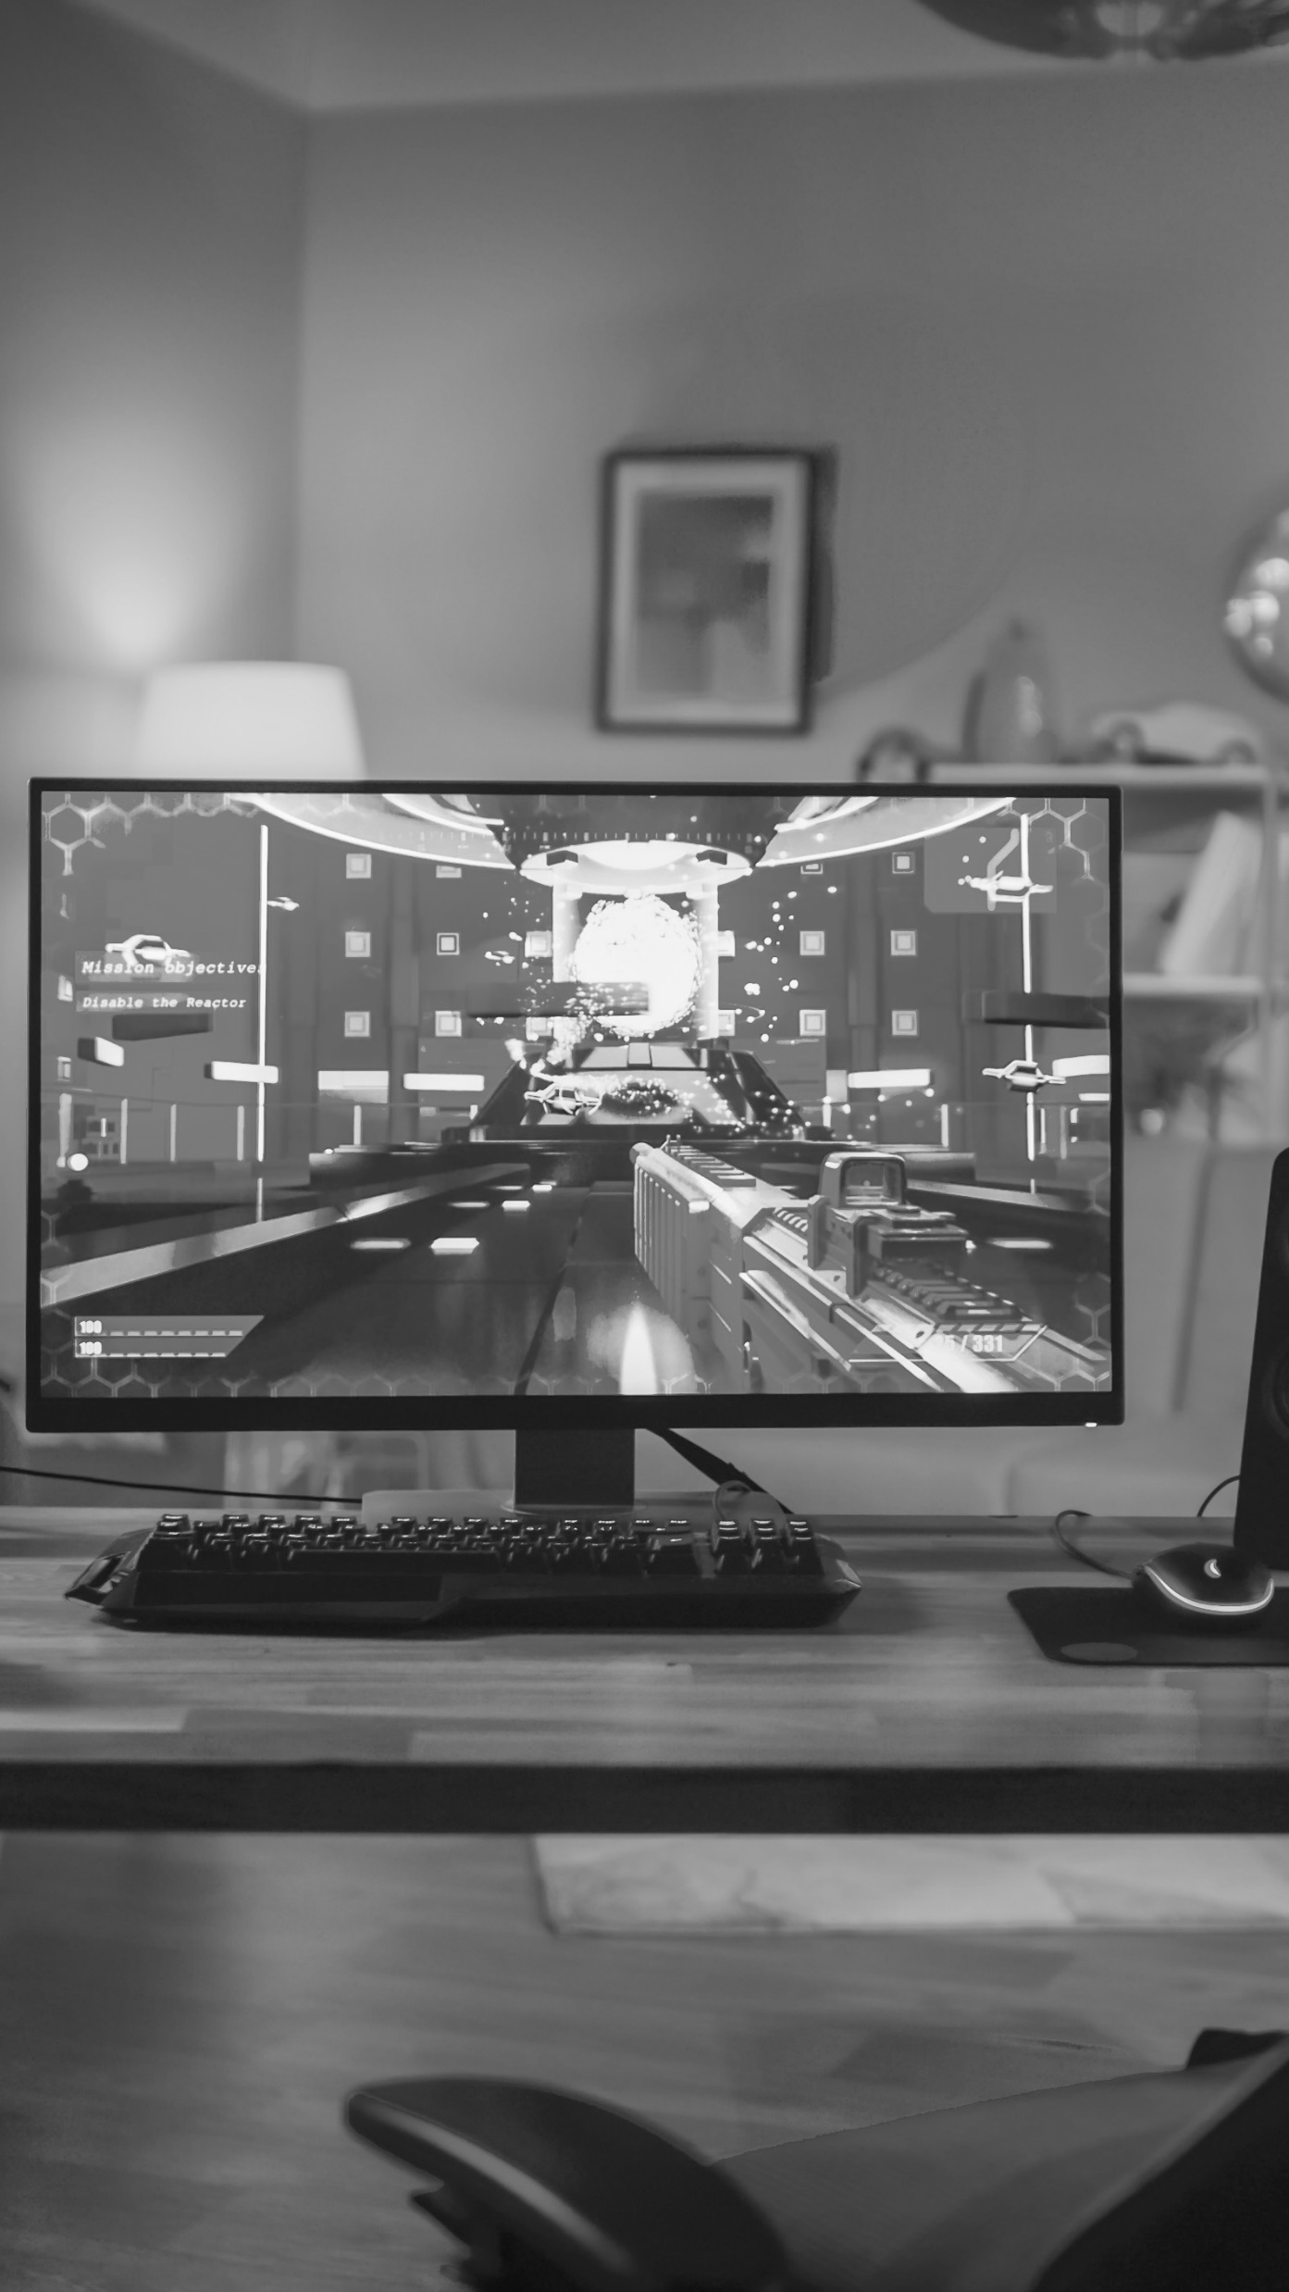
A visual timeline
01
Introduction
02
Skill sets
03
Work
04
Training Tool

Slide 3
Introduction
    Innovative E-Learning Developer with a passion for creating engaging and effective educational solutions. Experienced in designing and developing interactive e-learning content, I bring a blend of creativity and technical expertise to every project.
    Collaborating closely with Instructional Designers and SMEs to thoroughly understand storyboards and concepts.
    Defining the scope, timelines, and design strategies for course content.
    Leveraging my expertise in Articulate Storyline to bring creative and visually appealing training solutions to life.
    Understanding interactivity and functionality from an instructional perspective to create impactful learning tools.
    Applying my foundational graphic design skills to create templates in Photoshop or Illustrator.
    Designing and delivering engaging e-learning content that caters to diverse learning styles.
    Ensuring compliance with Learning Management Systems (LMS) and SCORM standards.
    Managing schedules and deadlines to consistently deliver high-quality work on time.
    Adapting to fast-paced environments and working independently to achieve project goals.

Slide 4
Skill sets
A
Articulate Storyline360
A
Articulate Rise
Pr
Adobe Premiere Pro
Ps
Adobe Photoshop CC
Ai
Adobe Illustrator CC

Slide 5
Showcase…
Showcasing my expertise through a curated selection of impactful projects and innovative solutions.

Slide 6

Level 3 Interactivities

Slide 7

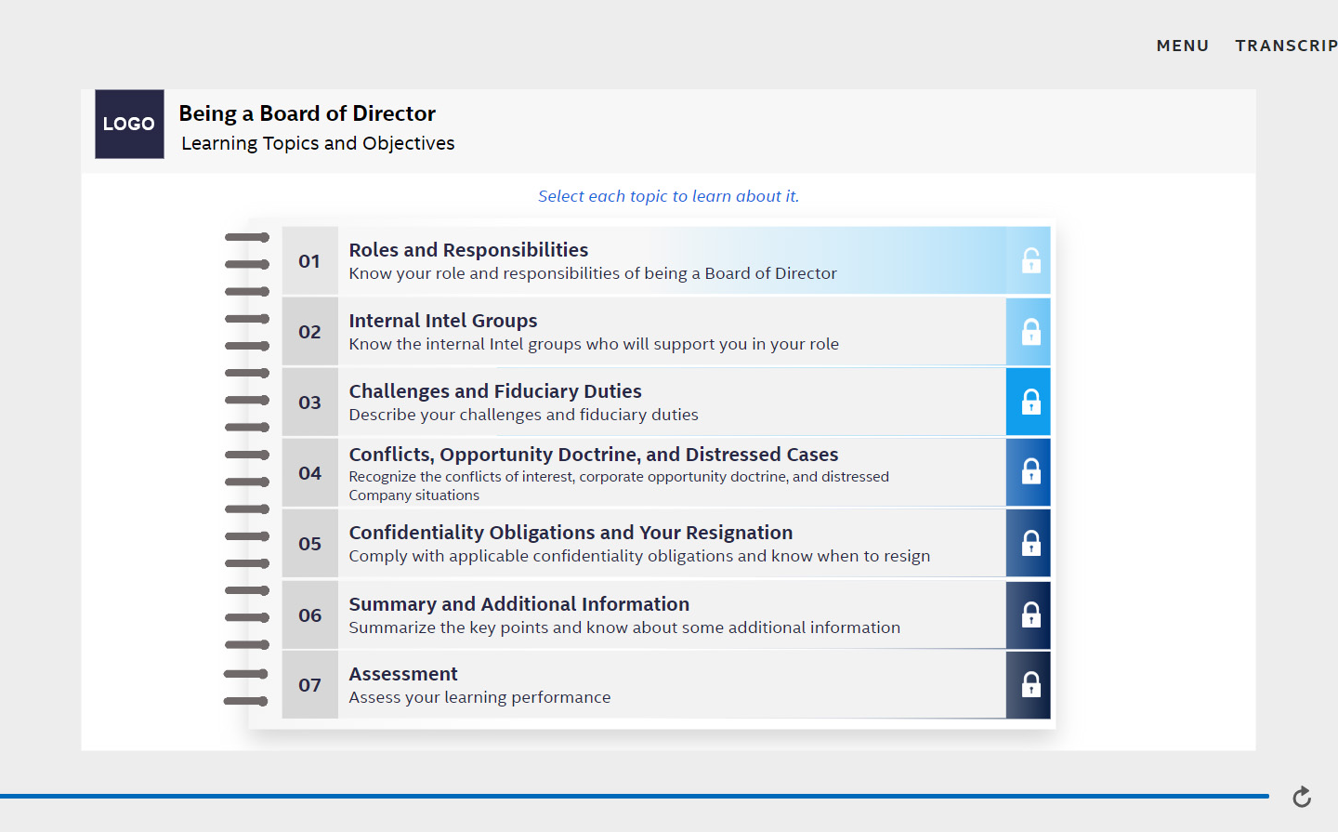
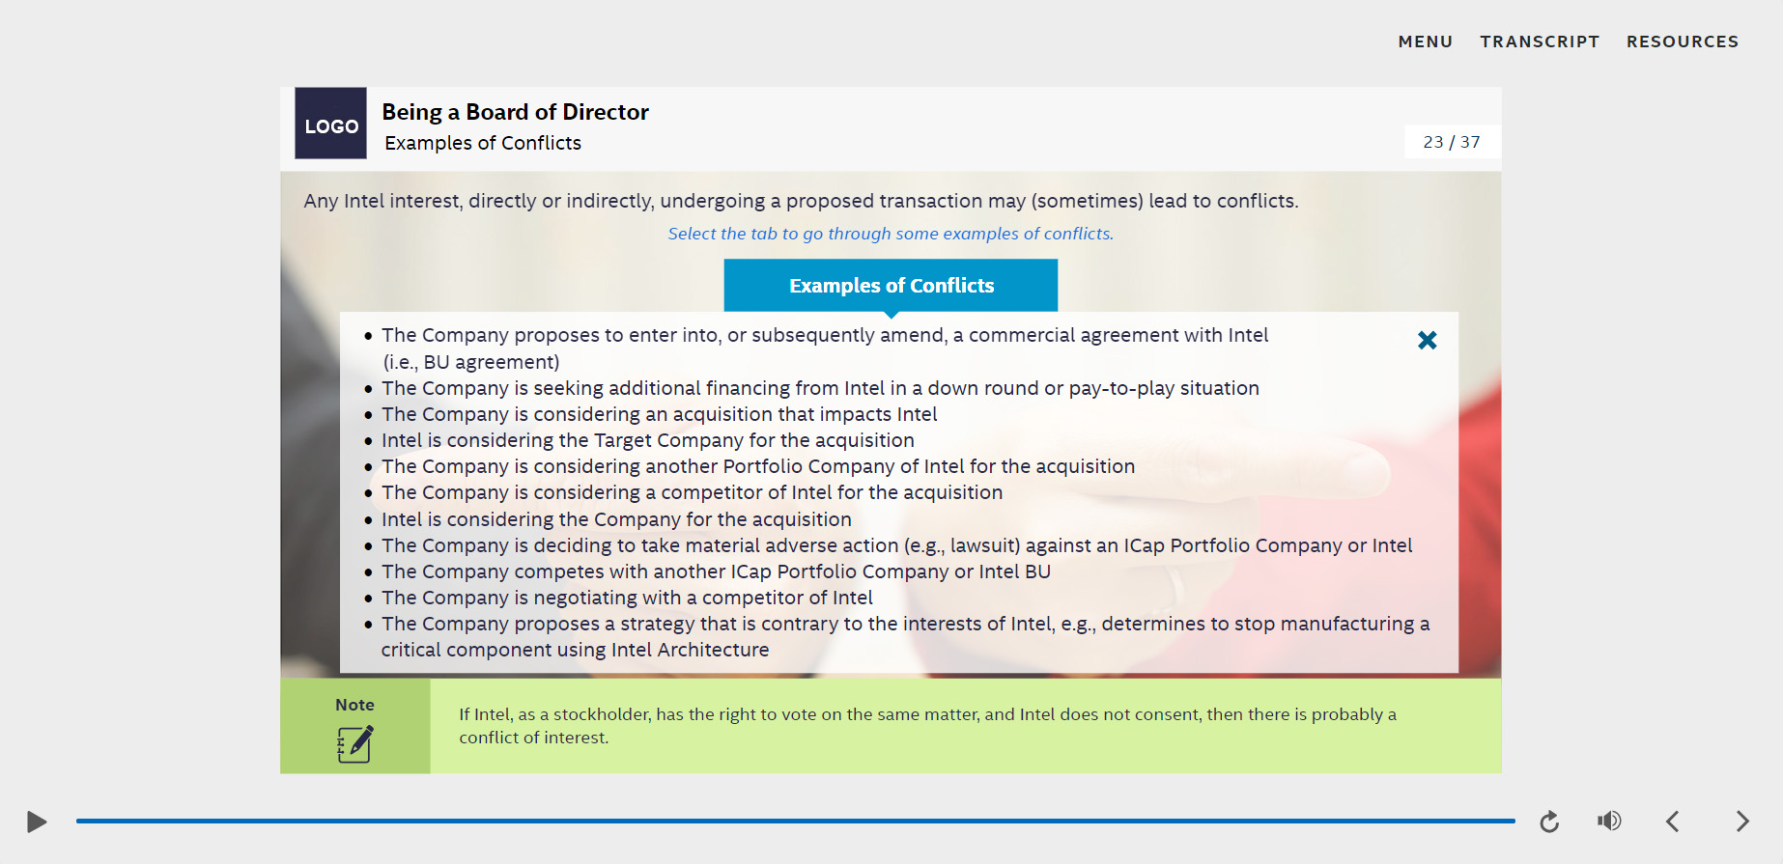
Storyline Sample
This storyline course is created using the tools mentioned below.
Tools:
Storyline 360
Adobe Photoshop CC
    View Demo

Slide 8
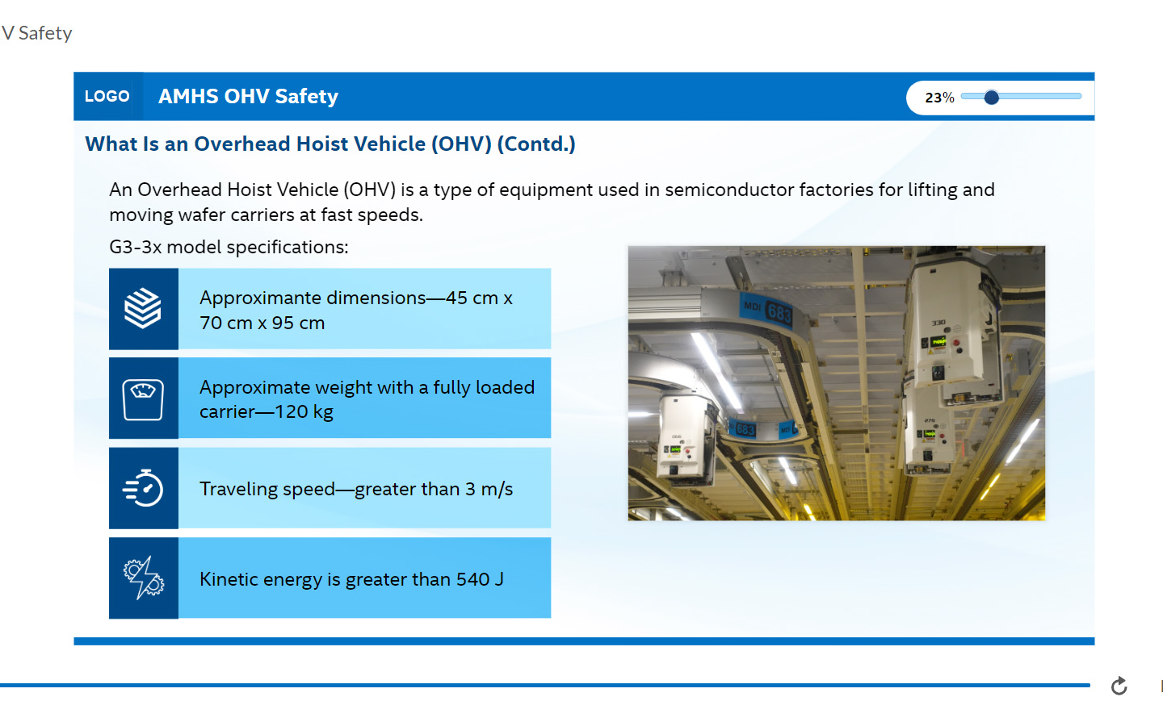
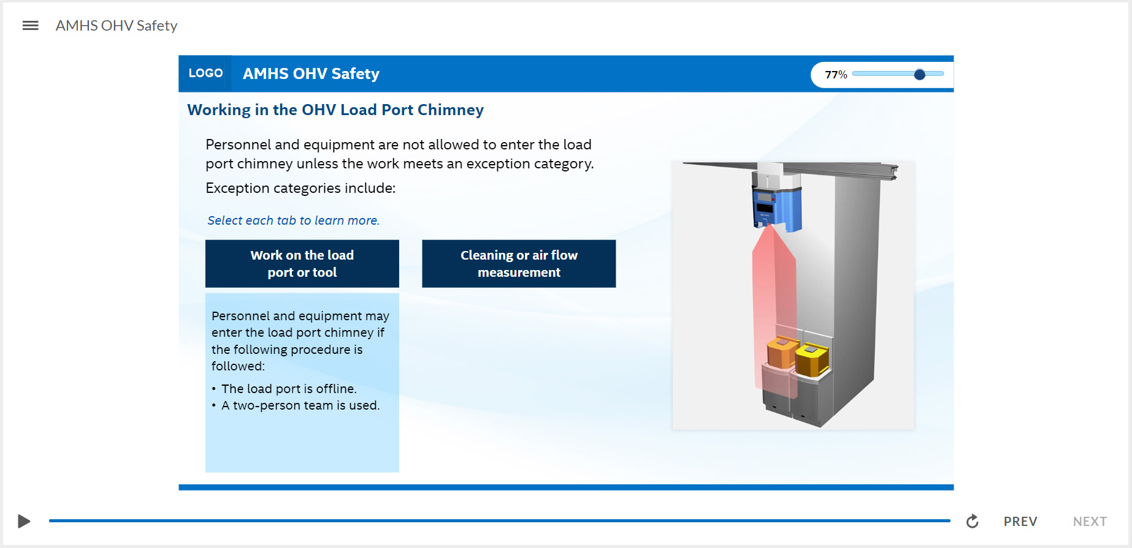
Storyline Sample
This storyline course is created using the tools mentioned below.
Tools:
Storyline 360
Adobe Photoshop CC
    View Demo

Slide 9
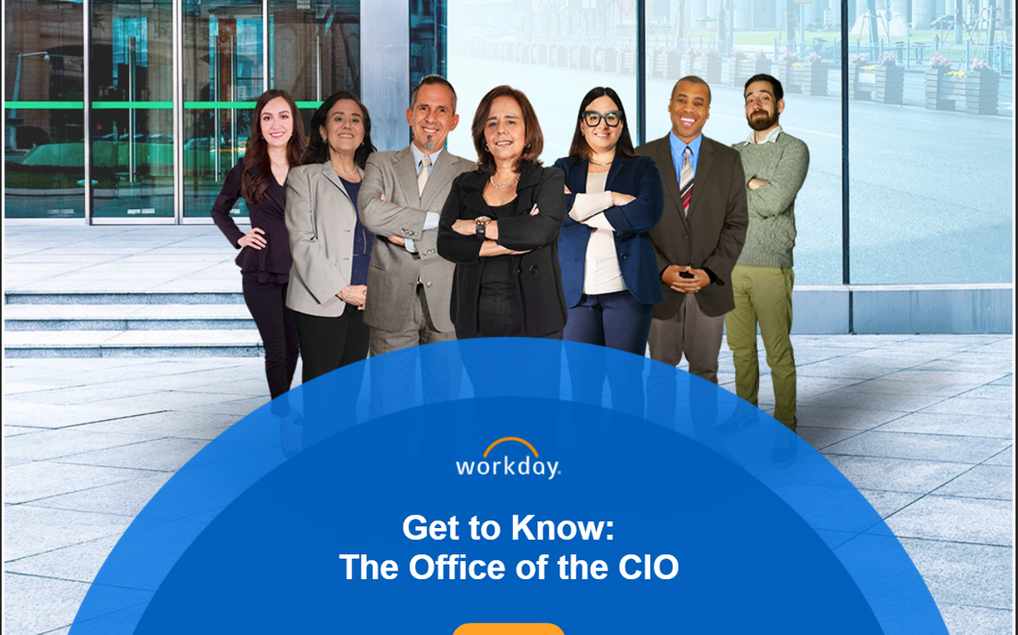
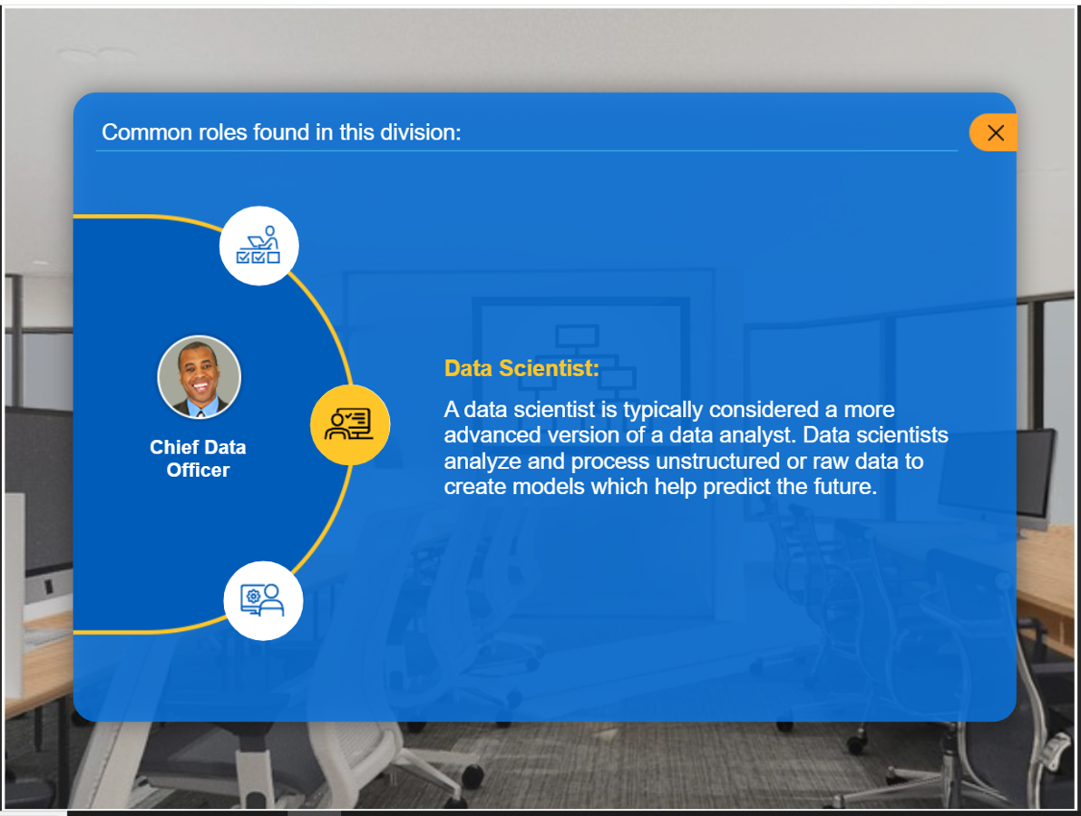
Storyline Sample
This storyline course is created using the tools mentioned below.
Tools:
Storyline 360
Adobe Photoshop CC
    View Demo

Slide 10
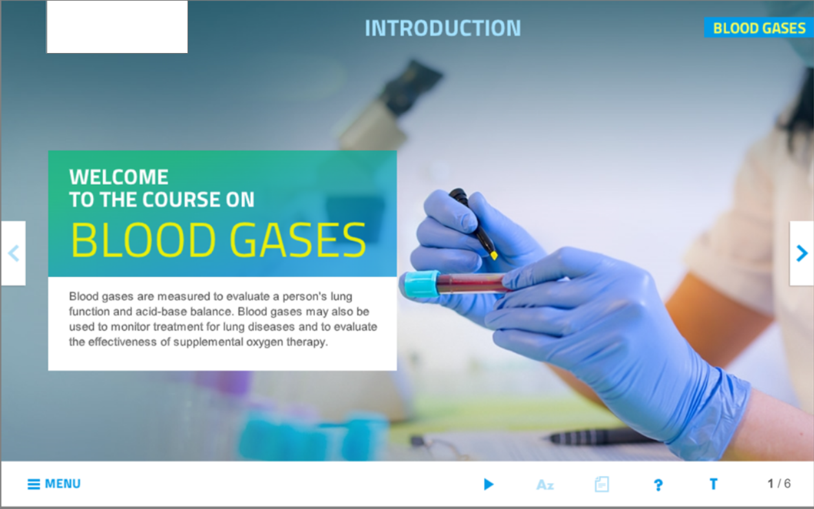
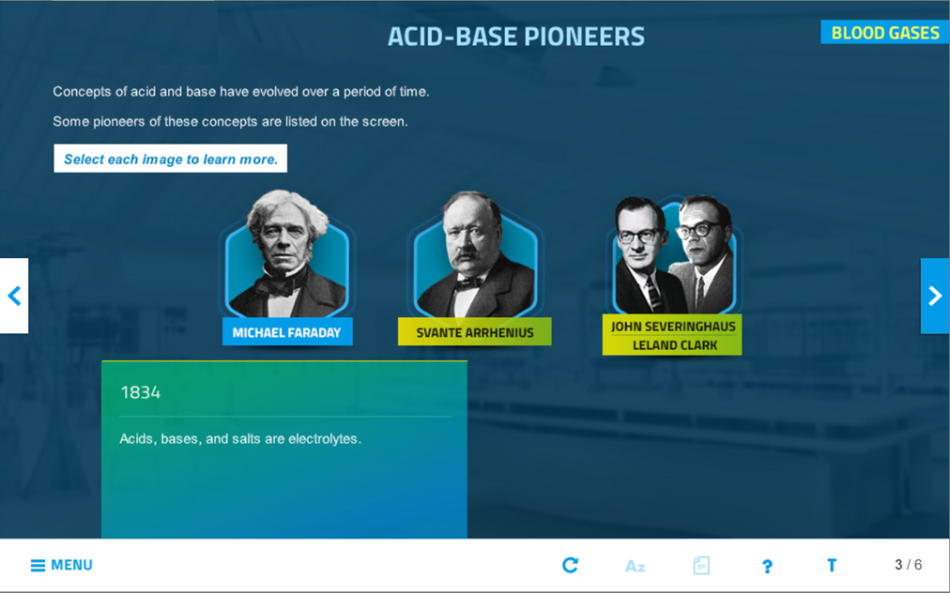
Storyline Sample
This storyline course is created using the tools mentioned below.
Tools:
Storyline 360
Adobe Photoshop CC
    View Demo

Slide 11
Articulate Rise

Slide 12
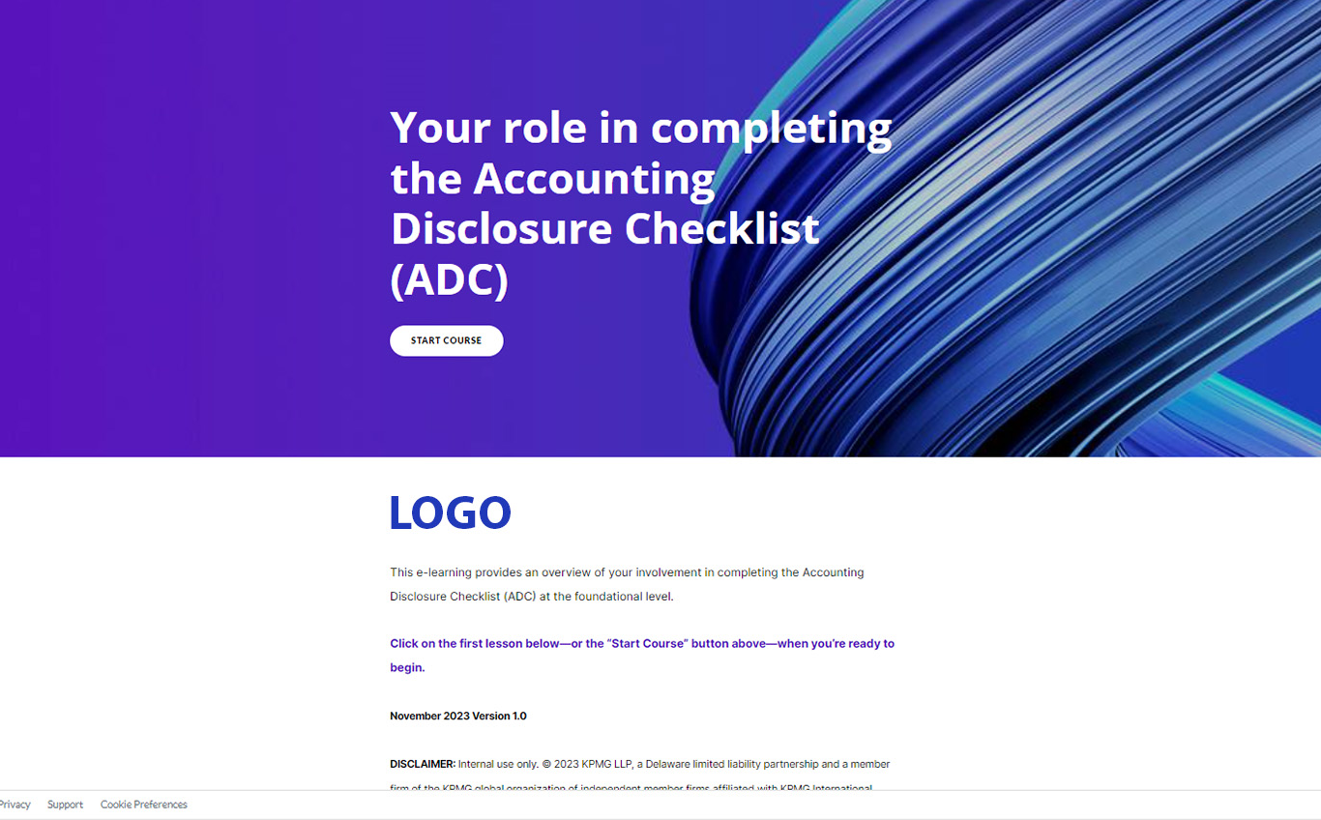
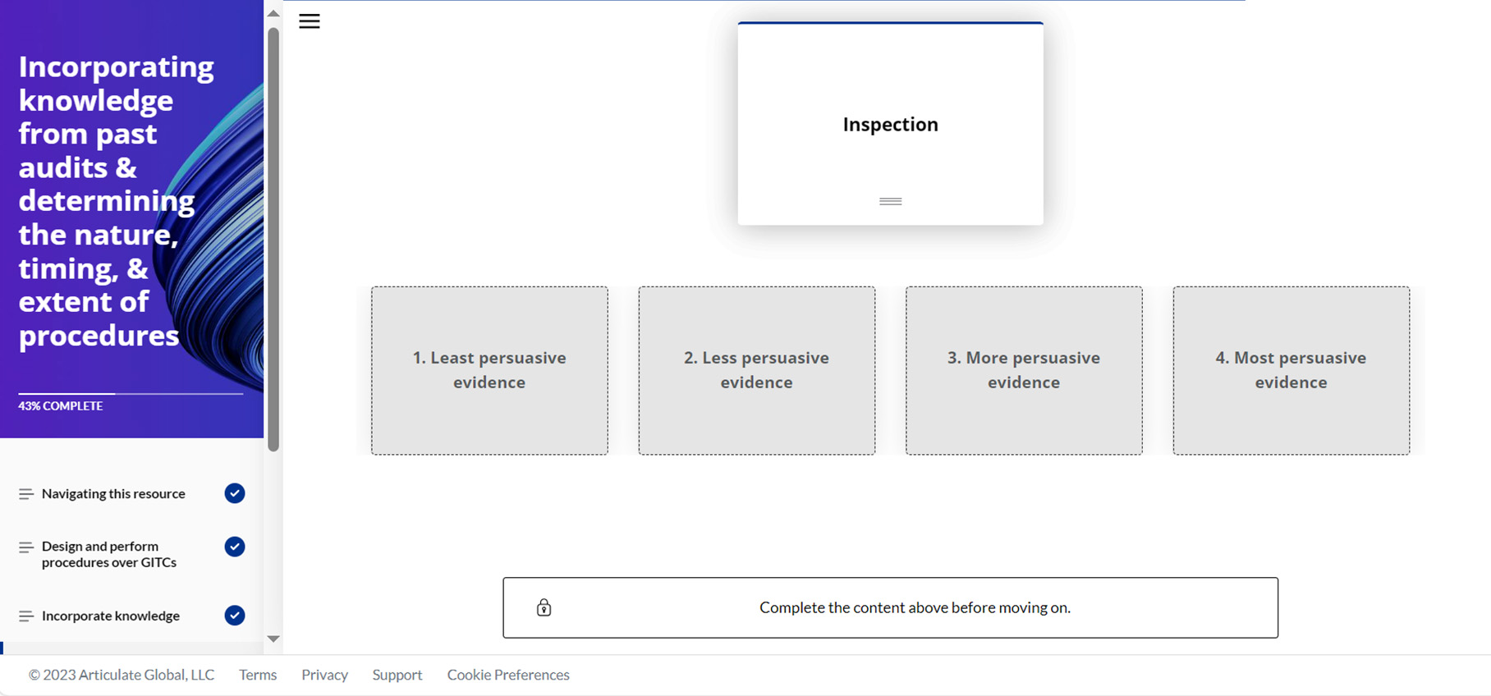
Articulate Rise Sample
This storyline course is created using the tools mentioned below.
Tools:
Articulate Rise

Slide 13
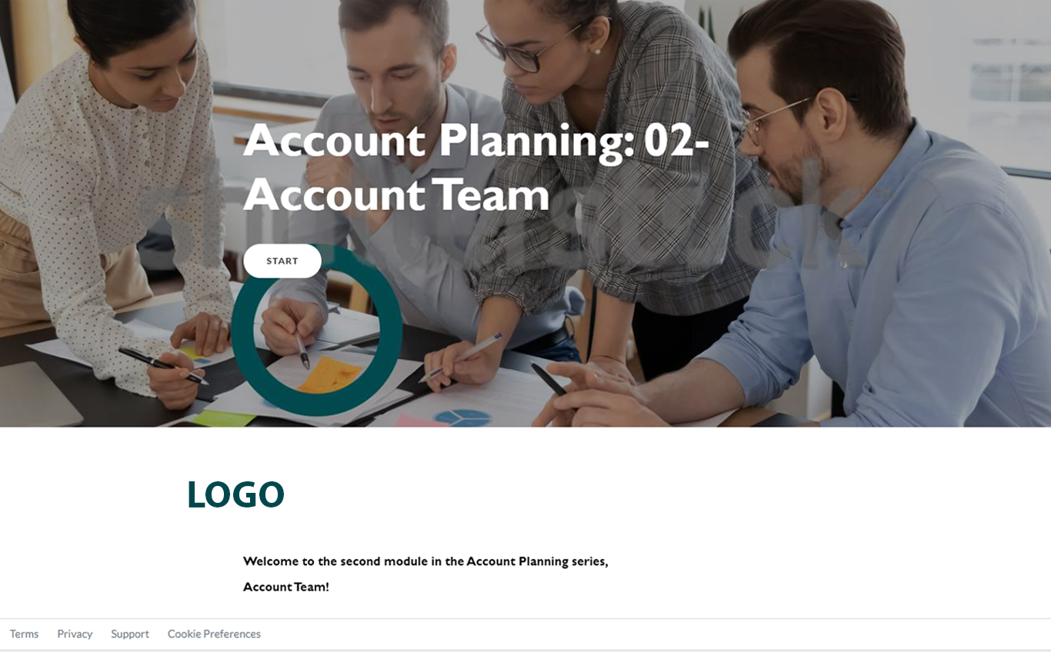
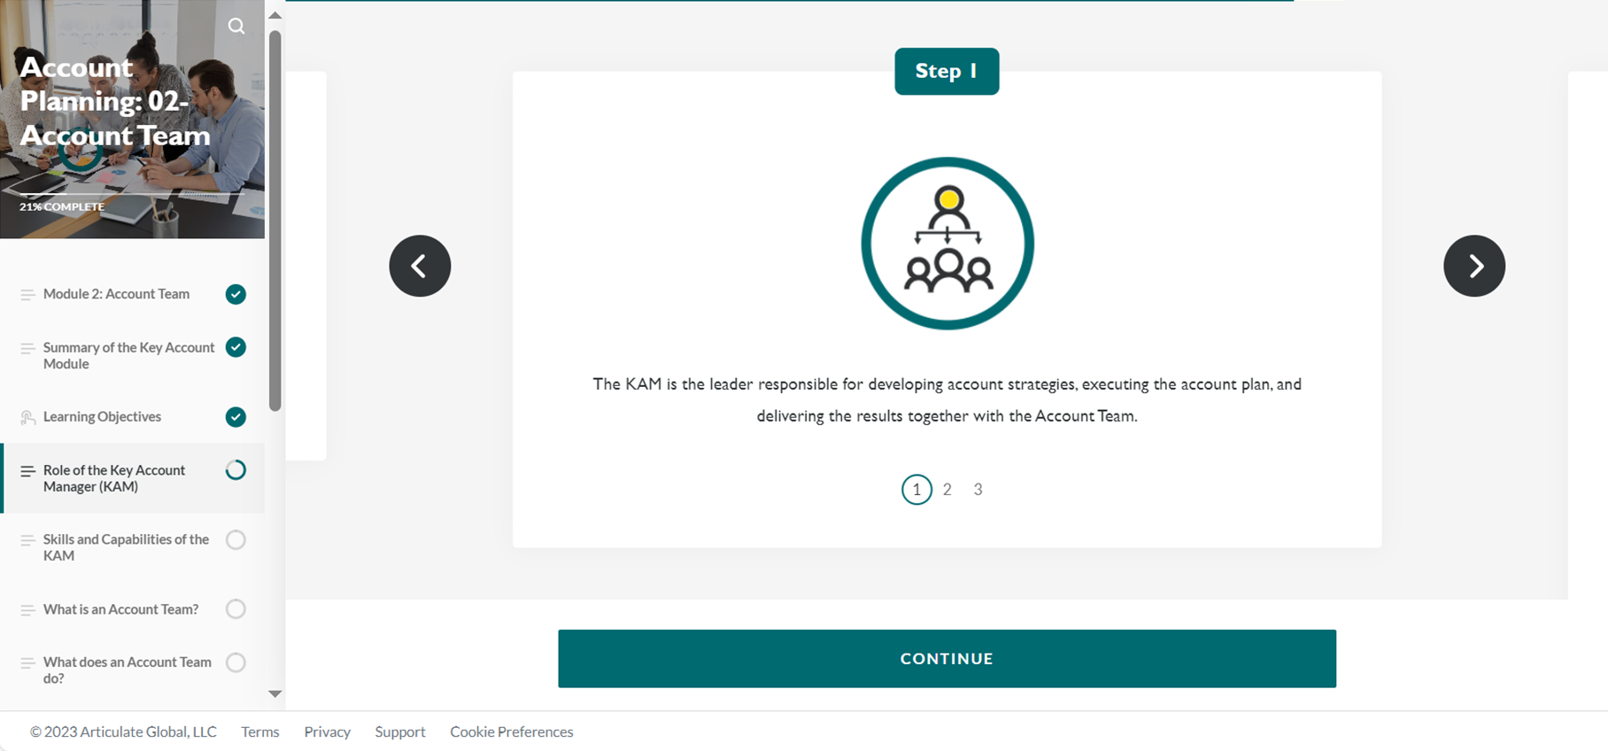
Articulate Rise Sample
This storyline course is created using the tools mentioned below.
Tools:
Rise 360
Adobe Photoshop CC

Slide 14
Video

Slide 15
Training Tool
Tool | Level (basic/intermediate/Expert)
Articulate Storyline360 | Expert
Articulate Rise | Expert
Adobe Photoshop CC | Expert
Audacity | Expert
Adobe Illustrator CC | Expert
MS Office Suite (PowerPoint, Word, Excel) | Expert
Vyond | Expert
Camtasia | Expert
Adobe Premiere Pro | Intermediate
Adobe XD | Intermediate

Slide 16
Thank You

