Slide 1






Quarterly
Business Review
Meeting
Thursday, 17 April 2025
Mohit Chaturvedi
Vice President - Strategic Accounts
mohit.chaturvedi@aptaracorp.com
m: +1.206.227.5861

Slide 2

















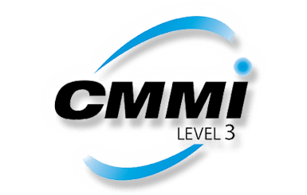
Aptara Overview
30K+
Headquartered in the United States
Employees worldwide
across our global delivery centres and service lines; Aptara employees approximately 5,000
9
Global delivery centres
60+
Awards & recognition
12th
$
150+
Serving fortune
1,000 clients
35+
Years of experience
in the training industry
Consecutive year in
the top 20 companies
in training industry watch list
Flexible
Pricing and working
models
ISO: 27001:2013, ISO 22301:2019,
ISO:9001:2015,
PCI DSS, SOC, HIPPA, GDPR and CMMI 3 Certified
Scalability
Capacity to process large volumes quickly and accurately 24/7/365
Learning Lifecycle
Author • design • format • enrich
• produce • package • distribute
• manage
Global Support Services
We work across industries, geographies, lines of service and specialties to bring you
customised solutions

Slide 3






Aptara's Managed Learning Services
LEARNER-CENTRED | INNOVATION-DRIVEN | TECHNOLOGY-POWERED
Strategic Analysis and Design
Delivery, Analytics and Technology Consulting
Learning Content Development and Transformation
Learning Aligned for Business Impact
Workforce Transformation
Change Management, Upskilling and Reskilling
Organisational and Leadership Development
Building training roadmap
Learning Delivery Framework and Infrastructure Consulting
Learning Experience Management Consulting
LMS Migration, Hosting and Maintenance
Virtual/Classroom In-Session Technical Support
Virtual/Classroom Facilitation​
Custom Reports, Dashboards and Analytics
Learner and Content Performance Evaluation
MANAGED
LEARNING SERVICES
Learning Experiences Design
Global Support Services
UX/UI Design
Outcome-Driven Learning
Prescriptive and Adaptive Learning Strategies
User-Generated and Community-Based Learning
Gamification and Business Simulations
Hands-on Application, Focused Reskilling and Upskilling
AI-Powered Learning Development
Dedicated Support Team and Short-/Long-Term Staff Augmentation
Learning Management and Administration
Custom Application Support Helpdesk
​ 24/7/365 Global Helpdesk (Email/Chat/Voice)​
Translation and Localisation Support
Application Hosting and Maintenance Support​
Dedicated Team for Vendor Management
Professional Services
Global Resources Available on Demand (Temporary, Permanent, Onsite and Remote)
Instructional Designers
eLearning Developers
Trainers/Facilitators
Technical Writers
Training Coordinators
LMS Administrators

Slide 4





















Aptara Strategic Partnerships at a Glance
Managed Content Learning Services
Professional Services
Content Technology & Analytic Services
Content Development and Translation
Support Services (LMS Admin & Tech Support)
Transformation
Regulatory Compliance

Slide 5




Making an Impact
Developing learning solutions to STRENGTHEN MULTICHANNEL ENGAGEMENT
Helping in developing engaging and effective UPSKILLING PROGRAMMES in short durations
18 Member DEDICATED TEAM to support Walmart in developing trainings using multiple tools and on subjects like INTERNATIONAL COMPLIANCE, ETHICS, COMMUNICATION, PACKAGING and more
Virtualisation and redesign of 500 hours of legacy classroom content into blended learning
REDUCED annual learning travel costs by $25m
”
”
”
DEDICATED TEAM
DEDICATED TEAM
Built STRATEGIC ALLIANCES with UBER for development of DEI programmes
An all-weather trusted partner who designs WORLD-CLASS TRAINING SOLUTIONS to empower UBER employees across various geographic locations
Learning experiences for a leading UPSKILLING PLATFORM
Learning content on EMERGING TECHNOLOGIES
Meeting learning demands for UPSKILLING AND RESKILLING
Aptara SAVED $800,000 YEAR ON YEAR for CISCO by converting their paper-based manuals to a digital e-book format
”
”
”
DEDICATED TEAM
Aptara helped Dassault Systèmes turn 5,000 PAGES OF ILT MANUALS INTO A SUCCESSFUL ECOURSE PROGRAM
Aptara created and continues to MAINTAIN 200 HOURS of professional, interactive eLearning
”
Extended Development Team of 140 design, media and support resources
Dedicated end to end learning services including AR/VR supporting 141,000 learners
”
DEDICATED TEAM to support training development requirements of 32 different BUSINESS UNITS
”

Slide 6
















Aptara’s XDT Client Portfolio
Aptara’s Extended Development Team (XDT) model is supporting many clients globally for their learning design and development needs. A few of them are listed below.
(Vertex)
TEAM SIZE
140
TEAM SIZE
18
TEAM SIZE
13
TEAM SIZE
11
TEAM SIZE
25
SERVICES PROVIDED:
SERVICES PROVIDED:
SERVICES PROVIDED:
SERVICES PROVIDED:
SERVICES PROVIDED:
End-to-end learning consulting, design and development
Learning administration services
Media and technology services
Learning design and development
Content transformation
Updates and maintenance of learning modules
Mobile responsiveness testing of modules
End-to-end learning design
Multimedia design
Power BI and SharePoint development
Sales and marketing collateral development
LMS administration support
End-to-end learning consulting, design and development
Multimedia design
Localisation and translation
Conversion/redesign
Staff augmentation for global locations including Central, US&C, EMEA
Learning design and development
Training administrative services
LMS administration and support (CSOD, SumTotal, Docebo and SuccessFactors)
LMS data analytics
Beedeez mobile learning app support
Others
TEAM SIZE
200
TEAM SIZE
25
TEAM SIZE
7
TEAM SIZE
9
SERVICES PROVIDED:
SERVICES PROVIDED:
SERVICES PROVIDED:
SERVICES PROVIDED:
Managing 13 services across standard (XBRL) and specialised services (Cyber security, Digital marketing, Sales operations, Legal data quality, etc.)
Employee learning and development programmes to enhance the skills of the workforce
End-to-end learning design and development
Video development using Adobe After Effects
LMS/LXP/DMS admin System support and cross-team coordination
Update platform procedures
User/course management, troubleshooting, virtual training, certifications
Web-Based Training (WBT) design and development
Copy editing

Slide 7





Client References
ORGANISATION
Contact Name and Title
Contact Details
Ryan C Snare
Transformation Leader, Director Learning & Development
rs439e@att.com
+1-404-345-7817
Seneca Luetke
Lead Vendor Strategist, Learning & Development
sl0677@att.com
+1-425-979-9384
Eric Rowlee
Sr. Director, Learning & Development
Global Talent & Learning (GTL)
Eric.Rowlee@walmart.com
+1-479-799-7636
Gina Alesse
Director, Learning Strategy and Innovation
gina.alesse@pmi.org
+1-408-310-1129
Ravi Daithankar
Director, Digital Learning and Performance Support
Ravi.Daithankar@bcbsnc.com
+1-919-433-7619
Emmanuel Coumbias
Global Learning Design and Development Lead, Consulting
emmanuel.coumbias@au.ey.com
Boris Libman
Associate Director, Learning Technology & Innovation
Commercial Learning & Development, USBU
boris.libman@takeda.com
+1-617-293-3352

Slide 8
















+
Engagement Highlights
Long-Term Partnership for Workforce Transformation
Partner with key lines of businesses and their clients
Extend AT&T team with 140+ design, media and support resources for 3 years
Utilise 50+ design tools and platforms
Aim to design 2000+ hours of learning content per year
Transformed 230+ learning modules with over 80 hours of content including translation into Spanish
Value Propositions
Design modalities:
WBT | ILT | VLL | Blended | Simulation | Animation video | Job aid | Gamification | AR/VR/XR
Training areas:
Onboarding | Leadership | Soft skills | Products | Systems and Processes
Cost efficiency by 50–60%
Exploit efficiency of scale in design by 15–30%
Faster time to learner by 15–30%
Operational efficiencies and excellence
Time zone efficiencies using One Team Model (OTM)
Reduced AT&T headcount and
fixed cost base
Transformation Objective
Partner for Workforce Transformation
Transformation Support
Optimising a 400 people team for AT&T L&D with a $60M budget
Selected through a rigorous partner selection process
$18M positive impact in the first year
Built a 140+ design, media and support dual shore team
A long-term partnership to:
Build capacity
Encourage design efficiency
Improve productivity and TAT
Standardise design tools and processes
Bring cost efficiencies
Current state assessment (learning environment, design processes, operating model)
The target operating model implementation
Extended team for Design and Support services
Extended Executive, Consulting, Operational, Automation and Innovation support
8

Slide 9
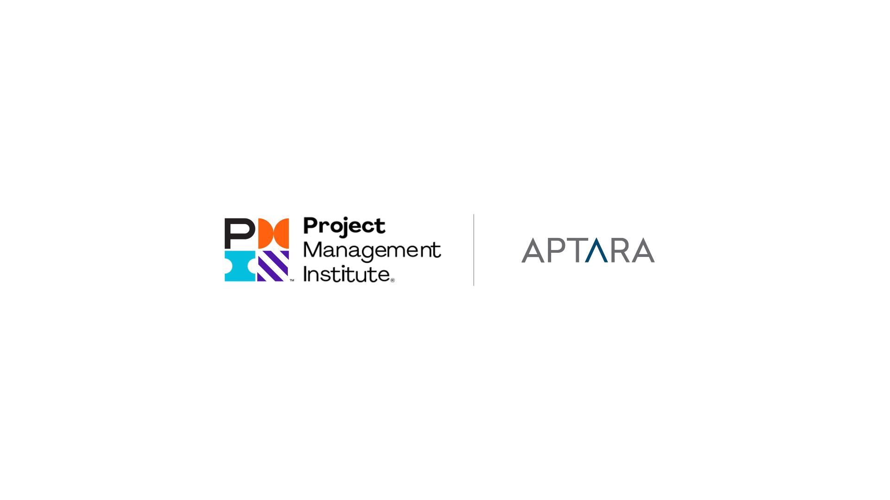

Slide 10
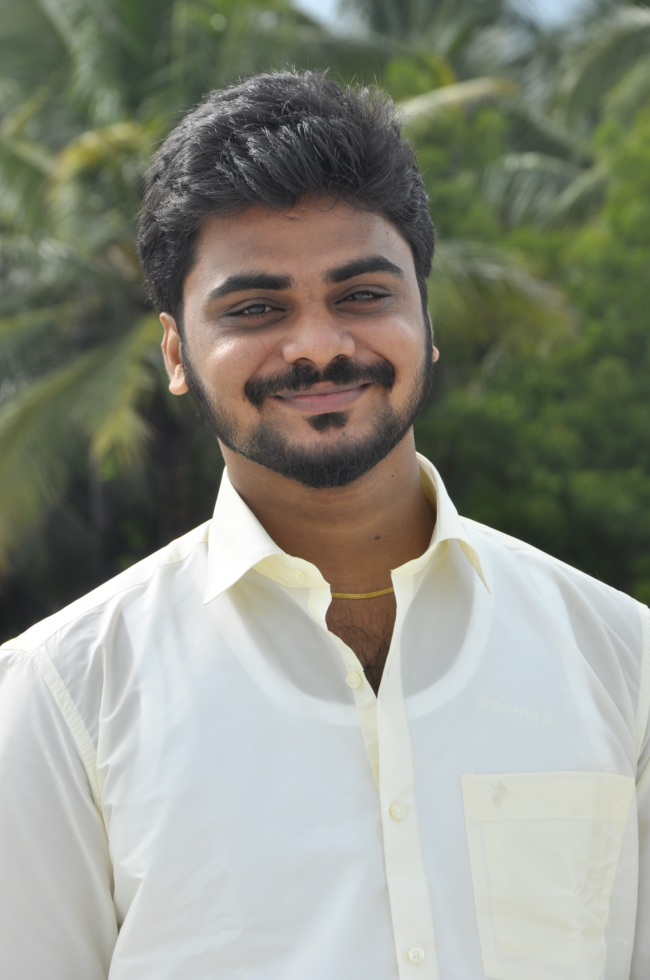
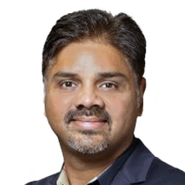
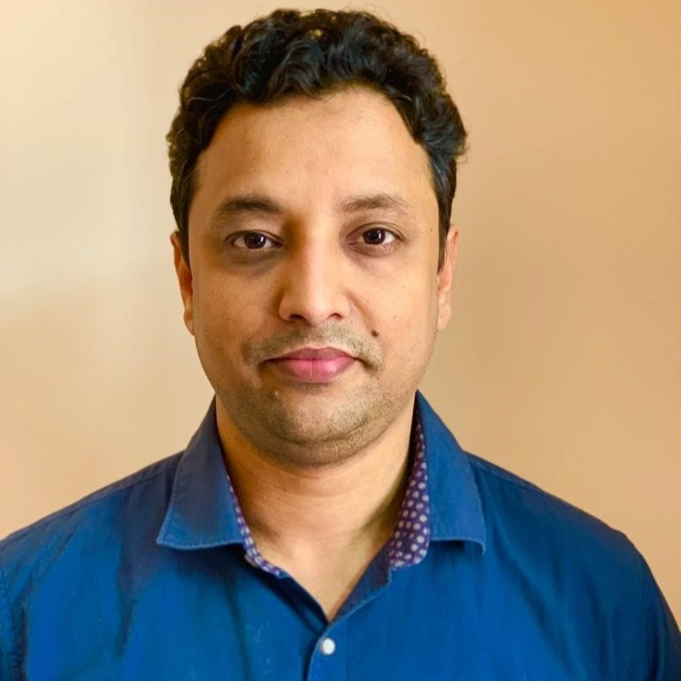
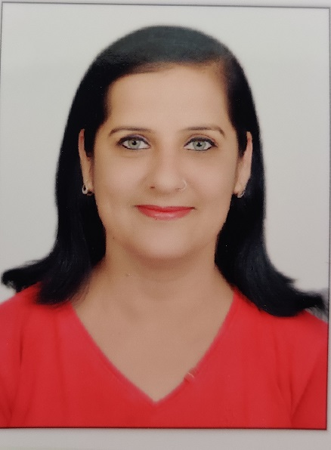
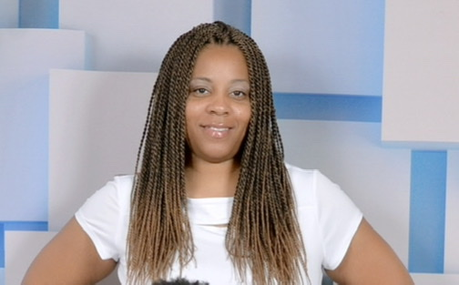

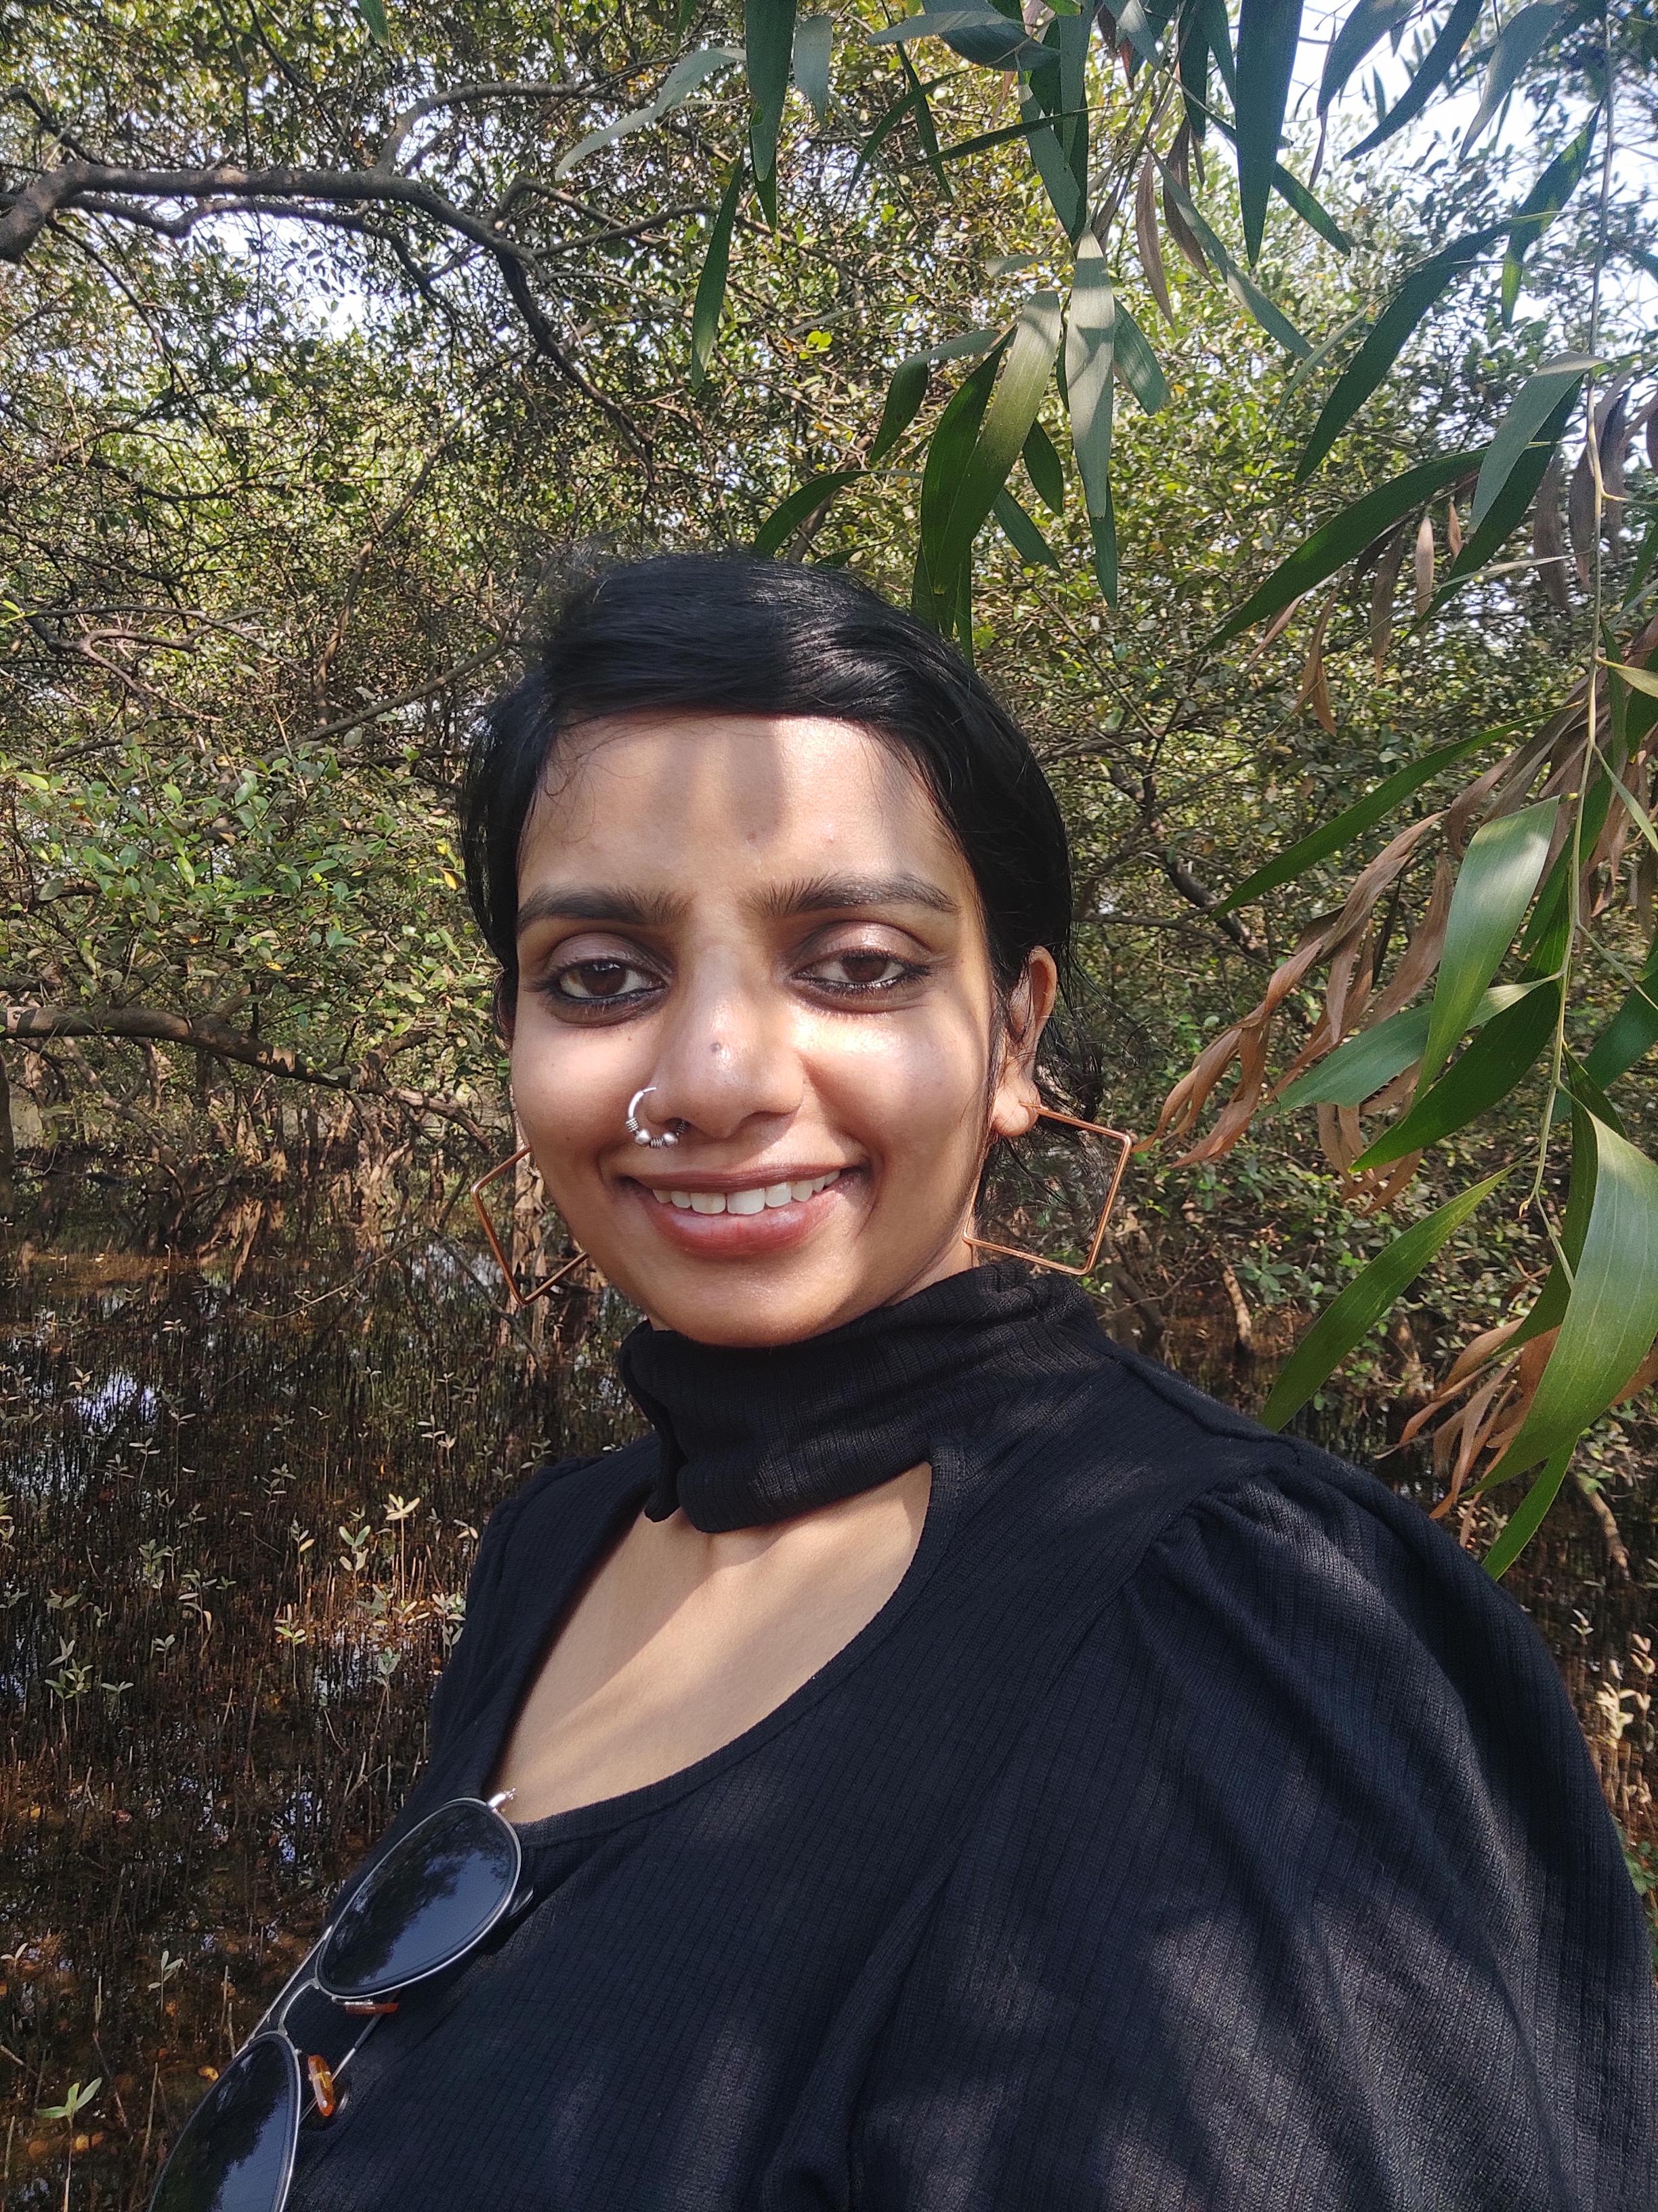
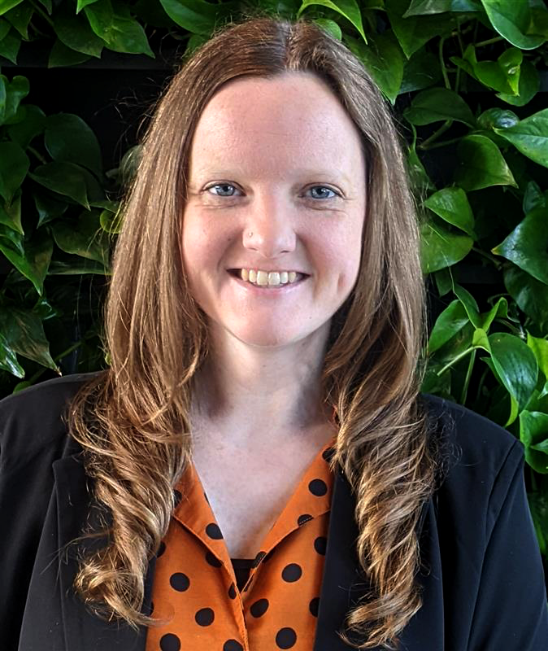
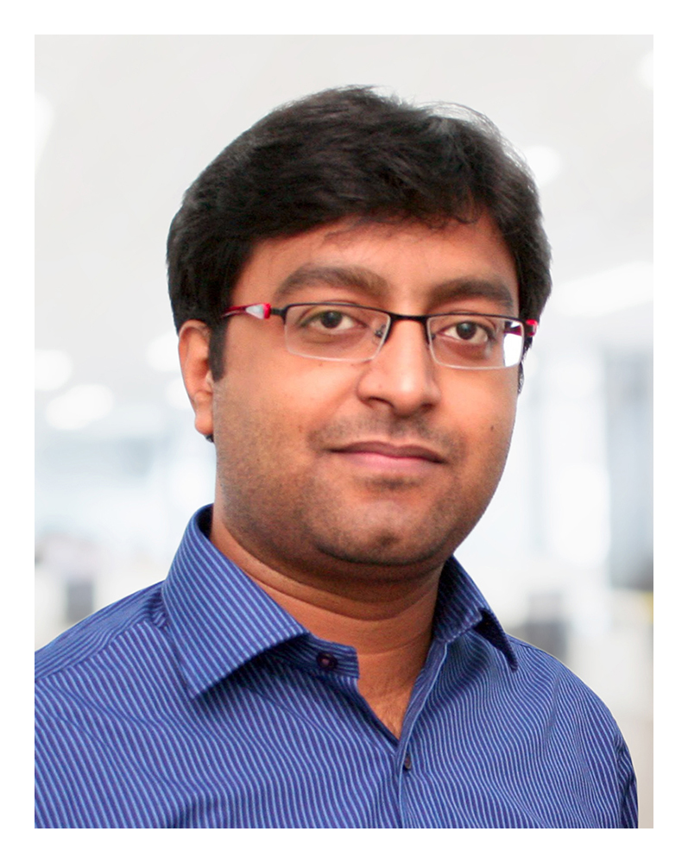
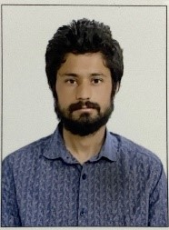
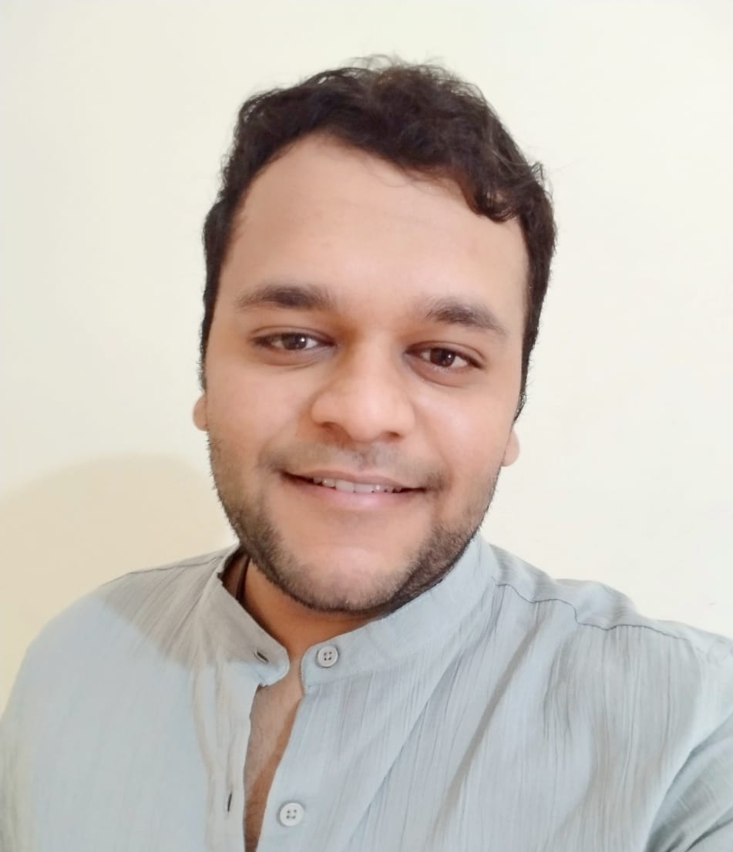
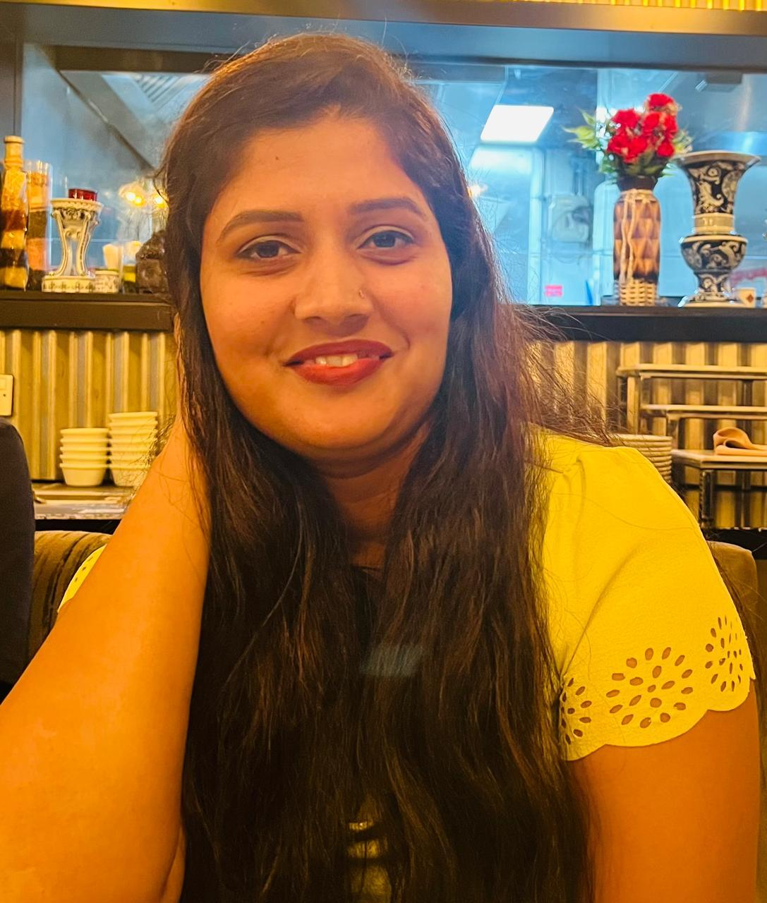
Team Introduction
Mohit Chaturvedi
Summit Kumar
Vice President –
Strategic Accounts
Associate - Vice President (Delivery)
Smita Surnis
Keisha Raines
Nilashree Das
Arun Prakash
Joyce
Chacko
Project Coordinator (Support)
Engagement Manager
Instructional Designer
Instructional Designer
Instructional Designer
Stephanie Yasko
Kamar Hussain
Deepak
Choudhary
Ajinkya Dambelkar
Ashwini Dhumal
Graphic Designer
Graphic Designer
Graphic Designer
Graphic Designer
Functional Quality Analyst

Slide 11
Team Structure
Stakeholders
Executive/Transformation Support
Kelly Heuer
Gina Alesse
Sarah Philbrick
Mohit Chaturvedi
Program Delivery, Operations, and Functional Support
Summit Kumar
Product Owners
Engagement Manager
Kim Marcelliano
Leah Huf
Phillip Cooke
Keisha Raines
Team Members
Content Developers, Subject Matter Experts, Product Specialists, Copyeditors
Nilashree Das (ID)
Stephanie Yasko (GD)
Neha Sharma (GD)
Ashwini
Dhumal
(QA)
Joyce Chacko (ID)
Kamar Hussain (GD)
Deepak Choudhary (GD)
Arun Prakash (ID)
Ajinkya Dambelkar (GD)
Nana Tupe (GD)

Slide 12










Partnership Overview
A long-term partnership for delivering innovative learning solutions.
Engagement Highlights
Part of the core project team along with PMI members
Involved in day-to-day activities, including planning the schedule, determining the instructional approach, and designing the course
The Path
Ahead
Design modalities:
WBT | ILT | Content creation | JS-coded interactivities | Animation videos | Branching scenarios | Documents | Product design
Skillsets:
Instructional design | Content creation | Course development | Graphic design | Video | JS programming in Storyline | Quality analysis | Copyediting
Flex team model allows PMI to plug and play team members from Aptara based on the current project requirements.
We can incorporate latest technologies to improve learner engagement and development efficiency.
Engagement Objective
2023
2024
2025
As a consulting partner, Aptara aims to help shape learning strategies, align training with business objectives, and advise on optimal practices in digital learning and certification.
CAPM
New engagement model
ACP
PMO-CP
RMP
CAPM
12
Notes:
Engagement Objective:
As a consulting partner, Aptara aims to help shape learning strategies, align training with business objectives, and advise on optimal practices in digital learning and certification.
Engagement Highlights:
Part of the core project team along with PMI members
Involved in day-to-day activities, including planning the schedule, determining the instructional approach, and designing the course
Work Transformation:
<Here we could talk about the number of eLearning modules, ILTs, resource documents, etc. we have created for them so far. I don’t have the data for the entire team. Smita might have.>
The Path Ahead
Flex team model that allows PMI to plug and play team members from Aptara based on the current project requirements
Incorporate latest technologies to improve learner engagement and development efficiency
<Any other plans or initiatives that Summit or Mohit have in mind>

Slide 13
Projects Status
No | Project Name | Type | Start and End |  | Seat Time (hr) | Involvement
1 | ACP - Agile Certified Practitioner | eLearning, Assessments, Maintenance | Mar, 2024 | Aug, 2024 | 28 | End-to-end development
2 | PMI-RMP – Risk Management Practitioner | eLearning, ILT, Workbook updates, Assessments | Aug, 2023 | Aug, 2023 | 23
3 | PMO-CP – Project Management Office – Certified Practitioner | eLearning, ILT, Workbook | May, 2024 | June, 2025 | 7
4 | PMI-CAPM | eLearning; Maintenance | Jul, 2023 | Nov, 2023
5 | PMI-CPMAI | eLearning (38 lessons, Rise development only) | Oct 2024 | May 2025 | 28.5 | Course migration to Rise
6 | PMI- Green Project Management | eLearning (Rise) | Mar, 2024 | Apr, 2024 | 0.5
7 | GenAI: Prompt Engineering for Project Managers | eLearning, Workbook, Assessments | Mar, 2024 | Apr, 2024 | - | Miscellaneous tasks
8 | Data Landscape of GenAI for Project Managers | Video scripts and development; Maintenance | Jan, 2024 | Jan 2024 | -
9 | PMI - (Microcred) - (Certification Program) | Assessments, Backlog fixes | Jul, 2024 | Aug, 2024 | -
10 | PMI - Digital Construction Practitioner Course. (Oracle Assessment) | Assessments | May, 2024 | May, 2024 | -
11 | GenAI Overview for Project Managers | Layout, formatting, and design improvements; Resource documents (inDesign) | Apr, 2024 | May, 2024 | -
12 | Agile Metrics | Feedback fixes | Jun, 2024 | Jun, 2024 | -

Slide 14
Projects Status
No | Project Name | Project Type | Status
1 | GenAI: Prompt Engineering for Project Managers | eLearning; Workbook; Assessments | Completed
2 | GenAI Overview for Project Managers | Layout, formatting, and design improvements; Resource documents (inDesign) | Completed
3 | Data Landscape of GenAI for Project Managers | Video scripts and development; Maintenance | Completed
4 | PMI - Digital Construction Practitioner Course. (Oracle Assessment) | Assessments | Completed
5 | PMI- Green Project Management | eLearning (Rise) | Completed
6 | ACP - Agile Certified Practitioner | eLearning; Assessments; Maintenance | Completed
7 | PMI - (Microcred) - (Certification Program) | Assessments; Backlog fixes | Completed
8 | Agile Metrics | Feedback fixes | Completed
9 | PMI-CPMAI | eLearning (Rise) | Completed
10 | PMI-CAPM | eLearning; Maintenance | In progress
11 | PMI-RMP – Risk Management Practitioner | eLearning; ILT; Workbook updates; Assessments | In progress
12 | PMO-CP – Project Management Office – Certified Practitioner | eLearning; ILT; Workbook | In progress

Slide 15



Utilization
January
February
March
89%
91%
89%
Core Team
Core Team
Core Team

Slide 16

PMI Testimonials
The prototype looks good! The interactive approach is interesting but for this document I’d rather keep it non-interactive and have all the content on one page. Thanks for looking into alternative solutions though.
Looks great, can’t wait to see more.
Arun is really doing a great job on the PMO project….taking leadership….helping to train other people and is an “invaluable” resource on the team. very impressed!!
Hi Everyone, I just wanted to pass along some Kudos and wanted to make sure it was amplified on the Aptara side of our team. Kamar Hussain (Aptara) has been an OUTSTANDING partner for the RMP course. From day 1 he oversaw the SL team and has stepped up and has done an amazing job. He has gone out of his way to make sure the course is beautiful, well developed, and up to PMI standards. He is going above and beyond to make sure we hit our timelines and supporting multiple other SL designers throughout the process. If you have the chance to talk to him (or ping him on teams!) please make sure to say thank you and Keisha please pass along to the Aptara leadership team as well" Thanks!
Gina Alesse
Director, Learning Strategy and Innovation
Sarah Philbrick
Product Manager, AI Training Portfolio
Arun is an amazing asset and the star of the show
Beautiful! I reviewed all videos, and they look great.
Gina Alesse
Leah Huf
Director, Learning Strategy and Innovation
Product Manager for RMP course
Sarah Philbrick
Product Manager, AI Training Portfolio

Slide 17
PMI Testimonials
First, I want to sincerely thank you for the opportunity to evaluate this course. Without any exaggeration, I can confidently say that this is one of the best courses I have reviewed so far. With my experience, reflected in the certifications and studies listed on my LinkedIn profile, I have encountered many learning materials, and this one truly stands out. The course excels in every aspect— (B) Thank you, great course, I believe that it's PMI best elearning one. Go team!!!!!
It has always been a very enriching experience working closely with PMI & helping in their various initiatives and product offerings, over the past several years and this one too tops the list !!... And the final outcome has come extremely well. I showed it to my team today and everyone was highly praising it for the content, clarity & convenience it will provide for aspirant RMP professionals. Kudos to the entire team
The course is well done, and the approach to learn in a problem base scenario works well and let understand clearly the approach and the identify the flow to follow in order to do an excellent Risk management.
With the launch of this course, we now have an excellent resource for aspiring RMP candidates to meet their PDU requirements as part of the application process.
Volunteer reviewer for PMI-PMOCP
Thank you EVERYONE, for your dedication, expertise, and just overall being great people to work with (Kim to the whole team)
Kim Marcelliano
Volunteer reviewer for PMI-RMP
Product Manager, PRODUCTS :: Learning (Strategy & Innovation)
Notes:
Feedback shared by Kim for Arun:
You've really stepped up and shown your leadership, ID abilities and your understanding of the content; I consider you the "lead" of the team. I just wanted you to know that and know I really appreciate you. And yes, we definitely have a way to go for sure, but we will get there
Happy birthday! Wanted to say THANK YOU for all of the work you have done for this project - truly wouldnt have been able to do it without you. I'm at the conference now and attending a session about creating value and aligning services...I think both of us could actually be a speaker for this ! Hope you have a great day off. Enjoy!
Feedback shared by Gayla for Arun and Priyanka:
I am thankful to Arun and Priyanka, we just got them in too late and I hate to feel like scrambled eggs LOL (Gayla’s feedback on our course review)
Feedback shared by a volunteer reviewer for PMO-CP:
First, I want to sincerely thank you for the opportunity to evaluate this course. Without any exaggeration, I can confidently say that this is one of the best courses I have reviewed so far. With my experience, reflected in the certifications and studies listed on my LinkedIn profile, I have encountered many learning materials, and this one truly stands out. The course excels in every aspect— (B) Thank you, great course, I believe that it's PMI best elearning one. Go team!!!!! (A survey volunteer’s feedback on the PMOCP course)
Feedback shared by Kim for the entire team:
Thank you EVERYONE, for your dedication, expertise, and just overall being great people to work with (Kim to the whole team)
Feedback shared by Nicole for Kamar:
A HUGE thank you to the massive amounts of work that Gayla Wright and Kamar Hussain (Aptara) have done in Storyline - their work has enabled us to create the library and the sheer volume that they've produced is astounding!
Feedback shared by volunteer reviewer for PMI-RMP:
It has always been a very enriching experience working closely with PMI & helping in their various initiatives and product offerings, over the past several years and this one too tops the list !!... And the final outcome has come extremely well. I showed it to my team today and everyone was highly praising it for the content, clarity & convenience it will provide for aspirant RMP professionals. Kudos to the entire team
The course is well done, and the approach to learn in a problem base scenario works well and let understand clearly the approach and the identify the flow to follow in order to do an excellent Risk management.
With the launch of this course, we now have an excellent resource for aspiring RMP candidates to meet their PDU requirements as part of the application process.

Slide 18



Collaborative Partnership
PMI and Aptara have worked together collaboratively to:
Design new learning strategies and approaches geared to support professional training and expertise
Create more comprehensive courses that not only provide information but also skill-based knowledge and useful industry know-how
Explore different modalities and technologies to enhance learner engagement and learning experience
Build courses faster, better, richer, and fuller
  Faster: Shorter TAT for course development using time-zone efficiencies
  Better: Content-driven courses with a focus on comprehensive coverage and quality
  Richer: Visually-rich layouts and high level of interactions to support learner engagement
  Fuller: Holistic learning approach that not only teaches the core concepts but also focuses on its applications in a global environment

Slide 19

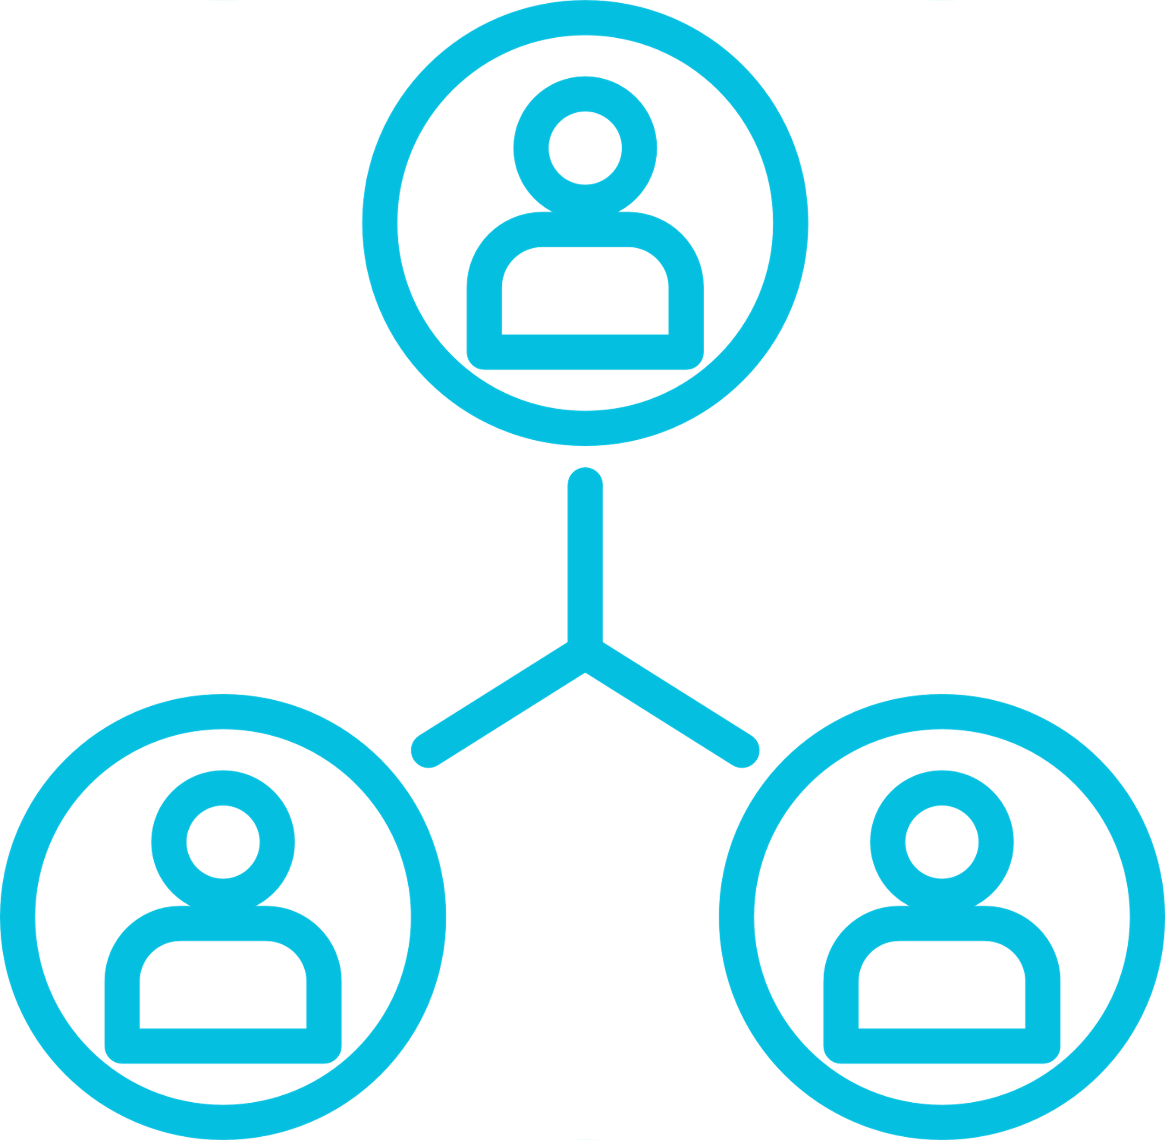

Skill Requirement
Current Team and Skills
3
1
Instructional Designer
4
?
Skillset
Engagement Manager
MS Office
Articulate Storyline
Rise360
Graphic Designer
Skillset
Skillset
Leadership
Project management
Client relationship management
Adobe Photoshop, XD, Illustrator, InDesign
Articulate Storyline, Rise360
Video Animations
PowerPoint presentations
Skillset required for next quarter
1
Functional Quality Analyst
April – June 2025
Skillset
LMS testing
Accessibility testing
Performed WCAG compliance using JAWS reader

Slide 20

Lessons Learned
What has worked well:
Working model: PMI and Aptara working together as a core project team
Time-zone adjustments: Aptara agreeing to flexible work timings for an optimal time overlap with their PMI counterpart
What can make it better:
Schedule dashboard: An overall schedule listing all projects and the people involved for improved talent utilization and risk management
Work pipeline: Greater visibility of upcoming projects for better allocation of talent based on required skillsets
Capabilities: Integrated discussions quarterly or yearly to look at project solutioning options that Aptara can provide
Notes:
Build courses faster, better, richer, and fuller – build courses in faster than before, better (more comprehensive and content-driven) than before, richer (visually rich and highly interactive), fuller (providing a more holistic approach to learning, with the focus

Slide 21
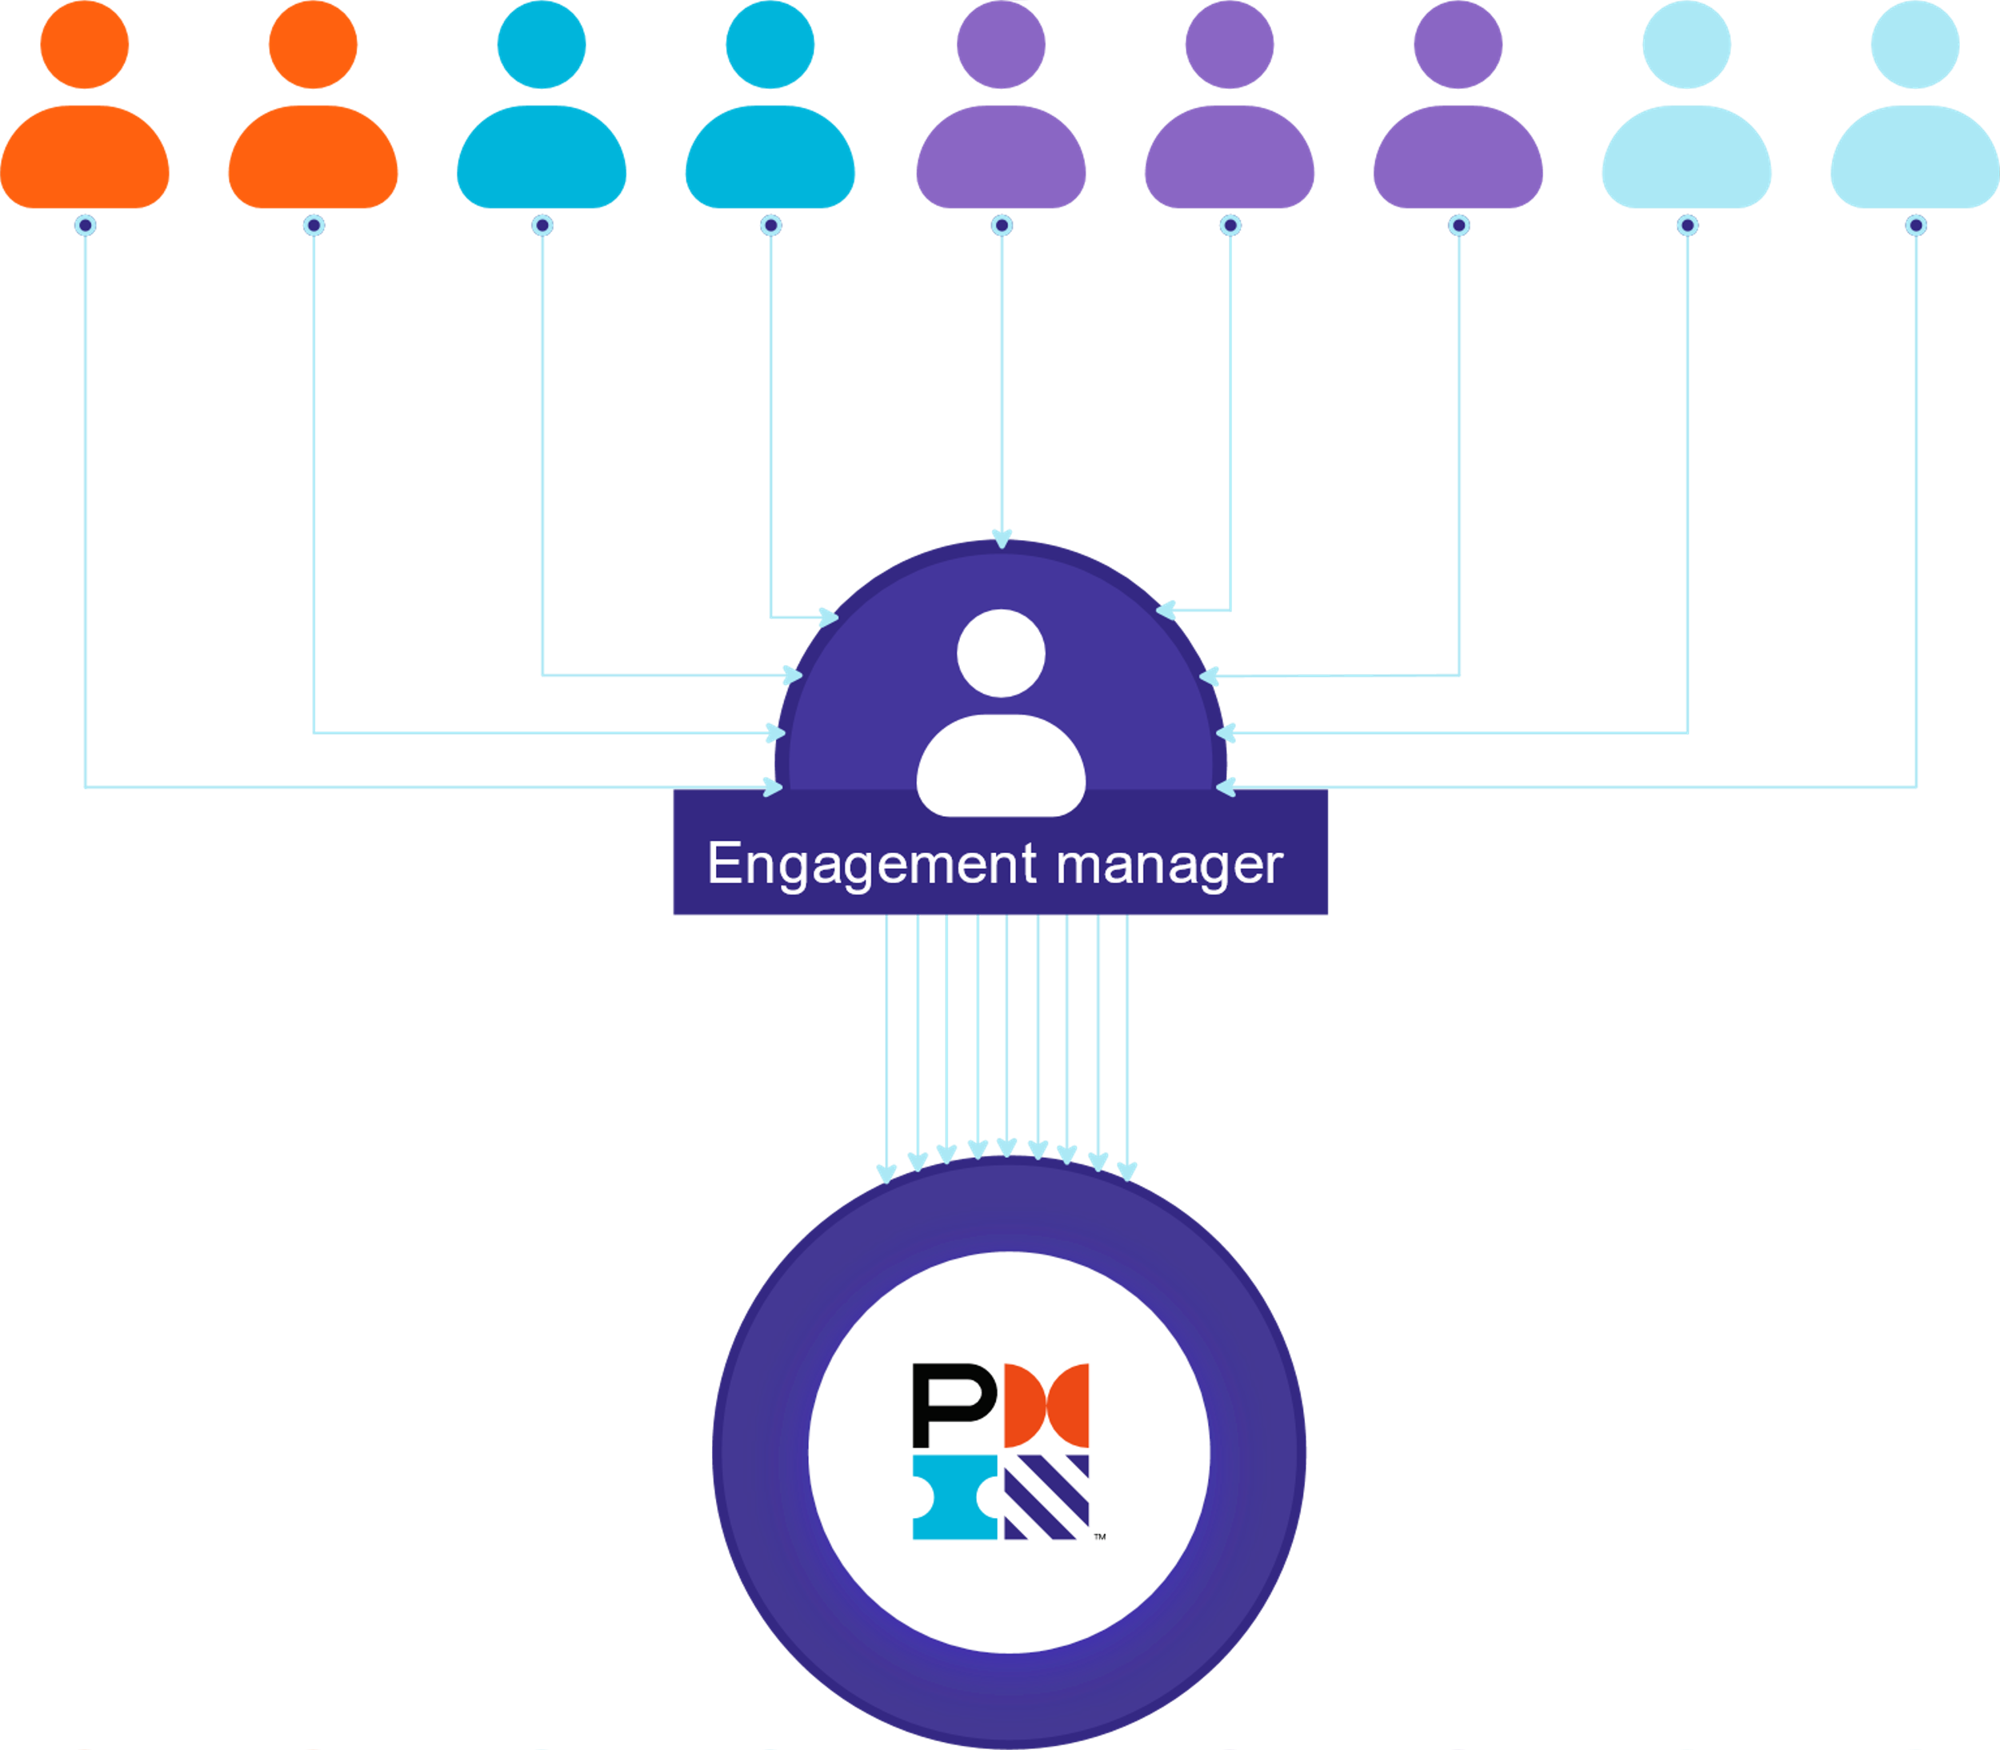
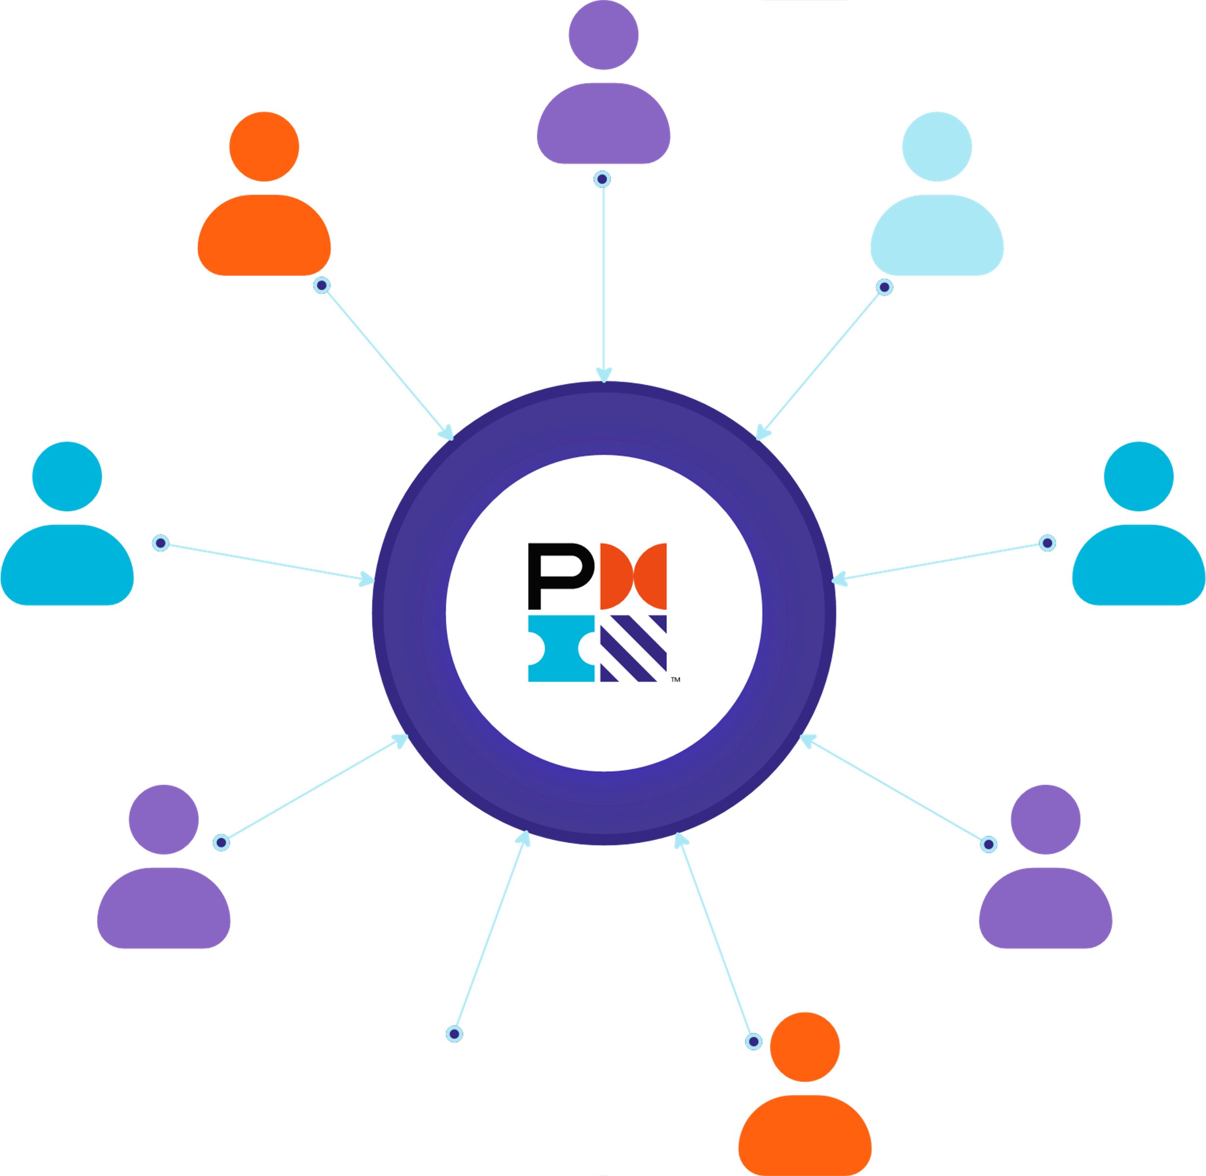

Engagement Model
OLD Engagement Model
A US-based engagement manager liaised between Aptara and PMI for all communication and project-related activities.
NEW Engagement Model
Members from Aptara and PMI are part of the core project team responsible for all decisions and day-to-day activities.

Slide 23

Service Models
MODEL 1
MODEL 2
MODEL 3
CONSULTING
DEVELOPMENT
ONE TEAM
Instructional Designers
Trainers
Tech Writers
Process and Procedures
LMS Consultants
ILT
eLearning
Mobile Apps
Content & Audio Translation
Portals and Application Development
A unique combination of Model 1 and Model 2, providing clients with highly qualified local resources with the cost efficiencies of an offshore team

Slide 24



Aptara Delivery Models
Fixed Bid Engagement
When to choose:
Clear deadlines, detailed specification, short project duration, no major planned changes
Extended Development Team (XDT)
When to choose:
Iterative development, complex projects, long-term collaboration, one team to service multiple business groups
Staff Augmentation
When to choose:
Ongoing project, fill short-term positions or supplement a team on a particular project, specific skillsets needed
Defined scope of the project.
Ideal for small to medium sized engagements.
    Fixed pricing for a defined scope.
    Requirement based staffing as per milestones.
Project completion within budget and timeline assurance.
Well defined milestones and deliverables.
All project details are clearly defined in the statement of work; expectation management can be controlled by the project manager.
Project is managed without excessive supervision on the part of the client.
Good approach if budget approval requires an elaborate or extensive process
Works well as an extension of the current client team.
Multiple options for multi-location or offshore-only teams.
Ideal for iterative development when the project scope is not well defined.
Dedicated team for a specified tenure.
Hourly billing on the resources deployed.
Program management office to manage demand and utilization of team members.
Onshore teams can work from client offices when possible.
Team's capacity can be scaled based on requirements.
Model allows a better knowledge retention leading to time and effort efficiencies.
Client teams are in control of the project, can influence the process, and stay involved at all stages.
Existing teams and supplemented teams work as a solid mechanism. Individuals align with the teams more effectively and quickly compared to external teams.
Additional team members fill skillset gaps in the existing team .
It is easy to scale the team to match demand.
Smaller learning curve since the added team members are specifically hired for pre-existing skillsets.
Depending on the nature of the project, in-house teams can work well with supplemented staff due to a combination of tacit knowledge and supplemented skillsets rather than a fully outsourced project team
This engagement model works well for pre-defined scope and deliverables as compared to iterative development.
Approval of new features may take longer and can potentially delay the development process.
A fixed-price contract demands in-depth planning. Developers need to prepare risk mitigation plans in detail.
Absence of well-defined specifications can lead to mismatched expectations.
Defining project specifications is critical for project success.
The model allows for iterative development and flexibility in scope and timelines.
The product owner needs to manage the creative process for iterations as well as the overall development process.
Timelines need to be managed with phased releases to account for unpredictably.
Design level specifications need to be monitored for each phase. Some features or design elements that were originally planned are no longer relevant based on interim UAT.
Supplemented staff will still need to be trained to follow internal processes and embrace the company culture.
New team members may not perform at expected levels; some time may be spent in adjusting new team members into the project and team.

Slide 25



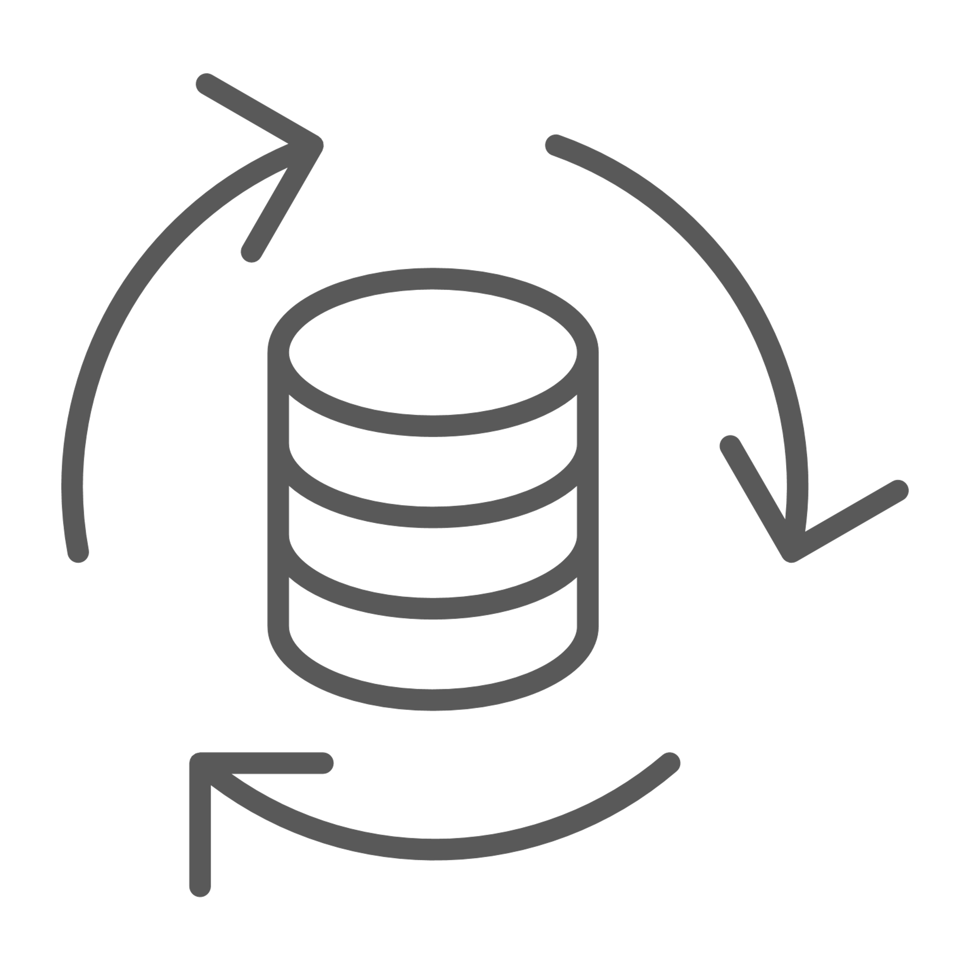


Aptara’s Content Solutions
At Aptara, we specialize in end-to-end Custom Content Services across a wide range of industry domains and topic areas. Our strength lies in creating tailor-made training solutions that precisely meet the unique needs and objectives of our clients.
Our team of experienced instructional designers, subject matter experts, and multimedia specialists collaborate closely with our clients to develop highly engaging and effective training programs from scratch. These programs are designed to meet your various learning needs.
Our training offerings include:
Mobile Apps
Video-Based Learning
ILT and vILT
Content Migration
Content Localization
Application Simulations
On-the-go learning freedom and flexibility
Just-enough, just-in-time, just-for-me learner-centric approach
Enhanced collaboration and social connect
Learner preferences clearly toward “on-the-go” videos
Cost-effective and time-saving
Effective and efficient
Accommodates different learning styles
High learner attention and engagement
Traditional ILT remains indispensable in learning kinesthetic skills
vILT is one of the fastest growing synchronous learning delivery mode that:
  Saves training cost
  Removes location barrier
  Increases training capacity and scalability
  Brings learner diversity and collaboration
eMigration is the transformation of learning content from classroom and paper-based formats to online, interactive, globally accessible, and highly reusable media
It typically involves redeveloping course material for optimum effectiveness in the new delivery channels
Localization expands audience reach and improves knowledge retention
Effective learning requires audience understanding
For multilingual audiences, eLearning localization is essential
Accurate and culturally appropriate translation is crucial for comprehension and retention
Watch-Try-Do simulations help practice and gain hands-on experience
Faster skill gain through experiential learning
Increased work efficiency
Improved processes
Reduced training cost and duration

Slide 26






Aptara’s Content Solutions
Our training capabilities aim at providing enhanced learner experiences and flexibility. Our training solutions enable organizations to provide continuous learning opportunities, track learner progress, and maintain consistency in training initiatives while offering cost efficiency and scalability.
Our training solutions prioritize the use of current and emerging learning technologies to effectively respond to the evolving demands of our industry, ensuring an enhanced and engaging learning experience.
Our training offerings include:
Business Simulations
Gamification
Microlearning
Adaptive Learning
Artificial Intelligence
AR/VaR
  Mirrors the dynamic real-world settings
  Experiential learning without any risk
  Effective in strategic thinking, decision-making, problem-solving, financial or market analysis, operations, teamwork, and leadership
  More engaging and challenging interactivities
  Increased learner motivation
Learning games are based on constructivism. The power of play brings in:
  Immersive and autonomous learning experience
  Learning from failures
  Higher learner motivation and engagement
  More confidence on the abilities gained
Learning using self-contained, small chunks or bits of learning assets can cater to:
Just-in-Time Learning
Contextual Learning
Adaptive Learning
Social Learning
Organic Learning
One-size-fits-all never works with learning
Mandatory certification and refresher trainings have become a great burden for many organizations
Leveraging on adaptive learning can dynamically personalize training
Needs analysis and Gen AI readiness consulting
AI-based learning transformation
AI in development and efficiencies
Use of AI-generated media and AI-based chatbot for higher learner engagement
Content summarization, quiz generation, and translation support for rapid development
Higher learner engagement
Real-world application
Adaptive learning
Analytics and performance tracking
Encourages collaboration and teamwork
Accessibility and inclusivity

Slide 27
Rate Card
WBT Level | Cost Range (USD) for 15 Minutes of WBT
 | Single Orientation HTML5 | Rapid Authoring Tool
Level 1 | $2,240-$2,560 | $1,540-$1,760
Level 2 | $3,080-$3,520 | $2,380-$2,720
Level 3 | $5,180-$5,920 | $3,220 - $3,680
Virtualization Level | Unit (mins) | Cost Range (USD)
Webinar/Classroom Video to WBL | 60 | $1,785 - $1,945
ILT to vILT (Existing) | 60 | $2,260 - $2,420
Microlearning | 10 | $7,488 - $8,232
Microsimulation | 15 | $11,042 - $12,131
Interactive Flipbook (20-25 pages) | 30 | $13,151 - $14,596
Animation Video | 5 | $14,767 - $16,333
Gamification/Gamified Assessment | 10 | $16,400 - $18,200
Infographic | 5-10 | $2,260 - $2,420
WBT Level | Cost Range (USD) for 30 Minutes of WBT
 | Single Orientation HTML5 | Rapid Authoring Tool
Level 1 | $3,080-$3,520 | $2,380-$2,720
Level 2 | $4,200-$4,800 | $3,640-$4,160
Level 3 | $7,840-$8,960 | $4,760 - $5,440
WBT Level | Cost Range (USD) for 60 Minutes of WBT
 | Single Orientation HTML5 | Rapid Authoring Tool
Level 1 | $4,480-$5,120 | $3,500-$4,000
Level 2 | $6,440-$7,360 | $5,460-$6,240
Level 3 | $11,900-$13,600 | $7,000 - $8,000
Notes:
*Cost includes the cost of content gap/need analysis, content gathering, and detailed design or content roadmap (CRM) by our onshore US-based Learning Consultant (LC). For vILT, the design cost also includes the cost of creating vILT presentation decks and other deliverables by our LC.
**Cost includes the cost of storyboarding, development of Alpha, Beta, and Gold versions of learning materials by our offshore development teams along with the narration voice over audio, as applicable.
Note: The pricing doesn’t include the cost of recording of audio.
Scenario | Tasks | Cost (USD)
 |  | Level 1 | Level 2 | Level 3
Content Translation | Translation of content of 1 WBT Module (1 hour) | $2,500 - $4,000
Audio Translation | Audio recording of 1 WBT Module (1 hour) | $1,700 - $2,500
Content and Audio Integration (HTML5) | Integration of content for 1 WBT Module (1 hour) | $1,000 | $1,500 | $2,000

Slide 28

Professional Services Rates
RESOURCES / EXPERTISE | OFFSHORE HOURLY BILL RATE | ONSHORE HOURLY BILL RATE
Program / Project Managers |  | $90 - $150
Instructional Designers | $27 | $75- $95
Instructional Designer Lead | $30
Graphics Designers | $30 | $70
Quality Analyst | $28
Engagement Manager |  | $95
Course Developer | $20-$22 | $65 - $75
Technical Writers | $20-$22 | $55 - $90
eLearning Developer | $20-$22 | $65 - $85
Learning Coordinators | $16-$18 | $40 - $55
Trainers | $30-$35 | $55 - $80 (Plus travel)
Specialty Trainer | $40-$55 | $95-$150 (Plus travel)
Facilitators | $40-$55 | $95-$150 (Plus travel)
Organizational Development Consultants | - | $90 - $150
LMS Support | $14-$25 | $35- $50
Subject Matter Experts | $35-$65 | $95-$150

Slide 29






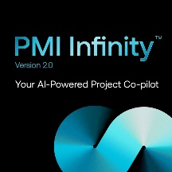



Tools and Technology
CAPM
ACP
PMI-RMP
PMO-CP
Storyboards: MS Word
eLearning development: Storyline
Audio: WellSaid Labs
Video: RenderForest
ILT deck: MS PowerPoint
Scripts/storyboards: MS Word
Video: Adobe AfterEffects
eLearning development: Storyline
Audio: WellSaid Labs
Video uploads: Vimeo
Project management: Miro
ILT deck: MS PowerPoint
Scripts, workbook: MS Word
Real-person AI generated audio and video: Synthesia
eLearning development: Storyline
Video uploads: Vimeo
Project management: Smartsheet
Content support, assessments: PMI Infinity
Content editing: Writer
ILT deck, visual storyboards: MS PowerPoint
Scripts, participant guide: MS Word
eLearning development: Storyline
Video: Adobe AfterEffects, Final Cut Pro
Audio: WellSaid Labs, Elevenlabs
Project management: Trello, Miro

Slide 31

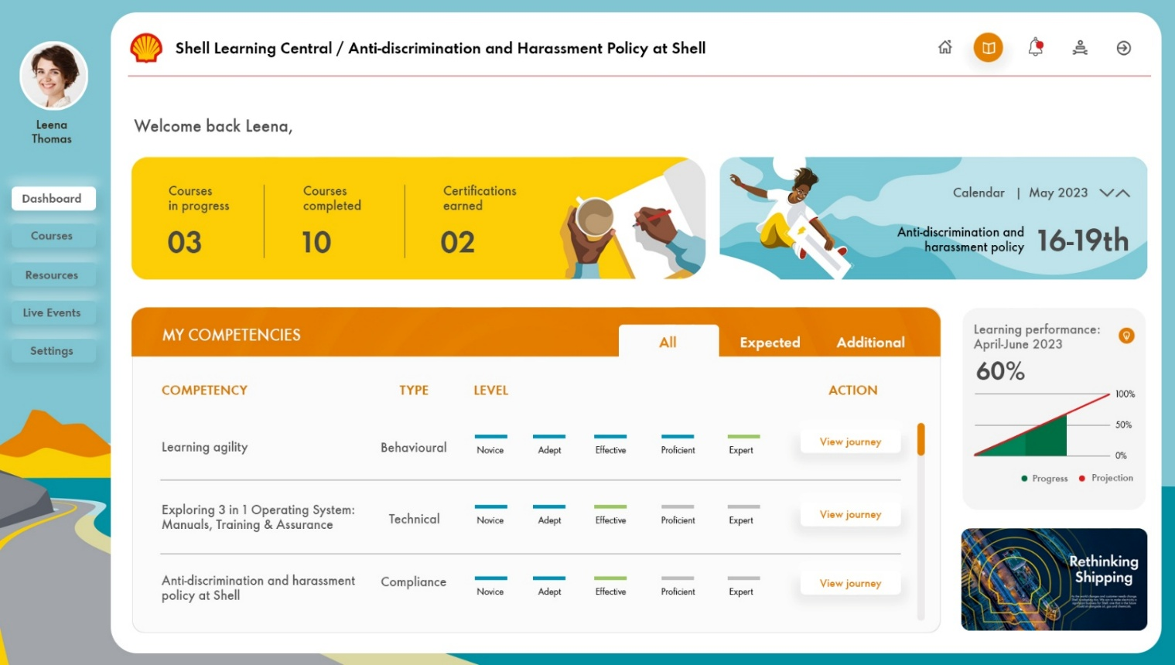
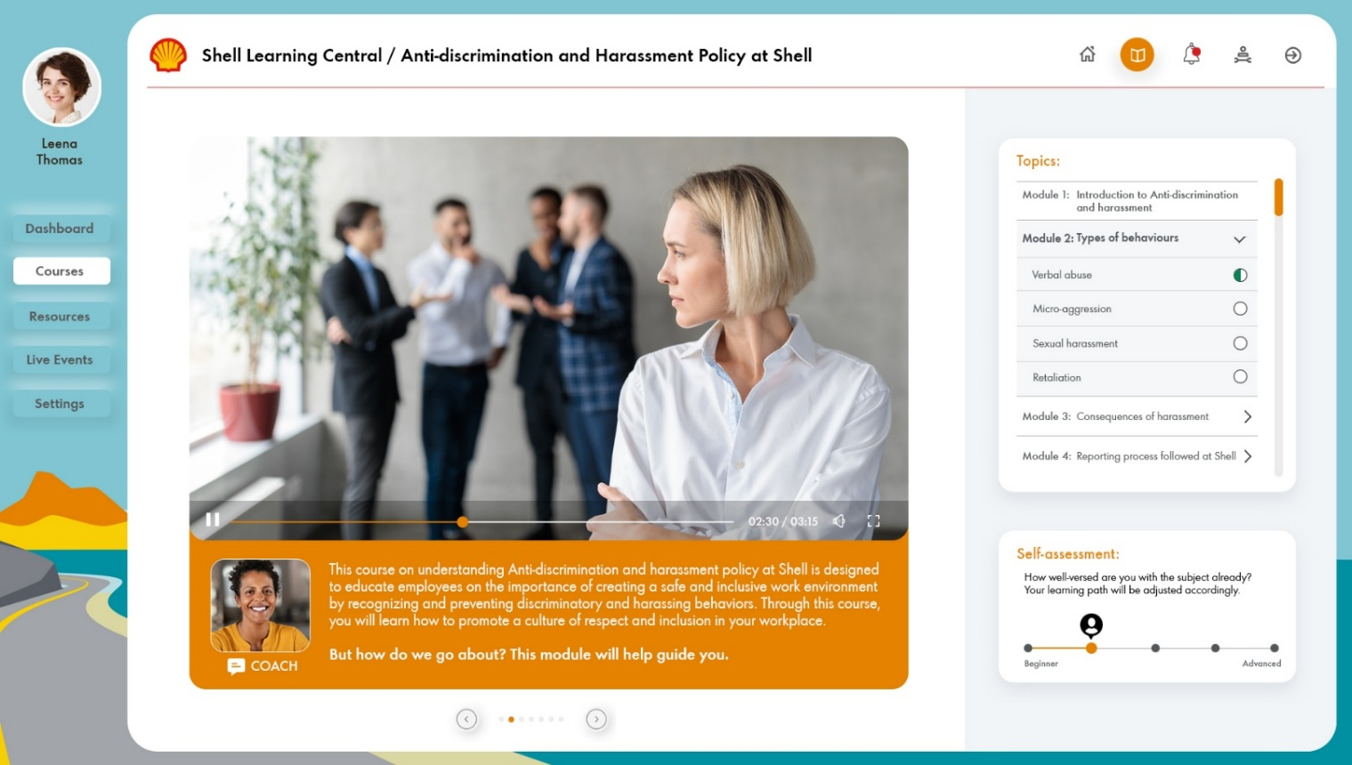
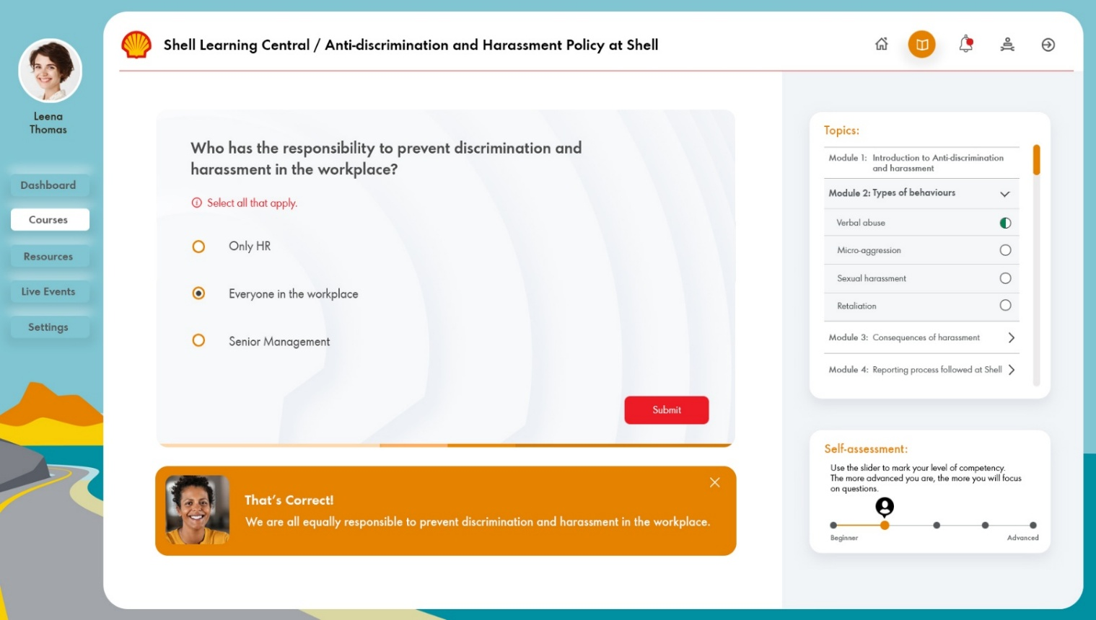
Shell Learning Portal Redesign
Notes:
Show 2 options

Slide 32
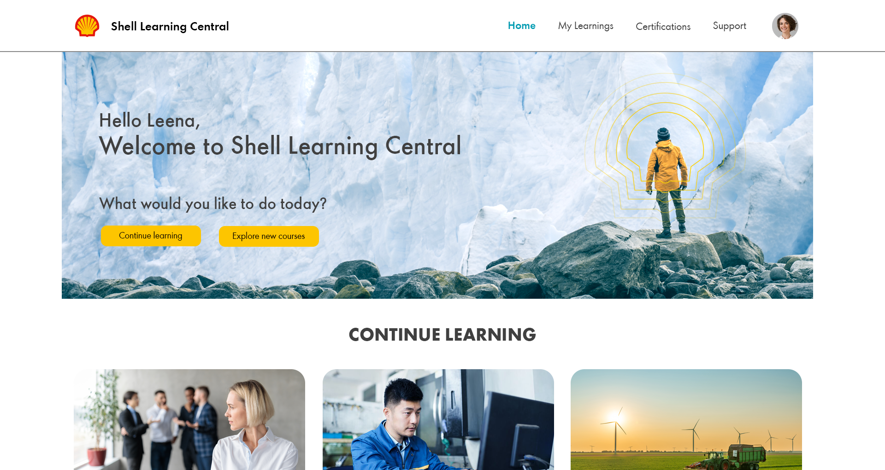
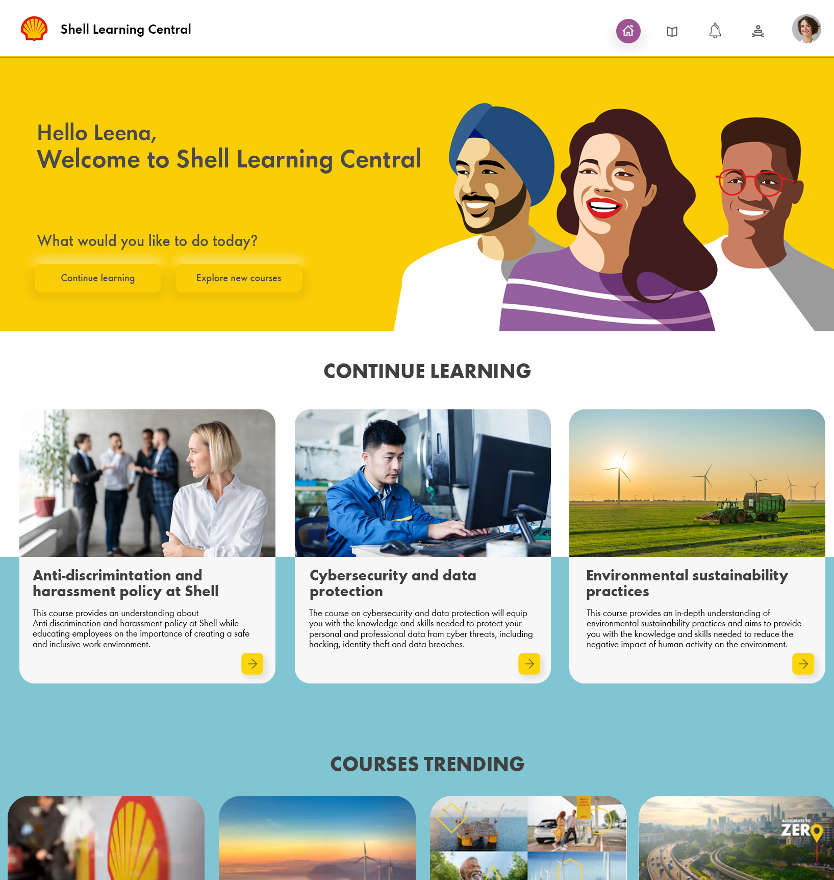
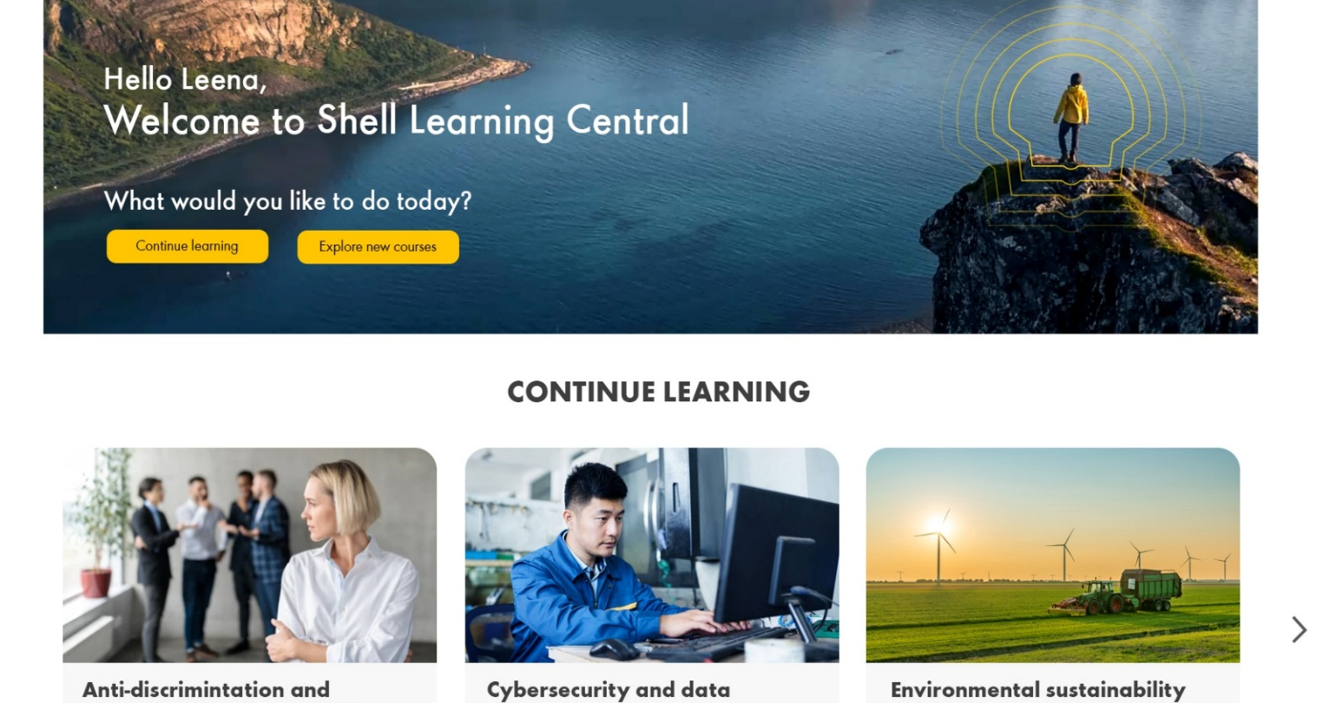
Shell Learning Portal Redesign

Slide 33
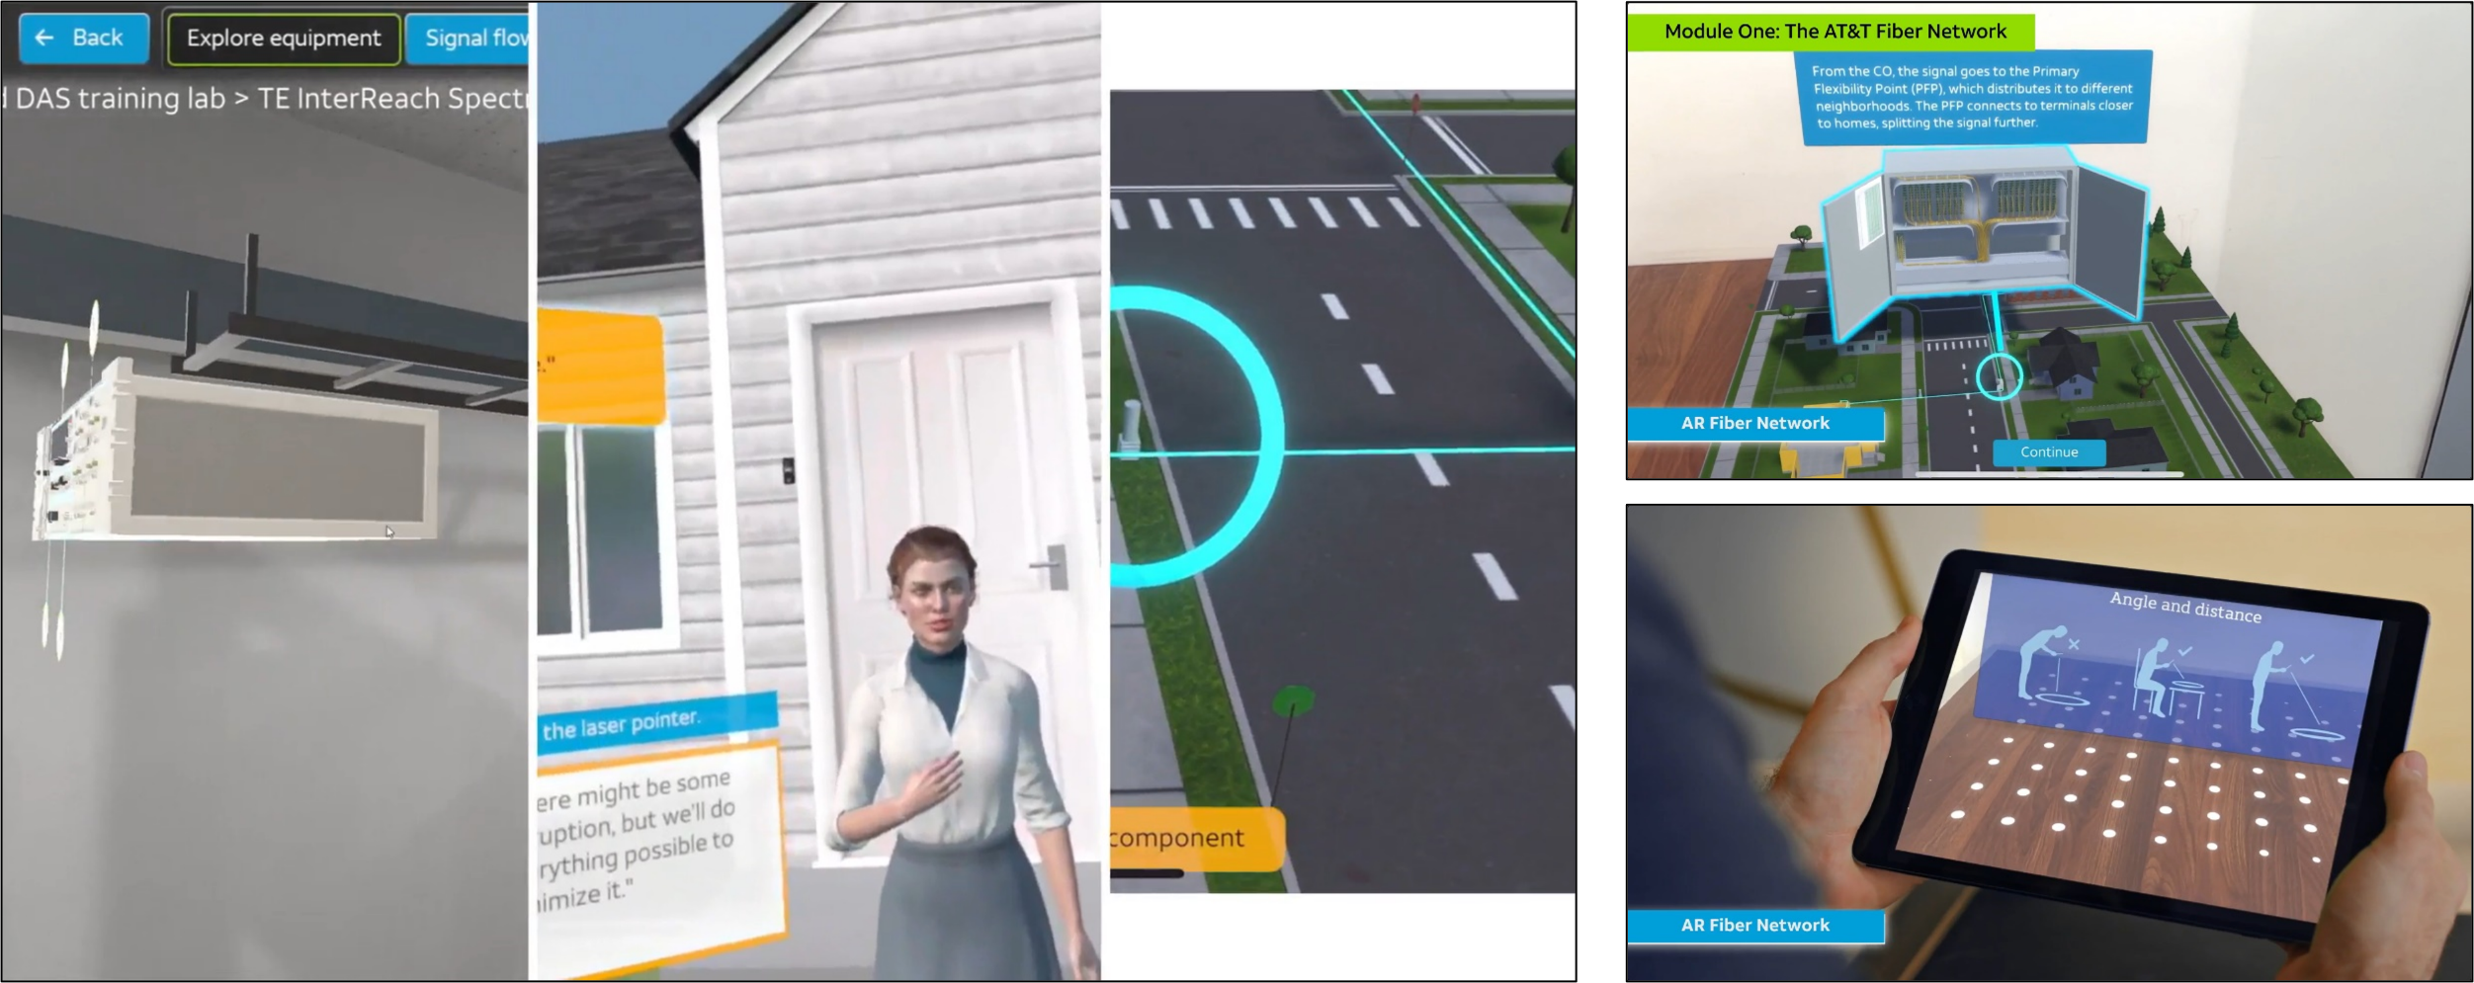
Emerging Technologies—XR-Based Learning
VIEW DEMO

Slide 34
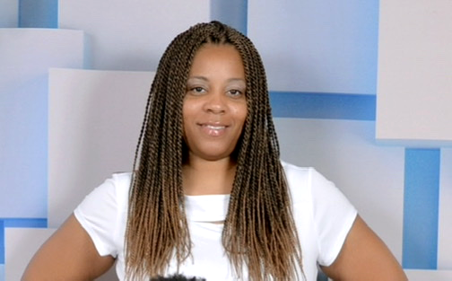
Utilization Report 2025
Keisha Raines
Nilashree Das
Arun Prakash
Joyce
Chacko
Engagement Manager
Instructional Designer
Instructional Designer
Instructional Designer
96%
84%
87%
87%
Available hrs.
d
Available hrs.
Actual hrs.
Available hrs.
Actual hrs.
Available hrs.
Actual hrs.
Core Team

Slide 35
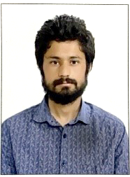

Utilization Report 2025
Stephanie Yasko
Kamar Hussain
Deepak
Choudhary
Nana Tupe
Graphic Designer
Graphic Designer
Graphic Designer
Graphic Designer
96%
91%
92%
97%
Available hrs.
Actual hrs.
Available hrs.
Actual hrs.
Available hrs.
Actual hrs.
Available hrs.
Actual hrs.
Core Team

Slide 36
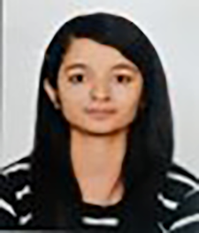
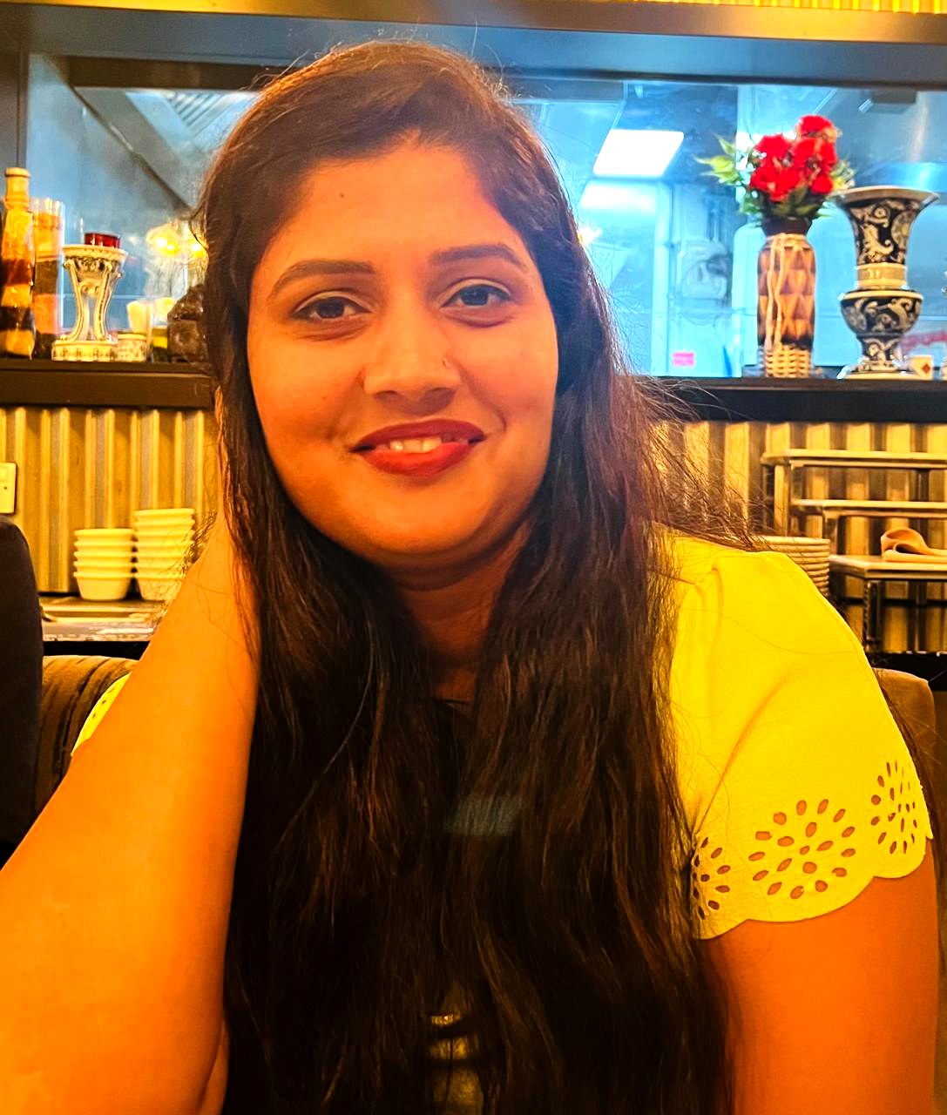
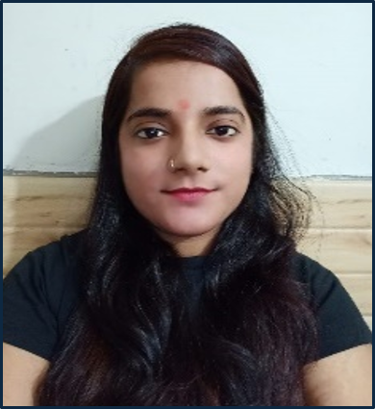
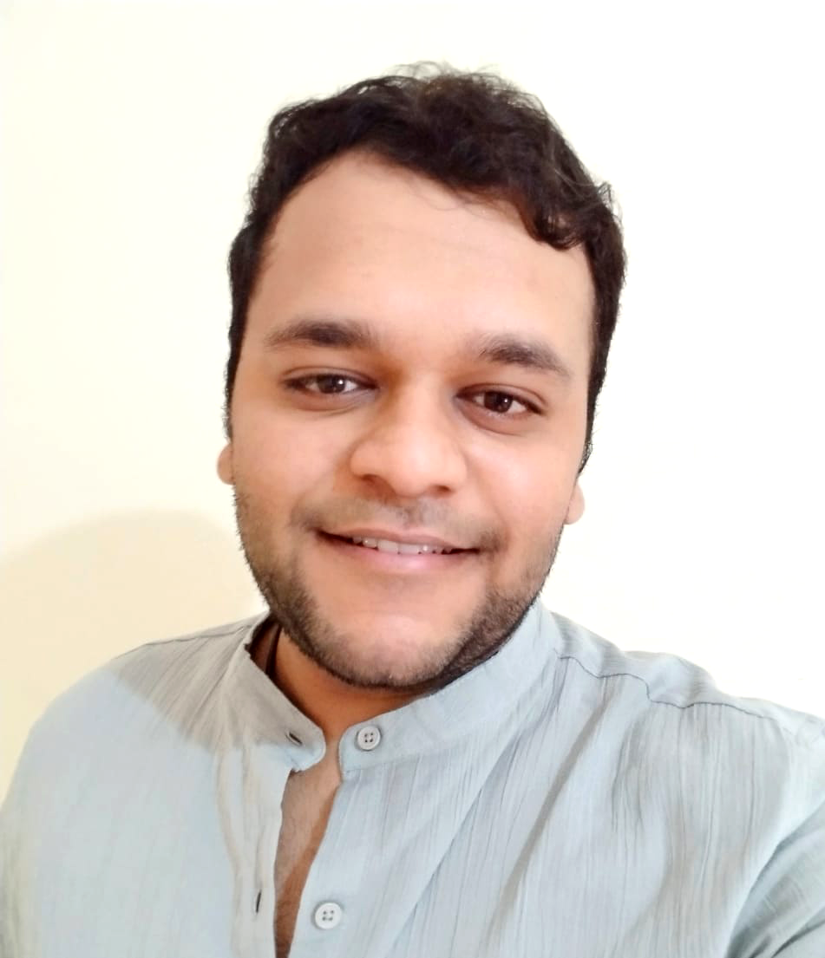
Utilization Report 2025
Priyanka Pandey
Ashwini Dhumal
Neha Sharma
Ajinkya Dambelkar
Functional Quality Analyst
Functional Quality Analyst
Graphic Designer
Graphic Designer
68%
65%
90%
94%
Available hrs.
Actual hrs.
Available hrs.
Actual hrs.
Available hrs.
Actual hrs.
Available hrs.
Actual hrs.
Core Team
Flex Team

Slide 37
Invoicing Data
Oct – Dec 23
Jan – Mar 25
Jan – Mar 24
Apr – Jun 24
Jul – Sep 24
Oct – Dec 24
Jul – Sep 23
Notes:
Period
SOW Value
Invoice Value
July 2023 to June 2024
$753,600
$633,364
July to Dec 2024
$475,200
$328,346
Jan to Mar 2025
$210,168
$197,032
Total
$1,438,968
$1,158,742

Slide 38
Invoicing Data
Total SOW Value
(Jul 23 – Mar 25)
$1,438,968
Value (USD)
Core team Invoice Value (Jul 23 – Mar 25)
$1,131,942
Flex team Invoice Value (Jan 25 – Mar 25)
$26,800
Notes:
Period
SOW Value
Invoice Value
July 2023 to June 2024
$753,600
$633,364
July to Dec 2024
$475,200
$328,346
Jan to Mar 2025
$210,168
$197,032
Total
$1,438,968
$1,158,742

Slide 39
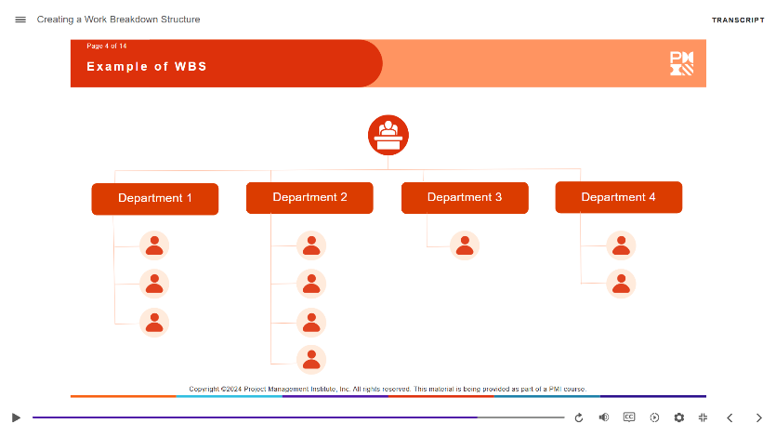
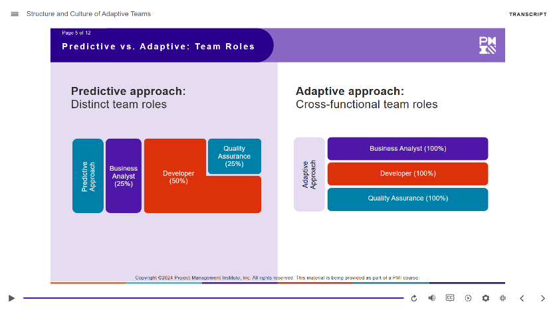
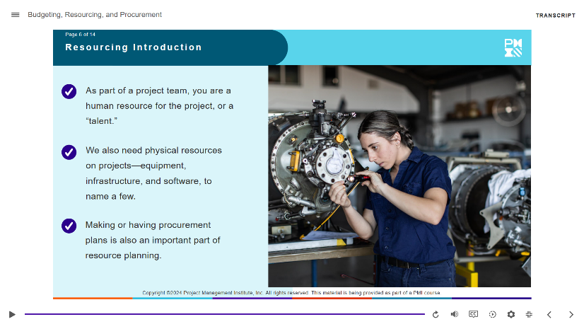



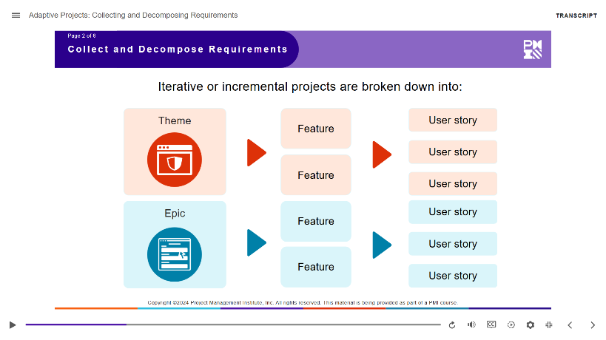
Challenges and Proposed Solutions
Project name:
CAPM
What the challenge was
Because of the time difference, Aptara and PMI initially communicated with each other via a US-based engagement manager. Aptara was assigned tasks but were not involved in the overall design, approach, or day-to-day planning of the project.
Process improvement
What was done: Members from Aptara became part of a talent pool. PMI would pull in the relevant talent based on their requirement. The talent would then become a part of the core project team, involved in all project-related activities and decisions.
How it helped: This enabled a more open and collaborative partnership between PMI and Aptara.

Slide 40
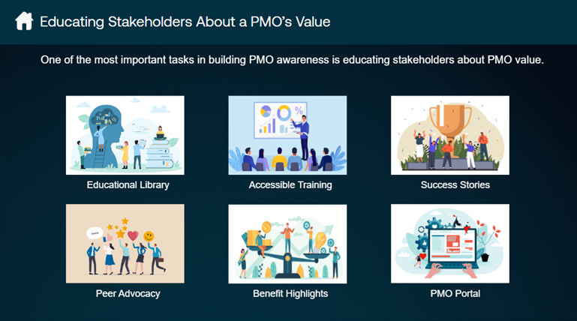
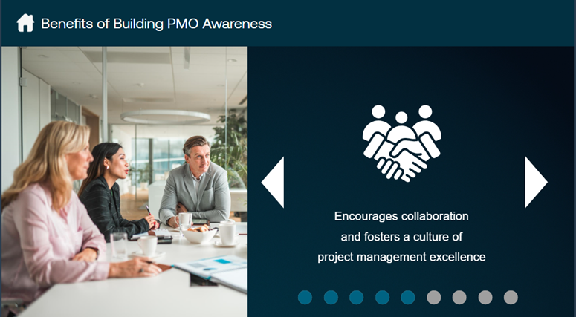
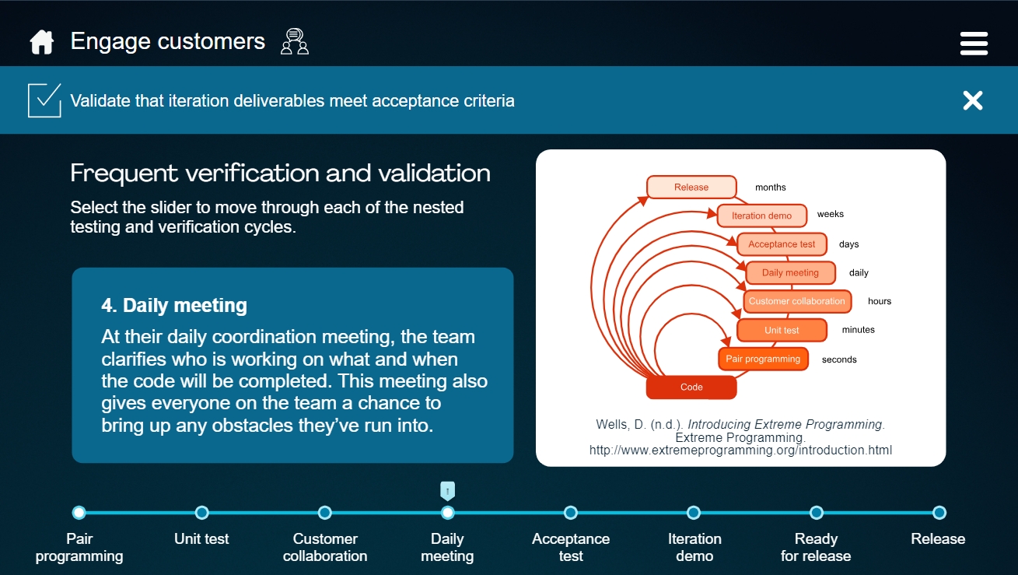
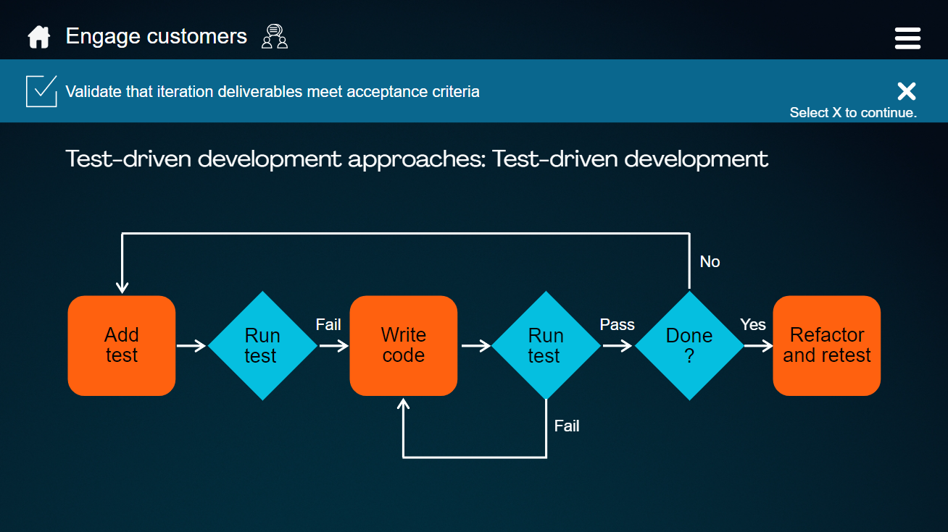
A Snapshot
Notes:
Screenshot info:
Top left and right: PMO-CP
Bottom left and right: ACP

Slide 41
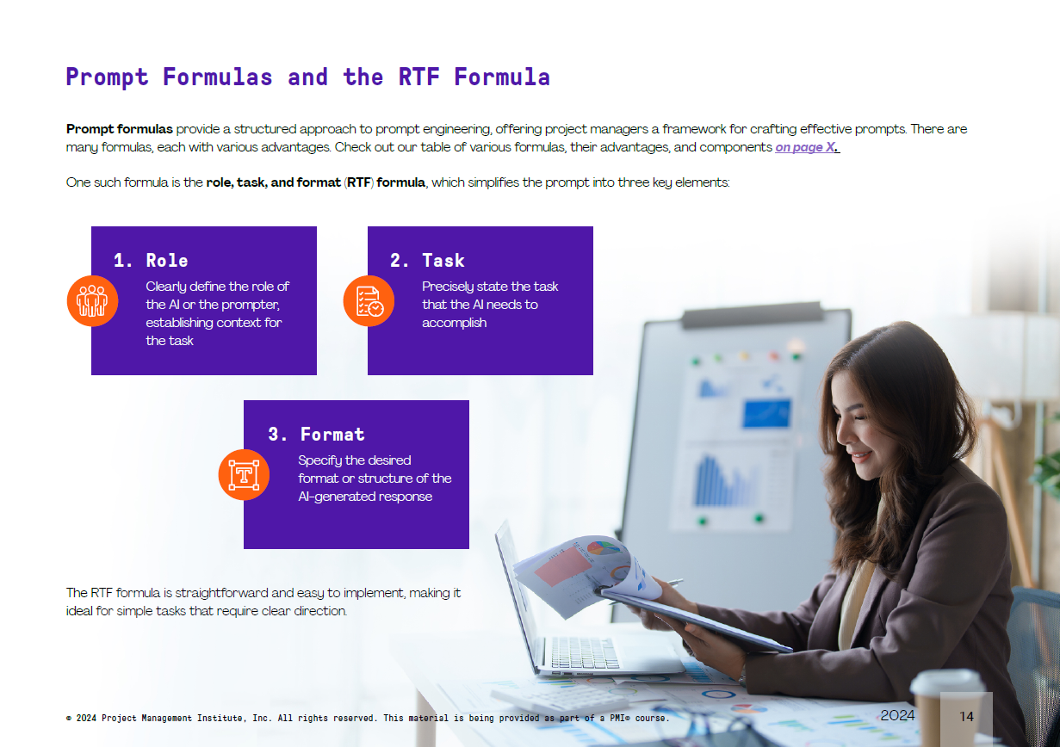
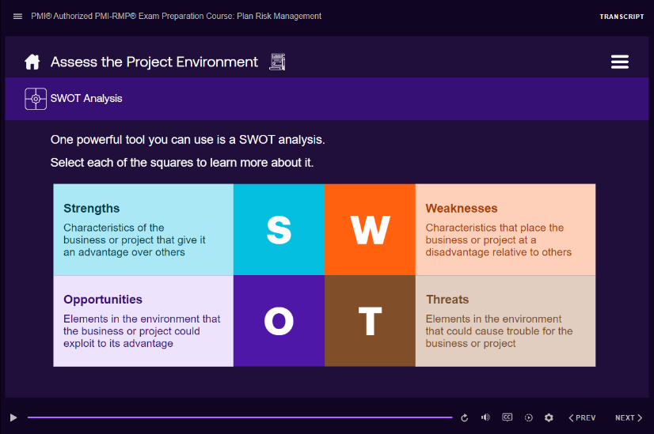
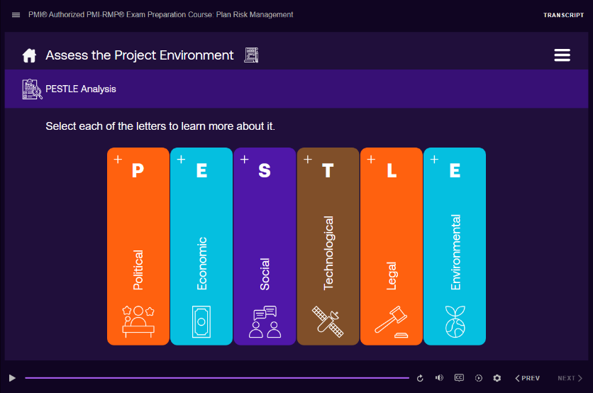
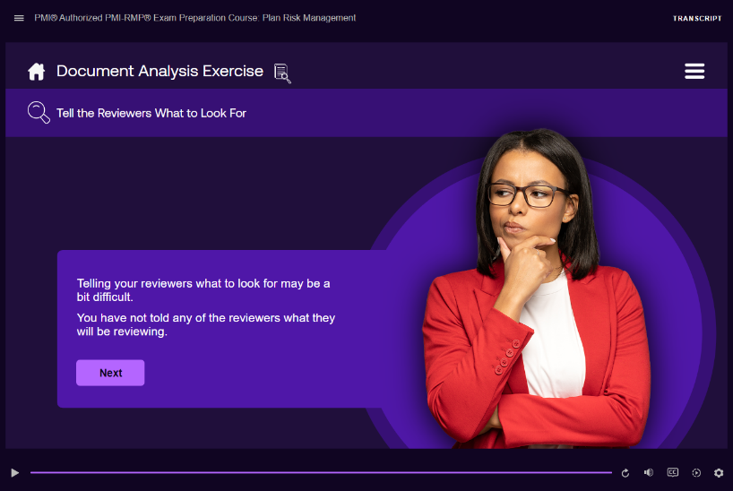
A Snapshot
Notes:
Screenshot info:
Top left: GenAI workbook
Rest: RMP

Slide 42
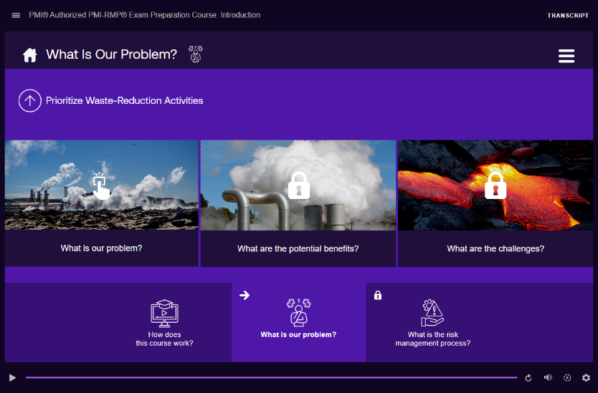


Challenges and Proposed Solutions
Project name:
PMI-RMP
What the challenge was
Learners felt that the earlier PMI-RMP course didn’t cover the subject in depth.
They also felt it didn’t help them apply concepts in their respective fields.
Learning strategy innovation
What was done:
A new, more in-depth content was created using the ECO as a framework and PMI knowledge base as references.
A problem-based course was designed. Each major section was preceded and followed by a complex scenario. The preceding scenario set the stage for the learning content while the end scenario allowed learners to apply their newly acquired knowledge.
How did it help:
Learners were provided a highly informative course material, beyond what was included in the Practice Guide
Learners had access to problem-based scenarios and job aids that they could use in their own projects.

Slide 43

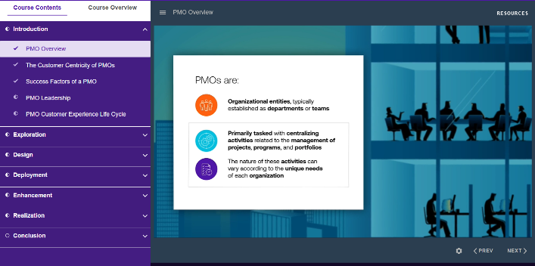
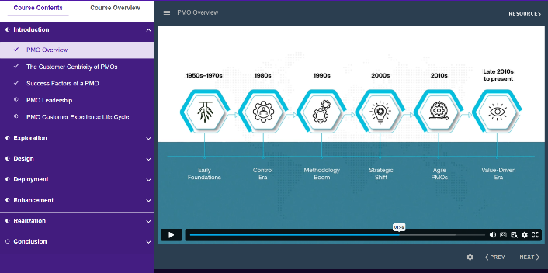

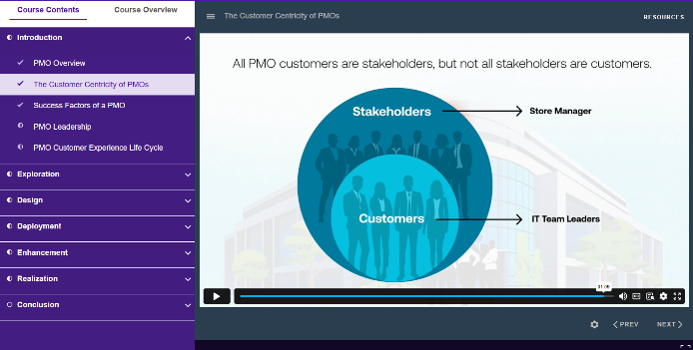
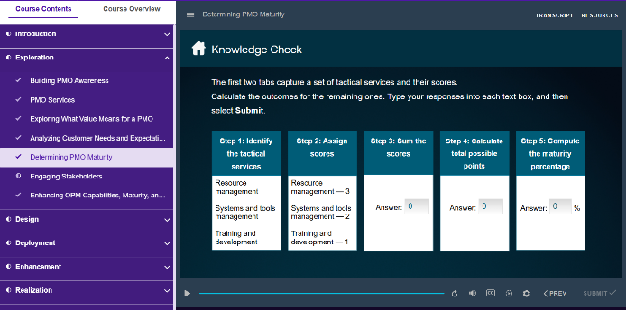
Challenges and Proposed Solutions
Project name:
PMO-CP
Challenge
Improved utilization of limited resources
The Practice Guide and ECO didn’t exactly map to each other.
There were frequent updates to the Practice Guide during development.
Review from PMI members outside the core team wasn’t possible as the PMO methodology was new.
SMEs were available for review for a limited timeframe.
We mapped ECO tasks to sections of the Practice Guide to ensure related topics were clustered together and content was thoroughly covered.
We introduced a version-control tracker and paused media development until key content areas were stabilized.
The team frequently checked-in, maintaining decision logs to track why certain content choices were made.
We researched available materials and external sources to draft content, which was then reviewed and validated by SMEs.
How it helped:
We created a course on a new methodology that received accolades from SMEs across the globe.
With version trackers and decision logs, we ensured that the content stayed true to the ECO and PMI references.

Slide 44
Improvement Suggestion for Next Quarter
Project name:
Overall Planning and Project Resourcing
Challenge
There is a lack of overall plan for project schedule and talent availability. A dashboard that can provide a bird’s eye view of the schedule and talent requirement would be useful.
Improvement
PMI is currently working on creating the plan.

Slide 45
Thank You

