Slide 1

HTML5 development Samples
Portfolio
Nilesh Bhalerao
Web Designer

Slide 2

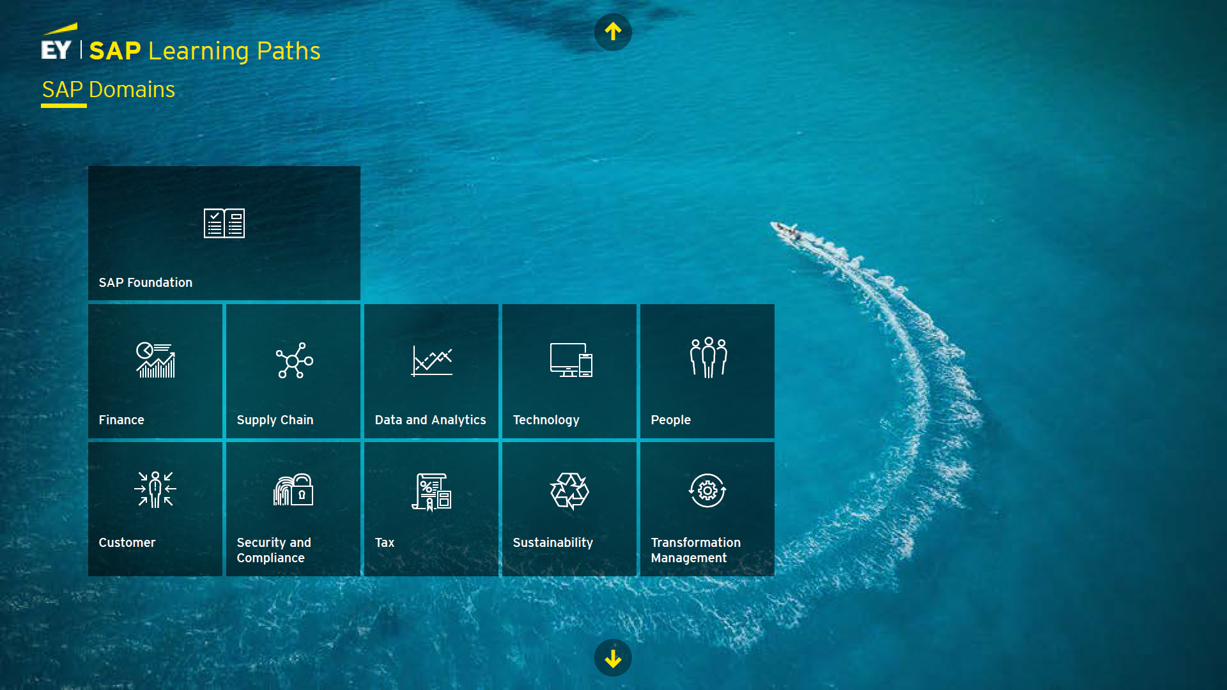



Course Catalog page for EY
EY SAP Learning Paths
HTML Integration:
Fully responsive layout built using HTML5, angular and CSS ensured optimal rendering across desktops, tablets, and mobiles. CSS3 media queries and grid systems ensured it scales cleanly across enterprise devices.
In design
HTML5, Angular & CSS
Responsive
Design

Slide 3
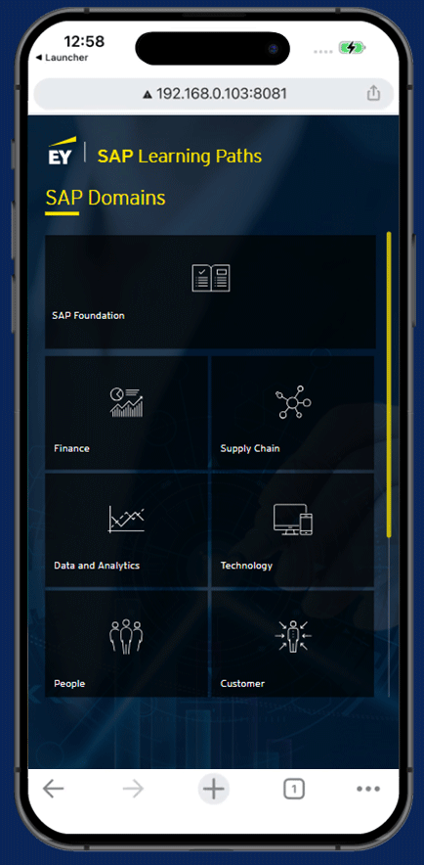
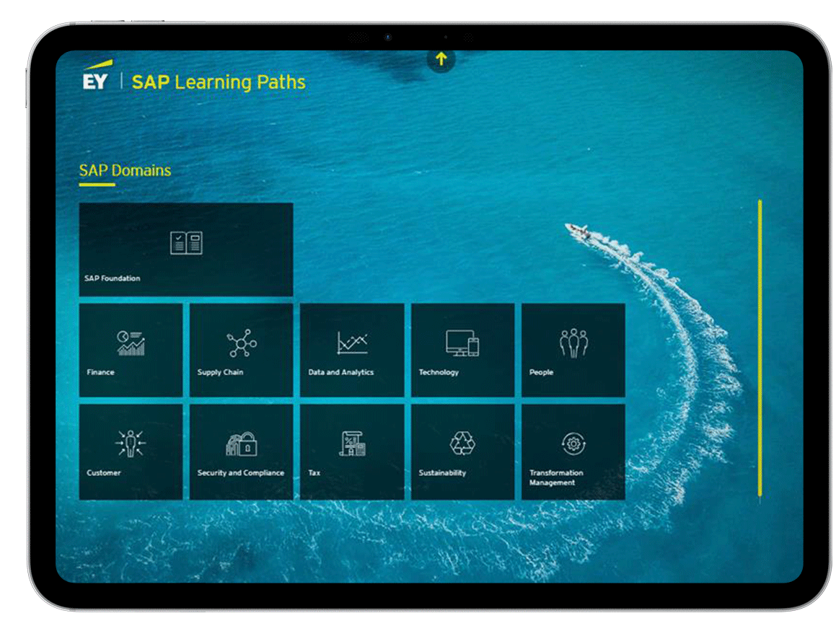
Course Catalog page for EY

Slide 4
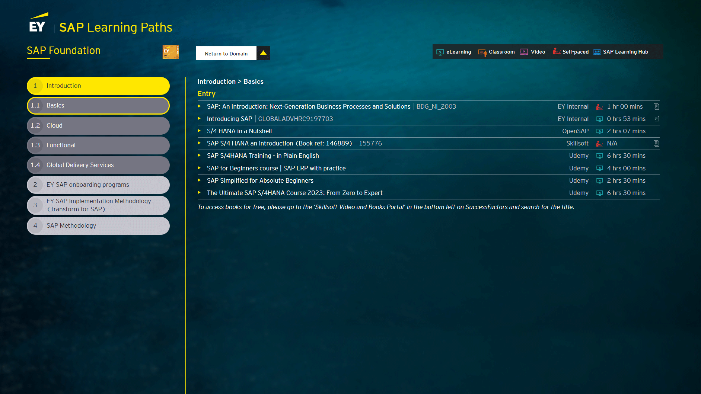
Course Catalog page for EY

Slide 5
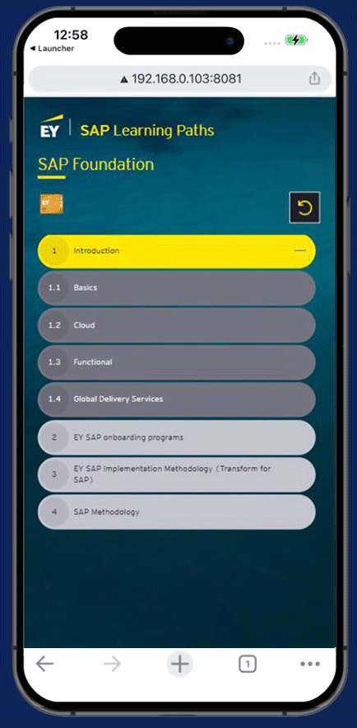
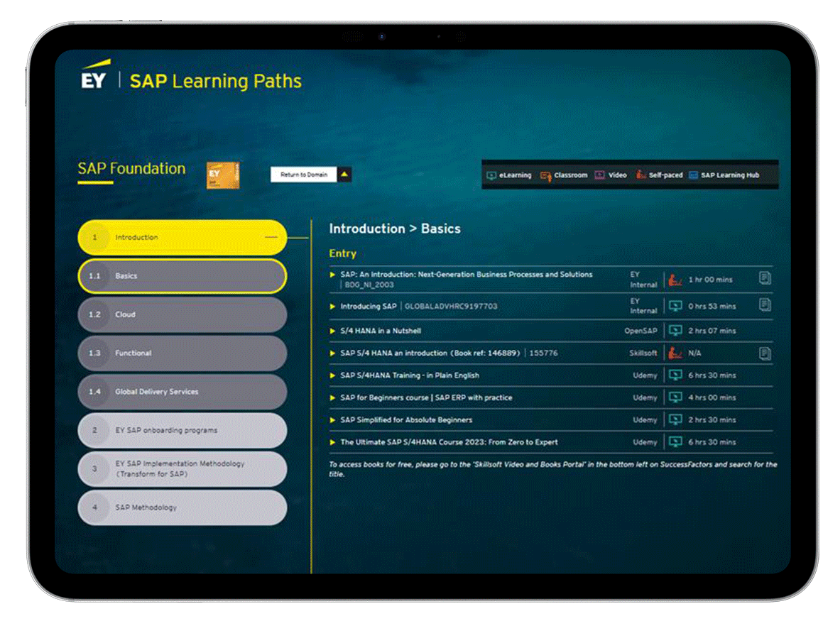
Course Catalog page for EY

Slide 6
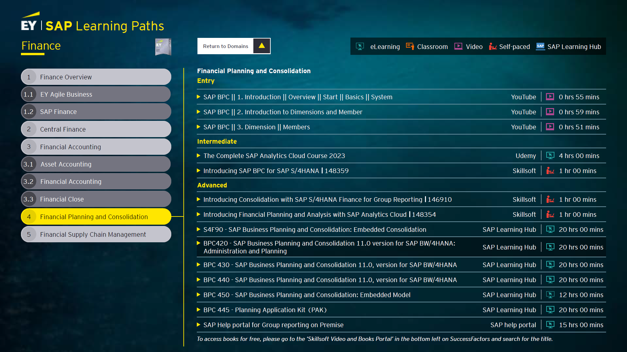
Course Catalog page for EY

Slide 7
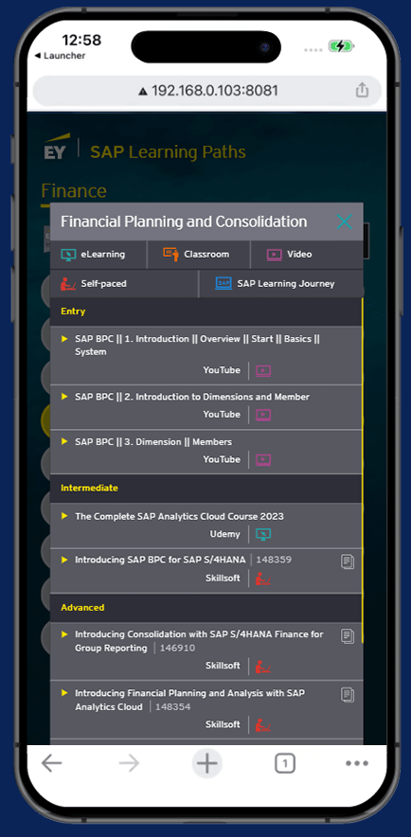
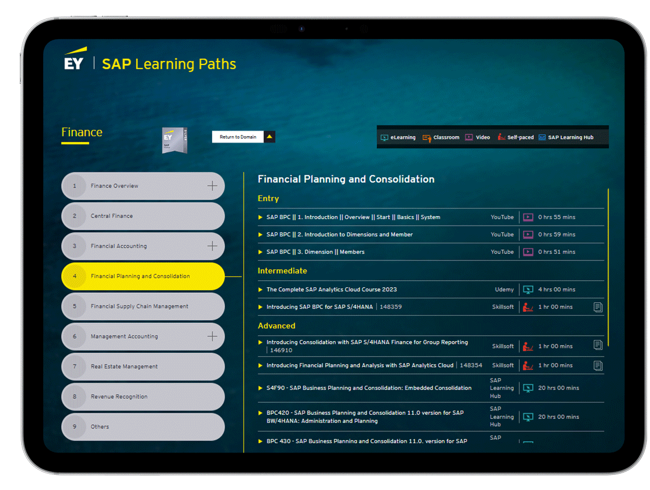
Course Catalog page for EY

Slide 8
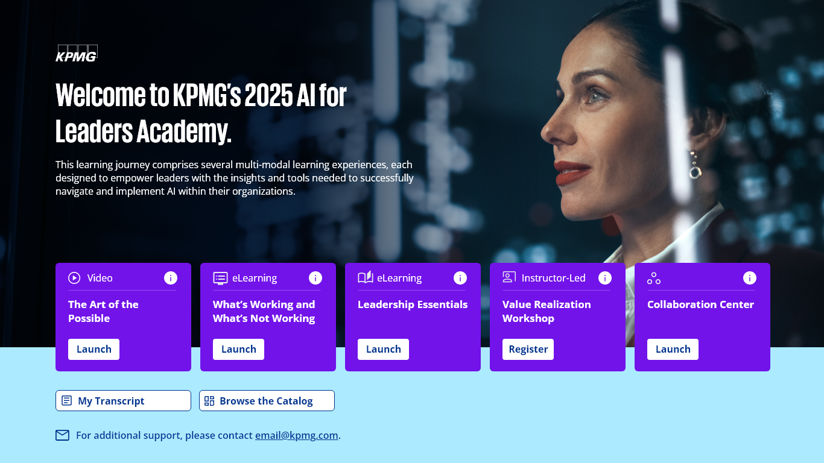

Course Catalog page for CSOD
KPMG AI for Leaders Academy
HTML Integration:
Custom HTML5, JavaScript and CSS was used to develop
This page was custom created in the Cornerstone LMS
Adobe
XD
HTML5 & CSS
Responsive
Design

Slide 9
Course Catalog page for CSOD

Slide 10
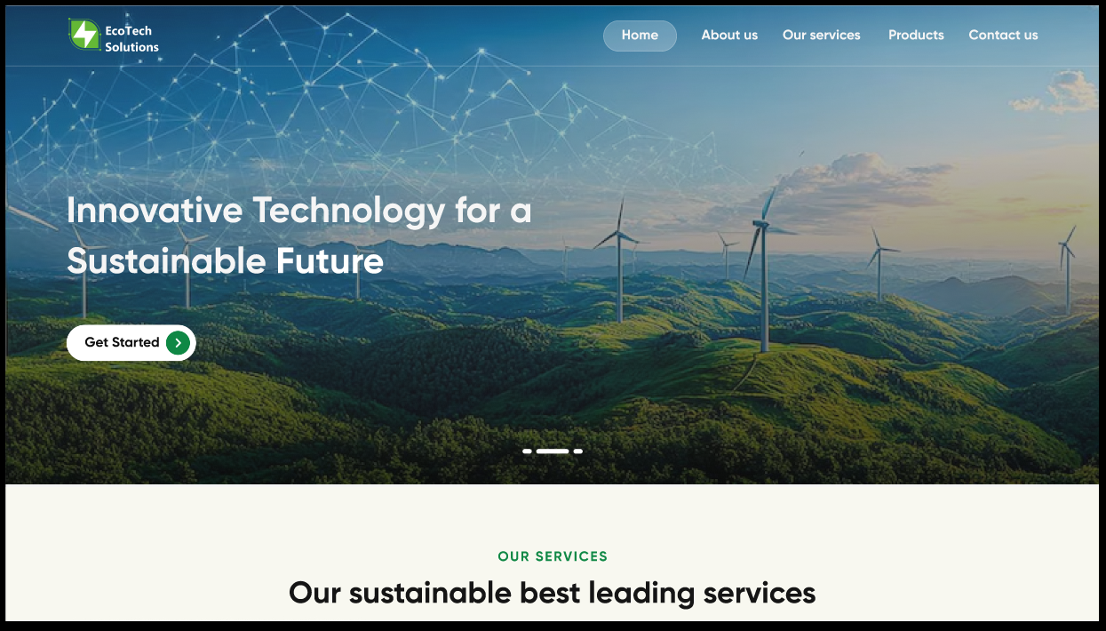
Website Design
HTML Integration:
Requirement was to create a responsive website which will work well across different devices and resolutions.
Responsive design using CSS and grid layout
Adobe XD designs translated into HTML with pixel accuracy.
Adobe
XD
HTML5 & CSS
Responsive
Design

Slide 11
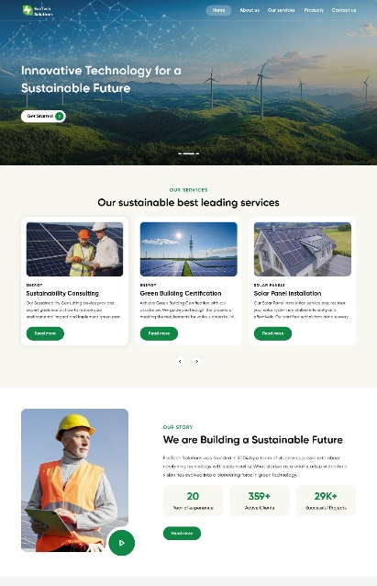
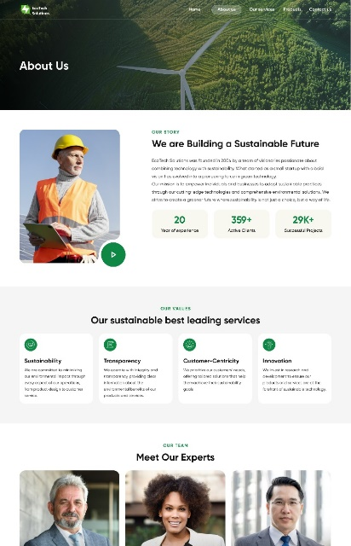
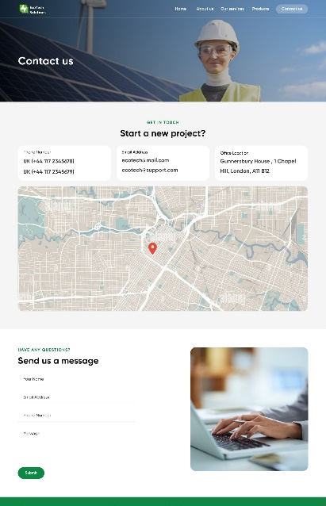
Website Design

Slide 12
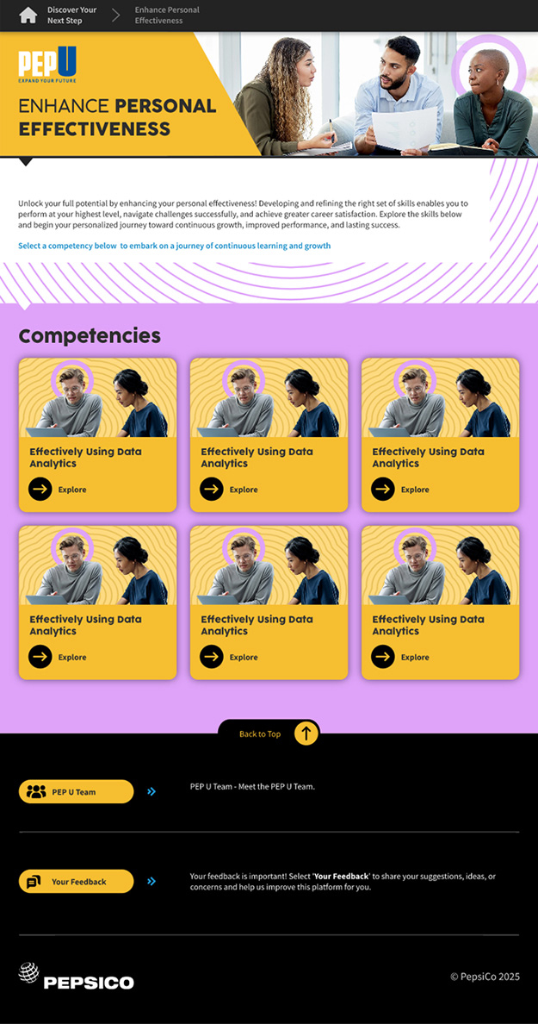
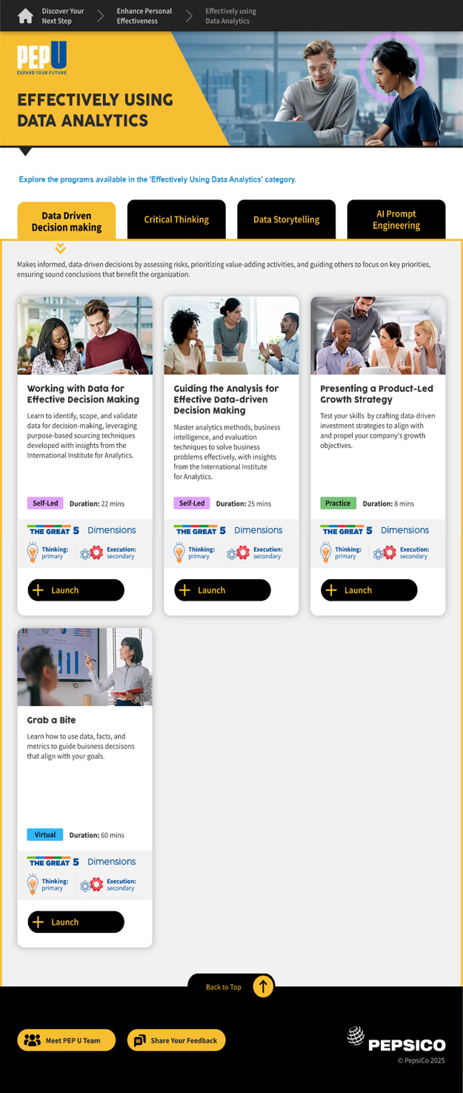
Portal
HTML Integration:
Responsive design using CSS and grid layout
Adobe XD designs translated into HTML with pixel accuracy.
Single Page Application-like behavior with real-time updates and notifications using WebSockets or AJAX.
Adobe
XD
HTML5 & CSS
Responsive
Design

Slide 13
Portal

Slide 14
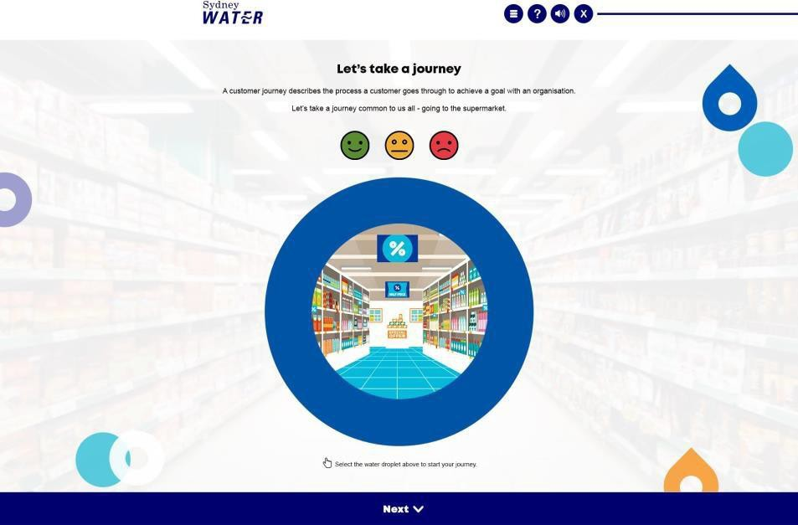

E-learning Design
E-Learning Design – Food Mall Shopping
This e-learning module is designed to simulate a real-world food mall shopping experience, helping users understand store layouts, product categories, and checkout processes.
Fully responsive layout built using HTML5, angular and CSS ensured optimal rendering across desktops, tablets, and mobiles. CSS3 media queries and grid systems ensured it scales cleanly across enterprise devices.
Adobe
Photoshop
HTML5 & CSS
Responsive
Design

Slide 15

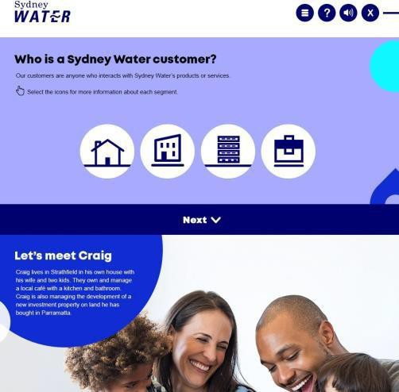
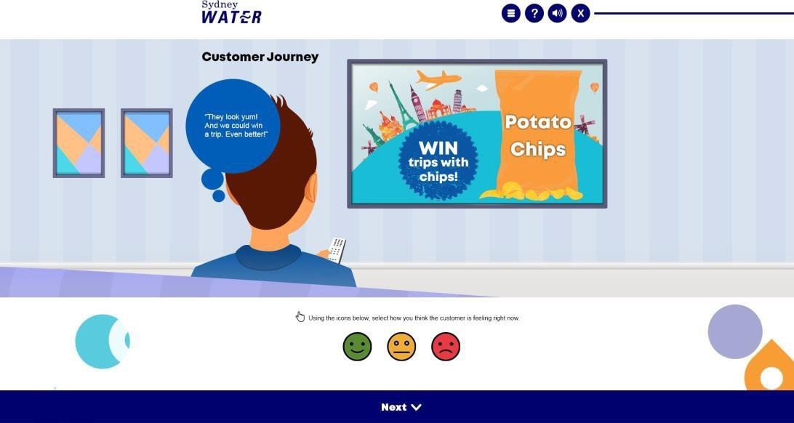
E-learning Design

Slide 16
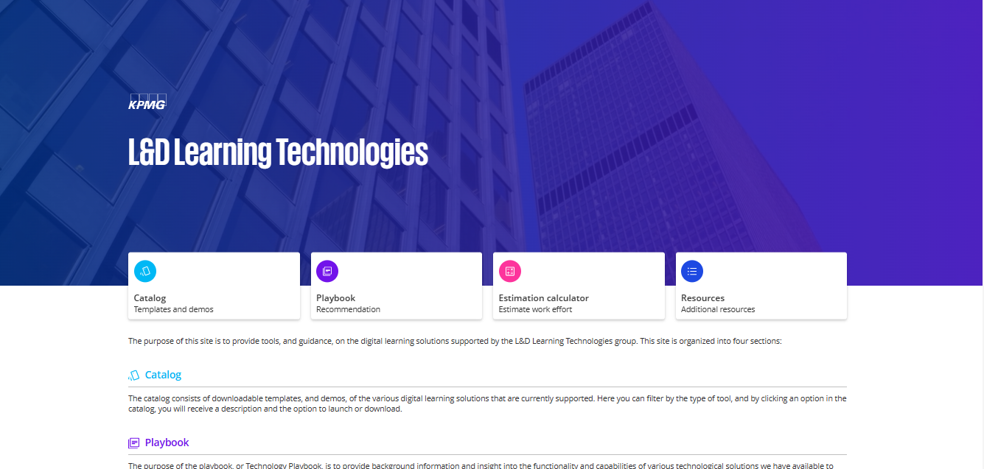
Website
KPMG Learning Technologies
A sleek, responsive platform designed to showcase KPMG’s learning tools. The interface uses tabbed navigation and clean layouts to provide easy access to key resources like catalogs and playbooks. Developed from Adobe XD designs into HTML5, the site ensures consistent performance across all devices while maintaining KPMG’s brand integrity.
Adobe
XD
HTML5, Angular & CSS
Responsive
Design

Slide 17
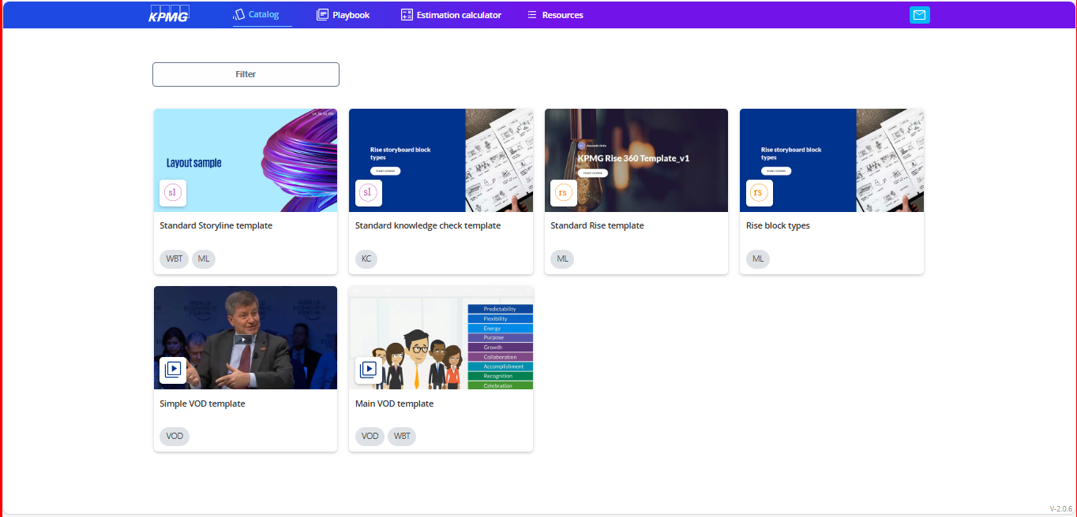
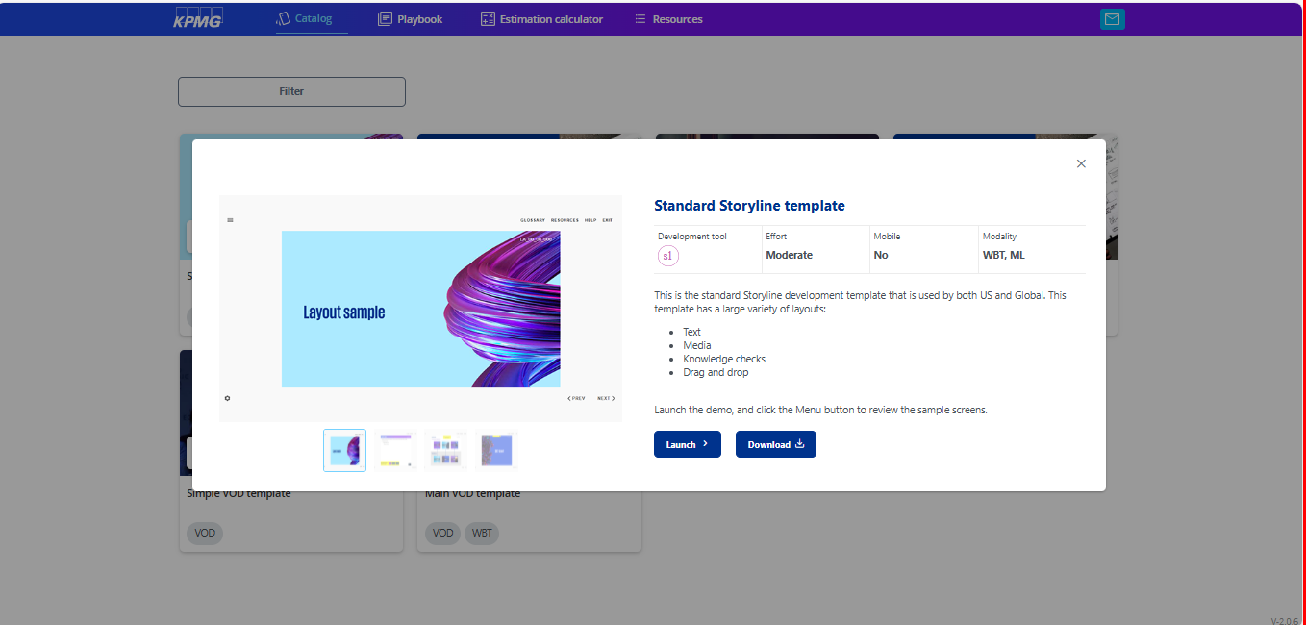
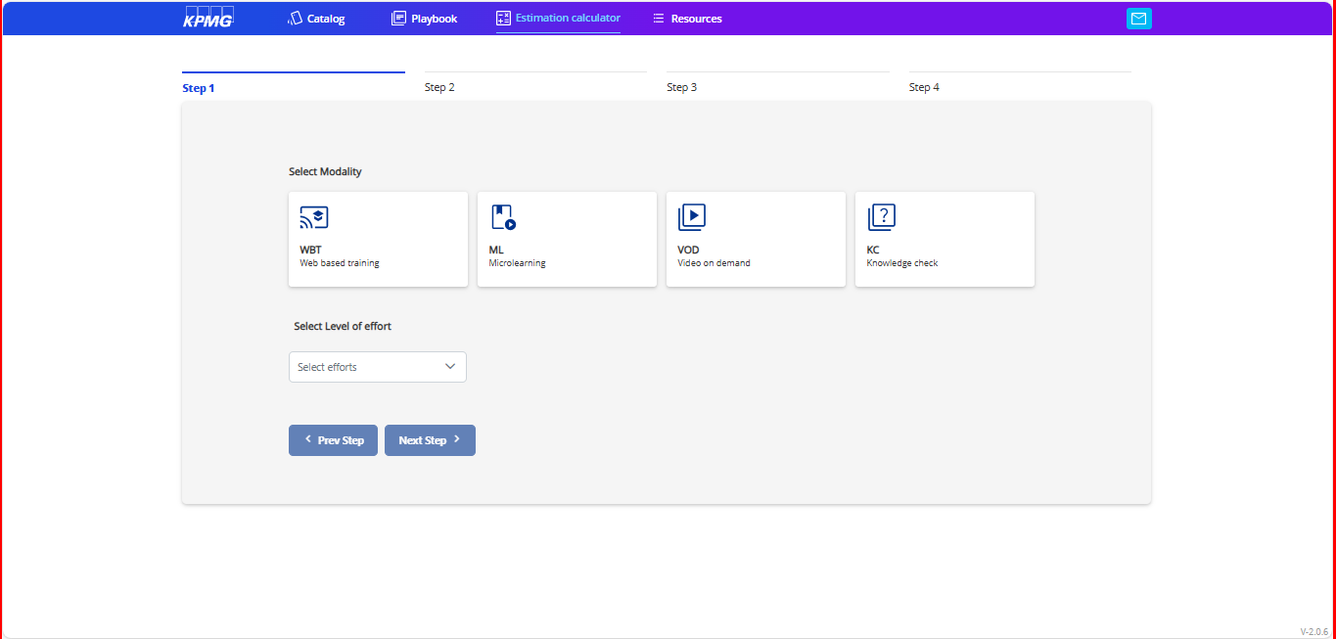
Website

Slide 18

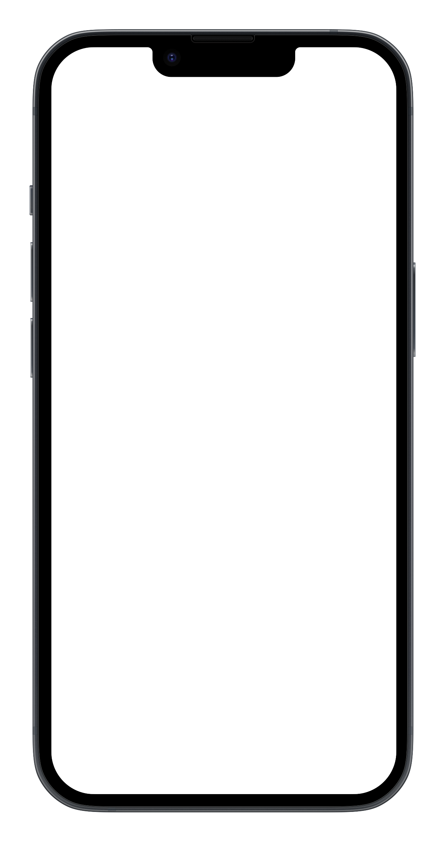
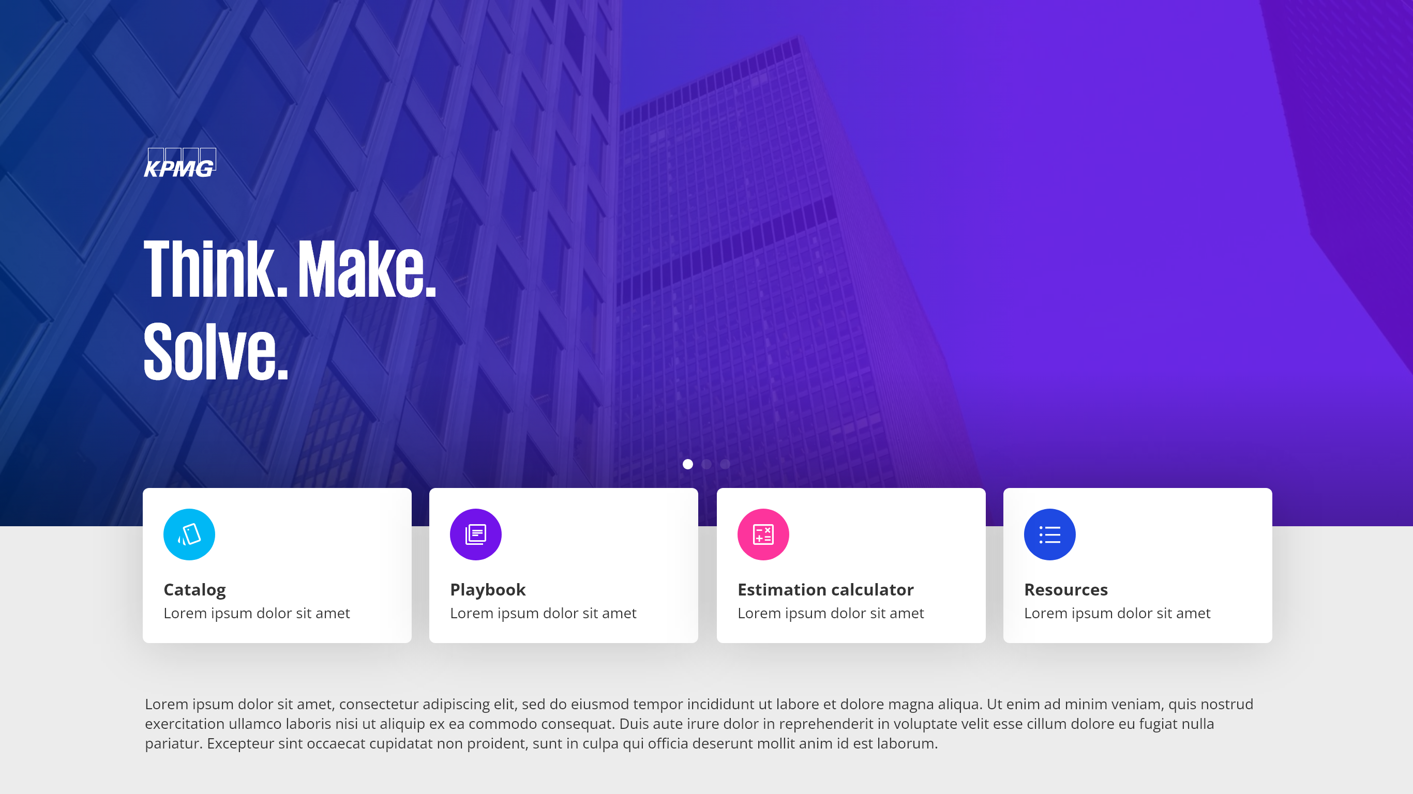
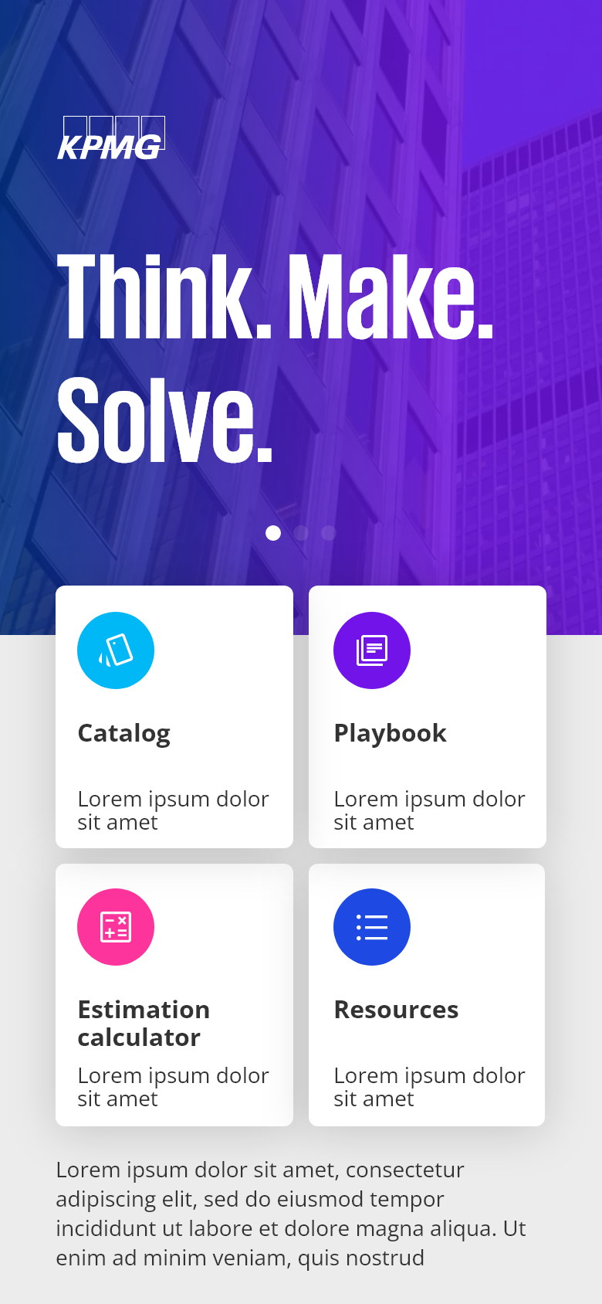
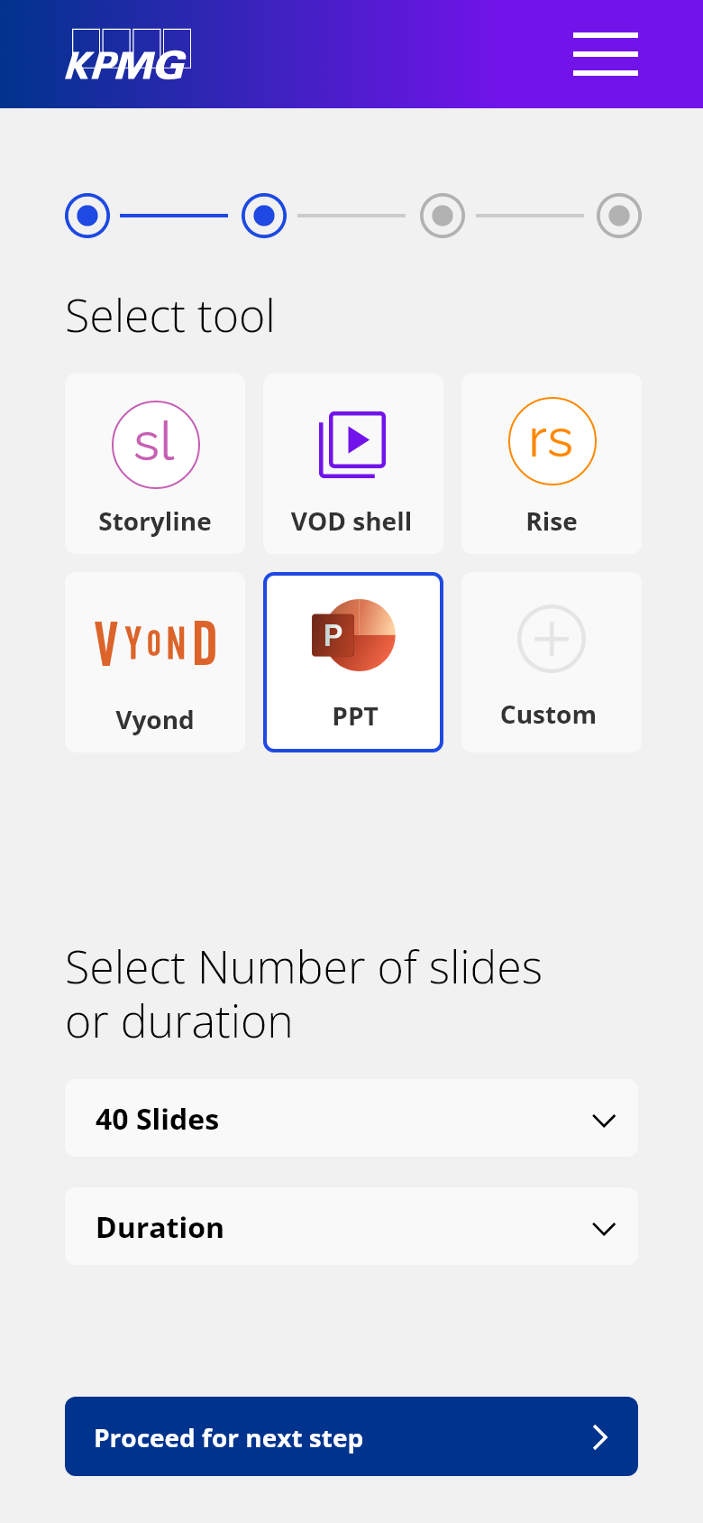
Website

Slide 19
Website

Slide 20
Thank You

