Slide 1
SOMNATH PAWAR
SENIOR GRAPHIC DESIGNER - PORTFOLIO

Slide 2
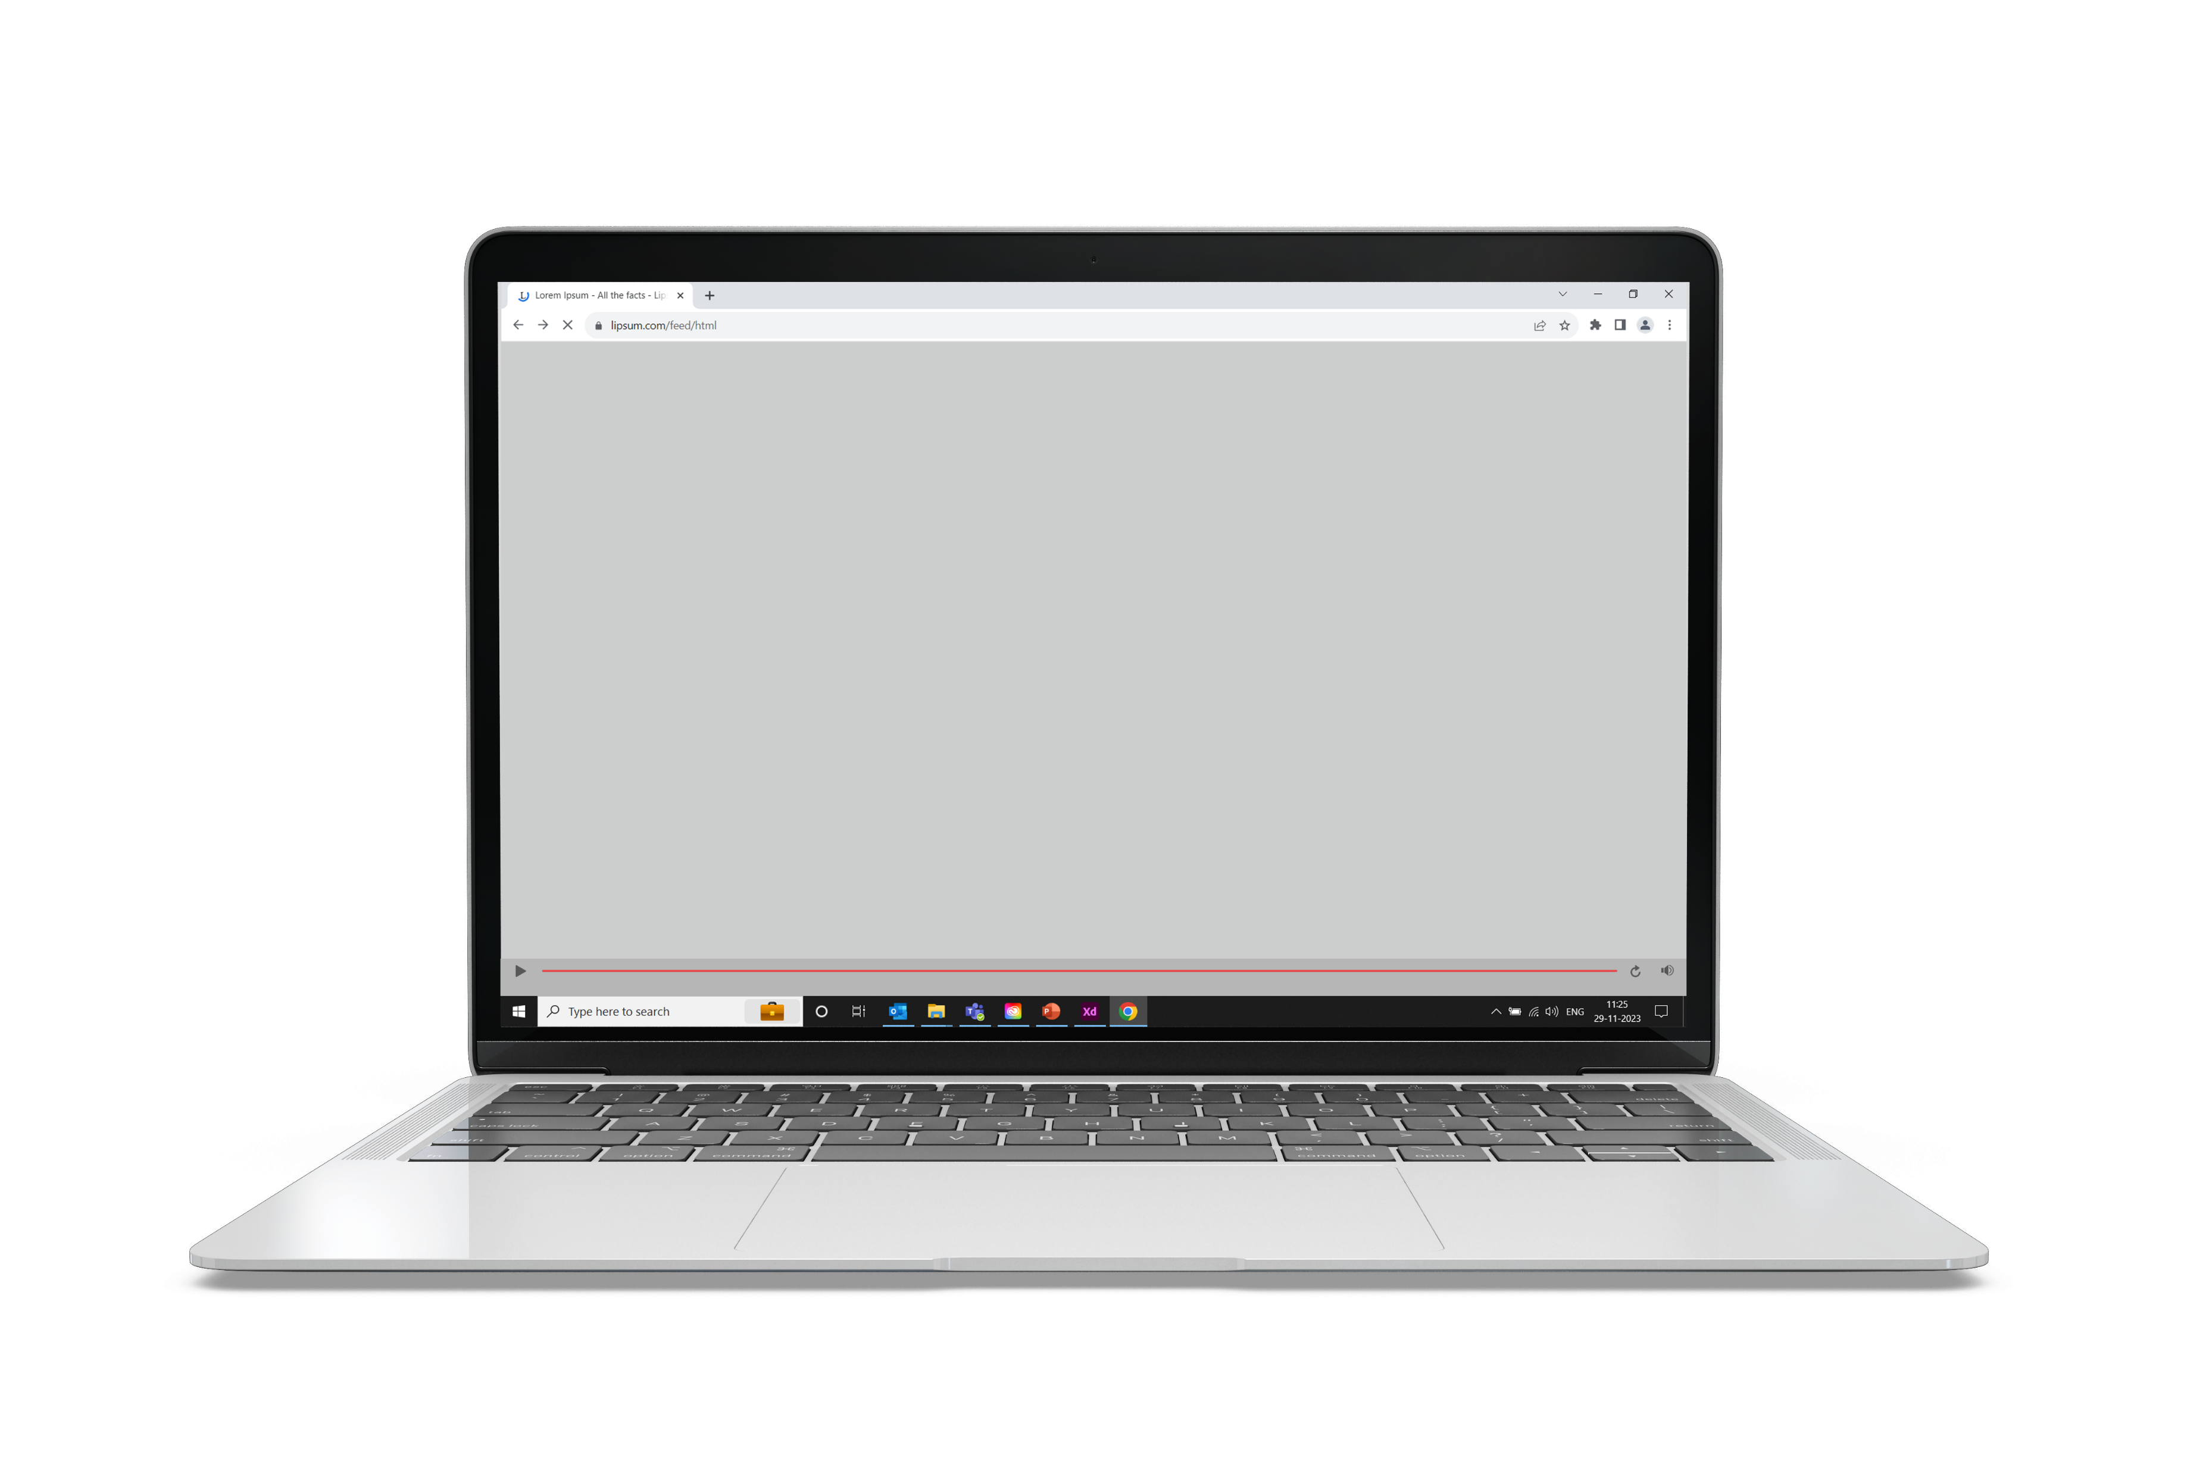
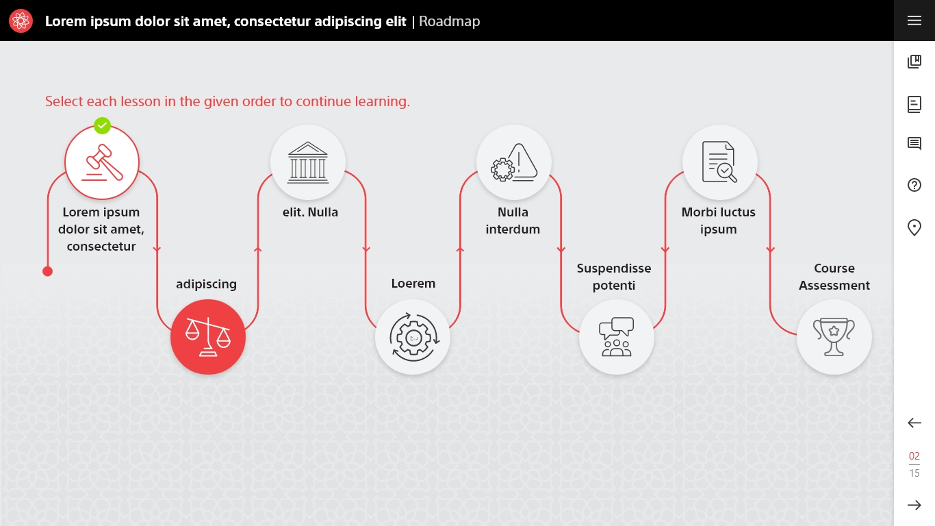
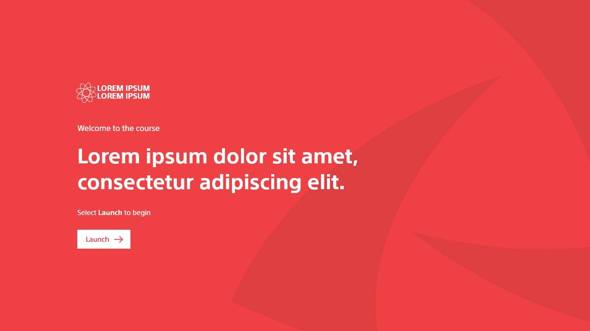
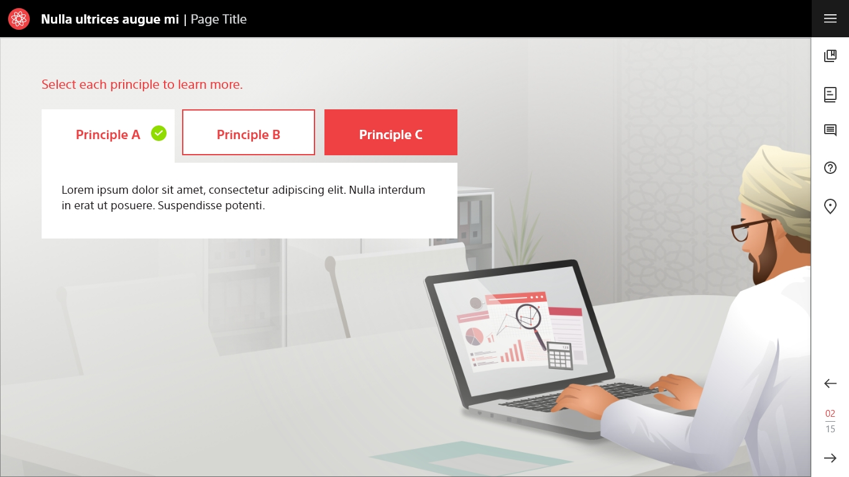
Articulate Storyline 360 Course Design Sample - 1
The complete customized course was developed using Articulate Storyline 360.
Used Adobe XD to edit/extract the assets.

Slide 3
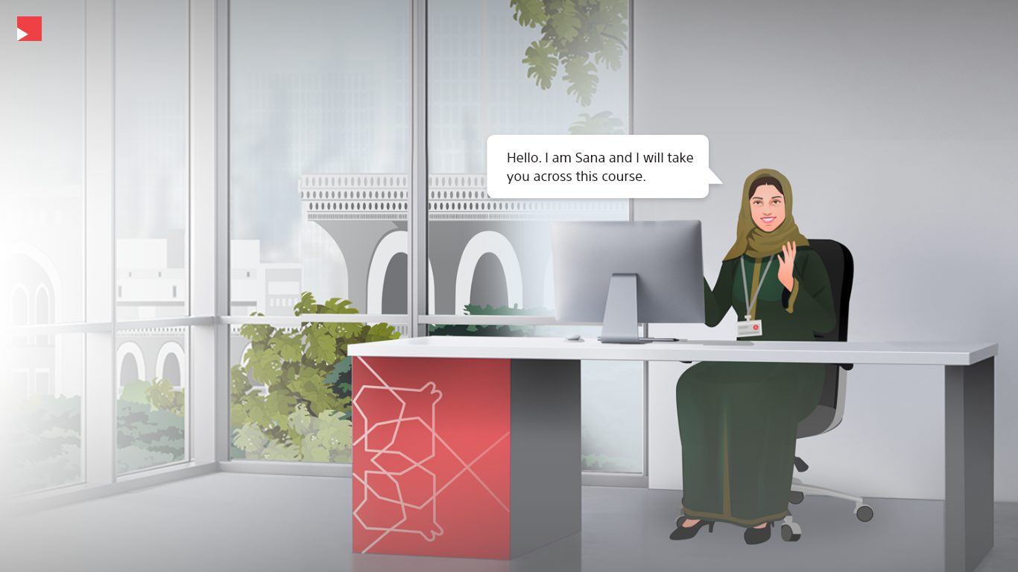
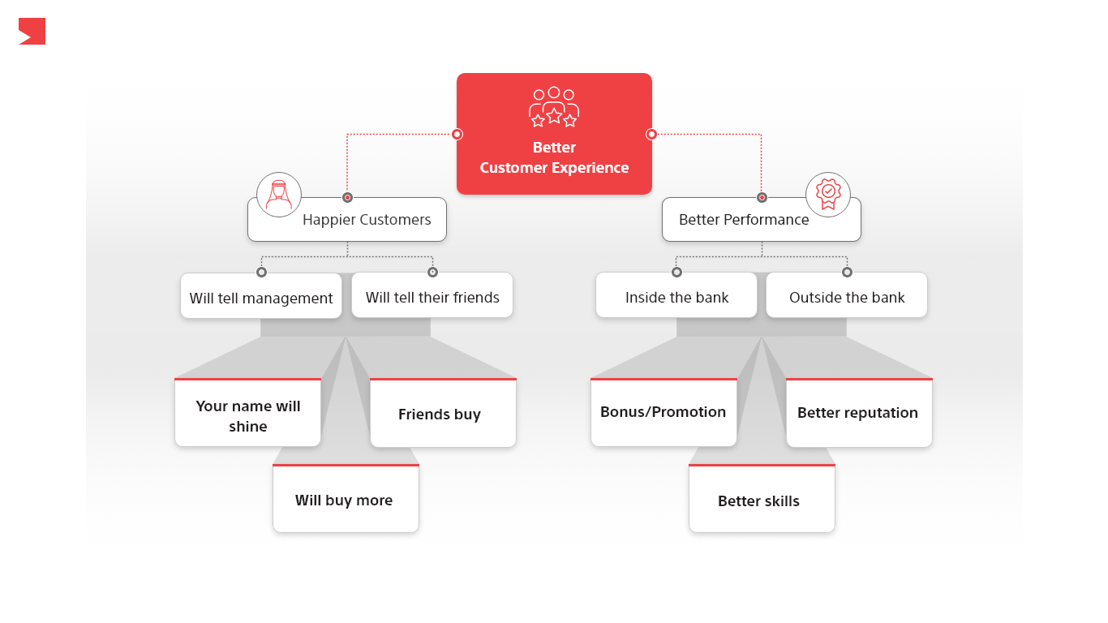
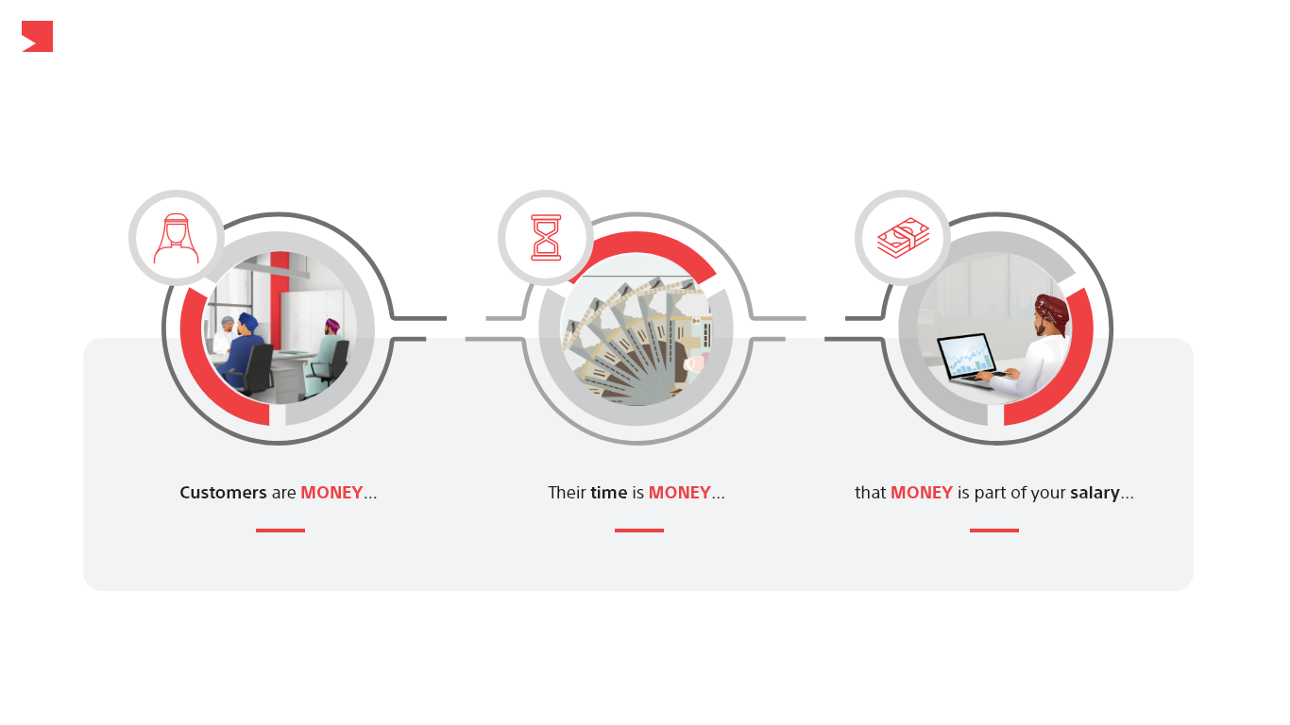
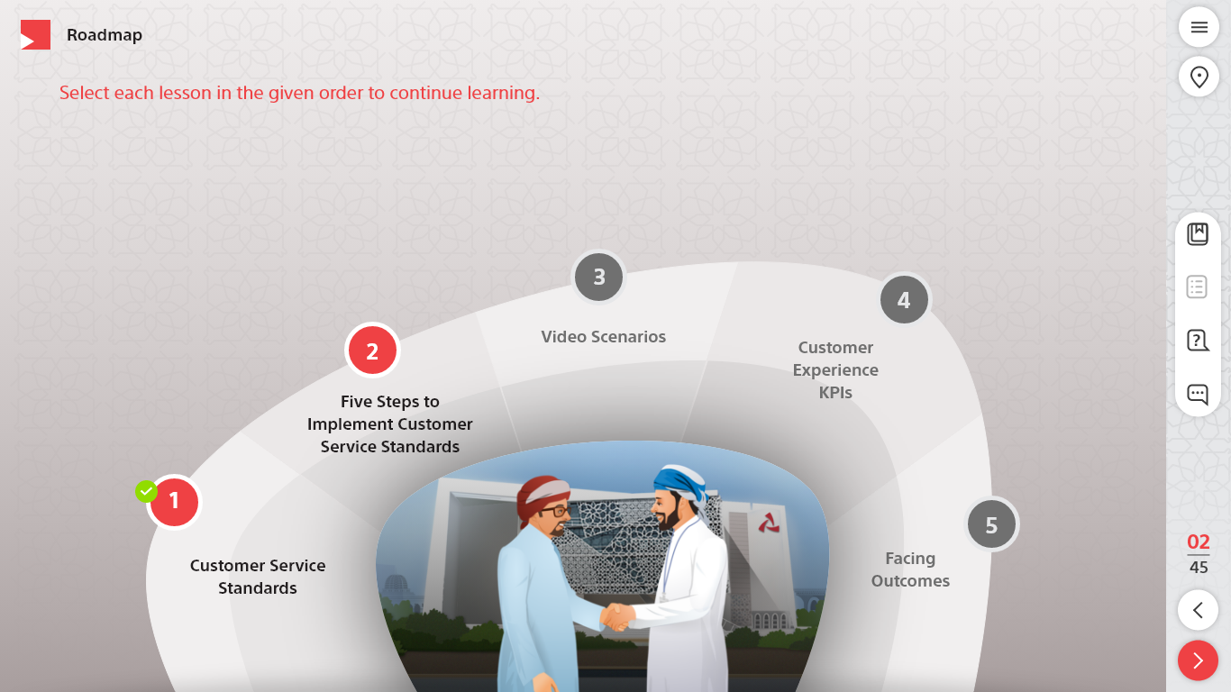
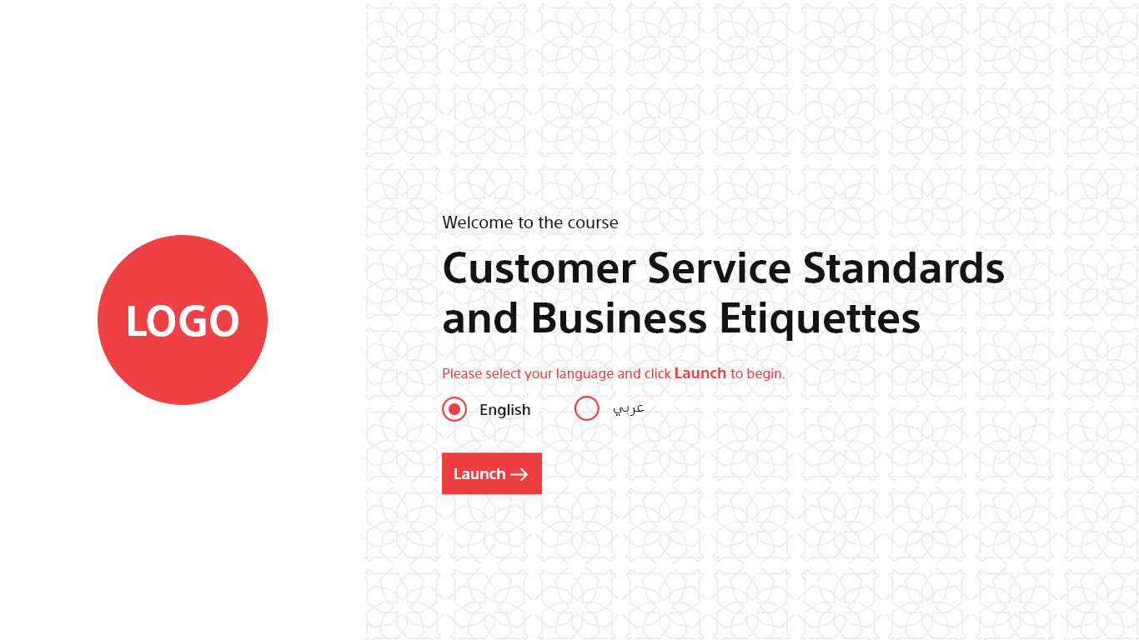
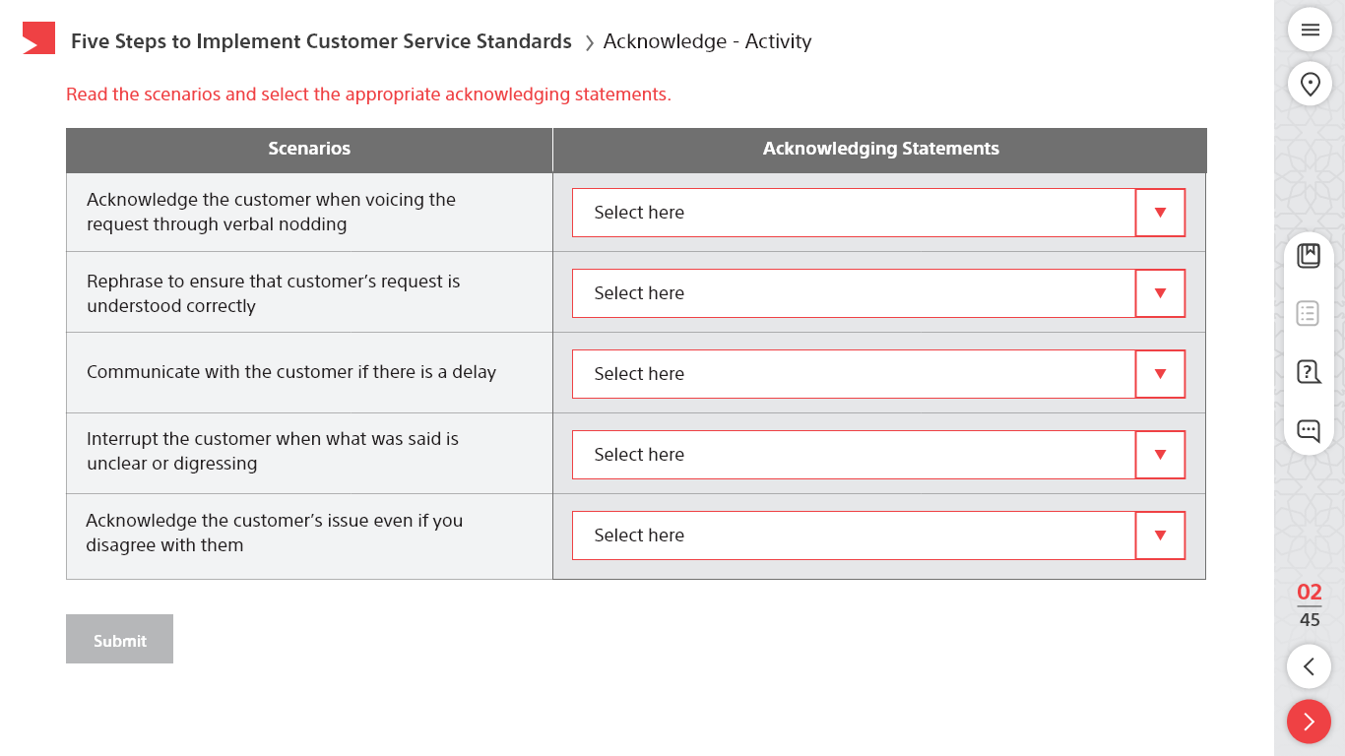
Articulate Storyline 360 Course Design Sample - 2
The complete customized course was developed using Articulate Storyline 360.
Used Adobe XD to edit/extract the assets.

Slide 4
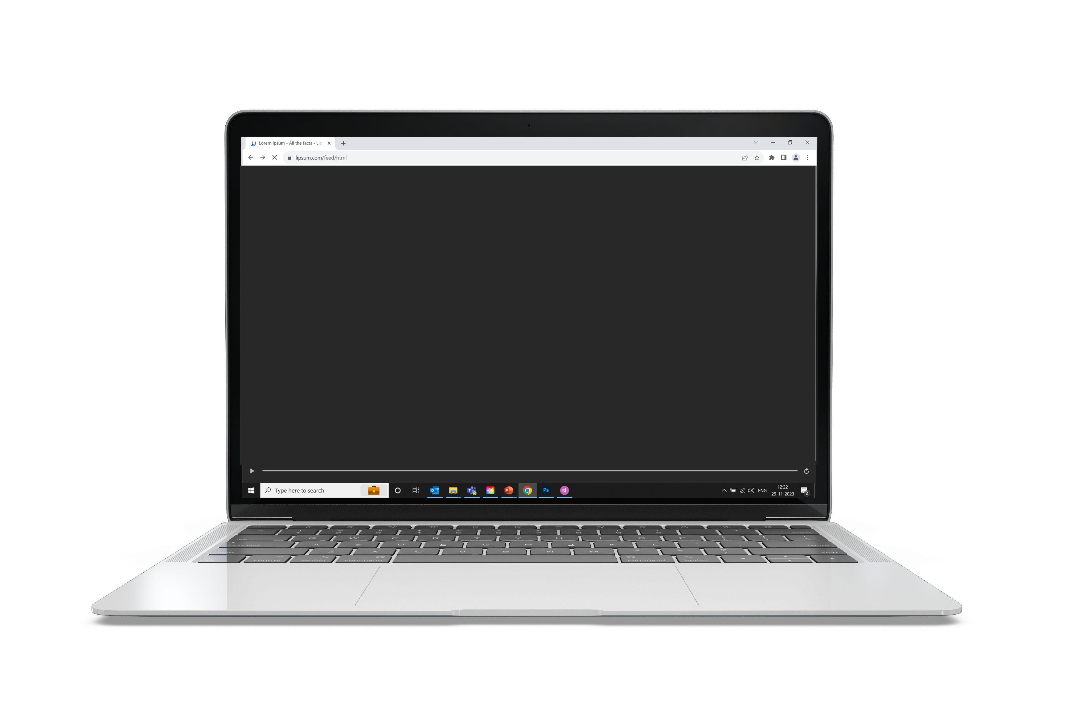
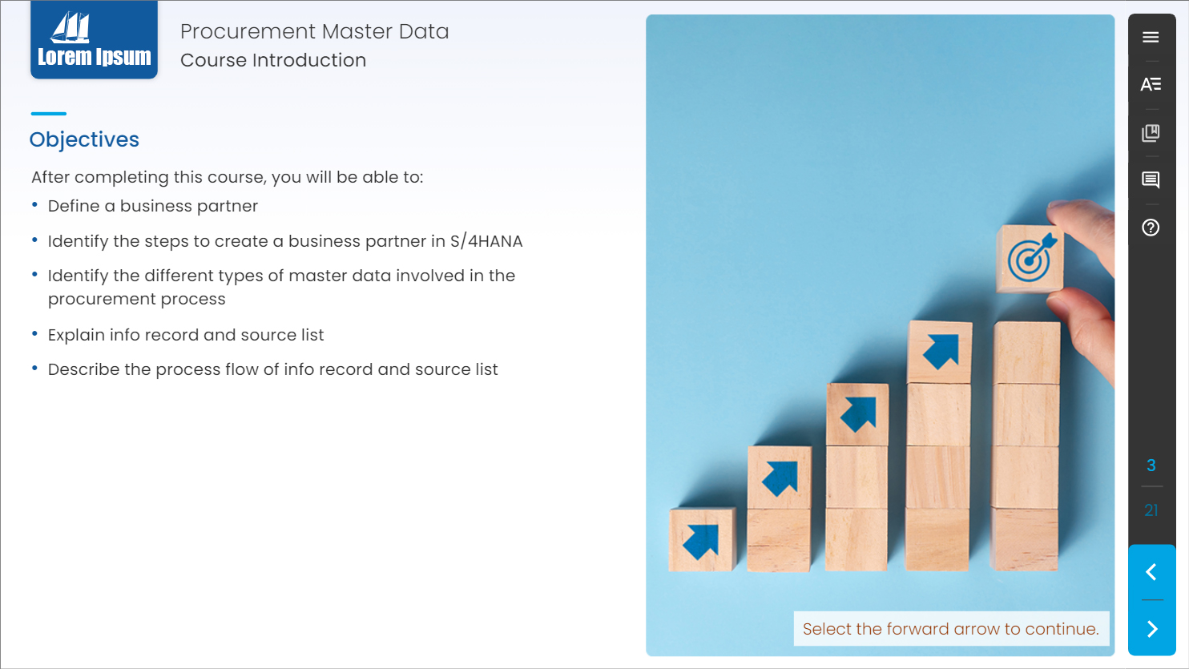
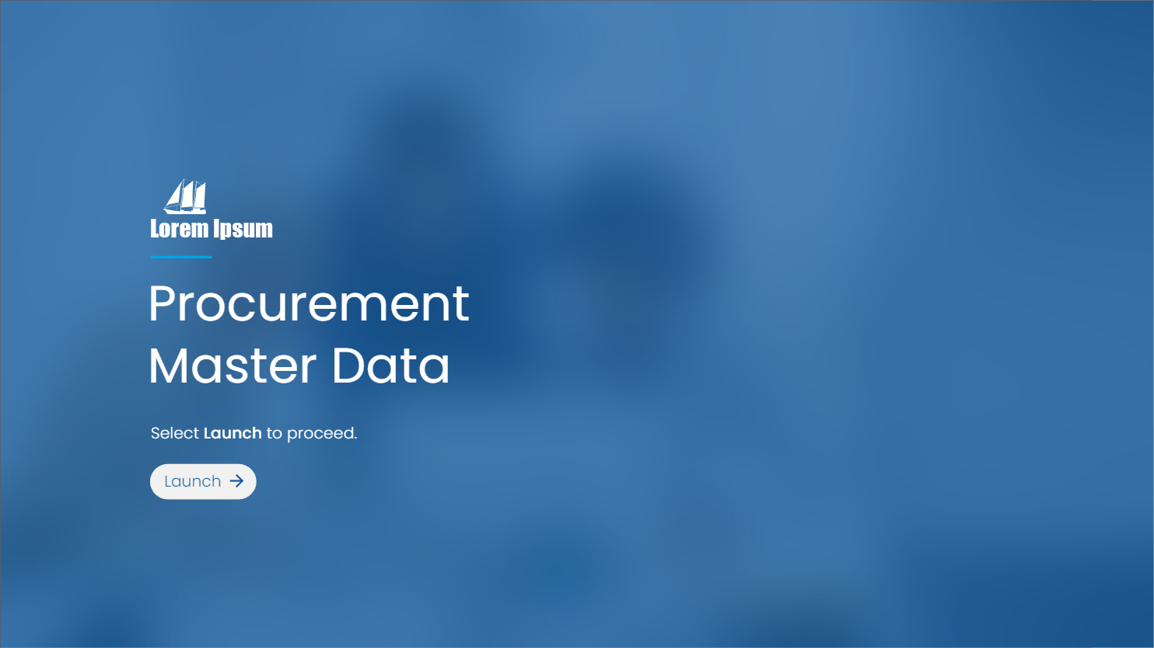
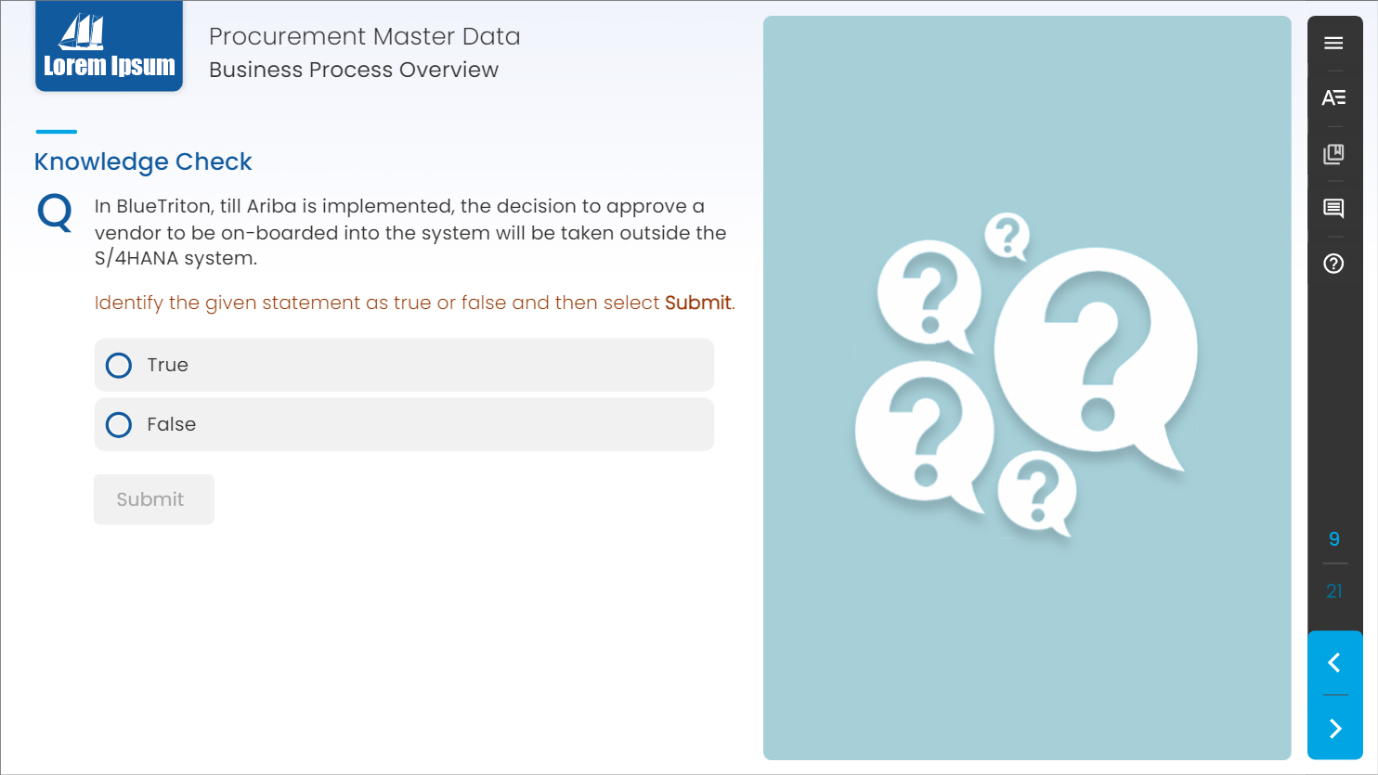
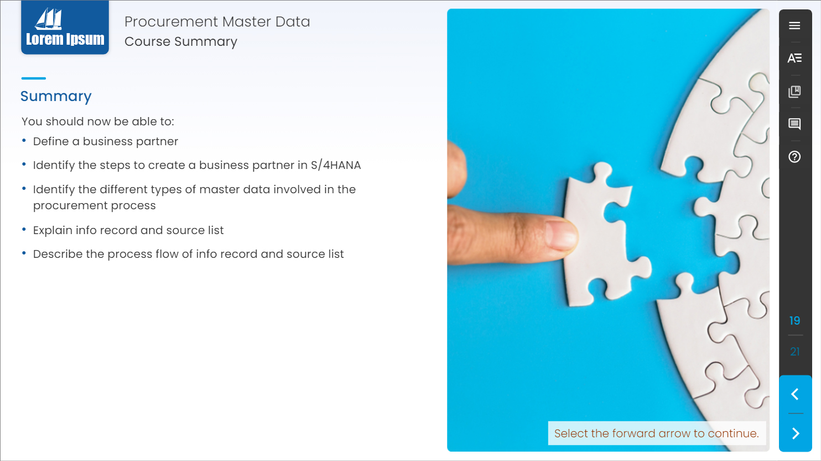
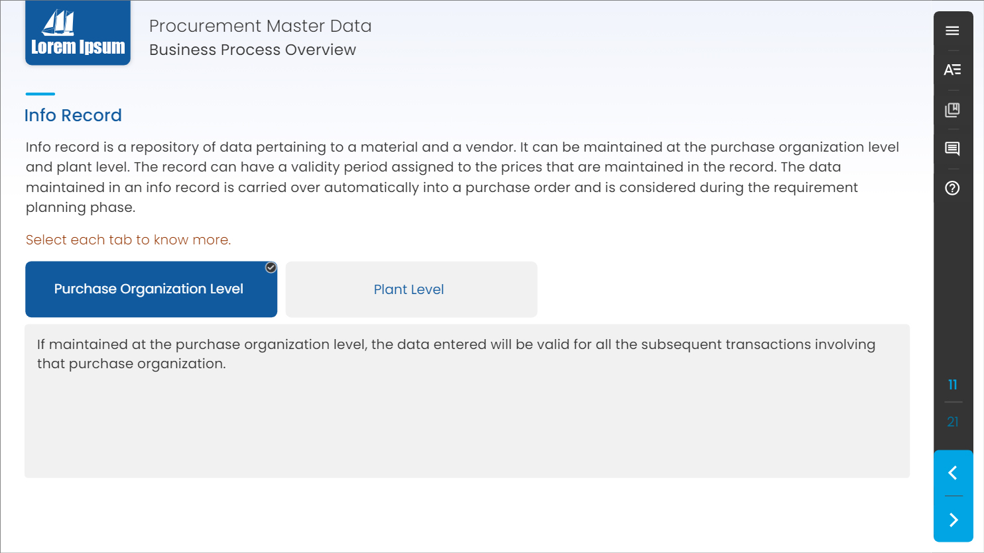
Articulate Storyline 360 Course Design Sample - 3
The complete customized course was developed using Articulate Storyline 360.
The course was Web Content Accessibility Guidelines (WCAG) Compliance.
Used Photoshop CC to design/edit mockups.

Slide 5
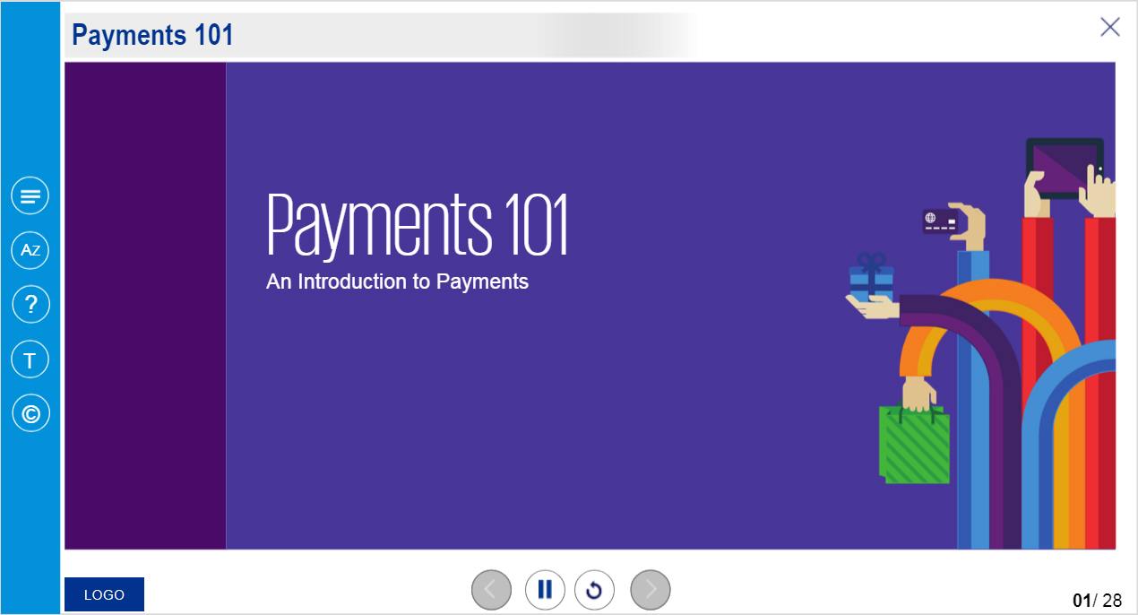
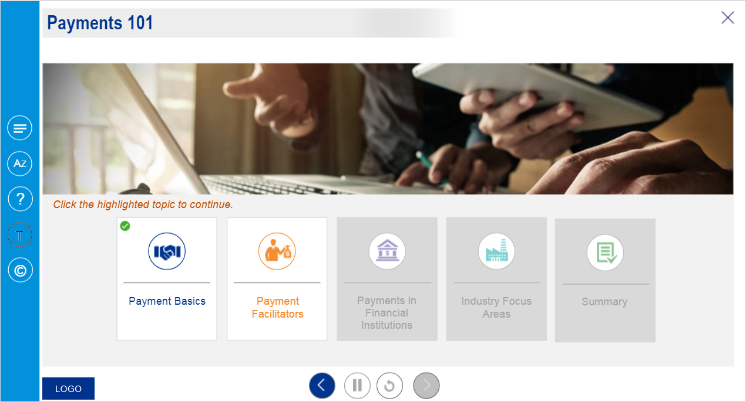
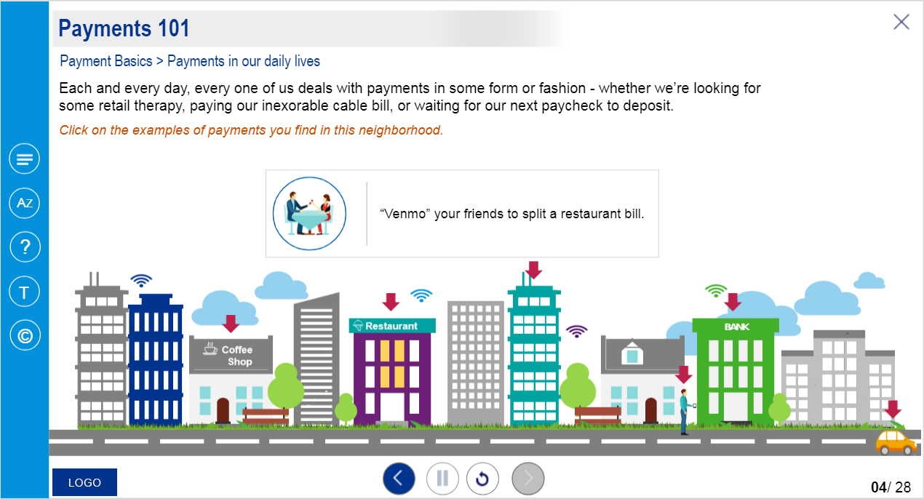
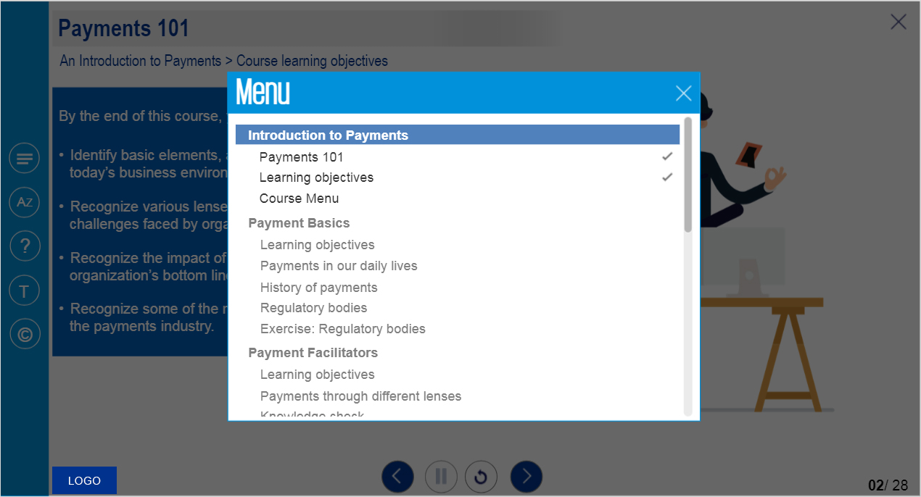
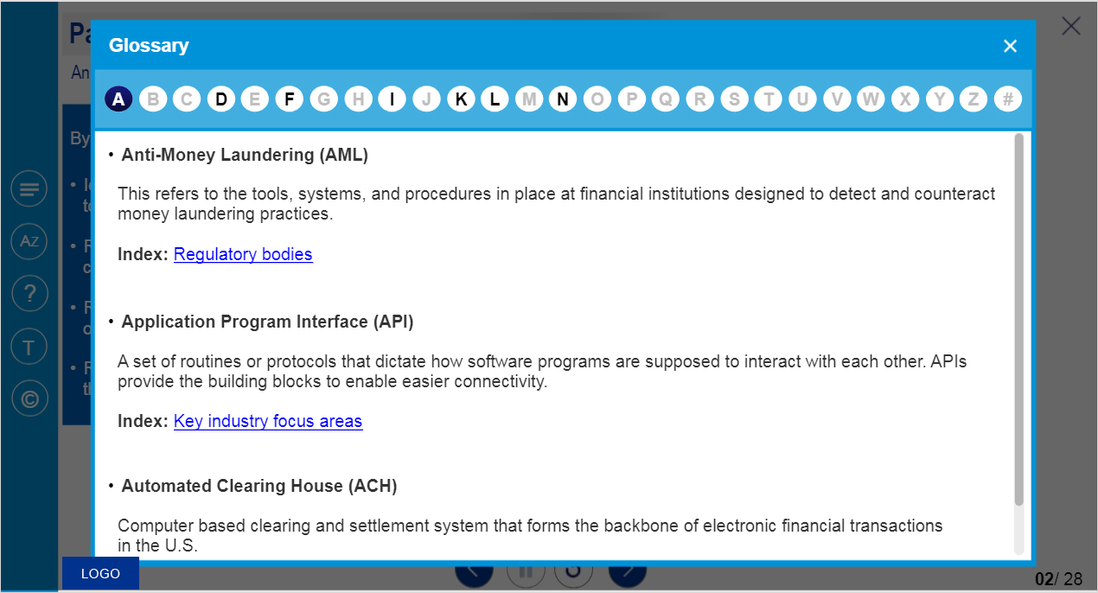
Articulate Storyline 3 Course Design Sample - 1
The course was developed using Articulate Storyline 3.
Used Photoshop CC to design/edit mockups.

Slide 6
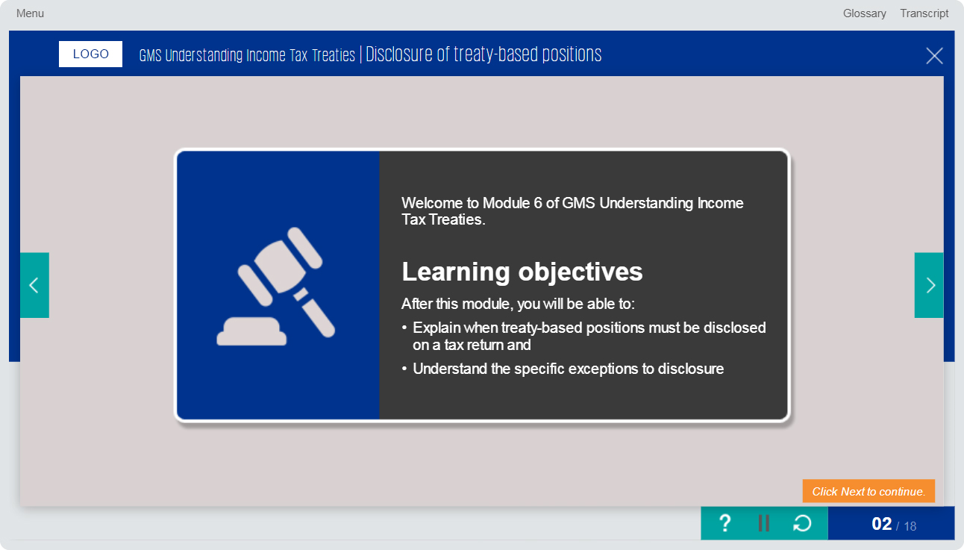
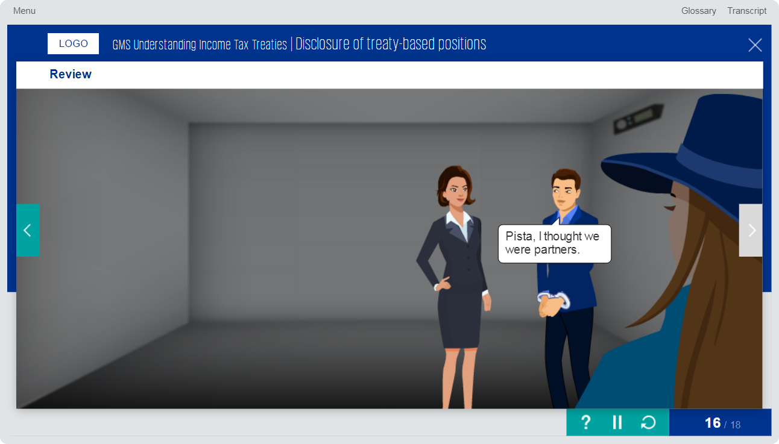
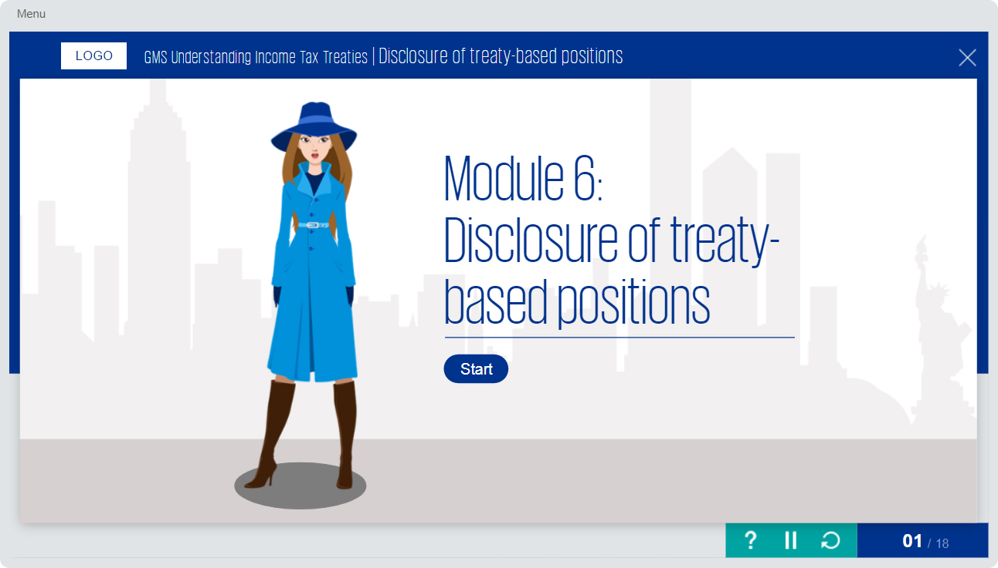
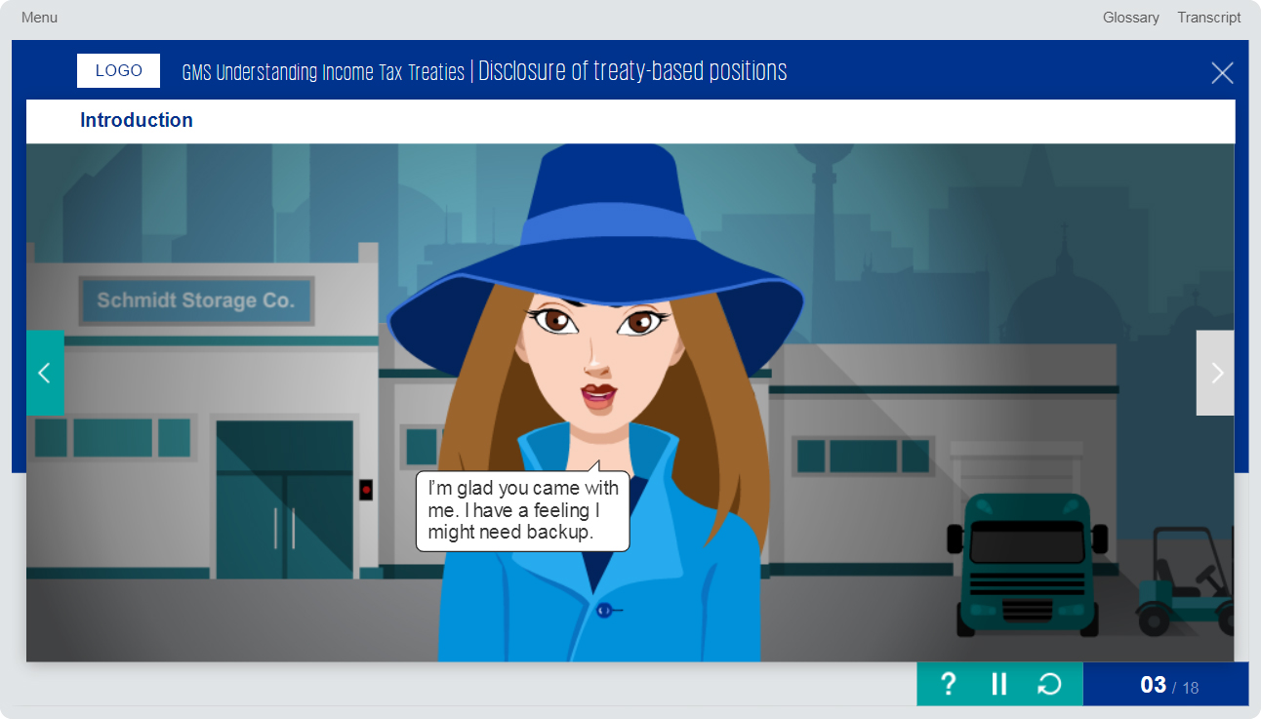
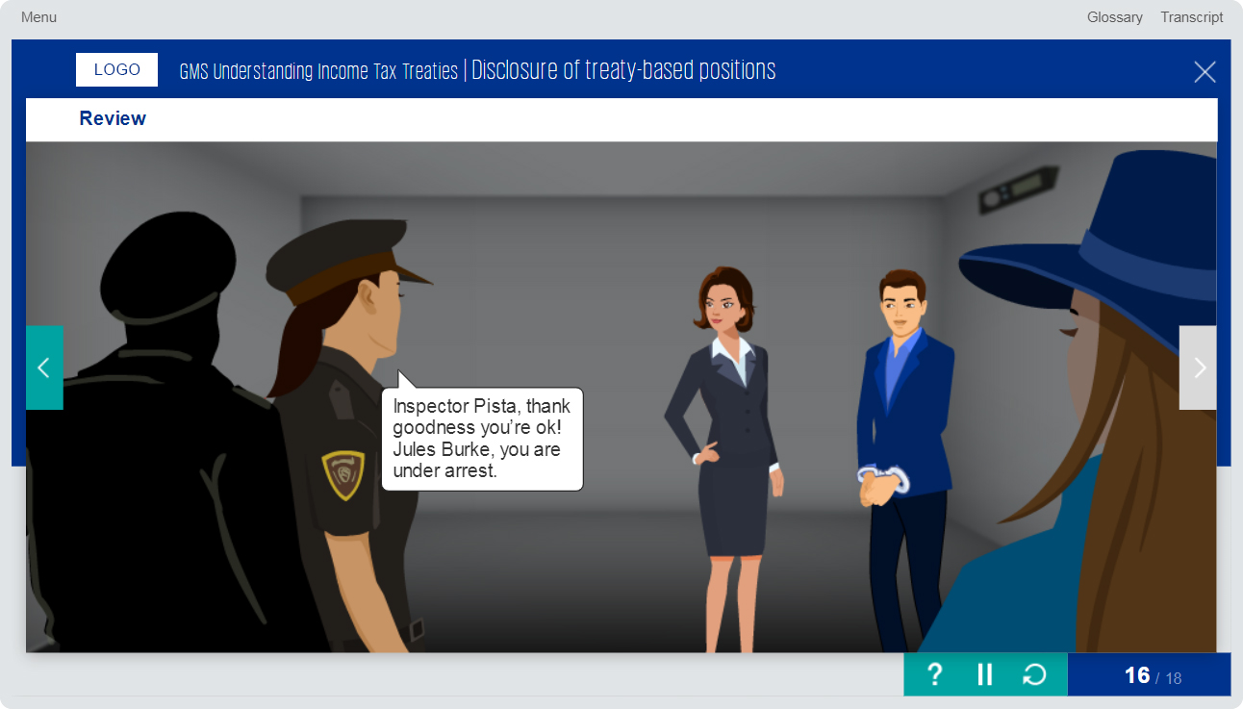
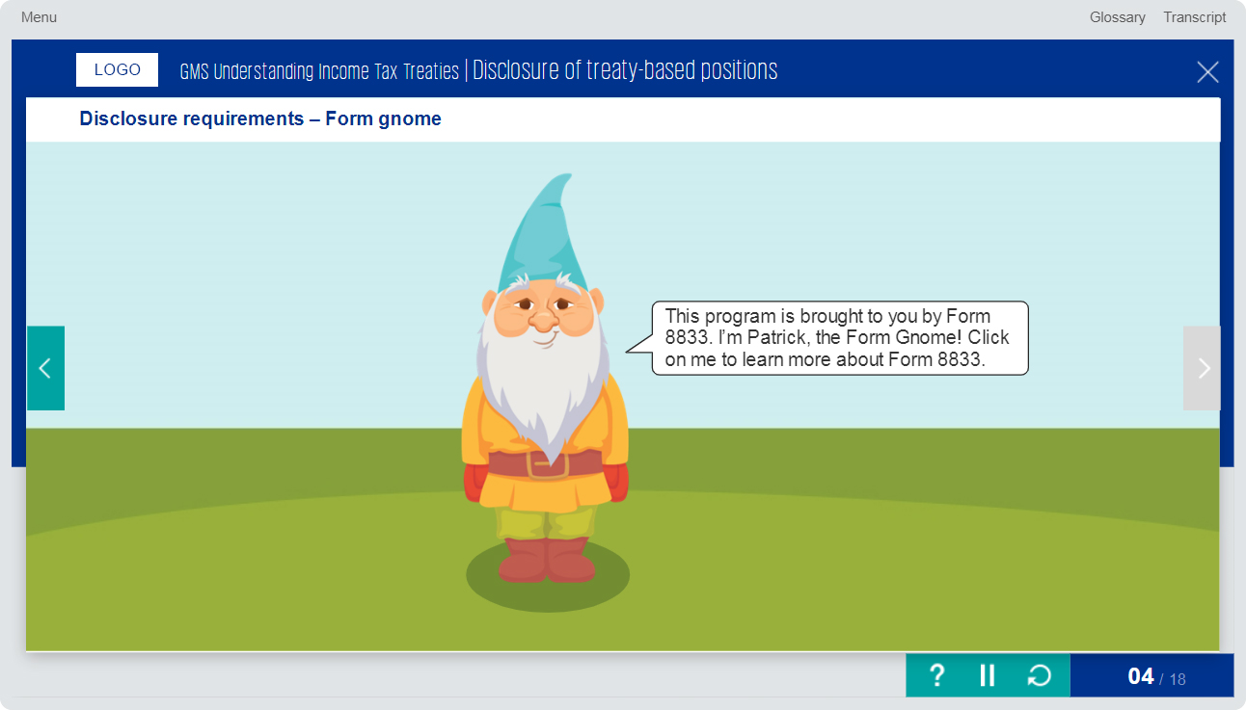
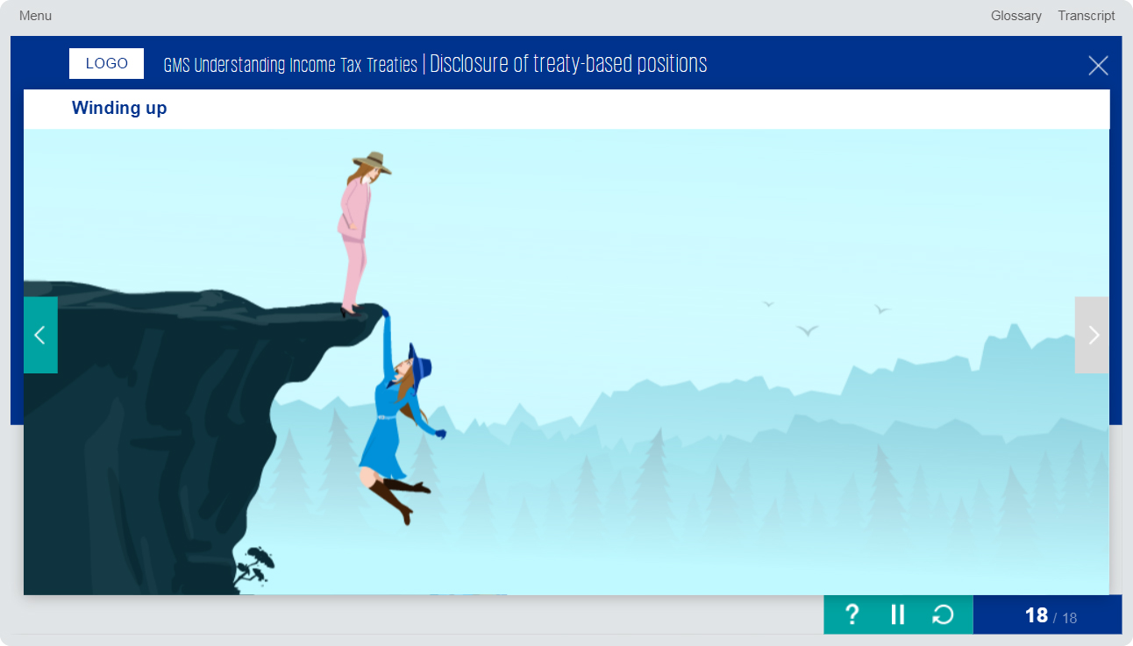
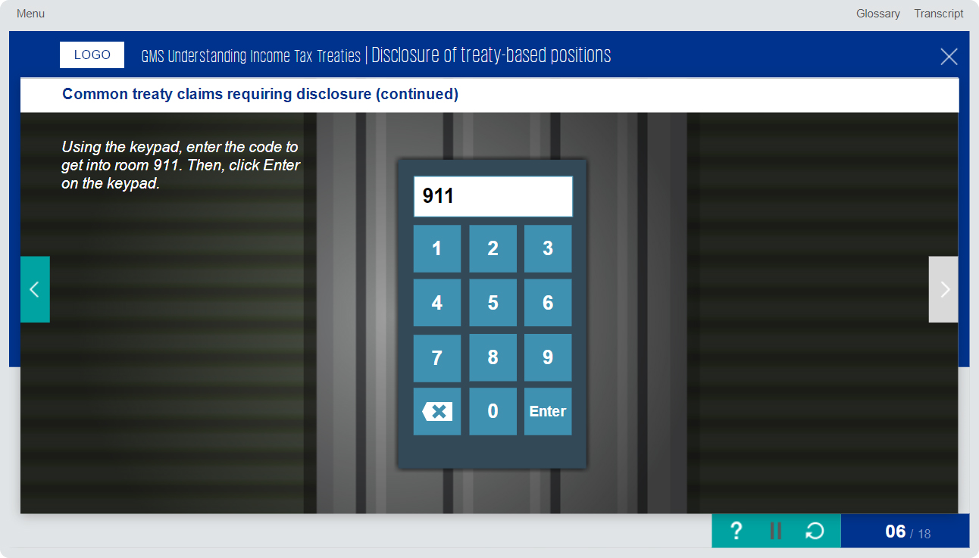
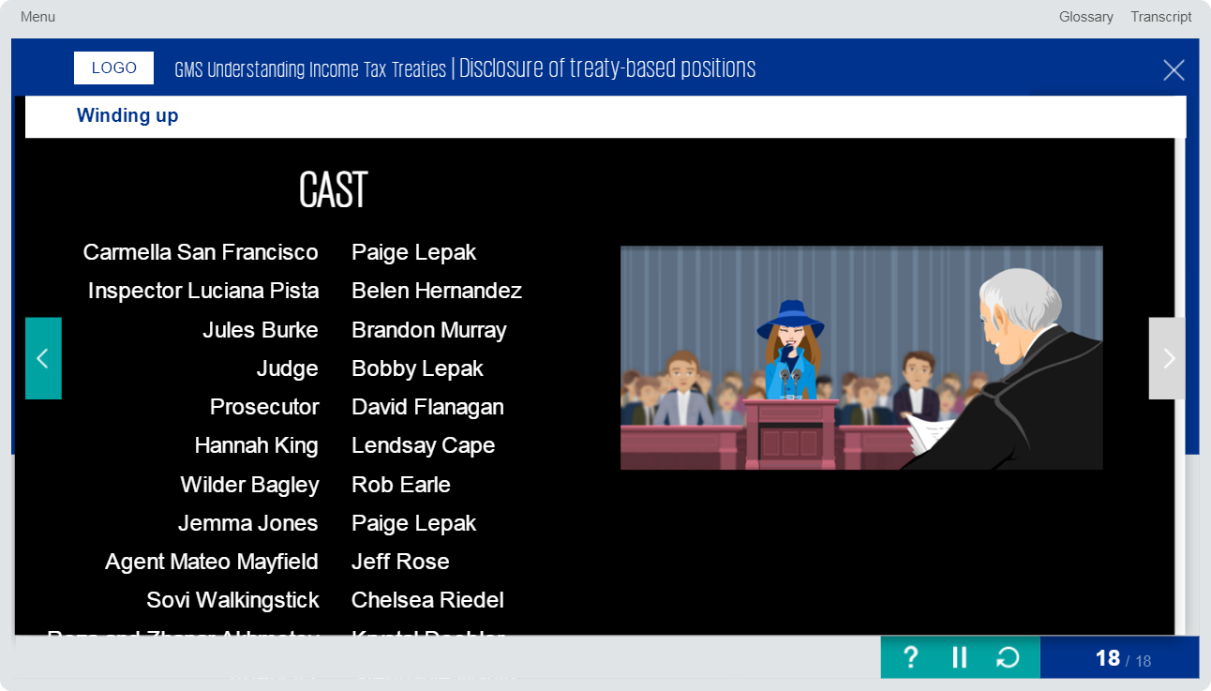
Articulate Storyline 3 Course Design Sample - 2
The course was developed using Articulate Storyline 3.
Used Photoshop CC to design/edit mockups.

Slide 7
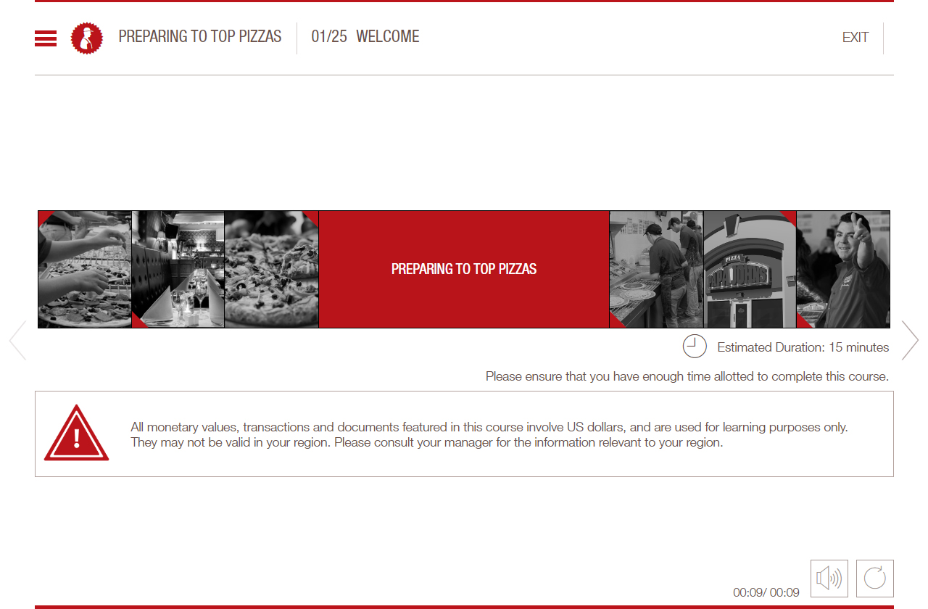
Micro Learning Sample
Used Storyline to develop the micro learning. Photoshop CC and Audacity tools used for assets and audio editing
Click the Play button to play the Micro Learning sample

Slide 8
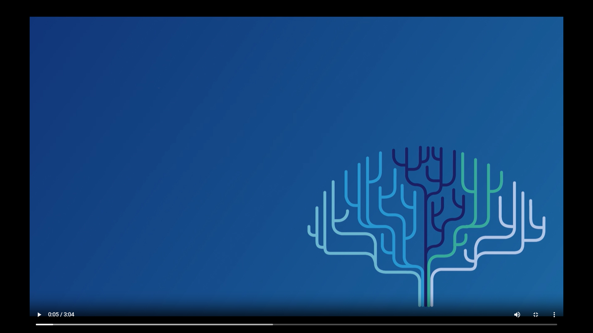
Video Based Learning Sample 1
Used Adobe Premiere, Photoshop CC, Audacity applications to design and develop this learning video.
Click the Play button to play the video sample

Slide 9
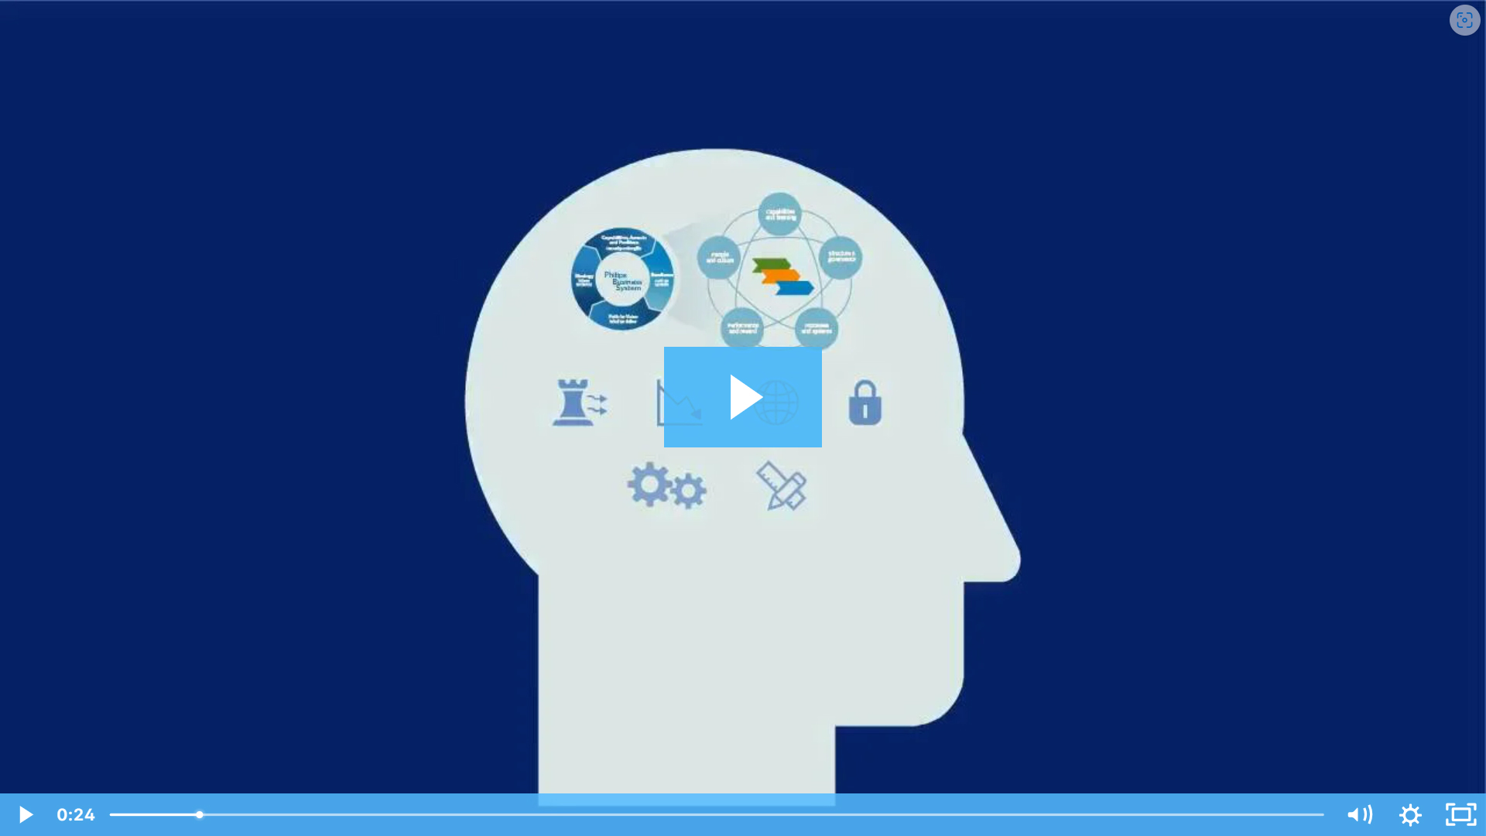
Video Based Learning Sample 2
Used Adobe Premiere, Photoshop CC, Audacity applications to design and develop this learning video.
Click the Play button to play the video sample

Slide 10
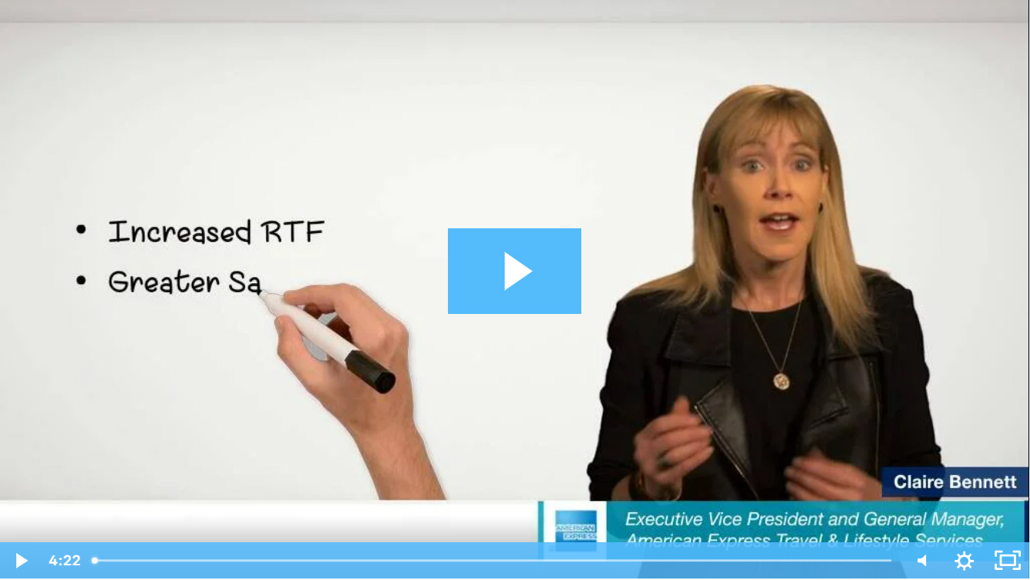
Green Screen Animations Sample
Used Adobe Premiere, Animate CC, Photoshop CC, Audacity applications to design and develop this learning video.
Click the Play button to play the video sample

Slide 11
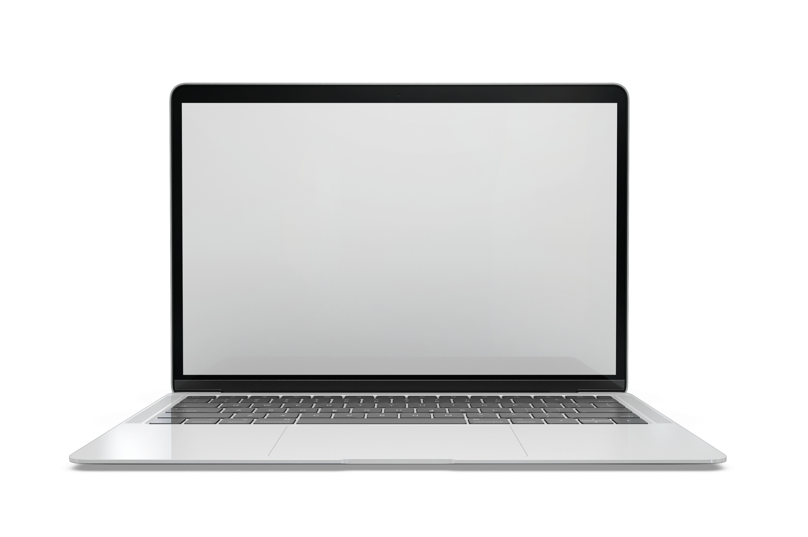
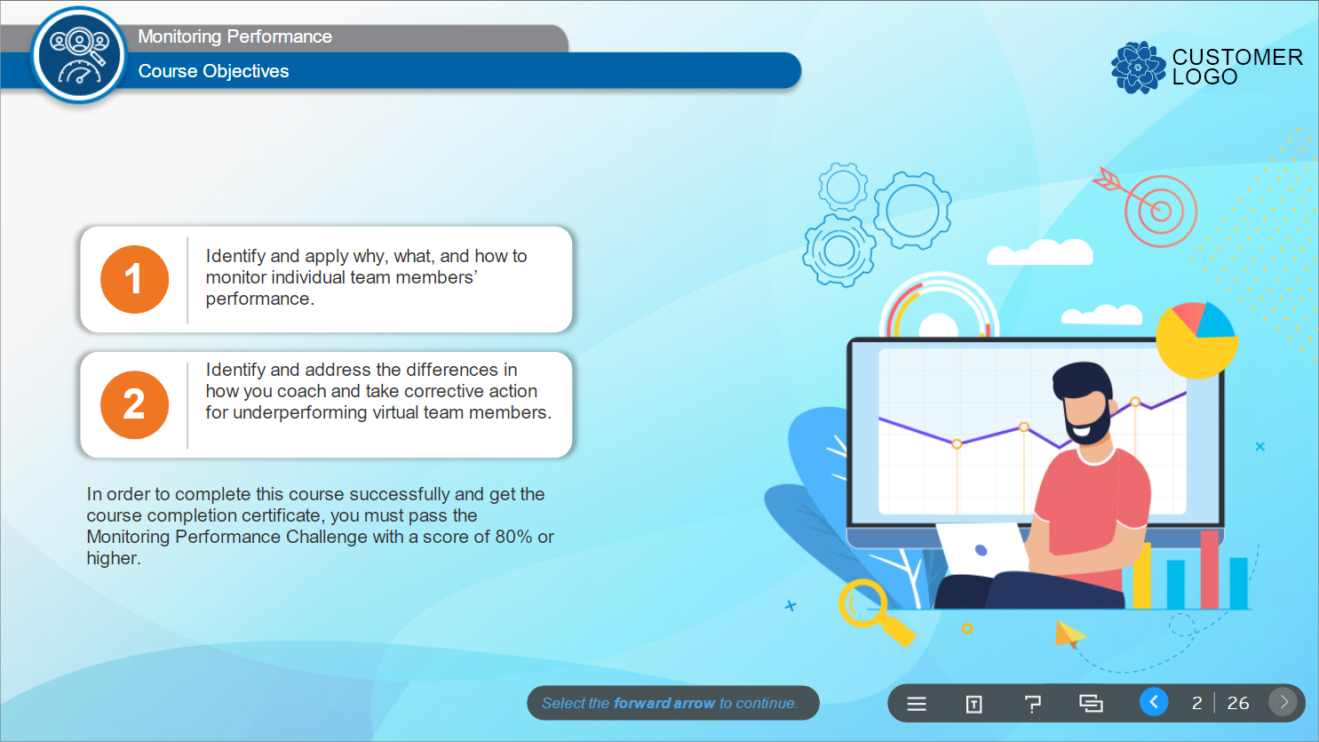
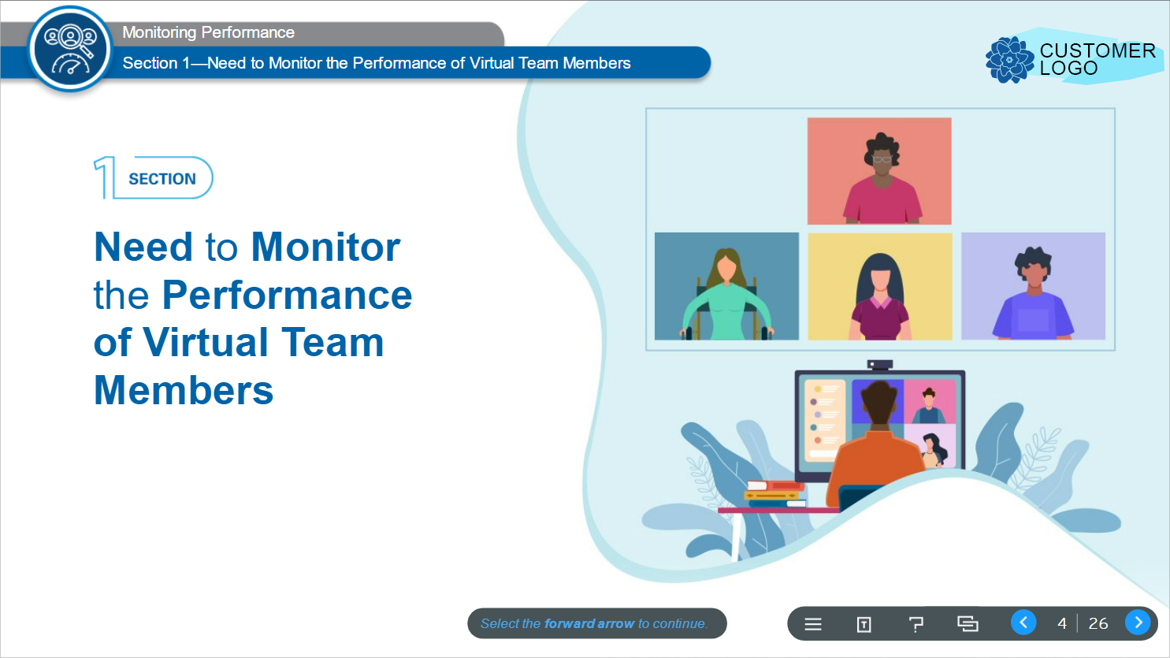

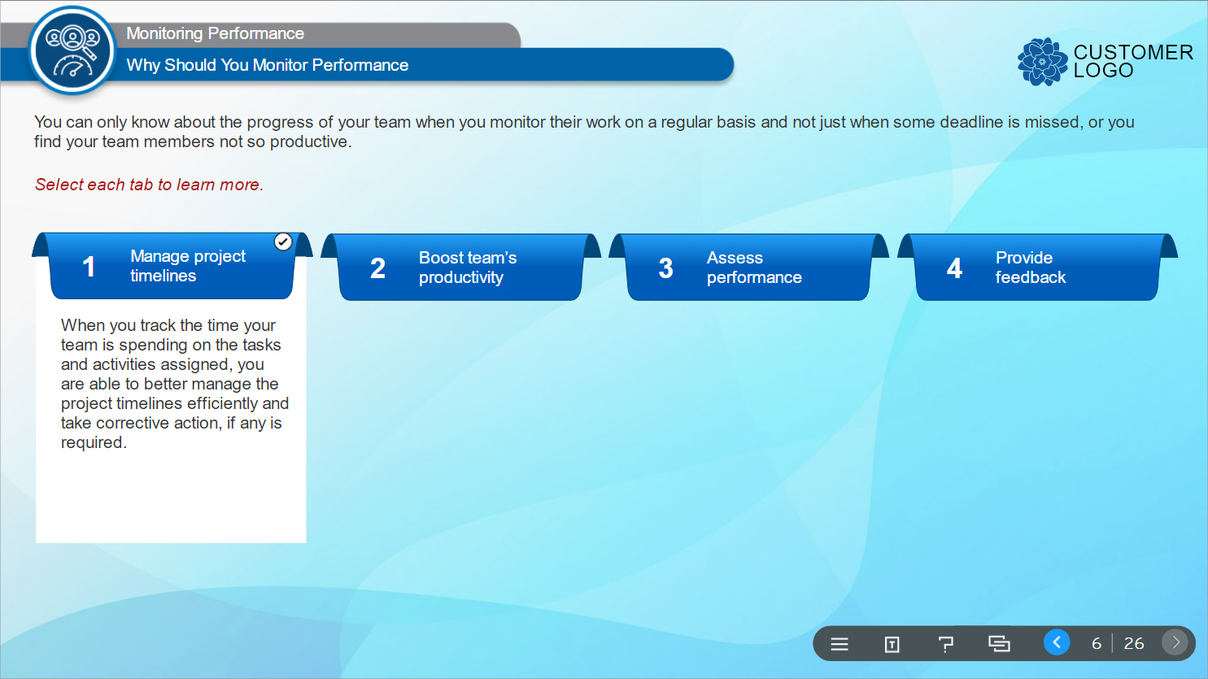
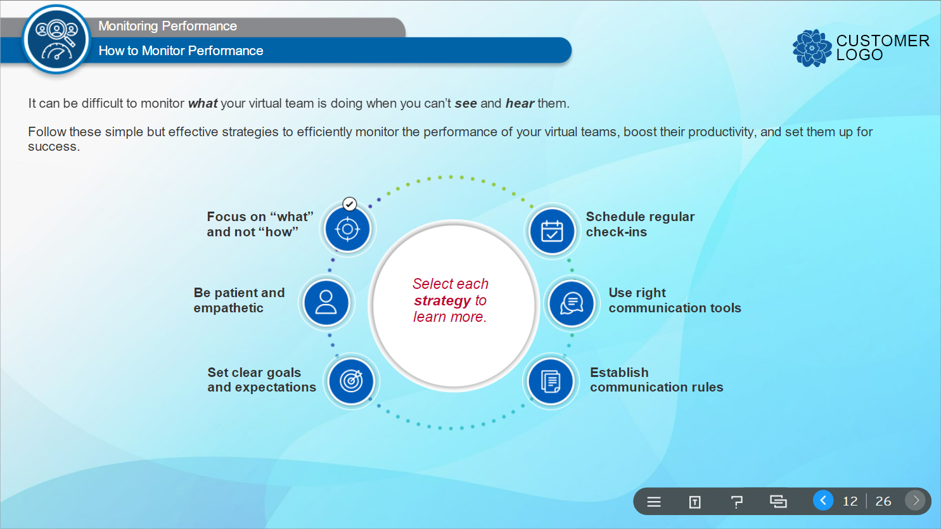
Photoshop Mock-up Design Sample - 1
The course was developed using Articulate Storyline 360.
Used Photoshop CC to design mockups.

Slide 12
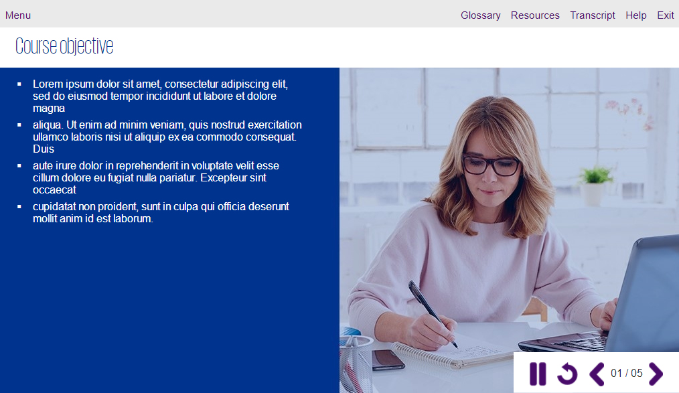
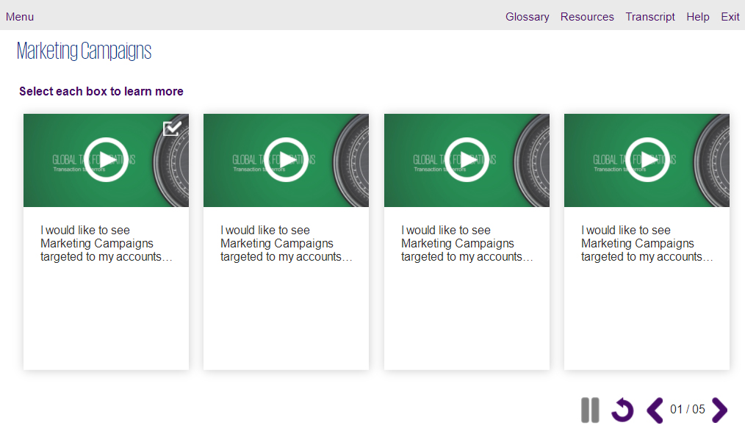
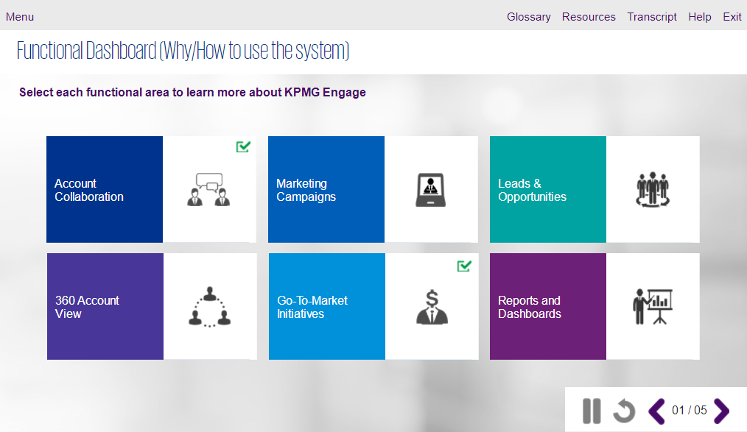
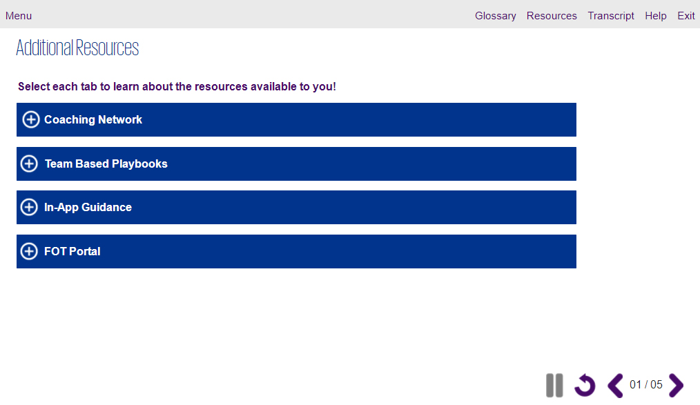
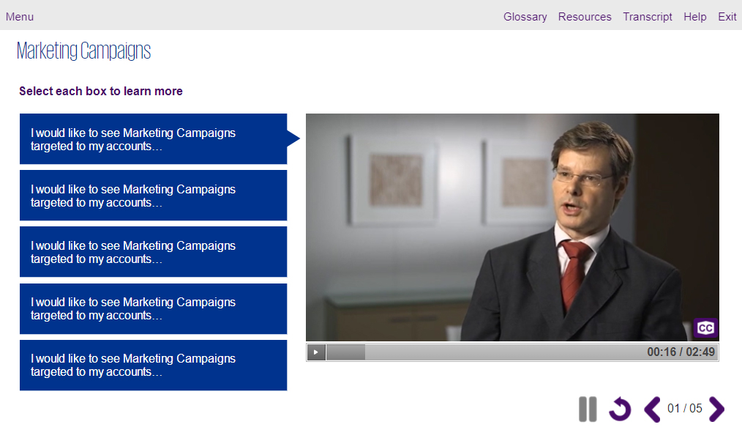
Photoshop Mock-up Design Sample - 2
The course was developed using Articulate Storyline 3.
Used Photoshop CC to design mockups.

Slide 13
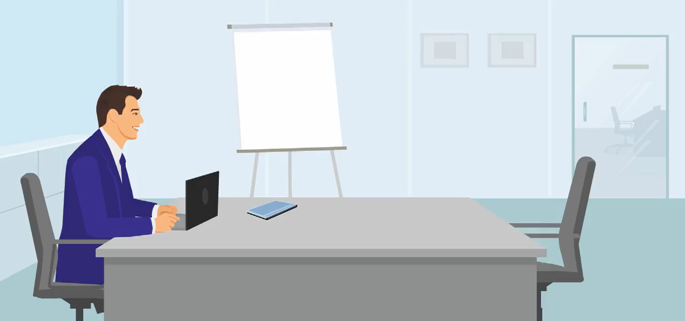
Adobe Flash Animation
The animation was created using Adobe Flash.
Click the Play button to play the video sample

Slide 14

Adobe Flash Animation
The animation was created using Adobe Flash.
Click the Play button to play the video sample

Slide 15




Tools Proficiency
Development tools
Articulate Storyline 360
Articulate Storyline 3
Design Tools
Adobe Creative suite (Photoshop, Illustrator, Indesign, XD)
MS Office Suite (PowerPoint, Word, Excel)
Animation/Video Tools
Adobe Flash/Animate
Sound Editing Tools
Audacity

Slide 16
Thank You

