Slide 1

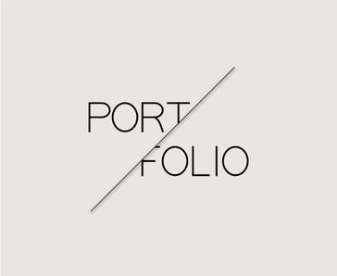
Kamar Hussain
E-learning Designer and Developer

Slide 2

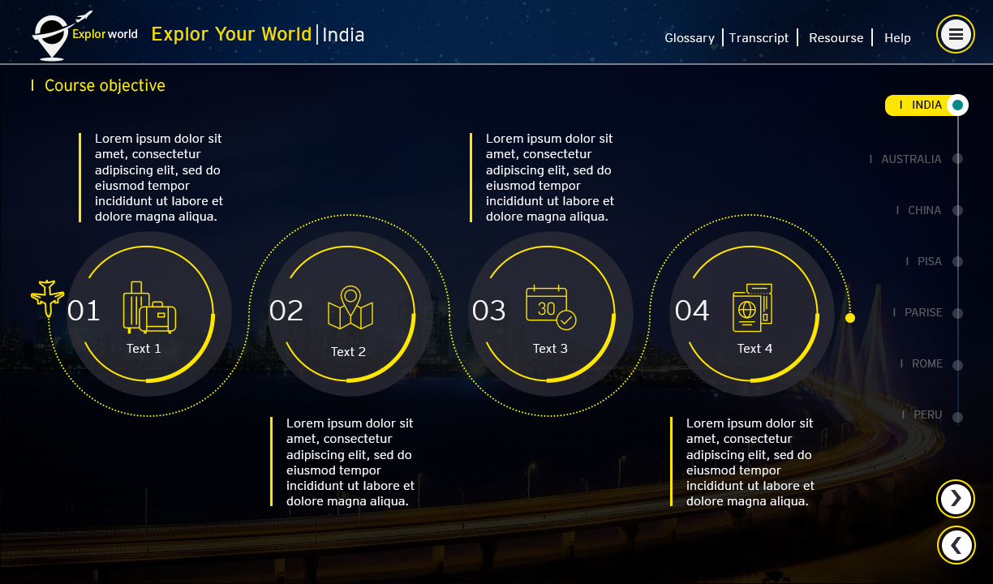
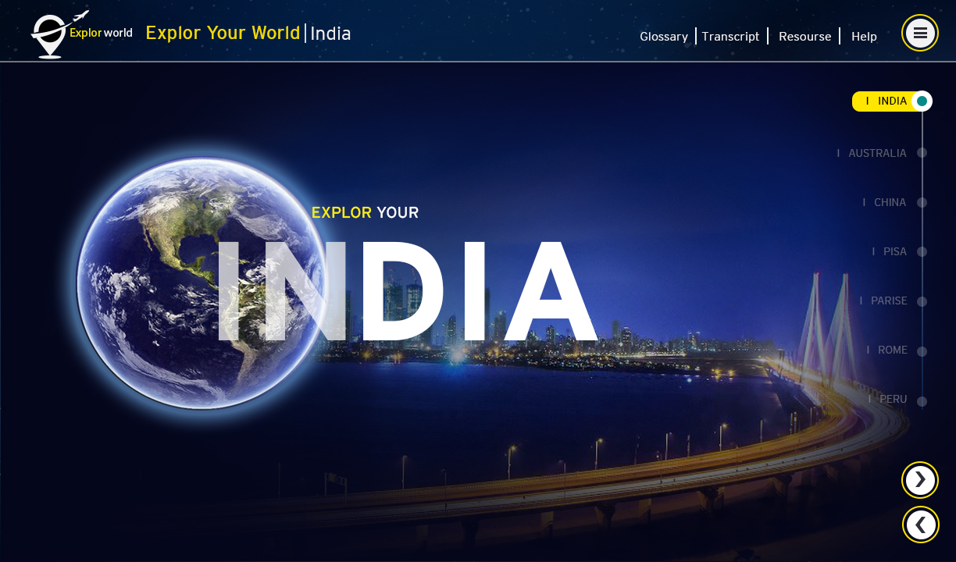
Photoshop Samples
Mockups created for storyline course using Photoshop.

Slide 3

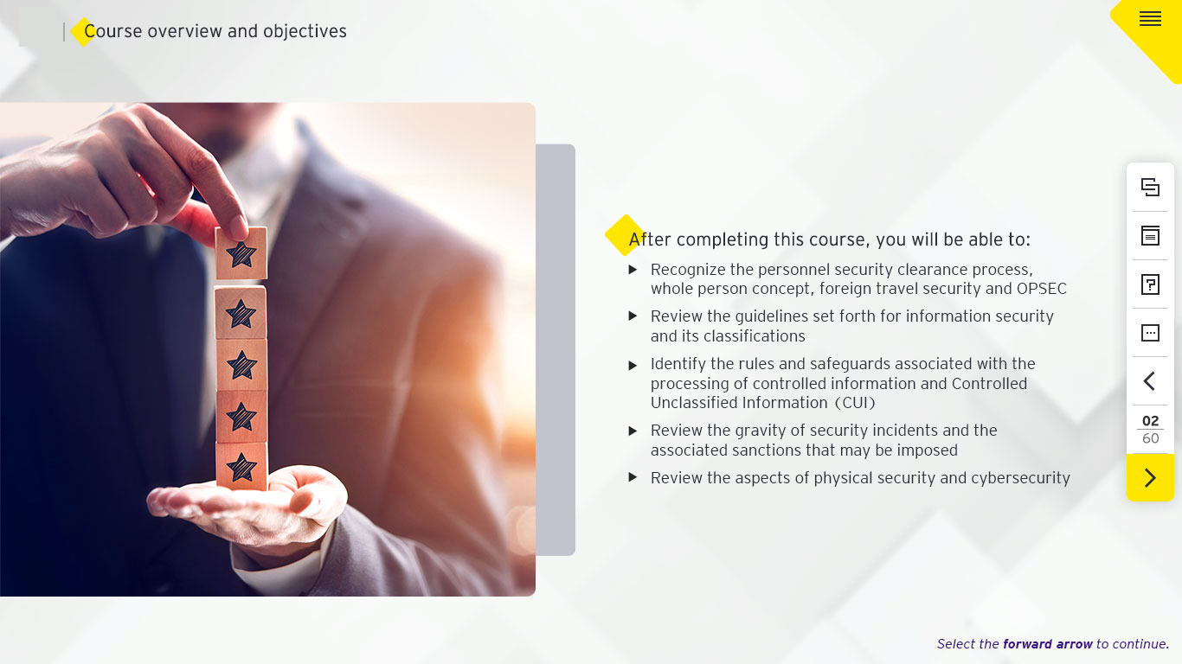
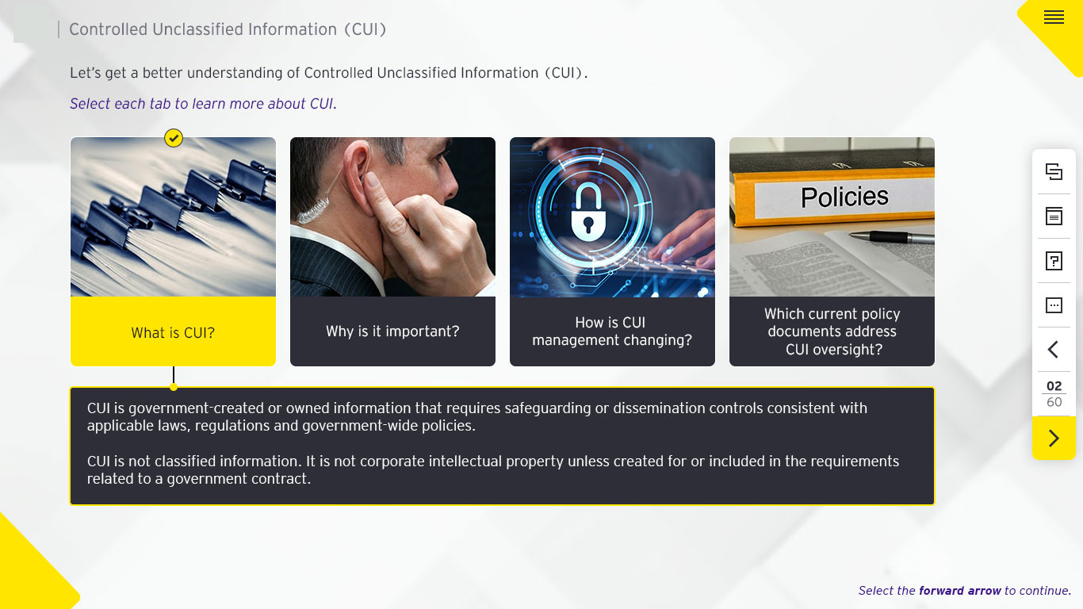
Photoshop Samples
Mockups created for storyline course using Photoshop.

Slide 4
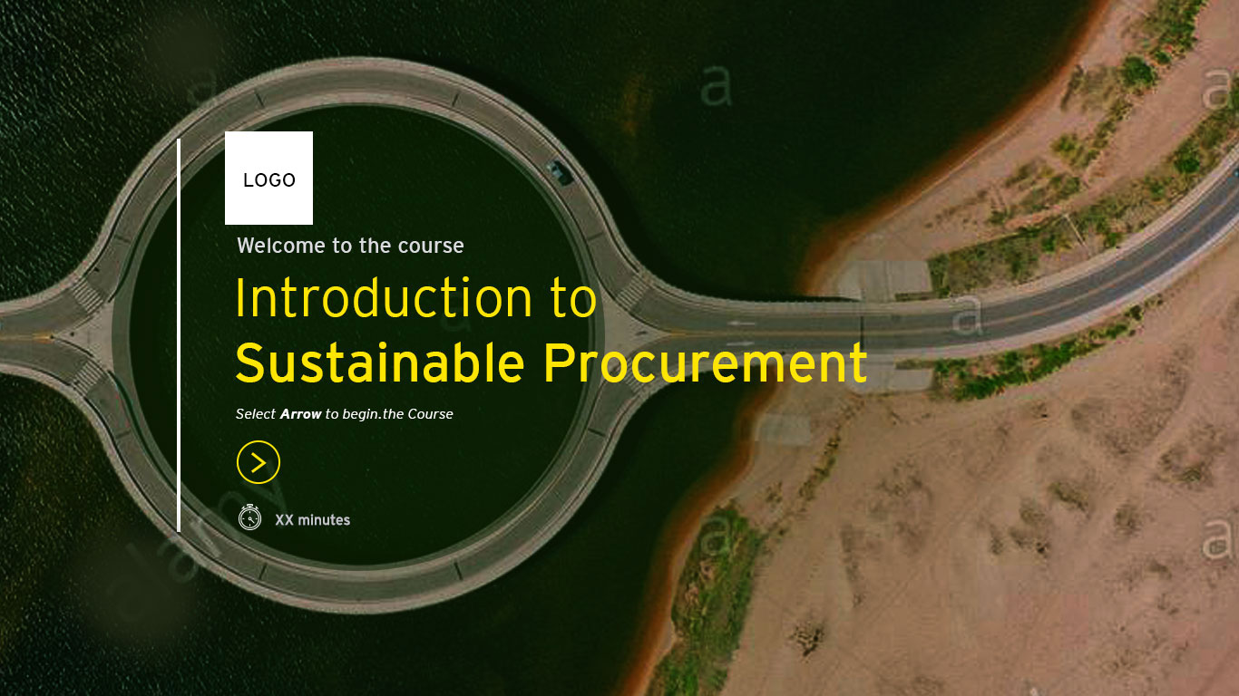
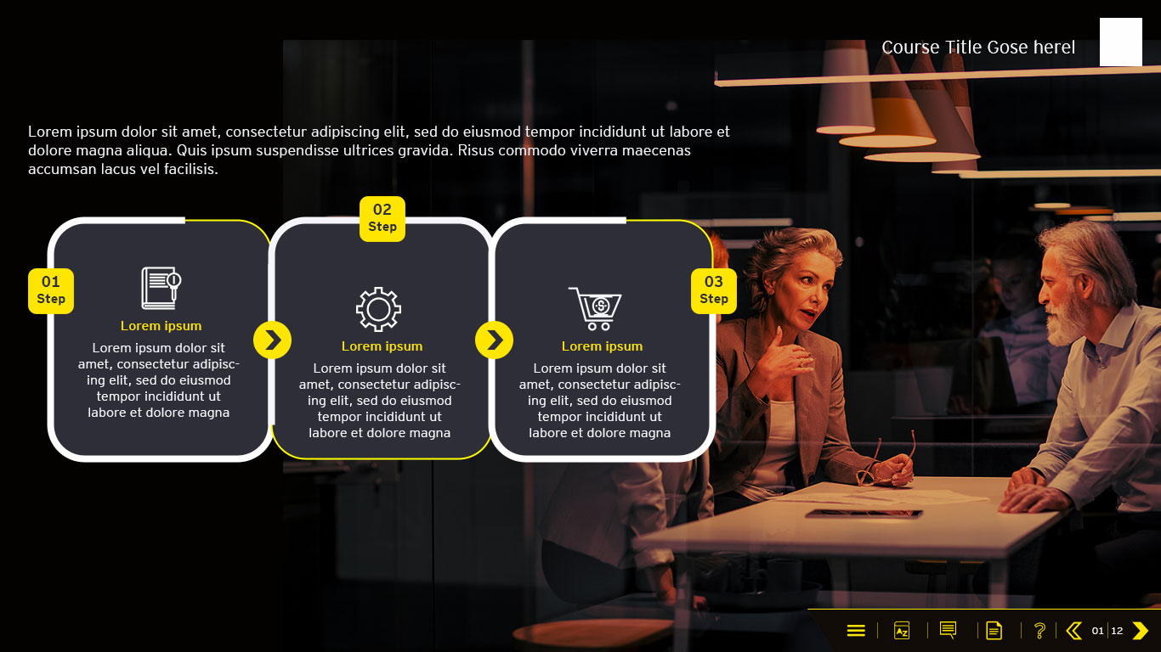
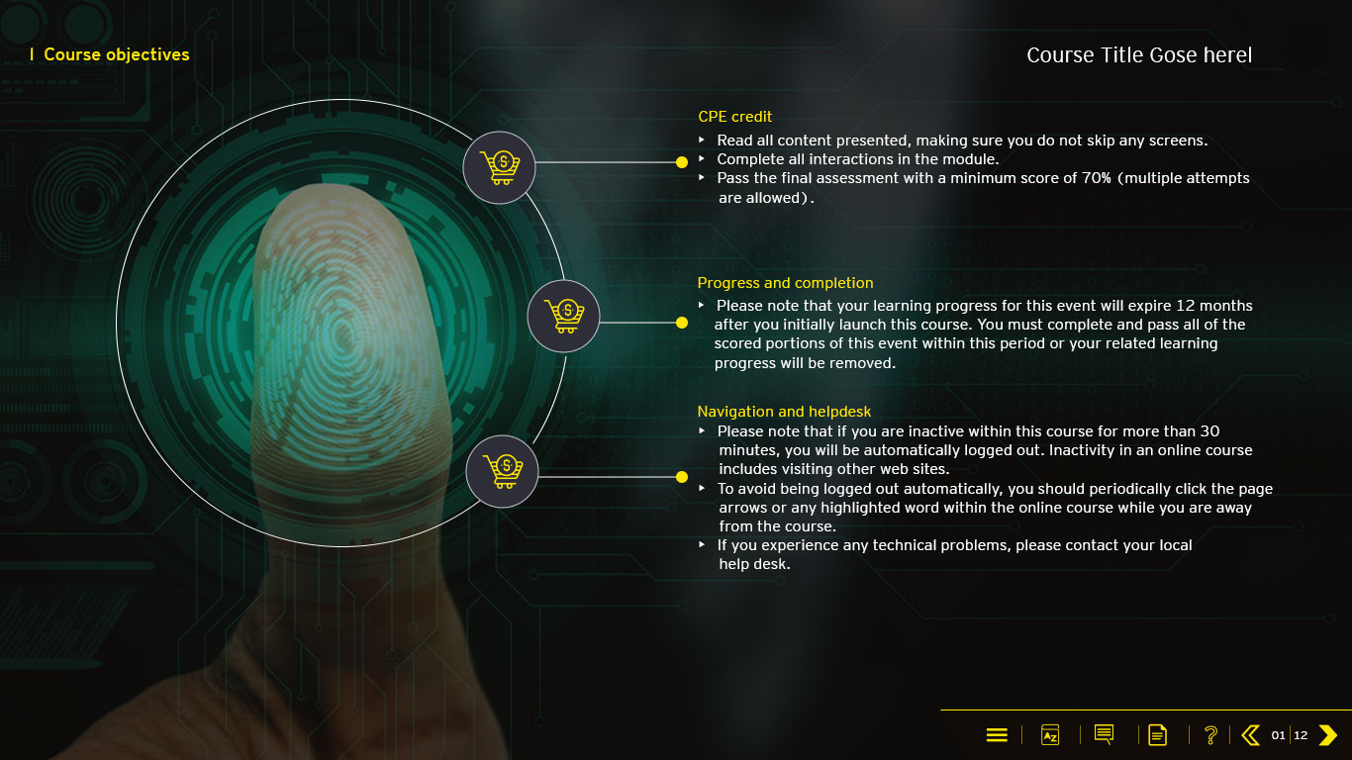
Photoshop Samples
Mockups created for HTML course using Photoshop.

Slide 5

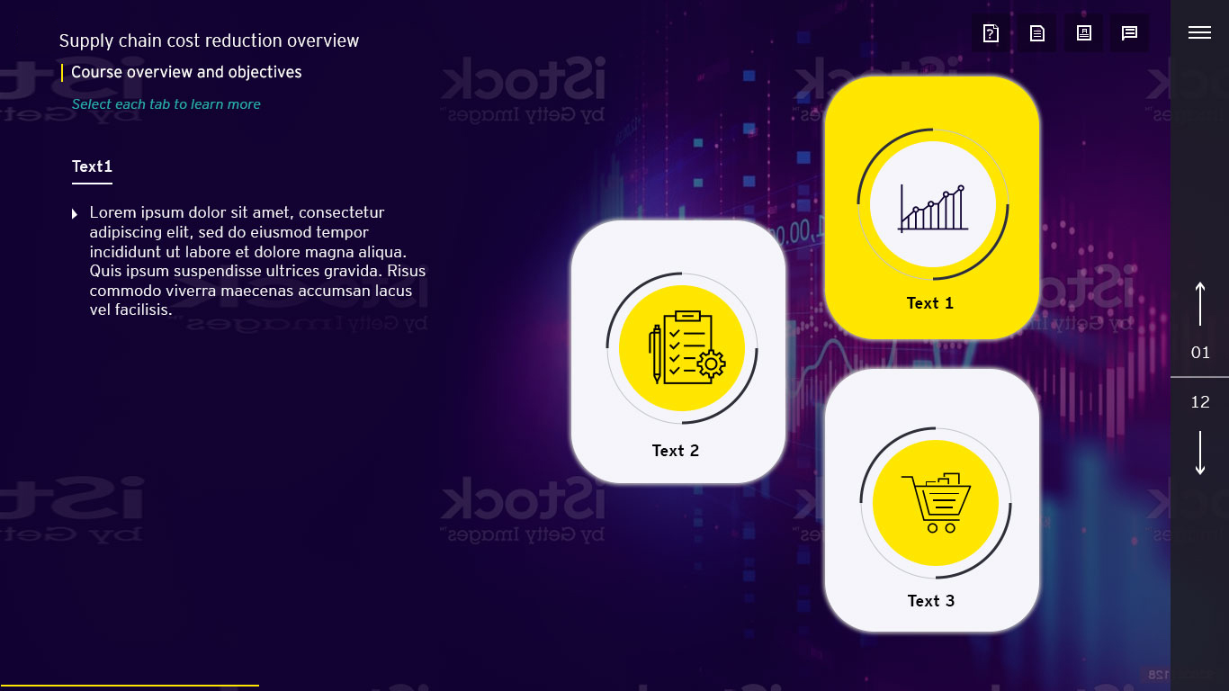
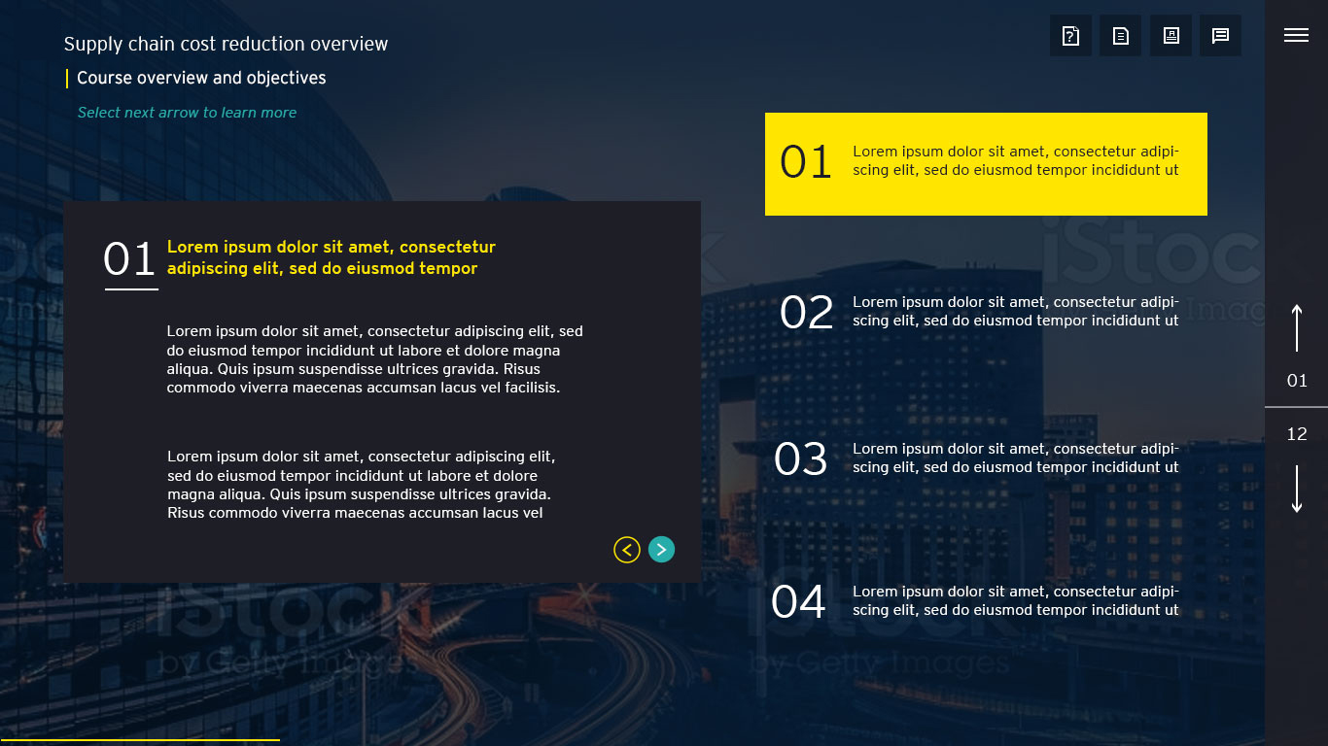
Photoshop Samples
Mockups created for HTML course using Photoshop.

Slide 6
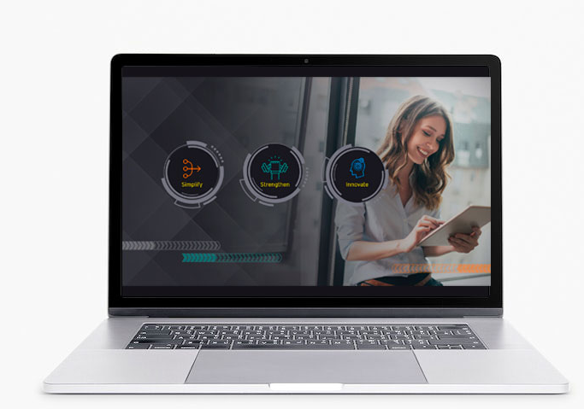
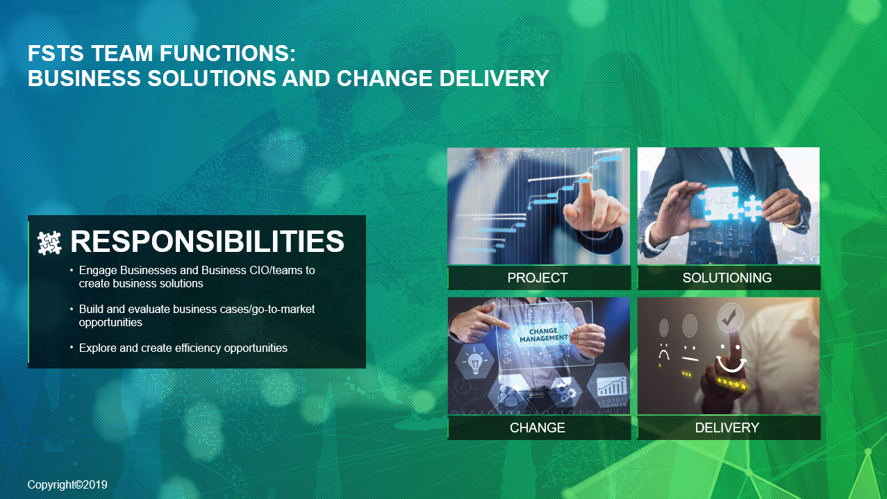


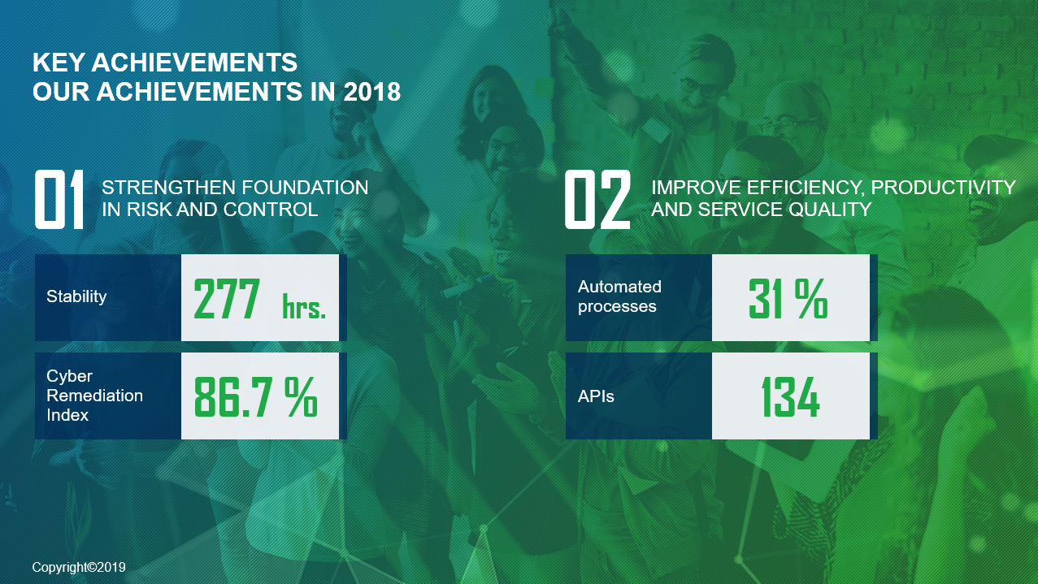
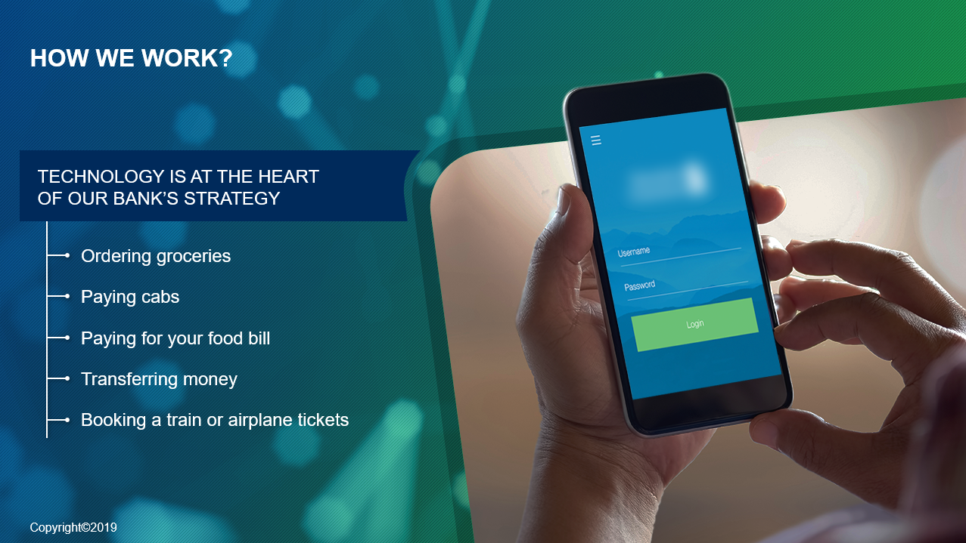
ILT Design in PowerPoint
This ILT created using the tools mentioned below.
Tools:
Microsoft PowerPoint
Adobe Photoshop
Adobe Illustrator

Slide 7
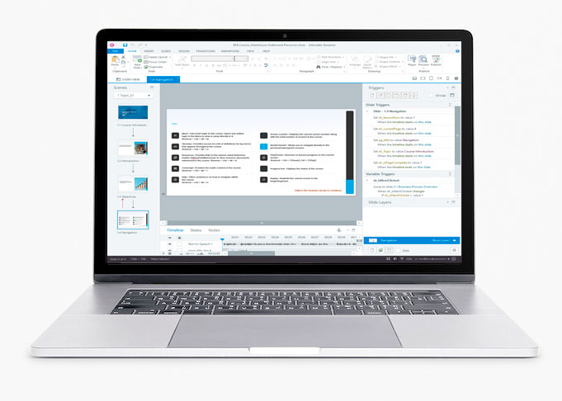

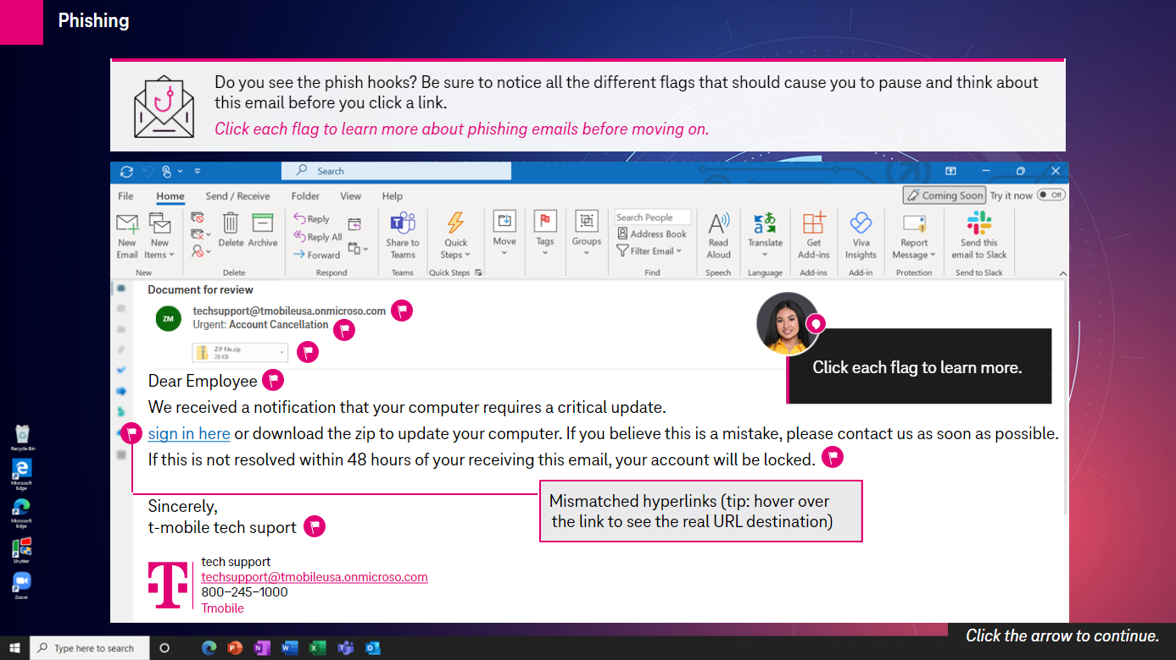
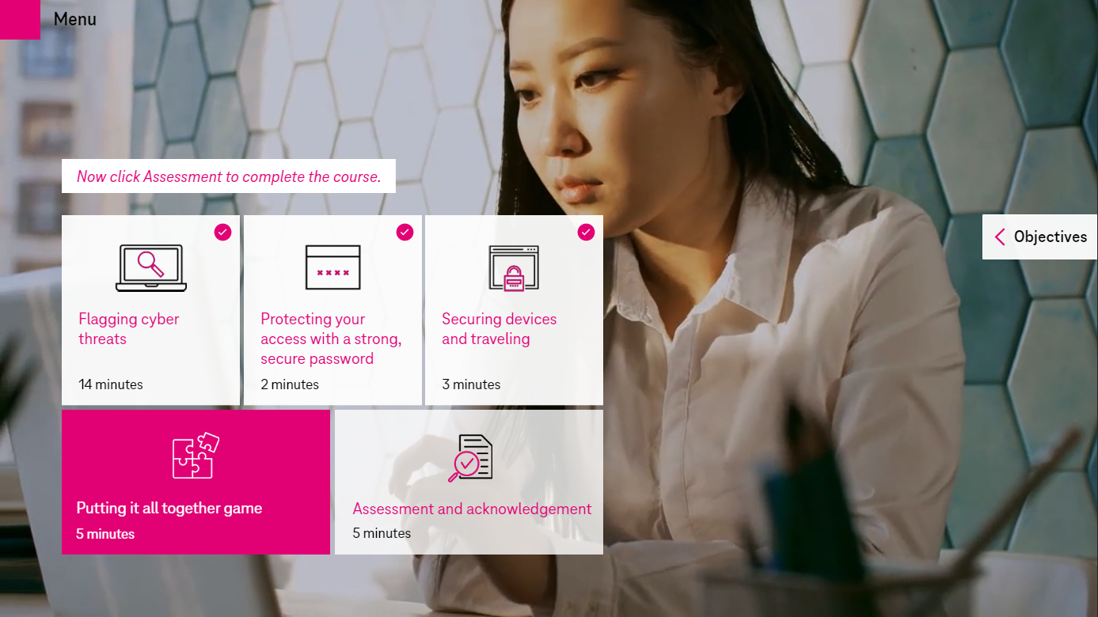
Storyline Samples
This WCAG storyline course is created using the tools mentioned below.
Tools:
Storyline 360
Adobe Photoshop
Camtasia

Slide 8
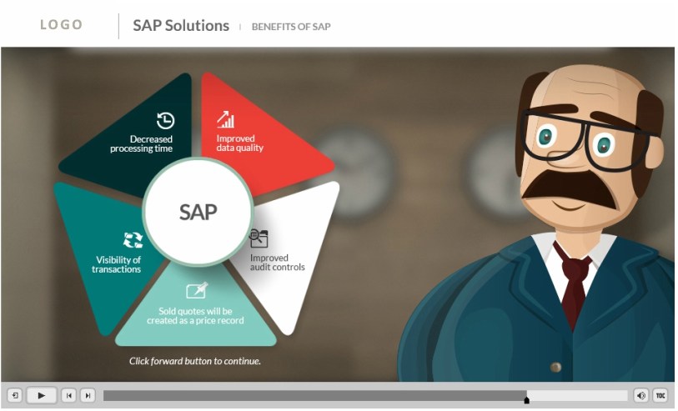
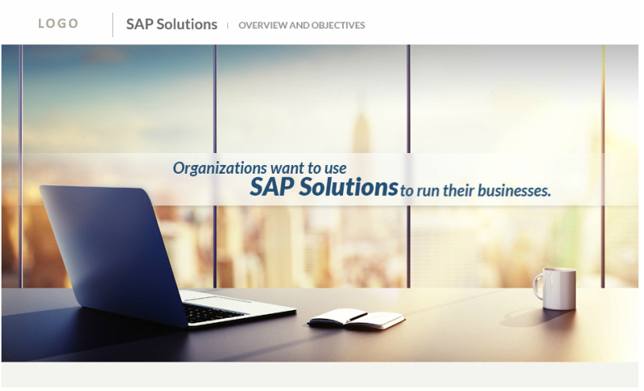
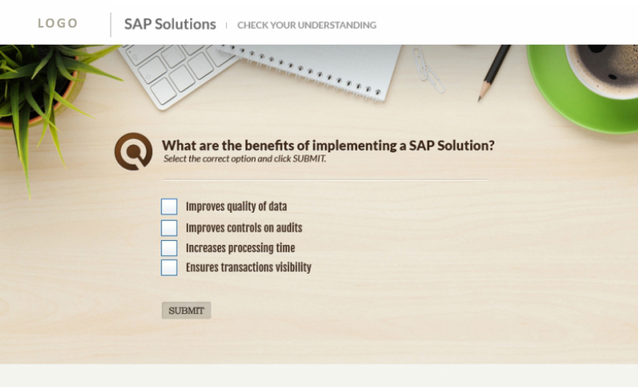
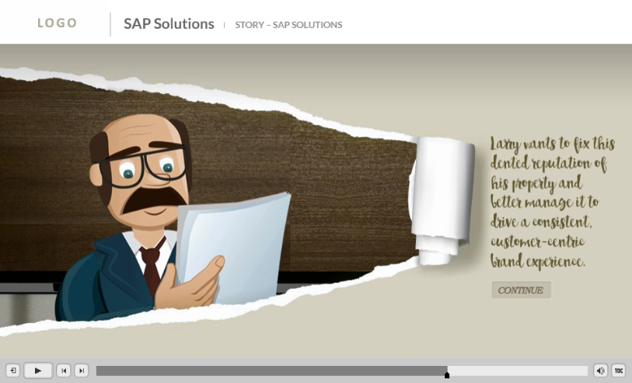
Storyline Samples
This storyline course is created using the tools mentioned below.
Tools:
Storyline 2
Adobe Photoshop
Adobe Illustrator
Sound Forge

Slide 9

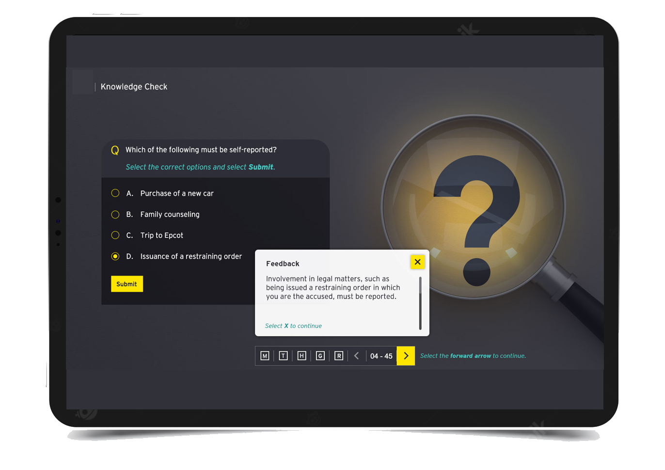
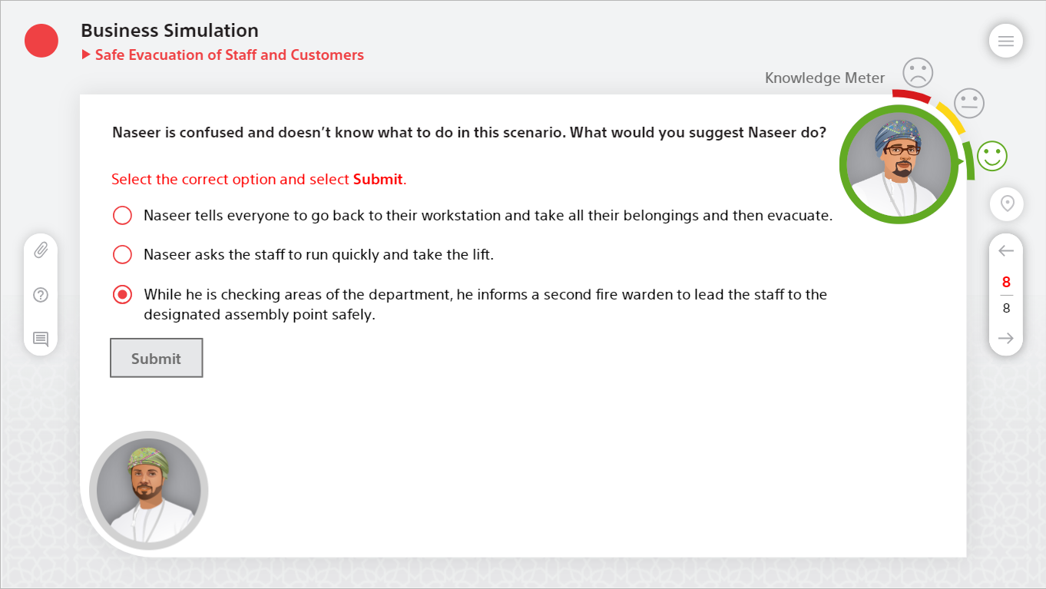
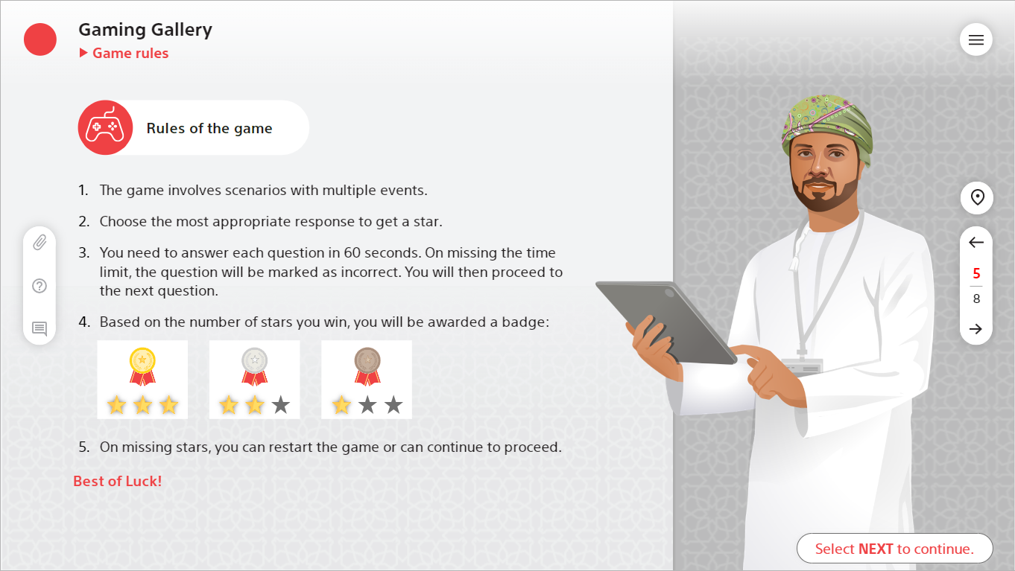
Storyline Samples review link
This storyline course is created using the tools mentioned below.
Tools:
Storyline 360
Adobe Photoshop
Adobe XD
Time based quizzes and scenario-based question and answers.
Created by SUBAIDA
Click the Play button to play the sample

Slide 10

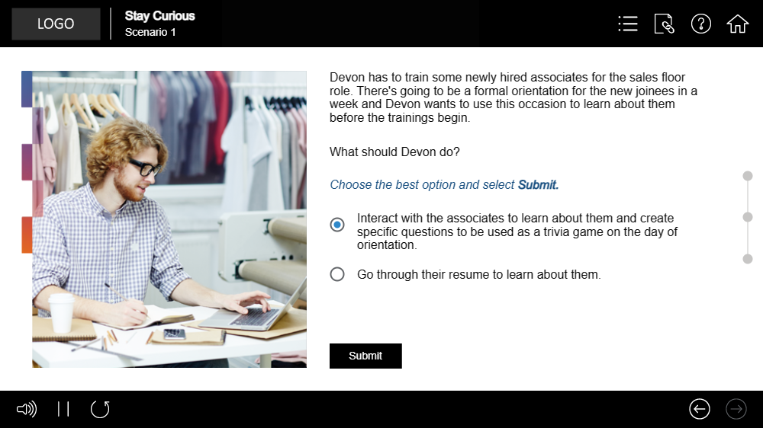
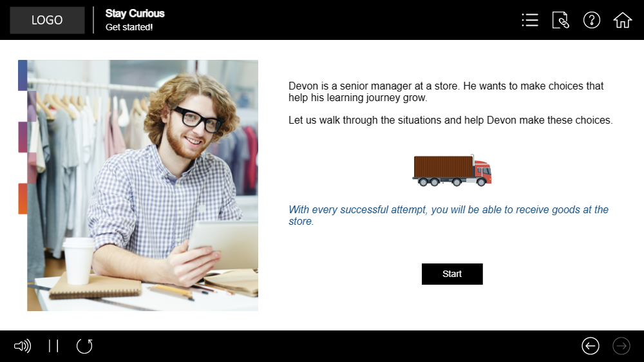
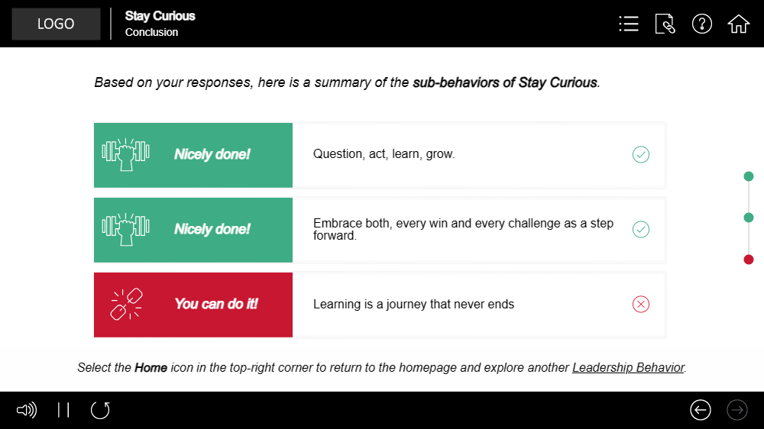
Captivate Samples (Micro Learning)
This captivate course (full custom GUI) is created using the tools mentioned below.
Tools:
Captivate 2019
Adobe Photoshop
Sound Forge

Slide 11
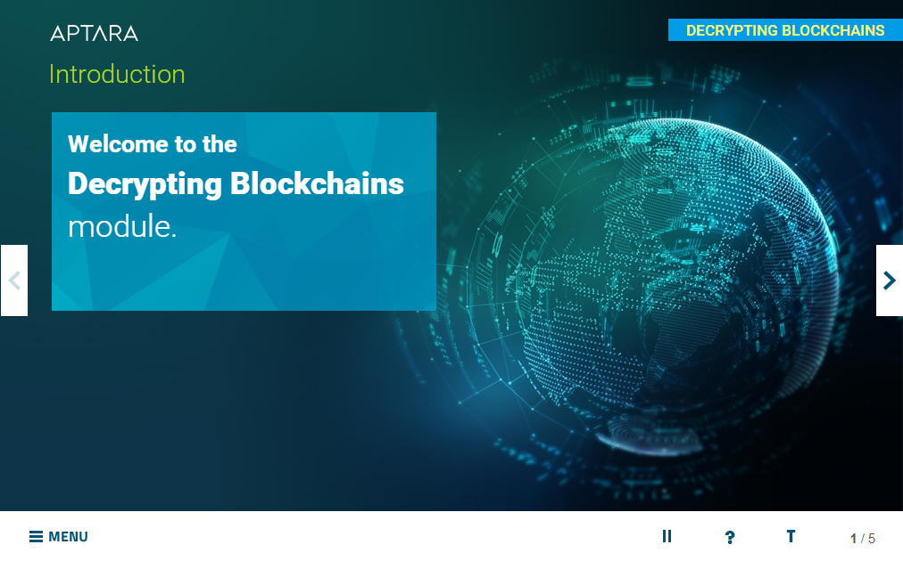
Micro Learning
This captivate course (full custom GUI) is created using the tools mentioned below.
Tools:
Captivate 2019
Adobe Photoshop
Sound Forge
Click the Play button to play the sample

Slide 12
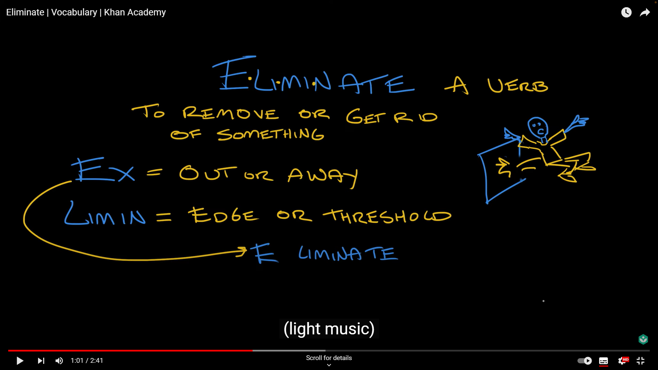
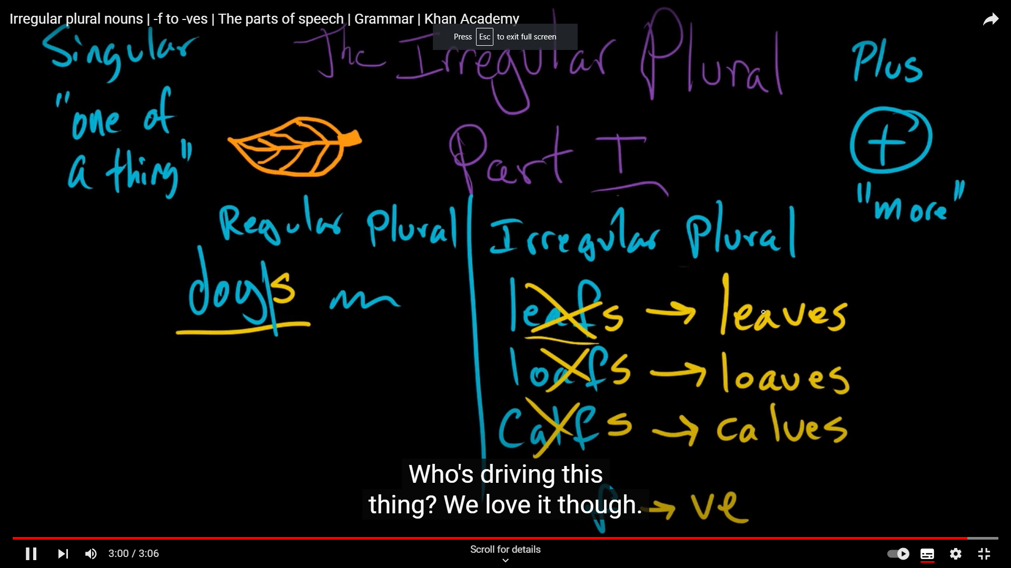
Camtasia Sample link
Video editing in using Camtasia, here are some sample work.
Tools:
Camtasia
Adobe Photoshop
Sound Forge
Click the Play button to play the video sample

Slide 13
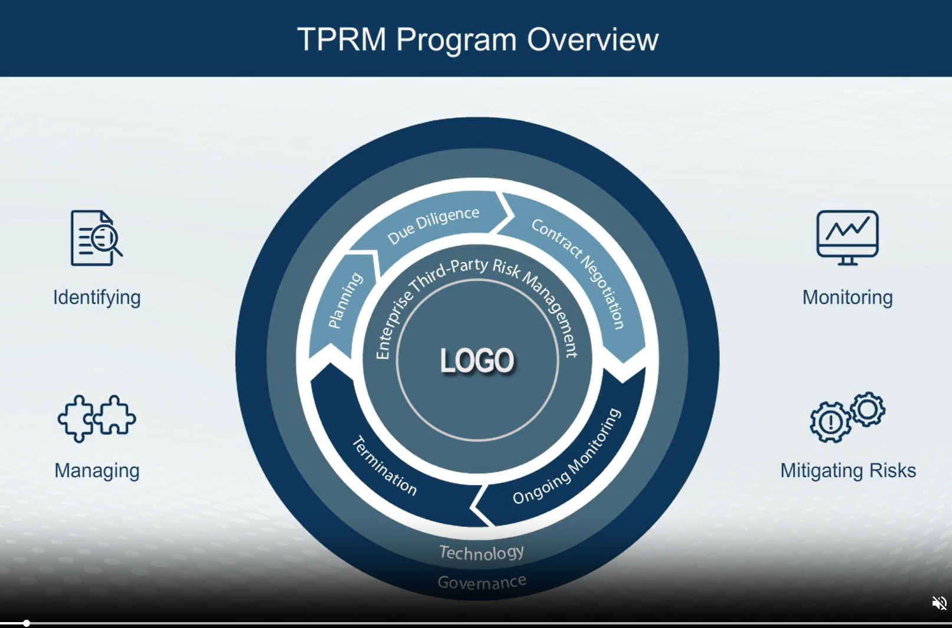
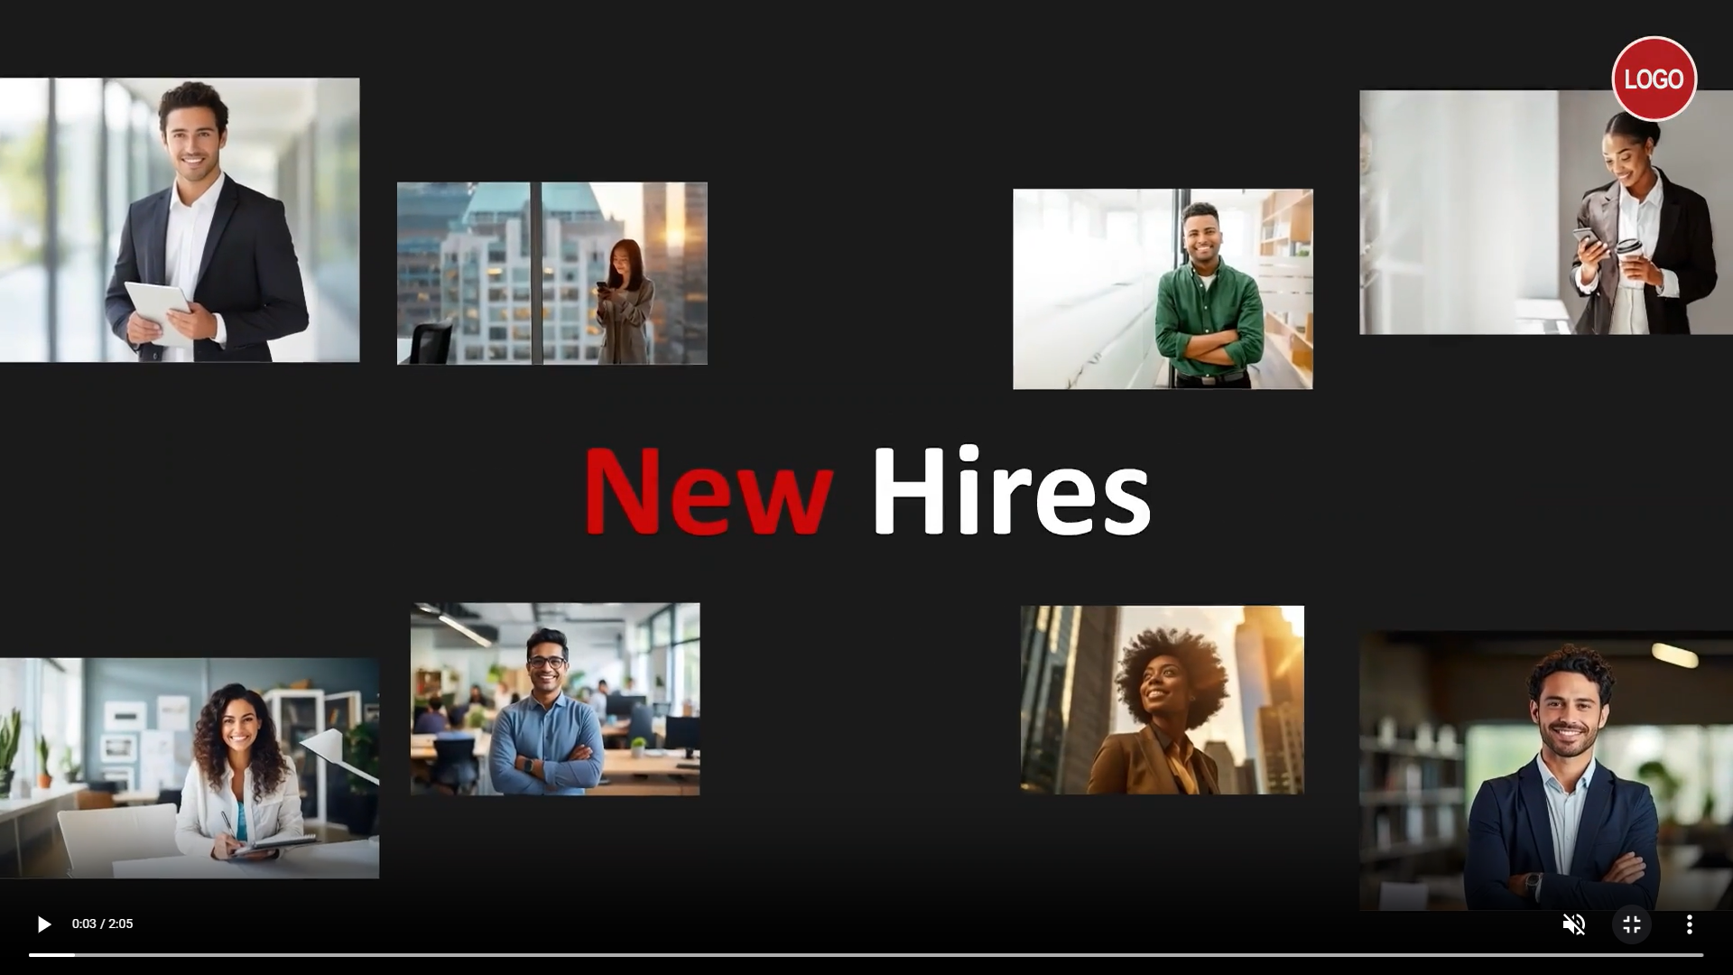
Video Based Learning
Video editing in using Camtasia, here are some sample work.
Tools:
Camtasia
Adobe Photoshop
Sound Forge
Click the Play button to play the video sample

Slide 14
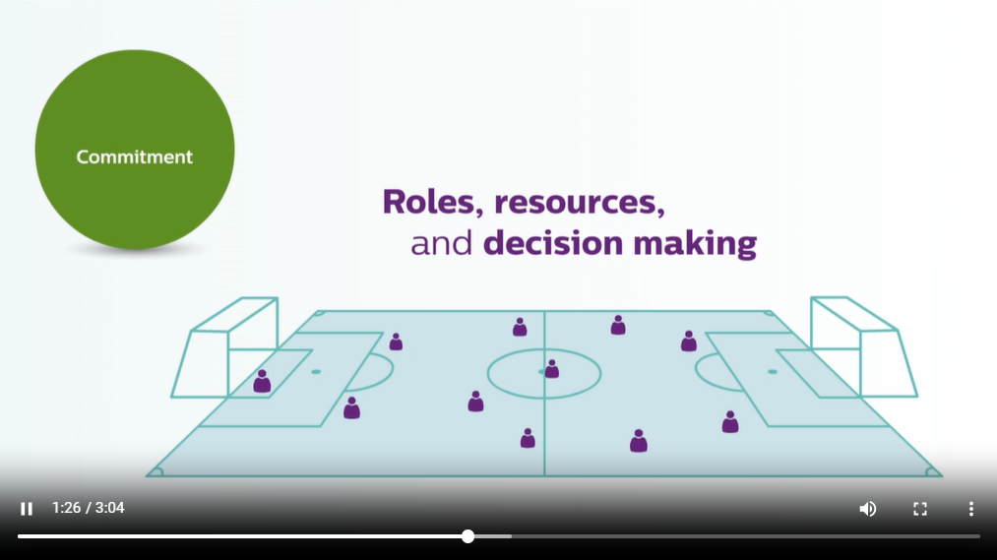
Video Based Learning (Whiteboard or Green screen videos)
Video editing in using Camtasia, here are some sample work.
Tools:
Camtasia
Adobe Photoshop
Sound Forge
Click the Play button to play the video sample

Slide 15
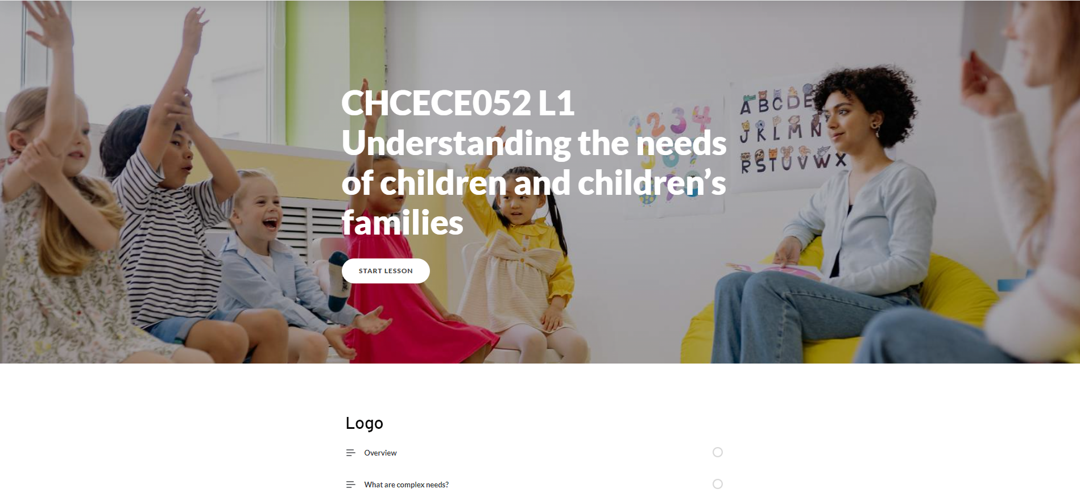
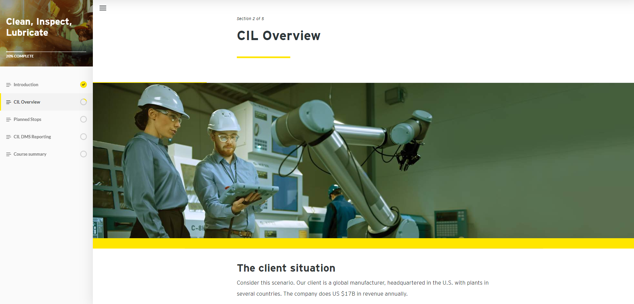
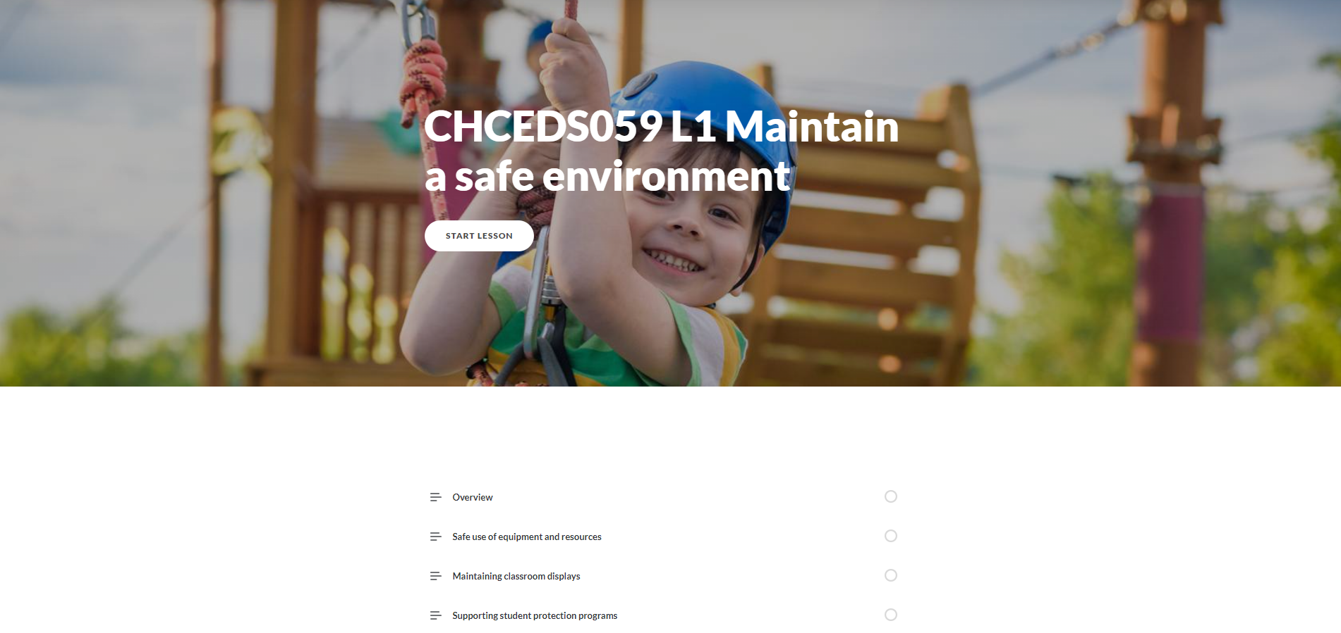
Rise Samples
This course are created using Rise360

Slide 16
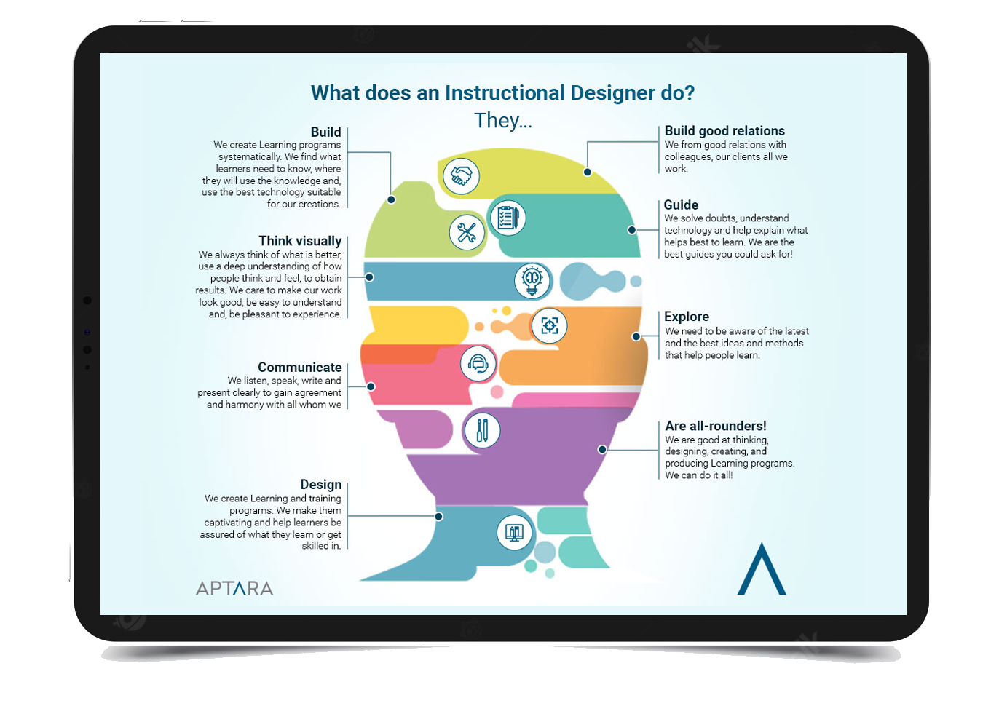
Illustrator Samples
Below mockup are created in Adobe Illustrator

Slide 17
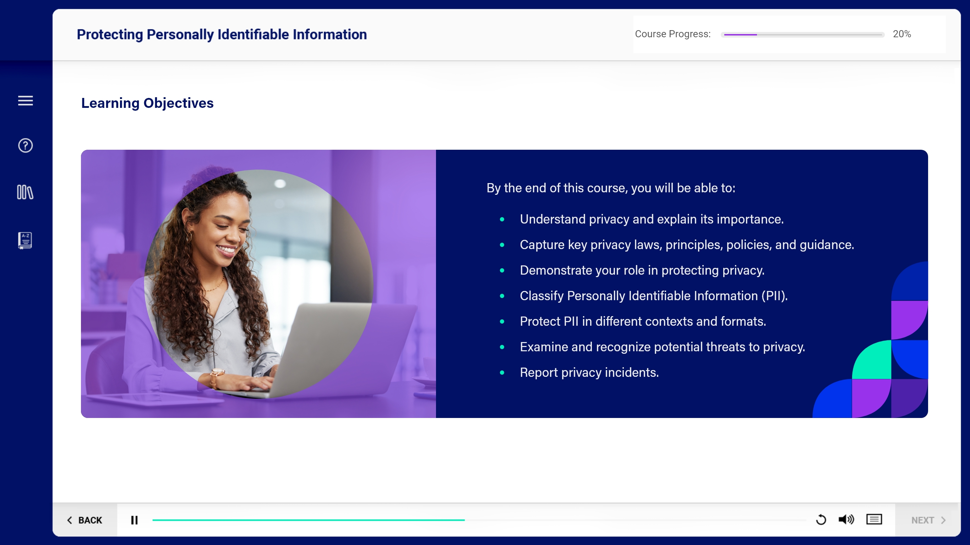
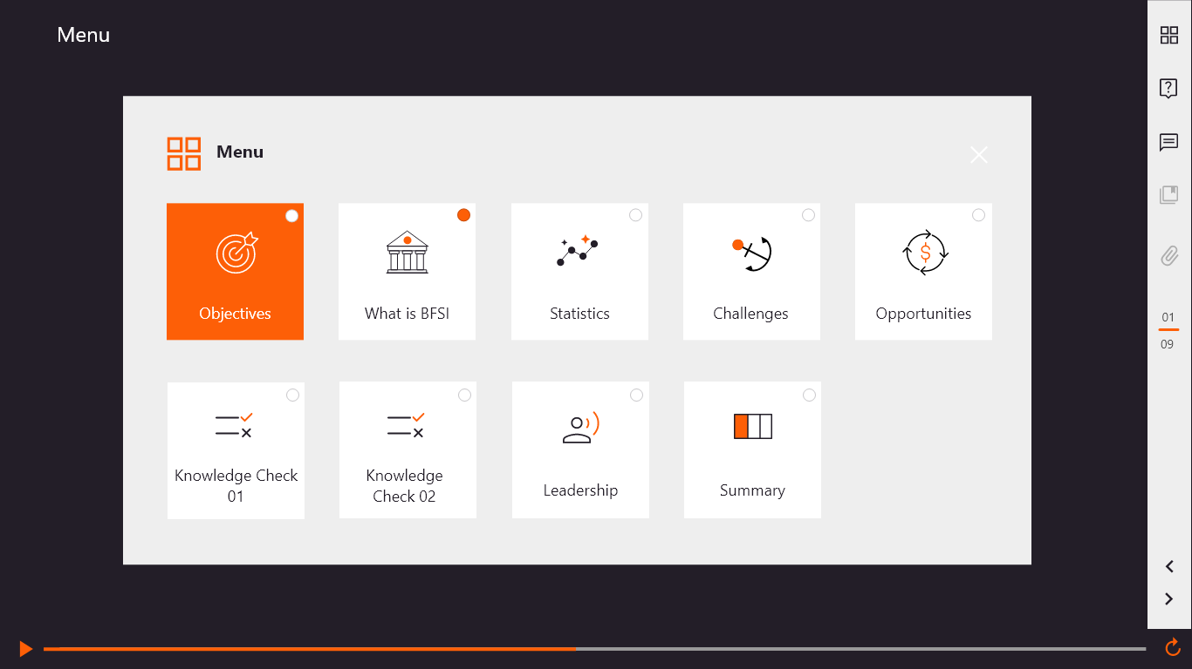
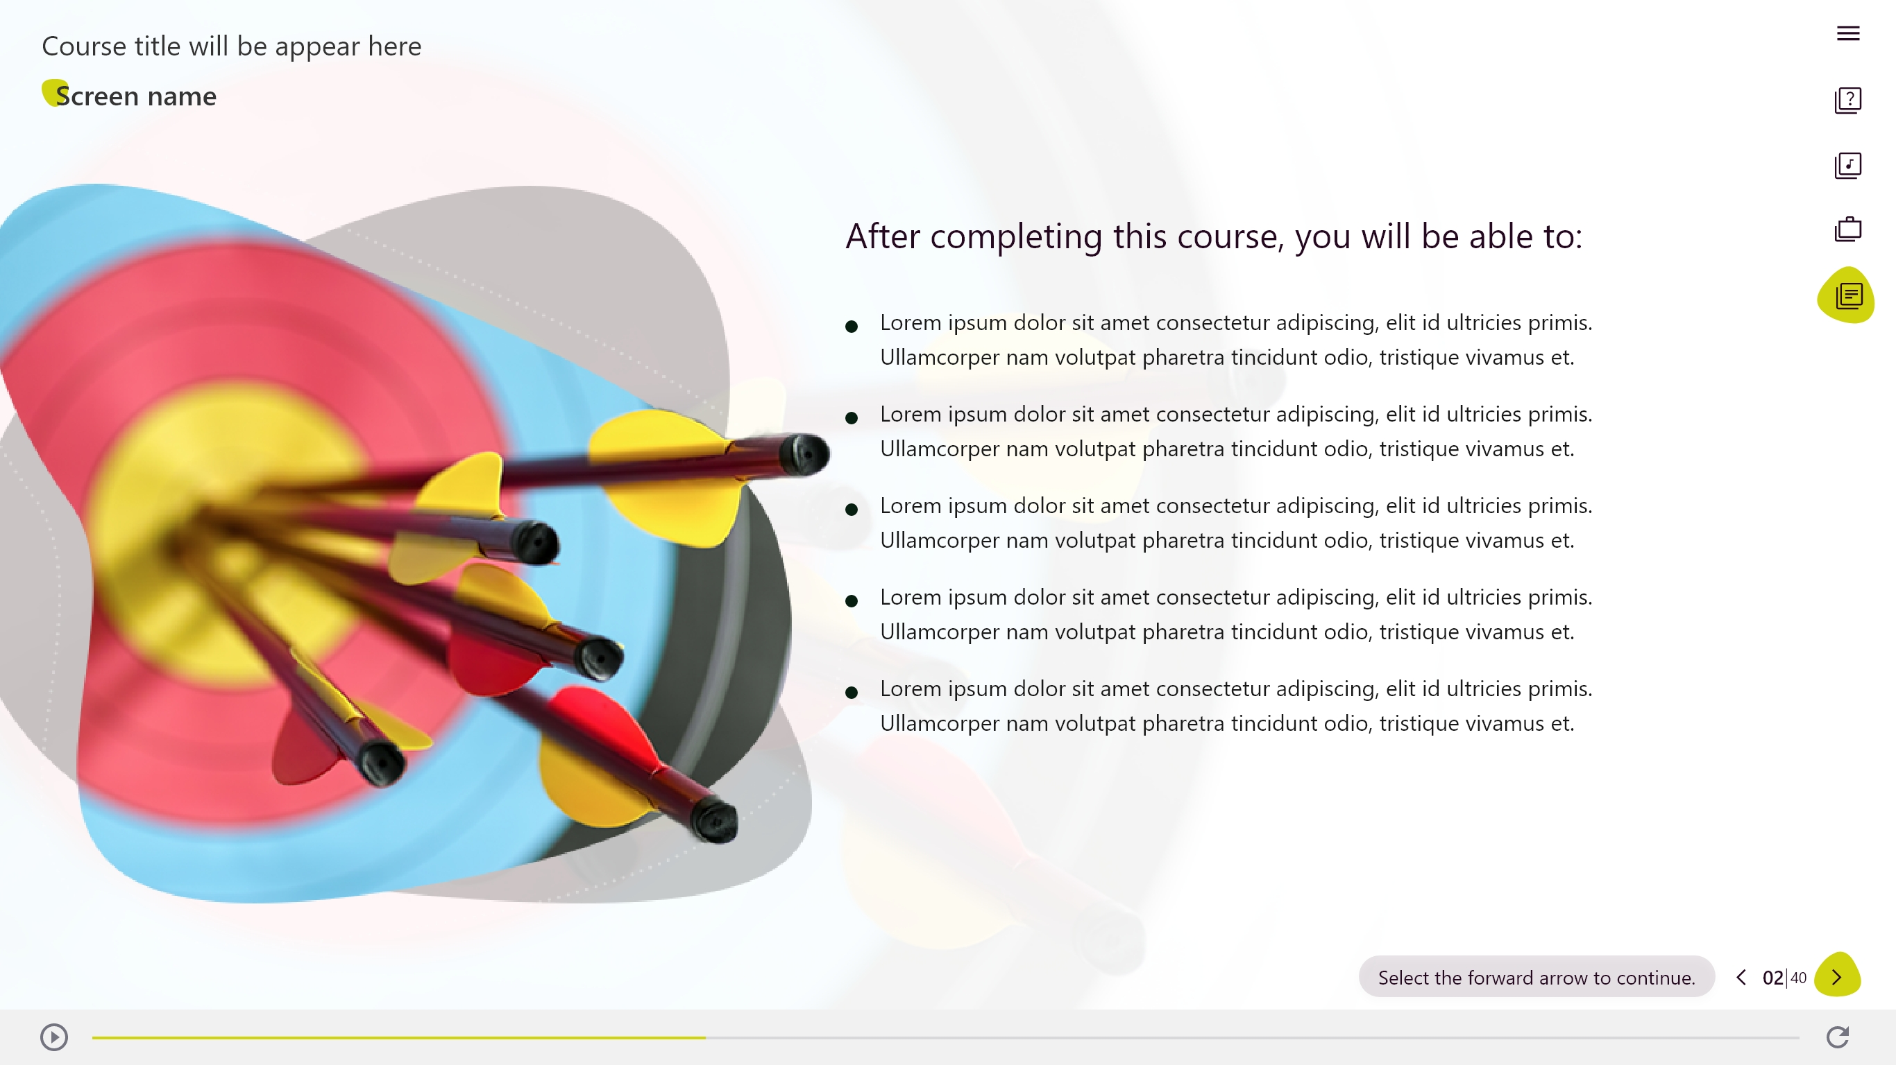
Adobe XD Samples
Mockups created for HTML, and storyline course using XD.

Slide 18

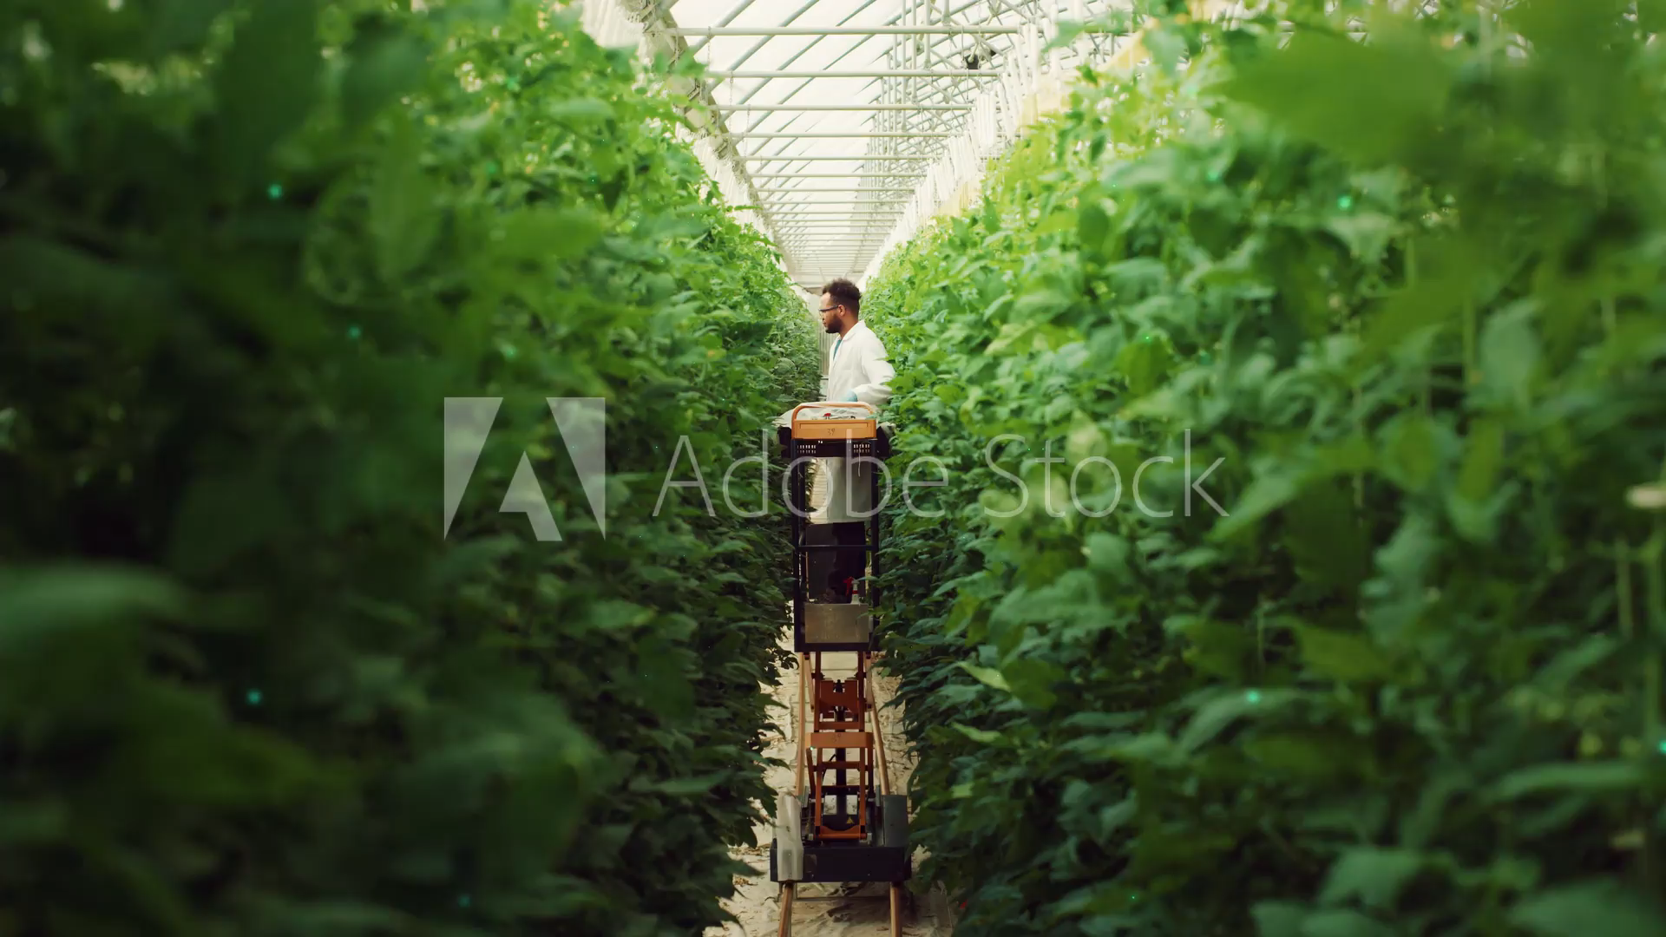


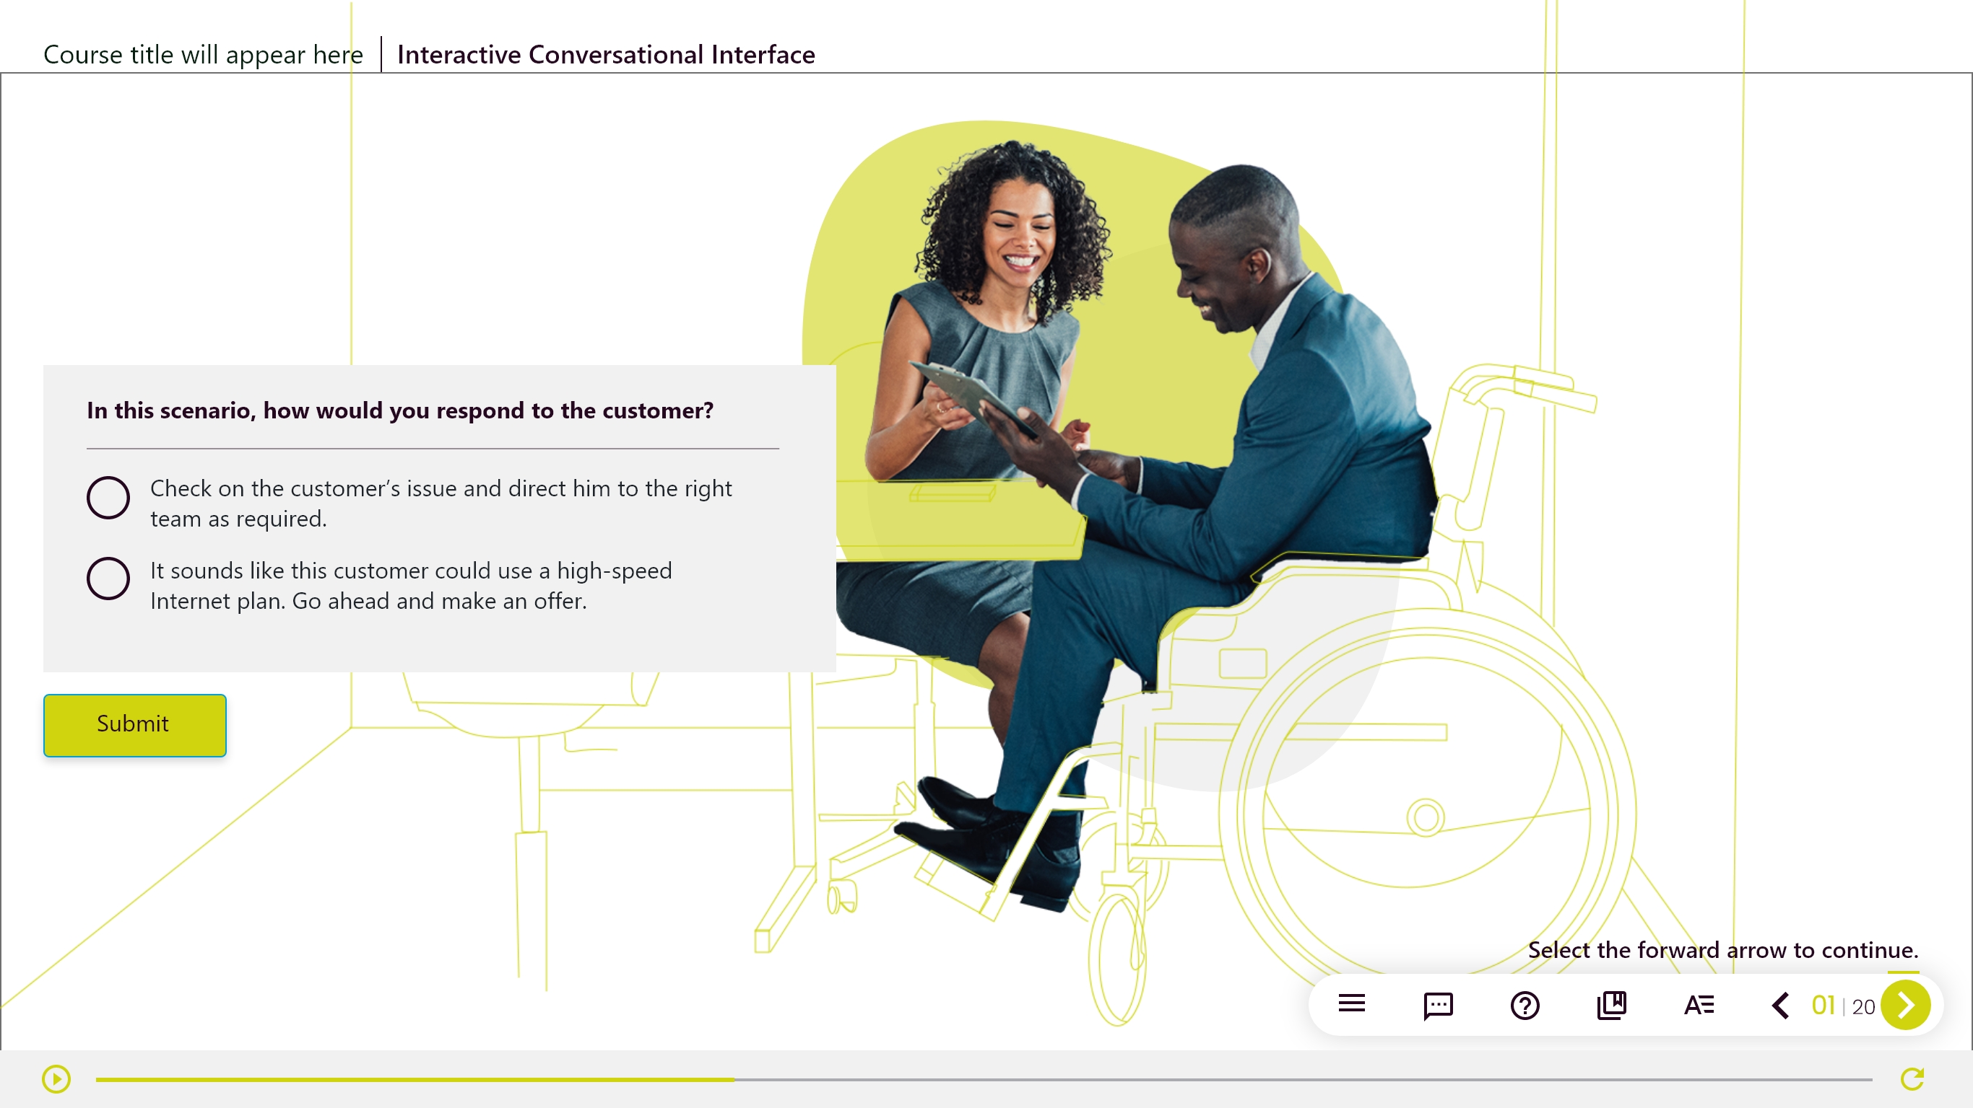
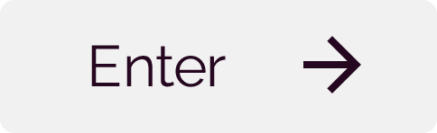
Adobe XD Samples
Mockups created for HTML, and storyline course using XD.

Slide 19


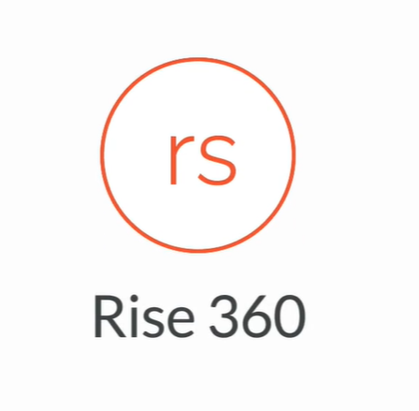


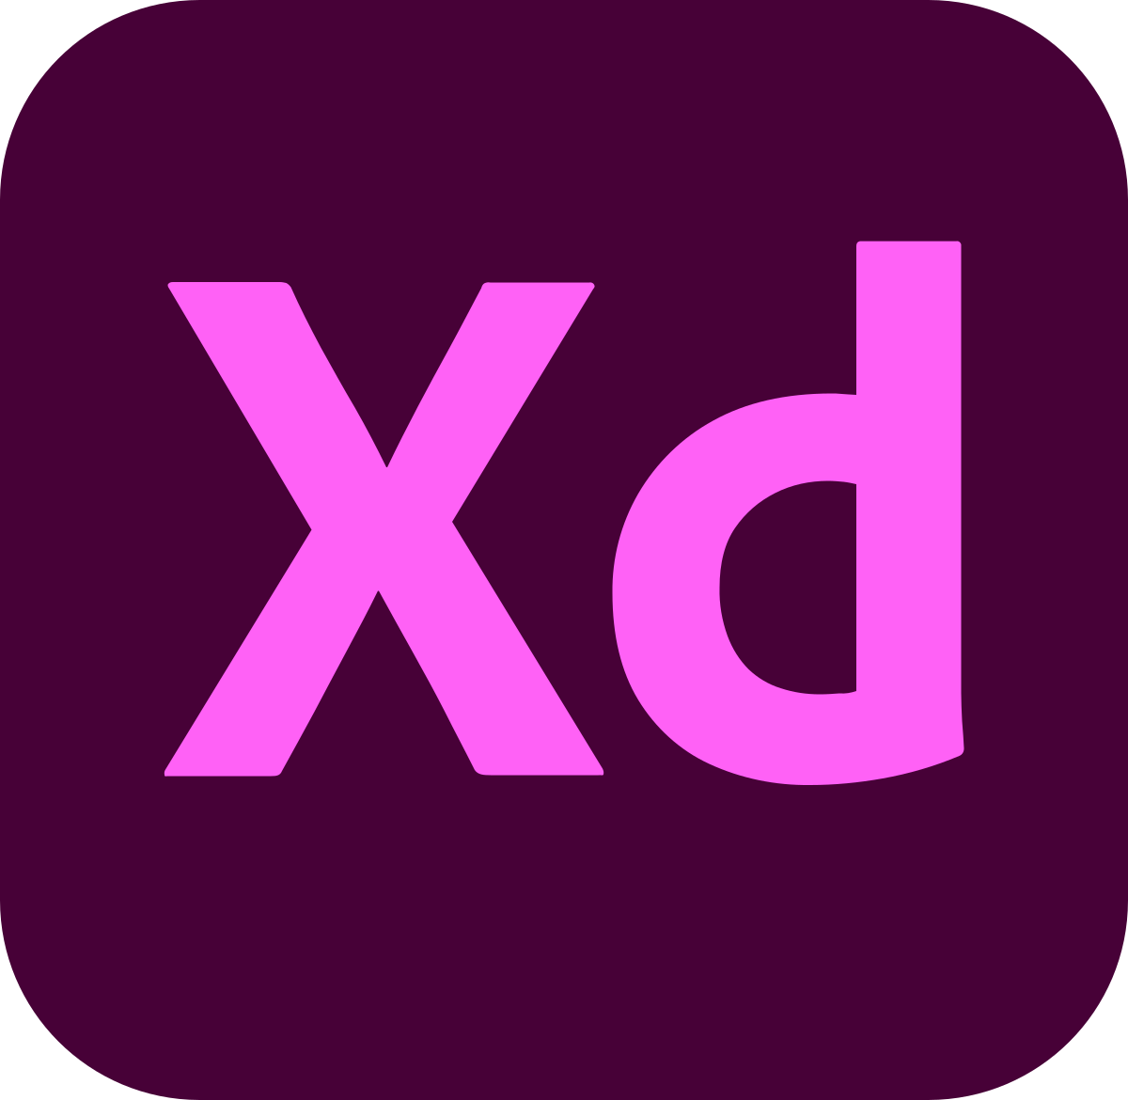
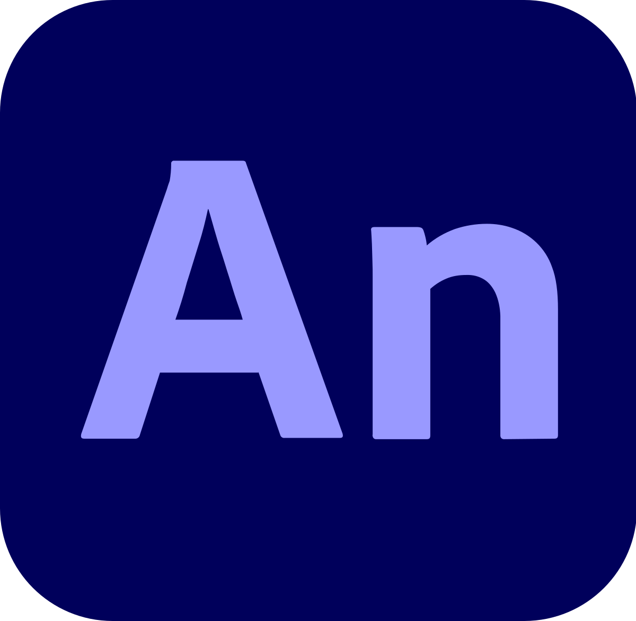

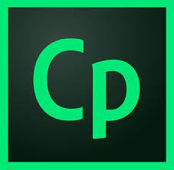




Training Tool
Tool
Level (Intermediate/Advanced/Expert)
Adobe Photoshop CC
Expert
Adobe Illustrator CC
Expert
Articulate Rise
Expert
Audacity
Expert
MS Office Suite (PowerPoint, Word, Excel)
Advanced
Adobe XD
Advanced
Adobe Animate
Expert
Vyond
Intermediate
Adobe Captivate
Expert
Articulate Storyline 360
Expert
Camtasia
Expert
HTML5
Advanced
CSS
Intermediate

Slide 20
THANK YOU

