Slide 1


Day 6: Agenda
Week 1 Recap
US Banking Laws and Regulation
Tickets and Back-Office Support
Handling Disputes
30 mins
45 mins
100 mins
95 mins
Pay Wallet
Tools Exploration
Wrap-Up
BAI Compliance Training
70 mins
80 mins
40 mins
60 mins
Notes:
Duration: 2 minutes
Say:
You were introduced to tools such as Zendesk and Slack in earlier sessions. Recall that Zendesk is your primary tool for documenting interactions, note-taking, submitting tickets, and escalating customer issues, and that Slack facilitates internal communication.
In this module, we will discuss these tools in more detail and how they assist you in helpdesk management and customer communication. We will also engage in hands-on practice using real scenarios.
Transition:
Let’s get started!

Slide 2
Tools Exploration
Notes:
Duration:
NA
Notes:
NA

Slide 3

Zendesk

Slide 4
Zendesk: Overview
Help Desk Management
Customer Communication
Manages
Customer inquiries
Documents interactions
Submits tickets
Escalates issues
Facilitates:
Centralized communication across multiple channels
Supports back-office interactions
Notes:
Duration: 1 minute
Say:
Zendesk helps specialists manage customer inquiries, document interactions, submit tickets, and escalate issues. It also facilitates centralized communication across multiple channels like email, chat, phone, and social media, with support for back-office interactions.
Transition:
So, how does Zendesk work? Let’s discuss.

Slide 5
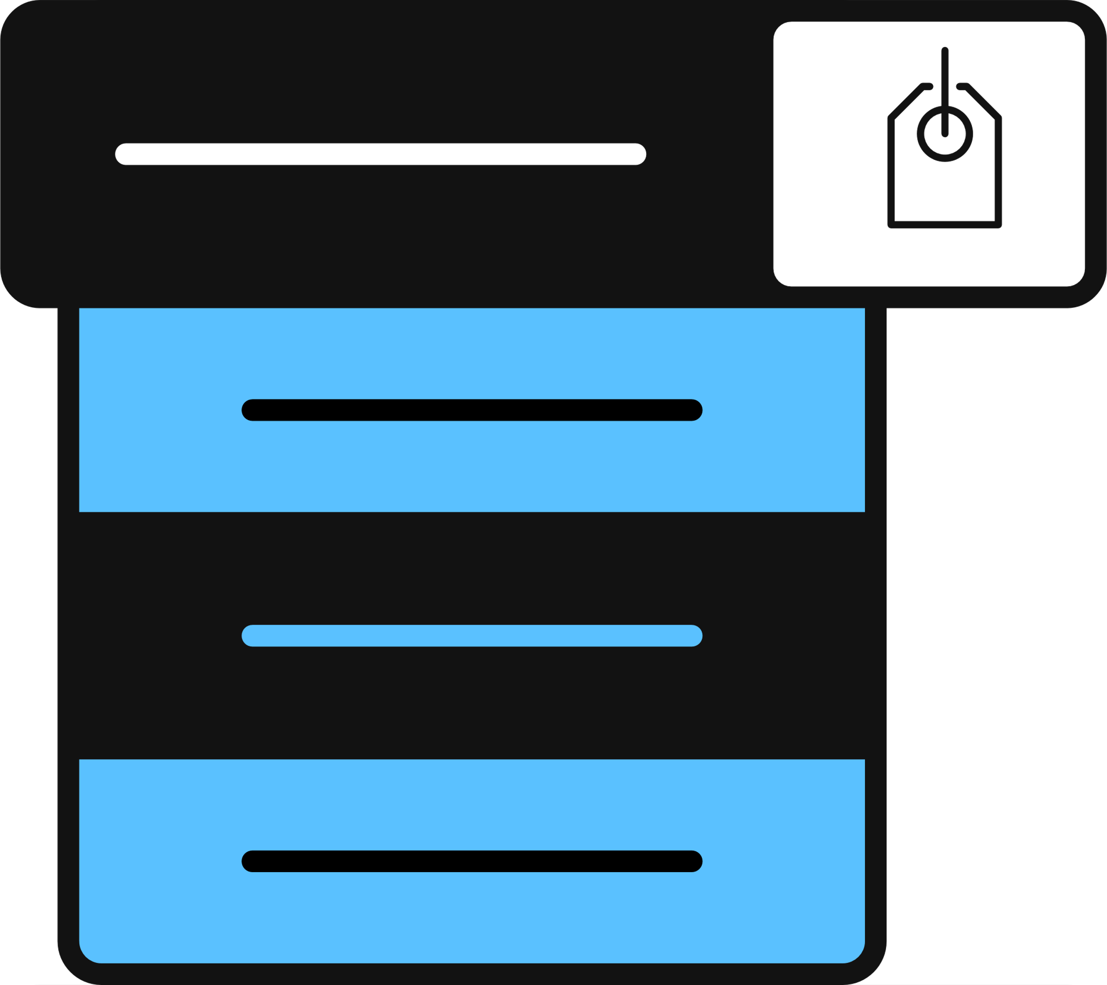
Zendesk: How It Works
Complete the following actions in Zendesk
Internal notes
Capture key points of the interaction and track the contact details.
Ticket assignment
Assign tickets to specific teams for further action, If needed.
Contact driver tagging
Select the appropriate contact driver for the contact.
Complaint tagging
Select the appropriate category under which the complaint falls.
Notes:
Duration: 4 minutes
Say:
Zendesk is your primary tool for documenting interactions, submitting tickets, and escalating customer issues. It helps you keep thorough notes and track the status of each ticket.
You have to complete the following actions in Zendesk for ticket submission, categorization of customer complaints, escalation, and tracking of ticket status.
Internal notes: You must document the summary notes in the Zendesk ticket, capturing key points of the interaction and tracking the contact details for future reference.
Ticket assignment: If the tickets need to be distributed to specific teams for further action, you must do what is required. Macros assign the tickets to the appropriate teams.
Select the Contact Driver: Contact drivers specify the reason for the customer’s inquiry. These help you understand the product and the reason the customer contacted us. Be sure to select the appropriate contact driver for the contact.
Complaint tagging: You must determine the category the complaint falls under and select accordingly.
Zendesk also includes some general forms for non-transaction related disputes like disputes for rewards received, APY deposits, issues with the product etc. Apart from this, it also facilitates customer contact through email.
Transition:
As with every tool, it will help if you follow certain best practices while working with the Zendesk tool.

Slide 6
Zendesk: Best Practices
Login to Zendesk at the beginning of every shift.
Always review all ticket history. It helps better understand the customer problem.
After filling out ticket notes in CCAT, complete pending fields, add additional notes, if any, and submit the ticket in Zendesk.
Use Zendesk to send customer communications.
Notes:
Duration: 3 minutes
Say:
Let’s look at some of the best practices.
Login to Zendesk at the beginning of every shift.
Always review all ticket history. It helps us better understand the customer problem and not repeat the previous specialist’s actions.
After filling out ticket notes in CCAT, complete any pending fields in Zendesk as listed below.
Complaints
Applying macros
Assigning tickets to the right teams as directed in MASTER
Abusive customer
Add additional notes, if any, and submit the tickets.
Use Zendesk to send customer communications.
Transition:
Having seen a broad overview of the Zendesk tool, let’s now get a better understanding of your tasks.

Slide 7
Zendesk: Internal Notes
Fields to be filled
Resolution
What was the resolution, and what are the next steps?
MASTER resources used
Link to MASTER cards used during the contact
Issue
Summary of reason customer contacted
Capture key points of the conversation and the steps taken toward resolution.
Check whether you are in the Public Reply or Internal Note mode in Zendesk.
Draft detailed notes for each contact.
Notes:
Duration: 5 minutes
Notes:
Have Zendesk screen on the projector when the points are being explained. Also, instruct participants to login to Zendesk and have it open on their desktops.
Say:
Once your interaction with the customer has ended, you must document the key points of the conversation and the steps taken toward resolution. This is especially useful when the issue needs further escalation or follow-up.
Use the Internal Note option in Zendesk.
Fill out these fields while documenting the notes.
Issue: A summary of the reason the customer contacted.
Resolution: What was the resolution for the customer, and/or what are the next steps the specialist or customer needs to take to resolve the issue?
MASTER resources used: Link to the MASTER cards used during the contact.
Ensure you have selected Internal Note, which is private. Public Reply is only used when sending an email to the customer. Do not put your internal note in a Public Reply, as it will be sent directly to the customer.
Add internal notes before applying a macro because adding notes after applying the macro will undo the fields filled out by the macro. Detailed notes are especially critical when the issue is escalated or needs investigation by other teams. Ensure everything is recorded for smooth follow-ups.
Transition:
You’ve already learned how to submit tickets in Zendesk. One more step that you need to complete before submitting the ticket is tagging contact drivers.

Slide 8
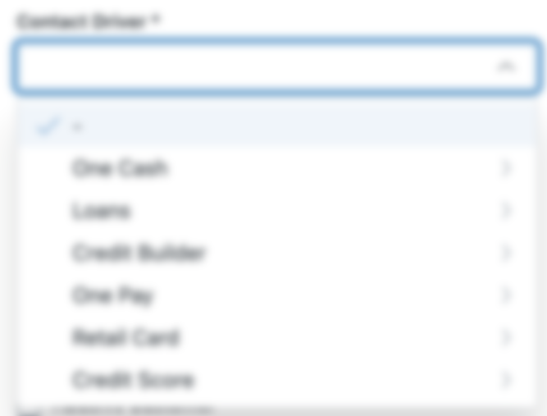
Zendesk: Contact Drivers
The Contact Driver structure:
Supports our multi-product environment
Enables specialists to provide precise context for each ticket
Provides a clear understanding of customer interactions and specific issues encountered
Notes:
Duration: 5 minutes
Say:
I’m sure you recall that contact drivers are key pieces of information that help us understand the product and the reason a customer contacted our customer support.
The Contact Driver structure supports our multi-product environment. It enables you to provide precise context for each ticket. With this, a clearer understanding of customer interactions and the specific issues encountered can be achieved. You can select contact drivers by choosing the drop-down selections available in Zendesk.
There are three drop-downs in the Contact Drivers menu. The category and subcategory sections will auto-populate depending on the product selected from the Contact Driver drop-down menu.
Product: EzPay Cash, EzPay Loans, Credit Builder, EzPay Wallet
Category: Theme of the issue
Sub-category: Specific Issue
Transition:
The final step before you submit the ticket is updating the ticket status.

Slide 9
Activity
Identifying Ticket status
20 minutes
Individual Activity
Scenario 1
Scenario 2
Scenario 3
The ticket is awaiting action from the customer.
The ticket is resolved, and no further action is needed.
The ticket has been assigned to a specialist and is in progress.
Scenario 4
Scenario 5
Scenario 6
The ticket is awaiting our action; more information is required.
The ticket is just assigned, and no action has been taken.
A solution has been provided to the customer.
Notes:
Duration: 10 minutes​
​Notes:​
In the slideshow, you will find animated text that will ear with a click action to be used at the appropriate time during the discussion. Be mindful of these clicks when on the slide.​
Activity Name: Identifying Ticket Status
Leaderboard Activity: No ​
Objective: To determine the participants’ understanding of identifying ticket status.​
Group/Individual/Pair: Individual​
Time Required: 20 mins (10 mins for the activity and 20 minutes for debrief)
Materials Needed: Erasable notepads​, markers​
Activity Steps:​
1. Step 1 (1 minutes):​
Inform the participants that they identify the correct status that you will categorize the tickets into.
2. Step 2 (9 minutes):​
<Click for the scenarios to appear one by one along with answers.>​
Read out each scenario from the screen as they appear on click.
Call out a participant at random and ask them to identify the ticket status for the scenario.
For wrong answers, call out another participant for identifying the correct ticket status.
Click to display the correct answer and discuss the rationale. ​
Repeat the process for the remaining scenarios.​
Say:
Let’s look at some scenarios that describe the current position of a customer complaint. You will need to identify the correct status that you will categorize the tickets into.
Do:
Conduct the activity as per the instructions.
Move to the next slide for a debrief.

Slide 10
Let’s Debrief
Identifying Ticket status
Scenario 1
Scenario 2
Scenario 3
The ticket is awaiting action from the customer.
The ticket is resolved, and no further action is needed.
The ticket has been assigned to a specialist and is in progress.
Pending
Closed
Open
Scenario 4
Scenario 5
Scenario 6
The ticket is awaiting our action; more information is required.
The ticket is just assigned, and no action has been taken.
A solution has been provided to the customer.
Solved
On-hold
New
Notes:
Duration: 10 minutes
Say:
Great discussion everyone! Let’s review your answers along with the reasoning behind them.
Pending: The ticket is awaiting action from the customer; hence, it is tagged as Pending. Specialists can’t proceed with resolving the ticket until the customer provides additional information.
Closed: When the ticket has been resolved and no further action is needed, it is tagged as Closed. The ticket status automatically changes to Closed if the customer does not reply within 28 days. Specialist cannot select the status “closed”
Open: When a ticket assigned to a specialist is in progress, it is an Open ticket waiting for action by the specialist.
Solved: When a solution has been provided to the customer, the ticket is tagged as Solved.
On-hold: When a ticket is awaiting action, specialists can’t proceed with resolving it until they receive more information from someone else at EzPay.
New: A New ticket status is assigned when a ticket is entered, and no action has been taken. Once a New ticket’s status has been changed, it can never be set back to New.
​Transition:
Well, you must have gained a clear understanding of Zendesk by now. Next, let’s explore another tool, Slack, that helps you in internal communications.

Slide 11

Slack

Slide 12
Slack: Overview
Internal Communication
Collaboration & Support
Used for internal communications, typically among a group of people
Used to seek help, obtain updates, and provide feedback or insights regarding tools or customer pain points
Notes:
Duration: 1 minute
Say:
Slack is used for internal communications, typically among a group of people. It is used to seek help, obtain updates, and provide feedback or insights regarding tools or customer pain points.
Transition:
Let’s see how to use Slack.

Slide 13
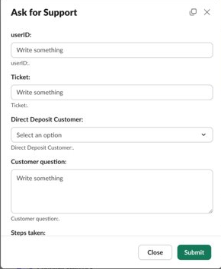
How to Work in Slack
Step 1
Specialists ask questions primarily through the broad support channel.
Notes:
Duration: 1 minute
Say:
Here’s how Slack works:
Specialists use the broad support channel as their primary method for asking questions.

Slide 14
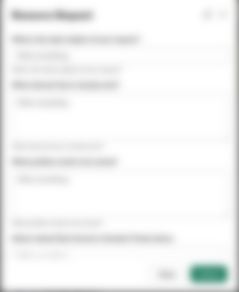
How to Work in Slack
Step 2
Users select a workflow and complete a required form.
Notes:
Duration: 1 minute
Say:
In most cases, the user will first select a workflow and complete a form with the required details.

Slide 15
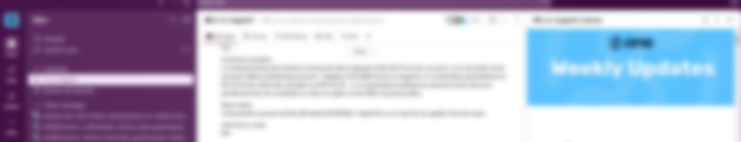
How to Work in Slack
Step 3
Dedicated reviewers provide direct support, either locally or remotely.
Notes:
Duration: 1 minute
Say:
Dedicated individuals will review and provide direct support as appropriate. Support may come from a local or remote team member.

Slide 16
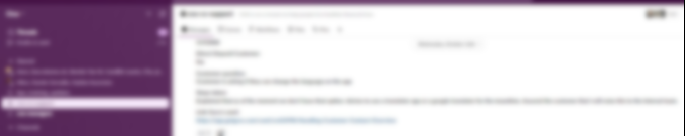
How to Work in Slack
Step 4
Users see posted messages and must acknowledge and apply information as needed.
Notes:
Duration: 1 minute
Say:
Users will also see when messages are posted and are expected to acknowledge and apply the information as needed. For example, if there is an outage, Slack is where updates will be communicated.
Specialists can have direct or group DMs with their manager, team, or other colleagues.
Transition:
Let’s look at the workflow templates in Slack.

Slide 17
Slack Workflow Templates
Need help answering customer query
Wallet customer with multiple profiles
For incorrect or inappropriate chatbot response
Ask for Support
EzPay Wallet - Unenroll, move rewards
Chatbot Feedback
Request for material resources like MASTER or training
Opportunities, ideas, or enhancements
Ops Resource Request BPO
Suggestion BPO
Notes:
Duration: 2 minutes
Say:
Use the workflow templates that are provided in cs-debit-support when you select the Workflow tab for internal communication. Here are some Slack workflow templates:
Ask for Support: When you need help answering a customer inquiry or to solve an issue.
EzPay Wallet - Unenroll, move rewards: To be submitted to point out customers with multiple profiles.
Chatbot feedback: To be submitted when chatbot is incorrect or inappropriate.
Ops Resource Request BPO: When you want to request agent material resource such as MASTER.
Suggestion BPO: When you want to communicate opportunities, ideas or enhancements.
Transition:
Follow these dos and dont’s for using Slack workflow templates effectively.

Slide 18


Slack: Best Practices
Pros
Don’ts
Dos
Cons
Communicate respectfully (everything is monitored).
Use workflows to provide all relevant information to get the best assistance quickly.
Review frequently for updates.
Don’t save information from other sources.
Don’t send PII or other sensitive information (only send ticket numbers or User IDs).
Don’t use for personal conversations.
Notes:
Duration: 2 minutes
Do:
Explain the dos and don’ts as shown on the slide.
Transition:
Next up, we are going to learn about a training tool that helps you complete all your mandatory training requirements throughout your journey at EzPay.

Slide 19

BAI

Slide 20
BAI: Overview
Tool for continued learning, eLearning, and refresher training programs
Learning Management System (LMS)
Performance tracker
A platform for mandatory compliance training and topic-specific courses
Monitors attendance, completion rates, and performance
Notes:
Duration: 2 minutes
Say:
Through the BAI training tool, you can complete all your eLearning, continued learning, and refresher training programs.
BAI is a Learning Management System (LMS) and provides a platform for mandatory compliance training and topic-specific courses throughout your journey at EzPay.
BAI tracks your training by monitoring attendance, completion rates, and performance, which allows leadership to identify areas where additional support or training may be needed.
Transition:
Let's explore how BAI supports you as a comprehensive training tool.

Slide 21

BAI: Overview
What you can expect
Self-paced learning
Specialists can work through training at their own pace, allowing for flexibility and the ability to revisit materials if needed.
Training completion
BAI ensures that training is fully completed and in time and specialists are equipped to deliver the best possible customer service.
Notes:
Duration: 2 minutes
Say:
BAI is a centralized training platform that is user-friendly where all required training is easily accessible. You can work through BAI’s self-paced learning allows flexibility and the ability to revisit materials if needed.
BAI ensures that training is completed fully and in time and you are equipped to deliver the best possible customer service, stay compliant with company policies, and contribute to team success.
Transition:
You must do your bit to ensure that you make the best use of this tool.

Slide 22
BAI: Best Practices
Pros
Don’ts
Dos
Cons
Complete all assigned training modules by the specific deadlines.
Revisit and reinforce areas where you need more clarity.
Fully engage with the material for better understanding and improved customer interactions.
Don’t rush through or skip important sections.
Don’t wait until the last minute to finish mandatory trainings.
Don’t rely on others to complete their training and to copy their responses.
Notes:
Duration: 2 minutes
Do:
Explain the dos and don’ts as shown on the screen.
Transition:
So, what does this tool look like for you? Let’s explore.

Slide 23
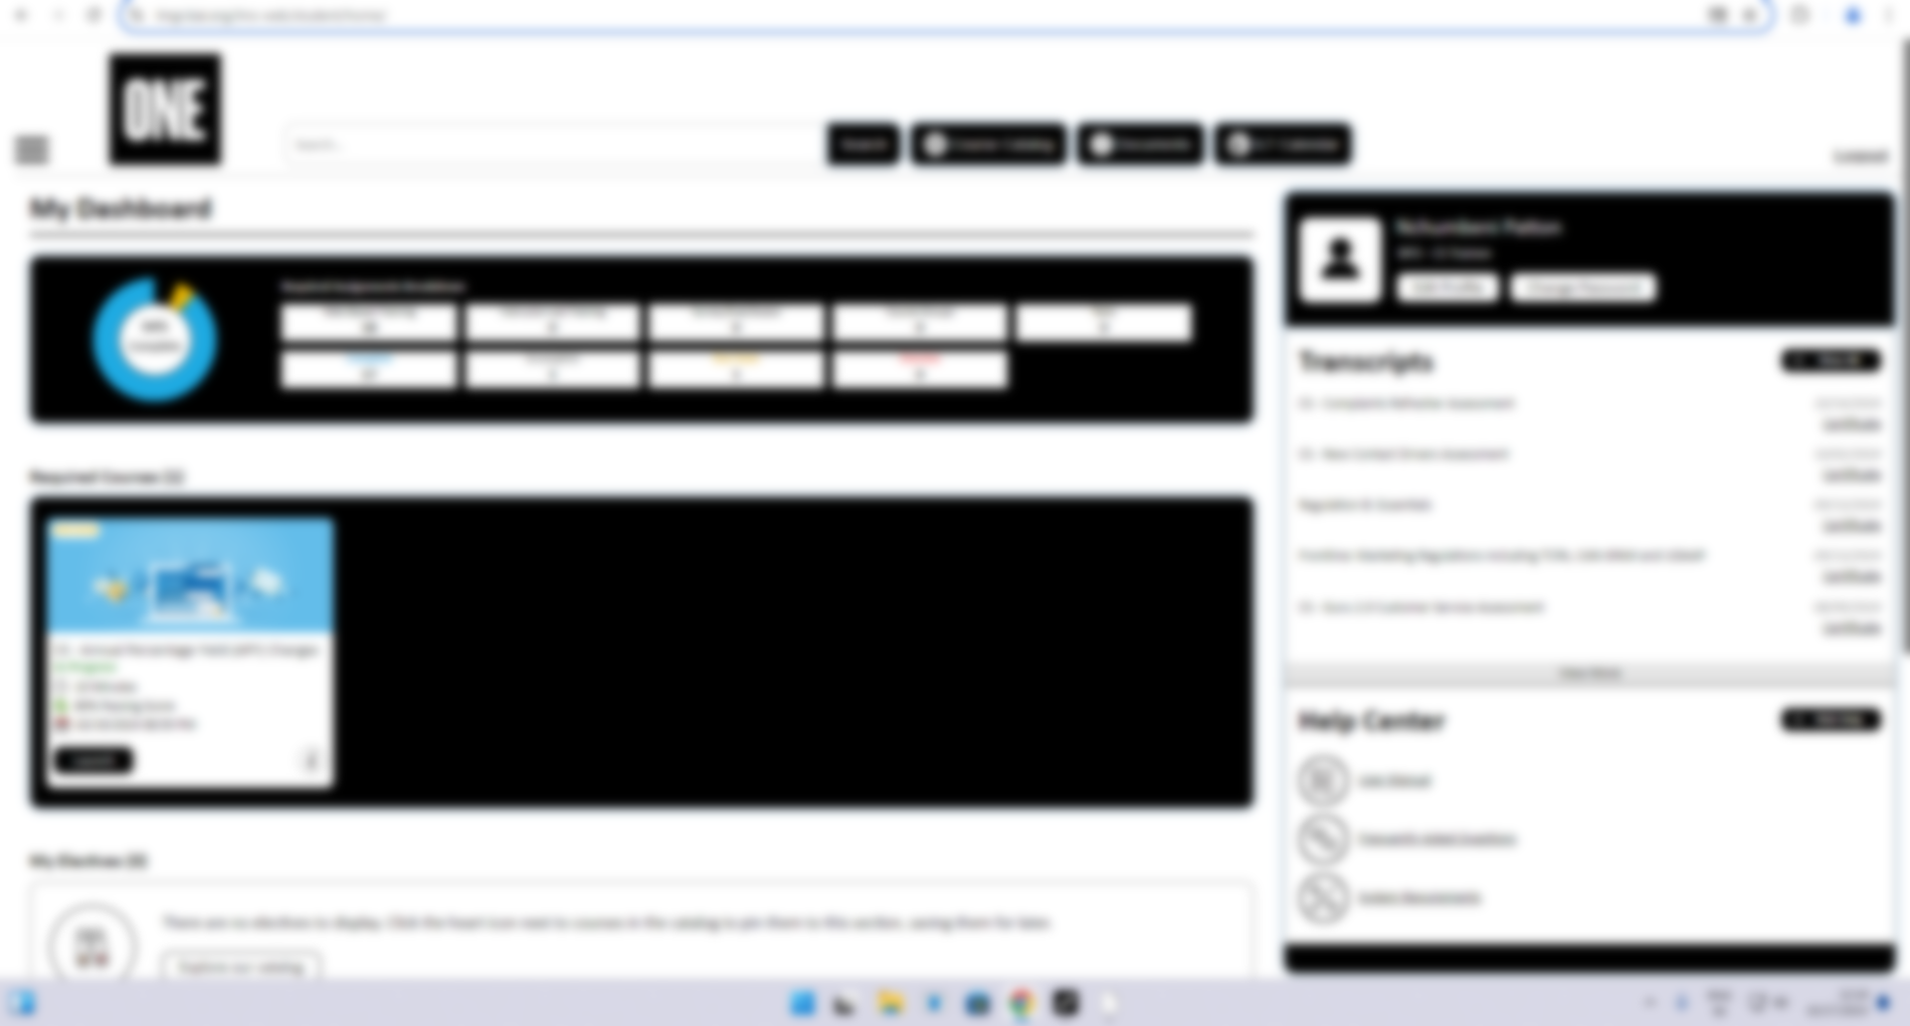
BAI: How It Works
Log in to BAI using Okta.
Identifying Customer Challenges
Check your status here.
View your assigned courses.
Notes:
Duration: 20 minutes
Say:
As with the other tools, you can log in to BAI using Okta. In BAI:
You can check the status of your training in the My Dashboard section, which gives a summary of the courses that have been completed and those that are yet to be done.
You can use the Required Courses section to view your assigned courses.
Remember to finish your assigned training on time, whether it is compliance-related or job-specific modules.
Do:
Walk through the BAI tool and help participants set it up so that they are ready for the BAI compliance training for the day.
Transition:
We have now completed all the modules scheduled for the day. Let’s wrap up what we learned in the next module.

