Slide 1


Day 5: Agenda
Call and Chat Etiquette
Importance of Note-Taking
Transferring Contacts
Tools Exploration
85 mins
35 mins
45 mins
135 mins
Day 4 Recap
20 mins
Retail Card
Contact Drivers
Assessment
Wrap-Up
30 mins
40 mins
60 mins
15 mins
Notes:
Duration: 2 minutes
Say:
Hope you had a good lunch break.
Ask:
Which tools do you think are specifically focused on customer service?
Expected Responses:
Okta
KB
CCAT
Zendesk
Slack
Ask:
What is the other category of tools that we use?
Expected Response:
Specialist-focused
Say:
Great! In this session, we’ll focus on exploring two key customer service tools: CCAT and MASTER are designed to support live customer interactions. These tools enable clear and quick communication, making it easier to troubleshoot issues independently and efficiently. Mastering them will make our jobs smoother.

Slide 2

Energizer
Mirror, Mirror
5 minutes
Pair up and stand facing each other.
One of you will be the “leader,” and the other will be the “mirror.”
The “leader” must make slow simple movements, and the “mirror” must mimic them as closely as possible.
Notes:
Duration:
5 minutes
Say:
Let’s shake off that post-lunch slump with a quick energizer to get us moving!
Do:
Pair up the participants and have them stand facing each other.
Make one person in each pair the “leader” and the other the “mirror.”
Ask the “leader” to make slow, simple movements (e.g., raising an arm, nodding their head, stepping to the side), and the “mirror” must mimic the movements as closely as possible.
Remind them that mirrors are laterally inverted, so the mirror participant must mimic accordingly.
Ensure this activity not only gets participants moving but also helps them re-engage their minds and bodies.
Conduct the energizer activity as per the instructions.
Transition:
Feeling recharged? Awesome! Let’s delve in to uncover what these tools are all about.

Slide 3
Tools Exploration
Notes:
Duration:
NA
Notes:
NA

Slide 4
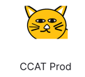
CCAT
Notes:
Duration:
NA
Notes:
NA

Slide 5
Purpose of CCAT
Troubleshoot during chats/calls using guides.
Communicate via chat or phone
Take detailed notes
Purpose:
Manage customer interactions efficiently.
Look up customer information
Complete workflows
Notes:
Duration:
1 minute
Do:
Read the pointers and explain the concept of CCAT.
Say:
CCAT is a versatile tool designed to efficiently manage customer interactions. It allows you to look up customer information, communicate via chat or phone, troubleshoot during chats or calls using guides, take detailed notes, and complete workflows; all within one interface.
Transition:
Let’s look at the CCAT Interface.

Slide 6

The CCAT Interface
CCAT
Amazon Connect
Agent Assist
Look up account details and manage customer interactions.
Receive and manage customer calls and chats.
Access relevant articles from MASTER and the Help Center.
Notes:
Duration:
1 minute
Do:
Read the text on slide.
Say:
The interface is divided into three key sections, each serving a specific purpose:
CCAT: The primary tool for managing and streamlining customer interactions, enables you to look up account details.
Amazon Connect: Integrated into CCAT to receive and manage customer calls and chats.
Agent Assist: Appears during chats and pulls information from the MASTER knowledge base and Help Center to support troubleshooting.
Transition:
Let’s see CCAT in action.

Slide 7

CCAT Home Page
Tabbed interface for different apps
Customer PII
Guides
Shortcuts
Features, Account Information, Products
What products does this customer use? What can you tell from their account information?
Notes:
Duration:
2 minutes
Do:
Display callouts and highlights one-by-one using up/down arrows or left/right arrows on the keyboard.
Say:
This is the CCAT homepage. On the left panel, you’ll access customer PII, additional features, account details, and products. You can use the top navigation for the tabbed interface to switch between different apps. You can find helpful resources in the guide's section to collect information and assist customers effectively. Using shortcuts, you can quickly navigate to the right section of CCAT for efficient workflow.
Transition:
Let’s check out a few important apps used by specialists for customer service.

Slide 8
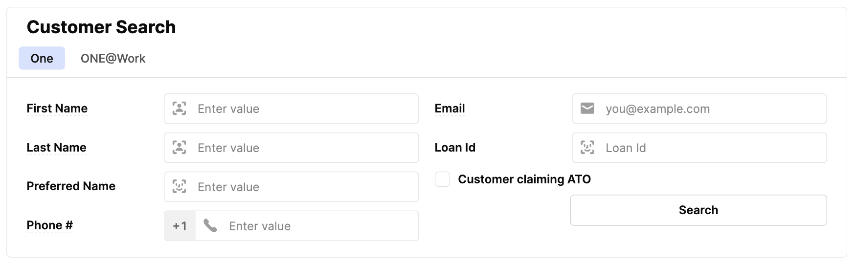
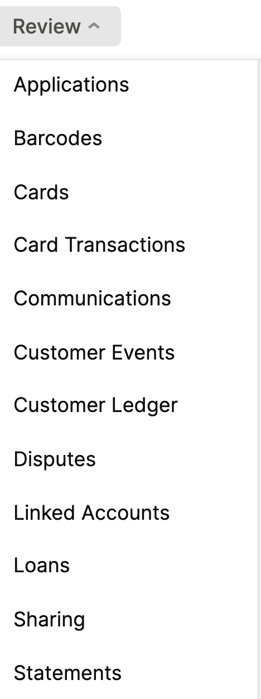
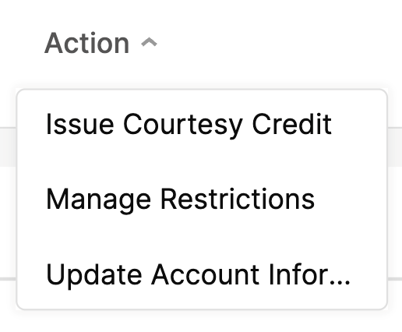
Apps
Notes:
Duration: 2 minutes
Do:
Display highlights one-by-one using up/down arrows or left/right arrows on the keyboard.
Say:
The tool is designed for customer service specialists, with a tabbed interface at the top that houses various apps for accessing account-specific details. Key tabs include:
Customer Ledger: Provides a clear view of customer transactions and account balances.
Pay: Displays information about the customer’s Pay cards, linked accounts, and rewards.
Communications (Customer Comms): Allows specialists to review messages sent to customers, including emails, SMS, and push notifications.
For quick navigation, many of these apps are also accessible via shortcuts on the homepage.
Transition:
Let’s understand how to check the essential details in the Customer Ledger.

Slide 9
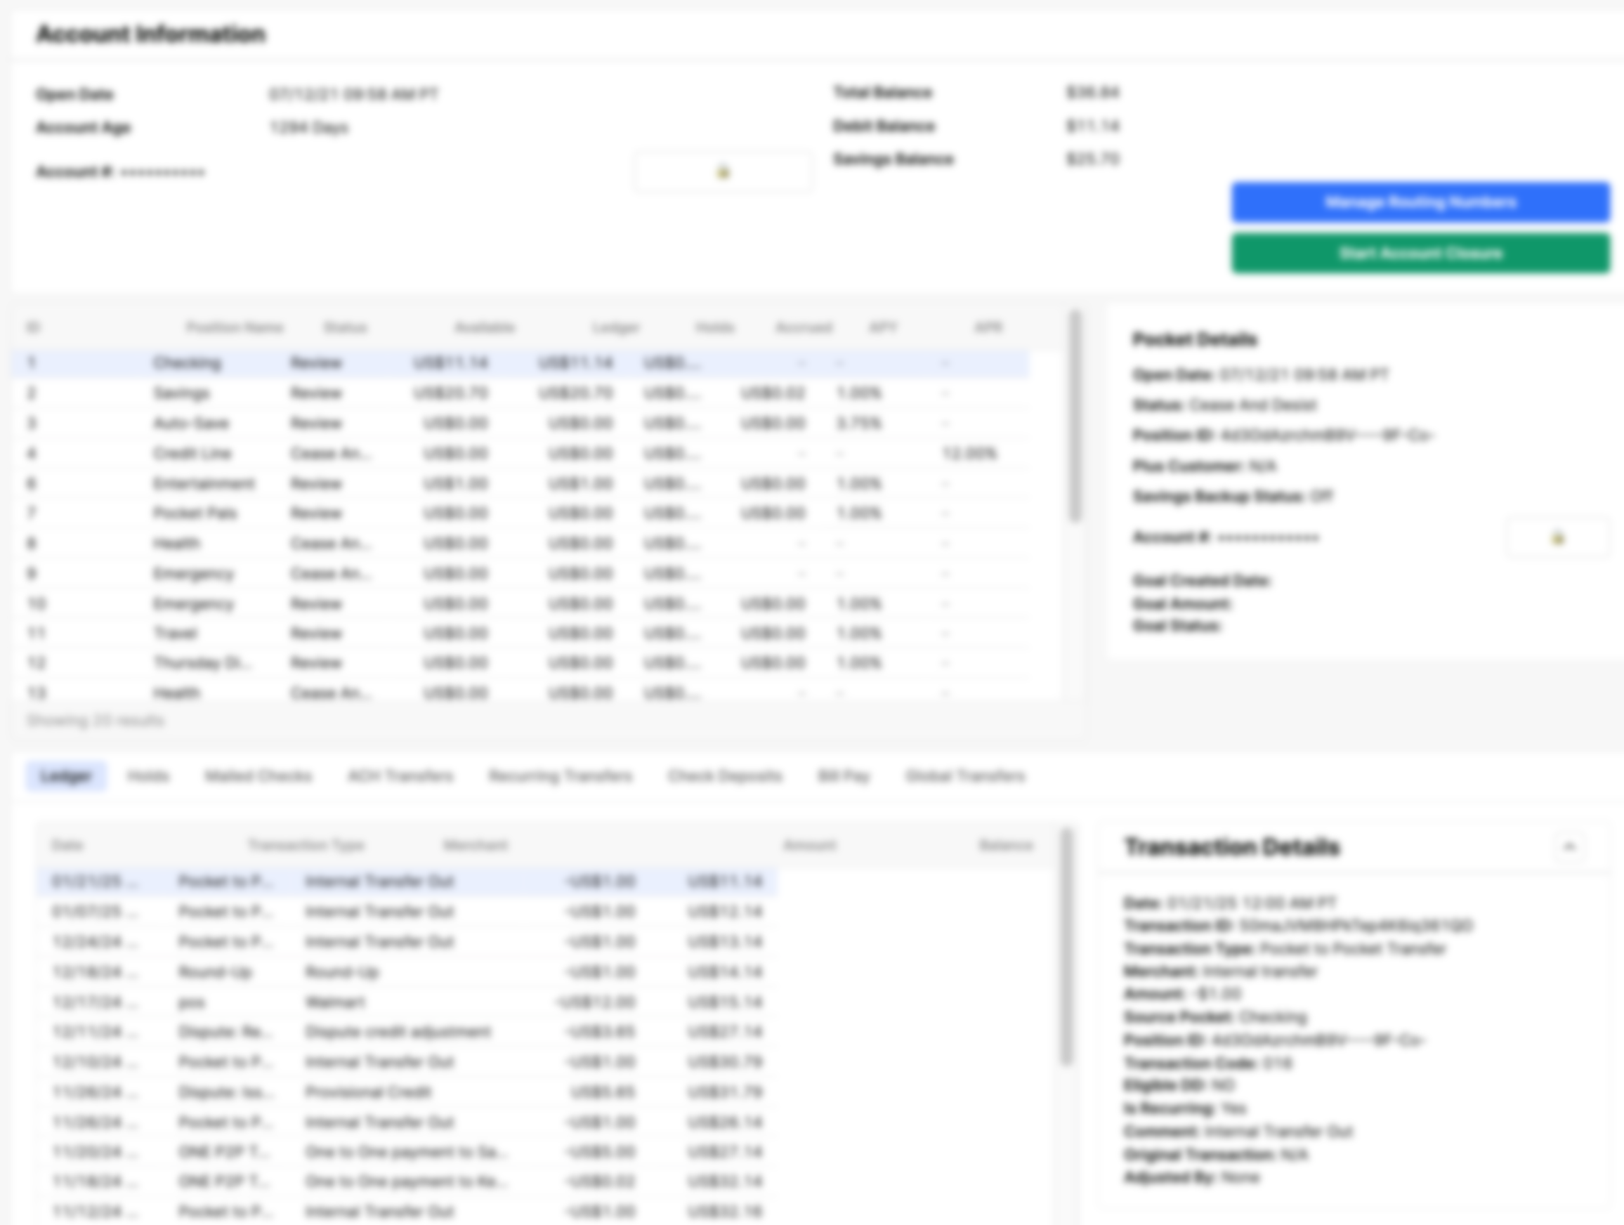
Customer Ledger
Account Information
Pocket Details
Ledger
Notes:
Duration:
2 minutes
Do:
Display callouts and highlights one-by-one using up/down arrows or left/right arrows on the keyboard.
Say:
As a customer service specialist, the Customer Ledger helps you quickly access essential account details.
Here's how it's structured:
Top: Account Information: Instantly view key account details, including the account's opening date, current debit and savings balances, and overall account health.
Middle: Pocket Details: Easily identify which pocket (Checking, Savings, or Goals) was used for transactions.
Bottom: Ledger: Access a complete list of all transactions, including timestamps, amounts, and descriptions, to assist customers with accuracy.
This layout ensures you can efficiently address customer inquiries and provide precise support.
Transition:
Let’s understand the purpose of using guides and workflow tabs in the CCAT.

Slide 10
What is CCAT Used for?
Step-by-Step Problem-Solving
Efficient Pathways
Provides step-by-step instructions and talking points for specialists to resolve common customer issues
Guides specialists through the appropriate workflows to deliver solutions quickly and effectively
Tool Uses
Notes:
Duration:
2 minutes
Ask:
Imagine you're assembling a piece of flat-pack furniture. What helps you do it correctly?
Expected Responses:
YouTube tutorials, help guide, instruction manual, etc.
Say:
Just like step-by-step instructions ensure your furniture is assembled correctly, Guides provide clear pathways to troubleshoot and resolve customer issues effectively.
Do:
Display the screen and briefly explain.
Show the tool on projector in real-time during explanation.
Say:
The Guides are designed to simplify problem-solving by providing clear, step-by-step instructions, such as processing transaction refunds or managing customer cards. By following the pathways outlined in the tool, you can navigate workflows efficiently, delivering accurate and timely solutions.
Transition:
Let’s understand how Card Management Guides work.

Slide 11
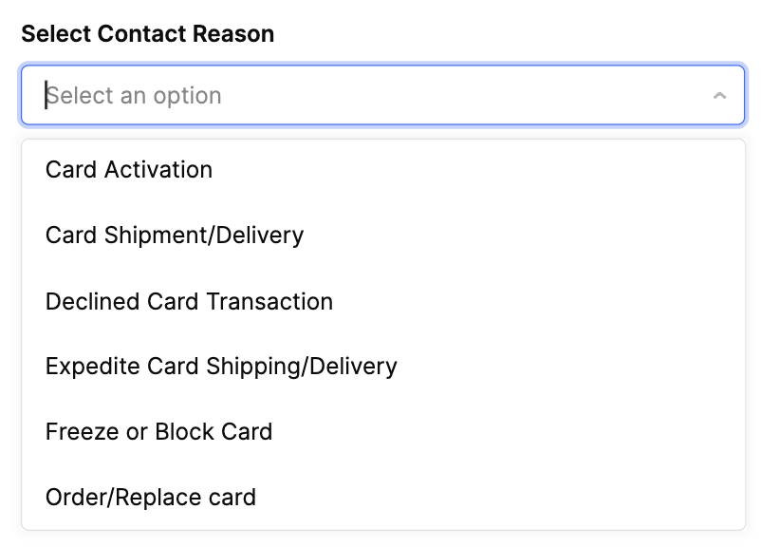
Guides: Card Management
Troubleshoot all card-related inquiries with a single button.
Select the card type and follow the guided workflow.
Use dropdowns for specific card contact scenarios.
Notes:
Duration:
2 minutes
Say:
If you encounter a customer with issues related to card delivery, declined transactions, ordering a new card, or frozen or blocked cards, you can resolve their concerns using the Card Management section in Guides.
You can easily troubleshoot any card-related inquiry with just one button!
Simply select the card type, and the guided workflow will walk you through the steps to assist the customer. Use the dropdowns to access detailed guides for specific card scenarios, ensuring a smooth and efficient resolution.
Transition:
Let’s go through a few types of Card Management guides.

Slide 12
Types of Card Management Guides
Types of Card Contacts
Type of Card
What do they mean?
Card Activation | Retail Card at MM Debit Card | Assist customers in activating cards and setting/changing the pin.
Card Shipment/Delivery | MM Debit Card | Assist customers with the status of their card shipment and delivery, as well as updating their mailing address.
Declined Card Transaction | Virtual, Physical, Retail, and Limited-use | Assist customers with reason for declined transactions.
Expedite Card Shipment/Delivery | MM Debit Card | Prioritize sending a physical card in 3-4 days to meet urgent customer needs, like missed card orders, upcoming travel, or no access to funds.
Freeze or Block Card | MM Debit Card | Assist customers in self-serving temporary card blocking or unblocking to manage transactions for security or other concerns.
Order/Replace Card | MM Debit Card | Assist customers in getting a new card when the previous one is damaged, missing, stolen, or compromised, and help update their mailing address.
Notes:
Duration:
2 minutes
Say:
This table outlines the different types of card-related inquiries you may handle and how to assist customers effectively. Use this guide to quickly identify the correct process based on the customer’s concern and ensure a smooth resolution.
Do:
Read and briefly explain the types of card management guides displayed on screen.
Transition
Let’s learn how to use Card Management Guides with an example.

Slide 13
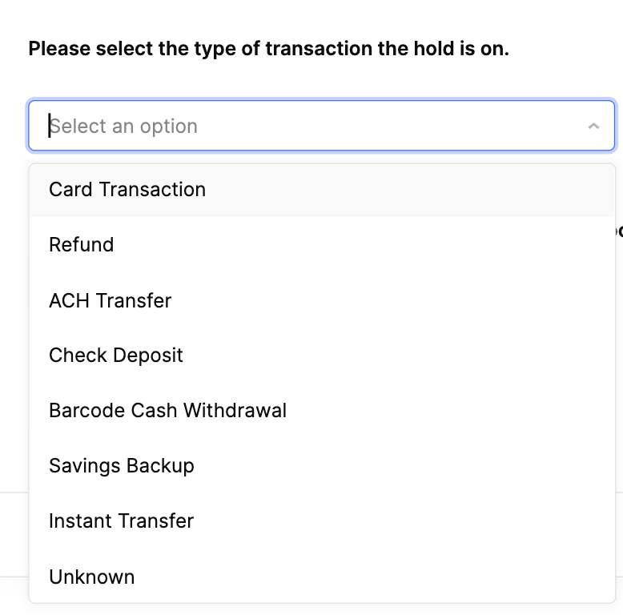
Guides: Transaction/Refund Holds
Helps troubleshoot all transaction-related questions with just one button
Select the card type to follow a guided workflow for customer assistance.
Use dropdowns specific guides for different transaction types
Notes:
Duration:
2 minutes
Say:
If a customer requests a hold on a refund or transaction, use the Transaction/Refund Hold guide to troubleshoot all transaction-related questions with just one button. Select the type of card contact, and the workflow will guide you through the steps to assist the customer. Use the dropdowns to access specific guides for different transaction types, making it easier for you to resolve the issue quickly and effectively.
Transaction
Let’s move on to understand the types of Hold transactions.

Slide 14
Types of Hold Transactions
Hold Transactions
What do they mean?
Card Transactions | Holds on purchases made using a physical or virtual Cash Card.
Refund | Holds on pending funds for a returned purchase or cancelled service.
ACH Transfer | Holds on electronic transfer of funds from a customer’s Cash account to an external bank account.
Check Deposit | Holds on checks deposited by customers from their app.
Notes:
Duration: 2 minutes
Do:
Randomly call out participants to read the types of hold transactions on this and the next slide.
Move to the next slide after the participants complete reading.
Say:
Let’s read the types of Hold Transactions guides one-by-one.

Slide 15
Types of Hold Transactions
Hold Transactions
What do they mean?
Barcode Cash Withdrawal | Holds on cash withdrawn by customers at MM stores by scanning a barcode generated from their app.
Savings Backup | Holds on funds transferred from primary savings pocket to cover purchases when the debit balance is insufficient.
Instant Transfer | Holds on funds transferred to and from a linked debit card.
Unknown | Pulls up all holds if the customer or specialist are unsure of the transaction details.
Notes:
Duration
NA
Transition
Now, let’s learn how to use Hold Transactions guides with an example.

Slide 16
Amazon Connect
Notes:
Duration:
NA
Notes:
NA

Slide 17


Purpose of Amazon Connect
Contact Management
Customer Verification
Status Management
Receive and manage customer calls and chats based on Calabrio Schedule
Prior Conversations
Verify and authenticate the customer before proceeding with account actions
Closure
Update status to “Available” or “Break” (aligned with Calabrio schedule)
Review prior bot conversations for context on customer inquiries
End the interaction after resolving the issue
Notes:
Duration:
3 minutes
Say:
Amazon Connect is integrated into CCAT and enables you (specialists) to efficiently manage live customer calls and chats. It streamlines customer routing, provides important details like customer intent, authentication status, and previous bot conversations, ensuring you have the context needed to assist quickly. It primarily runs in the background, requiring you (specialists) to launch it along with their other tools.
Do:
Read the key features and explain briefly.
Transition:
Let’s check out a few examples of Amazon Connect.

Slide 18
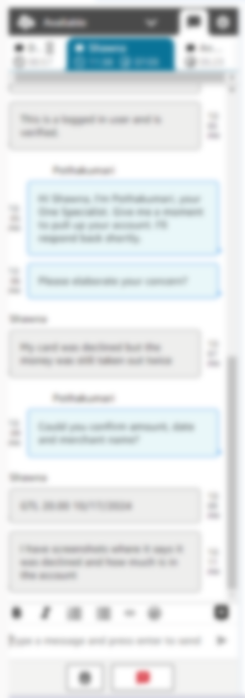

Amazon Connect Examples
Status Management
Status Management
Verification Status (this is a logged-in user and is verified)
Bot Interaction
Multiple active chats
End interactions
End interactions
Notes:
Duration:
3 minutes
Do:
Display callouts and highlights one-by-one using up/down arrows or left/right arrows on the keyboard.
Say:
These are examples of interactions connecting through Amazon connect.
As a customer service specialist, you play a key role in managing your status within the system, whether you’re available, on a break, in training, or handling back-office tasks. Based on your schedule in Calabrio, Amazon Connect ensures that you receive calls or chats only when you're available.
To provide a seamless experience, you can review the customer’s previous interactions with the Bot, giving you valuable context before engaging. You’ll also see their verification status, allowing you to take the right steps before addressing their issue.
Once the issue is resolved, you’ll end the interaction, ensuring your status updates correctly in the system. Additionally, you’ll keep an eye on two key chat timers: the total chat duration and the time since the customer last responded, helping you manage conversations efficiently.
Transition
Now let’s learn about the purpose of Agent Assist during a specialist’s interactions with a customer.

Slide 19
Agent Assist
Notes:
Duration:
NA
Notes:
NA

Slide 20
Purpose of Agent Assist
Automatically surfaces relevant articles from MASTER or the Help Center
Reduces the time specialists spend searching for information
Monitors live conversations
Notes:
Duration:
1 minute
Say:
Agent Assist is your smart assistant during live conversations with customer. It automatically pulls up the most relevant articles from KB (Knowledge Base) or the Help Center, saving you time and effort in searching for answers. By showing the right resources based on the customer's inquiry, it helps you resolve issues faster and more efficiently, so you can focus on delivering smooth and helpful experience.
Transition
Let’s check out examples of Agent Assist.

Slide 21
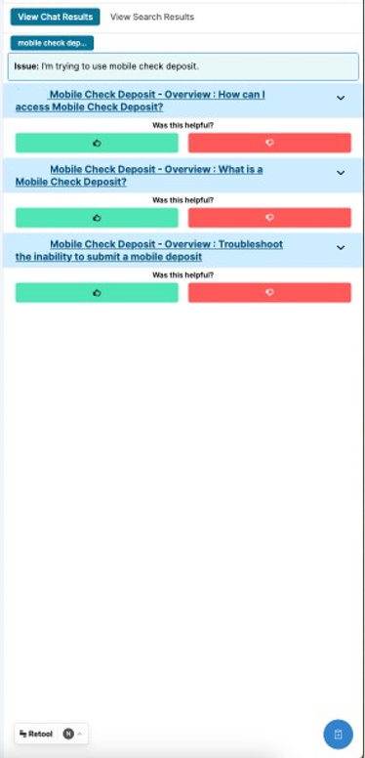

Agent Assist Examples
Quick summary of the customer’s issue.
(I'm trying to use mobile check deposit, activate card)
Quick summary of the customer’s issue.
(activate card)
Relevant Articles from MASTER and Help Center
Relevant Articles from MASTER and Help Center
Notes:
Duration:
2 minutes
Say:
Agent Assist is your go-to support tool during interactions, helping you resolve customer issues more efficiently. It provides a Quick Summary of the customer’s issue and instantly suggests relevant resources, such as articles or guides, so you can quickly find the best solution. Additionally, it offers Contextual Help by analyzing the customer’s interaction history and surfacing related articles from the Help Center or MASTER. This ensures you have the right information at the right time to deliver accurate and timely solutions.
Do:
Display callouts and highlights one-by-one using up/down arrows or left/right arrows on the keyboard.
Transition
Let’s understand how all tools (Agent Assist, CCAT, and Amazon Connect) together help you to work efficiently.

Slide 22
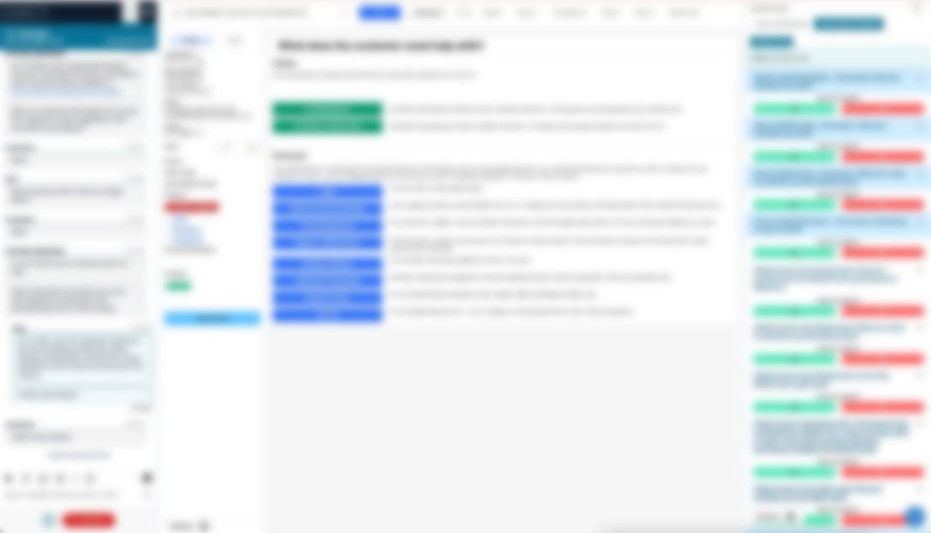
How It All Comes Together!
Amazon Connect
Agent Assist
CCAT
Notes:
Duration:
2 minutes
Say
Here’s how everything comes together to support you as a customer service specialist:
Amazon Connect ensures that customer calls and chats are routed to you based on your availability, so you can focus on assisting customers efficiently.
CCAT (Customer Contact Analytics Tool) provides guides/insights from customer interactions, helping you improve your WMroach and deliver even better service.
Agent Assist works alongside you in real time, pulling up relevant articles and guides to help you resolve issues quickly and confidently.
With these tools working together, you can provide faster, smarter, and more personalized support, making every customer interaction smoother and more effective!
Do:
Display callouts and highlights one-by-one using up/down arrows or left/right arrows on the keyboard.
Transition
Let’s watch a demonstration on CCAT.

Slide 23

How Does CCAT Work?
Working of CCAT
Watch a video demonstrating CCAT in action.
Play the video.
Notes:
Duration: 5 minutes
Say:
Watch how CCAT works in this simulation.
Transition:
Let’s explore the role of CCAT sections through an activity.
.

Slide 24



Activity
Exploring the Role of CCAT Sections
10 minutes
Group Activity
Read the following scenarios and determine which section of CCAT should be used to address them.
You need to communicate with a customer via chat to resolve their issue.
You’re troubleshooting a customer's problem and need to check MASTER for guidance to resolve it.
You need to access customer account information and log the details of your interaction.
Notes:
Duration: 5 minutes
Activity Name: Exploring the Role of CCAT Sections
Leaderboard Activity: No​
Objective: Identify the appropriate CCAT sections to efficiently manage interactions and resolve customer issues based on given scenarios.
Group/Pair/Individual: Group
Time Required: 10 minutes (5 minutes for the activity and 5 minutes for a debrief)​
Materials Needed: Whiteboard, timer, desktop computer tools (already available in the room), small erasable notepads for specialists
Activity Steps:
1. Step 1 (0.5 minute):
Form three groups.
Assign a scenario to each group and ask them to identify the specific section of CCAT that helps manage the interaction or resolve the issue most effectively.
2. Step 2 (4.5 minutes):
Allow 4.5 minutes for this activity.
Invite a member from each group to present their response.
Say: ​
Let’s explore the role of each section of the CCAT tool and determine which section is the most appropriate to use for managing interactions and resolving issues.
Do:
Conduct the activity as per the instructions.
Move to the next slide for a debrief.

Slide 25
Let’s Debrief
Exploring the Role of CCAT Sections
You need to communicate with a customer via chat to resolve their issue.
You’re troubleshooting a customer's problem and need to check MASTER for guidance to resolve it.
You need to access customer account information and log the details of your interaction.
Amazon Connect
Agent Assist
CCAT
Notes:
Duration: 5 minutes
Do:
Thank the participants for completing the activity and facilitate a group discussion.
Say:
Which CCAT section is the most appropriate to use in these scenarios?
Do:
Steer the discussion to highlight the reason to choose a section of CCAT tools for the scenarios.
Clarify the role of Agent Assist (embedded on the right-hand side of the CCAT interface) and MASTER briefly.
Expected Responses:
Scenario 1: You need to communicate with a customer via chat to resolve their issue. Which CCAT section would you use?
You will use Amazon Connect to communicate with customers via chat to resolve their issues.
Scenario 2: You’re troubleshooting a customer's problem and need to check GURU for guidance to resolve it.
Agent Assist provides real-time troubleshooting guidance to resolve issues efficiently.
Scenario 3: You need to access customer account information and log the details of your interaction. Which section will you use?
You will use the CCAT’s main interface for managing customer account information and logging details of interactions.
Transition:
Let’s put our knowledge into practice with CCAT.

Slide 26
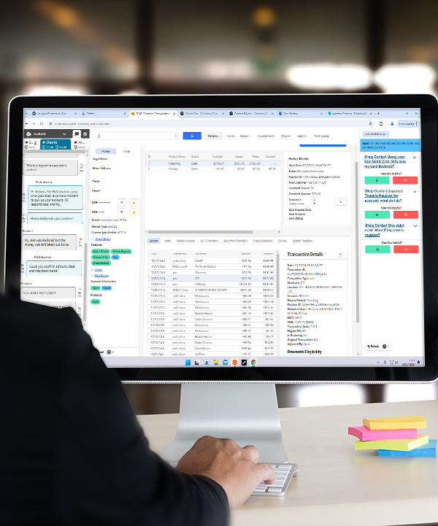
Hands-On Activity
Exploring CCAT
30 minutes
Individual
The spotlight is on you now! Take this time to delve into CCAT and experience what it’s like to be a specialist!
As per Ahsheka’s comment, we have marked the slide “TBD basis access to the Retool Training Env for Specialist.
Notes:
Duration: 30 minutes
Notes:
Activity Name: Hands-On Activity
Leaderboard Activity: No
Objective: To explore CCAT tool.
Group/Pair/Individual: Individual
Time Required: 30 minutes
Materials Needed: Desktops/laptops with CCAT and a timer
Activity Steps:
1. Step 1 (1 minute):
Have the participants log in from their respective stations.
Ask the participants to explore CCAT interface features and functionality to efficiently handle customer interactions.
2. Step 2 (29 minutes):
Allow 29 minutes for this activity.
Do:
Begin with a trainer-led demo to guide participants.
Assign real-world scenarios for practice.
Conduct the activity as per the instructions.
Walk around the classroom to check how the participants are exploring CCAT. Guide them if needed.
Say:
Take this time to navigate and familiarize yourself with CCAT interface and its features. Understand how to use them to manage customer interactions effectively. Explore the interface and try to look up account details, access relevant articles, facilitate calls and chats. This hands-on time will help you gain confidence and prepare for real-world scenarios. Get set on focusing on mastering this tool for seamless customer interactions.
Transition:
Alright! I hope this activity has strengthened your understanding of CCAT. Let’s continue our journey with the next tool in focus, MASTER.

Slide 27
MASTER
Notes:
Duration:
NA
Notes:
NA

Slide 28
Purpose of MASTER
Knowledge Management Tool
Source of Truth
Critical Tool for Success
Supports Quality Performance
Centralized resource for all product information, step-by-step procedures, and workflows
Primary tool specialists should rely on to find the latest and most accurate information when assisting customers
Essential for finding accurate answers and guiding the specialist’s actions during customer interactions
Trusted, updated and accurate resources to reflect new product or procedure information on how best to handle a customer’s contact
Notes:
Duration:
2 minutes
Say:
MASTER serves as our centralized knowledge management tool, providing a comprehensive resource for all product information, step-by-step procedures, and workflows. It is the primary source of truth that you should rely on to access the latest and most accurate information when assisting customers. As a critical tool for success, MASTER plays a vital role in finding precise answers and guiding your actions during customer interactions. By ensuring the use of trusted and regularly updated resources, MASTER supports high-quality performance and helps you stay informed about new products or procedural updates to handle customer contacts effectively.
Transition:
Let’s understand an overview of customer service collection.

Slide 29
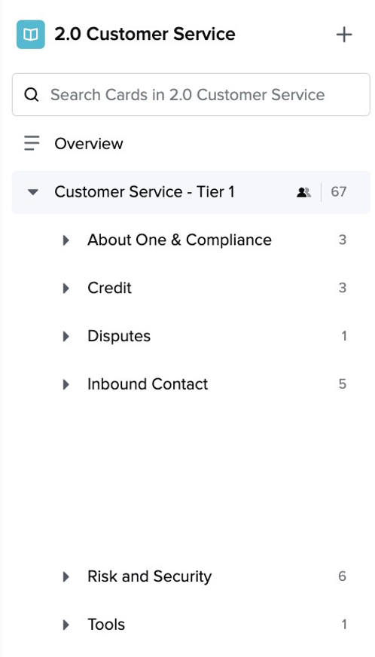
Overview: Customer Service Collection
MASTER resources are organized by Product and Features.
All resources related to a specific product or feature will be available in a single Overview card.
Everyone, go and pin (📌) the 2.0 Customer Collection now!
Notes:
Duration
3 minutes
Say:
Here's how MASTER has been improved to help you navigate resources more efficiently:
Organized Resources: The cards are now better categorized by product and features, making it easier for you to find what you need without searching through multiple cards.
Efficient Navigation: Whether you have questions about Pay or Inbound Contact, all related information is now readily accessible at your fingertips.
Consolidated Cards: The cards have been streamlined to reduce confusion and simplify navigation. While some older cards will be phased out, the new structure ensures you have everything you need in one place.
Now, to make sure you can quickly access the MASTER 2.0 Collection whenever you need it, go to ‘All Collections’ in MASTER and click the pin icon next to the MASTER 2.0 Collection. Pinning it ensures easy access from your sidebar, so you can find important resources without searching. Go ahead and pin your collection now.
For now, you should keep both MASTER 1.0 and 2.0 Collections pinned until everything has fully transitioned to the 2.0 Collection.
Transition:
Let’s take a closer look at the card structure and how it helps you find information more efficiently.

Slide 30
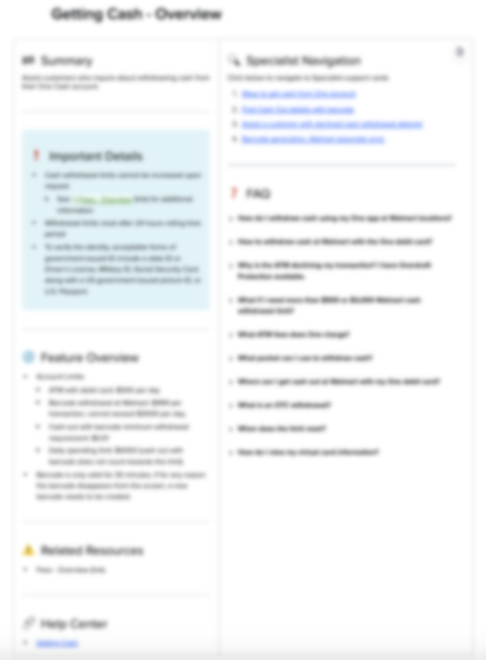
Card Structure
Each Overview card for a product or feature has:
Important Details
Product/Feature Overview
FAQs
Specialist Navigation
Related Resources
Related Help Center Articles
Notes:
Duration
2 minutes
Say:
The latest enhancements to the Cards make it easier for you to access all the resources you need in one place. Whether you're looking for information to complete a task or answering customer inquiries, you can now navigate more seamlessly. Here’s what’s new:
Specialist Navigation: Find step-by-step guides and procedures designed specifically for you.
FAQ Section: Quickly access frequently asked questions to assist customers more efficiently.
Help Center Articles: Get direct links to detailed articles, making it easier to guide customers toward self-service.
Overview Cards: Each card includes key details and a quick summary, helping you focus on the most important information.
These improvements ensure you can provide accurate and timely support to customers with greater ease.
Transition
Let’s understand the search option 1 in GURU home page.

Slide 31
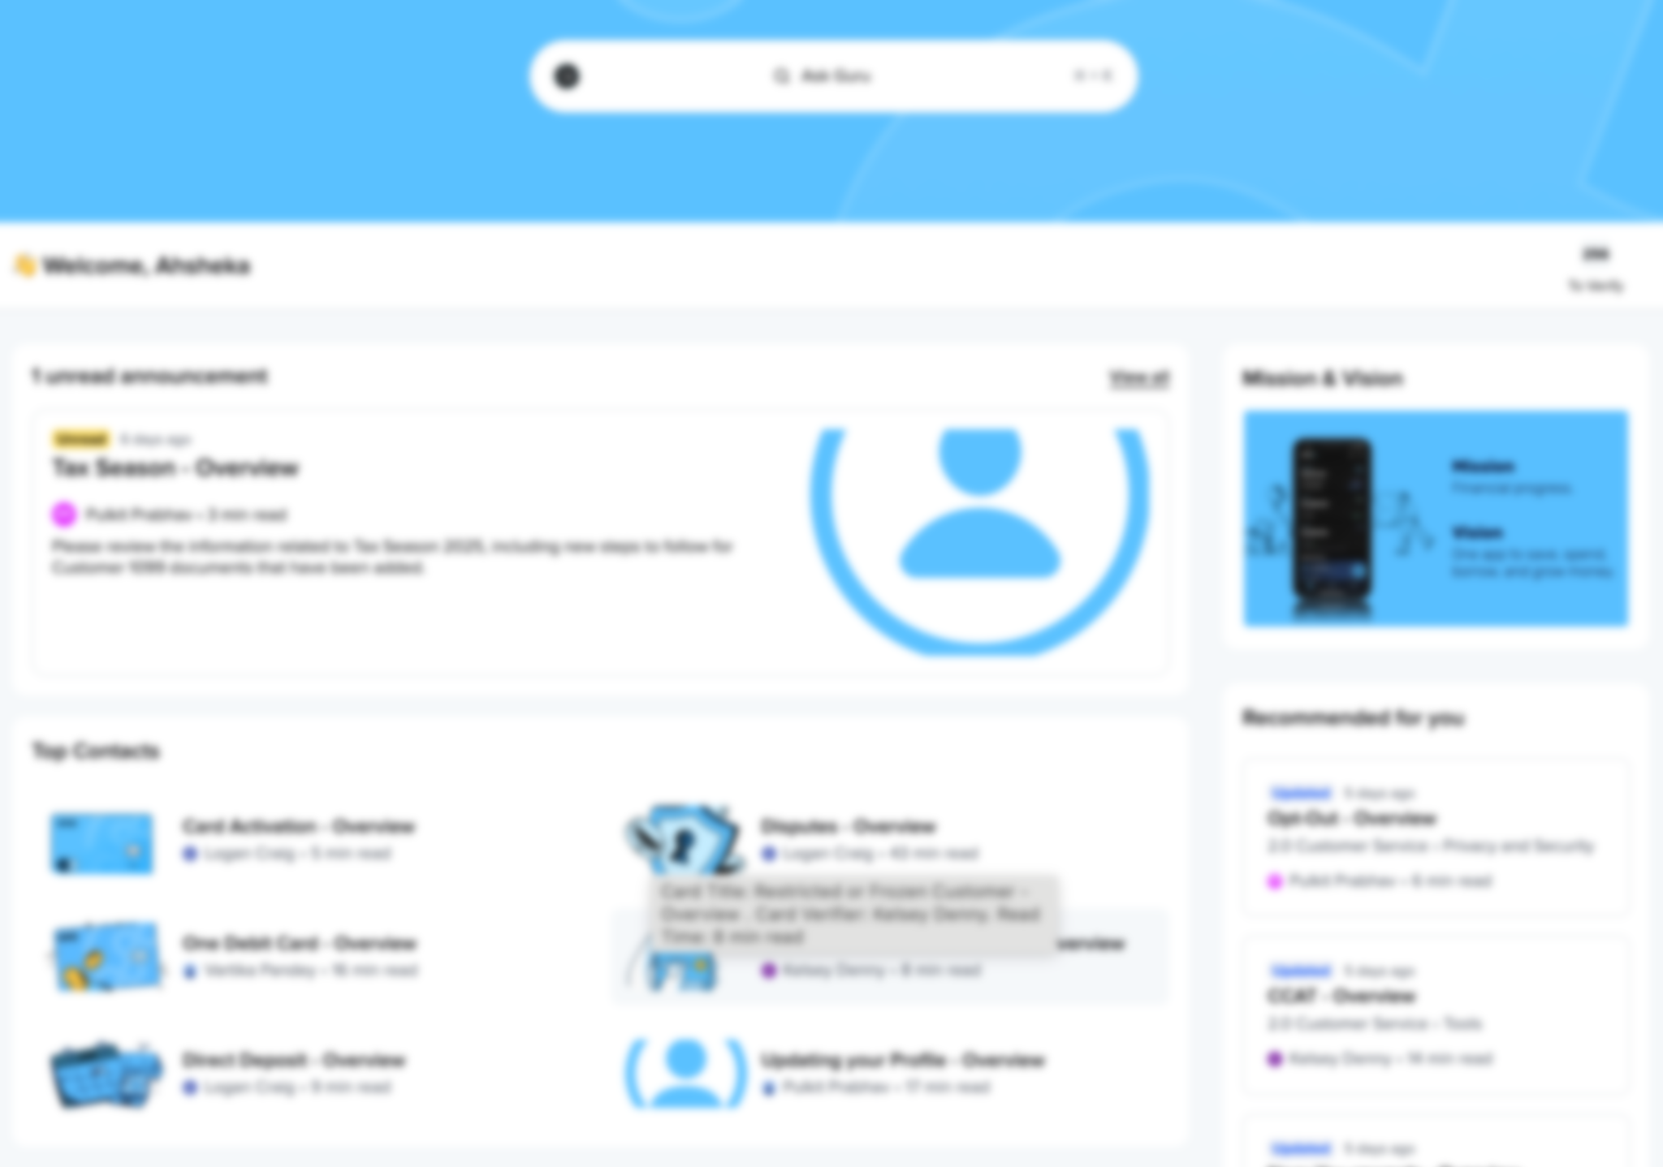

Search Option 1: 🏠 Search Bar
Use the search bar on the MASTER Home page
Notes:
Duration
1 minute
Say:
Use the search bar on the GURU home page to find relevant information and resolve the customer's issue.
Transition
Let’s understand the search option 2 in pinned GURU 2.0 Customer Service Collection

Slide 32

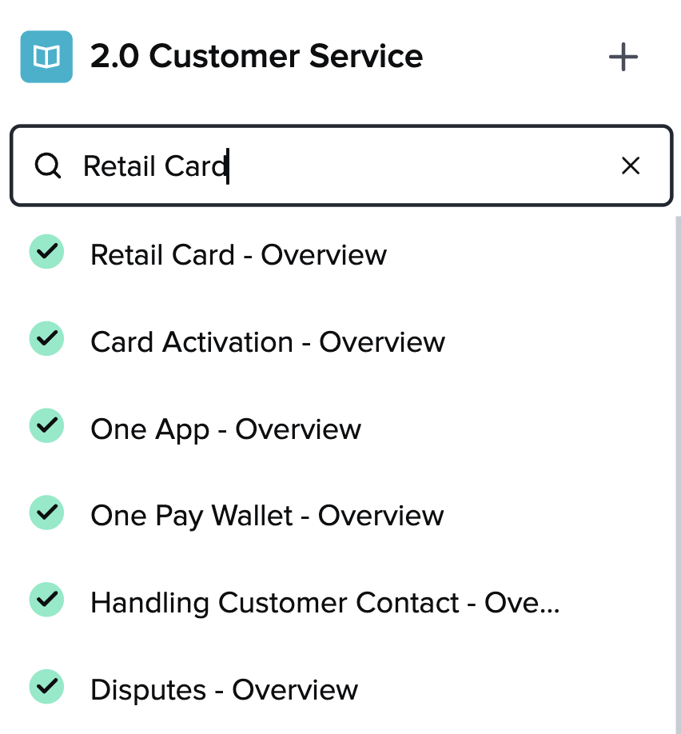
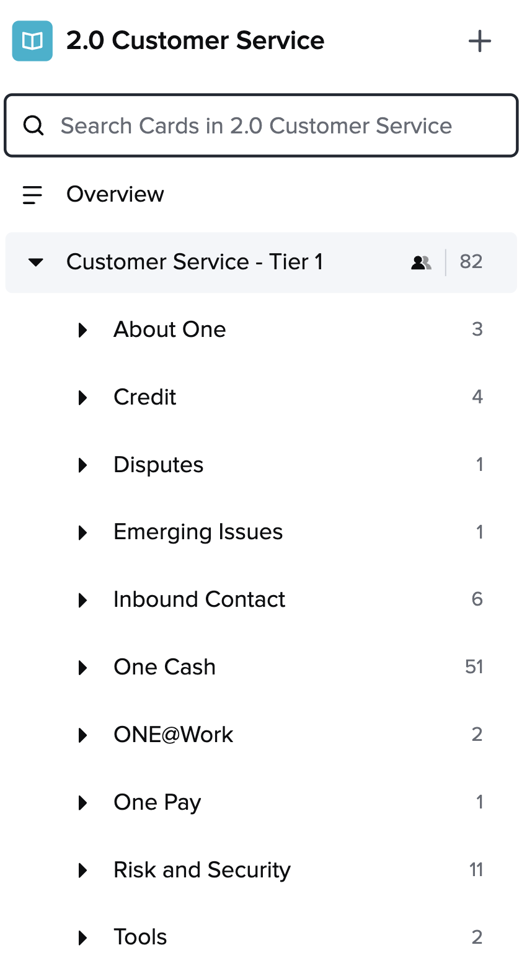
Search Option 2: Collection
Search in the 2.0 Customer Service Collection
Notes:
Duration
1 minute
Say:
Use the search bar on the GURU 2.0 Customer Service Collection (pinned) to find relevant information and resolve the customer's issue.
Transition
Now, let’s view a demonstration on GURU search option.

Slide 33
Review Announcements in MASTER
Review daily
After leave or absence
Start, end, and periodically during your shift.
Check all announcements to stay updated.
Notes:
Duration:
1 minute
Do:
Display the slide and explain the importance of regularly reviewing MASTER announcements.
Say:
Make it a habit to review your announcements daily at the beginning and end of your shift, as well as periodically throughout your shift.
If you’ve been on leave or unwell, make sure to review all announcements when you return to work to stay up to date.
Transition:
Let’s look at some MASTER announcement examples.

Slide 34
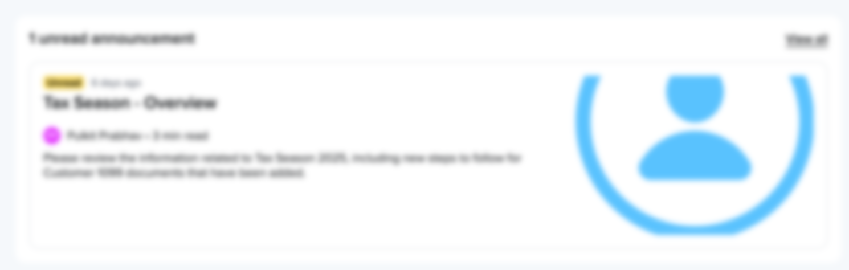
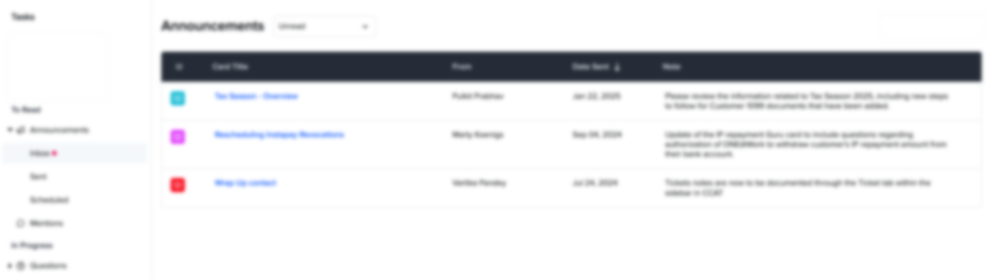
MASTER Announcements Examples
Notes:
Duration:
1 minute
Say:
Here are a few examples of MASTER Announcements.
Transition:
It’s time to put what we’ve learned into practice. Let’s explore MASTER.

Slide 35
Hands-On Activity
Exploring MASTER
30 minutes
Individual
The spotlight is on you now! Take this time to the plunge into MASTER and experience what it’s like to be a specialist!
Explore MASTER for the following scenarios.
Card Activation
"How do I activate my card?"
Retail Card
"Why do I need to activate the Retail card I purchased at MM"
Mobile Check Deposit
"How can I access Mobile Check Deposit"
Mobile Check Deposit
“I am unable to submit a mobile deposit"
Notes:
Duration: 30 minutes
Notes:
Activity Name: Hands-On Activity
Leaderboard Activity: No
Objective: To explore MASTER, the knowledge management tool.
Group/Pair/Individual: Individual
Time Required: 30 minutes
Materials Needed: Desktops/laptops with MASTER and a timer
Activity Steps:
1. Step 1 (1 minute):
Have the participants log in from their respective stations.
Ask the participants to explore MASTER for the given scenarios to resolve customer issues.
2. Step 2 (29 minutes):
Allow 29 minutes for this activity.
Do:
Begin with a trainer-led demo to guide participants.
Assign scenarios and ask them to explore GURU
Conduct the activity as per the instructions.
Walk around the classroom to check how the participants are exploring MASTER. Guide them if needed.
Say:
Let’s explore MASTER. Use MASTER to find accurate product information, procedures, and workflows. Navigate the tool to solve problems, discover precise answers, and handle customer interactions efficiently by leveraging its trusted, regularly updated resources.
This hands-on time will help you gain confidence and prepare for real-world scenarios. Get set on focusing on mastering this tool for seamless customer interactions.
Transition:
Let’s move on to the next module to dive into the Retail Card and its features.

