Slide 1
Lesson at a glance
Section name | Description | Time (minutes)
Welcome and WIIFM | Participants are welcomed and provided with an overview of the session. | 10
Recognizing the prospecting mindset | Participants explore how a focused and intentional prospecting approach lays the foundation for stronger sales outcomes. | 10
Researching and identifying the right prospects | Participants apply research techniques to evaluate potential customers and identify high-quality leads that align with ABC solutions. | 30
Crafting outreach and starting conversations | Participants practice creating personalized, value-driven outreach messages that capture ABCention and spark meaningful customer engagement. | 10
Applying salesforce alignment to the sales cycle | Participants learn how to accurately document selling actions in Salesforce to improve visibility, collaboration, and forecasting accuracy. | 20
Applying the forecasting and pipeline metrics | Participants analyze pipeline stages, qualification criteria, and sales metrics to strengthen pipeline health and improve forecasting. | 30
Key takeaways and next steps | Participants reflect on their learning, share key actions, and commit to applying effective prospecting and Salesforce alignment strategies in their daily selling. | 10
Total |  | 120
Notes:
Topic format: Title
Estimated time: 1 minute
Description: Section breakdown, description, and preparation for the session
Instructor note:
This slide gives you a quick overview of the session's structure and timing. It outlines each section by name, includes a brief description, and shows the estimated time for each part. This helps you stay on track and manage your time throughout the session. Use it as a guide to plan transitions and keep things running on schedule.
Total session duration: 2 hours (approximate)
Do: Inform participants of the total duration of the session.
Prepare to begin the session.

Slide 2

ABC Business
Prospecting
and salesforce alignment
©2025 ABC Intellectual Property – ABC Proprietary (Internal Use Only)
Not for use or disclosure outside the ABC companies except under written agreement.
Notes:
Topic format: Title
Estimated time: 1 minute
Description: Introduction of the topic and session
Do: Display this slide at the beginning of the class.​
Say: Welcome, everyone. This session explores what it takes to find the right prospects, spark meaningful conversations, and use Salesforce insights to guide next steps while connecting all of this to the ABC Business sales cycle for stronger prospecting outcomes. The goal is predictable success from first interaction to closed deal.
Transition: Before you start the session, let’s look at some ground rules.
Instructor note: Continue to the next slide.

Slide 3

Before you start
During the session:
Turn on your camera.
Actively participate.
Stay focused.
Ask as many questions as needed.
ABC Business
Notes:
Topic format: Session setup
Estimated time: 1 minute
Description: Introduction of ground rules for the session
Do:
After welcoming the participants:​​
Display this slide.
Greet the participants and thank them for their participation.
Review the class roster to find out if any participants haven’t arrived yet.
Briefly review housekeeping guidelines for the session.
Say: Let’s run through a few quick guidelines to help us get the most out of today’s session:
Actively participate in discussions and activities.
Take the time to disconnect from other things.
Avoid multi-tasking.
Focus on the session.
Respond and ask questions as needed in the chat or by raising your hand.
Instructor note:
Set the stage by connecting prospecting to the importance of active engagement and learning from peers.
Say:
This session helps you strengthen your prospecting skills by learning how to identify the right customers, start meaningful conversations, and create opportunities that lead to successful sales outcomes.
Transition: Let’s take a look at what today’s session is about.
Instructor note:
Continue to the next slide.

Slide 4

Agenda
Lesson 1
Lesson 4
10 mins
20 mins
Recognizing the prospecting mindset
Applying salesforce alignment to the sales cycle
Lesson 2
Lesson 5
30 mins
30 mins
Researching and identifying the right prospects
Applying the forecasting and pipeline metrics
Lesson 3
Lesson 6
10 mins
10 mins
Crafting outreach and starting conversations
Key takeaways and next steps
Notes:
Topic format: Agenda overview
Estimated time: 1 minute
Description: Overview of the session agenda and what participants will learn through each topic.
Do:
Review the agenda with the class.
Instructor note:
Briefly walk participants through the agenda, highlighting how each lesson builds from recognizing the value of prospecting to applying practical techniques for real customer scenarios.
Say:
Here’s what you’ll cover today. We’ll begin by understanding the prospecting mindset, then move to researching and identifying the right prospects.
Next, you’ll focus on crafting outreach and starting meaningful conversations. Finally, you’ll close with key takeaways and next steps to apply what you’ve learned.
Transition:
Now that you know the plan for today, let’s focus on what you’ll gain from this session.
Instructor note:
Continue to the next slide.

Slide 5

What’s in it for me?
Get ready to build stronger, more intentional prospecting habits.
In this session, you’ll learn how to apply purposeful contact strategies, create high-quality lists with ABC tools, and track the right activities in Salesforce to support the sales cycle.
Walk away with practical techniques, clear guidance, and the confidence to maintain a clean and predictable pipeline.
Notes:
Topic format: Topic set-up
Estimated time: 1 minute
Description: Introduces the session and shows how better prospecting and Salesforce can improve sales.
Say:
This session invites you to take a more intentional approach to prospecting. You’ll explore how to apply purposeful contact strategies, build high-quality lists with ABC tools, and capture activities in Salesforce in a way that supports the sales cycle. You’ll also see how these habits help you maintain a clean and predictable pipeline. By the end, you can expect fresh techniques, practical insights, and a clearer sense of how focused prospecting efforts lead to stronger outcomes.
Transition:
To get us warmed up, let’s kick off with a quick, fun icebreaker that connects back to how you think as sellers.
Instructor note:
Continue to the next slide.

Slide 6
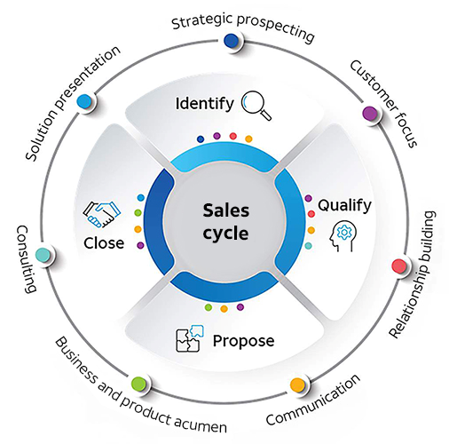
Icebreaker: Sales cycle connection challenge
Instructions:
You’ll see five seller actions appear one by one. Type Match in chat if it reflects the sales cycle, or No match if not.
ABC Business
Notes:
Topic format: Icebreaker activity
Estimated time: 1 minute
Description: An interactive icebreaker to reinforce effective sales cycle practices through real seller actions
Say:
The sales cycle is supported by seven core capabilities designed to help you deliver customized and effective solutions to customers.
Let’s start with something fun. You’ll see a few seller actions. Decide whether each action aligns with the sales cycle, and respond in chat with Match or No match.
Some responses may be incorrect. That is expected. This activity is meant to surface different interpretations before moving into a deeper discussion.
Do:
Share five prompts one by one as shown on the next slide.
Have participants respond using chat.
Acknowledge responses and clearly explain whether each action aligns with the sales cycle.
Instructor note:
Continue to the next slide.

Slide 7
Icebreaker: Sales cycle connection challenge (Continued)
Prompts
Sending a follow-up email after a first meeting.
Reviewing past deals before meeting a new client.
Sharing pricing before understanding needs.
Logging customer feedback in Salesforce.
Calling a customer without an agenda.
ABC Business
Notes:
Topic format: Icebreaker activity
Estimated time: 5 minutes
Description: Quick game to identify actions that align with the sales cycle.
Sample prompts (displayed one by one):
Sending a follow-up email after a first meeting.
Reviewing past deals before meeting a new client.
Sharing pricing before understanding needs.
Logging customer feedback in Salesforce.
Calling a customer without an agenda.
Instructor note:
Below are the answers for the above prompts:
Sending a follow-up email after a first meeting. (Match: Demonstrates proactive communication and follow-through.)
Reviewing past deals before meeting a new client. (Match: Reflects preparation and leveraging insights—key selling behaviors.)
Sharing pricing before understanding needs. (No match: Jumps to solutioning before discovery; not aligned to consultative selling.)
Logging customer feedback in Salesforce. (Match: Encourages data-driven selling and collaboration across teams.)
Calling a customer without an agenda. (No match: Shows lack of preparation; doesn’t reflect effective planning and customer focus.)
Ask:
What pABCerns did you notice about what fits or doesn’t fit the sales cycle?
Listen for:
Themes like intentional actions, planning, or customer-first mindset
Transition:
Excellent thinking! The sales cycle is not just about actions; it’s about intentional, customer-centered behaviors that drive meaningful outcomes. Now, let’s zoom in on prospecting, the heartbeat of your pipeline.
Instructor note:
Continue to the next slide.

Slide 8


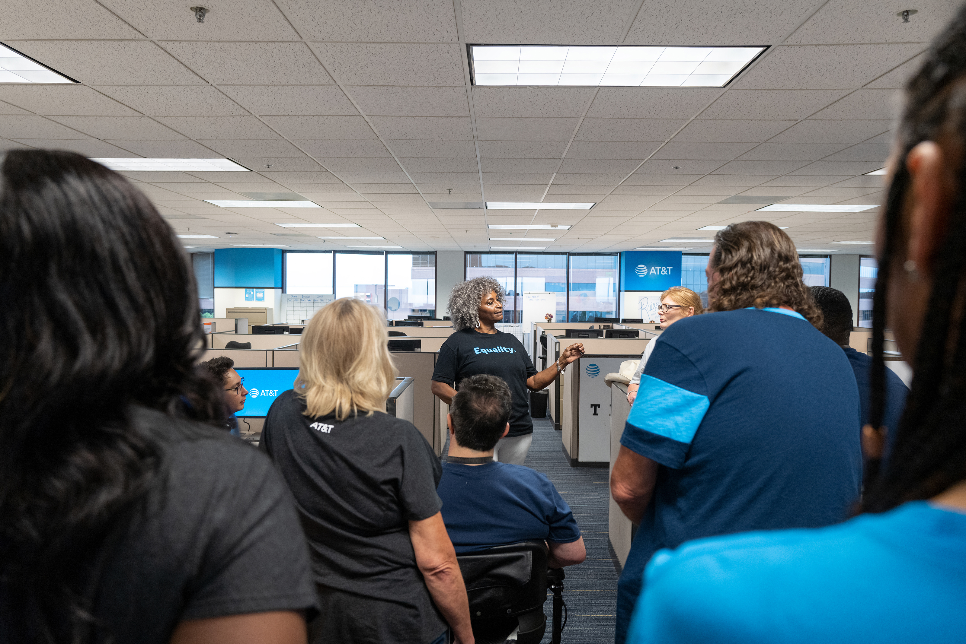
Lesson 1:
Recognizing
the prospecting mindset
ABC Business
Notes:
Topic format: Lesson introduction
Estimated time: 1 minute
Description: Introduce the overall focus and objectives of the lesson.
Do:
Provide a description of the topic.
Say:
In this lesson, you’ll uncover what it takes to find, qualify, and engage the right prospects with confidence. You’ll see how strong qualification and effective use of Salesforce can turn prospecting into a smarter, more focused process.
Instructor note:
Continue to the next slide.

Slide 9
What is prospecting?
Finding and engaging potential customers
Keep opportunities flowing
Uncover
business needs
Build a qualified
lead pipeline
Identify
decision-makers
Start
relationships
Notes:
Topic format: Concept introduction
Estimated time: 5 minutes
Description: Foundational discussion to define what prospecting really means and how it supports a healthy sales pipeline.
Say:
Prospecting isn't about sending mass emails. It's about identifying the right people and building meaningful conversations.
Do: (Chat storm):
Type one word that describes how you feel about prospecting.
Ask:
What’s the difference between a name on a list and a true prospect?
Listen for:
Responses highlighting intent, qualification, and business fit
Transition:
To find the right prospects, you need solid research and clear selection criteria. So, let’s apply that mindset to real-world research.
Instructor note:
Continue to the next slide.

Slide 10

Where prospecting fits in the sales cycle
Prospecting fuels every step of the sales journey.
Notes:
Topic format: Discussion
Estimated time: 4 minutes
Description: A brief discussion that highlights how strong prospecting sets the foundation for success in later sales stages.
Say:
Prospecting drives everything that follows. The quality of early interactions impacts discovery, proposal, negotiation, and closing.
Ask:
How does the quality of prospecting influence later sales stages?
Listen for:
Better discovery, clearer proposals, higher close probability, shorter cycles
Transition:
With the sales cycle established, let’s explore how sellers identify the right prospects.

Slide 11


Lesson 2:
Researching and identifying the right prospects
ABC Business
Notes:
Topic format: Lesson introduction
Estimated time: 1 minute
Description: Introduce the lesson topic and set the stage for exploring how to research and identify the right prospects.
Do:
Provide a brief overview of what the lesson will cover and how it connects to effective selling practices.
Say:
Every successful sales conversation begins long before the first meeting; it starts with knowing who to approach and why. In this lesson, we’ll uncover how research can reveal the most promising prospects and how to use available tools and insights to qualify them effectively. Get ready to sharpen your discovery skills and learn practical ways to focus your efforts where they’ll make the biggest impact.
Instructor note:
Continue to the next slide.

Slide 12

Prospecting strategies
1
Industry-based: Focusing your efforts on specific industries (verticals) like healthcare, finance, retail, or manufacturing
2
Product-based: Targeting companies or contacts that are a strong fit for a specific ABC product or solution
3
Wallet share: Looking for more business within current ABC customer accounts, upselling or cross-selling
4
Geography-based: Organizing your prospecting by physical location, national, regional, state, city, or metro area
5
Cross-sell and convergence: Approaching existing ABC customers with bundled solutions that combine multiple products or services
Notes:
Topic format: Topic introduction
Estimated time: 2 minutes
Description: Introduction to core prospecting strategies that help sellers focus efforts and improve targeting.
Say:
Prospecting becomes powerful when it starts with intention. These prospecting strategies give you multiple ways to focus your outreach with intention. Each approach helps you narrow your efforts, so you spend more time with the right customers and fewer cycles on low-value leads. Together, they create a more structured, predictable path for building a healthy pipeline.
Ask:
Before moving ahead, which of these prospecting strategies do you already rely on most often, and why?
Listen for:
Responses highlighting industry focus, product alignment, account expansion, geographic targeting, or cross-sell opportunities.
Transition:
Now that the strategies are established, let’s look at how to apply them with focus and consistency.

Slide 13
Activity: Strategy to scenario match
Instructions:
Scenarios
In your breakout group:
Review your assigned scenario.
Identify the prospecting strategy that best fits.
Note the cues that guided your decision.
Choose one person to share your group’s match.
1
A hospital network expanding telehealth wants secure connectivity and compliance support.
2
A chain of restaurants is struggling with customer Wi-Fi and mobile ordering.
3
A current ABC Business customer uses ABC Fiber but not Wireless backup.
4
A Dallas metro territory shows high growth in logistics and manufacturing.
5
An accounting firm with multiple locations currently uses ABC for their wireless plans but not for internet services.
Notes:
Topic format: Skill-building activity: Peer role-play and poll voting​
Estimated time: 7 minutes
Description: Scenario-based activity to create personalized outreach messages
Say:
Outreach is your first impression. Let’s make it meaningful. A well-crafted message earns a response. Your goal is to connect quickly and personally.
You’ve already practiced what makes great outreach in your Prospecting for success prework. Now it’s time to put that into action through a real scenario.
Do:
Send teams into breakout rooms with their assigned scenario.
Encourage creativity: Make it conversational, short, and specific to the prospect’s context.
After five minutes, bring the teams back and have each group’s volunteer read their message aloud.
Use a poll for participants to vote for the most engaging outreach. (The poll question is given on the next screen.)
Instructor note:
Continue to the next slide.
13

Slide 14
Activity: Strategy to scenario match (Continued)
Scenarios
Expected strategy
A hospital network expanding telehealth wants secure connectivity and compliance support.
Industry
A chain of restaurants is struggling with customer Wi-Fi and mobile ordering.
Product
A current ABC Business customer uses ABC Fiber but not Wireless backup.
Wallet-share
A Dallas metro territory shows high growth in logistics and manufacturing.
Geography
An accounting firm with multiple locations currently uses ABC for their wireless plans but not for internet services.
Cross-sell and converged
Notes:
Topic format: Activity
Estimated time: 1 minute
Description: Team activity to review sales scenarios and identify the most relevant prospecting strategy
Ask:
What cues helped match the scenario to the strategy?
Listen for:
Industry drivers, product triggers, account potential, regional business trends, and opportunities to bundle or converge solutions.
Transition:
Now that the strategies are set, sellers need the right tools to start building strong prospect lists.
14

Slide 15
Prospecting tools
Tool
Purpose
Key function
Best time to use
Surface warm, campaign-driven prospects.
Search, segment, and sync leads in Salesforce.
Validate locations and enrich prospect data.
MQO
Start with pre-filtered, prioritized leads.
Build and organize targeted lead lists.
Build lists and confirm prospect eligibility.
Before building additional lead lists.
When creating or refreshing lead lists.
Before outreach, especially for door knocking.
Prospecting Tab
Ponder
Notes:
Topic format: Topic introduction
Estimated time: 1 minute
Description: Introduction to the key prospecting tools that support pre-filtered lead review, list building, eligibility validation, and data readiness
Say:
These platforms help you start with pre-filtered leads, build your own lists, and confirm eligibility before outreach. Together, they streamline the early stages of prospecting so you can focus more on meaningful conversations and less on manual work.
Transition:
Now that the tools are clear, it's time to test tool selection in a quick lightning round.

Slide 16
Activity: Tool selection lightning round
1
Need to generate a list of businesses that match a territory
Instructions:
During the lightning round:
Review the prospecting task that appears on the screen.
Type the prospecting tool that best fits.
Focus on the cues in the task that guided the selection.
2
Need to identify eligible business addresses for prospecting
Prospecting task
3
Need to identify leads that marketing says are ready
4
Need to see which accounts are assigned during door knocking.
5
Need to export a clean list for targeted outreach
Notes:
Topic format: Activity
Estimated time: 3 minutes
Description: Team activity to review prospecting tasks and identify the most relevant prospecting tool.
Say:
This is a lightning round. A prospecting task will appear on the screen. Type the tool that best fits in the chat. Keep the responses quick and concise. After the responses come in, one person will briefly share what influenced the selection.
Do:
Display each task one at a time.
Pause for chat responses.
Acknowledge the first few correct entries.
Confirm the correct tool (use the answer key below).
Ask one participant to briefly explain the reasoning before moving to the next task.
Maintain a quick, energetic pace.
Task list with correct responses (for facilitator only)
Need to generate a list of businesses that match a territory (Prospecting Tab)
Need to identify eligible business addresses for prospecting (Ponder)
Need to identify leads that marketing says are ready (MQO)
Need to see which accounts are assigned during outdoor knocking(Ponder)
Need to export a clean list for targeted outreach (Prospecting Tab)

Slide 17
Activity: Tool selection lightning round (Continued)
Prospecting task
Tool
Need to generate a list of businesses that match a territory
Prospecting Tab
Need to identify eligible business addresses for prospecting
Ponder
Need to identify leads that marketing says are ready
MQO
Need to see which accounts are assigned during outdoor knocking.
Ponder
Need to export a clean list for targeted outreach
Prospecting Tab
Notes:
Topic format: Activity
Estimated time: 2 minutes
Description: Team activity to review sales scenarios and identify the most relevant prospecting strategy
Ask:
What was the main factor behind the selection?
Listen for:
Territory relevance, data cleansing accuracy, prioritization readiness, ROE alignment
Transition:
Now that the data is clean, verified, and prioritized, one more filter guides what moves into Salesforce. That filter is the ICP.
17

Slide 18
Ideal Customer Profile (ICP)
The ICP check is a final filter to confirm ABC Business fit before adding prospects to Salesforce.
Industry
Company size
Technology use
Growth potential
Notes:
Topic format: Concept introduction
Estimated time: 3 minutes
Description: Review of the Ideal Customer Profile (ICP) criteria used to confirm that a prospect aligns with the strongest fit for ABC Business.
Say:
As covered in the iPDF on Prospecting tools and sales cycle alignment, the Ideal Customer Profile (ICP) forms the foundation of effective prospecting. ICP outlines the type of business that represents the strongest fit for ABC Business solutions, based on cues such as industry, company size, technology use, and growth potential. Before any prospect moves into Salesforce, this ICP check acts as the final filter to confirm that the prospect aligns with the customer profile most likely to convert and deliver long-term value for ABC Business.
Ask:
How could applying ICP early in the prospecting process save time and improve results?
Listen for:
Focus on accounts with higher likelihood to convert;
Avoiding time spent on poor-fit prospects;
Prioritization of resources and efforts; and
Better alignment with ABC Business goals.
Transition:
With the ICP check complete, it’s time to put detective skills to work.

Slide 19


Activity: Prospect detective
Each team receives a prospect file with partial data.
Instructions:
Identify what to verify before reaching out.
Decide if this prospect belongs in your Salesforce pipeline.
List two next steps you’d take.
Notes:
Topic format: Activity
Estimated time: 10 minutes
Description: Breakout investigation with clues
Say:
Every strong sale begins with solid research. In your prework on Prospect list quality scrubbing and ROE tools, you learned how to validate lists for accuracy and relevance. Let’s play detective and evaluate which leads are truly worth pursuing.
Do:
Paste each profile (given below) into a breakout room chat.
Profiles (assigned per team):
1. Brightmed Health Systems
Company size: 3,500 employees, five hospitals in the Midwest
Business focus: Expanding telehealth services
IT Infrastructure: Experiencing bandwidth issues during peak telehealth hours
Decision-makers: CIO ABCended ABC webinar, no other contacts engaged yet
Timeline: Expansion planning ongoing, no firm rollout date
Notes: Interested in cloud-based solutions; regulatory compliance is critical
2. Speedlogix Logistics
Company size: 250 trucks, four regional distribution centers
Business focus: Supply chain optimization and real-time fleet tracking
Current tools: Competitor IoT platform in use
Decision-makers: CEO interested in better tracking; logistics manager partially engaged; no IT contact yet
Pain points: Tracking delays, operational inefficiencies, high fuel costs
Timeline: Wants solution evaluation within next 3–4 months
Notes: Prioritize cost savings and ROI metrics for pitch
3. Edunova Charter Schools
Company size: 15 schools, ~6,000 students
Business focus: Hybrid learning expansion; integrating digital classrooms
IT Infrastructure: IT manager engaged, budget pending
Decision-makers: IT manager and principal are key contacts
Pain points: Limited bandwidth in some schools, outdated video conferencing hardware
Timeline: Planning for next academic year
Notes: Highlight educational solutions, scalability, and ease of deployment
Give 10 minutes for analysis.
Prompt each group with:
Which details build your confidence?
What would you verify?
Bring groups back to main room.
Ask (debrief):
Which indicators helped you validate prospect quality?
Listen for:
Budget fit, business growth potential, and alignment to ABC solutions
Transition:
Once you’ve identified strong prospects, how do you grab their ABCention? Let’s find out.
Instructor note:
Continue to the next slide.

Slide 20

Lesson 3:
Crafting outreach and starting conversations
ABC Business
Notes:
Topic format: Topic introduction
Estimated time: 1 minute
Description: Introduction of the lesson topic and overview of what participants will learn and practice.
Do:
Provide an engaging overview of the lesson focus and set expectations for the upcoming activities.
Say:
In this lesson, you’ll focus on what makes an initial connection stand out. You’ll explore how to create outreach messages that capture ABCention, spark curiosity, and set the stage for meaningful conversations. Together, you’ll look at ways to personalize communication, strike the right tone, and use insights to make every interaction count.
Instructor note:
Continue to the next slide.

Slide 21
Activity: The message match-up
Instructions:
In your breakout group:
Review your outreach scenario.
Draft a short message (email, LinkedIn, or call opener).
Choose one team member to present it.
Other groups will vote on the most engaging message.
1
Healthcare: BrightMed’s CIO ABCended an ABC webinar. Write a LinkedIn message.
Scenarios
2
Logistics: SpeedLogix operations head posted about delivery delays. Draft a cold call opener.
3
Education: EduNova’s IT manager downloaded a whitepaper. Create a follow-up email.
Notes:
Topic format: Skill-building activity: Peer roleplay and poll voting
Estimated time: 7 minutes
Description: Scenario-based activity to create personalized outreach messages.
Say:
Outreach is your first impression. Let’s make it meaningful. A well-crafted message earns a response. Your goal is to connect quickly and personally.
You’ve already practiced what makes great outreach in your Prospecting for success prework.
Ask:
Which outreach methods work best for different prospect types?
Listen for:
Use of personalized email, outbound calling, social selling, referrals, or networking
Selection of methods based on prospect type, engagement stage, or decision-maker role
Say:
Now it’s time to put that into action through a real scenario.
Do:
Send teams into breakout rooms with their assigned scenario.
Encourage creativity: Make it conversational, short, and specific to the prospect’s context.
After five minutes, bring teams back and have each group’s volunteer read their message aloud.
Instructor note:
Continue to the next slide.
21

Slide 22

Most engaging outreach message
Which group's message was the most engaging and well-crafted?
Select the option you feel is most engaging.
Group 1: Healthcare (BrightMed LinkedIn message)
Group 2: Logistics (SpeedLogix cold call opener)
Group 3: Education (EduNova follow-up email)
Notes:
Topic format: Quick chat vote
Estimated time: 2 minutes
Description: Quick feedback to identify the most engaging outreach message crafted during the activity
Say: Now it’s time to see which message resonated most. Please use the chat to share your choice. Type the option that you feel delivers the most engaging message:
Group 1: Healthcare (BrightMed LinkedIn message)
Group 2: Logistics (SpeedLogix cold call opener)
Group 3: Education (EduNova follow-up email)
Do:
Ask participants to type their vote in the chat.
Monitor the chat to tally which group received the most mentions.
Read out the winning message and acknowledge the team.
Ask (debrief):
What elements made the winning message stand out?
Listen for:
Personalization relevant to the prospect
Clear value proposition
Appropriate tone and clarity
Creativity and alignment with ABC prospecting strategies
Transition:
Great connections are valuable only when tracked effectively. Let’s explore how to set up the prospect accurately inside Salesforce.
Instructor note:
Continue to the next slide.

Slide 23
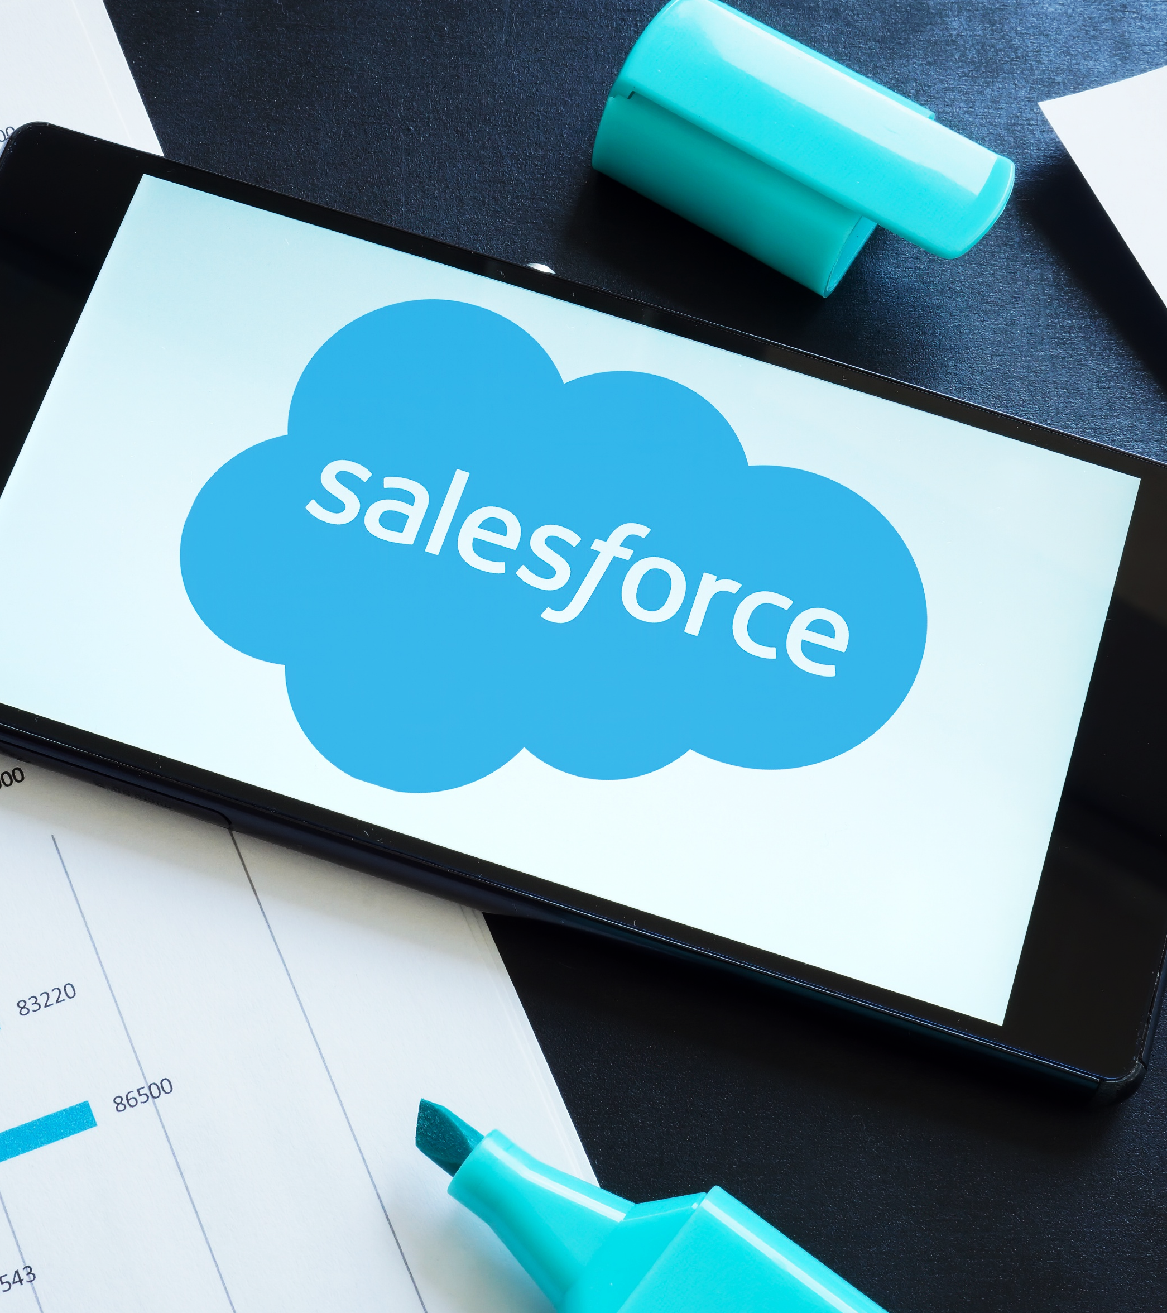
Lesson 4:
Applying salesforce alignment to
the sales cycle
ABC Business
Notes:
Topic format: Lesson introduction
Estimated time: 1 minute
Description: Introduction to Salesforce alignment and its importance in driving consistent sales success.
Do:
Set the stage for the lesson by highlighting that participants will explore real-world scenarios to practice mapping sales activities to Salesforce fields and objects.
Say:
Earlier, you reviewed prospecting tools and sales cycle alignment in your prework. That showed how Salesforce connects to every stage of selling. In this lesson, you’ll see how Salesforce brings all selling activity together in one place. It’s not just data entry; it’s a tool that helps you track progress, stay organized, and make stronger decisions. You’ll walk through a real customer situation, decide when to create an opportunity, log the right activity, and identify updates that keep your pipeline accurate and moving.
Instructor note:
Continue to the next slide.

Slide 24
Key stages in the sales pipeline
Below is a visual path showing how prospects move from contact to close.
Lead generation
Opportunity nurture
Propose and close
Pre-qualifying
Qualifying
Solutioning
Contracting
Closed/won
Proposing
Ordering
Notes:
Topic format: Introduction
Estimated time: 1 minute
Description: Discuss how the sales cycle aligns with Salesforce actions.
Say:
Before beginning the scenario, here is a quick visual reminder of how the sales cycle connects to Salesforce. Your pipeline is a mirror of your selling habits. Each phase triggers specific Salesforce actions that ensure the opportunity progresses accurately.
Ask:
Which phase typically creates the first data entry in Salesforce?
Listen for:
Lead creation or early qualification
Do:
Capture participant responses in the chat and summarize key points.
Acknowledge common challenges and reinforce that recognizing them is the first step to improving pipeline health.
Transition:
Let’s use this foundation to work through the scenario.
Instructor note:
Continue to the next slide.

Slide 25

Scenario: Customer interaction
A business manager requests information about upgrading connectivity. A short call confirms interest, and a follow-up meeting is scheduled.
Notes:
Topic format: Pipeline reflection discussion
Estimated time: 1 minute
Description: Exploring selling habits and identifying challenges across pipeline stages
Say:
This scenario mirrors a common early-stage customer interaction. The goal is to determine how this engagement translates into Salesforce activity.
Do:
Read the scenario aloud and give the participants a few seconds to reflect.
Ask:
What is the first Salesforce action required based on this interaction?
Listen for:
Logging a call, or creating a lead
Transition:
Now let’s decide whether this qualifies as an opportunity.

Slide 26
Activity: Define the opportunity
A business manager requests information about upgrading connectivity. A short call confirms interest, and a follow-up meeting is scheduled.
Is this an opportunity?
Consider:
ICP fit
MQO readiness
Early BANT details
Confirmed interest
Notes:
Topic format: Opportunity qualification discussion
Estimated time: 2 minutes
Description: Determining if a customer interaction meets the criteria to be logged as a formal opportunity in Salesforce.
Say:
The question here is not whether the conversation was productive, but whether it reaches the threshold for opportunity creation. That decision depends on ICP fit, MQO readiness, and early signs of budget, need, authority, or timeline.
Type your response in the chat: Yes or No, and include a brief reason why.
Do:
Monitor chat for participant responses (Yes/No + brief reason).
Emphasize that this is the only step participants need to complete for this activity.
Ask (debrief):
What in the scenario influenced your decision to mark it as an opportunity or not?
Listen for:
Interest confirmation and follow-up meeting scheduled
Early BANT signals: budget, need, authority, timeline
ICP fit and MQO readiness
Instructor note (Why):
Yes: Participant sees ICP fit, MQO readiness, confirmed interest, and early BANT signals; qualifies to log as an opportunity
No: Authority unclear, budget or need uncertain, or prospect does not fit the ICP; does not qualify to log as an opportunity
Transition:
Once readiness is confirmed, the next step is accurate Salesforce logging.
26

Slide 27
How to log an activity in Salesforce
Navigate to the relevant record:
Lead, Contact, Account, or Opportunity
Find the Activity composer:
Activity tab/Open Activities/Activity Timeline
Log a Call, New Task, or New Event:
Enter the Subject, Comments/Description, Date, and other required details
Save the activity:
Activity appears in the Activity Timeline
Notes:
Topic format: System walkthrough
Estimated time: 2 minutes
Description: Demonstrates how to log an activity in Salesforce before applying it in the activity exercise
Say:
Logging an activity in Salesforce is a key way to keep track of interactions with leads, contacts, accounts, and opportunities.
To begin, navigate to the relevant record. This may be a Lead, Contact, Account, or Opportunity where the interaction occurred.
At the top of the record page, locate the Activity tab. This may appear as Activity, Open Activities, or Activity Timeline. From here, select the appropriate option—Log a Call, New Task, or New Event.
When logging the activity, enter the Subject, Comments or Description, and any other relevant details such as Date or Call Type. Files can be ABCached and related contacts can be added if needed.
Once the information is complete, select Save. The activity will now appear in the Activity Timeline on the record.
This ensures the interaction is accurately documented and visible for future reference.
Instructor note: Share the Salesforce Quick Start Guide Logging and Activities with participants as a reference. Encourage them to bookmark it for future use when working with activities in Salesforce.
Transition:
Now that you’ve reviewed how to log an activity in Salesforce, let’s apply this to determine what should be logged.
Instructor note:
Continue to the next slide.

Slide 28
Activity: Log the correct activity
A business manager requests information about upgrading connectivity. A short call confirms interest, and a follow-up meeting is scheduled.
Call
summary
Meeting scheduled
Updated BANT details
Stage
placement
Notes:
Topic format: Logging and stage adherence discussion
Estimated time: 2 minutes
Description: Ensuring every customer touchpoint is accurately and completely documented in Salesforce, reflecting the true status of the interaction
Say:
Every customer touchpoint requires an accurate and complete Salesforce entry. This includes documenting the call, adding meeting details, and updating any BANT items that surfaced. The stage should reflect the true status of the interaction.
Do:
Ask learners to map the scenario into the correct Salesforce actions:
Activity type: What kind of activity is logged?
Fields updated: Which BANT elements need ABCention?
Stage: Does the lead stay as a lead, or convert to an opportunity?
Ask:
Which part of this update is most frequently overlooked in real situations?
Listen for:
Incomplete notes or missing updates to BANT fields
Transition:
Now let’s examine the potential gaps.
28

Slide 29
Activity: Spot the missing update
A business manager requests information about upgrading connectivity. A short call confirms interest, and a follow-up meeting is scheduled.
Spot the missing Salesforce update.
What might be incomplete?
Notes:
Topic format: Identifying pipeline reporting gaps
Estimated time: 3 minutes
Description: Highlighting common pitfalls in Salesforce logging (e.g., missing fields, inaccurate stages) that distort the pipeline forecast.
Say:
Even when activities are logged, common gaps still appear, such as missing BANT fields, inaccurate stage placement, or limited detail in the notes.
Do:
Ask each team to identify one likely missing update from the scenario and briefly explain why it mABCers.
Ask:
Which missing update could cause the most pipeline distortion?
Listen for:
Inconsistent stage movement or incomplete qualification data
Transition:
Excellent insights. Let’s now qualify deals in the pipeline using the BANT framework.
.

Slide 30
Activity: The BANT analyzer
Instructions:
Review your assigned customer scenario.
Identify which BANT elements are missing.
Write one qualifying question for each gap.
Decide if this opportunity should move forward.
Budget
Need
Does the customer have approved funding?
What business challenge is being solved?
1
3
2
4
Authority
Timeline
Are you talking to the decision-maker?
When is the customer planning to buy or implement?
Notes:
Topic format: BANT application activity
Estimated time: 10 minutes
Description: Applying BANT to qualify and prioritize opportunities through real-world scenarios
Say:
BANT helps you qualify and prioritize high-value opportunities. This is also how leadership will be evaluating each lead you submit, and it’s the type of information your managers will be asking you about.
As you work through the scenario, think not only about what qualifies as an opportunity, but also how your answers will be viewed by leadership for decision-making and pipeline planning.
Do:
Send participants to breakout rooms of four to five people.
Post each group’s assigned scenario in the chat. (Scenarios are given on the next screen.)
Provide a shared whiteboard for teams to capture their notes.
Allow eight minutes for discussion.
After time is up, bring everyone back to the main room and ask one group per scenario to summarize their insights.
Ask (debrief):
What qualification questions uncovered the biggest insights?
How can Salesforce fields help track those?
Listen for:
Responses highlighting authority gaps
Unclear timelines
Missing budget data
Transition:
Let’s now see how pipeline data supports accurate forecasting.
Instructor note:
Continue to the next slide.

Slide 31
Activity: The BANT analyzer
Scenario 1
Scenario 2
Scenario 3
Nova Financial Group:
Secure data migration, decision-maker unclear, budget next quarter
GreenSpark Energy:
Evaluating fiber connectivity, unclear authority and timeline
Horizon Retail Chain:
New store expansion, funding approved, evaluating vendors

Slide 32

Lesson 5:
Applying the forecasting and pipeline metrics
ABC Business
Notes:
Topic format: Topic introduction
Estimated time: 1 minute
Description: Introduction of the lesson topic and flow.
Do:
Provide a description of the lesson and what participants will explore.
Say:
Get ready to master your sales pipeline from contact to close. In your Understanding the sales pipeline prework, you learned how pipeline stages mirror your selling rhythm. In this lesson, you’ll apply those concepts by placing real scenarios into the pipeline, examining how stage placement impacts forecasting, confirming qualification using BANT, and analyzing ratios that highlight what’s working and what needs ABCention.
Do
Pause briefly and invite participants to think back to the prework before responding.
Ask
What signals tell you an opportunity is ready to move forward in the pipeline?
Why does accurate stage placement mABCer beyond your own deal, especially for forecasting and leadership visibility?
Listen for:
References to qualification signals such as confirmed need, authority, or timing
Awareness that stage accuracy impacts forecasting, pipeline health, and leadership reporting
Transition
Let’s apply that thinking as we work through scenarios that test how opportunities move through the pipeline and influence the forecast.
Instructor note:
Continue to the next slide.

Slide 33

Activity: Place the scenario in the pipeline
Scenario:
A designated ABC expert schedules a detailed discussion after the initial contact.
Instructions:
Review your assigned scenario.
Decide which stage of the pipeline the situation fits into.
Identify the clues that indicate the customer’s current stage.
Notes:
Topic format: Pipeline placement exercise
Estimated time: 3 minutes
Description: Identifying where real customer situations belong in the sales pipeline
Say:
You’ll collaborate in groups to figure out where this situation sits in the pipeline. Look at the customer’s behavior and their level of engagement.
Do:
Send participants into breakout groups.
Ask each group to:
Review the scenario.
Select the correct pipeline stage.
Identify one clear clue that drove the choice.
Share a one-sentence reasoning in chat.
Visit groups and nudge thinking with prompts like:
Does a detailed discussion signal deeper discovery?
What’s already completed in earlier stages?
What still needs to happen?
Ask (debrief):
What was the biggest clue your group relied on?
Listen for:
Clear references to needs analysis, discovery depth, or information gathering.
Transition:
Now let’s look at whether this scenario affects the pipeline, the forecast, or both.
Instructor note:
Move to the next slide.

Slide 34
Activity: Pipeline or forecasting?
Scenario:
A solutions architect schedules a detailed discussion after the initial contact.
Instructions:
Discuss the scenario with your group.
Decide if it affects the pipeline, the forecast, or both.
Identify one detail that supports your decision.
Post your group’s answer and explanation in chat.
Notes:
Topic format: Pipeline-forecast alignment discussion
Estimated time: 5minutes
Description: Differentiating pipeline progression from forecast impact
Say:
Now let’s decide how this moment affects deal visibility. Does it shift only the pipeline stage? Does it change your forecast confidence? Or both?
Do:
Keep participants in their breakout rooms.
Ask them to:
Choose pipeline, forecast, or both.
Identify the key detail influencing that choice.
Visit rooms and probe with questions like:
Does the meeting make the deal more predictable?
Does it clarify next steps or timelines?
Would this update be visible in Salesforce forecasting tools?
Ask (debrief):
What detail caused the most debate in your group?
Listen for:
Confirmed next steps, clarified needs, and customer commitment signals
Transition:
Next, let’s use real pipeline numbers to calculate ratios.
Instructor note:
Move to the next slide.

Slide 35
Activity: Apply sales ratios
20 leads
12 qualified
6 proposals
3 closed deals
Instructions:
Calculate the conversion rate as a group.
Calculate the win rate based on the pipeline numbers.
Identify one insight these ratios reveal.
Post your group’s results in the chat.
Notes:
Topic format: Sales ratios group challenge
Estimated time: 5 minutes
Description: Calculating key ratios to interpret pipeline effectiveness
Say:
Before jumping into the activity, let’s take a moment to revisit why sales ratios mABCer. Sales ratios help sellers understand where deals are progressing smoothly and where they are breaking down. This allows effort to be focused on the stages that mABCer most. These ratios also connect daily seller actions to pipeline health, forecast accuracy, and leadership expectations.
Let’s start with a quick refresher on how these numbers are calculated using the data on the screen.
The conversion rate looks at how many leads ultimately turn into closed deals. In this example, that’s closed deals divided by total leads.
The win rate focuses on how many proposals result in a closed deal, calculated by closed deals divided by proposals.
These are the same ratios leadership uses to assess pipeline quality, identify risk, and build confidence in forecasts.
Now, let’s analyze this pipeline snapshot. You’ll calculate two numbers: the conversion rate and the win rate.
Do:
Keep participants in breakout groups.
Ask them to calculate ratios using either the sample data on the screen or their own current pipeline numbers (if available).
Ask them to:
Calculate the conversion rate (leads → closed).
Calculate the win rate (proposals → closed).
Share one insight about where the pipeline is strong or weak.
Visit groups and prompt reflection:
Where does the biggest drop-off occur? What does that indicate about qualification?
What pABCerns appear between qualified opportunities and proposals?
How do your own numbers compare to the sample?
Ask (debrief):
What insight stood out most during your calculations?
Listen for:
Recognition of early-stage versus late-stage losses
Strong close rates paired with weaker qualification, or the reverse
Connections to pipeline quality and forecast reliability
Transition:
Let’s apply that analytical thinking to a full pipeline review.
Instructor note:
Move to the next slide.

Slide 36
Activity: The pipeline metrics challenge
Instructions:
Review the data table.
Calculate conversion rate and weekly revenue.
Identify the strongest week and why.
Share insights in chat.
Metric
Week 1
Week 2
Week 3
Week 4
Opportunities created
40
35
50
45
Opportunities won
10
12
15
9
Avg. deal size
($K)
25
30
20
28
Notes:
Topic format: Sales metrics challenge
Estimated time: 10 minutes
Description: Interpreting sales ratios to identify performance trends and improvement areas
Say:
Sales ratios tell you what’s working and where to adjust your selling rhythm.
Do:
Give participants 5 minutes in teams to calculate their assigned sales ratios and post answers in the chat.
Prompt discussion with the following questions:
What does your conversion rate say about your selling focus?
How can you use Salesforce dashboards to improve it?
Acknowledge teams that calculate accurately and highlight insightful observations.
Listen for:
Comments about spotting drop-offs, forecasting more effectively, and focusing on high-value deals.
Transition:
Let’s wrap up with some personal reflections.
Instructor note:
Continue to the next slide.

Slide 37
Reflection: Managing the pipeline
1
2
3
Know your stages.
Update regularly.
Review metrics weekly.
Notes:
Topic format: Guided reflection
Estimated time: 6 minutes
Description: Quick reflection to assess pipeline habits and identify one actionable improvement for better accuracy in Salesforce.
Say:
A strong pipeline isn’t about having the most opportunities. It’s about having the right ones, updated consistently, and tracked clearly in Salesforce.
Your prework on Understanding the sales pipeline reminded us that accuracy is a habit, not a one-time action. As you reflect, think about how those best practices can shape your daily Salesforce rhythm. Reflect on what one improvement could make your pipeline more reliable and actionable this week.
Do:
Pause for a few seconds to let participants think.
Ask everyone to share their commitment in the Teams chat.
Read two to three responses aloud, acknowledging diverse approaches.
Reinforce the value of consistent updates and visibility for the broader sales team.
Ask:
How does keeping your Salesforce pipeline accurate help you close deals more effectively?
What’s one way your pipeline data could make your manager’s coaching or forecasting more valuable for you?
Listen for:
It helps me stay on top of deals that need ABCention sooner.
It keeps me organized and focused on the right opportunities.
Accurate updates make forecasts more reliable and minimize surprises.
It gives my manager a clear view of where support can make the biggest impact.
Transition:
Great insights. These small daily habits make a big difference in how you sell, forecast, and grow.
Let’s close with a quick recap of your biggest takeaways from today’s session.
Instructor note:
Continue to the next slide.

Slide 38

Lesson 6:
Key takeaways and next steps
ABC Business
Notes:
Topic format: Title
Estimated time: 1 minute
Description: Introduction to the closing lesson focused on consolidating learning and defining actionable next steps.
Do:
Encourage participants to prepare for reflection and sharing as the session wraps up.
Say:
In this section, you'll summarize the key takeaways and focus on what comes next.
Instructor note:
Continue to the next slide.

Slide 39

Key takeaways
Prospecting fuels every sales stage.
The key takeaways from the session are:
Collaboration sharpens selling behaviors.
Salesforce ensures visibility and forecasting accuracy.
Notes:
Topic format: Session close
Estimated time: 7 minutes
Description: Collaborative recap and commitment
Say:
Before you close, let’s look at how everything connects.
Today, you practiced prospecting smarter, qualifying with clarity, crafting personal outreach, aligning actions in Salesforce, and managing your pipeline with purpose.
Every one of these skills supports better selling outcomes and stronger relationships with customers.
Do:
Ask participants to share their key takeaway or next-step action in the chat.
Read a few responses aloud to highlight different perspectives (e.g., outreach improvement, consistent updates, better qualification).
Reinforce that these habits build both sales effectiveness and credibility.
Ask:
Which skill from today’s session do you believe will have the biggest impact on your pipeline?
How can consistent Salesforce alignment help you spend more time selling and less time searching for information?
Listen for:
Qualifying better before outreach;
Updating Salesforce after every interaction;
Using data to plan next steps; and
Staying organized and confident in customer follow-ups.
Transition:
You’ve now connected all the prework learnings, from prospecting fundamentals to pipeline accuracy, and applied them in live practice. These concepts work best when revisited regularly as part of your selling rhythm. Keep applying these skills; it’s how strong pipelines turn into successful customer partnerships.
Instructor note:
Continue to the next slide.

Slide 40

Next steps
What are the next steps?
Your next big win starts with the way you prospect and track.
ABC Business
Notes:
Topic format: Topic discussion
Estimated time: 2 minute
Description: Open discussion to explore the next steps with audience participation
Say:
Now, think about your next customer interaction or Salesforce update. What’s one action from today that you’ll put into practice immediately?
Do:
Encourage participants to set a personal action for their next client interaction and share in the chat.
Acknowledge a few responses and thank participants for sharing.
Say:
Remember, every accurate log, thoughtful message, and proactive follow-up shapes your success and builds your reputation as a trusted seller.
Transition:
Next, you’ll move into a question-and-answer session to address any final questions.
Instructor note:
Continue to the next slide.
40

Slide 41

Q and A
ABC Business
Notes:
Topic format: Open discussion
Estimated time: 2 minutes
Description: Open discussion to clarify concepts, revisit activities, and connect learning to real situations.
Instructor note: This is the space for participants to ask about anything covered in the session. Keep answers concise and connect them back to the key takeaways.
Do:
Invite participants to share questions openly or through a quick round where each table or group can ask one question.
Ask:
What questions do you have about prospecting and salesforce alignment?
Transition:
Thank you for sharing your questions and reflections. Let’s close today’s session.
Instructor note:
Continue to the next slide.
41

Slide 42

Survey
Almost done!
Before you complete the training, share your experience with ABC.
Your feedback helps ensure the success of future participants.
Notes:
Topic format: Survey
Estimated time: 1 minute
Description: Participant survey
Say: Before you wrap up, please fill out a quick survey. The link will be shared in the chat right after the training. It only takes a minute or two, and your feedback helps ensure the success of future participants. ABC values your input.
Instructor note: Please share the PLE survey link with the participants in the appropriate chat.
Do: Encourage the participants to take the survey. Share the link with the participants.
Instructor note:
Continue to the next slide.
42

Slide 43

Thank you!
ABC Business
Notes:
Topic format: Session closure
Estimated time: 1 minute
Description: Closing thank-you to acknowledge participants’ time, ABCention, and engagement.
Say:
Thank you for being such wonderful participants. I appreciate the energy and insights you brought into this session. It was great to see how you connected the dots between prospecting, Salesforce alignment, and building a stronger pipeline.
I look forward to seeing how you apply these strategies in your daily selling—qualifying smarter, tracking consistently, and turning opportunities into wins.
43

