Slide 1



Aptara Design Showcase
Presented to KPMG
Focus: Working in the Metaverse
February 03, 2023

Slide 2
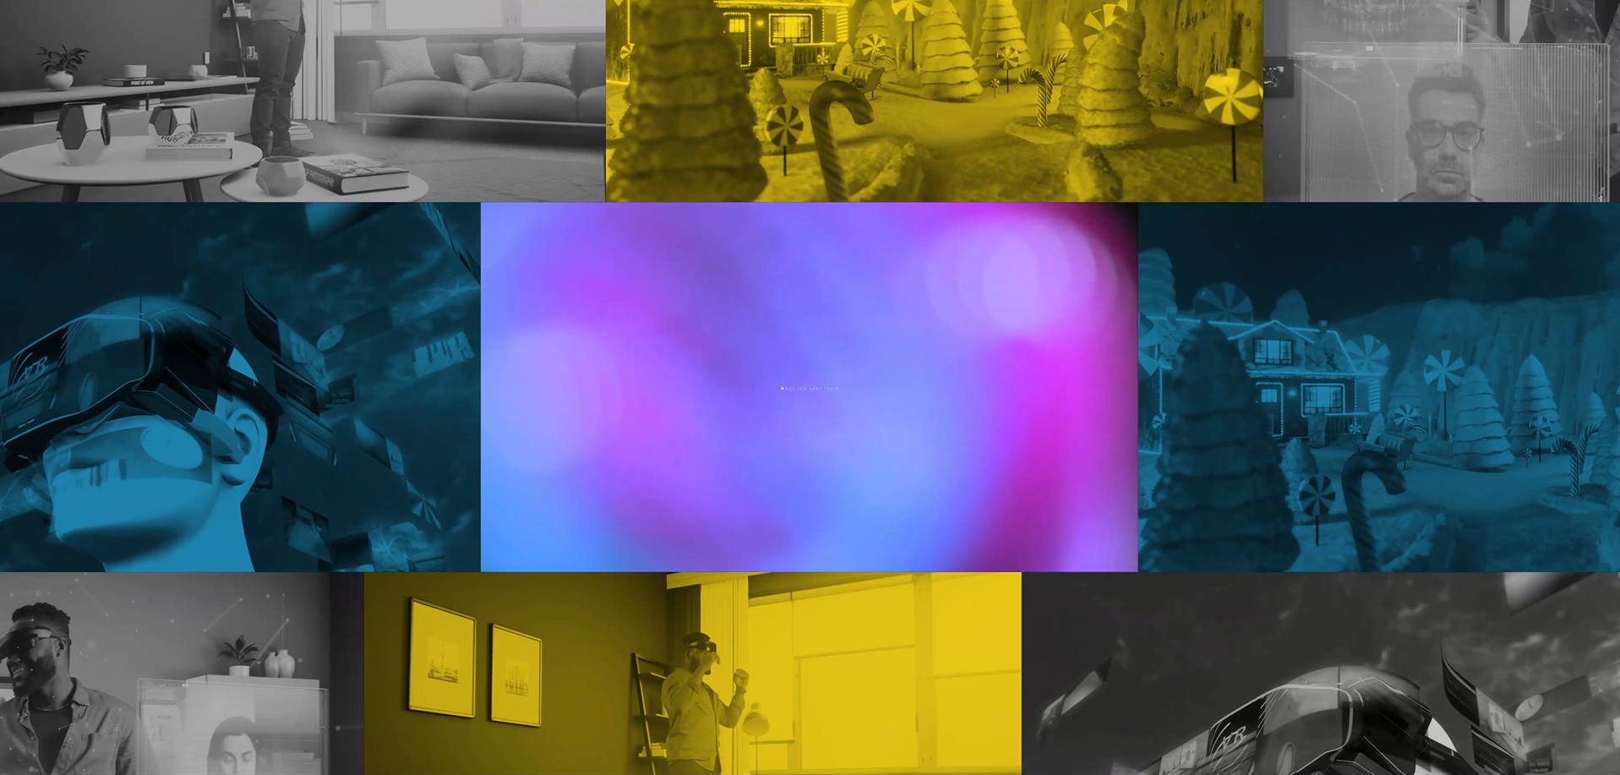
Metaverse
THE FUTURE OF THE INTERNET
Notes:
Let me begin with a short audio visual that showcases some possibilities of integrating the metaverse into the kind of work we do

Slide 3


Virtual Space – Centralized
Either users can simply log in, perform their activities, and customize their avatar, or their actions can influence and affect the marketplace of the Metaverse they are in.
In a centralized Metaverse, users can freely create content or games, but the ownership of these is given to the entity that owns the virtual space. It helps to secure the environment by restricting access to external entities. In the case of a decentralized Metaverse, instead, the content or games that are being set up there remain owned by the users.
The decision of allowing users to commercialize products or services within the Metaverse may drive an entity’s decision to make its virtual space either centralized or decentralized.
Centralized
Decentralized
Single entity is the owner​ of the Centralized space
No virtual transactions like buying or selling of assets or content in the Metaverse
Recommended for internal organizational requirements
Decentralized space has multiple owners​
It's required for commercial transactions like buying and selling of NFTs and uses cryptocurrencies​
It stores all transactions, user data​
Widely used for games​
A decentralized system is unnecessary if the virtual space activities do not require the sale of assets or content.
In such a case it is preferrable to use a centralized system, where everything is owned and controlled by the Organization.
3
Notes:
An important start point in creating your own Metaverse is selecting the virtual space you want to operate in. Since there will be no commercial transactions in requirements we have, the space we pick will be de-centralized. Which means that ownership of all content created within the environment remains with the organization.

Slide 4
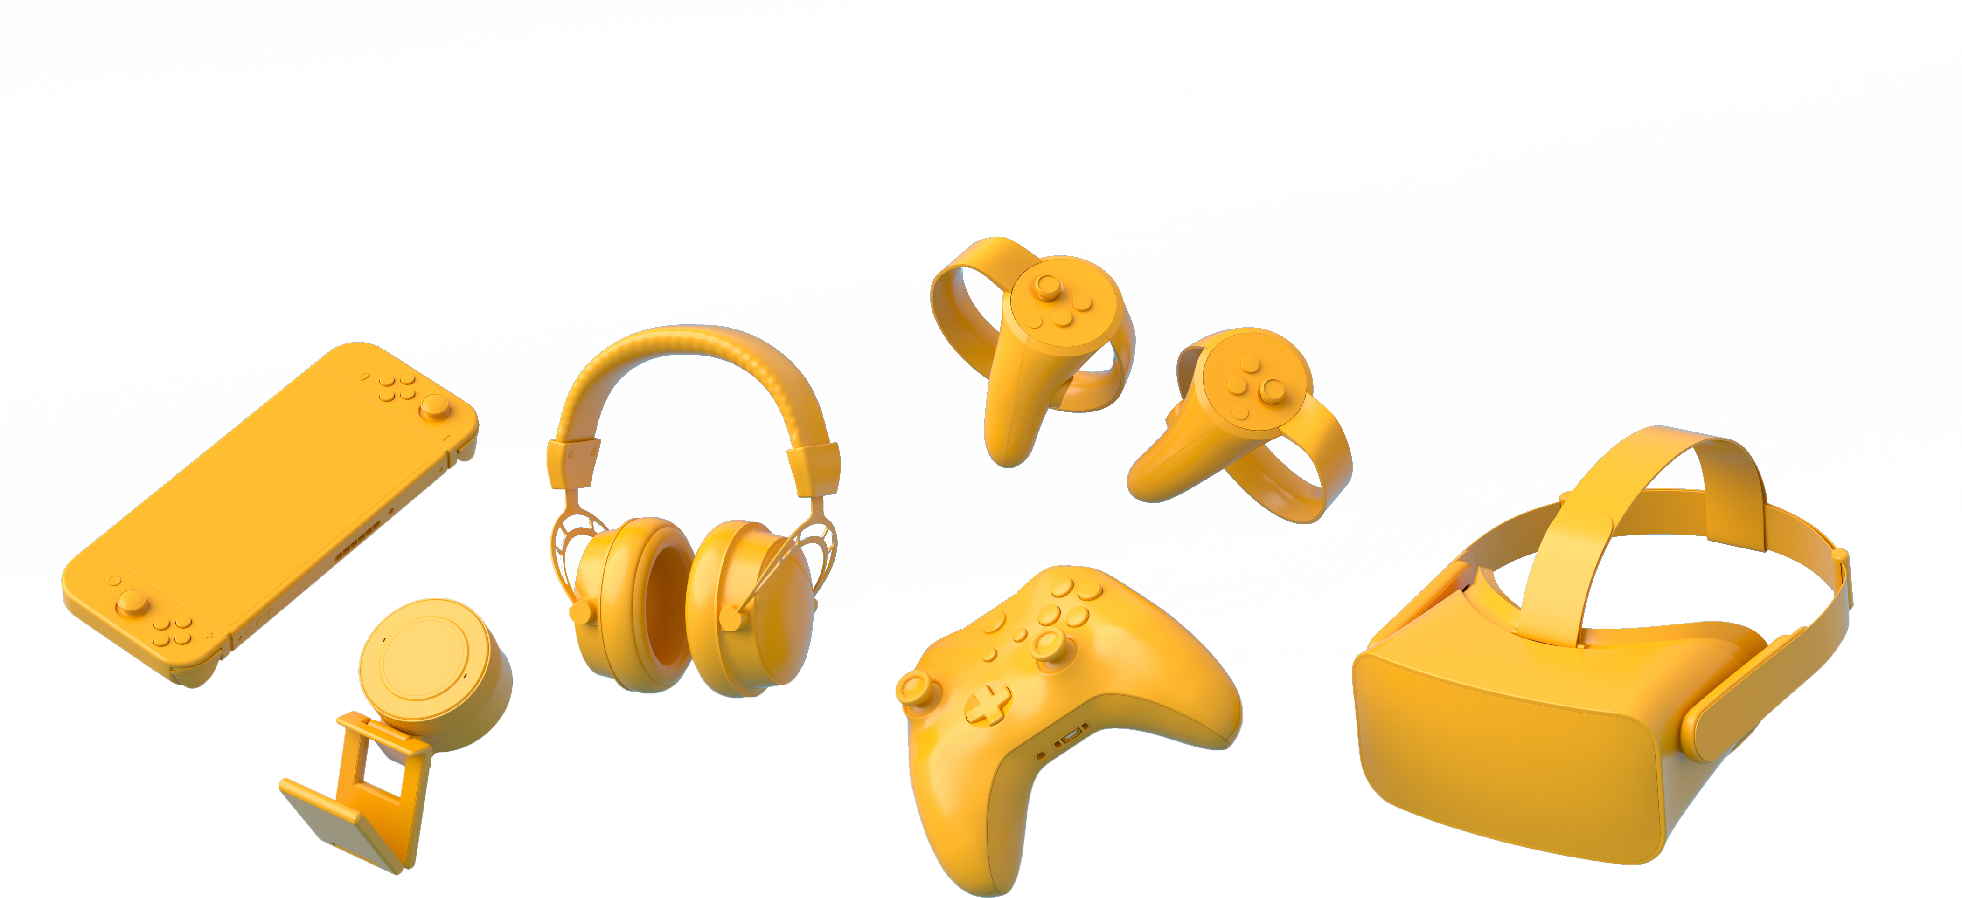
Equipment for Users
Desktops, Laptops
Smartphone​s
Above 8 Mbps bandwidth
VR Headsets
VR Gloves​ or Wrist-Based Bands​
With Headset
Without Headset
Headsets are equipped with sensors
User can feel handling objects​
Motor movements can be captured with wristbands and VR gloves​
Immersive experience​
Best used in industrial simulations​
Metaverse experiences can be accessed with any computer​
Easy interactions using keyboard and mouse, or video console​
One can spend more time on interactions​
The experience is engaging​
Good for interactions with people at various locations​​
Notes:
Here’s a glance at the equipment required for users. What’s interesting about the Metaverse, is that it allows a mix of content, some that can be accessed with VR headsets – which is useful for situations that require the sense of touch or a literal hands-on experience.

Slide 5


Reporting, Analysis of Learner Interactions​
All the learner interactions can be captured with the time spent on the activity, activity results, and other data points.
These reports can be stored in an external database.​
Reports will be extensive, and the data from these reports will provide the basis to enhance the training, and measure training impact.​
We can also connect the Metaverse with an LMS if the LMS API is made available.​
Notes:
While making the switch from traditional training or interaction methods (which now includes eLearning and virtual meeting rooms) One question that often comes to mind is the usage of data stored or analysis of performance like we see within our LMS’s. The Metaverse is able to capture all of this and additionally can also be integrated with an LMS. Therefore, data capturing. reporting, analysis and interactions are superior when content is accessed through the Metaverse.

Slide 6




Process
Identify the project requirements
Ideate on possible concepts to meet the requirement
Finalize the concept
Create wireframes of the 3D environment
Detail the user experience: interaction with the environment, result of interaction, activities, etc.
Identify shoot locations
Design character roles and dialogues
Finalize visual styling
Use the 360° space as the canvas and assets required for construction of the scenes
Procure required assets (for example, a 3D office environment)
Set up the architecture
Customize assets to project requirements
Build the characters and the gestures, office environment look and feel, animate the environment, etc.
Autodesk - 3Ds Max and Maya, UNITY, WebGL,
Build elements within the environment
Coordinate with SMEs in a live environment
Place assets in the 3D environment
Build interactions
Combined meetings to explore the output in the development environment
Complete the output package
Test output across the various browsers and on scoped devices
Review the reporting and analytics captured
Fix bugs
Deliver a functional build
Collaborate with SMEs to calibrate the live experience
Review and fixes
Deploy the final product
-------------------------------
Maintenance and updating the Metaverse
Set Up and Conceptualization
Wireframing and Storyboarding
Finalization of 3D assets
Development
Testing
Product Delivery
Deployment and Maintenance
AGILE APPROACH
Notes:
This is a glimpse of the process at a high-level. The metaverse much like its purpose is created in collaboration. What you will see done differently is creations happens together. In approach as well as between you and us. There will be constant access to the environment that is being created and not just once an output is developed.

Slide 7
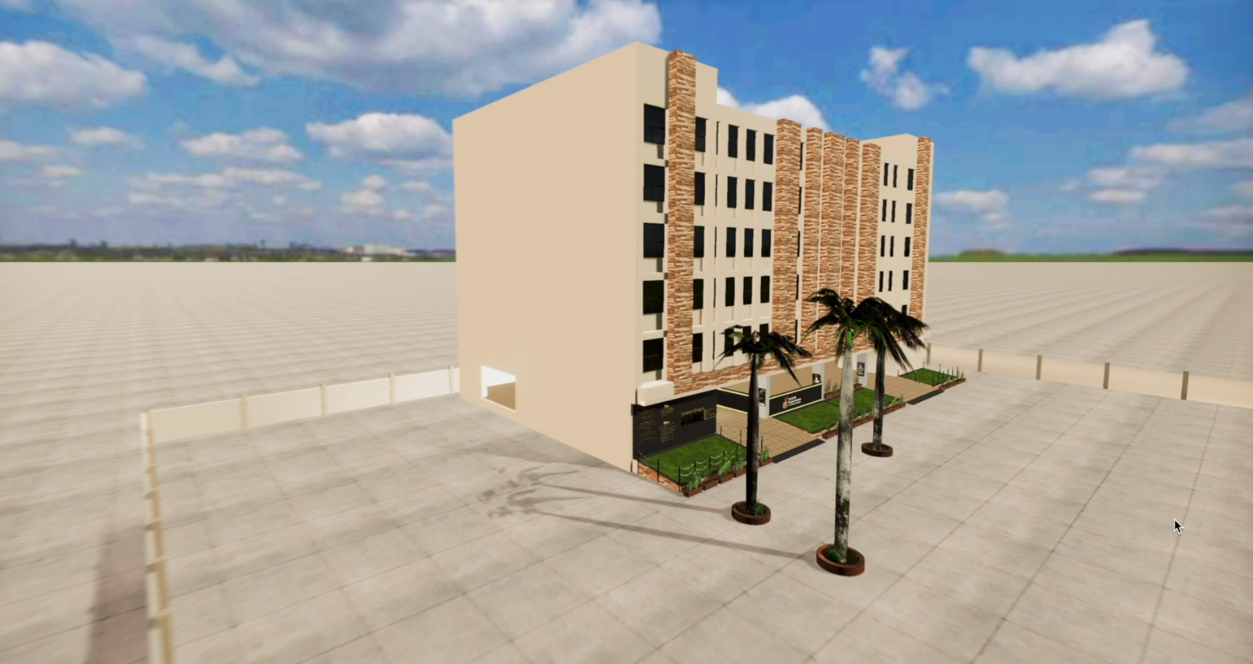
Metaverse Video
Notes:
What are the thoughts that you’ll have had about using the Metaverse. What elements and uses have you thought about?

Slide 8
Metaverse – Overall Benifits
Upon joining KPMG, new employees are invited to a virtual welcome and orientation session in the Metaverse. This immersive experience introduces them to the company's history, values, and mission through interactive presentations and simulations. New hires can explore the virtual office spaces, meet their team members, and virtually interact with mentors and senior executives. This not only streamlines the onboarding process but also establishes a strong foundation for building relationships within the organization.
Welcome to KPMG's Metaverse Campus
Connecting with Your Team
Personalized Learning Journey
Meeting KPMG Leaders and Experts
Embracing KPMG's Inclusive Culture
Celebrating Your Onboarding Success
Upon entering the metaverse, you find yourself in a vibrant virtual campus specially designed for onboarding.
Your avatar interacts with a friendly virtual guide who introduces you to KPMG's culture, values, and vision. You attend interactive presentations that showcase KPMG's diverse projects and global impact.
In the metaverse, geographical boundaries no longer exist.
You join a virtual team space where you meet your colleagues from different parts of the world.
Together, you engage in team-building activities, brainstorming sessions, and collaborative projects.
As you progress in the metaverse, you access a tailored learning curriculum based on your role and interests.
Virtual classrooms host interactive workshops, skill-building sessions, and knowledge-sharing webinars.
You can practice real-life scenarios in virtual simulations, gaining hands-on experience that prepares you for the challenges ahead.
In the metaverse, you have the unique opportunity to attend virtual town hall meetings where KPMG's top leadership addresses the entire workforce.
You can ask questions, share your insights, and connect with experienced professionals in informal virtual meetups.
This level of accessibility empowers you to engage with KPMG's leadership on a personal level.
The metaverse highlights KPMG's commitment to diversity and inclusion.
Virtual meet-and-greet sessions enable you to connect with Employee Resource Groups (ERGs) and participate in events that celebrate different cultures and backgrounds.
You are inspired by the inclusive environment KPMG fosters.
As you near the end of your onboarding journey in the metaverse, KPMG hosts a virtual celebration in your honor.
You receive virtual awards and recognition badges for completing your onboarding tasks with excellence.
This moment marks the beginning of your successful career at KPMG.

Slide 9
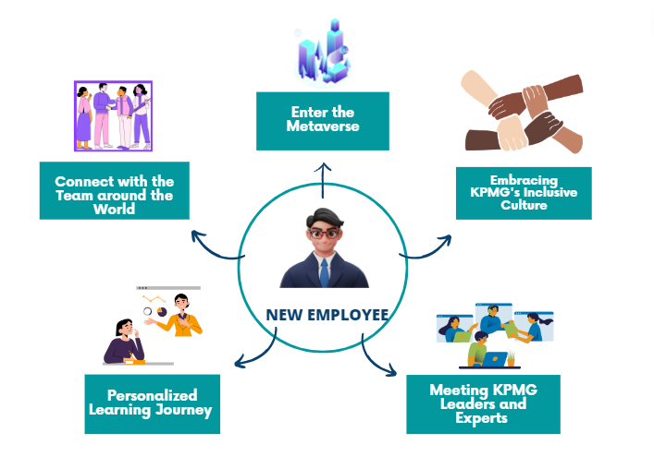
Overview
Use Case Name:
Use Case Flow
Employee Onboarding
Participants:
New Employees: Individuals joining KPMG for the first time.
KPMG HR Team: Responsible for implementing the metaverse onboarding program.
Pre-Conditions:
KPMG has integrated the metaverse platform into its onboarding process.
New employees have access to the necessary virtual reality equipment.
Traceability:
This use case is directly linked to KPMG's strategic goal of enhancing employee engagement and fostering an innovative workplace culture through metaverse integration. By leveraging the Metaverse, KPMG aims to create an engaging and efficient onboarding experience for new employees, fostering a sense of community and seamless integration into the organization's culture.
9

Slide 10








Overview
Use Case Name:
Employee Engagement
Participants:
USE CASE FLOW
Management
Employees
Pre-Conditions:
KPMG has integrated the metaverse platform into its onboarding process.
New employees have access to the necessary virtual reality equipment.
Log in & Personalized Avatars
Receive Virtual Coaching & Mentorship
Access Resource Libraries
Measure Engagement & Impact
Traceability:
Explore Virtual Engagements
Interactive Meetings & Workshops
Provide Feedback & Suggestions
Achieve Continuous Learning
The use case aims to illustrate how KPMG leverages the metaverse platform to revolutionize employment engagement. By immersing employees in an interactive virtual environment, KPMG fosters a dynamic and inclusive workplace culture that encourages collaboration, innovation, and a strong sense of belonging. The purpose is to showcase KPMG's commitment to embracing cutting-edge technologies and creating a future-forward and engaging work experience for its workforce.
10

Slide 11



Overview
Use Case Name:
Leadership and Sales Training
Participants:
USE CASE FLOW
KPMG Leaders
Sales Team
Pre-Conditions:
KPMG has integrated the metaverse platform into its onboarding process.
New employees have access to the necessary virtual reality equipment.
Leadership Training in the Metaverse
Empowering Sales Leadership
Creating a Positive Sales Culture
Data-driven
insights
Traceability:
Sales Techniques and Strategies
Communication and Emotional Intelligence
Continuous Learning and Development
Measuring Training
Impact
The Leadership and Sales Training in the Metaverse for KPMG propels leaders and sales teams into a new realm of success, where immersive experiences and skill development create a competitive edge. By leveraging the metaverse platform, KPMG fosters a culture of exceptional leadership, effective sales techniques, and client-focused engagement, driving business growth and customer satisfaction.
11

Slide 12
Why Aptara
Continuous R&D
Experience in consulting on the best use cases for the Metaverse
Metaverse design, development, deployment, and maintenance
Skilled resources

Slide 13
Q&A

Slide 14
Thank You!

