Slide 1

CAPABILITIES
PRESENTATION
Mohit Chaturvedi
VP, Strategic Accounts
Mohit.Chaturvedi@aptaracorp.com
+1.206.227.5861

Slide 2
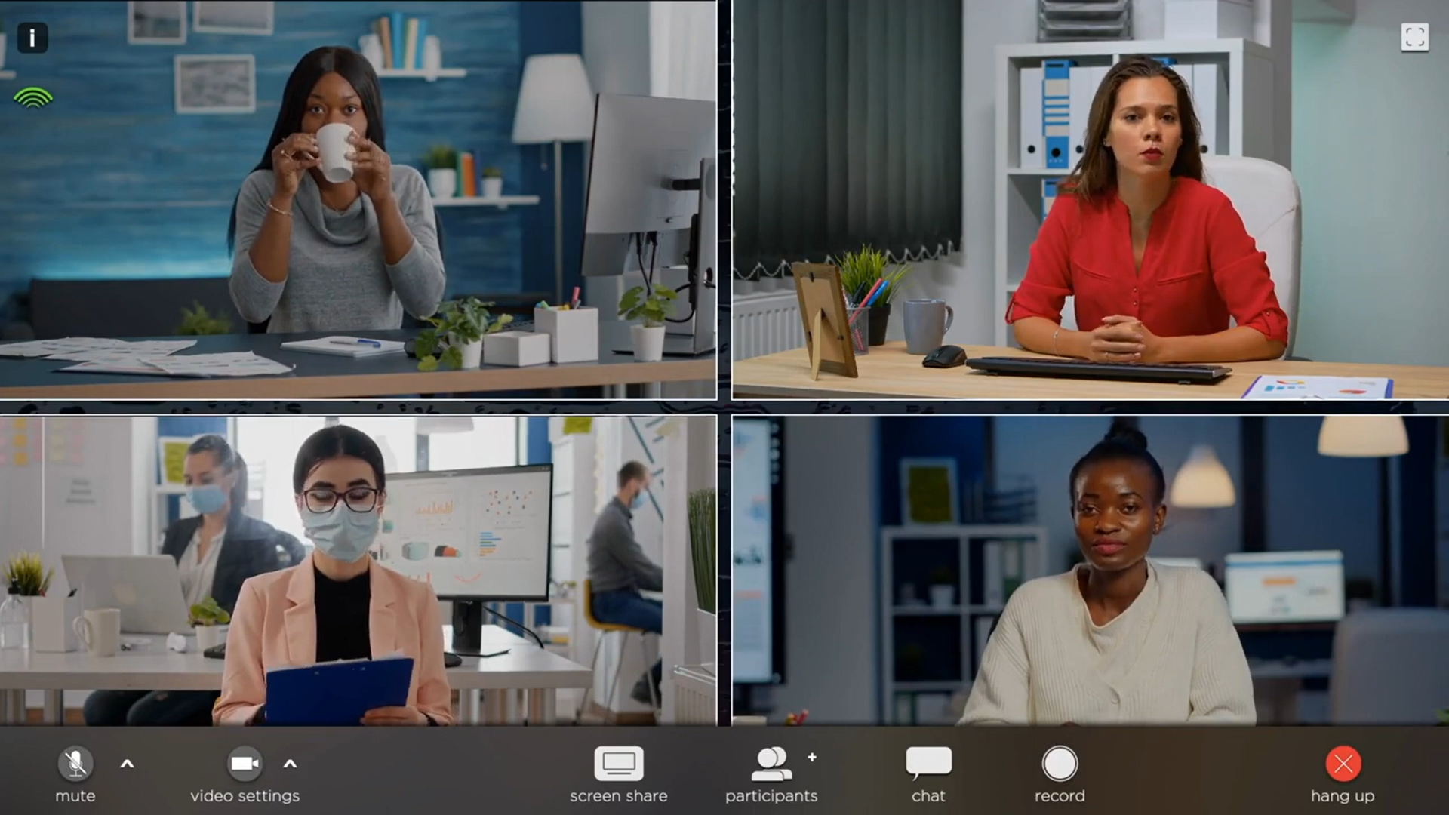
Showreel

Slide 3

















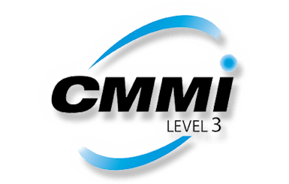
Aptara Overview
30K+
Headquartered in the
employees worldwide
across our global delivery centers and service lines. Aptara employees approximately 5000.
9
Global delivery
centers
60+
Awards &
recognition
United States
12th
$
30+
Years of experience
in the training industry
150+
Serving fortune
1,000 clients
Consecutive year in
the top 20 companies
In training industry watch list
Flexible
Pricing and working
models
ISO: 27001:2013, ISO 22301:2019
ISO:9001:2015,
PCI DSS, SOC, HIPPA, GDPR and CMMI 3 Certified
Scalability
Capacity to process large volumes quickly and accurately 24/7/365
Learning Lifecycle
Author • design • format • enrich
• produce • package • distribute
• manage
Global Support Services
We work across industries, geographies, lines of service and specialties to bring you
customized solutions

Slide 4






















































Our Clients
Healthcare and Pharmaceutical
Engineering & Manufacturing
Non-profit Organizations
Insurance
BFSI
Consulting, HR & Telecom
Retail
EdTech
Publishing

Slide 5














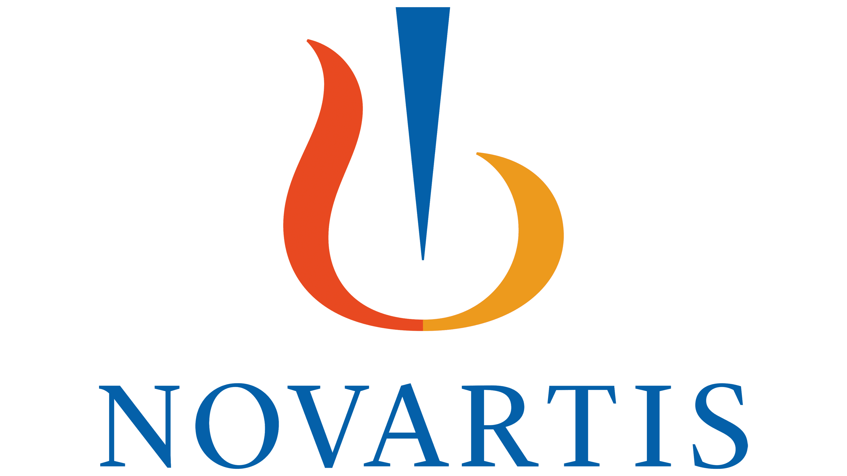




Aptara Strategic Partnerships at a Glance (Partial List)
Managed Content Learning Services
Professional Services
Content Technology & Analytic Services
Content Development
Support Services (LMS Admin & Tech Support)
Transformation
Regulatory Compliance

Slide 6






Aptara Managed Learning Services
LEARNER-CENTERED | INNOVATION-DRIVEN | TECHNOLOGY-POWERED
Strategic Analysis and Design
Delivery and Analytics
Learning Curriculum Redesign
Cultural Transformation: DEI Learning Strategy
Learning Aligned for Business Impact
Workforce transformation:
Change Management, Upskilling and Reskilling
Organizational and Leadership Development
Learning Delivery Framework and Infrastructure Consulting
Learning Experience Management Consulting
LMS Migration, Hosting and Maintenance
Virtual/Classroom In-Session Technical Support
Virtual/Classroom Facilitation​
Custom Reports, Dashboards​, and Analytics
Learner and Content Performance Evaluation
MANAGED
LEARNING SERVICES
Learning Experiences
Global Support Services
Outcome Driven Learning
Learning in the Flow of Work
Prescriptive and Adaptive Learning Strategies
User Generated and Community-based Learning
Gamification and Business Simulations
Hands-on application, focused reskilling and upskilling
Dedicated Support Team and Short/Long Term Staff Augmentation
Learning Management and Administration
Custom Application Support Helpdesk
​ 24/7/365 Global Helpdesk (Email/Chat/Voice)​
Translation and Localization Support
Application Hosting and Maintenance Support​
Dedicated team for Vendor Management
Professional Services and Analytics
Global Resources available on demand (temporary, permanent, onsite and remote)
Instructional Designers
eLearning Developers
Trainers/Facilitators
Technical Writers
Training Coordinators

Slide 7

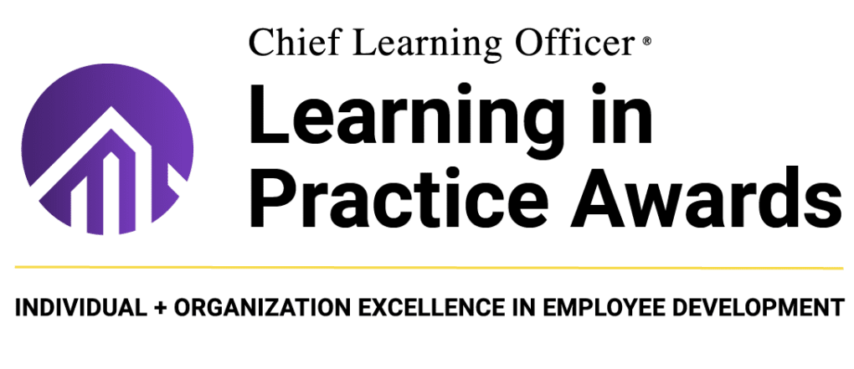
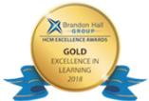





Awards and Recognition
At Aptara, our work speaks volumes; we believe in quality above everything else. Our work is accoladed every year by industry trend-watchers and trend-setters for our strategic learning services, content development and production, and business solutions and content technology integrations.
HIGHLIGHTS
Best Results Of Learning Program
Brandon Hall Awards for Excellence
Top 20 Learning Portal Company
Top 100 Digital Content Company
Top 100 Global Outsourcing Company
Best Education &Training Campaigns
Learning In Practice Award: Silver

Slide 8







Aptara’s Training Solutions
At Aptara, we specialize in Custom Content Development across a wide range of industry domains and topic areas. Our strength lies in creating tailor-made training solutions that precisely meet the unique needs and objectives of our clients.
Our team of experienced instructional designers, subject matter experts, and multimedia specialists collaborate closely with our clients to develop highly engaging and effective training programs from scratch. These programs are designed to meet your various learning needs.
Our training offerings include:
Mobile Apps
Video-based Learning
ILT and vILT
Content Migration
Content Localization
Application Simulations
On-the-go learning freedom and flexibility
Just-enough, just-in-time, just-for-me learner-centric approach
Enhanced collaboration and social connect
Learner preferences clearly toward “on the go” videos
Cost-effective and time-saving
Effective and efficient
Accommodates different learning styles
High learner attention and engagement
Traditional ILT remains indispensable in learning kinesthetic skills
VILT is one of the fastest growing synchronous learning delivery mode that:
  Saves training cost
  Removes location barrier
  Increases training capacity and scalability
  Brings learner diversity and collaboration
eMigration is the transformation of learning content from classroom and paper-based formats to online, interactive, globally accessible, and highly reusable media
It typically involves redeveloping course material for optimum effectiveness in the new delivery channels
Localization expands audience reach and improves knowledge retention
Effective learning requires audience understanding
For multilingual audiences, eLearning localization is essential
Accurate and culturally appropriate translation is crucial for comprehension and retention.
Watch-Try-Do simulations help practice and gain hands-on experience
Faster skill gain through experiential learning
Increased work efficiency
Improved processes
Reduced training cost and duration

Slide 9






Aptara’s Training Solutions
The training catalog also aims at providing enhanced learner experiences and flexibility. It enables organizations to provide continuous learning opportunities, track learner progress, and maintain consistency in training initiatives while offering cost-effective and scalable solutions.
Our training catalog prioritizes the incorporation of current learning technologies in our solutions to effectively respond to the ever-changing demands of our industry.
Our training offerings include:
Business Simulations
Gamification
Microlearning
Adaptive Learning
Artificial Intelligence
AR/VR
Mirrors the dynamic real-world settings
Experiential learning without any risk
Effective in strategic thinking, decision making, problem solving, financial or market analysis, operations, teamwork and leadership
More engaging and challenging interactivities
Increased learner motivation
Learning games are based on constructivism. The power of play brings in:
  Immersive and autonomous learning experience
  Learning from failures
  Higher learner motivation and engagement
  More confidence on the abilities gained
Learning using self-contained, small chunks or bits of learning assets can cater to:
Just-in-Time Learning
Contextual Learning
Adaptive Learning
Social Learning
Organic Learning
One-size-fits-all never works with learning
Mandatory certification and refresher trainings have become a great burden for many organizations
Leveraging on adaptive learning can dynamically personalize training
Personalized learning experiences
Real-time feedback and assessment
Data-driven insights and analytics
Continuous learning and upskilling
Higher learner motivation and engagement
Higher learner engagement
Real-world application
Adaptive learning
Analytics and performance tracking
Encourages collaboration and teamwork
Accessibility and inclusivity

Slide 10









Learning Professional Services
On-Demand Staffing
On-Demand Staffing
Customer Support Specialists
Strategic Needs Analysis
FLEXIBLE/DEDICATED STAFFING MODELS
LEARNING CONSULTING SERVICES
Aptara places expert consultants with our clients on a flexible timeline or a dedicated basis, allowing organizations to expand their teams’ skills and support without the expense of adding permanent headcount.
Aptara provides consultants with a cross cultural training and multilingual capabilities. Our consultants work closely with you on a variety of requirements from process transformation, CX support and helpdesk to systems administration and maintenance. Our teams help bridge the cultural gap and boost your training initiatives.
Change Management Specialists
Process Development Specialists
User Adoption and Transformation
Data Analytics and Dashboard Specialists

Slide 11
Aptara Translation Capabilities
Content Localization:
Localization expands audience reach and improves knowledge retention
Effective learning requires audience understanding
For multilingual audiences, eLearning localization is essential
Accurate and culturally appropriate translation is crucial for comprehension and retention.
ASIAN | BALTIC | EAST EUROPEAN | AMERICAN
Chinese S. | Lithuanian | Romanian | French (Canada)
Chinese T. HK | Estonian | Polish | Portuguese (Br)
Chinese T TW | Latvian | Hungarian | Spanish - Mexican
Japanese | WESTERN EUROPE | Czech | Spanish - Latin American
Korean | French | Bulgarian | Haitian Creole
Thai | German | Ukrainian | NORDIC
Indian Languages - 10 | Italian | Slovak | Finnish
Malay | Portuguese | Russian | Norwegian
Laos | Spanish | MIDDLE EAST | Swedish
Khmer | Greek | Arabic | Danish
Indonesian | Dutch | Farsi
Tagalog | Turkish | Hebrew
Vietnamese | French | Turkish
Note: Aptara has localized more than 2,000 hours of content (yearly) in 50+ different languages. Our capabilities include translation, voice-over recordings, integration, and templatization of learning materials for reusability.

Slide 12































Tools and Technologies Expertise
Aptara uses the latest industry standard tools and technologies to develop courses that are Tin Can, SCORM 1.2/2004 or AICC compliant. We have developed thousands of hours of eLearning courses using the latest tools and technologies. Our courses are developed to support multiple platforms (desktop, laptop, tablets and smartphones).
The list of tools and platforms below is from industry standards; Aptara is a tool agnostic company and can easily adapt to any new technology or client’s proprietary tool.
DIGITAL/WEB CONTENT TOOLS
MOBILE/AR & VR TOOLS
LMS & LXP PLATFORMS
AI BASED TOOLS
Microsoft Viva

Slide 13
Service Models
Model 1
Consulting
Model 2
Development
Model 3
One Team
Instructional Designers, Trainers, Tech Writers, Process and Procedures, LMS Consultants
ILT, eLearning, Mobile Apps, Content & Audio Translation, Portals and application development
A unique combination of Model 1 and Model 2, providing clients with highly qualified local resources with the cost efficiencies of an offshore team

Slide 14



Aptara Pricing Model
Fixed Bid Engagement
When to choose:
Clear deadlines, detailed specification, short project duration, no major planned changes
Extended Development Team (XDT)
When to choose:
iterative development, complex projects, long-term collaboration, one team to service multiple business groups
Staff Augmentation
When to choose:
Ongoing project, fill short-term positions or supplement a team on a particular project, specific skillsets needed
Defined scope of the project.
Ideal for small to medium sized engagements.
    Fixed pricing for a defined scope.
    Requirement based staffing as per milestones.
Project completion within budget and timeline assurance.
Well defined milestones and deliverables.
All project details are clearly defined in the statement of work, expectation management can be controlled by the project manager.
Project is managed without excessive supervision on the part of the client.
Good approach if budget approval requires an elaborate or extensive process
Works well as an extension of the current client team.
Multiple options for a multi-location or offshore only teams.
Ideal for iterative development when the project scope is not well defined.
Dedicated team for a specified tenure.
Hourly billing on the resources deployed.
Program management office to manage demand and utilization of team members.
Onshore teams can work from client offices when possible.
Team's capacity can be scaled based on requirements.
Model allows a better knowledge retention leading to time and effort efficiencies.
Client teams are in control of the project, can influence the process and stay involved at all stages.
Existing teams and supplemented teams work as a solid mechanism. Individuals align with the teams more effectively and quickly compared to external teams.
Additional team members fill skillset gaps in the existing team .
It is easy to scale the team to match demand.
Smaller learning curve since the added team members are specifically hired for pre-existing skillsets.
Depending on the nature of the project, in-house teams can work well with supplemented staff due to a combination of tacit knowledge and supplemented skillsets rather than a fully outsourced project team
This engagement model works well for pre-defined scope and deliverables as compared to iterative development.
Approval of new features may take longer and can potentially delay the development process.
A fixed-price contract demands in-depth planning. Developers need to prepare risk mitigation plans in detail.
Absence of well-defined specifications can lead to mismatched expectations
Defining project specifications is critical for project success.
The model allows for iterative development and flexibility in scope and timelines.
The product owner needs to manage the creative process for iterations as well as the overall development process.
Timelines need to be managed with phased releases to account for unpredictably.
Design level specifications need to be monitored for each phase, some features or design elements that were originally planned are no longer relevant based on interim UAT.
Supplemented staff will still need to be trained to follow internal processes and embrace the company culture.
New team members may not perform at expected levels, some time may be spent in adjusting new team members into the project and team.

Slide 15
Aptara Rate Card
WBT
Video
WBT Level | Cost Range (USD) for 15 Minutes of WBT
 | Articulate Storyline | HTML5
Level 1 | $3,000 - $3,500 | $3,450 - $4,025
Level 2 | $4,500 - $5,500 | $5,175 - $6,325
Level 3 | $5,400 - $6,600 | $6,210 - $7,590
Animation Level | Cost Range (USD) for 1 to 2 Minutes of Animation
 | Animation | Audio
Level 1 | $1,500 - $2,000 | $500
Level 2 | $3,000 - $4,500 | $500
Level 3 | $7,000 - $7,500 | $500 - $800
WBT Level | Cost Range (USD) for 30 Minutes of WBT
 | Articulate Storyline | HTML5
Level 1 | $4,500 - $5,000 | $5,175 - $5,750
Level 2 | $6,500 - $7,500 | $7,475 - $8,625
Level 3 | $7,800 - $9,000 | $8,970 - $10,350
WBT Level | Cost Range (USD) for 60 Minutes of WBT
 | Articulate Storyline | HTML5
Level 1 | $6,000 - $6,500 | $6,900 - $7,475
Level 2 | $10,500 - $11,500 | $12,075 - $13,225
Level 3 | $12,600 - $13,800 | $14,490 - $15,870
Notes:
*Development cost includes the cost of storyboarding, development of Alpha, Beta, and Gold versions of learning materials by our offshore development teams.
** WBT cost does not include Audio cost and responsive design cost.

Slide 16
Level Description
The table below lists brief description and features of Web-based Training (WBT) or eLearning modules at different levels of complexity.
 | Level 1 | Level 2 | Level 3
BRIEF DESCRIPTION | A basic eLearning module that teaches concepts, with help of graphics, and text. It has some required interactivity and tests learner's understanding with use of knowledge checks and assessments. This is usually a knowledge ware and can be up to Bloom Level 1. | Besides all features of Level 1, this eLearning module includes use of demonstrations, animations, simple scenarios, real-life case studies and examples. This is usually a skill ware or advanced knowledge ware and can be at Bloom Level 1 and 2. | Besides features of level 2, this also includes simulations, practicing concepts in safe environment, branched scenarios, case study-based testing and assessment. This can be at Bloom Level 3 and onwards.
SCREEN TYPES | Static - 72% Interactive - 25% Client provided videos - 3% | Static - 50% Simple animation - 4% Interactive - 42% Client provided videos - 4% | Static – 20% Animation - 10% Interactive - 65% Video – 5%
MEDIA | Stock photographs Simple 2D graphics and icons Simple transition animations Simple interactions (click and learn, MCSS, MCMS) | Stock photographs Simple complexity graphics (icons, graphs, charts, diagrams, and props) Simple and Medium Conceptual Animations Simple to medium complexity interactions (Click and reveal, Tab, MCMS, MCSS, Carousel, Timeline, Hotspot, Drag-and-drop, and Drop-down) Application/system demonstrations in Show Me mode only | Stock photographs Medium complexity graphics (icons, graphs, charts, diagrams, and props) Medium to complex conceptual animations (animation of flow diagrams and graphs; mathematical equations; animation of image-text, collage of images, and speech bubbles) Medium to complex interactions (Click and reveal, Tab, MCMS, MCSS, Carousel, Timeline, Hotspot, Drag-and-drop, and Drop-down) Application/system simulations in demonstration (Show Me) and practice (Try It) modes
INTERACTIVITIES | Teach screens, knowledge checks and assessments | Teach screens, knowledge checks and assessments | Teach screens; branched scenarios; problem-solving, knowledge checks; assessments

Slide 17

Learning Consultant Rate Card
Role | Location | Rates in USD / Hour
Learning Program Manager | US | $90
Learning Consultant with ID Background | US | $95
Aptara LC
Aptara places expert consultants with our clients on a flexible timeline or a dedicated basis, allowing organizations to expand their teams’ skills and support without the expense of adding permanent headcount.
Aptara provides consultants with a cross-cultural training and multilingual capabilities. Our consultants work closely with you on a variety of requirements from process transformation, CX support, and helpdesk for systems administration and maintenance. Our teams help bridge the cultural gap and boost your training initiatives.

Slide 18












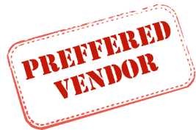

Retail Giant
+
Best Learning Program that Supports and Promotes Diversity, Equity, and Inclusion
+
7
Years, 18 divisions and going strong
2023
2016 - 17
2018 - 19
2020 - 21
GOING STRONG
2015
MULTIPLE DIVISIONS, WIDER REACH
BRINGING IN A RICH REPERTOIRE
THE SUCCESS STORY CONTINUES
Cash Flow Program-one of the biggest training programs
Successful migration of courseware from Skillsoft LMS to ULearn LMS
CUSTOM CONTENT AS THE BIGGEST DRIVER
Animations
Infographics
Persona posters
Facilitator and participant guides
Job aids
Business Review magazine
XDT Team expanded –40 members
High-impact design solutions and strategies
Custom HTML makes complex design interventions possible
Articulate Storyline 360, Elucidat, and Camtasia contribute to successful designs
Aptara starts to liaise with 18 + divisions at client end
WBTs continue, Explainer Videos are well received.
Aptara's localized content services ensures accessibility in multiple languages
Innovatively utilized Adobe Flash and Custom HTML5 for building customized courseware
Time-sensitive business objectives met in a diligent manner
2014
JOURNEY BEGINS
Kick-started with a short WBT module (Adobe Flash)
18

Slide 19


















+
North Carolina
ACCOLADES
Best Learning Program that Supports and Promotes Diversity, Equity and Inclusion -2022
THE MAKING OF AN INNOVATIVE PARTNERSHIP
Best Use of Virtual Worlds for Learning – 2022
Best Unique or Innovative Learning and Development Program – 2021
Best Use of Video for Learning – 2016
2020 - 23
Aptara has produced an estimated annual savings of $844,880 for Blue Cross NC, and the cost savings is expected to grow moving forward.
Adri Maisonel - Morales, VP-L&D,
BLUE CROSS NC
NEWER PRECEDENCE
Best Learning Program Supporting a Change Transformation Business Strategy – 2015
Best Use of Video for Learning – 2014
Best Custom Content – 2014
Best Learning Team category – 2013
Shift in Engagement model: Project-driven to Business-area centric
In one of the firsts, Aptara’s ID chosen to be the PoC for business stakeholders
2012
2013 - 14
2017 - 18
2019
ONE TEAM MODEL DEPLOYED
ADOPTION OF EXTENDED TEAM (XDT) MODEL
GETTING BIGGER AND BETTER
THE SUCCESS STORY CONTINUES
2011
Increased Speed-to-market by 45%
High Scalability
  Scalable tools, increase in volume of courses delivered
Reduced learning curve
  Attributed to staffing continuity
  Optimized review timelines
Significant Cost Reduction achieved through 35% effort efficiency during this period
Growing team size for BCBSNC
Increasing variety in learning solutions--bite-sized nuggets, videos and marketing collateral
Evolving with specialized learning using the Adaptive Learning Model
Increased team composition and strength
JOURNEY BEGINS
Engages with business for Needs analysis and Design
Develops training based on the design strategy
Learning Consultants conduct a skill gap analysis
Training gets recognized as a strategic competency
Affordable Care Act introduced in 2010.
Aptara and Blue Cross NC formed a tactical and strategic engagement in 2012 to update the Training to comply with the newly introduced Act.
19

Slide 20






A BIG 4
Accounting Firm
+
2021 - 2023
Strategic partnership with Canada, US, UK, India
Supporting workforce transformation
Architect for innovative learning solutions
ONWARD AND UPWARD
Best Advance In Competencies And Skill Development
Best Use Of Performance Support
Best Custom Content
Best Competencies And Skill Development
Best Use Of Blended Learning
Best Use Of Games For Learning
Best Use Of Mobile Learning
Best Custom Content
Best Custom Content
Best Learning Team
Best Learning Game
Start of a dedicated team for Audit practice (US)
Partnership with Organization Change Management (OCM)
2008 - 2010
2011 - 2013
2014 - 2018
2007
SETTING NEW TRENDS AND PRECEDENCE
BUILDING A SOLID GROUND
EXPANDING OUR REACH
MANY FIRSTS
JOURNEY BEGINS
Services to:
Business Support (global SAP implementation), Consulting group, Global wing (Canada), Audit group, Global Tax (Canada)
Training content for large transformational initiative, SYNC
Two global apps for the Canada group
First project with UK entity
Aptara partners with Global L&D, Canada
Partnership expands with Digital Marketing, Canada, for an app
Partnership with Executive Education Group
First project with
  India group
  Deal Advisory Group
  Canadian Business School
  Learning Academy India
With 30 projects and a whopping growth in revenues!
First, true game-based learning on VAT, accessible on web and Appstore
Training development partner for client’s Global SAP implementation across 36 countries.
Video-on-demand player
Full mobile apps–Tax App and Thought leadership app
Learning operations workflow for Global Tax, using SharePoint
At the request of the client, Aptara develops a dashboard in Flex for an internal group
Signaled the start of a great L&D journey
Designed IFRS curriculum, using photo realistic characters and learning pathways
Reported savings worth more than 1 million!
1,232
projects since then!
estimated savings stand at a record
$ 4.7 M
20

Slide 21







+
2023
Established a dedicated Offshore Development Centre (ODC)
SOC 2 Type2 Certification
Continuous Improvement
Newer
Portfolios
Dedicated Team to focus on growth
Head of Delivery
Program Mangers
Project Managers
Reporting and Dashboards for Executive Management
Making A Difference
A range of new business lines expand our reach:
Content Development
Salesforce and Veracode
QA& Testing
Data Analytics
Doc Setup and XBRL
2018
Content Authoring and Management
Facility and infrastructure to accommodate staffing plans
Onsite training for onboarded resources
Journey Begins
200⁺
Aptara commences Pilot testing for two major processes
Team members
2018 - First Pilot project begins
2018 - ODC Established
2019 - Added new line of businesses
21

Slide 22


Thank You

