Slide 1
CAPABITIES PRESENTATION
GAMIFICATION SAMPLES

Slide 2
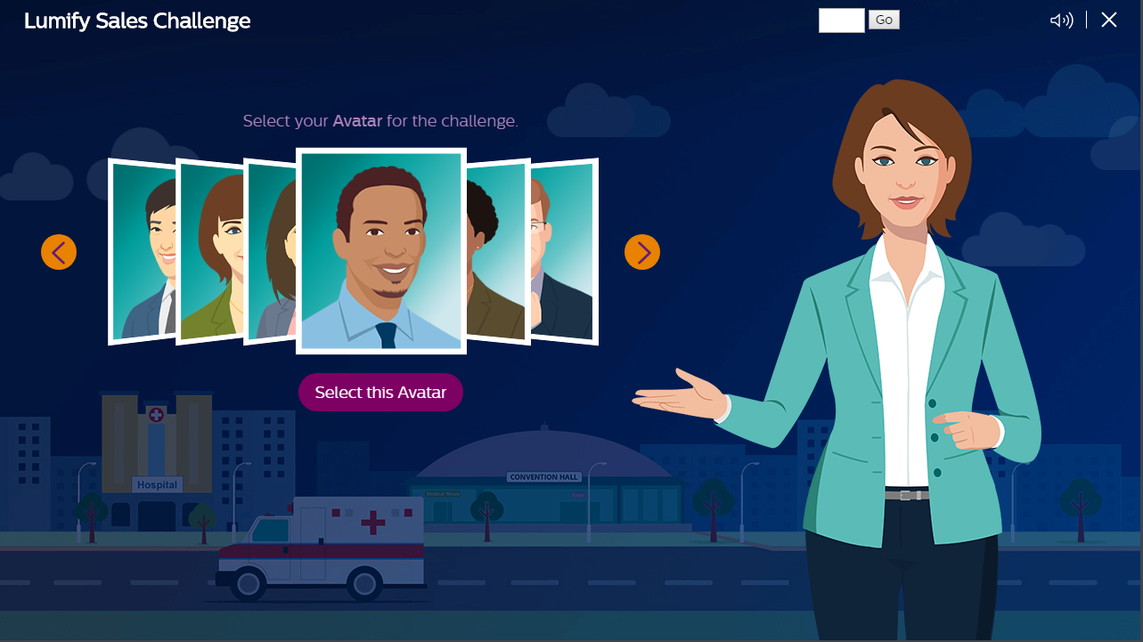
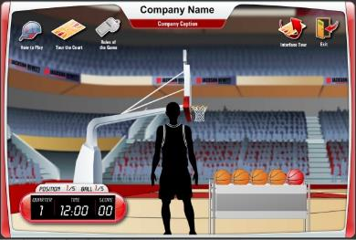
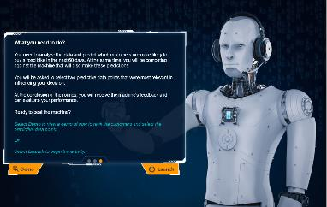



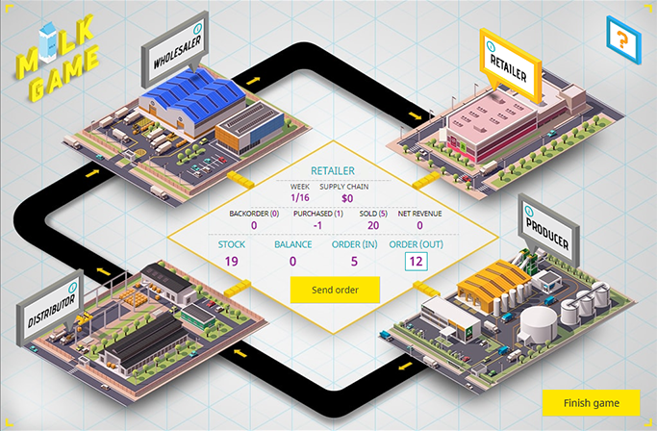
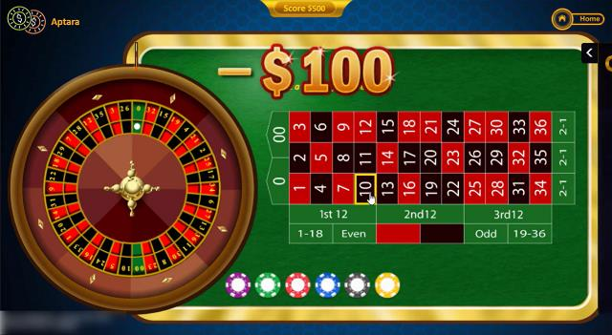
Gamification and Game-based​
Lumify_Sales_Challenge
3 Point Shootout
Infuse_Analytics
IPM
    Milk Game
Intel Game

Slide 3

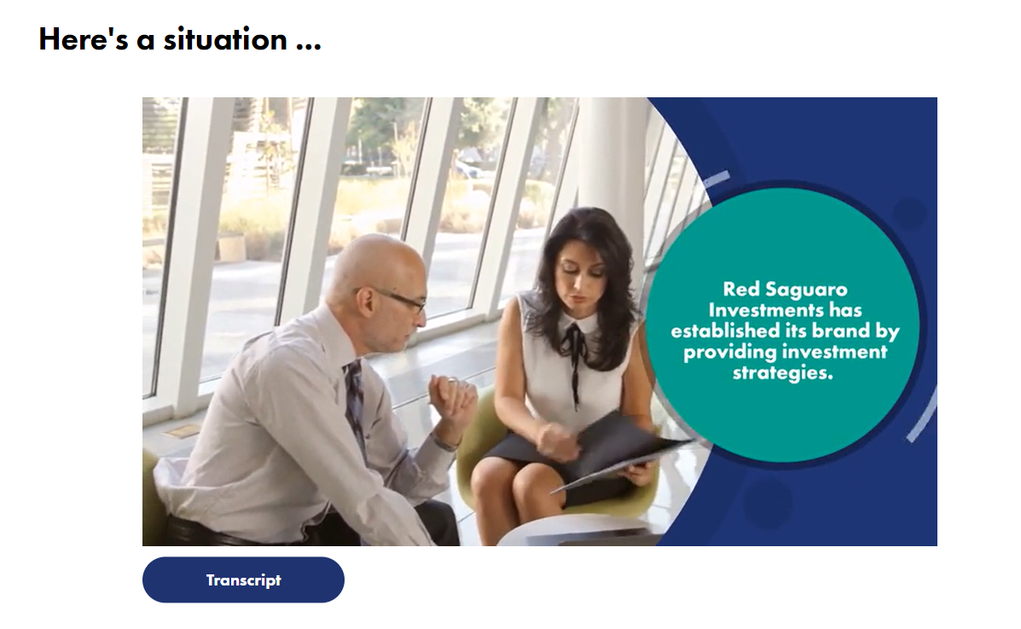
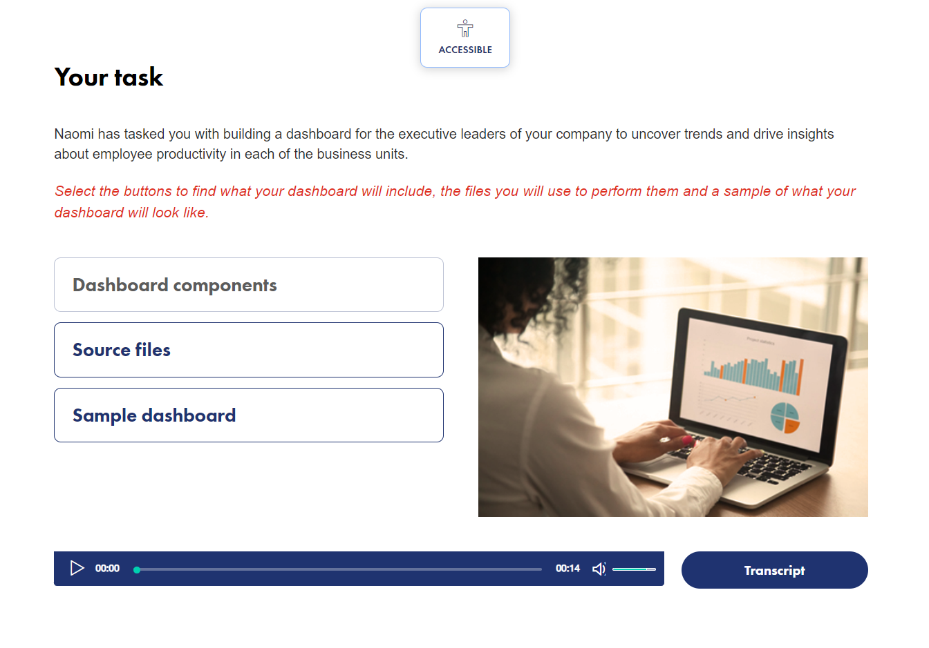


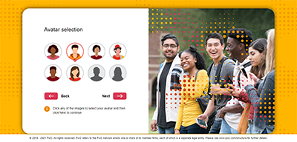

Gamification and Game-based (Contd.)​
Escape Room Scenario
Credentials
Credentials
Customer Call Process
AYP (PwC)
The Long call

Slide 4
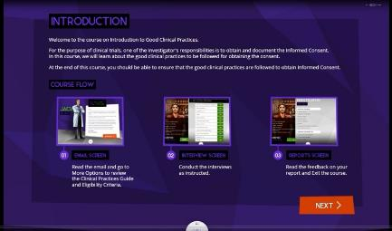
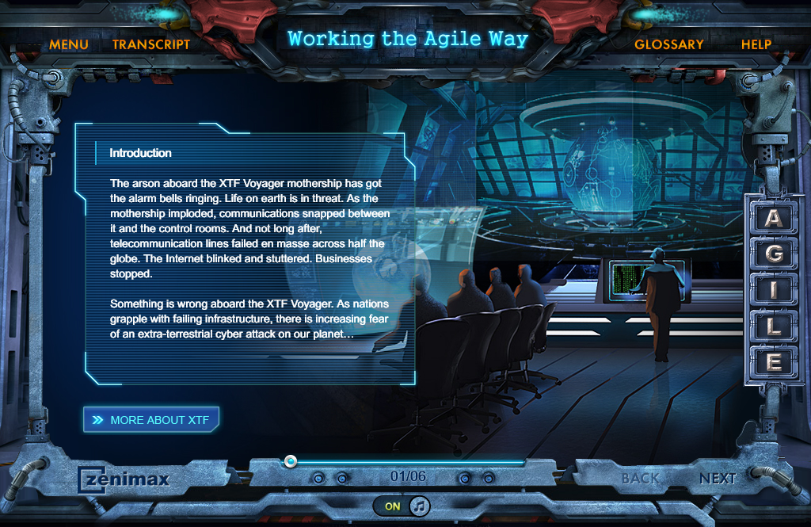
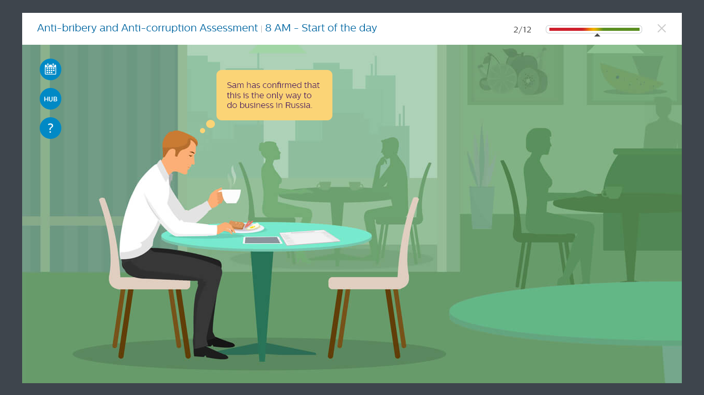
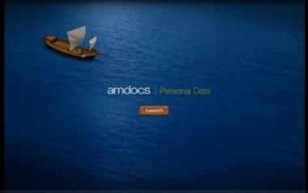
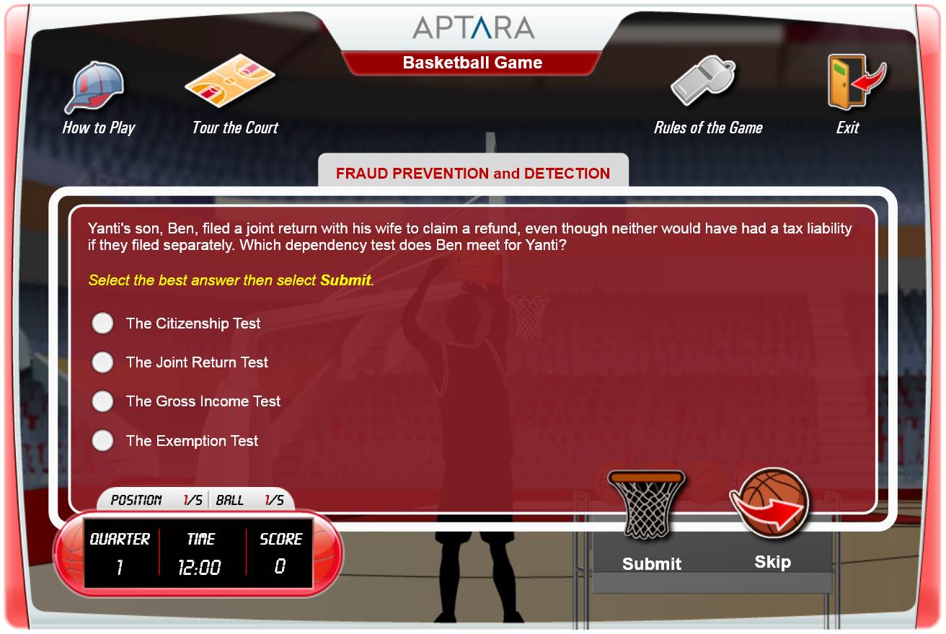
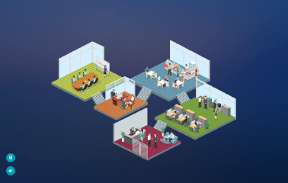
Gamification and Game-based (Contd.)​
PPD - Clinical Practices
Zenimax – Agile Process
ABAC Game
AMDOCS - Game Based Assessment
Basketball Game
AMEX vPayment

Slide 5
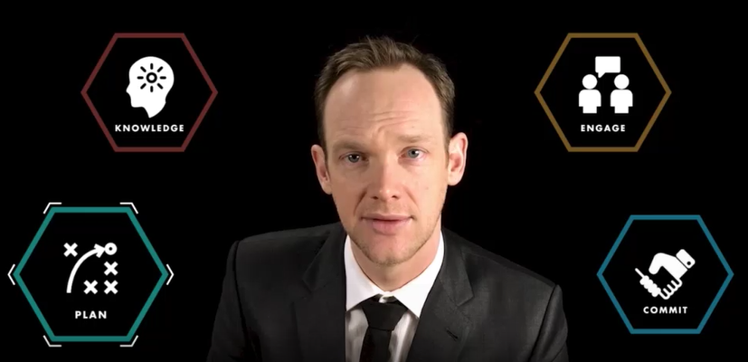
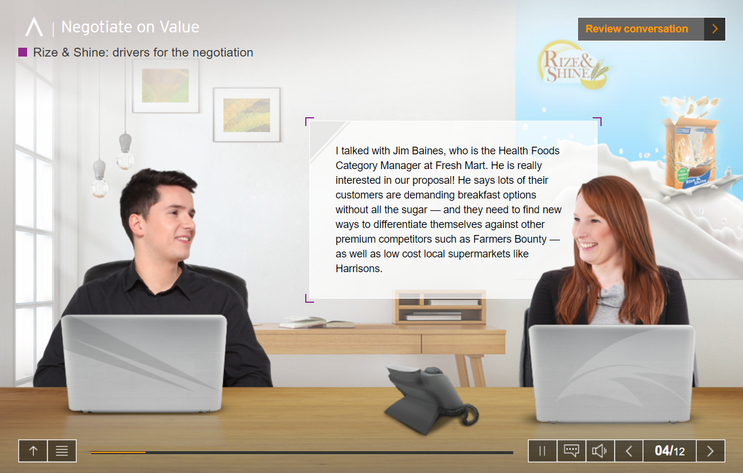
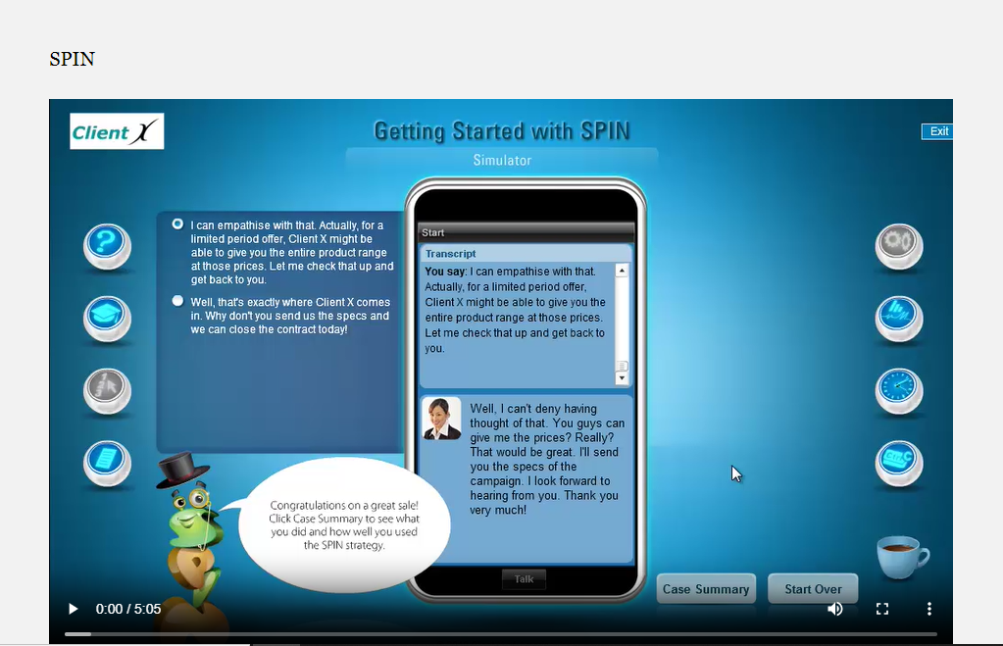
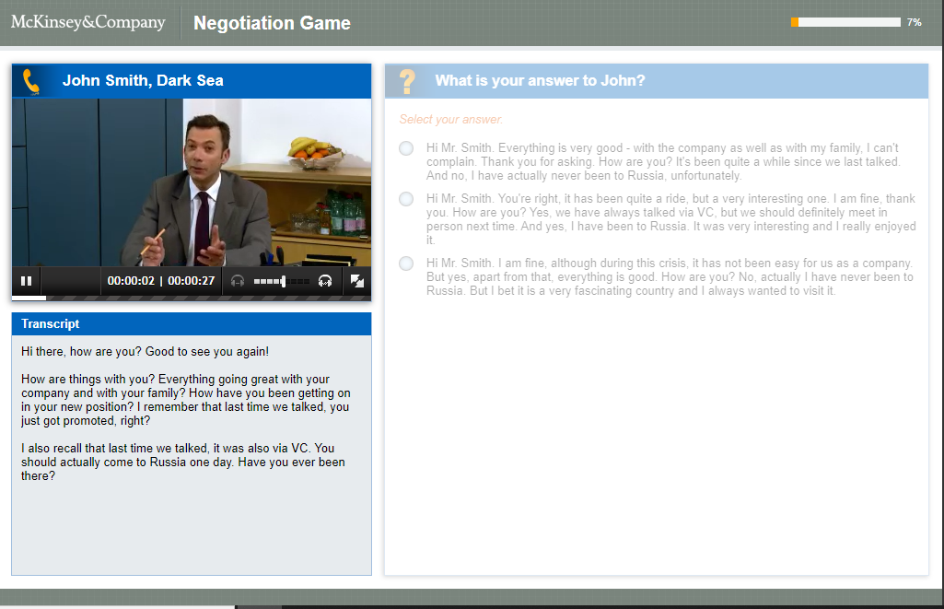

Sales Training and Business Simulations​
Sales_Negotiation
Negotiate_on_Value
Spin Selling
McKinsey Negotiation
Taxiway

Slide 6

THANK YOU

