Slide 1

eXcellence in AI Showcase
A presentation by
Daren Harber
Sr. VP, Managed Services
Daren.Harber@aptaracorp.com
+1.703.389.5524
April 2026

Slide 2
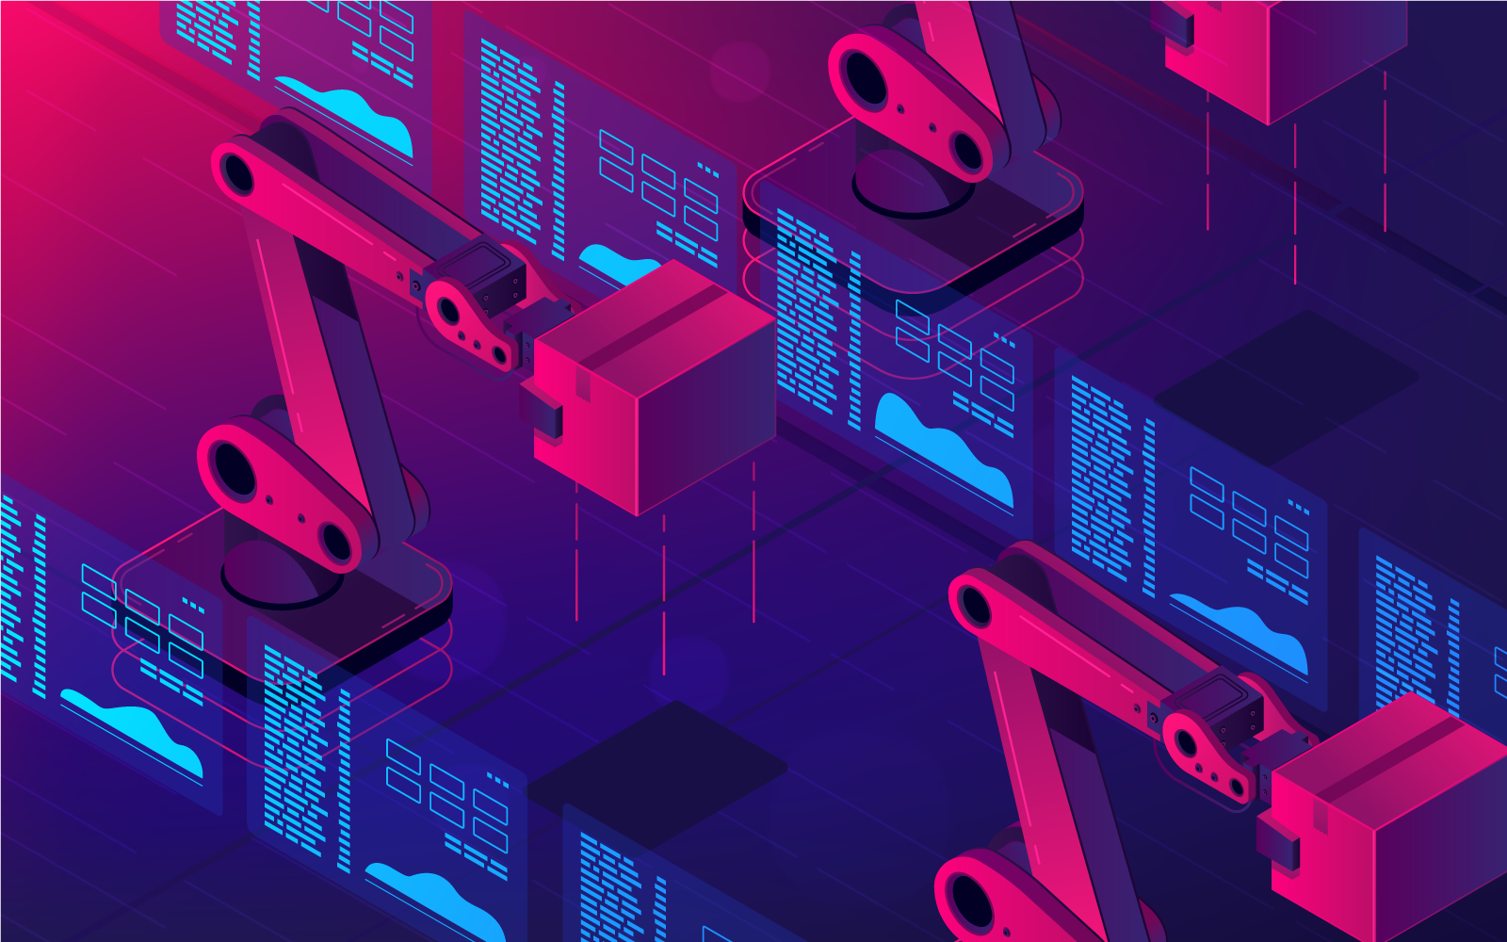
Introduction: Showcasing Our AI Capabilities
Dive into the heart of our organization's AI journey, highlighting the cutting-edge capabilities we have developed through:
Purpose-built internal AI tools:
  Designed to boost productivity and streamline operations
  Tailored to meet our organization’s unique needs, especially in the eLearning domain
  Designed to minimize the threat of data security
  Proof-of-concept (POC ):
  Explores bold ideas through practical AI experimentation
  Demonstrates how variety of AI tools can address real-world challenges, such as process automation
  Lays the groundwork for scalable solutions that drive organizational growth
  Project samples:
  Showcase the tangible outcomes of our AI initiatives
  Highlight how AI techniques solve specific business problems

Slide 3






















Tools and Technologies Expertise
Leverage industry‑standard tools to deliver SCORM and Tin Can (xAPI) compliant eLearning solutions
Deliver thousands of hours of proven digital learning content
Ensure multi‑device compatibility across desktops, laptops, tablets, and smartphones
Rapidly adapt to emerging technologies
AI-BASED TOOLS
DIGITAL/WEB CONTENT TOOLS
MOBILE/AR & VR TOOLS

Slide 4
AI for eLearning Creation

Slide 5

Using Storyline for Automation
Create templates and seamlessly use it with an automated process developed in-house for course authoring
Automated content population within the Storyline
structure
Key Features:
Dynamic branching
Conditional formatting and randomization of quizzes
Audio and video synchronization
Custom navigation
Word and PowerPoint based storyboarding
Macros to automate Storyline course structure based on storyboards
Progress tracking
Data collection

Slide 6

Automation with Storyline: Sample
AI-Enhanced Time Management Learning Experience
AI support in Storyline for real-time content and adaptive design
Microlearning for just-in-time learning
Multilingual voiceover and subtitles (English, Spanish, French)
Infographics and explainer videos for concept reinforcement
Reflection and self-assessment tools to evaluate time management habits
View demo

Slide 7

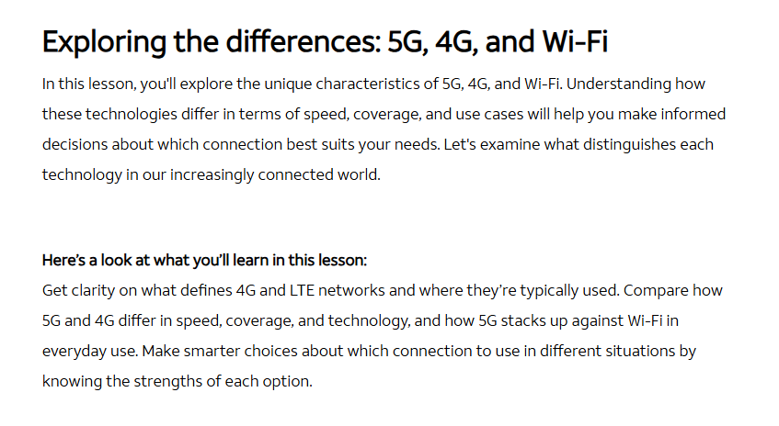
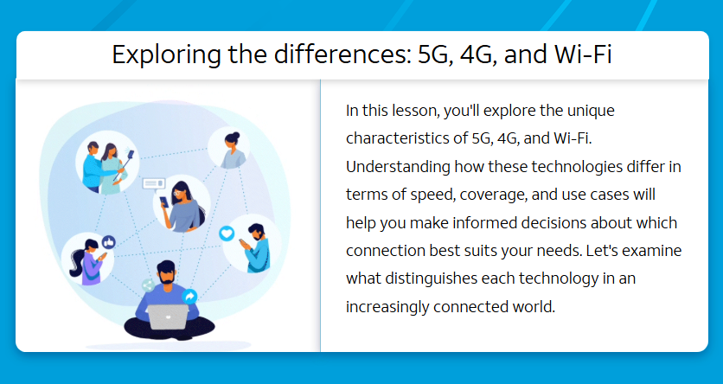
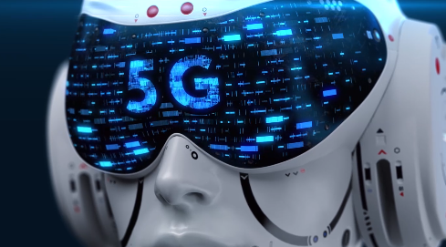
Using Articulate Rise AI Features
To speed up course creation and structuring content automatically
Rise AI-generated Default Output
Rise AI with Custom Visuals and Layouts
Rise AI with HTML5 Interactions
  Default Rise course output
  Rise’s default lesson structure, layouts, visual blocks, and AI-generated images
  Minimal manual intervention
  Default Rise course output
  Default lesson structure and layouts
  Integrated custom layouts
  Manual intervention for enhancements
  Default Rise course output
  Default lesson structure and layouts
  Custom HTML responsive layouts and interactivities
  Enhanced visual design and media
  Manual intervention for enhancements
Demo
Demo
Demo

Slide 8
AI for Video Creation

Slide 9
AI-powered Video Creation: Transforming Scripts into Finished Videos in Minutes
What AI Video Platforms Can Do
Enable teams to produce polished, professional video content without cameras, studios, or actors
Core Capabilities
Realistic AI avatars delivering scripted content
Voice cloning and multilingual dubbing
Automated voiceovers synced to visuals
Short-form video generation from written scripts
Auto-captioning and B-roll insertion

Slide 10
How AI Video Tools Fast-track Development
Replace Multiple Tools
Reduce Rework Effort
Traditional | With AI Videos
PowerPoint + Articulate Storyline + video production + LMS interactions | Single platform handles video + interactivity + localization
Traditional | With AI videos
Any change → re-shoot + re-edit | Edit script → auto-update the video
Saves SME time and shorten production cycles
Reduce Production Cost
Reduce Localization Cost
Traditional | With AI Videos
Studio setup + actors or voiceover artists + video editing team | AI avatars + voice + editing
Traditional | With AI videos
Build interactivity in LMS (Storyline, Captivate) | Interactivity inside video itself
Saves instructional design and development hours

Slide 11
Synthesia: From Static AI Videos to Interactive, Adaptive Learning Experiences
Synthesia transforms video from a passive medium into an interactive learning system.
Key Upgrades/Capabilities
Interactive videos with buttons, branching paths, and quizzes
SCORM export for LMS integration
AI video assistant to convert PPT/PDF into videos
Analytics and engagement tracking
Multi-language auto-translation (80+ languages)
Emerging AI video agents enabling conversational learning

Slide 12
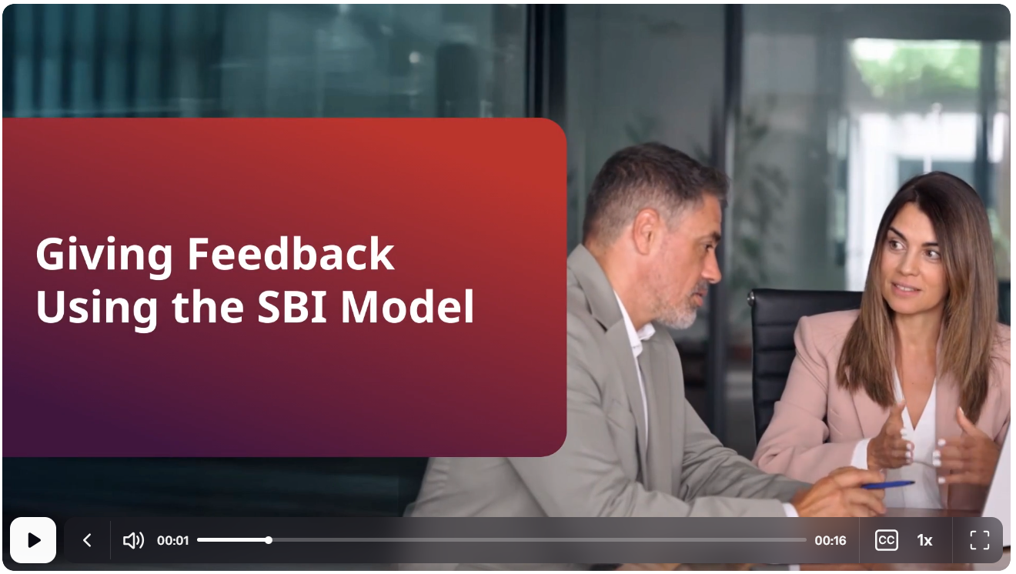

Synthesia Samples
The demos showcase videos integrated with interactive elements like buttons and questions, enabling learners to actively participate rather than just watch, resulting in higher engagement.
View demo
View demo

Slide 13
HeyGen
Hyper-realistic video avatars with real-time lip sync and voice cloning capabilities
Key Upgrades/Capabilities
Create realistic avatars from a photo or short video
Power Ai video agents for conversational learning
Convert PPT/PDF into video using an AI video assistant
Support AI video dubbing in 175+ Languages
Enable Live Avatar: AI chatbot with a human-like face for the live video interaction

Slide 14
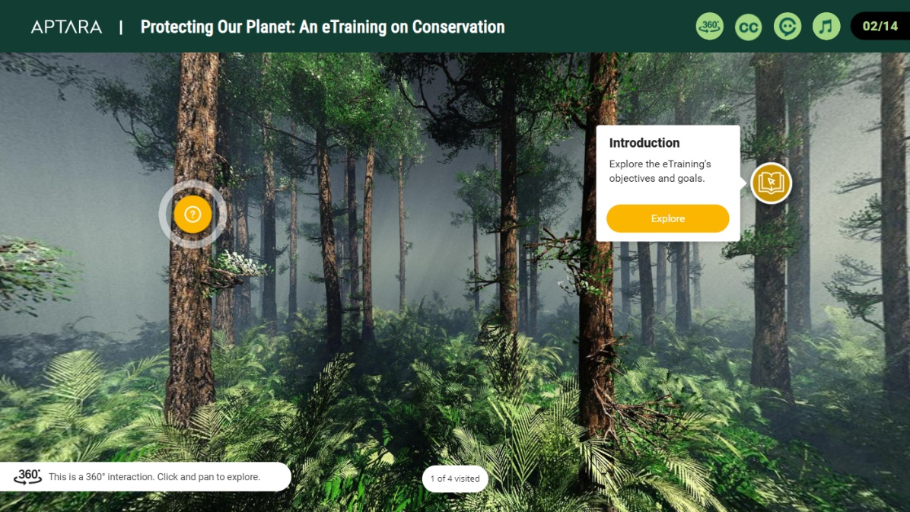
HeyGen Sample
The demo showcases the use of the HeyGen AI avatar “IVY” to guide learners through an immersive conservation journey.
Key Benefits:
  Human-like presence through IVF, enhancing learner engagement over plain text or voiceovers
  Consistent tone, clarity, and quality across all modules, eliminating variations typical of human presenters
  Increased learner engagement through dynamic and immersive viewing experiences
  Multilingual delivery with accurate lip-syncing for global and localized training programs
View Demo

Slide 15
Colossyan
AI video platform specifically designed for workplace learning, training, and corporate communications
Key Upgrades/Capabilities
Choose emotional characteristics for avatars
Add engaging screen recordings to videos
Use professionally designed, fully customizable templates
Use expressive AI voices in any language

Slide 16
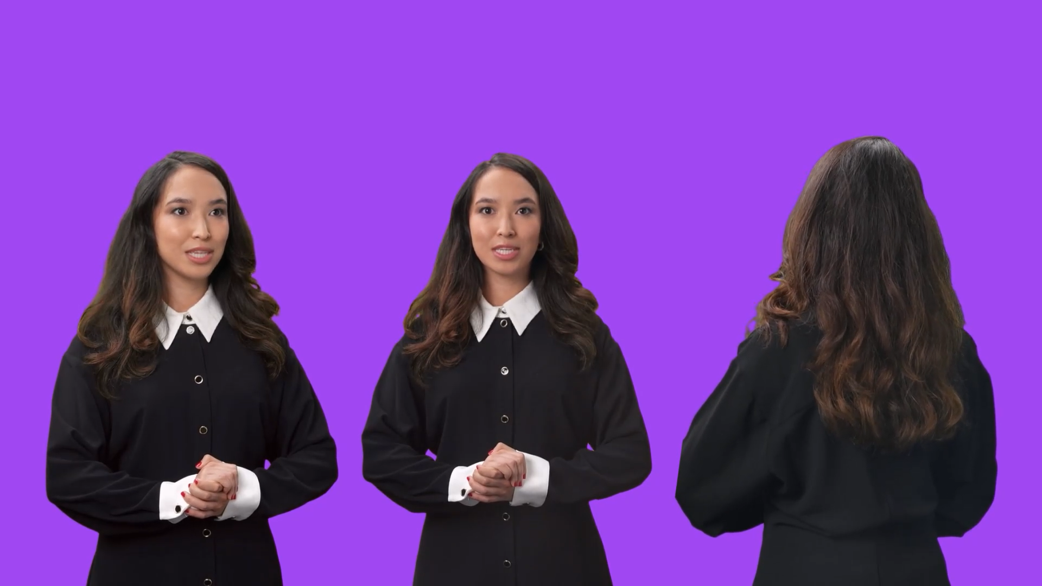
Colossyan: Multi-view Talking AI Avatar
The demo showcases the use of Colossyan AI avatar in three distinct angles—side front, front, and side back—to simulate real-life conversational dynamics.
Watch the sample video.
Benefits:
  Create the illusion of natural dialogue between characters
  Seamlessly integrate avatars into diverse settings such as boardrooms, break areas, or virtual calls
  Deliver a dynamic learner experience that moves beyond static visuals
  Matches tone and context of each scene, whether formal (presentation) or informal (discussions)
  Enhances realism through varied camera perspectives
  Increases learner engagement with more dynamic viewing experiences
Side front
Front
Side back

Slide 17
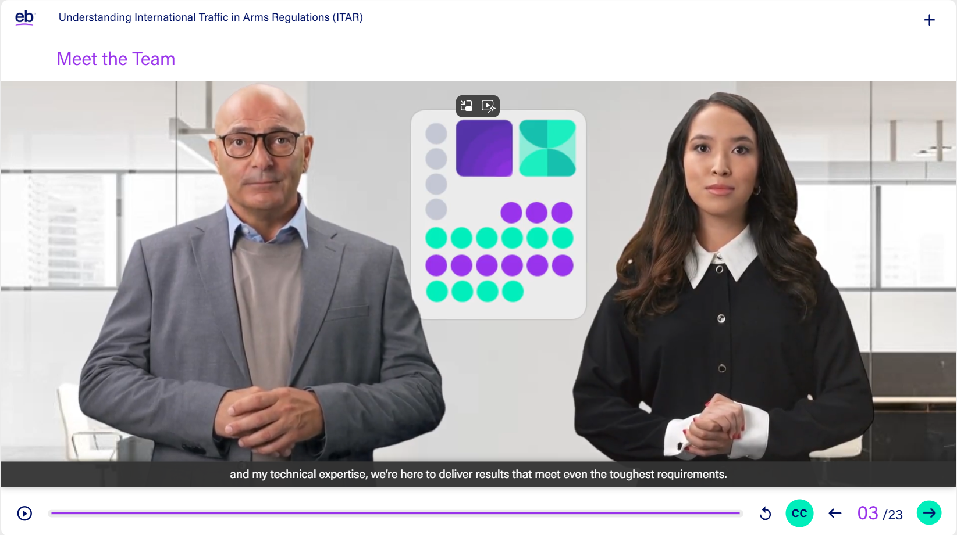
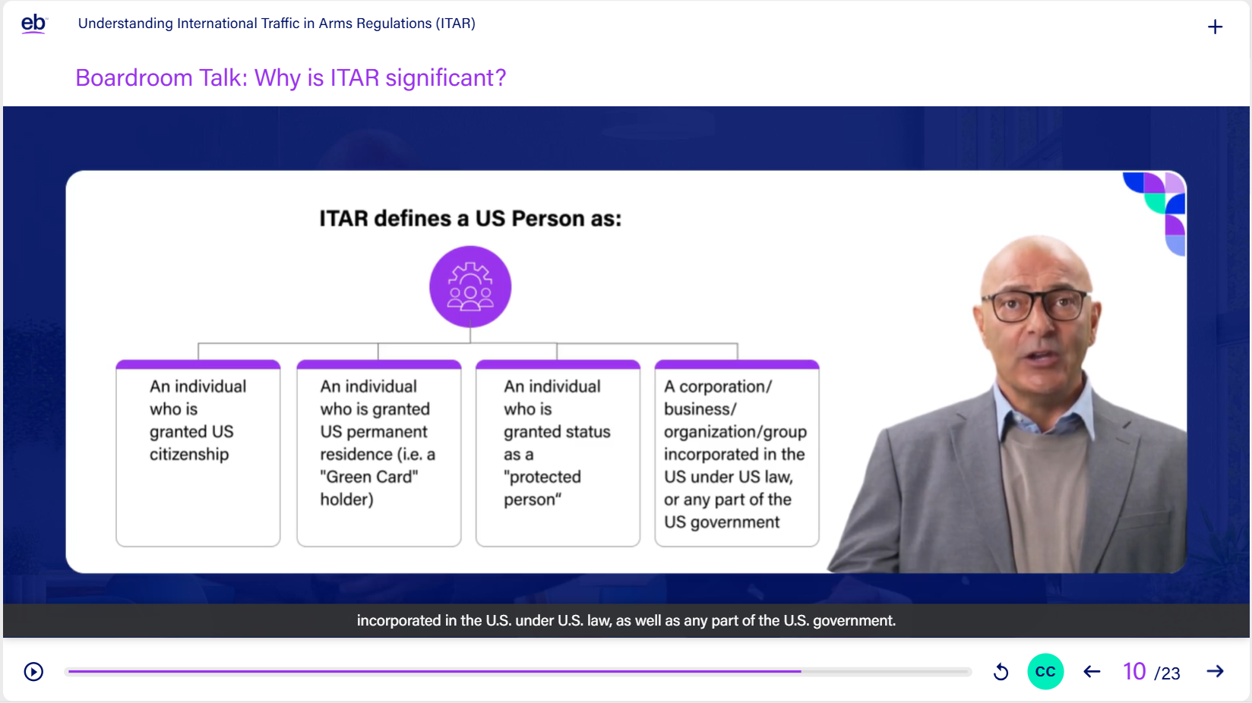
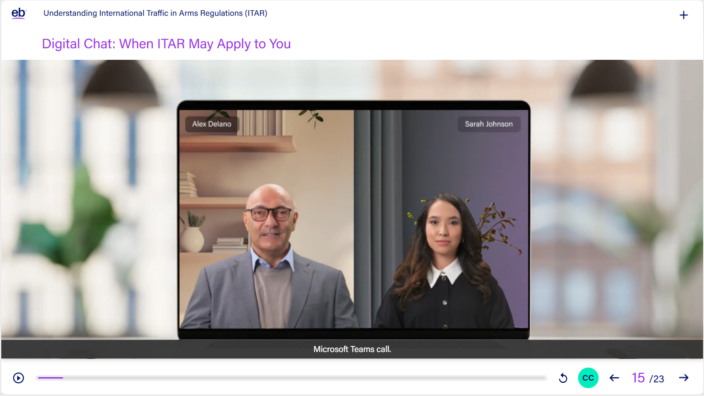
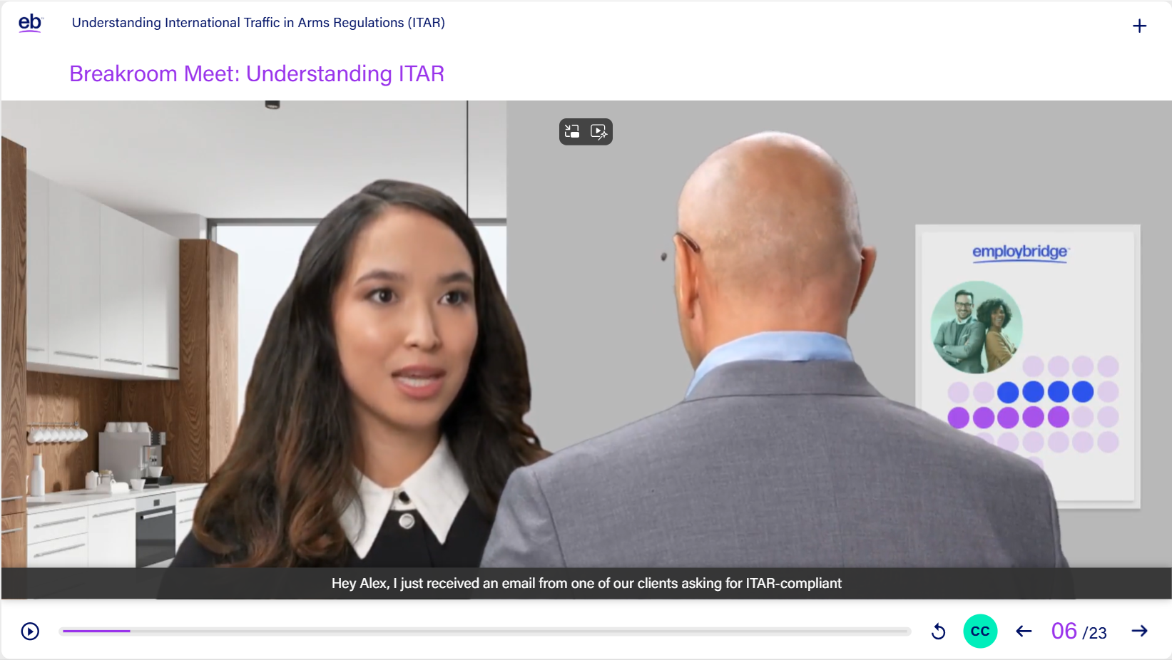
Colossyan Samples: Multi-view Talking AI Avatar
Meet the Team
Boardroom Talk
We used this feature in an actual course (snapshots shown alongside) featuring realistic characters placed in varied backgrounds that reflect the learning context.
Impact: Enhanced visual cohesion, increased realism, and improved client delight
Fireside Chat
Breakroom Meet

Slide 18
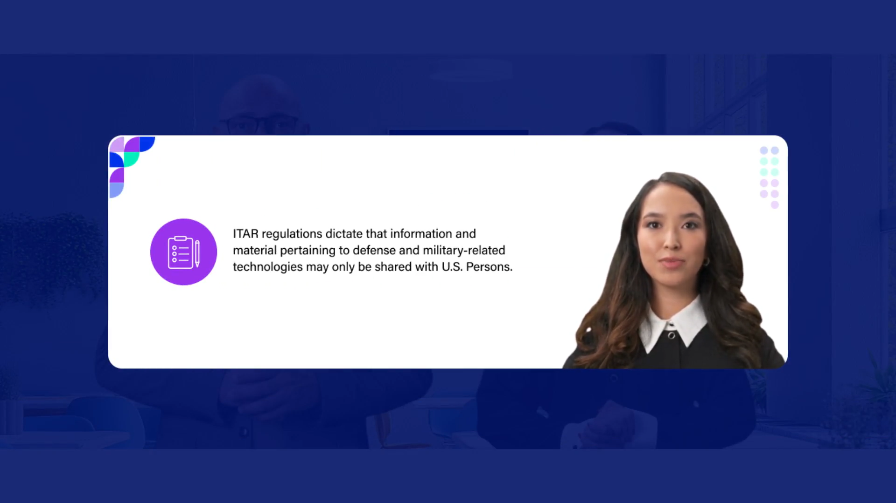
Colossyan Samples: Multi-view Talking AI Avatar (Continued ...)
Videos were embedded throughout the course to maintain learner interest and continuity, supported by custom motion graphics and After Effects transitions for a seamless, polished, storytelling experience.
Watch the sample video.

Slide 19

AI-driven lip sync
AI-driven lip sync significantly reduces animation effort by eliminating manual frame-by-frame mouth movements, enabling faster production turnaround and improved resource utilization across projects.
Watch the sample video.
* This video sample created specifically for this CGI Presentation

Slide 20
AI for Voiceover Generation

Slide 21


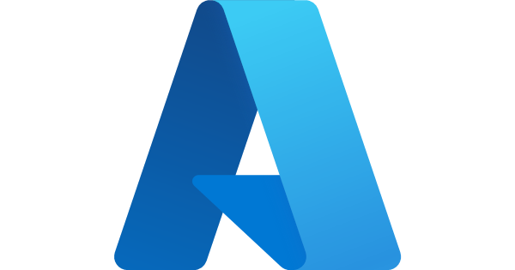


AI for Audio Creation: From Script to Audio in Minutes
Realistic voiceover artists in multiple languages with wide range of custom controls
Key Features:
Storyline
Natural Reader
MurfAI
Modify pace, exaggeration, emphasis, emotions and other voice characteristics
View sample
View sample
View sample
Access a large voice library with multiple ethnicities
Enable voice cloning capability
Azure
Vyond
Elevenlabs
View sample
View sample
View sample

Slide 22
AI for Illustrations

Slide 23
AI-enabled Adobe Illustrator: A “turntable” Approach to Illustration
A single character design can be automatically generated across multiple viewing angles, ensuring consistency and scalability
  Key Features:
  Generate 360° character views (front, side, 3/4, back)
  Maintain consistent proportions, lighting, and styling
  Enable quick pose and expression variations
  Rapidly adapt characters for different scenes and perspectives
  Eliminate repetitive redrawing of characters
  Accelerate asset creation and iteration cycles

Slide 24
AI for Chatbots

Slide 25

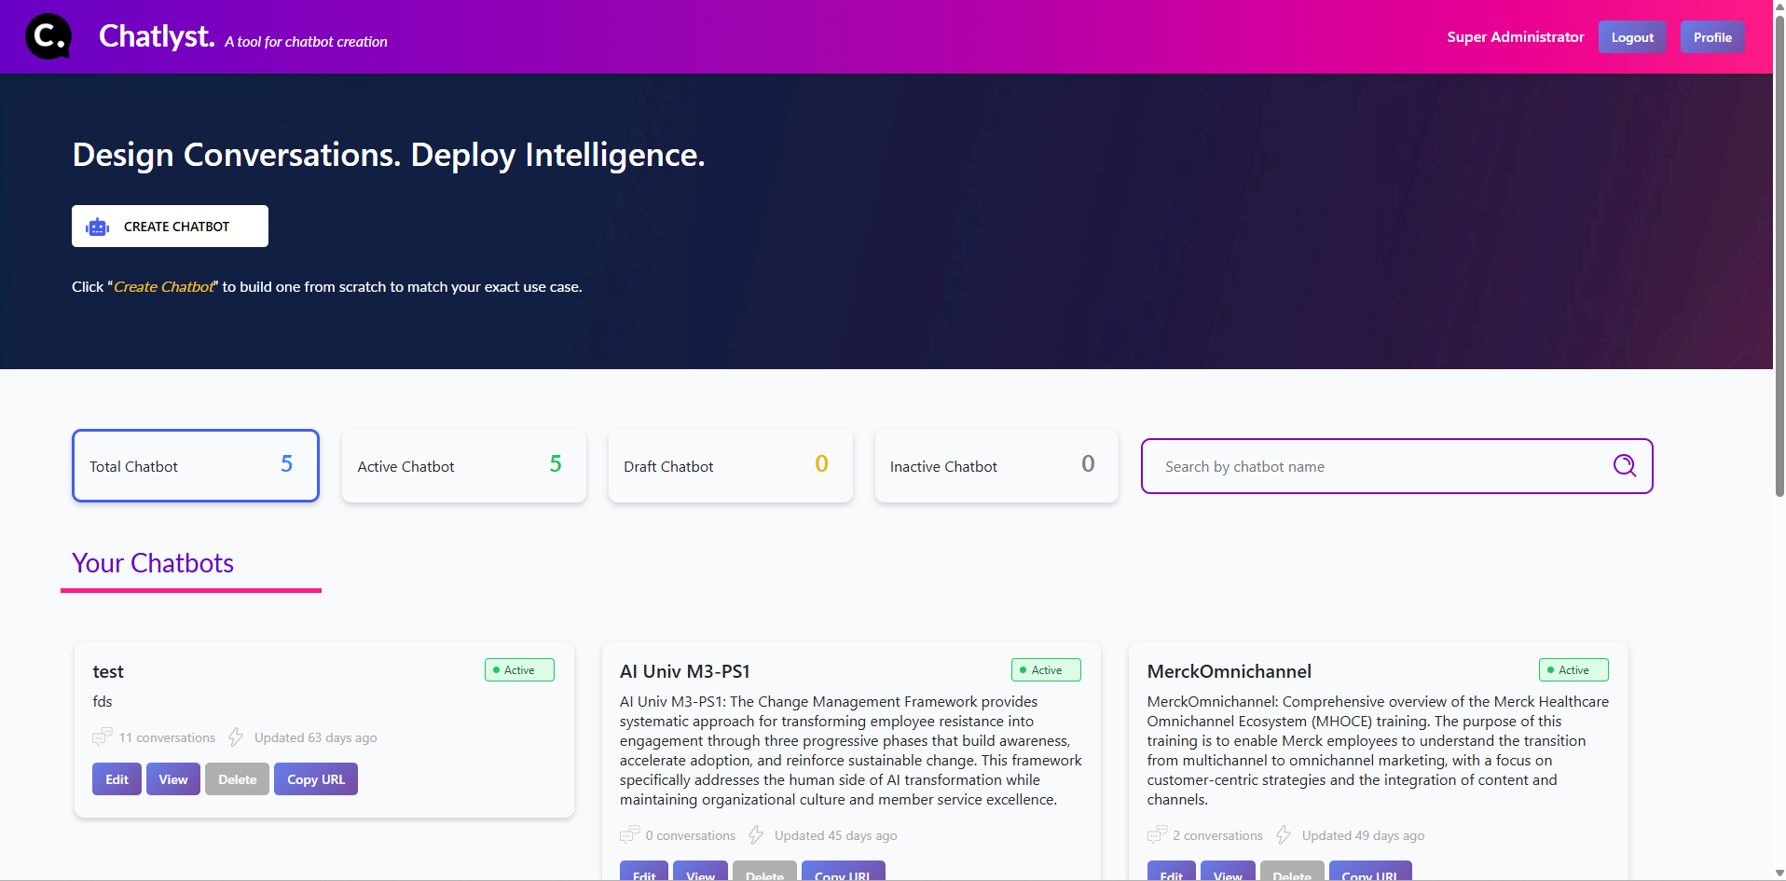
Chatlyst: AI Chatbot Generator
An instant Chatbot creation tool with customized knowledge base and user interface (UI)
Key Features:
Deliver highly targeted, accurate responses from provided knowledge base
Create multiple chatbots based on specific needs
Support ingestion of documents and webpage URLs as knowledge sources
Maintain conversation history for certain period (WIP)
Ensure data-security and seamless chatbot deployment

Slide 26

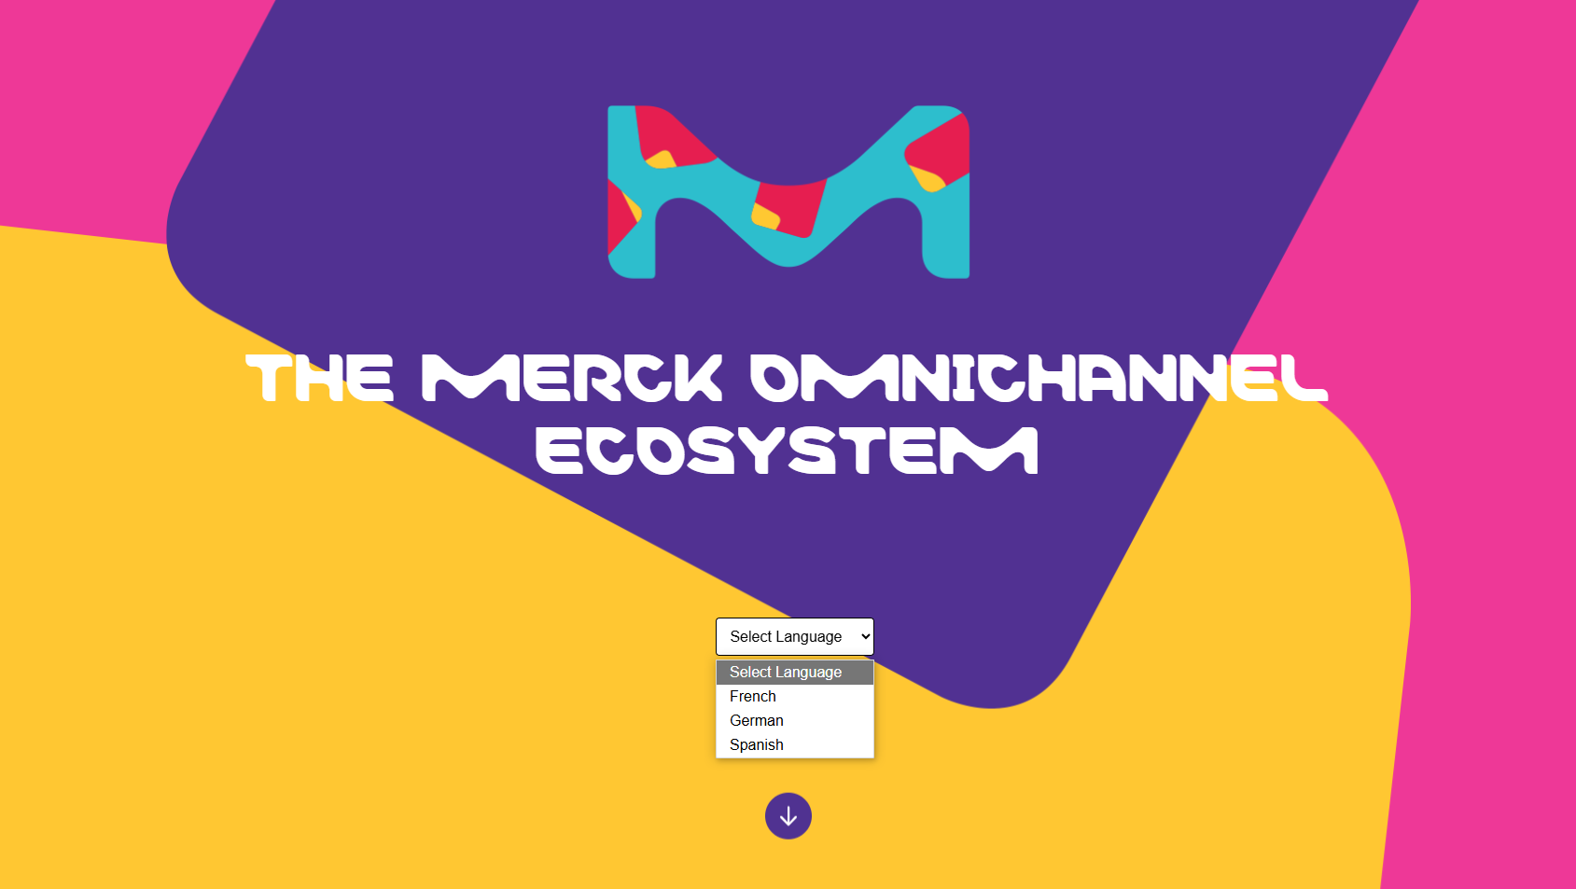
Articulate RISE Sample with Chatbot
Demo Highlights:
Responsive course generated with simple interactions
Deep scroll navigation generated for enhanced engagement
Branding templates easily adapted for consistent standards
View demo

Slide 27
AI for LMS UI Design

Slide 28
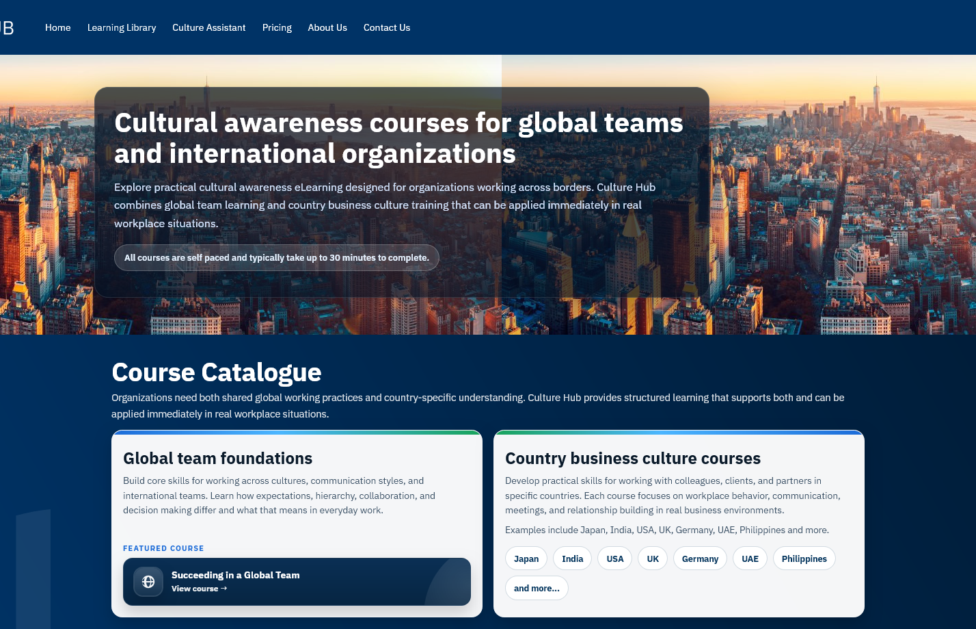
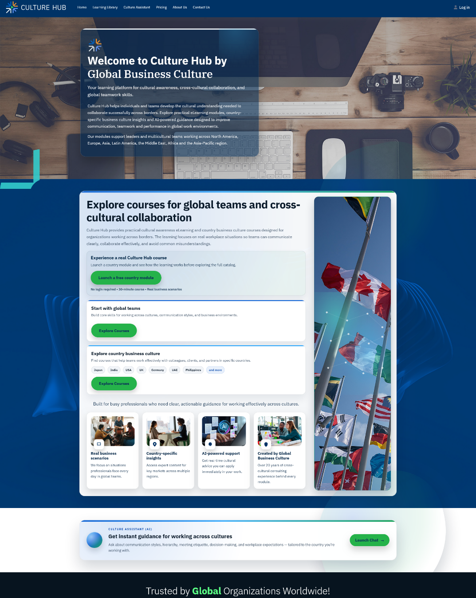
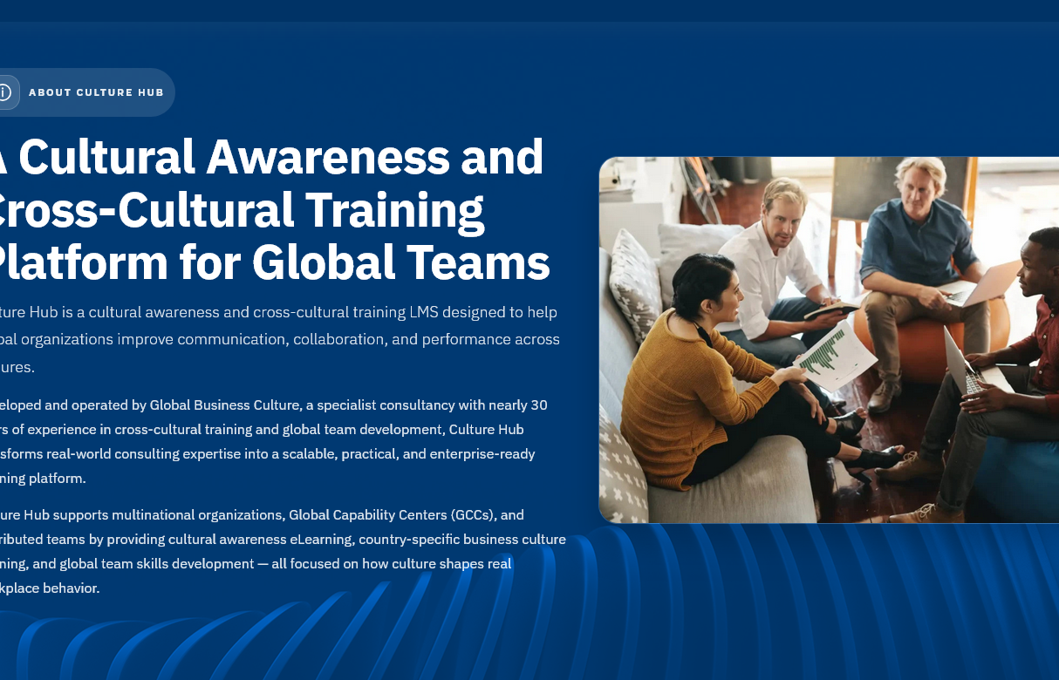
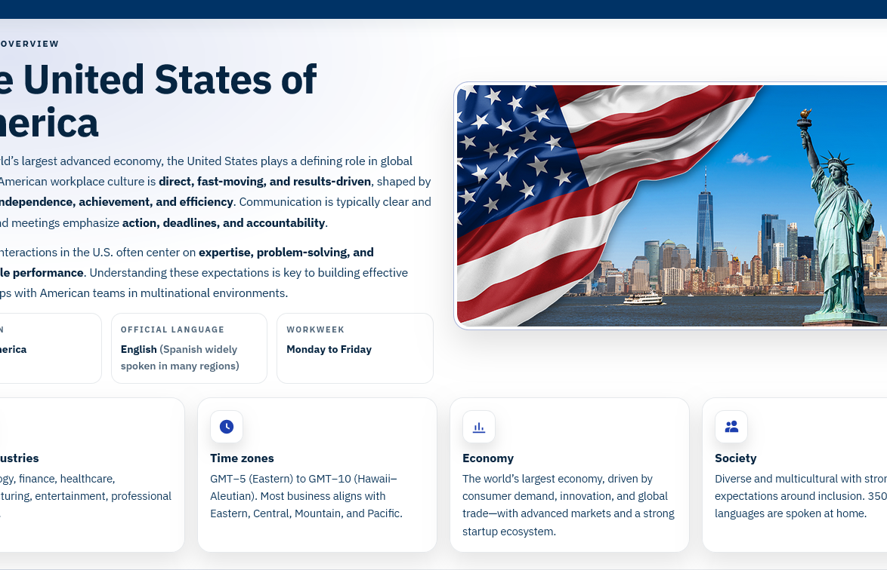
GBC LMS Design: Accelerating UI Development with AI
Objectives:
Build a modern, scalable learning interface
Ensure high-quality UX with faster turnaround
Key Features:
AI integrated across the entire development lifecycle
Enabled end-to-end execution by a single developer
Faster feedback and decision-making through rapid prototyping and UI refinements
Reduced turnaround time for changes
Improved Code quality and development consistency

Slide 29
AI Custom Workflow Samples
Good user experience (UX) is rarely driven by a single AI tool—it results from multiple AI tools working together across the user journey.

Slide 30
AI-driven Learning Experience: Sample 1
Inspired by global conservation, this proof of concept—Protecting Our Planet—reimagines how technology can enhance learning and empower conservation efforts.
AI Avatar
Personalized, simplified guidance
360-degree Learning Journey
Immersive, hands-on exploration
AI Interactive Chatbot Support
Instant responses
Language Selection
View Demo
French, Spanish, or English for learning ease
Articulate Storyline
Customized interactions for engagement

Slide 31
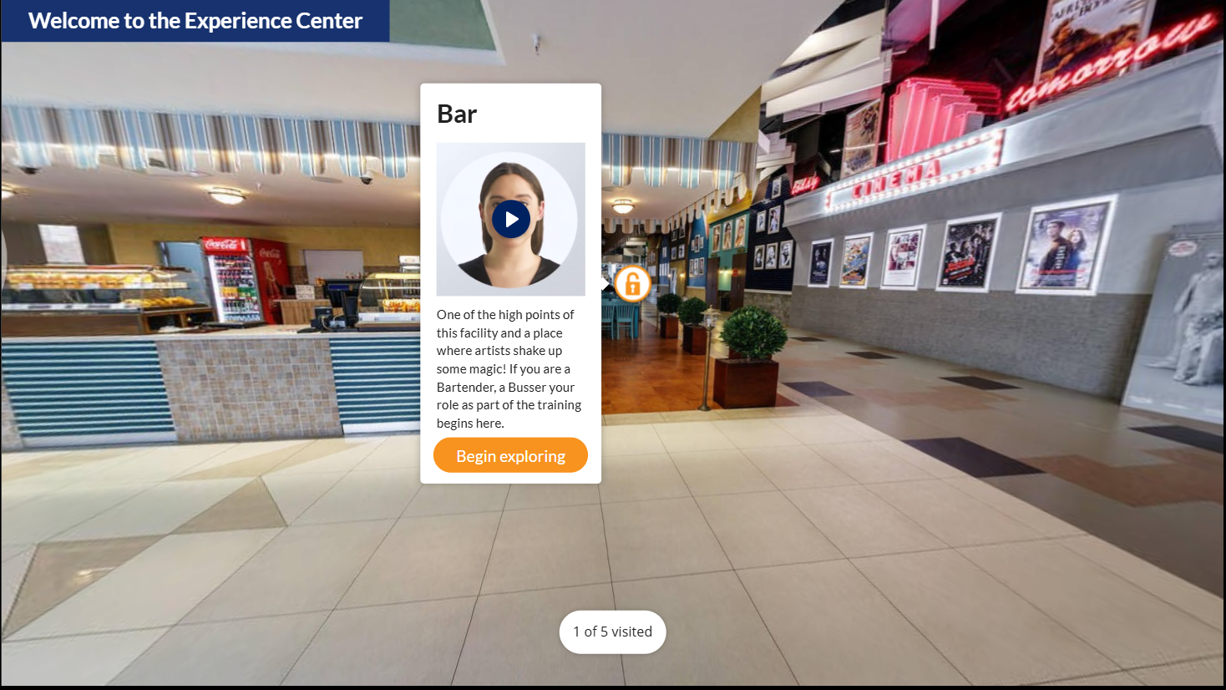
AI-driven Learning Experience: Sample 2
Inspired by the hospitality industry’s push for immersive training and realistic simulations, this POC—Live Bar Experience—replicates an authentic bar environment to train staff in customer interaction, service protocols, and decision-making using advanced AI tools.
AI Avatar
Personalized, simplified guidance
360-degree Learning Journey
Immersive, hands-on exploration
Language Selection
French, Spanish, or English for learning ease
View demo
Articulate Storyline
Customized interactions for engagement

Slide 32
AI Curriculum for Senior Leaders and Managers

Slide 33
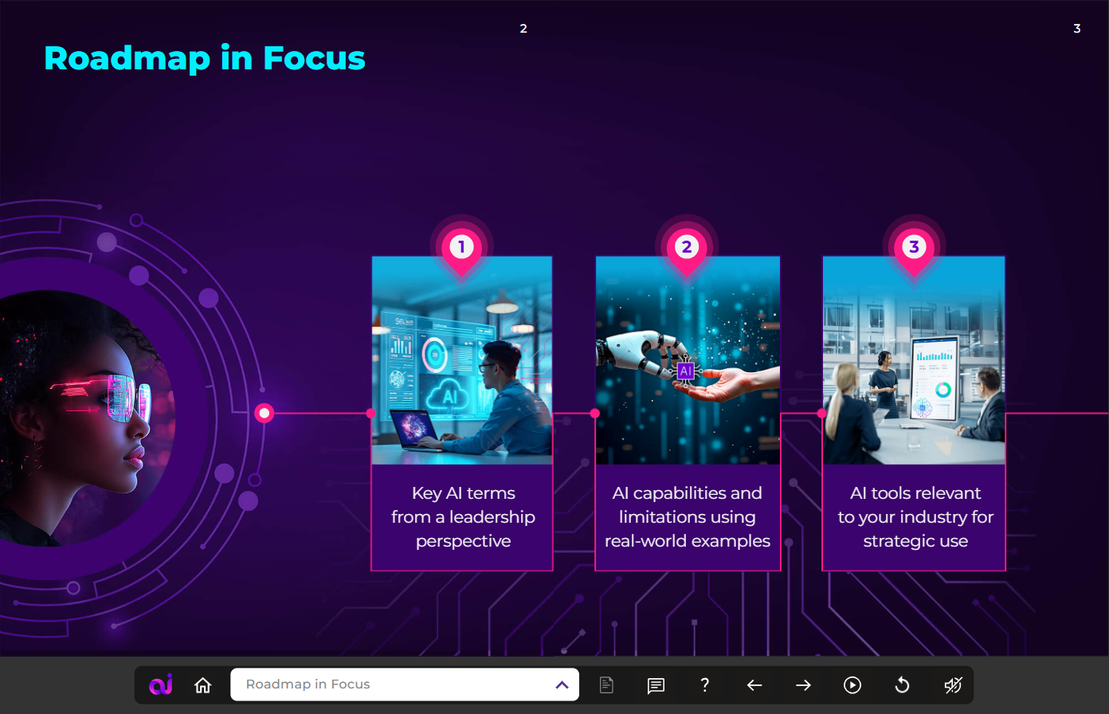
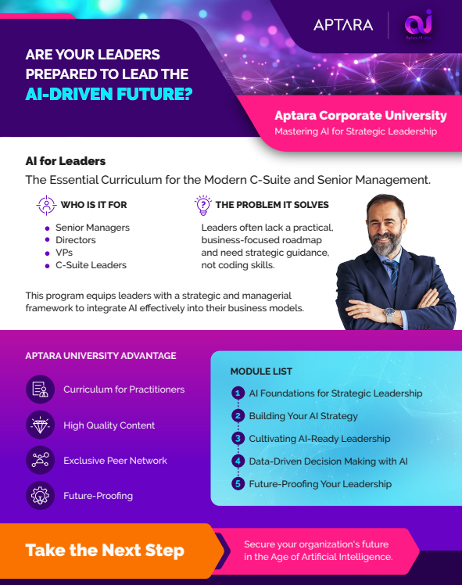
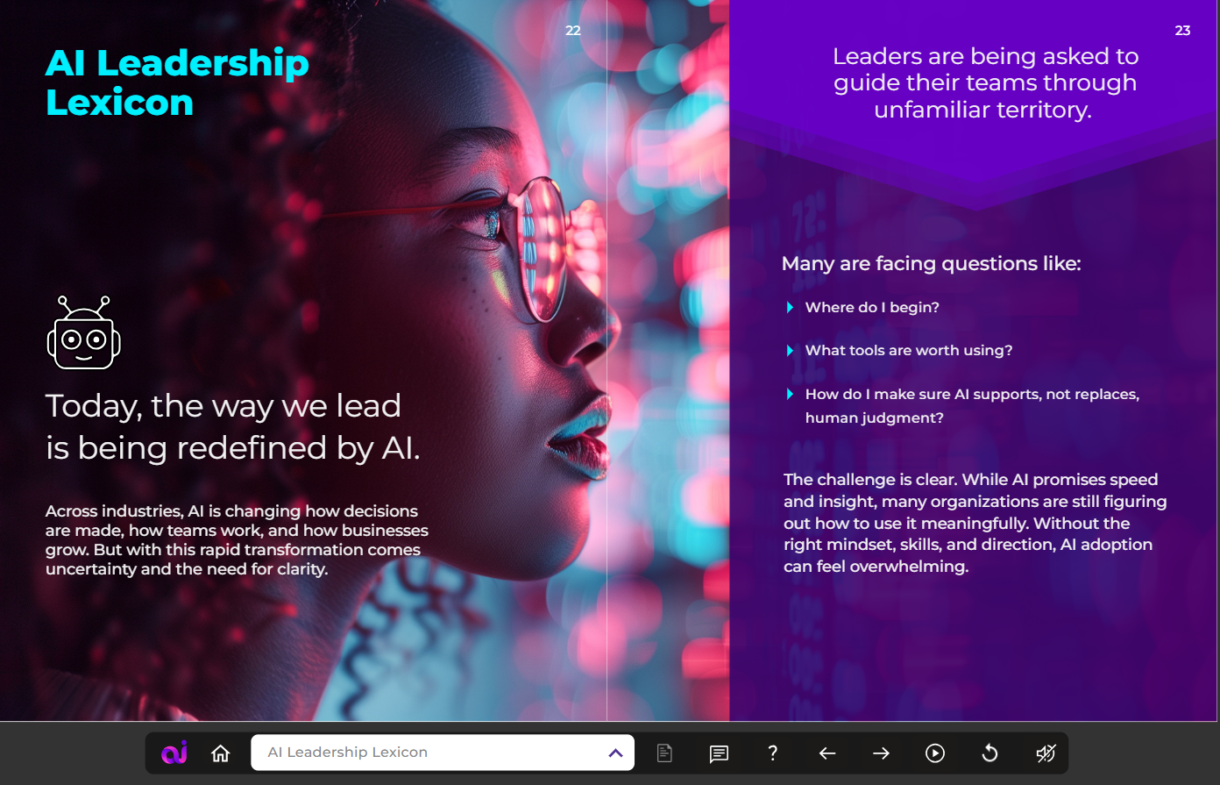
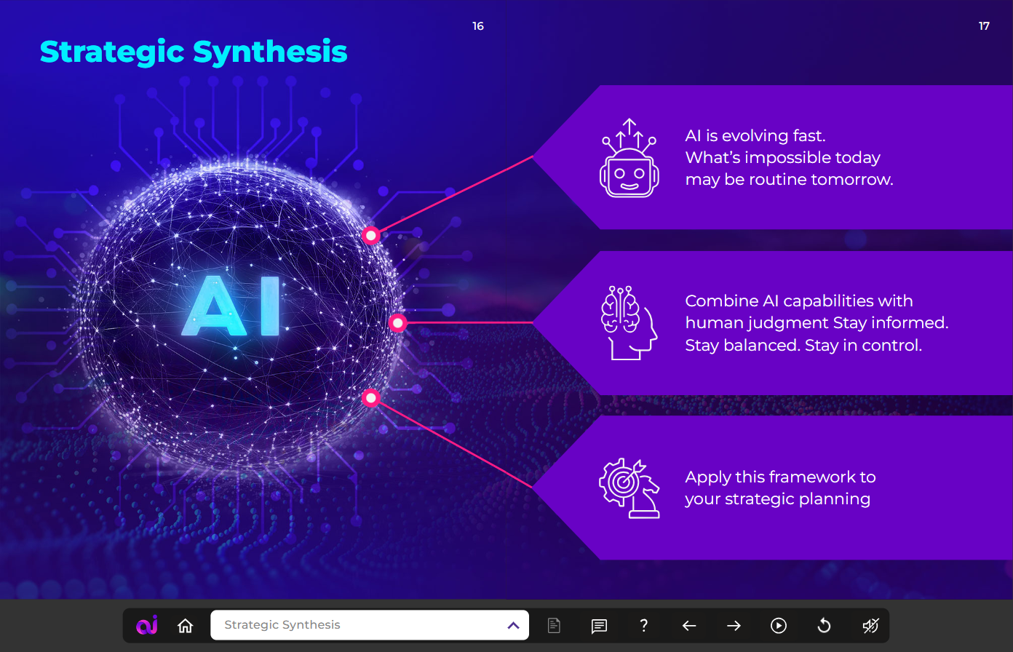
Aptara AI University
Offers an AI Strategy curriculum for senior leaders, designed to bridge knowledge gaps and guide effective AI adoption
Curated by experts, the program includes:
Five focused modules covering key aspects of AI and strategy
Engaging video content presented with a book-inspired learning format
Scenario libraries in each module for hands-on practice
Guidance on selecting and tailoring an AI strategy for organizational success
Video

Slide 34
Recommended AI Strategies and Tools for CGI

Slide 35
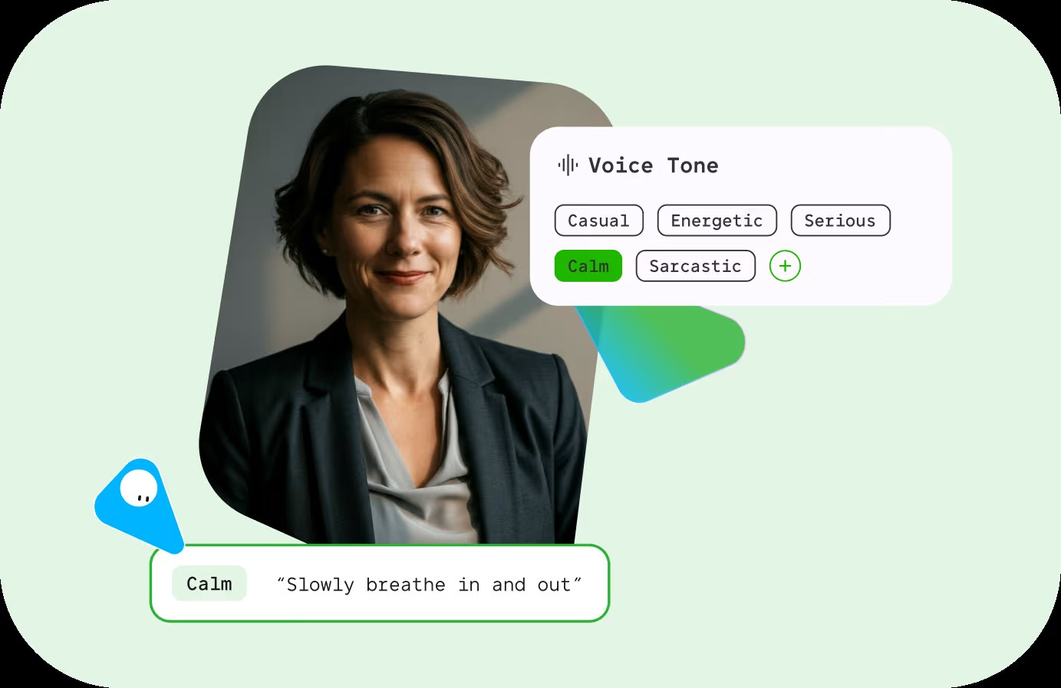

Recommended AI Opportunities for CGI to Improve Efficiency
Considering the modalities that we have developed for CGI – Below are the current traditional approaches followed with proposed recommendations to speed up production with good quality.
In our previous CGI course project, we developed a podcast setup that combined illustrated visuals with audio content. While the outcome was engaging, the process required significant time and effort across ideation, illustration, animation, and post-production.
To streamline this workflow and enhance scalability, we propose integrating AI-powered video generation tools such as Synthesia, HeyGen, and Colossyan. These platforms enable the rapid creation of visually rich, avatar-driven interactive video podcasts with minimal manual intervention.
AI tools can transform text scripts into fully produced video podcasts by:
Generating realistic or stylized AI avatars to act as hosts
Converting scripts into natural-sounding voiceovers
Automatically syncing lip movements with speech
Providing customizable backgrounds, including illustrated or branded environments
Supporting multilingual output for wider audience reach
This eliminates the need for manual illustration, rigging, and animation while still maintaining a visually compelling format.
Recommended AI Tool

Slide 36
Recommended AI Opportunities for CGI to Improve Efficiency
To enhance learner engagement and provide continuous support, we propose integrating an AI-powered chatbot into the course platform. This chatbot will act as a virtual teaching assistant, enabling learners to ask questions at any time and receive instant, context-aware responses.
Given that the course covers multiple topics related to ethics and security, the chatbot can be trained or configured to provide accurate, responsible, and policy-aligned guidance—helping learners better understand complex and sensitive concepts.
Technologies such as ChatGPT or Google Dialogflow can be leveraged to build a responsive, scalable, and intelligent support system tailored to course content.
How the Chatbot Will Function
Answer learner questions in real time based on course materials
Provide explanations, summaries, and examples for complex topics
Guide users through modules, assignments, and key concepts
Offer clarifications on ethics and security scenarios with safe, policy-aligned responses
Be accessible 24/7 across devices, ensuring uninterrupted learning support

Slide 37
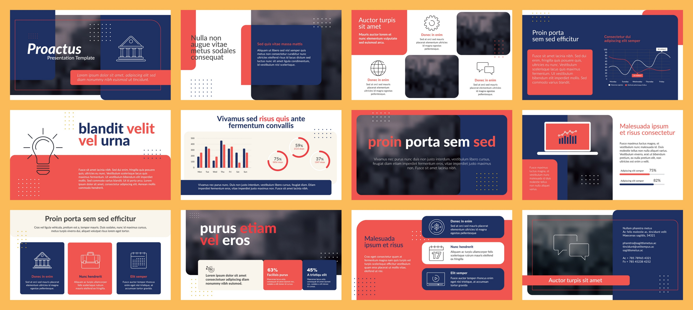
Recommended Automation capabilities for CGI to Improve Efficiency
As part of our programming and automation capabilities, we can develop VBA-based solutions within Microsoft PowerPoint to streamline presentation management and enforce brand consistency at scale.
Many organizations face challenges in maintaining uniform branding across multiple presentation decks, especially when updates to templates, fonts, or visual guidelines are required. These updates are often performed manually, leading to increased effort, inconsistencies, and longer turnaround times.
Our capability in VBA automation enables us to address these challenges by building customized scripts that can standardize and update presentations efficiently. This can reduce the manual efforts by up to 50%, which may vary based on source presentation deck formats.
What the Solution Can Do
Automate updates to slide masters across multiple decks
Apply the latest branding elements such as themes, colors, and logos
Standardize fonts, layouts, and formatting consistently
Enable batch processing of multiple presentations
Ensure alignment with evolving brand guideline

Slide 38
30–40% Effort Savings with AI-Based Tools and Platforms

Slide 39

Thank you!

